Slide 1
INDUSTRIAL MARKETING
LECTURE 13
STRUCTURAL ALTERNATIVES FOR INDUSTRIAL MARKETERS
BY
DR. WANJIKU KINYANJUI

Slide 2
Topic Objectives
By the end of this topic, you should :
describe organization structure alternatives
• understand the considerations in choosing the most effective structure
understand how to manage organizational change
• Appreciate the future of b2b marketing

Slide 3
Marketing organization structures distribute and oversee marketing operations, procedures and strategies within a business.
These structures define and organize employee job roles, including who they report to, and outline the processes a business can use to achieve success.
An effective marketing organization structure can support business objectives and give employees a clear understanding of the objectives they are working to achieve.

Slide 4
Introduction
Marketing can be organized around functions like product lines, target markets, or some combination of these.
The five broad ways to organize marketing tasks include
Functional
Each marketing activity has a specialist in charge of it.
This structure would have an advertising manager, a product development manager, a market research manager, and so forth.

Slide 5
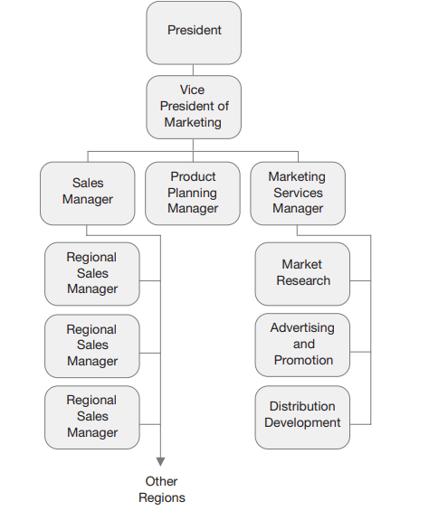
Functional Structure
A major advantage of this approach is simplicity.
Decision making is centralized

Slide 6
b) Product
Each manager is responsible for all the marketing decisions concerning a particular product.
The firm may also employ specialists to advise and assist, but each product manager would have overall responsibility

Slide 7
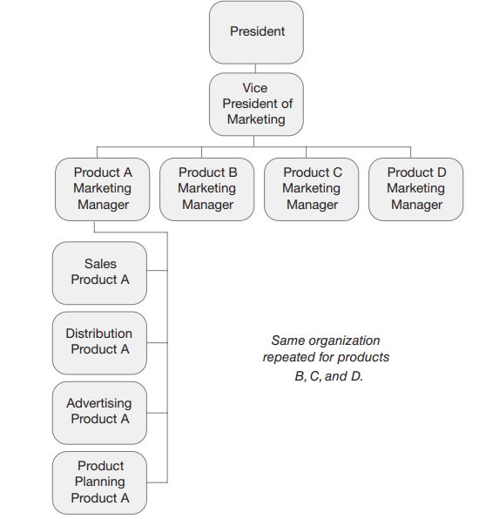
Product Structure
This is a combination approach where marketing is organized on a functional basis but the sales organization is organized by product.
The difficulty with this organization is the obstacles it presents for functions such as manufacturing and engineering to interact with product line experts

Slide 8
c) Segment/Market
Each manager is responsible for a given market segment.
For example, a glass manufacturer might have one manager in charge of marketing to the automotive industry, another for marketing to the building trade, another marketing to the bottling industry, and so forth.
Each manager would thus be able to develop specialist knowledge of the customers’ needs.

Slide 9
Focusing on individual segments gives employees the opportunity to create marketing strategies that appeal to different consumers.
These structures are best for a business that aims to provide services to particular parts of a market or industry.

Slide 10
d) Geographical area
This approach usually is used in international markets, but can be used elsewhere.
Managers are each responsible for all the marketing activities within their own geographical region

Slide 11
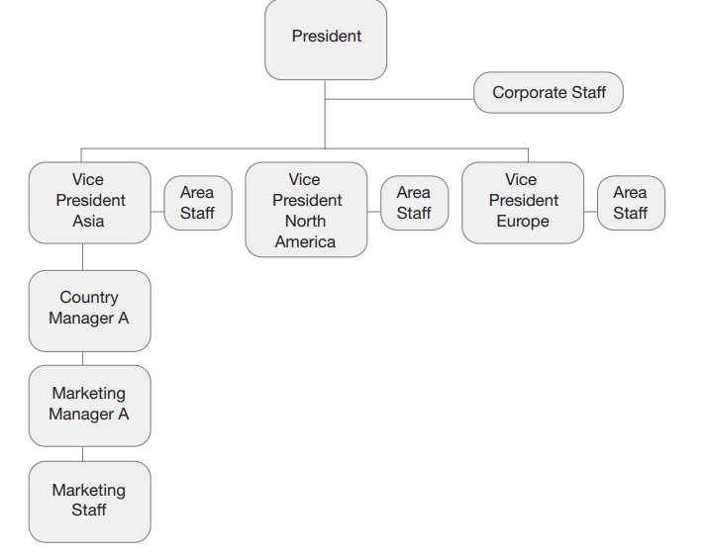
Geographic Structure
This structure is best employed by companies with short or similar product lines with vastly different conditions in its geographic markets.
The structure allows local managers to adapt their marketing programs very well to specific markets.
However, it limits the exchange of information from one area to another and adds a level of complication to rationalizing the product line.

Slide 12
e) Matrix
Features joint decision making between the specialist market researchers, sales managers, product managers, and all the other functional managers.
No one manager has overall control, and decisions are made by balancing each person’s role and demands.

Slide 13
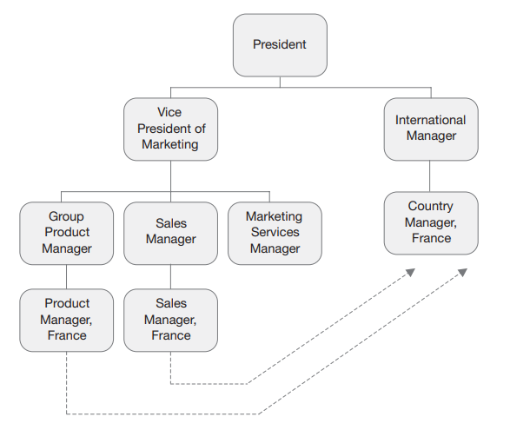
This is best for arranging employee departments or teams based on their job roles and the products they are working with because each department handles one specific product.
A marketing organization structure like this can provide more information at a faster rate since multiple specialty teams oversee one project.
Having a variety of specialty teams responsible for one project can help employees openly communicate and provide more resources for other employees to use while working toward their goals.

Slide 14
Choosing the most effective structure
From a planning perspective, the type of organizational structure which is most appropriate will depend on the volatility of the market and the degree of control the organization has over its environment.
A well-designed organisation structure can aid in improving teamwork and productivity by creating a structure within which individuals can most effectively cooperate.
A good organisational structure helps a company flourish by increasing its capacity to manage a larger workforce.

Slide 15
An organisational structure establishes communication channels and patterns. It makes proper administration possible.
Implementation of organisational structure aids in the expansion and diversification of an organisation's activities.
A structure eliminates duplication of functions and allows for maximum output with a given amount of effort.

Slide 16
Features of the good organization structure
Simplicity: an organization structure should simple. The concept of the simplicity implies that various organizational relations should be kept minimum possible.
Flexibility: an organization structure should be flexible enough so that changes can be incorporated whenever needs arise.
Clear line of authority: whatever the form of structure is adopted, there should be clear lines of authority running from top to bottom or in horizontal directions.

Slide 17
Application of ultimate responsibility: The concepts of the ultimate responsibility suggest that although a superior manager assigns some of the work of his subordinates. He is ultimately responsible for performance of total work.
Proper delegation of authority: the concept of ultimate responsibility can work only when there is proper delegation of authority at various levels of the organization. Delegation of the authority refers to authorization by a manager to make certain decisions.
Minimum possible managerial levels: the greater the number of managerial levels, the longer is the line of communication and the chain of command and the communication has to travel along the line creating problems of delay and distortion.

Slide 18
Principals of unity of direction and command: unless absolutely essential, principals of unity of the direction and the unity of command should be followed.
Proper emphasis on staff: line functions should be separated from staff functions and adequate emphasis should be placed on important staff activities.
Provision for top management: in corporate form of organization, it is imperative to provide some means by which the shareholder and members of the board of directors participate in management process.

Slide 19
Future B2B Marketing
Technologies are opening up new possibilities for communication and business management.
Globalization has forced companies to reconsider logistics as they source raw materials globally and market to global customers.
Heightened competition is causing companies to reconsider the traditional combative approach to other channel members.

Slide 20
The Increasing Importance of Data
Data and analytics are playing a bigger role in B2B marketing. Companies are looking to measure the effectiveness of their campaigns and optimize their marketing.

Slide 21
E-commerce and advanced IT capabilities are helping evolve the supply chain into what can readily be seen as a network.
The idea is that e-commerce allows not only the connecting of firms, but the coordinating of firms and their inter-firm processes. This creates a coordinated – rather than a merely connected – environment.

Slide 22
Restructure the marketing department
Keep Global Marketing goals clear
Today’s customer and prospect expects a brand to be relevant and clear in their messaging and outreach. They expect brands to know who they are.
For mid to larger marketing teams, aligning on future global marketing perspectives helps drive a better internal marketing structure

Slide 23
Hire and match both: people resources and martech resources
The right use of martech and salestech with a proper centralized integration process is crucial to aligning brand messaging and outreach.
It is also important on the other hand to ask existing marketing team members and future hires about what martech training support they may need.

Slide 24
Set measurable KPIs at every stage
How a brand builds out their marketing team depends on what they need done from the team.
It’s important to also align core KPIs (Key Performance Indicators) to each marketing member on the team so that the marketing function as a whole can measure and prove their overall results much more easily.

Slide 25
Keep your marketing team lean
The best of today’s marketers and sales leaders will swear by having a lean martech-salestech stack and a lean team.
Many marketing roles can overlap for larger teams.
Understanding how you can build a team that is lean with most of the members performing more than one task can actually prevent over hiring and reduce the chances of layoffs in future as well.

Slide 26
Managing Organization Change
Organizational change is necessary for companies to succeed and grow. Change management drives the successful adoption and usage of change within the business.
It allows employees to understand and commit to the shift and work effectively during it.

Slide 27
Managing Organization change
Adaptive changes are small, incremental changes organizations adopt to address needs that evolve over time.
Typically, these changes are minor modifications and adjustments that managers fine-tune and implement to execute upon business strategies.
Throughout the process, leadership may add, subtract, or refine processes.

Slide 28
Without effective organizational change management, company transitions can be unpredictable and expensive in terms of both time and resources. They can also result in lower employee morale and skill development.
A company’s reaction and adaptation to change is also a critical consideration for key stakeholders like investors, suppliers, and prospective employees when deciding whether to work with or for a company. As a result, a lack of effective change management can lead to an organization’s failure.

Slide 29
Transformational changes have a larger scale and scope than adaptive changes. They can often involve a simultaneous shift in mission and strategy, company or team structure, people and organizational performance, or business processes.
Because of their scale, these changes often take a substantial amount of time and energy to enact. Though it's not always the case, transformational changes are often pursued in response to external forces, such as the emergence of a disruptive new competitor or issues impacting a company’s supply chain.

Slide 30
A company’s reaction and adaptation to change is also a critical consideration for key stakeholders like investors, suppliers, and prospective employees when deciding whether to work with or for a company. As a result, a lack of effective change management can lead to an organization’s failure.

Slide 31
Conclusion
Overall, B2B marketing in the twenty-first century presents many new challenges.
Shrinking markets, green issues, runaway advances in communications technology, and rapidly changing public attitudes
toward consumption and communication predicate major changes not only in marketing techniques but
The future of business marketing in corporate strategy

Slide 32
References
Zimmerman, A., & Blythe, J. (2021). Business to Business Marketing Management: A Global Perspective (4th ed.). Routledge, New York

