Slide 1
STRATEGIC MANAGEMENT
BMA 404
WEEK three: ENVIRONMENTAL ANALYSIS
BY Dr. Julius Kahuthia Mwangi

Slide 2
Expected learning outcomes
BY the end of this lesson every student is expected to:
Distinguish the three levels of organization environments
Explain the importance of environment scanning
Explain how to scan internal environment using SWOT analysis
Explain how to scan environment using the BCG matrix
Explain how to carry out value chain analysis

Slide 3
Part one
Introduction
Environment levels
SWOT analysis

Slide 4
ENVIRONMENTAL ANALYSIS
ENVIRONMENT ANALYSIS is the study of the organizational environment to pinpoint environmental factors that can significantly influence organizational operations and performance.
The environment of an organization is generally divided into 3 distinct levels:
    Internal Environment
    Operating Environment/ micro
    General Environment / remote /macro

Slide 5
THE GENERAL ENVIRONMENT
The factors in the remote or general environment affect the performance of the organization but the organizational management does not have any control on them.
The components normally considered part of the general environment are: Economic; Social; Political; Legal; Technological

Slide 6
THE OPERATING ENVIRONMENT
The factors in this environment affects the performance of the organization and the organizational management has little control on them.
They includes components like: Customer; Competition; Labour; Supplier; International Issues.

Slide 7
THE INTERNAL ENVIRONMENT
The components in this level affects the performance of the organization and the organization management has high degree level of control on them.
These includes: marketing; finance and accounting; planning; organizing; influencing; and controlling within the organization.

Slide 8
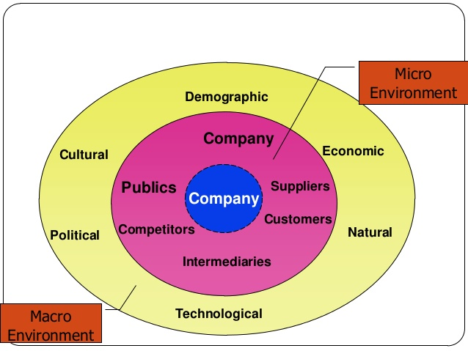
Environmental Levels

Slide 9
SWOT Analysis
Environmental factors internal to the firm usually can be classified as strengths (S) or weaknesses (W), and those external to the firm can be classified as opportunities (O) or threats (T).
Such an analysis of the strategic environment is referred to as a SWOT analysis.

Slide 10
Strengths
A firm's strengths are its resources and capabilities that can be used as a basis for developing a competitive advantage.
Examples of such strengths include:
Corporate culture
Patents
Strong brand names

Slide 11
Strengths
Examples of such strengths include:
Good reputation among customers
Cost advantages from proprietary know-how
Exclusive access to high grade natural resources
Favorable access to distribution networks

Slide 12
Weaknesses
The absence of certain strengths may be viewed as a weakness.
Examples weaknesses:
lack of patent protection
a weak brand name
poor reputation among customers

Slide 13
Weaknesses
Examples weaknesses:
high cost structure
lack of access to the best natural resources
lack of access to key distribution channels

Slide 14
Opportunities
The external environmental analysis may reveal certain new opportunities for profit and growth. Examples of such opportunities include:
an unfulfilled customer need
arrival of new technologies

Slide 15
Opportunities
Examples of such opportunities include:
loosening of regulations
removal of international trade barriers
Opening of a new market
Change in political arena

Slide 16
Threats
Changes in the external environmental also may present threats to the firm.
Examples of such threats include:
shifts in consumer tastes away from the firm's products; emergence of substitute products; new regulations; increased trade barriers; Taxation

Slide 17
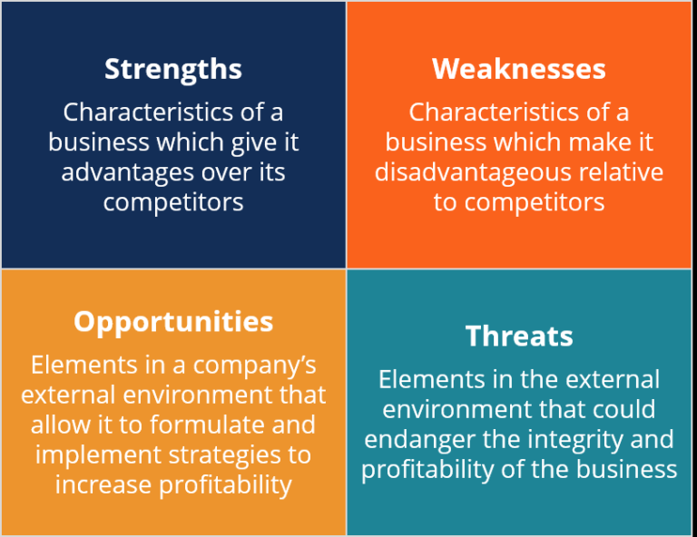
Analyzing internal environment
SWOT

Slide 18
SWOT Matrix
 | Strengths | Weaknesses
Opportunities | S-O strategies | W-O strategies
Threats | S-T strategies | W-T strategies

Slide 19
SWOT Matrix
S-O strategies pursue opportunities that are a good fit to the company's strengths.
W-O strategies overcome weaknesses to pursue opportunities.
S-T strategies identify ways that the firm can use its strengths to reduce its vulnerability to external threats.
W-T strategies establish a defensive plan to prevent the firm's weaknesses from making it highly susceptible to external threats

Slide 20
End of part one

Slide 21
Part two
BCG matrix
Value chain analysis

Slide 22
BCG growth-share matrix
In the early 1970's the Boston Consulting Group developed a model for managing a portfolio of different business units (or major product lines).
The BCG growth-share matrix displays the various business units on a graph of the market growth rate vs. market share relative to competitors:
Resources are allocated to business units according to where they are situated on the grid as follows:

Slide 23
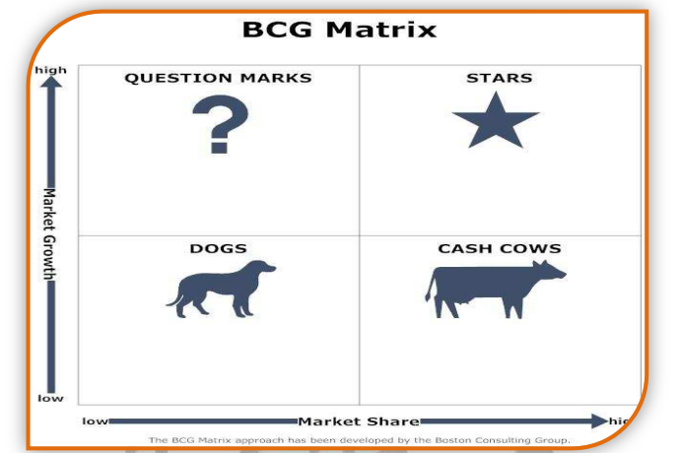
BGC Matrix
Image source BCG Matrix, SWOT Analysis and Porter Model; Sidhant Jain, Academia edu, 2020, pg 2

Slide 24
Cash Cow
Cash Cow - a business unit that has a large market share in a mature, slow growing industry.
Cash cows require little investment and generate cash that can be used to invest in other business units.

Slide 25
Star
Star - a business unit that has a large market share in a fast growing industry. Stars may generate cash, but because the market is growing rapidly they require investment to maintain their lead.
If successful, a star will become a cash cow when its industry matures.

Slide 26
Question Mark / Problem Child
Question Mark (or Problem Child) - a business unit that has a small market share in a high growth market.
These business units require resources to grow market share, but whether they will succeed and become stars is unknown.

Slide 27
Dog
Dog - a business unit that has a small market share in a mature industry.
A dog may not require substantial cash, but it ties up capital that could better be deployed elsewhere.
Unless a dog has some other strategic purpose, it should be liquidated if there is little prospect for it to gain market share.

Slide 28
The Value Chain
To analyze the specific activities through which firms can create a competitive advantage, it is useful to model the firm as a chain of value-creating activities.
Michael Porter identified a set of interrelated generic activities common to a wide range of firms.
The resulting model is known as the value chain.

Slide 29
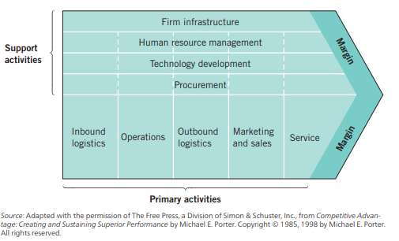
Value Chain

Slide 30
Primary Value Chain Activities
The goal of these activities is to create value that exceeds the cost of providing the product or service, thus generating a profit margin.
Inbound logistics include the receiving, warehousing, and inventory control of input materials.
Operations are the value-creating activities that transform the inputs into the final product.

Slide 31
Primary Value Chain Activities
Outbound logistics are the activities required to get the finished product to the customer, including warehousing, order fulfillment, etc.
Marketing & Sales are those activities associated with getting buyers to purchase the product, including channel selection, advertising, pricing, etc.
Service activities are those that maintain and enhance the product's value including customer support, repair services, etc.

Slide 32
Support Activities
The primary value chain activities described above are facilitated by support activities. Porter identified four generic categories of support activities, the details of which are industry-specific.
Procurement - the function of purchasing the raw materials and other inputs used in the value-creating activities.

Slide 33
Support Activities
Technology Development - includes research and development, process automation, and other technology development used to support the value-chain activities.
Human Resource Management - the activities associated with recruiting, development, and compensation of employees.
Firm Infrastructure - includes activities such as finance, legal, quality management, etc.

Slide 34
Summary
Environment levels
SWOT analysis
BCG matrix
Value Chain Analysis

Slide 35
End of lesson three

