Slide 1
STRATEGIC MANAGEMENT
BMA 404
WEEK FOUR: EXTERNAL ENVIRONMENT ANALYSIS
By
Dr. Julius Kahuthia Mwangi

Slide 2
Learning Objectives
Explain how to carry out five forces analysis
Explain the role of PESTEL analysis
Explain how to scan a given environment using the appropriate tool

Slide 3
Part one
Introduction
Porter’s five forces analysis

Slide 4
Industry analysis/Porter’s Five Forces Analysis
Industry analysis—also known as Porter’s Five Forces Analysis—is a very useful tool for business strategists.
It is based on the observation that profit margins vary between industries, which can be explained by the structure of an industry.

Slide 5
Industry analysis
The Five Forces primary purpose is to determine the attractiveness of an industry.
However, the analysis also provides a starting point for formulating strategy and understanding the competitive landscape in which a company operates.

Slide 6
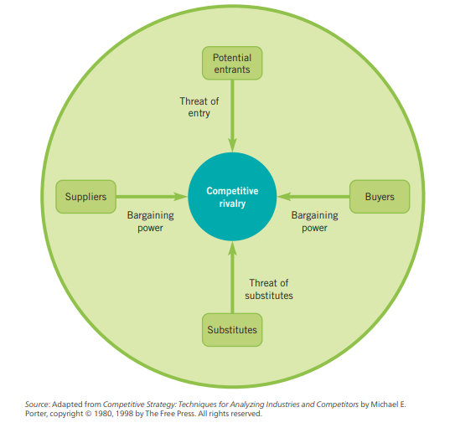
Porter’s Five Forces

Slide 7
Rivalry
Firms strive for a competitive advantage over their rivals.
The intensity of rivalry among firms varies across industries
If rivalry among firms in an industry is low, the industry is considered to be disciplined.
When a rival acts in a way that elicits a counter-response by other firms, rivalry intensifies.
The intensity of rivalry commonly is referred to as being cutthroat, intense, moderate, or weak, based on the firms' aggressiveness in attempting to gain an advantage.

Slide 8
Competitive Moves
In pursuing an advantage over its rivals, a firm can choose from several competitive moves:
    Changing prices
    Improving product differentiation
    Creatively using channels of distribution
    Exploiting relationships with suppliers

Slide 9
Industry characteristics that influence the intensity of rivalry
A larger number of firms increases rivalry.
Slow market growth causes firms to fight for market share.
High fixed costs result in an economy of scale effect that increases rivalry.
High storage costs or highly perishable products cause a producer to sell goods as soon as possible.
Low switching costs increases rivalry.

Slide 10
Industry characteristics that influence the intensity of rivalry
Low levels of product differentiation is associated with higher levels of rivalry.
Strategic stakes are high when a firm is losing market position or has potential for great gains.
High exit barriers place a high cost on abandoning the product.
A diversity of rivals with different cultures, histories, and philosophies make an industry unstable.

Slide 11
Threat of Substitutes
Substitute products refer to products in other industries.
A threat of substitutes exists when a product's demand is affected by the price change of a substitute product.
Threat of Substitute comes from products outside the industry.
There can be other concerns in assessing the threat of substitutes e.g students schooling in local and international university

Slide 12
Buyer Power
The power of buyers is the impact that customers have on a producing industry.
When buyer power is strong, the relationship to the producing industry is near to what an economist terms a monopsony - a market in which there are many suppliers and one buyer (the buyer sets the price).

Slide 13
Buyers are Powerful if:
Buyers are concentrated
Buyers purchase a significant proportion of output
Buyers possess a credible backward integration threat

Slide 14
Buyers are Weak if:
Producers threaten forward integration
Significant buyer switching costs
Buyers are fragmented
Producers supply critical portions of buyers' input

Slide 15
Supplier Power
A producing industry requires supplies.
Suppliers, if powerful, can exert an influence on the producing industry.

Slide 16
Suppliers are Powerful if:
Credible forward integration threat by suppliers
Suppliers concentrated
Significant cost to switch suppliers
Customers Powerful

Slide 17
Suppliers are Weak if:
Many competitive suppliers
Credible backward integration threat by purchasers
Concentrated purchasers
Customers Weak

Slide 18
Threat of New Entrants and Entry Barriers
The possibility that new firms may enter the industry affects competition.
Barriers to entry are more than the normal equilibrium adjustments that markets typically make.
Barriers to entry are unique industry characteristics that define the industry.
Barriers reduce the rate of entry of new firms, thus maintaining a level of profits for those already in the industry.
From a strategic perspective, barriers can be created or exploited to enhance a firm's competitive advantage.

Slide 19
Sources of Barriers to entry
Government creates barriers.
The regulatory authority of the government in restricting competition is historically evident in the banking industry.
Patents and proprietary knowledge serve to restrict entry into an industry.
Asset specificity inhibits entry into an industry. Asset specificity is the extent to which the firm's assets can be utilized to produce a different product.
Organizational (Internal) Economies of Scale.

Slide 20
Easy to Enter if there is:
Common technology
Little brand franchise
Access to distribution channels
Low scale threshold

Slide 21
Difficult to Enter if there is:
Patented or proprietary know-how
Difficulty in brand switching
Restricted distribution channels
High scale threshold

Slide 22
Easy to Exit if there are:
Salable assets
Low exit costs
Independent businesses

Slide 23
Difficult to Exit if there are:
Specialized assets
High exit costs
Interrelated businesses

Slide 24
End of part one

Slide 25
Part Two
Industrial analysis and competition
Industry analysis and structure
PESTEL Analysis
Steps in conducting external environmental analysis

Slide 26
Industry analysis and competition
Competition within an industry is grounded in its underlying economic structure.
It goes beyond the behaviour of current competitors.
The state of competition in an industry depends upon five basic competitive forces.

Slide 27
Industry analysis and competition
The collective strength of these forces determines profit potential in the industry.
Profit potential is measured in terms of long-term return on invested capital.
Different industries have different profit potential—just as the collective strength of the five forces differs between industries.

Slide 28
Industry analysis as a tool to develop competitive strategy
Industry analysis enables a company to develop a competitive strategy that best defends against the competitive forces or influences them in its favour.
The key to developing a competitive strategy is to understand the sources of the competitive forces.

Slide 29
Industry analysis as a tool to develop competitive strategy
By developing an understanding of these competitive forces, the company can:
Highlight the company’s critical strengths and weaknesses
Animate its position in the industry
Clarify areas where strategic changes will result in the greatest payoffs
Emphasize areas where industry trends indicate the greatest significance as either opportunities or threats

Slide 30
Industry analysis and structure
The five competitive forces reveal that competition extends beyond current competitors.
Customers, suppliers, substitutes and potential entrants—collectively referred to as an extended rivalry—are competitors to companies within an industry.
The five competitive forces jointly determine the strength of industry competition and profitability.

Slide 31
Industry analysis and structure
The strongest force rules and should be the focal point of any industry analysis and resulting competitive strategy.
Short-term factors that affect competition and profitability should be distinguished from the competitive forces that form the underlying structure of an industry.
Although these short-term factors may have some tactical significance, analysis should focus on the industry’s underlying characteristics.

Slide 32
SCANING REMOTE EXTERNAL ENVIRONMENT
PESTLE analysis allows businesses to take a look at the external factors.
The letters in PESTLE, also called PESTEL, denote:
    Political factors
    Economic factors
    Social factors
    Technological factors
    Legal factors
    Environmental factor

Slide 33
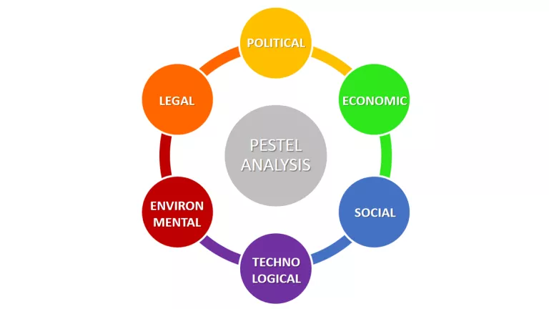
Scanning Remote Environment
PESTEL

Slide 34
Political factors
Political stability
Corruption level
Tax policies
Freedom of press
Government regulation
Trade control
Government involvement in trade unions and agreements
Competition regulation
Level of government subsidies
Size of government budgets

Slide 35
Economic factors
Economic growth rate
Interest rate
Inflation rate
The foreign exchange rate
Level of disposable income
Propensity of people to spend
Unemployment trend
Stock market trends
Price fluctuations
Credit accessibility
Unemployment rates
The monetary or fiscal policies

Slide 36
Social Cultural factors
Population size and growth rate
Immigration and emigration rates
Demographic
Wealth distribution
Social classes
Family size and structure
Health consciousness
Buying habits
Ethical concerns
Cultural norms and values
Religion and beliefs
Education level
Crime levels
Attitude towards investing
Attitudes towards leisure time

Slide 37
Technological factors
New discoveries
Rate of technological obsolescence
Rate of technological advances
Innovative technological platforms
Technology incentives
Automation
R&D activity
Technological change
Access to new technology
Technological awareness
Internet infrastructure
Communication infrastructure

Slide 38
Environmental factors
Geographical location
The climate and weather
Energy consumption regulation
Support for renewable energy
Environmental policies
Pressures from NGO’s
Natural disasters
Air and water pollution
Recycling standards
Waste disposal laws

Slide 39
Legal factors
Employment laws
Consumer protection laws
Copyright and patent laws
Data protection laws
Product regulations
Competitive regulations
Health and safety regulations

Slide 40
5 steps for conducting external environmental analysis:
Understand all the environmental factors before moving to the next step.
Collect all the relevant information.
Identify the opportunities for your organization.
Recognize the threats your company faces.
The final step is to take action

Slide 41
Summary
Industrial analysis using Porter’s five forces analysis
PESTEL Analysis
Steps in conducting external environmental analysis

Slide 42
End of lesson four

