Slide 1
COURSE TITLE: BASIC PHONETICS AND ENGLISH PHONOLOGY
MAIN TOPIC: THE SPEECH PROCESS
INSTRUCTOR: DR. LILLIAN KEMUNTO OMOKE.

Slide 2
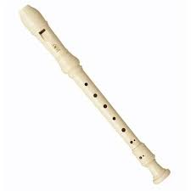
THE SPEECH PROCESS
Picture of a flute
https://lgoodov.xyz/product_details/1979050.html (Retrieved on 18/09/2023)

Slide 3
THE VOCAL TRACT
The processes that the vocal tract uses in creating a multitude of sounds are similar to those of wind instruments and organ pipes
Produce different musical sounds by varying the shape, size and acoustic character of the cavities through which air passes
Every speech sound sounds different from every other speech sound :
some unique combination of features in the way you shape the mouth and tongue and move parts of the vocal apparatus when you make the speech sound.

Slide 4
SPEAKING PROCESS
sound is moving air
Speaking means using your vocal tract
(lungs, trachea, larynx, mouth, and nose) to get air moving and vibrating and the shaping that movement in different ways.

Slide 5
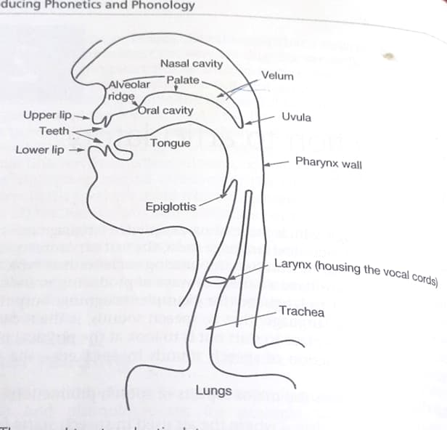
THE VOCAL TRACT AND ARTICULATORY ORGANS
Davenport,M& Hannahs, S.J.2010. Introducing phonetics and phonology. Routledge.

Slide 6
Most speech sounds are made with air exiting the lungs; therefore speech begins with breath.
To begin to speak you, you pull down your diaphragm, the big muscle that separates your chest cavity from your stomach.
This enlarges the lungs, which draws air in.
Then the diaphragm relaxes and the muscles around the ribs contract, slowly squeezing the lungs and forcing the air out and up the windpipe or trachea

Slide 7
Take time to identify them in your system.
At the top of the trachea is a little box or cartilage, called the larynx (the Adam’s apple)
Inside the larynx, two folds of soft tissue, called the vocal folds (vocal cords) lie across the top of the trachea.
If the vocal folds are held in the correct position with the correct tension, the air flowing out of the trachea causes them to flap open and close very quickly.

Slide 8
Practical
Find your larynx (in front of your throat) and then hum a tune.
You will feel the opening and closing motion as vibration in your throat.

Slide 9
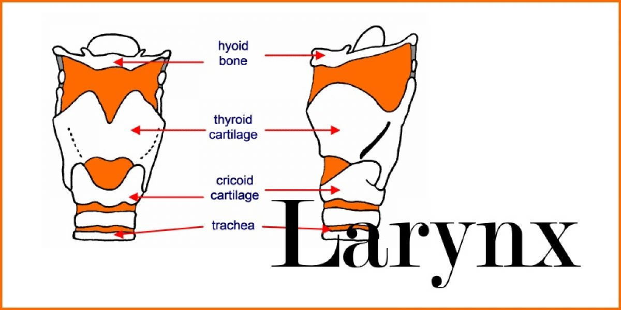
Picture of larynx
Picture of the larynx
Williamson, G.(2014). Anatomy. [Photograph] https://www.sltinfo.com/larynx/ (Accessed on 20/09/2023).

Slide 10
Just above the larynx at the base of the tongue, is the epiglottis.
It’s a muscular structure that folds down over the larynx when you swallow to prevent food from going down into the lungs.
At the lower side of the throat, is the pharynx.
It allows the tongue the freedom for front and back movement

Slide 11
Just above the larynx at the base of the tongue, is the epiglottis.
It’s a muscular structure that folds down over the larynx when you swallow to prevent food from going down into the lungs.
At the lower side of the throat, is the pharynx.
It allows the tongue the freedom for front and back movement

Slide 12
Inside the mouth, there are many different structures- active articulators and passive articulators that we use to shape speech sounds as the air passes through the vocal tract.
Active articulators move towards the passive articulators in order to constrict and shape the air that is moving out of the lungs.

Slide 13
Active articulators include:
The lower lip.
The tongue, i.e. the upper surface of the tongue.
The lower teeth.
The uvula ( in some cases – like those languages that make use of kh sound.)

Slide 14
Passive articulators are:
Passive articulators lie along the top of the vocal tract.
The alveolar ridge- the bony rise just behind your upper teeth.
Practical ( run your tongue along the top of your mouth beginning behind your upper teeth)
b. Hard palate/ the roof of the mouth-
Practical (curl your tongue very far back in your mouth, you will feel the bony structure of the hard palate).

Slide 15
c. Soft palate/ velum- behind the hard palate.
When the velum is lowered, the port is open and air flows freely between the nose and the lungs.( /m/, /n/ sounds are produced this way.
When it is raised, the opening to the nose is closed off and the airstream is directed to the mouth
d. Uvula – at the end of the velum, is uvula, the little pink pendulum you can see hanging down in the back of your mouth when you wide and say ‘ah’. ( In some cases it is passive)
Other passive articulators are:
The upper lip.
The upper teeth.
The roof of the mouth.
The back wall of the throat (or pharynx).

Slide 16
AIRSTREAM MECHANISMS
Arflow:
Where is it initiated?
Which direction does it travel in?
Answers:
The major initiator is the lungs.
The direction-commonly, air flows out from the lungs through the trachea (windpipe), larynx (Adam’s apple) and vocal tract (nose and mouth)

Slide 17
AIRSTREAM MECHANISMS
Speaking involves using the structure of the vocal tract in different ways to control and shape moving air.
The movements of speech are goal directed gestures (to produce sounds).
Each sound is comprised of a set of articulatory goals that will get the vocal tract in the right position to make the sounds you wish to make.

Slide 18
Three basic mechanisms
Lung airflow (pulmonic )
Glottalic airflow (Glottal )
Velaric airflow

Slide 19
PULMONIC
All human languages involve this type of airstream mechanism:
Pulmonic egressive (= from the lungs outwards)
It involves air moving out of the lungs.
Lung airflow and the respiratory cycle are basic to speech production.
Air coming out is the source of power in nearly all speech sounds.

Slide 20
PULMONIC
In principle, air flowing either into or out of the lungs during the respiratory cycle may be used in generating speech sounds
The nature of the sound produced will depend on what is happening in the vocal tract above the trachea-
(i.e on the action of the larynx and how the rest of the tract is constricted or modified in shape.)

Slide 21
The two mechanisms are often referred to as egressive pulmonic (outward and ingressive pulmonic (ingressive).
Most sounds used by most world languages are pulmonic egressive.
The lungs are sponge like tissues near the diaphragm
When the diaphragm contracts, it enlarges the lungs by raising the rib cage.
Air can be pushed out of the lungs by pulling the rib cage.

Slide 22
GLOTALLIC AIRTREAM MECHANISM
Sometimes known as pharyngeal
Made by moving air inwards or outwards by lowering of raising the larynx in the throat.
If the glottis(in the larynx)is tightly closed, and there is at the same time, closure in the mouth, a small quantity of air will be trapped between the closed glottis and the oral closure.

Slide 23
If the larynx is slightly open, the air trapped between the closed glottis and the oral closure will be compressed.
Then if the oral closure is suddenly released, the trapped air pressure will be released into an explosion.
If the larynx moves upwards, it can generate an egressive glottalic airstream. Sounds produced this way are called ejectives
If it moves downwards, it produces an ingressive glotallic airstream. Sounds produced this way are called implosives.

Slide 24
The larynx is thus the initiator, and because of the importance of the glottal closure within the larynx, this type of initiation of articulation is called glotallic.
The glottis can either be open or closed to give voiced or voiceless sounds.
Voiced sounds are produced with vocal folds vibration.
Voiceless sounds are produced without the vibration.

Slide 25
VELARIC/ORAL AIRSTREAM MECHANISM
It is made by making a velar closure (as for /k/, /g/, and sliding the tongue backwards or forwards to move air inwards and outwards.
Movement of air in the mouth is called velaric airstream mechanism.
Entirely generated within the oral cavity by raising the back of the tongue to make firm contact with the soft palate.
Air in front of this tongue may then be sealed off by closing the lips or by pressing the sides of the tongue against the roof of the mouth behind the teeth.
Sounds produced this way are called clicks.
Some languages like Zulu and Khosa, also Luyha use this mechanism in the production to clicks-

Slide 26
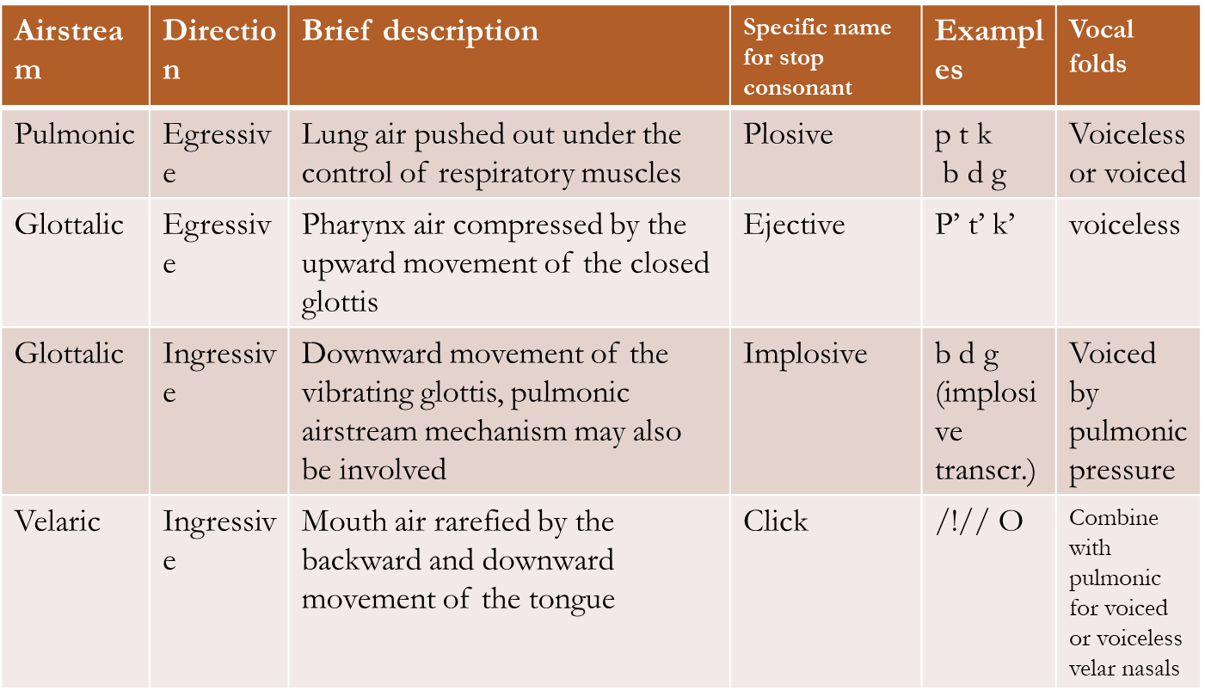

Slide 27
PHONATION PROCESS / STATE OF THE GLOTTIS
Phonation refers to vocal fold vibration but can also be taken to include all the means by which the larynx functions as a source of sound.
There are five phonation modes:
Voicelessness
Whisper
Breathy voice
Voice
Creak
https://youtu.be/f62dqc-L36o

Slide 28
PHONATION PROCESS
The larynx contains two horizontal folds of tissue, which protrude into the passage of air from the sides: the vocal folds.
The gap between the vocal folds, through which the air stream passes upwards into the pharynx and the mouth, is called the glottis.
This is where the process of phonation takes place. The vocal folds can be manipulated by the speaker and brought into a variety of different positions, thus altering the shape of the glottis. .

Slide 29
The distinction between voiceless and voiced sound applies in a high proportion of the world’s languages;
distinctive use of breathy voice and creak is much less common,
whisper could arguably be omitted as non-linguistic.

Slide 30
Voiceless means the absence of any phonation.
The vocal folds are held far apart to allow a non-turbulent airflow through the glottis.
The vocal folds are spread and do not vibrate; the glottis is sufficiently wide open so as to allow the air stream to pass through without obstruction.
Meaning that the glottis is open.
Like production of sounds s t k f h in the beginning of words as in heart.

Slide 31
Whisper requires greater constriction than the voiceless setting of the glottis.
It’s generally achieved by reducing or narrowing the ligamental vocal folds while maintaining an opening of the arytenoid cartilages.
The characteristic consequence of the whisper is that there is significant turbulence at the glottis.

Slide 32
Breathy voice/ murmur
Normal vocal fold vibration is accompanied by some continuous turbulent airflow.
Occurs when glottal closure during the vibration cycle is not complete (hence the term breathy).
The arytenoid cartilages remain slightly apart while the ligamental folds vibrate.
Murmured sounds occur in English in the pronunciation of /h/ in between vowels as in ahead, behind.

Slide 33
Voice refers to a normal vocal fold vibration occurring along most or all of the length of the glottis.
When the vocal folds are brought together in such a way that only a narrow gap is left for the air stream to pass through, the passage of air makes them vibrate.
This vibration of the vocal folds in turn causes vibration on the part of the air column above the glottis.
The resulting sound waves characterise voiced sounds of speech.

Slide 34
Vocal folds are close together and are vibrating.
The glottis is narrowed
All languages have voiced sounds e.g g z d l
All vowels are voiced

Slide 35
Creak is a phonation mode characterized by low frequency vibration of the vocal folds.
The folds open only for a short time and often quite irregularly from cycle to cycle of vibration.
Practical- sing the lowest voice that you can, and try to go even lower.
Creaky sounds may also be called laryngealized.

Slide 36
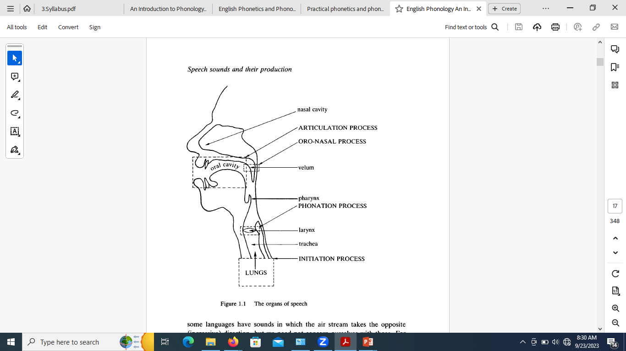
(Giegerich, H. 1992. English phonology: An introduction. Cambridge University press.)

Slide 37
REFERENCES
Davenport, M. & Hannahs, S.J. (2010). Introducing phonetics and phonology. London: Routledge.
Giegerich, H. 1992. English phonology: An introduction. UK: Cambridge University press.)
Roach, P. (2009). English phonetics and phonology: A practical course. UK: Cambridge University Press.

