Slide 1
Course: Building Services III
Lecture 1: Thermal comfort, basics of hvac
Lecturer: Manchan Tiwari

Slide 2
Course Introduction
HVAC System
  Thermal Comfort,
  HVAC, HVAC Design
  Components and Types of HVAC Systems.
  Installation of HVAC Systems
  Psychometric Chart, Ventilation Standard
  Heating System.( Solar/Boilers)
  Cooling Load and Calculations
  Indoor Air Quality, Natural Ventilation
Fire Protection System
  Types of fire and safety codes
  Wet/dry pipe system design
  Hydrant and sprinklers system design
Vertical transportation systems and Construction Equipment
  Lifts and Escalators
  Transportation Lifts and Construction Hoist
  Construction Equipment
Coordination of Services with other discipline of Construction
  Air- conditioning system
  Fire protection System demonstration
  Solar PV and Heating System
  Construction sites
  Energy, Energy Planning and Auditing

Slide 3
Introduction
Building services engineers are responsible for strategizing, designing, overseeing, and inspecting various systems within buildings to ensure they are both comfortable and safe, as well as functional and energy-efficient.
These systems typically encompass heating, ventilation, air conditioning (HVAC), water supply and drainage, lighting, electrical power, information and communication technology (ICT), elevators, escalators, and control systems.
In more complex structures such as airports, hospitals, factories, and laboratories, specialized systems like gas distribution, humidity control, and pathogen management may also be necessary (Chadderton, 2007).

Slide 4
Introduction
Building services engineers play a pivotal role in shaping the design of a building.
They contribute not only to defining overall strategies and performance standards but also influence the design elements such as the building's facade, the placement, size, and weight of major equipment and machinery, the layout of vertical service risers, pathways for horizontal service distribution, drainage solutions, energy sources, sustainability measures, and more.
Consequently, integrating building services design into the overall building concept becomes crucial, especially in intricate construction projects.
While architects often lead building design teams, in cases with intricate building services demands, a building services engineer may assume the role of the lead designer (Chadderton, 2007).

Slide 5
Introduction
A primary objective of a building services engineer is to not only create a functional building but also to minimize energy consumption and reduce environmental impact as much as possible.
Building services encompass the various systems and installations within a building that collectively aim to enhance its comfort, functionality, efficiency, and safety.
Building services are the systems installed in buildings to make them comfortable, functional, efficient and safe (Chadderton, 2007).

Slide 6
Building services might include:
Building control systems.
Energy distribution.
Energy supply (gas, electricity and renewable sources such as solar, wind, geothermal and biomass).
Escalators and lifts.
Facade engineering (such as building shading requirements).
Fire safety, detection and protection.
Heating, ventilation and air conditioning (HVAC).
Information and communications technology (ICT) networks.
Lighting (natural and artificial).
Lightning protection.
Refrigeration.
Security and alarm systems.
Water, drainage and plumbing (including sustainable urban drainage systems (SUDS) (Fred Hall, 2007).
Specialized building services may encompass systems designed for the control of bacteria and humidity, specialized lighting and security, backup power for emergencies, specialized gas distribution, fume containment units, surgical operating rooms, and similar features.

Slide 7
Thermal Comfort
Thermal comfort is the state of feeling satisfied with the temperature conditions in a given environment, where one doesn't feel excessively hot or cold.
Defining the human thermal experience isn't straightforward, and it can't be boiled down to specific temperatures or acceptable temperature ranges.
It's a subjective sensation influenced by numerous factors, varying from person to person even within the same space.
For instance, someone climbing stairs in a cold place while wearing a coat might feel too warm, whereas another person sitting quietly in a shirt in the same setting might feel too cold (Pita, 2002)..

Slide 8
Thermal Comfort
An environment can be considered to offer "reasonable comfort" when at least 80% of its occupants feel thermally comfortable.
This means that assessing thermal comfort can be as simple as asking people if they are unhappy with their thermal conditions.
When individuals are dissatisfied with their thermal surroundings, it not only poses potential health risks but also affects their ability to perform effectively, their job satisfaction, their likelihood of remaining a customer, and more (Pita, 2002)..

Slide 9
Thermal Comfort
Efforts to ensure comfort in indoor spaces aim to maintain consistent conditions despite external weather changes or internal heat variations.
Because people differ greatly in their physiological and psychological comfort preferences, finding the perfect temperature for everyone in a given space is challenging.
Six primary factors directly impact thermal comfort, which can be categorized into personal factors (related to occupants) and environmental factors (pertaining to the thermal environment).
Personal factors include metabolic rate and clothing level, while environmental factors encompass air temperature, mean radiant temperature, air velocity, and humidity.
Using an incorrect metabolic rate for sizing air conditioning systems can lead to oversized and less efficient equipment (Pita, 2002)..

Slide 10
Thermal Comfort
Comfort applications are quite different for various building types and may be categorized as:
Commercial buildings, which are built for commerce, including offices, malls, shopping centers, restaurants, etc.
High-rise residential buildings, such as tall dormitories and apartment blocks
Industrial spaces where thermal comfort of workers is desired
Institutional buildings, which includes government buildings, hospitals, schools, etc.
Low-rise residential buildings, including single-family houses, duplexes, and small apartment buildings
Sports stadiums.
In addition to buildings, air conditioning can be used for many types of transportation, including automobiles, buses and others (Pita, 2002)..

Slide 11
Parameter of Thermal Comfort
Temperature
Humidity
Air velocity
Mean radiant temperature (MRT)
Indoor air quality requirements
Sound/ Vibration levels

Slide 12
Factors Effecting Thermal Comfort
Age and activity of the occupants
Occupants’ density
Contaminants likely to be present in the space
Physical character of space (walls, floors)
Occupant clothing
Economic parameters (life cycle cost)
Complexity and practicality of design (Design objectives will have but a slim chance of being realized if system design features reach beyond the capabilities or understanding of operating and maintenance staff (assuming there is such staff).
Temperatures of 77°F [25.0°C] for summer and 72°F [22.2°C] for winter are the likely choices, with RH values of 45% and 50%, respectively

Slide 13
Important Terminologies
  Humidity
Humidity refers to the quantity of water vapor present in the atmosphere. Water vapor, the gaseous form of water, is typically invisible to the human eye. Humidity provides insights into the likelihood of precipitation, dew formation, or the presence of fog.
The quantity of water vapor required to reach saturation increases as the temperature rises. Conversely, when the air temperature drops, it will eventually reach a saturation point without gaining or losing water mass.
The saturation point denotes the state of air where it can no longer hold any additional moisture or water vapor. The amount of water vapor within the air can vary considerably.
For instance, air close to saturation at 30 °C might contain 28 grams of water per cubic meter, whereas at 8 °C, it may hold only 8 grams of water per cubic meter.

Slide 14
Important Terminologies
  Absolute Humidity
Absolute humidity is the total mass of water vapor present in a given volume or mass or air. Its unit is gm per m³ or gm per kg
  Specific Humidity
Specific humidity is the ratio of mass of water vapor to the total mass of the moist air.

Slide 15
Important Terminologies
  Relative Humidity
The relative humidity is used for finding the water vapor content in the air. The relative humidity is defined as the ratio between the amount of moisture in the air at a particular temperature to the maximum moisture air can withstand at the same temperature.
The relative humidity can be close to 100% during rainy seasons.
Elevated humidity levels decrease the body's capacity to cool itself by slowing down the evaporation of sweat, resulting in a sensation of discomfort. In low humidity due to excessive evaporation, body feels dry. In cold climates, the outdoor temperature limits the ability of water vapor to circulate.
Consequently, even though it may be snowing outside with relatively high humidity, when that air enters a building and is heated, its new relative humidity becomes very low, resulting in dry indoor air. This dry air can lead to discomfort and issues such as dry, cracked skin.

Slide 16
Important Terminologies
  Relative Humidity
Low humidity levels can cause the mucous membranes lining the nasal passages to dry out and crack, making them more vulnerable to Rhinovirus cold viruses.
Nosebleeds are a common consequence of low humidity. Using a humidifier, especially in bedrooms, can alleviate these symptoms.
To maintain a comfortable and healthy indoor environment, it's recommended to keep indoor relative humidity levels above 30%. Humans can generally feel comfortable within a broad range of humidities, depending on the temperature, spanning from 30% to 70%, but ideally between 50% and 60%.
Very low humidity can lead to discomfort, respiratory issues, and can worsen allergies for some individuals. During the winter, it's advisable to maintain relative humidity levels at 30% or higher.
Extremely low relative humidities, below 20%, may also cause eye irritation.

Slide 17
Important Terminologies
  Dry Bulb Temperature
The air's temperature, as measured by a standard thermometer, is commonly known as the dry bulb temperature, abbreviated as DBT.
When a regular thermometer is exposed to the environment, it displays the dry bulb temperature, which is essentially the atmospheric temperature.
The term "air temperature," often used when discussing the temperature of the air, primarily refers to the dry bulb temperature.
This is because the dry bulb temperature is the air property most frequently cited in such contexts.
The Dry Bulb Temperature essentially denotes the overall ambient air temperature.
It's termed "Dry Bulb" because it's measured by a thermometer unaffected by the moisture content in the air.

Slide 18
Important Terminologies
  Wet Bulb Temperature
The wet bulb temperature of air is determined using a regular thermometer, but with a distinct approach – the thermometer's bulb is enveloped in a moist cloth. When this thermometer, covered by a wet cloth or wick, gauges the temperature of the surrounding air, it yields what's known as the wet bulb temperature, abbreviated as WBT.
As air makes contact with the wet cloth, it absorbs moisture and releases heat, causing a reduction in air temperature. This diminished temperature, as recorded by the thermometer, is referred to as the wet bulb temperature.
The wet-bulb temperature (WBT) is specifically the temperature detected by a thermometer wrapped in a water-soaked cloth (termed a wet-bulb thermometer) through which air is circulated.
Under conditions of 100% relative humidity, the wet-bulb temperature coincides with the air temperature (dry-bulb temperature), but it decreases as humidity levels decline.
It's important to note that the wet-bulb temperature signifies the lowest temperature attainable under prevailing environmental circumstances solely through the process of water evaporation.

Slide 19
Important Terminologies
  Dew Point
The temperature at which moisture begins to condense out of the air is known as the dew point temperature. Dew point is also referred to as saturation temperature. It represents the temperature at which air becomes fully saturated, causing water vapor to transition into liquid form. Above this temperature, moisture remains in the air.
When the dew-point temperature is close to the temperature of dry air, it indicates high relative humidity. Conversely, if the dew point is significantly lower than the dry air temperature, it suggests low relative humidity.

Slide 20
Important Terminologies
  Dew Point
For example, when moisture condenses on a cold bottle removed from the refrigerator, it signifies that the dew-point temperature of the surrounding air is higher than the temperature inside the refrigerator.
It's important to note that the Dew Point temperature is always lower than the Dry Bulb temperature and aligns with 100% relative humidity (when the air is fully saturated). As air temperature changes, the Dew Point typically remains relatively constant unless moisture is introduced to or removed from the air.
The distinction between dry bulb and wet bulb temperature is closely tied to relative humidity.
Enthalpy
It is a measurement of energy in a thermodynamic system. It is the thermodynamic quantity equivalent to the total heat content of a system. It is equal to the internal energy of the system plus the product of pressure and volume.

Slide 21
British Isles Comfort Criteria
The main comfort criteria for sedentary occupants in buildings in climates similar to that of the British Isles are as follows.
Operative temperature should be in the range 19–23◦C depending on room use. A feeling of freshness is produced when the mean radiant temperature is slightly above air temperature. A significant amount of radiant heating is needed in order to achieve this.
Air temperature and the mean radiant temperature should be approximately the same. Large differences cause either radiant overheating or excessive heat loss from the body to the environment, as would be experienced during occupation of a glasshouse through seasonal variations(Chadderton, 2007).

Slide 22
British Isles Comfort Criteria
Percentage saturation should be in the range 40–70%.
Maximum air velocity at the neck should be 0.1 m/s for a moving-air temperature of 20◦C d.b.
Both hot and cold draughts are to be avoided. Data are available for other temperature and velocity combinations.
Variable air velocity and direction are preferable to unchanging values of these variables. This is achieved by changes in natural ventilation from prevailing wind, movement of people around the building, on–off or high–low thermostatic operation of fan-assisted heaters or variable-volume air-conditioning systems (Chadderton, 2007).

Slide 23
British Isles Comfort Criteria
The minimum quantity of fresh air for room use that will remove probable contamination is 10 l/s per person.
Mechanical ventilation systems should provide at least 4 air changes/h to avoid stagnant pockets and ensure good air circulation.
Incoming fresh air can be filtered to maintain a clean dust-free internal environment.
The difference between room air temperatures at head and foot levels should be no more than 1◦C.
Ventilation air quantity can be determined by some other controlling parameter: for example, removal of smoke, fumes or dust, solar or other heat gains and dilution of noxious fumes (Chadderton, 2007).

Slide 24
Controlling the environmental condition
Natural Ventilation
Assisted Natural Ventilation
Mechanical Ventilation Type 1
Mechanical Ventilation Type 2

Slide 25
Controlling the environmental condition
Natural ventilation can be used to meet the thermal comfort criteria depending on the target region, type of building and requirement of the people. In mild climate localities, it may be used. The external weather conditions directly impact the large variation of internal air conditions. Various passive systems or design implementations can be used to provide limited cooling to assist natural ventilation.
Assisted Natural Ventilation: In the regions where the natural ventilations can be used, mechanical equipment such as exhaust fan, ventilation louvers can be used for controlled flow of air which provides more control in the internal thermal conditions. Evaporative cooling is also generally used to assist the natural ventilation.
(Chadderton, 2007).

Slide 26
Controlling the environmental condition
Mechanical Ventilation Type 1: It uses mechanical systems for cooling and air circulation. However, the circulated air is delivered only from outside zone. The exhaust air is supplied back to the environment. This type of system is feasible in zones where minimal cooling is required. The air can not be circulated due to presence of odor, carbon dioxide, pollutants etc.
Mechanical Ventilation Type 2: It uses mechanical systems for cooling and air circulation but the circulation air is only the recirculated room air. This type of system can be used to save energy.
(Chadderton, 2007).

Slide 27
Air Conditioning
Air conditioning is the process of treating air in an internal environment to establish and maintain required standards of temperature, humidity, cleanliness and motion. Basically air conditioning means controlling the following major parameters:
Temperature: Air temperature is controlled by heating or cooling the air
Humidity: air humidity, the water vapor content of the air, is controlled by adding or removing water vapor from the air (humidification or dehumidification)
Cleanliness: Air cleanliness or air quality is controlled by either filtration, the removal of undesirable contaminants using filters or other devices, or by ventilation, the introduction of outside air into the space which dilutes the concentration of contaminants. Often both filtration and ventilation are used in an installation
Motion: air motion refers to air velocity and to where the air is distributed. It is controlled by appropriate air distributing equipment.

Slide 28
Application of AC
Human comfort: Air conditioning enhances human comfort by controlling air temperature, humidity, cleanliness and air motion to the desired values.
Process control: air conditioning is also used to provide conditions that some processes require such as textile, printing and photographic facilities, computer rooms and medical facilities. Such process require certain air temperature and humidity for successful operation which is controlled by AV systems

Slide 29
General Components of AC
There are following major components in a general AC system
Heating Source:
  Heat always travels from a warmer to a cooler area. In winter, there is continual heat loss from within a building to outdoors.
  If the air in the building is to be maintained at a comfortable temperature, heat must be continually supplied to the air in the rooms, the equipment that supplies the heat required in called a heating system or heating source
Cooling source:
  In summer, heat continually enters the building from the outside as the temperature outside the building is high. In order to maintain the room temperature at a comfortable temperature, this excess heat must be continually removed from the room.
  The equipment that removes this heat is called a cooling system.

Slide 30
General Components of AC
There are following major components in a general AC system
Distribution system: Distribution system in a network of ducts or pipes, which carry fluid to the rooms to be heated or cooled.
Equipment (Fans or Pumps): The main purpose of the fan or pump is to move air or water through ducts to the desired space where cooling or heating takes place
Devices: There are also devices in AC system required to transfer heat between the fluid and the room
Other components: These are valves, automatic controls, insulations, dampers

Slide 31
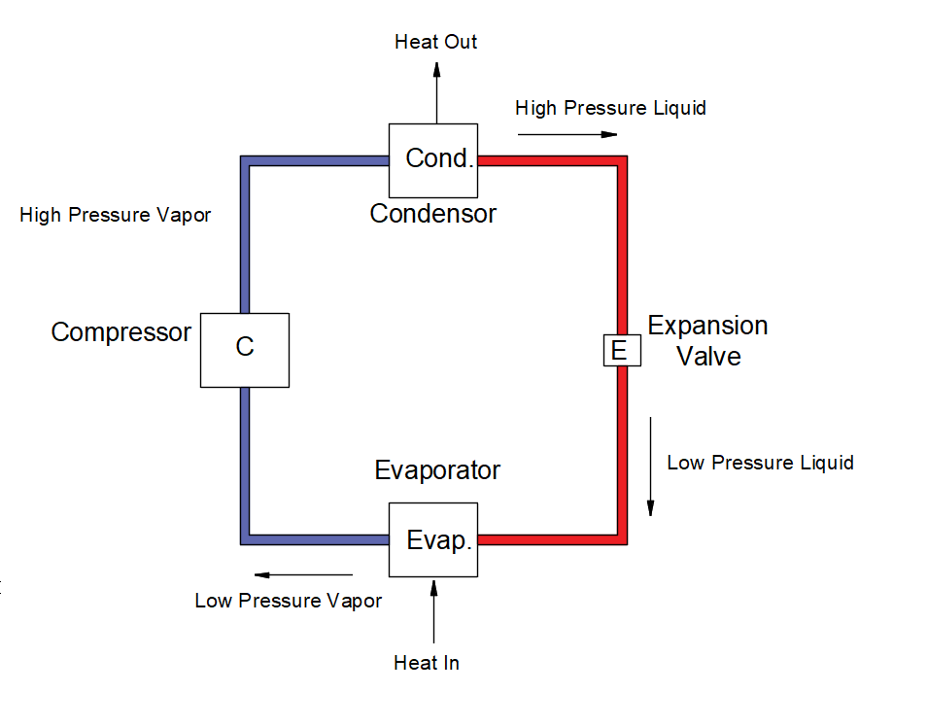
Working Principal of AC
Block Diagram of depicting working of AC System (Vapor Compression Refrigeration System)

Slide 32
Working Principal of AC
In the refrigeration cycle, heat is transported from a colder location to a hotter area. As heat would naturally flow in the opposite direction, work is required to achieve this.
A refrigerator is an example of such a system, as it transports the heat out of the interior and into its environment.
The refrigerant is used as the medium which absorbs and removes heat from the space to be cooled and subsequently rejects that heat elsewhere.
Circulating refrigerant vapor enters the compressor, where its pressure and temperature are increased.
The hot, compressed refrigerant vapor is now at a temperature and pressure at which it can be condensed and is routed through a condenser.
Here it is cooled by air flowing across the condenser coils and condensed into a liquid.

Slide 33
Working Principal of AC
Thus, the circulating refrigerant removes heat from the system and the heat is carried away by the air.
The removal of this heat can be greatly increased by pouring water over the condenser coils, making it much cooler when it hits the expansion valve.
The condensed, pressurized, hot liquid refrigerant is directed through an expansion valve (often nothing more than a pinhole in the system's copper tubing) where it undergoes an abrupt reduction in pressure.
That pressure reduction results in evaporation of a part of the liquid refrigerant, greatly lowering its temperature.

Slide 34
Working Principal of AC
The cold refrigerant is then routed through the evaporator.
A fan blows the interior warm air (which is to be cooled) across the evaporator, causing the liquid part of the cold refrigerant mixture to evaporate as well, further lowering the temperature.
The warm air is therefore cooled and is pumped by an exhaust fan/ blower into the room.
To complete the refrigeration cycle, the refrigerant vapor is routed back into the compressor.

Slide 35
References
Chadderton, D. V. (2007). Building Services Engineering (5th Edition ed.). New York: Taylor and Francis Group.
Fred Hall, R. G. (2007). Building Services Handbook (4th Edition ed.). Oxford, Burlington: Elsevier Limited.
Pita, E. G. (2002). Air Conditioning Principles and Systems; An Energy Approach (4th Edition ed.). New York: Prentice Hall, Ohio.

Slide 36
THANK YOU

