Slide 1
Course: Building Services III
LECTURE 2: PSYCHROMETRIC CHART, VENTILATION STANDARDS
LECTURER: MANCHAN TIWARI

Slide 2
Revision of Basic Concepts
Humidity: It is the measure of quantity of water vapor present in atmosphere.
Absolute Humidity: It is the ratio of total mass of water vapor present in given volume or mass of air. Its unit is gm/m³ or gm/kg
Specific Humidity: It is the ratio of mass of water vapor to the total mass of moist air.
Relative Humidity: It is the ratio of amount of moisture in the air at a particular temperature to the maximum moisture air can withstand at the same temperature.

Slide 3
Revision of Basic Concepts
Humidity Ratio: It is the ratio of the mass of water vapor to the mass of dry air contained in a sample of air.
Specific Volume is the ratio of unit volume of dry air per unit weight of dry air.
Dry Bulb Temperature: It is the temperature measured by a regular thermometer.
Wet Bulb Temperature: It is the temperature measured by a regular thermometer when the bulb of the thermometer is wrapped in a moist cloth.

Slide 4
Revision of Basic Concepts
Dew Point: It is the temperature at which condensation begins when air with relative humidity below 100% is cooled.
Enthalpy: It is equivalent to the total heat content of a system. The enthalpy of atmospheric air is the sum of the enthalpy of dry air and the enthalpy of water vapor present in it. This is equal to sensible heat of dry air and sensible as well as latent heat of the water vapor (Pita, 2002).

Slide 5
Some Basic Terminologies
  Heat
It is basically the measure of thermal energy.
Thermodynamically heat is defined at the energy flow between system and surrounding due to the virtue of temperature difference.
Its SI unit is Joule.
Quanity of heat is also measured in British thermal units (Btu).
Btu is defined as the amount of heat required to heat 0.45 kg of water from 15.3 ⁰C to 15.8 ⁰C.

Slide 6
Some Basic Terminologies
  Heat
Unit conversion
1 Btu = 1055 joules (J)
1 Btu = 0.293 watt-hour (W-hr)
1 Btu = 252 calories (C)

Slide 7
Some Basic Terminologies
  Temperature
  It refers to the quantification of the average kinetic energy of atoms and molecules within a substance at the microscopic level.
  Temperature is typically quantified using units like degrees Celsius (°C), degrees Fahrenheit (°F), or the Kelvin (K) scale, particularly in scientific applications.
  Conversion of units of temperature is done according to below:
  °C = (°F -32)/1.8
  °K = °C + 273

Slide 8
Some Basic Terminologies
  Mass density (ρ)
It is the ratio of mass per unit volume of a substance. Its unit is kg/m³
  Specific Heat
Specific Heat of a substance is defined as the amount of heat required to raise the temperature of 1 kg of mass of the substance through 1 °C.
Its unit is kJ/kg K.
It can also be understood as the property of a substance which indicates how slow its temperature rises when it is heated.
For example, if heat is applied at the same rate, then the temperature of water will rise slower as compared with iron as water has higher specific heat than iron

Slide 9
Some Basic Terminologies
  Specific Heat of Some Substance
Product | Specific Heat (kJ/kg K)
Water (20 ⁰C) | 4.15
Cast Iron | 0.460
Aluminium | 0.912
Copper | 0.389
Gold | 0.13
Brick | 0.92
Marble | 0.88
Wood | 2.3 to 2.7
Source: (Joseph B Wujek, 2010)

Slide 10
Some Basic Terminologies
  Sensible and Latent Heating
Sensible heat is the thermal energy associated with changing a substance's temperature, and this change in temperature is directly proportional to the added or removed heat.
This phenomenon, known as sensible heating, is observable through the sense of touch.
Sensible heating doesn't apply during state changes like solid to liquid or liquid to gas.
These transitions, known as phase changes, involve the storage or release of heat and can occur when heat is added or removed from a substance.

Slide 11
Some Basic Terminologies
  Sensible and Latent Heating
Latent heat is the heat associated with a substance's phase transition without affecting its temperature.
This "hidden" heat is absorbed or released when a material changes phase, such as from liquid water to water vapor, without any temperature change.
Latent heat of vaporization is the heat which is needed for a substance to change from liquid to gas and is released when it changes back from gas to liquid. In water, this heat is about 970 Btu/lb.
Latent heat of fusion is involved when a substance transitions from liquid to solid, as with water turning into ice, releasing 144 Btu/lb, and the same amount is absorbed when ice returns to a liquid state.

Slide 12
Some Basic Terminologies
  Power
Power is the rate of energy per unit time. Its SI unit is J/s or Watt (W). Btu/hr is also used as unit of power.
1 W = 3.413 Btu/hr
1 hp = 745.7 W
1 hp = 2544.3 Btu/hr

Slide 13
Psychrometrics
Psychrometrics is the study of the thermodynamic properties of gas-water vapor mixtures when temperature and pressure is varied.
It is essential in HVAC system design for analyzing conditions involving moist air, indoors and during ventilation, relying on an understanding of air and water vapor within air.
Atmospheric air, which is the air found in the atmosphere, is a mixture of different gases, including nitrogen (75.47%), oxygen (23.2%), Carbon dioxide (0.046%) water vapor, and contaminants like dust and pollen.
In contrast, the typical composition of gases exhaled by a seated individual is approximately: oxygen 16.5%, carbon dioxide 4.0%, nitrogen and argon 79.5%, along with minor trace gases. (Joseph B Wujek, 2010)

Slide 14
Psychrometrics
Dry air is devoid of water vapor and serves as a reference in psychrometrics, while moist air contains varying amounts of water vapor, present to some degree in all atmospheric air.
Saturated air holds the maximum moisture it can at a given temperature, and water vapor in air becomes superheated steam at low pressure and temperature, typically appearing clear unless tiny water droplets cause foggy conditions.
Due to the variability in atmospheric air, the terms dry air and moist air are mostly used in psychrometrics.
Heating, ventilation, and air conditioning systems are typically rated using standard air conditions, as outlined in the Table.
Air Property | Value for Standards Conditions in SI Units
Absolute Pressure | 101.325 kPa
Temperature | 21.1 ⁰C
Mass Density | 1.189 kg/m³
Specific Heat | 1.195 kJ/m³
Table: Standard Air Conditions (Joseph B Wujek, 2010)

Slide 15
Psychrometrics
However, it's important to note that when air experiences conditions different from the standard, such as variations in temperature and pressure, these factors significantly impact air density:
    Lower air pressure leads to reduced air density, while higher air pressure increases it.
    When air temperature drops, air density also decreases, and conversely, higher temperatures result in greater air density.
Changes in the density of dry air are directly proportional to alterations in specific heat and specific heat capacity. These variations necessitate adjustments by designers to account for real-world conditions, a consideration particularly crucial in building HVAC systems (Joseph B Wujek, 2010).

Slide 16
Psychrometric Chart
The chart or graph which represents the properties of the atmospheric air is known as psychrometric chart.
It represents the variation in value of various psychrometric variables.
The value of any two variable can be used to determine the state of the air, which also can be used to determine the values of other associated properties.
The dry bulb temperature scale is situated at the chart's base, denoting consistent dry bulb temperatures through vertical lines.
The wet bulb temperature scale is found along the upper curved section of the chart, with right-sloping lines indicating equivalent wet bulb temperatures (Joseph B Wujek, 2010).

Slide 17
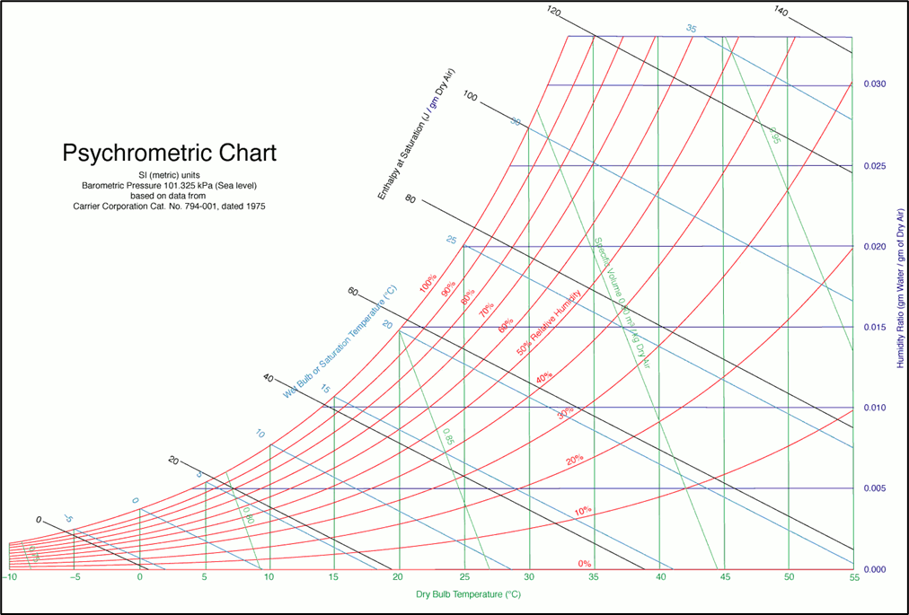
Relative Humidity
Specific Volume
Wet Bulb Temperature
Humidity Ratio
Enthalpy
Dry Bulb Temperature
Figure : Psychrometric Chart (Ogawa, 2012)

Slide 18
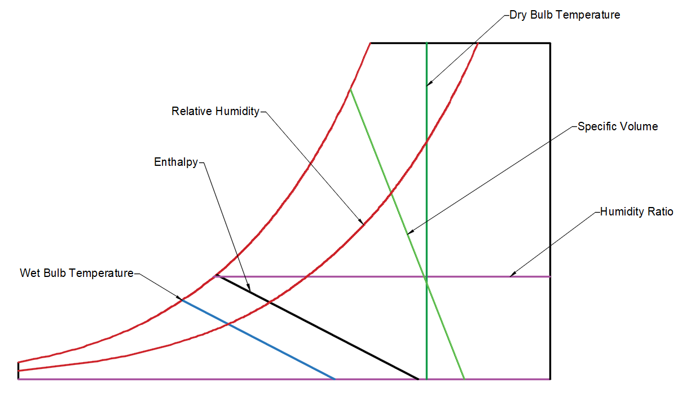

Slide 19
Psychrometric Chart
The dew point temperature scale is also positioned on the same curved section as the wet bulb temperature scale, with horizontal lines extending from this area indicating equal dew point temperatures.
The relative humidity scale is depicted by curved lines that sweep from the lower left to the upper right of the psychrometric chart.
The 100% relative humidity (saturation) line follows the upper curve and aligns with both the wet bulb and dew point temperature scales.
The 0% relative humidity line runs along the chart's base.
The 50% relative humidity line is determined by connecting points at various dry bulb temperatures, representing the humidity ratio when the air holds half of its maximum water content. These points are positioned midway between the 100% and 0% lines at a specific dry bulb temperature (Joseph B Wujek, 2010).

Slide 20
Psychrometric Chart
The humidity ratio or specific humidity is located on the chart's right side, with horizontally extending lines indicating constant moisture levels.
The specific volume scale is represented by diagonal lines that run from left to right.
The enthalpy scale is usually situated near the upper curved section of the chart, and its lines slope to the right, somewhat resembling the wet bulb temperature lines. However, they do not precisely correspond to the wet bulb temperature lines (Joseph B Wujek, 2010).

Slide 21
Psychrometric Chart
Heat exchange in moist air can be categorized into two terms: sensible heating and latent heating. Sensible heating and cooling are related solely to changes in dry bulb temperature, with no addition or removal of moisture.
On the other hand, humidification and dehumidification entail the introduction or removal of moisture, thus involving latent heat.
Latent heat represents the energy needed to alter the phase of a substance, in this instance, transforming water vapor in moist air.
Evaporative cooling, for instance, boosts the latent heat of the air through water evaporation, resulting in a decrease in sensible heat (a drop in the air's dry bulb temperature).
The wet bulb temperature represents the lowest temperature at which air can theoretically be cooled through the evaporation of water (Joseph B Wujek, 2010).

Slide 22
Psychrometric Chart Description
Vertical Lines are Dry Bulb Temperature
Horizontal Lines are humidity ratio (right axis) or dew point temperature (left axis)
Slanted lines are wet bulb temperature and enthalpy
Specific volume are the other slanted line which are not wbt and enthalpy

Slide 23
Reading Psychrometric Chart
Find relative humidity for DBT = 30 ⁰C and
WBT = 20 ⁰C
Figure : Psychrometric Chart (Ogawa, 2012)

Slide 24
Psychrometric Processes
Sensible cooling
Sensible heating
Cooling and dehumidification
Heating and humidification
Evaporative cooling
Dessiccant Dehumidification

Slide 25
Sensible Cooling
The sensible cooling of air is the process in which only the sensible heat of the air is removed so as to reduce its temperature, and there is no change in the moisture content (kg/kg of dry air) of the air.
What happens to DBT, WBT, Absolute Humidity, RH, DPT??????
How is sensible cooling achieved?
How is sensible cooling represented in psychrometric chart??

Slide 26
Sensible Cooling
What happens to DBT, WBT, Absolute Humidity, RH, DPT??????
  During sensible cooling process the dry bulb (DB) temperature and wet bulb (WB) temperature of the air reduces, while the latent heat of the air, and the dew point (DP) temperature of the air remains constant. There is overall reduction in the enthalpy of the air. Relative Humidity increases.
How is sensible cooling done?
  In the ordinary window or the split air conditioner the cooling of air is carried out by passing it over the evaporator coil, also called as the cooling coil. The room air or the atmospheric air passes over this coil carrying the refrigerant at extremely low temperatures, and gets cooled and passes to the space which is to be maintained at the comfort conditions.
How is sensible cooling represented on psychrometric chart??
  The sensible cooling process is represented by a straight horizontal line on the psychrometric chart. The line starts from the initial DB temperature of the air and ends at the final DB temperature of the air extending towards the left side from high temperature to the low temperature. The sensible cooling line is also the constant DP temperature line since the moisture content of the air remains constant.

Slide 27
Sensible Cooling
Sensible cooling entails the removal of heat from air without affecting its humidity ratio, often seen when cooling indoor air in buildings.
This leads to decreases in dry bulb and wet bulb temperatures and enthalpy.
It also causes an increase in specific volume and relative humidity. Similar to sensible heating, no alteration occurs in humidity ratio and dew point temperature.
On a psychrometric chart, this process is represented by a horizontal shift to the left along the specific humidity line (Joseph B Wujek, 2010).

Slide 28
Sensible Heating
In sensible heating process the temperature of air is increased without changing its moisture content.
What happens to DBT, WBT, Absolute Humidity, RH, DPT??????
How is sensible heating achieved?
How is sensible heating represented in psychrometric chart??

Slide 29
Sensible Heating
What happens to DBT, WBT, Absolute Humidity, RH, DPT??????
  During this process the sensible heat, DB and WB temperature of the air increases while latent of air, and the DP point temperature of the air remains constant.
How is sensible heating achieved?
  Sensible heating process is carried out by passing the air over the heating coil. This coil may be heated by passing the refrigerant, the hot water, the steam or by electric resistance heating coil.
An Example of Sensible Heating??
  Heating a room in a winter with electric heater
How is sensible heating represented in psychrometric chart??
  Like the sensible cooling, the sensible heating process is also represented by a straight horizontal line on the psychrometric chart. The line starts from the initial DB temperature of air and ends at the final temperature extending towards the right

Slide 30
Sensible Heating
In the sensible heating process, heat is introduced into the air without altering its moisture content. This commonly occurs during tasks like heating buildings in winter.
On a psychrometric chart, you can observe this as a horizontal shift to the right along the specific humidity line.
This results in an increase in dry bulb and wet bulb temperatures, as well as enthalpy, while specific volume and relative humidity decrease.
Since no moisture is added or removed, there is no change in humidity ratio and dew point temperature (Joseph B Wujek, 2010).

Slide 31
Humidifying
The process in which the moisture or water vapor or humidity is added to the air without changing its dry bulb (DB) temperature is called as humidification process.
This process is represented by a straight vertical line on the psychrometric chart starting from the initial value of relative humidity, extending upwards and ending at the final value of the relative humidity.
In actual practice the pure humidification process is not possible, since the humidification is always accompanied by cooling or heating of the air. Humidification process along with cooling or heating is used in number of air conditioning applications.

Slide 32
Cooling and Humidification
The cooling and humidification process is a commonly employed method in air conditioning for cooling purposes.
During this process, moisture is introduced to the air by passing it over a stream or spray of water at a temperature lower than the air's dry bulb temperature.
When ordinary air interacts with this water stream, the water particles within it tend to evaporate, and the air absorbs this evaporated moisture, increasing its humidity.
Simultaneously, as the temperature of the absorbed moisture is lower than the air's dry bulb temperature, it leads to an overall reduction in the air's temperature.

Slide 33
Cooling and Humidification
One of the most popular applications of cooling and humidification is the evaporative cooler, also called as the desert cooler.
The evaporative cooler is the sort of big box inside which is a small water tank, small water pump and the fan. The water from the tank is circulated by the pump and is also sprayed inside the box.
The fan blows strong currents of air over the water sprays, thus cooling the air and humidifying it simultaneously.
The evaporative cooler is highly effective cooling devise having very low initial and running cost compared to the unitary air conditioners. For cooling purposes, the cooling and humidification process can be used only in dry and hot climates like desert areas

Slide 34
Heating and Humidification
In the process of heating and humidifying air on the psychrometric chart, both the air's dry bulb temperature and humidity levels rise.
This procedure involves passing the air over a water spray maintained at a temperature higher than the air's dry bulb temperature or mixing the air with steam.
When regular air is directed over a water spray at a temperature exceeding the air's dry bulb temperature, the moisture particles from the spray evaporate and are absorbed into the air, leading to an increase in the air's moisture content.
Concurrently, because the temperature of the moisture is higher than the air's dry bulb temperature, it results in an overall elevation of the air's temperature.

Slide 35
Heating and Humidification
During heating and humidification process the dry bulb, wet bulb, and dew point temperature of the air increases along with its relative humidity.
The heating and humidification process is represented on the psychrometric chart by an angular line that starts from the given value of the dry bulb temperature and extends upwards towards right
Heating and humidification refer to the simultaneous increase of both the dry bulb temperature and humidity ratio of the air, as seen when human respiration adds both sensible heat and moisture to the surrounding air.

Slide 36
Dehumidification
The process in which the moisture or water vapor or the humidity is removed from the air keeping its dry bulb (DB) temperature constant is called as the dehumidification process.
This process is represented by a straight vertical line on the psychrometric chart starting from the initial value of relative humidity, extending downwards and ending at the final value of the relative humidity.
Like the pure humidification process, in actual practice the pure dehumidification process is not possible, since the dehumidification is always accompanied by cooling or heating of the air.
Dehumidification process along with cooling or heating is used in number of air conditioning applications.

Slide 37
Cooling and Dehumidification
The procedure in which air undergoes sensible cooling while simultaneously having its moisture removed is referred to as the cooling and dehumidification process.
This process is achieved by cooling the air below its dew point temperature when it is initially at a given dry bulb and dew point temperature.
As the air makes contact with a cooling coil maintained at a temperature below its dew point, its dry bulb temperature gradually decreases.
This cooling process continues until it reaches the air's dew point temperature. At this juncture, the water vapor present in the air begins to transform into dew particles, resulting in the formation of dew on the cooling surface and a reduction in the air's moisture content, consequently lowering its humidity level.
Therefore, when air is cooled below its dew point temperature, it undergoes both cooling and dehumidification.

Slide 38
Cooling and Dehumidification
The cooling and dehumidification process is most widely used air conditioning application. It is used in all types of window, split, packaged and central air conditioning systems for producing the comfort conditions inside the space to be cooled.
In the window and split air conditioners the evaporator coil or cooling coil is maintained at temperature lower than the dew point temperature of the room air or the atmospheric air by the cool refrigerant passing through it.
When the room air passes over this coil its DB temperature reduces and at the same time moisture is also removed since the air is cooled below its DP temperature. The dew formed on the cooling coil is removed out by small tubing.

Slide 39
Cooling and Dehumidification
In the central air conditioning systems the cooling coil is cooled by the refrigerant or the chilled water. When the room air passes over this coil, it gets cooled and dehumidified.
In the general the cooling and dehumidification process is obtained by passing the air over coil through which the cool refrigerant, chilled water or cooled gas is passed.
During the cooling and dehumidification process the dry bulb, wet bulb and the dew point temperature of air reduces. Similarly, the sensible heat and the latent heat of the air also reduce leading to overall reduction in the enthalpy of the air. The cooling and dehumidification process is represented by a straight angular line on the psychrometric chart. The line starts from the given value of the DB temperature and extends downwards towards left.

Slide 40
Heating and Dehumidification
The process in which the air is heated and at the same time moisture is removed from it is called as heating and dehumidification process.
This process is obtained by passing the air over certain chemicals like alumina and molecular sieves.
These elements have inherent properties due to which they keep on releasing the heat and also have the tendency to absorb the moisture. These are called as the hygroscopic chemicals.
In actual practice the hygroscopic elements are enclosed in the large vessel and the high pressure air is passed inside the vessel through one opening.
When the air comes in contact with the chemicals the moisture from the air is absorbed and since the chemicals emit heat, the DB temperature of the air increases.
The hot and dehumidified air comes out from the vessel through other opening in the vessel. The inlet and outlet openings of the vessel are controlled by the valve.

Slide 41
Ventilation
Fresh air supply is required from outside region to the indoor space to maintain the thermal comfort. Ventilation can be natural as well as mechanical. Various factors govern the quantity of fresh air required in a region or space. Ventilation can specifically be defined as the process which fulfills the following requirements:
Supply fresh air for breathing, typically at a rate of 0.1 to 0.2 liters per second per person.
Maintain the correct oxygen level in the air, which is approximately 21%.
Regulate carbon dioxide levels to stay below 0.1%. Concentrations exceeding 2% are dangerous as carbon dioxide can be lethal.
Manage humidity within a range of 30% to 70%.
Eliminate excess heat generated by machinery, individuals, lighting, etc.
Eliminate odors, smoke, dust, and other airborne contaminants (Fred Hall, 2007).
Alleviate stagnation and create a feeling of freshness through air movement ranging from 0.15 to 0.5 meters per second.
In case of Nepal, not much text regarding the guidelines of ventilation is found. In Building design code formulated by government of Nepal, following requirement for ventilation is mentioned:

Slide 42
Ventilation
Each basement shall be separately ventilated. Vents with cross sectional areas not less 2.5% of the floor area spread preferably around the perimeter of the basement shall be provided through stall boards, pavement light or through shafts [in case of double basements]. Each basement above 200 sq.m shall have minimum of one each system of air inlets and smoke outlet served through mechanical system. Additional vent system shall be provided for every 200sq.m of plinth area there on (GoN, 2015).
However, there are various ventilation requirements which can be followed and should be considered as well.

Slide 43
Types of Ventilation
Some of the ventilation techniques are:
Natural Ventilation: Suitable for mild coastal climates, this approach allows internal air conditions to vary with external weather. It involves features like central heating, shading blinds, passive solar architecture, and limited cooling through chilled-water beams or panels, but it doesn't provide ventilation air.
Assisted Natural Ventilation: An extension of natural ventilation, it incorporates mechanically operated louvers and exhaust fans to enhance air control. In hot, dry climates, outside air may be cooled with water spray evaporative coolers. The incoming outdoor air can be slightly cooled before being used for temperature control.
Mechanical Ventilation (Outside Air Only): Primarily used in moderate climates, like the UK, where little cooling is needed. It employs air-to-air heat exchangers or recuperative heat wheels to transfer heat between incoming and outgoing air streams, improving energy efficiency and temperature control.
Mechanical Ventilation (Recirculated Room Air): Maximizes energy savings by recirculating conditioned room air. Outside air dampers are modulated to control zone temperature without relying on mechanical refrigeration for as long as possible. When refrigeration is necessary, outside and exhaust air dampers are partially open to maximize recirculated room air use. Various ducted air-conditioning systems are employed (Chadderton, 2007).

Slide 44
Types of Ventilation
Use of mechanical or natural ventilation can be done based on following:
Natural inlet and outlet: This combination relies on features like openable windows, air bricks, and chimneys for air exchange, with up to about 3 air changes per hour possible. The effectiveness depends on factors like wind direction, stack effect from rising warm air, and openings around doors and windows.
Natural inlet, mechanical outlet: In this setup, natural means are used for fresh air intake, while mechanical systems like extract fans remove air contaminated with heat, fumes, or odors. It's suitable for various spaces, but there's no filtration of incoming impurities, and heating may be needed in winter.

Slide 45
Types of Ventilation
Mechanical inlet, natural outlet: This configuration involves blowing heated air into the building using mechanical systems, and air exits through openings and air bricks. It's suitable for spaces like offices, factories, and large halls.
Mechanical inlet and outlet: This approach assumes full mechanical control of air movement, particularly when natural ventilation openings are insufficient. It's used to handle high air flow rates without causing drafts or architectural disruption. In sealed environments, a complete air-conditioning system is employed (Chadderton, 2007).

Slide 46
References
Chadderton, D. V. (2007). Building Services Engineering (5th Edition ed.). New York: Taylor and Francis Group.
Fred Hall, R. G. (2007). Building Services Handbook (4th Edition ed.). Oxford, Burlington: Elsevier Limited.
Joseph B Wujek, F. R. (2010). Mechanical and Electrical Systems in Architecture, Engineering and Construction (5th Edition ed.). New Jersey: Pearson Education Inc.
Ogawa, A. (2012, May 2). Wikimedia Commons. Retrieved September 17, 2023, from https://upload.wikimedia.org/wikipedia/commons/1/1c/Psychrometric_chart.png
Pita, E. G. (2002). Air Conditioning Principles and Systems; An Energy Approach (4th Edition ed.). New York: Prentice Hall, Ohio.

