Slide 1
Course: Building Services III
Lecture 3: HVAC Design, components and types of hvac systems
Lecturer: Manchan Tiwari

Slide 2
Contents
Revision of Vapor Compression Refrigeration System
HVAC System
Specific Components of HVAC System
Types of HVAC System

Slide 3
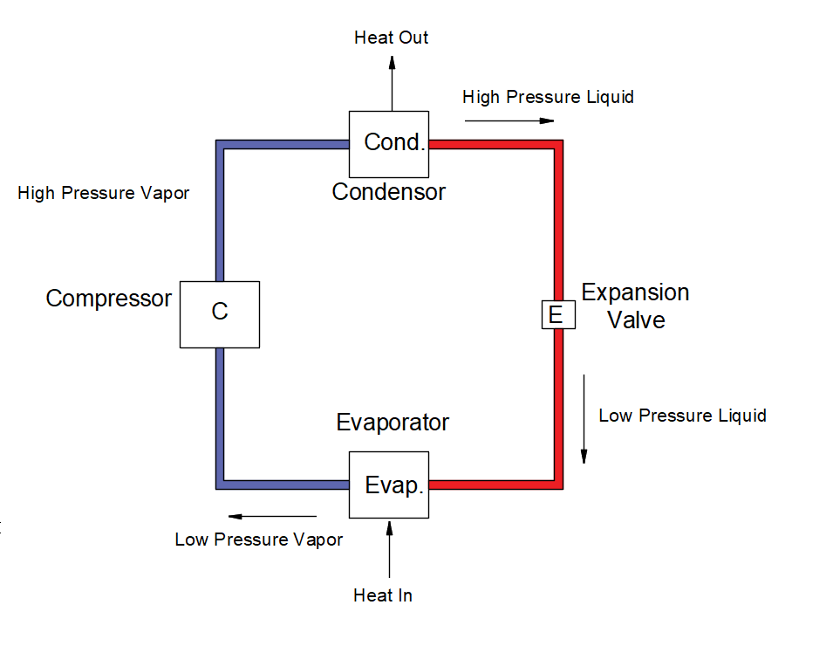
Vapor Compression Refrigeration System
The basic components of a air conditioning system working in the principle of vapor compression are:
Compressor
Condenser
Expansion Valve
Evaporator
Figure : Layout of Air Conditioning System

Slide 4
Vapor Compression Refrigeration System
Compressor:
Low pressure vapor (refrigerant) enters the compressor and is compressed to high pressure vapor while raising its enthalpy and temperature.
The high-pressure vapor then enters the compressor.
Condenser:
As the high-pressure vapor enter the condenser at relative high temperature, it is cooled to high pressure liquid at the condenser.
The cooling at the condenser can be done by either air or liquid which enter the compressor and gets heated while cooling the high-pressure vapor.

Slide 5
Vapor Compression Refrigeration System
Expansion Valve:
At expansion valve the high-pressure liquid enters and is changed to low pressure liquid. As the pressure of the liquid decreases, so does its temperature.
So, now the relatively cold low-pressure liquid is ready to get evaporated if it comes in contact with surrounding at temperature higher than that of the low-pressure liquid.
Evaporator:
The low-pressure liquid from the exit of the expansion valve enters the evaporator where the heat transfer between the low-pressure refrigerant and surrounding is facilitated.
As the surrounding is relatively at the higher temperature, the refrigerant absorbs the heat from the surrounding hence cooling it.
The refrigerant itself is converted to low pressure vapor.

Slide 6
HVAC System Introduction
An HVAC system conducts the processes that regulate the quality of air within a building, comprising of functions like heating, cooling, humidity control, dehumidification, and air filtration.
Although "air conditioning" commonly brings to mind cooling, it's crucial to understand that it involves various air quality adjustments.
Space heating equipment is used to warm the air inside buildings and can take various forms like heat pumps, furnaces, boilers, individual space heaters, or district steam or hot water systems.
Conversely, space cooling equipment cools indoor air, utilizing refrigeration (such as room air conditioners), evaporative cooling units, or central cooling systems that circulate chilled water. Humidifiers add moisture to indoor air, while dehumidifiers remove excess moisture.

Slide 7
HVAC System Introduction
Chilled water systems cool water centrally and distribute it to different building areas via coils or embedded pipes, mainly in larger buildings.
Heating and cooling distribution equipment, such as radiators, baseboards, and fan-coil units, disperse conditioned air and water throughout a building through pipes, ducts, or fans. This equipment also facilitates ventilation.
The choice of heating and cooling systems and equipment depends on factors like local climate, heating/cooling needs, occupant comfort preferences, budget constraints, and energy expenses (Joseph B Wujek, 2010).

Slide 8
Specific Components of
HVAC
In present context all major AC systems work under the principle of vapor compression cycle. The major components of AC systems working under vapor compression cycle are:
Compressor
Condenser
Expansion Valve
Evaporator
Ducts
Fans
Thermostat
Other Devices (Insulations, Dampers, Automatic Controls)

Slide 9
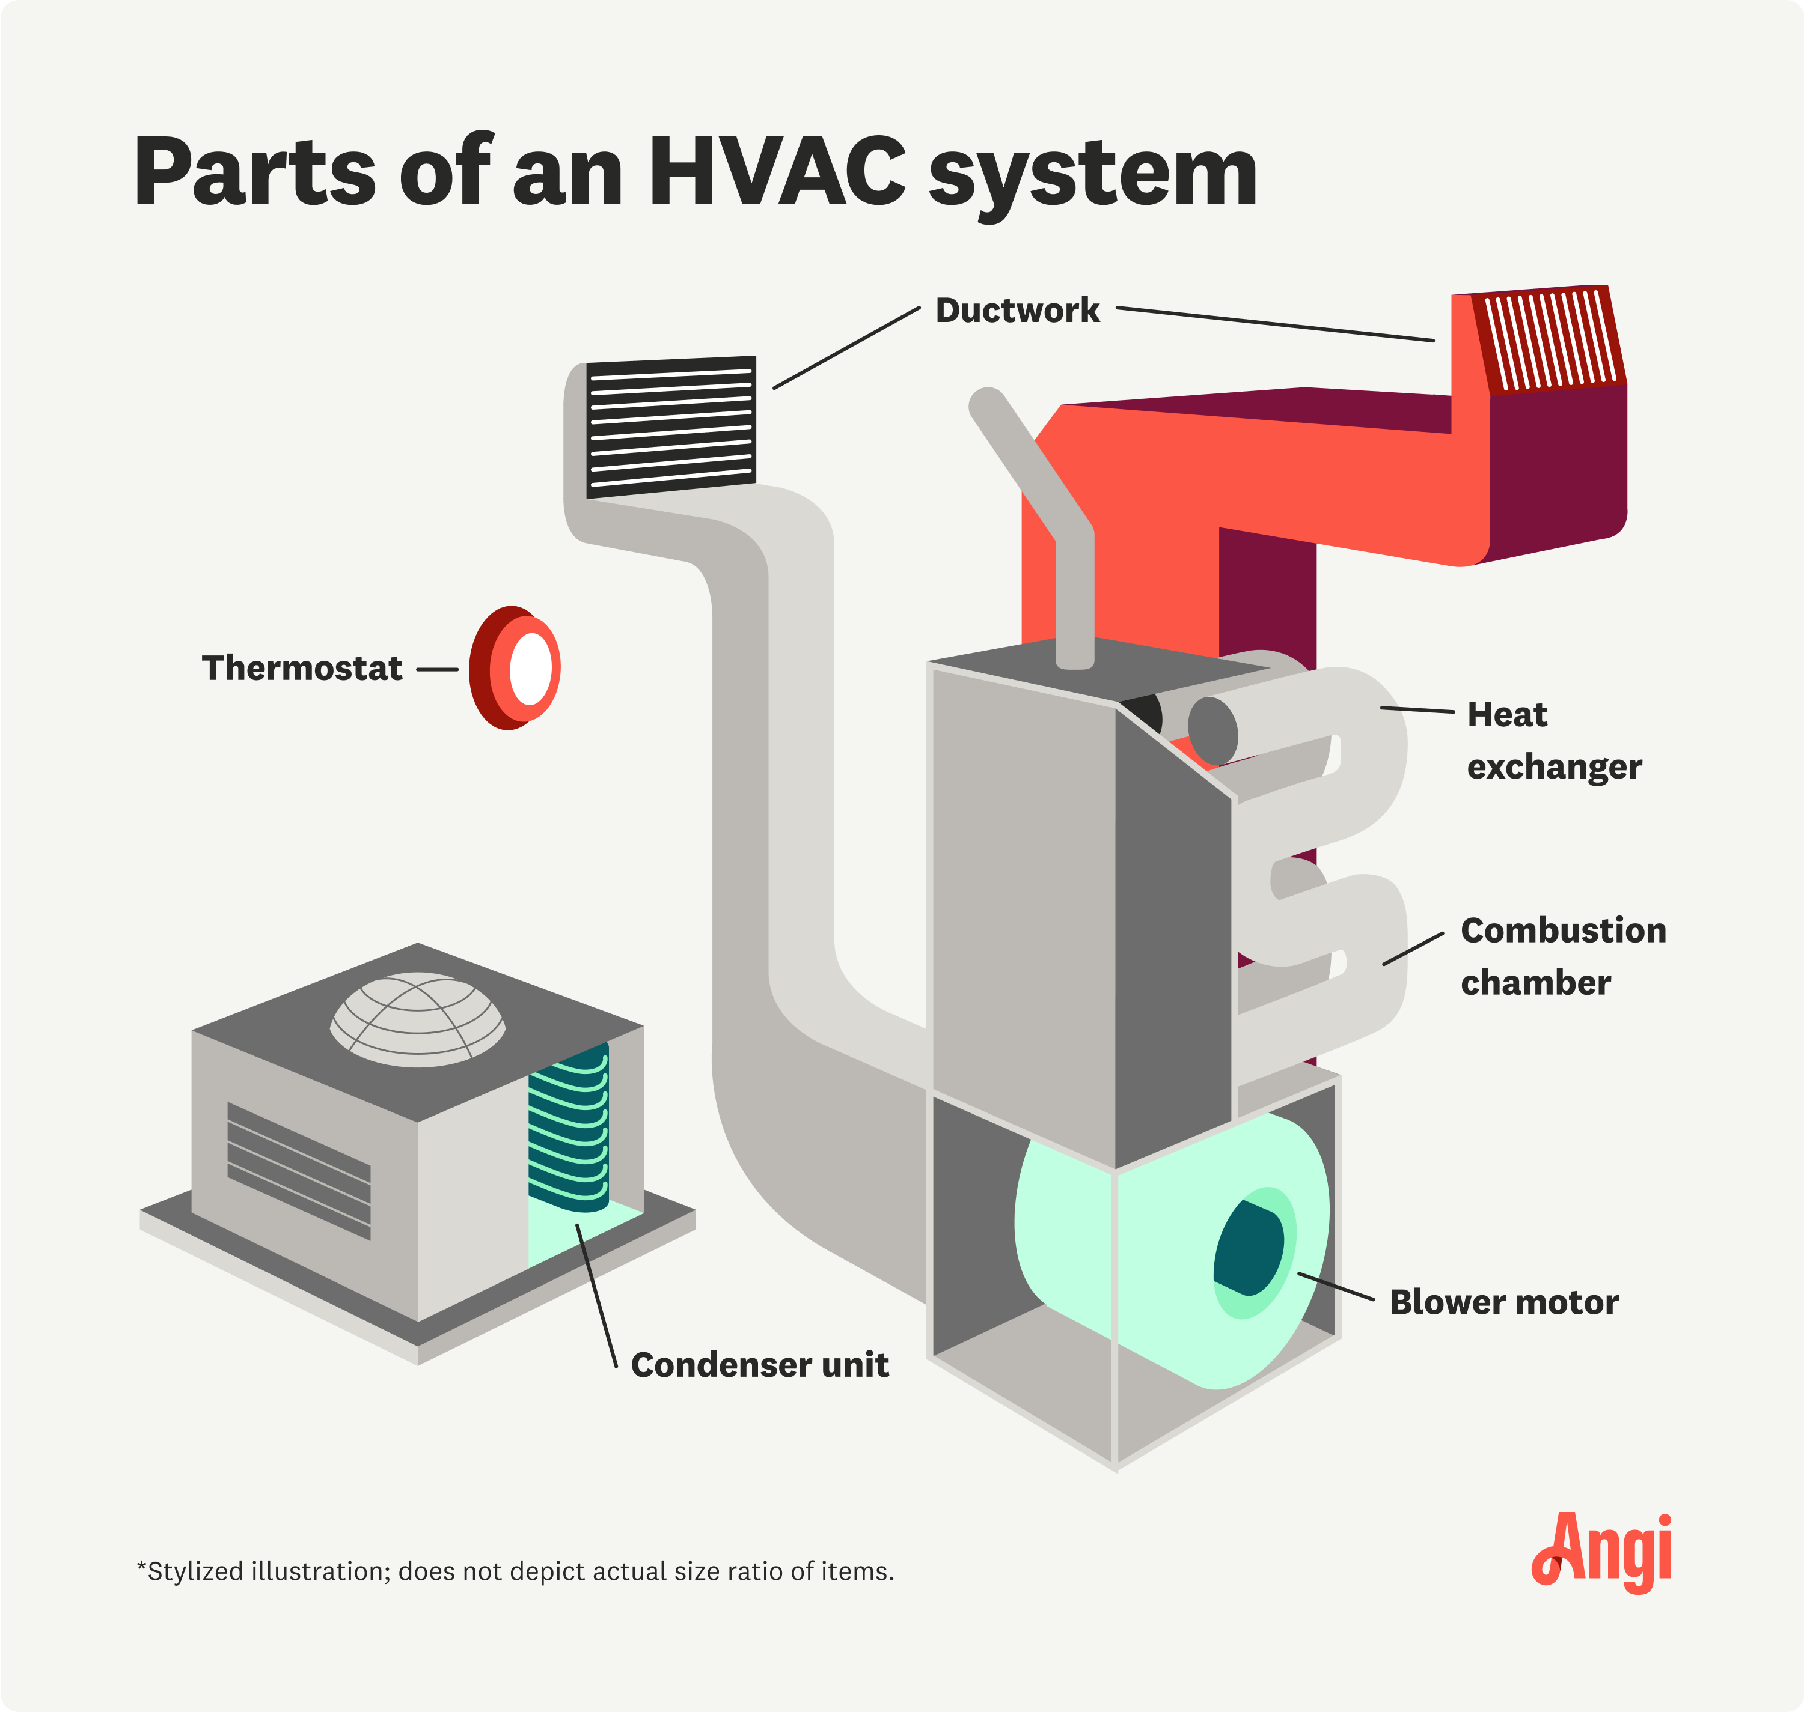
Specific Components of
HVAC
Figure: Components of HVAC System(Sparks, 2023)

Slide 10
Specific Components of
HVAC
  Compressor:
It is the central and most important component of an AC system, responsible for changing the low-pressure vapor-form refrigerant to a high-pressure state.
Following its exit from the evaporator, the low-pressure refrigerant enters the compressor, where it undergoes a transformation.
The compressor increases both the pressure and temperature of the refrigerant while it remains in a liquid state.
This compression ensures the refrigerant's proper condensation and circulation throughout the entire cycle.
The effectiveness of the refrigeration or air conditioning system hinges entirely upon the compressor's capacity.

Slide 11
Specific Components of
HVAC
    Reciprocating compressors:
One of the widely employed types of refrigeration compressors is the reciprocating compressor.
It incorporates a piston and cylinder arrangement akin to that found in an automotive engine.
The piston's reciprocating movement, driven by external power, compresses the refrigerant within the cylinder.
Reciprocating compressors are chosen when there is a need for a higher compression ratio (Sarao, 2020).

Slide 12
Specific Components of
HVAC
    Reciprocating compressors:
One of the widely employed types of refrigeration compressors is the reciprocating compressor.
It incorporates a piston and cylinder arrangement akin to that found in an automotive engine.
The piston's reciprocating movement, driven by external power, compresses the refrigerant within the cylinder.
Reciprocating compressors are chosen when there is a need for a higher compression ratio (Sarao, 2020).

Slide 13
Specific Components of
HVAC
    Scroll Compressors:
A scroll compressor, commonly referred to as a spiral compressor, is designed to compress air or refrigerant.
It is utilized in various residential central heat pump and air conditioning systems, as well as certain automotive air conditioning systems.
Scroll compressors are chosen instead of the more conventional rotary or reciprocating compressors
    Screw Compressors:
Comprising interlocking screws for compressing refrigerant, screw compressors can generate high pressure with minimal gas quantity.
They demonstrate lower power consumption compared to reciprocating compressors.

Slide 14
Specific Components of
HVAC
    Rotary Compressors:
Rotary compressors, with two rotating elements resembling gears, compress refrigerant efficiently.
These compressors can pump refrigerant at lower or moderate condensing pressures, finding application in fewer scenarios due to their capacity for handling smaller gas volumes and generating lower pressure.
These compressors are suitable for high speeds and are used when the capacity required is small.

Slide 15
Specific Components of
HVAC
    Centrifugal Compressor:
Centrifugal compressors consist of an impeller or blower capable of handling large volumes of gas but at relatively lower condensing pressures. The impeller is the rotating part which provides kinetic energy to the fluid which is then converted into static pressure. This type of compressor is mainly suitable when the volume to be compressed is large where as the increase in pressure is relatively less.
Centrifugal compressors have mainly following advantages:
Can be directly couple with electric motor or turbines
Lubrication and maintenance is simple due to absence of reciprocating parts
Relatively compact and smaller in size when compared with reciprocating compressor
Free from vibrations (Sarao, 2020)

Slide 16
Specific Components of
HVAC
  Condenser:
Condensers are typically heat exchangers.
In condensers, high pressure and high-temperature refrigerant are cooled by supplying cooling water or cooling air.
This process transforms the high-temperature, high-pressure vapor refrigerant into high-pressure liquid refrigerant. The cooling water/air, in turn, absorbs heat from the vapor and gets heated.

Slide 17
Specific Components of
HVAC
Types of condenser:
Water-cooled condenser:
While slightly more expensive to install, these condensers are more efficient and require regular service and maintenance. They also necessitate a cooling tower to conserve water. Depending on the application, one can choose from tube-in-tube, shell and coil, or shell and tube condensers, typically used in large commercial air-conditioning units.
Air-cooled condenser:
This type, located outside the unit, is easy to install and commonly used in domestic refrigerators, upright freezers, and residential packaged air conditioning units.

Slide 18
Specific Components of
HVAC
  Expansion Valve or Throttling Valve:
The expansion valve transforms high-pressure liquid refrigerant into low-pressure liquid refrigerant, maintaining constant pressure inside the evaporator.
It controls refrigerant flow into the evaporator, thereby regulating superheat at the evaporator outlet.
There are two main types: Constant Pressure Expansion Valve or Automatic Expansion Valve.
Constant Pressure Expansion Valve or Automatic Expansion Valve:
This valve keeps the pressure inside the evaporator constant, irrespective of the load inside the evaporator.
It doesn't allow control of refrigerant flow based on load, as its primary function is to maintain constant pressure inside the evaporator.

Slide 19
Specific Components of
HVAC
Capillary tubing:
Capillary tubing, usually made of copper, is commonly used in small refrigerating and air-conditioning systems.
Technicians need to be cautious during refrigerant charging to avoid overcharging, leading to excessive high discharge pressures and potential compressor overloading and refrigerant leakages.

Slide 20
Specific Components of
HVAC
  Evaporators:
Evaporators, typically heat exchangers, are used in air-conditioning systems to allow refrigerant to evaporate from liquid to gas while absorbing heat. They can also remove water or other liquids from mixtures.
  Thermostat:
A thermostat senses the system's temperature, maintaining it near a desired set point by switching heating or cooling devices on or off or regulating the flow of a heat transfer fluid.
  Solenoid Valve:
A solenoid valve is an electromechanically operated valve, controlled by an electric current through a solenoid. It is frequently used in fluidics to shut off, release, dose, distribute, or mix fluids.

Slide 21
Specific Components of
HVAC
  Pumps:
Pumps are used to move fluids, such as water in and out of the condenser and for operating cooling towers.
Centrifugal pumps are commonly used in HVAC systems.
  Fans:
Fans facilitate the flow of air for ventilation and in evaporators or air-cooled condensers.
They create flow within a fluid, typically air, and can be centrifugal, cross-flow, or axial-flow fans.
Centrifugal fans are commonly used in HVAC systems.

Slide 22
Types of AC Systems
According to the cooling/heating fluid:
  All air system
  All water (hydronic) system
  All air-water combination system
According to capacity:
  Window AC
  Split AC
  Packaged AC
  Central AC
According to zones:
  Single zone systems
  Multi-zone systems
According to purpose:
  Comfort air conditioning
  Industrial air conditioning
According to season:
  Winter air conditioning
  Summer air conditioning
  Year-round air conditioning

Slide 23
Windows AC System
Window air conditioners are popular and cost-effective.
They are installed on the wall, extending 2 feet beyond it, with an open space for dissipating heat and dripping water.
They can cool various spaces, and their components are housed in a single box. Rotary compressors make them less noisy and more efficient.
Advantages:
Easily available and cheaper
Efficient water drainage
Efficient heat exchange to the exterior
Suitable for various room sizes
Disadvantages:
Blocks the window where installed
Removal and relocation can be a hassle
Installation location impacts security and appearance

Slide 24
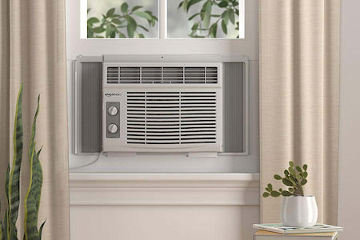
Windows AC System
Figure: Windows AC (Anker, 2023)

Slide 25
Split Type AC
A split air conditioner consists of an indoor unit and an outdoor unit, providing flexibility for zoning and heating/cooling individual rooms. The indoor unit includes the evaporator, cooling coil, and cooling fan, while the outdoor unit houses the compressor, condenser, and expansion valve.
Advantages:
Versatile and attractive
Quiet and energy-efficient
Disadvantages:
Costlier than window AC
Installation challenges
Noise concerns

Slide 26
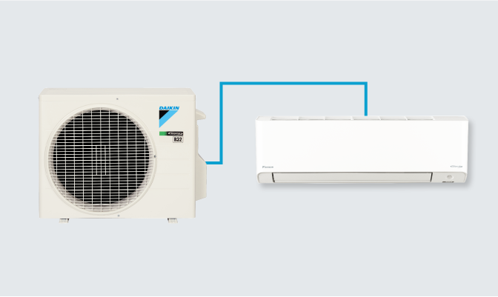
Split Type AC
Figure: Split AC (Daikin, 2023)

Slide 27
Packaged AC
A packaged AC system has a self-contained unit with the compressor, condenser, and evaporator located together.
It's often used on roofs and provides efficient space utilization, quick installation, and centralized maintenance.
Advantages:
Available in fixed capacities
Commonly used in various places
Space efficiency and quick installation
Aesthetically pleasing and safe
Disadvantages:
Vulnerable outside unit

Slide 28
Central AC Systems
Central air conditioning (AC) systems have become an integral part of modern living, providing unparalleled comfort and climate control in homes, offices, and various commercial spaces.
These systems represent a leap forward in cooling technology compared to traditional window units and have evolved to be more efficient, reliable, and customizable.
In this comprehensive exploration, we delve into the workings, components, benefits, and considerations of central AC systems (Sarao, 2020).
Central AC systems are designed to cool an entire building or a specific zone by distributing conditioned air through a network of ducts and vents.

Slide 29
Central AC Systems
Unlike individual room air conditioners, which are localized and limited in their capacity, central AC systems are capable of providing consistent and even cooling throughout a larger space.
Central air conditioning plants find usage in scenarios such as expansive hotels, multi-story buildings, and healthcare facilities, where substantial cooling capacities are essential.
The implementation of a Central AC system becomes cost-effective when aiming to cool an entire building, as opposed to employing window or split air conditioners in individual rooms.
Within central air conditioning systems, a designated plant room houses essential components, including a large compressor, condenser, thermostatic expansion valve, and evaporator.
The chilled air is then distributed through ducts to all the intended spaces, such as rooms and halls.

Slide 30
Central AC Systems
Consequently, each room features only the presence of ducts carrying chilled air, eliminating the need for individual cooling coils and other refrigeration system components.
The room is endowed with a completely silent and highly efficient air conditioning system.
Central air conditioning systems represent sophisticated applications of air conditioning technology and can often be intricate.
This complexity is reflected in the limited number of companies globally that specialize in these advanced systems.
In the contemporary age of computerization, central conditioning systems have incorporated numerous electronic utilities to enhance their functionality.

Slide 31
Advantages of Central AC
Whole-House Cooling: Central AC systems are designed to cool entire homes or buildings, ensuring uniform comfort throughout different rooms.
Energy Efficiency: Central AC systems can be more energy-efficient than individual units, especially when equipped with features like programmable thermostats, zone control, and variable-speed fans.
Improved Air Quality: These systems often include filters that trap dust, pollen, and other particles, enhancing indoor air quality.
Convenience and Control: Central AC systems offer centralized control and automation, allowing for easy regulation of temperature and other settings. Integration with smart home systems enables remote monitoring and control.
Aesthetic Appeal: The main components, such as the compressor, are typically located outdoors, preserving the aesthetic appeal of the interior.
Increased Property Value: Homes and buildings with central AC systems tend to have higher resale values due to the comfort and convenience they provide.
Humidity Control: Central AC systems not only cool the air but also dehumidify it, contributing to a more comfortable indoor environment.

Slide 32
Disadvantages of Central AC
Initial Cost: The installation of a central AC system involves a significant upfront cost, including the purchase of the system and any necessary ductwork.
Complex Installation: Installing central AC systems can be complex, especially in existing buildings that do not have pre-existing ductwork. This may require additional construction and result in higher installation costs.
Maintenance Challenges: Maintaining a central AC system can be more challenging than maintaining individual units. Regular inspections and maintenance of ducts, filters, and other components are essential for optimal performance.
Inflexibility: Central AC systems cool the entire space, which may result in energy wastage if certain rooms are unoccupied. While zoning systems can address this to some extent, they may add to the overall cost.

Slide 33
Disadvantages of Central AC
Space Requirements: The outdoor unit of a central AC system requires outdoor space, and the indoor unit may take up space in a utility room or attic.
Noise: While the main components are usually located outdoors, central AC systems can still generate noise during operation, especially if not well-maintained.
Dependency on Ducts: Central AC systems rely on a network of ducts to distribute air. Any issues with the ductwork can result in inefficiencies and increased energy consumption.

Slide 34
Type of Air Conditioner | Capacity Range | Usage | Characteristics
Window Air Conditioners | 0.5 to 2 Tons | Individual rooms or small apartments | Compact, window installation, cost-effective
Split Air Conditioners | 0.5 to 3 Tons | Individual rooms or specific zones | Indoor and outdoor units connected, flexible
Packaged Air Conditioners | Greater than 2 Tons to 10 Tons | Larger spaces or whole-house cooling | All components in a single unit, central air
Central Air Conditioners | Greater than 10 Tons | Entire homes, large offices, or commercial spaces | Ducted system, consistent cooling

Slide 35
References
Anker. (2023, June 15). Anker Solix. Retrieved October 3, 2023, from https://www.anker.com/blogs/home-power-backup/watts-window-ac-use
Chadderton, D. V. (2007). Building Services Engineering (5th Edition ed.). New York: Taylor and Francis Group.
Daikin Global. (2023). Retrieved October 3, 2023, from https://www.daikin.com/products/ac/lineup/split_multi_split
Fred Hall, R. G. (2007). Building Services Handbook (4th Edition ed.). Oxford, Burlington: Elsevier Limited.
GoN. (2015). Nepal National Building Code NBC 206:2015, Architectural Design Requirements. Government of Nepal, Ministry of Urban Development, Department of Urban Development and Building Construction.
Joseph B Wujek, F. R. (2010). Mechanical and Electrical Systems in Architecture, Engineering and Construction (5th Edition ed.). New Jersey: Pearson Education Inc.
Ogawa, A. (2012, May 2). Wikimedia Commons. Retrieved September 17, 2023, from https://upload.wikimedia.org/wikipedia/commons/1/1c/Psychrometric_chart.png
Pita, E. G. (2002). Air Conditioning Principles and Systems; An Energy Approach (4th Edition ed.). New York: Prentice Hall, Ohio.
Sarao, A. S. (2020). Refrigeration and AIr Conditioning. Satya Prakashan.
Sparks, V. (2023, September 21). Angi. Retrieved October 3, 2023, from https://www.angi.com/articles/hvac-system-parts.htm

