Slide 1
Course: Building Services III
Lecture 4: Heating systems, central ac systems
Lecturer: Manchan Tiwari

Slide 2
Contents
Central AC System
Components of Central AC System
Sub-system of Central AC System
Types of Central AC System
Introduction of Heating System

Slide 3
Central AC System
Central air conditioning (AC) systems are a popular and efficient means of cooling large spaces, such as homes, offices, and commercial buildings.
Unlike individual air conditioners that cool one room at a time, central AC systems provide uniform cooling throughout an entire structure.
They consist of a central unit connected to a network of ducts that distribute cooled air to various rooms or zones.
One of the primary components of a central AC system is the central unit, typically located outside the building.
This unit contains the compressor, condenser coil, and a fan.

Slide 4
Central AC System
The compressor plays a crucial role in pressurizing and circulating the refrigerant, while the condenser coil releases heat outside, and the fan helps dissipate this heat.
Inside the building, a network of ducts carries the cooled air to different areas.
These ducts are often installed within walls, ceilings, or floors to maintain a clean and unobtrusive appearance.
The central AC system also includes an evaporator coil located in the indoor unit or furnace.
This coil absorbs heat from the air, and the refrigerant evaporates, cooling the air in the process.
The cooled air is then pushed through the ducts and distributed throughout the building.

Slide 5
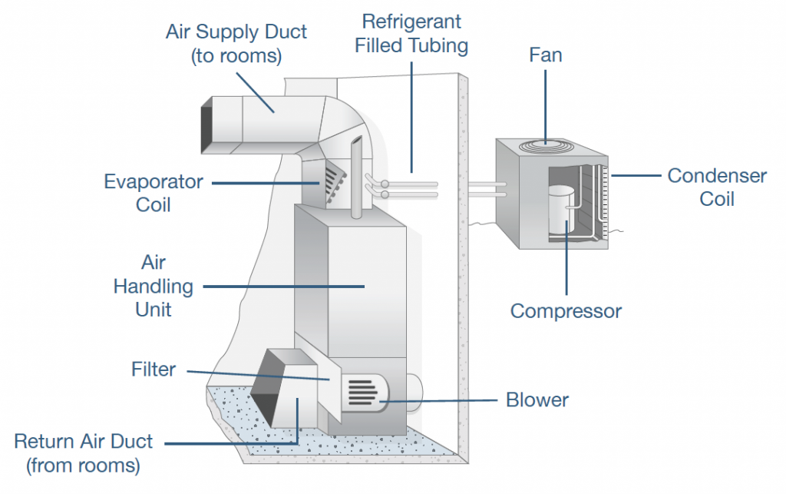
Central AC System
(Standard Heating and Air Conditioning, 2022)

Slide 6
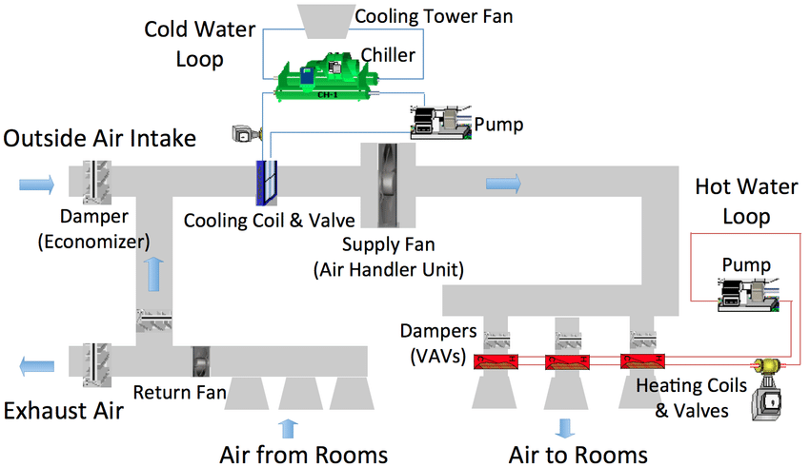
Central AC System
(Taneja, 2013)

Slide 7
Central AC System
Components
Air Handling Unit (AHU)
Cooling Towers (Condensers)
Supplying Duct
Return Duct
Diffusers/Registers
Compressor
Expansion Device
Evaporator
Thermostat

Slide 8
Air Handling Unit
An Air Handling Unit (AHU) serves the purpose of extracting air from rooms through return ducts, passing it through air filters, and then releasing the conditioned air back into the rooms.
Resembling a box, the AHU houses essential equipment such as filters and blowers.
In the context of a heating, ventilating, and air-conditioning (HVAC) system, an AHU plays a crucial role in controlling and circulating air.

Slide 9
Air Handling Unit
Air handlers are typically large metal boxes containing components such as blowers, heating or cooling elements, filter racks, sound attenuators, and dampers. These units connect to ductwork and a ventilation system, distributing conditioned air throughout a building.
In some cases, AHUs directly supply and return air to and from the space without the need for ductwork.
A more extensive AHU that conditions 100% outside air, without recirculating air, is referred to as a makeup air unit.

Slide 10
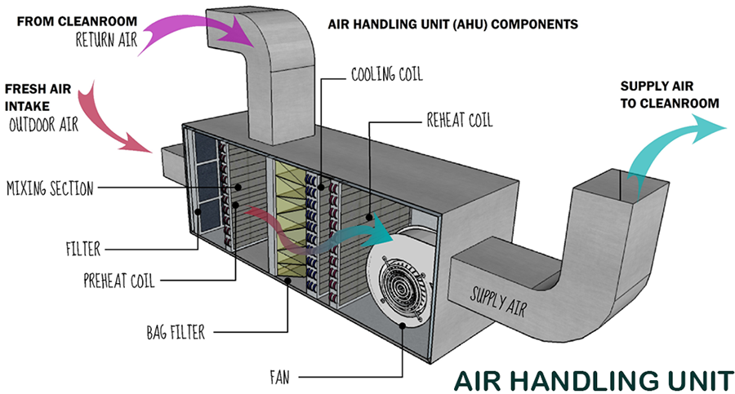
Air Handling Unit
(Cayuela, 2020)

Slide 11
AHU Components
Filters:
Air filtration is a constant feature to provide clean, dust-free air to building occupants. Filters are strategically placed at the beginning of the AHU, with a common arrangement involving successive banks of coarse-grade panel filters in front of fine-grade bag filters.
Heating and/or Cooling Elements:
AHUs may include coils for heating or cooling to adjust the supply air temperature and humidity. Heat exchanger coils within the AHU use hot water or steam for heating and chilled water for cooling.
Humidifier:
Humidification is crucial in colder climates to counteract dry air resulting from continuous heating. Various types of humidification methods, including evaporative, vaporizer, steam, or spray mist, may be incorporated.

Slide 12
AHU Components
Mixing Chamber:
To maintain indoor air quality, AHUs commonly have mixing chambers allowing the introduction of outside air and the exhausting of air from the building.
This helps achieve the desired supply air temperature by blending cooler outside air with warmer return air.
Vibration Isolators:
The blowers in an AHU can generate significant vibration.
Vibration isolators, flexible sections, are inserted into the duct before and after the AHU to prevent the transmission of noise and vibration to the building's occupants.

Slide 13
AHU Components
Controls:
Controls are essential for regulating various aspects of an AHU, including air flow rate, supply air temperature, mixed air temperature, humidity, and air quality.
This can range from simple thermostats to complex building automation systems.
Fan Coil Unit (FCU):
A Fan Coil Unit (FCU) is a simpler device consisting of a heating or cooling coil and a fan. Typically found in residential, commercial, and industrial buildings, FCUs circulate hot or cold water through a coil to condition a space. The unit can either be concealed or exposed within the room or area it serves.
FCUs can be controlled by their internal thermostat or wired to operate with a remote thermostat. The units receive hot or cold water from a central plant, and the speed control of fan motors within an FCU is used to regulate heating and cooling output.

Slide 14
Cooling Towers
Cooling towers facilitate the cooling of water in either open or closed circuits.
In open circuits, water is pumped into a system of pipes, nozzles, and sprayers within the tower. Air from the atmosphere enters the tower and flows upward through falling water.
The heated and moisture-laden air is then discharged, and water is recirculated to remove more heat from the condenser.
Types of Fill (Packing) in Cooling Towers:
The fill in cooling towers can include film fill, splash fill, or trickle, each designed to increase the surface area of contact between air and water

Slide 15
Air Distribution Systems
Ducts play a crucial role in heating, ventilation, and air conditioning (HVAC) systems, delivering and removing air.
Materials for ducts include galvanized mild steel, aluminum, polyurethane and phenolic foam panels, fiberglass duct board panels, and flexible ducts.

Slide 16
Air Flow and Control
Volume control dampers, turning vanes, and plenums contribute to the regulation and distribution of air within duct systems.
Proper planning and sealing of ducts are crucial for energy efficiency and indoor air quality.
Air Curtain:
An air curtain prevents air or contaminants from moving between open spaces. Commonly used over building entrances, it helps maintain conditioned air inside the building.

Slide 17
Air Flow and Control
Grilles and Diffusers:
Grilles supply or extract air vertically without deflection, while diffusers direct air at an angle as it leaves the unit.
They are critical for HVAC efficiency and are often mounted in various locations, including ceilings, floors, walls, doors, and ducts.
Registers:
Registers, equipped with moving parts, are part of HVAC systems and are crucial for efficiency.
They include dampers and differ from grilles in that they have a damper included.

Slide 18
Sub system of Central AC
The components of the central AC system can also be divided according to the sub-systems. The components of the Central AC fall under the following subsystems:
Chilled Water Plant
Condenser Water System (Heat Rejection System)
Air Delivery System

Slide 19
Central AC System
(Taneja, 2013)

Slide 20
Chilled Water System
The chilled water system supplies chilled water for the cooling needs of all the building air handling units (AHUs).
The system includes a chilled water pump which circulates the chilled water through the chiller’s evaporator section and through the cooling coils of the AHUs.
A chilled water system is a key component of central air conditioning (AC) systems, providing efficient and effective cooling for large buildings such as offices, hotels, and industrial facilities.
This system utilizes chilled water as a medium to absorb and transfer heat, playing a vital role in the refrigeration process of central AC systems.

Slide 21
Chilled Water System
    Key Components:
Chiller: The heart of the chilled water system is the chiller, a mechanical device that cools water to a temperature lower than the ambient air. Chillers are typically located in the building's mechanical room or an external location.
Chilled Water Circulation System: Chilled water is circulated through a closed-loop system that includes pipes, pumps, and the chiller. The water absorbs heat from the building's interior and returns to the chiller to be cooled again.

Slide 22
Chilled Water System
    Key Components:
Cooling Coils: Inside the air handling units (AHUs) of the central AC system, cooling coils are responsible for transferring the chilled water's coolness to the air that circulates through the ductwork.
Air Distribution System: Ducts and vents distribute the conditioned air throughout the building, maintaining a consistent and comfortable indoor temperature.

Slide 23
Chilled Water System
    Working of Chilled Water System
Heat Absorption: Warm air from the building is drawn into the AHUs through return ducts. This warm air passes over the cooling coils, and the heat is absorbed by the chilled water circulating through the coils.
Heat Rejection: The now-warmed chilled water returns to the chiller, where it releases the absorbed heat. The chiller then cools the water back to its initial temperature, and the cycle repeats.
Distribution: The cooled air is then distributed through supply ducts and vents into various rooms and spaces within the building, effectively lowering the ambient temperature.

Slide 24
Chilled Water System
    Advantages:
Energy Efficiency: Chilled water systems are known for their energy efficiency, especially when compared to traditional air-cooled systems. The water's high specific heat capacity allows for effective heat absorption and transfer.
Zoning Capabilities: Chilled water systems can be designed with zoning capabilities, enabling different parts of a building to be cooled independently based on specific temperature requirements.

Slide 25
Chilled Water System
    Advantages:
Space Efficiency: Chilled water systems are often more space-efficient than air-cooled systems, as the bulky condenser units are located outside the building.
Scalability: Chilled water systems can be easily scaled to meet the cooling demands of large and complex buildings, making them suitable for a wide range of applications.

Slide 26
Chilled Water System
    Limitations:
Initial Cost: The installation of a chilled water system can have a higher upfront cost due to the need for chillers, pumps, and a distribution network.
Maintenance Requirements: Regular maintenance is essential to ensure the efficient operation of the chiller and associated components.
Complexity: Chilled water systems, while efficient, are more complex to design and install compared to simpler air-cooled systems.

Slide 27
Condenser System
There are two options for heat rejection in condenser;
Water Cooled
Air Cooled

Slide 28
Condenser System
Water cooled
A water-cooled condenser system is a type of heat exchange mechanism commonly used in refrigeration and air conditioning systems.
Unlike air-cooled systems that dissipate heat into the air, water-cooled condensers use water as a cooling medium.
In this system, hot refrigerant vapor is circulated through a condenser coil.
Water is then used to absorb and carry away the heat from the coil, facilitating the phase change of the refrigerant from vapor to liquid.
The water-cooled condenser typically consists of a series of tubes or coils through which the refrigerant flows, surrounded by water.

Slide 29
Condenser System
Water cooled
The warm water is then pumped away, often to a cooling tower, where excess heat is released into the atmosphere.
Water-cooled condenser systems offer advantages such as increased efficiency and quieter operation compared to air-cooled counterparts.
They are particularly beneficial in environments where air-cooling may be challenging due to high ambient temperatures or limited airflow.
However, they require a consistent water supply, making them suitable for installations with access to ample water resources.
Proper maintenance is crucial to prevent issues like scaling and fouling in the water-cooled system.

Slide 30
Condenser System
Air cooled
Air-cooled condenser systems are a type of heat exchange system commonly used in refrigeration and air conditioning applications.
Unlike traditional water-cooled condensers, these systems dissipate heat through the surrounding air.
In an air-cooled condenser system, refrigerant vapor from the compressor is condensed into a liquid state by passing through a coil or series of coils.
These coils are equipped with fins to maximize the surface area for heat exchange

Slide 31
Condenser System
Air cooled
A fan or fans then draw ambient air across the coils, transferring the heat from the refrigerant to the air.
This process causes the refrigerant to release its heat and convert back into a liquid.
One of the key advantages of air-cooled condenser systems is their simplicity and cost-effectiveness.
They eliminate the need for a separate water supply, cooling tower, or complex plumbing, making them suitable for a wide range of applications.
However, they are sensitive to ambient temperature and may be less efficient in extremely hot climates.
Despite this, their ease of installation and maintenance makes them a popular choice for various cooling needs.

Slide 32
Air Delivery System
Air is drawn into buildings HVAC system through the air intake by the AHU.
Once in the system, supply air is filtered to remove particulate matter, heated or cooled and then circulated throughout the building via the air distribution system, which is typically a system of supply ducts and registers.

Slide 33
Types of Central AC System
Central AC System with CAV air handling units
Central AC System with VAV air handling units
VRF Systems

Slide 34
Types of Central AC System
  CAV Systems( Constant Air Volume)
CAV System is an all air system which accomplish cooling and heating by varying the supply air temperature and keeping the air volume constant.
The system works well and maintains comfortable conditions in spaces with uniform heating and cooling requirements.

Slide 35
Types of Central AC System
  VAV Systems (Variable Air Volume)
VAV system is an all air system which can satisfy the individual cooling requirements of multiple thermal zones.
This is achieved by supplying air at a constant temperature from central plant to one or more VAV terminal units in each zone and adjusting the amount of supply air to meet required cooling loads.
The primary benefit of VAV over constant volume systems (CV) is its ability to simultaneously provide the required level of cooling to any number of zones within a building.

Slide 36
Types of Central AC System
  VRF Systems
The Variable Refrigerant Flow (VRF) system is a highly efficient and flexible HVAC (Heating, Ventilation, and Air Conditioning) technology used in both residential and commercial buildings.
VRF systems provide simultaneous heating and cooling to different zones, offering precise temperature control.
The working principle and components of VRF systems contribute to their popularity for applications where energy efficiency, comfort, and zoning flexibility are essential.

Slide 37
Working of VRF System
    The VRF system operates on a variable refrigerant flow control mechanism that enables it to adapt to the specific heating and cooling requirements of different zones within a building.
    Unlike traditional HVAC systems that use constant speed compressors, VRF systems employ variable-speed compressors and multiple indoor units connected to a single outdoor unit.

Slide 38
Working of VRF System
Outdoor Unit:
The outdoor unit of a VRF system contains a variable-speed compressor, a condenser coil, and an expansion valve.
The compressor adjusts its speed based on the demand for heating or cooling in different zones. This variable speed capability contributes to energy savings.
The condenser coil releases or absorbs heat depending on whether the system is in cooling or heating mode.

Slide 39
Working of VRF System
Refrigerant Circulation:
The heart of the VRF system is the refrigerant, which circulates between the outdoor and indoor units through a network of piping.
In cooling mode, the refrigerant absorbs heat from indoor spaces, and in heating mode, it releases heat into the indoor spaces.
Branch Circuit Control:
VRF systems use a branch circuit control mechanism to regulate the flow of refrigerant to individual indoor units.
Each indoor unit is equipped with a fan coil, which is responsible for adjusting the air temperature in its respective zone.

Slide 40
Working of VRF System
Indoor Units:
Multiple indoor units, such as wall-mounted, ceiling-mounted, or floor-standing units, are connected to the outdoor unit.
Each indoor unit can operate independently, allowing for individual temperature control in different zones or rooms.
The variable refrigerant flow allows for the simultaneous heating and cooling of different zones, enhancing comfort and energy efficiency.

Slide 41
Working of VRF System
Electronic Expansion Valves (EEVs):
VRF systems utilize electronic expansion valves to control the flow of refrigerant into the indoor units.
EEVs provide precise control over the refrigerant flow, allowing the system to adapt quickly to changing heating and cooling requirements.
Heat Recovery Systems:
Some advanced VRF systems incorporate heat recovery technology. In these systems, excess heat from zones in cooling mode can be redirected to zones requiring heating, improving overall system efficiency.

Slide 42
Advantages of VRF
Energy Efficiency: VRF systems are highly energy-efficient due to the variable-speed compressors and precise control of refrigerant flow.
Zoning Flexibility: Each indoor unit can be controlled independently, allowing for individual temperature control in different zones.
Simultaneous Heating and Cooling: VRF systems can provide simultaneous heating and cooling to different areas of a building, improving overall energy efficiency.
Space-saving Design: The compact design of indoor units allows for more flexibility in installation, especially in spaces with limited room for HVAC equipment.
Quiet Operation: VRF systems are known for their quiet operation, making them suitable for various applications, including residential settings.

Slide 43
References
Cayuela, R. (2020, October 9). CIQA QMS Online University. Retrieved October 3, 2023, from https://ciqa.net/what-is-air-handling-unit/
Chadderton, D. V. (2007). Building Services Engineering (5th Edition ed.). New York: Taylor and Francis Group.
Fred Hall, R. G. (2007). Building Services Handbook (4th Edition ed.). Oxford, Burlington: Elsevier Limited.
GoN. (2015). Nepal National Building Code NBC 206:2015, Architectural Design Requirements. Government of Nepal, Ministry of Urban Development, Department of Urban Development and Building Construction.
Joseph B Wujek, F. R. (2010). Mechanical and Electrical Systems in Architecture, Engineering and Construction (5th Edition ed.). New Jersey: Pearson Education Inc.
Ogawa, A. (2012, May 2). Wikimedia Commons. Retrieved September 17, 2023, from https://upload.wikimedia.org/wikipedia/commons/1/1c/Psychrometric_chart.png
Pita, E. G. (2002). Air Conditioning Principles and Systems; An Energy Approach (4th Edition ed.). New York: Prentice Hall, Ohio.
Sarao, A. S. (2020). Refrigeration and AIr Conditioning. Satya Prakashan.
Standard Heating and Air Conditioning, How much will my HVAC replacement cost. (2022, February 6). Retrieved October 3, 2023, from https://www.standardheating.com/blog/2022/february/how-much-will-my-hvac-replacement-cost-/
Taneja, J. (2013, June). Researchgate. Retrieved October 3, 2023, from https://www.researchgate.net/figure/A-typical-HVAC-system-for-a-commercial-building_fig1_261269500

