Slide 1
Course: Building Services III
Lecture 7: TYPES OF FIRE, WET/DRY PIPE SYSTEM, HYDRANT AND SPRINKLER SYSTEM
Lecturer: Manchan Tiwari

Slide 2
Fire Triangle
The fire triangle is a simple and fundamental concept that illustrates the three essential components required for a fire to occur.
These three components are often represented as the vertices of a triangle, hence the term "fire triangle."
The elements of the fire triangle are fuel, oxygen, and an ignition source, and the interaction among these three elements is crucial for the initiation and sustenance of a fire.
The fire triangle serves as a basic model for understanding the conditions necessary for combustion (NFPA, 2021).
Components of Fire Triangle
  Fuel
  Oxygen
  Ignition Source

Slide 3
Fire Triangle
Fuel
Fuel is any material that can undergo combustion.
This can include solids, liquids, or gases.
Common examples of fuel in the context of a fire might be wood, paper, gasoline, or natural gas.
The nature and properties of the fuel play a significant role in determining the characteristics of the fire, including its intensity and rate of spread.
Oxygen
Oxygen is a vital component for combustion.
In most fires, oxygen from the air is necessary to support the chemical reaction between the fuel and the ignition source.
The level of oxygen in the surrounding environment can influence the speed and efficiency of combustion.
Firefighters often use techniques such as ventilation to control the supply of oxygen to a fire.

Slide 4
Fire Triangle
Ignition Source
The ignition source is the heat energy required to initiate the combustion process.
This can be in the form of an open flame, a spark, or any heat source with sufficient temperature to ignite the fuel.
The ignition source provides the activation energy needed to start the chemical reactions between the fuel and oxygen, leading to the release of heat and light

Slide 5
Fire Triangle
Understanding the fire triangle is critical for fire safety and prevention. Fire safety measures often focus on disrupting one or more elements of the fire triangle to prevent or extinguish fires. For instance:
Removing or controlling the fuel source can be accomplished through proper storage and handling of combustible materials.
Oxygen control involves methods like using fire suppressants or adjusting ventilation systems.
Managing the ignition source involves practices such as electrical safety measures and proper use of equipment.
By manipulating these components, fire safety professionals can effectively reduce the risk of fire incidents and enhance overall safety in various environments.

Slide 6
Classification of Fire
Fires are classified into different types based on the nature of the fuel involved and the specific characteristics of the fire.
The classification system helps in identifying the most appropriate firefighting methods and equipment.
The common types of fire are often categorized using letters, and these are known as fire classes (NFPA, 2021):
Class A: The Ordinary Combustibles
Class B: Flammable Liquids and Gas
Class C: Fires Energized in Electrical Equipment
Class D: Fires Involving Combustible Metals
Class K: Fires in Kitchen

Slide 7
Class A Fire:
Ordinary Combustibles
Class A fires involve the combustion of ordinary combustibles, typically materials found in everyday environments. The key characteristics of Class A fires include:
Fuel:
  Common combustibles such as wood, paper, fabric, and plastics are the primary sources of fuel for Class A fires. These materials are readily available in homes, offices, and various other settings.
Traits:
  Class A fires are characterized by materials that leave behind ash when burned. They are the most common type of fire encountered in routine scenarios
Extinguishing Method:
  The most effective method for extinguishing Class A fires is to quench them with water or water-based solutions. The water cools the fuel below its ignition temperature, preventing further combustion.

Slide 8
Class A Fire
Prevention:
Prevention strategies for Class A fires involve proper storage and handling of combustible materials. This includes safely disposing of waste, keeping flammable materials away from heat sources, and using fire-resistant containers.
Understanding and appropriately responding to Class A fires are essential for general fire safety. This knowledge empowers individuals to take proactive measures to prevent the occurrence of such fires and equips them with the means to respond effectively in case of an emergency involving Class A combustibles.

Slide 9
Class B Fire:
Flammable Liquids and Gases
Class B fires involve flammable liquids and gases, presenting unique challenges in fire safety and suppression.
These fires encompass a wide range of substances, including gasoline, oil, grease, propane, and various industrial solvents.
The distinguishing trait of Class B fires is the ignition and sustained combustion of these liquids or gases.
    Characteristics:
Flammable Materials: Class B fuels are liquids or gases that readily vaporize and ignite when exposed to an open flame, spark, or other heat sources.
Rapid Spread: These fires can spread quickly, making rapid response and effective suppression crucial to preventing escalation., and automotive settings

Slide 10
Class B Fire
    Extinguishing Methods:
Foam: Foam is commonly used to create a barrier over the fuel surface, suppressing the release of flammable vapors and cooling the fire.
Dry Chemical Agents: Dry chemical extinguishers interrupt the chemical reaction of the fire and are effective for a variety of flammable substances.
Carbon Dioxide (CO2): CO2 is a gas that displaces oxygen, removing one leg of the fire triangle and effectively suppressing Class B fires.

Slide 11
Class B Fire
    Safety Considerations:
Avoid Water: Using water on Class B fires is generally not recommended as it can spread flammable liquids and may be ineffective or hazardous.
Awareness of Hazards: Responders must be aware of potential hazards, such as the volatility and re-ignition potential of flammable liquids.
    Prevention:
Storage and Handling: Proper storage and handling of flammable liquids are crucial to preventing Class B fires. This includes using approved containers and storage areas.
Fire Safety Equipment: Facilities with potential Class B fire risks should have appropriate fire safety equipment, such as fire extinguishers specifically designed for flammable liquids.
Understanding the characteristics and proper extinguishing methods for Class B fires is essential for effective fire safety planning and response, particularly in environments where flammable liquids and gases are present, such as industrial facilities, laboratories, and automotive settings

Slide 12
Class C Fire:
Fire in Electrical Equipment
Class C fires present a distinct set of challenges as they involve energized electrical equipment. These fires pose additional risks due to the presence of live electrical currents, necessitating specialized approaches for both suppression and safety.
Characteristics:
Electrical Involvement: Class C fires originate in live electrical equipment, including wiring, motors, appliances, and electronic devices.
Potential for Shock: Responders must be cautious of the potential for electric shock, adding an extra layer of complexity to firefighting efforts.
Extinguishing Methods:
Dry Chemical Agents: Fire extinguishers with dry chemical agents are commonly used for Class C fires. These agents suppress the flames without conducting electricity.
Carbon Dioxide (CO2): CO2 extinguishers displace oxygen, crucial for fire suppression, and are safe for use in electrical fires.

Slide 13
Class C Fire
Safety Considerations:
Electrical Shutdown: Whenever possible, efforts should be made to de-energize the equipment before attempting to extinguish the fire to minimize the risk of electric shock.
Non-Conductive Tools: Responders should use non-conductive tools and equipment to avoid electrical conductivity.
Prevention:
Regular Maintenance: Periodic inspection and maintenance of electrical equipment reduce the risk of electrical malfunctions leading to fires.
Electrical Safety Training: Building occupants and personnel should be educated on electrical safety practices to minimize the likelihood of Class C fires.
Understanding the distinctive characteristics and employing appropriate extinguishing methods for Class C fires is crucial for the safety of responders and the effective mitigation of electrical fires. Additionally, emphasis on preventive measures and electrical safety practices contributes to a safer environment in spaces where energized electrical equipment is present, such as homes, offices, and industrial settings.

Slide 14
Class D Fire:
Fire Involving Combustible Metals
Class D fires pose a unique and challenging scenario, involving combustible metals that burn at exceptionally high temperatures. Addressing these fires requires specialized knowledge and extinguishing agents due to the distinctive properties of the metal fuels.
Characteristics:
Metal Fuels: Class D fires involve combustible metals such as magnesium, titanium, aluminum, and lithium.
High Temperature: Combustion temperatures in Class D fires can be extremely high, presenting challenges in suppression and cooling.
Extinguishing Methods:
Specialized Dry Powder Agents: Class D fires require extinguishing agents specifically designed for metal fires. These dry powder agents smother the fire, interrupting the chemical reaction and cooling the metal.
Specialized Equipment: Firefighters may use specialized equipment to apply the extinguishing agent from a safe distance.

Slide 15
Class D Fire
Safety Considerations:
Avoid Water: Water can react violently with certain metals, exacerbating the fire. It is crucial to avoid using water on Class D fires.
Remote Extinguishing: Due to the high temperatures and potential for re-ignition, responders often use equipment designed for remote application of extinguishing agents.
Prevention:
Proper Storage: Safe storage and handling of combustible metals minimize the risk of accidental ignition.
Training and Awareness: Personnel should be trained to recognize the characteristics of combustible metals and respond appropriately.
Understanding the specialized nature of Class D fires and employing the correct extinguishing methods is vital for the safety of responders and the effective control of fires involving combustible metals. Prevention measures, including proper storage and handling, contribute to a safer working environment in industries where these metals are used, such as laboratories, manufacturing, and metalworking facilities.

Slide 16
Class K Fire:
Fire in Kitchens
Class K fires are specific to cooking environments, particularly in commercial kitchens where cooking oils and fats are prevalent. These fires demand specialized attention due to the unique characteristics of the fuel involved and the potential for rapid escalation.
    Characteristics:
Cooking Media: Class K fires involve highly flammable cooking oils and fats commonly found in commercial kitchens.
Highly Reactive: The cooking media in Class K fires can react violently, leading to intense and challenging fire conditions.
    Extinguishing Methods:
Wet Chemical Agents: Wet chemical extinguishing agents are designed specifically for Class K fires. These agents not only suppress the flames but also create a barrier to prevent re-ignition.
Fire Suppression Systems: Automatic fire suppression systems, often installed in commercial kitchens, release wet chemical agents to quickly control and extinguish Class K fires.

Slide 17
Class K Fire
    Safety Considerations:
Swift Response: Due to the rapid escalation potential, swift response and suppression are crucial to preventing extensive damage in commercial kitchen fires.
Safe Evacuation: In the event of a Class K fire, the safety of occupants is a priority, necessitating well-practiced evacuation procedures.
    Prevention:
Regular Maintenance of Equipment: Regular cleaning and maintenance of cooking equipment help reduce the buildup of grease and prevent potential fire hazards.
Employee Training: Staff in commercial kitchens should undergo training on the proper use of fire suppression equipment and safe practices to minimize the risk of Class K fires.
Understanding the characteristics and employing specialized extinguishing methods for Class K fires is essential for safeguarding commercial kitchen environments. Additionally, a strong emphasis on preventive measures and staff training contributes to a safer cooking environment in restaurants, hotels, and other food service establishments.

Slide 18
Stages of Fire
Fires progress through various stages, and understanding these stages is crucial for effective firefighting and fire safety. The stages of a fire are commonly categorized into four main phases (NFPA, 2021):
  Initial Stage:
  Characteristics: This is the initial stage of a fire, often marked by a small, localized flame. At this point, the fire is in its early development, and it might be easily extinguishable with the right intervention.
  Response: Early detection and prompt action, such as using a portable fire extinguisher or calling emergency services, can effectively control the fire during the incipient stage.
  Growth Stage:
  Characteristics: As the fire gains fuel and oxygen, it enters the growth stage. The flames become more visible and intense, and the fire may start spreading rapidly.
  Response: Firefighters focus on preventing the fire from expanding further. Evacuation procedures may be initiated for occupant safety, and more advanced firefighting equipment and strategies are employed.

Slide 19
Stages of Fire
  Fully Developed Stage:
  Characteristics: In this stage, the fire reaches its maximum intensity. The flames are widespread, and the release of heat and smoke is substantial. The fire is consuming available fuel and oxygen rapidly.
  Response: Firefighters concentrate on containment and extinguishment. Evacuation efforts continue, and strategies may include applying water or other extinguishing agents to control the blaze.
  Decay (or Burnout) Stage:
  Characteristics: As the available fuel diminishes, and oxygen is consumed, the fire enters the decay stage. The flames subside, and the fire gradually loses its intensity.
  Response: Firefighters continue monitoring the scene, ensuring that any remaining hot spots are fully extinguished. Investigation into the cause of the fire may also begin during this stage.
Firefighters and emergency responders use their training and experience to adapt firefighting strategies to the specific circumstances of a given fire incident. Additionally, fire prevention and safety measures play a critical role in minimizing the likelihood of fires reaching the later, more dangerous stages.

Slide 20
Fire Hazards
Fire hazards refer to conditions or situations that increase the likelihood of a fire occurring or that may intensify the severity of a fire if one does break out. Identifying and mitigating fire hazards is a fundamental aspect of fire safety and prevention. These hazards can exist in various settings, including homes, workplaces, industrial facilities, and public spaces. Understanding and addressing fire hazards are essential for protecting life, property, and the environment. Some common examples of fire hazards are (NFPA, 2021):
  Combustible Materials:
Combustible materials, such as wood, paper, textiles, and certain plastics, pose a significant fire hazard. Understanding the properties of different materials helps in assessing their flammability and potential for contributing to fire spread.
  Electrical Hazards:
Electrical equipment and wiring can be sources of ignition. Overloaded circuits, faulty wiring, and electrical appliances can lead to electrical fires. The chapter may cover guidelines for electrical system design and maintenance to reduce fire risks.

Slide 21
Fire Hazards
  Flammable Liquids and Gases:
Substances like gasoline, propane, and other flammable liquids and gases present fire hazards. Proper storage, handling, and use of these materials are critical to prevent accidents and fires.
  Chemical Hazards:
Certain chemicals, especially those with reactive or oxidizing properties, can pose fire hazards. Understanding the chemical properties of substances is crucial for managing the risks associated with their storage and use.
  Equipment and Machinery:
Malfunctioning or poorly maintained equipment and machinery can generate heat or sparks, leading to fires. The chapter may discuss fire prevention measures related to industrial equipment and machinery.

Slide 22
Fire Hazards
  Human Factors:
Human activities, such as smoking, careless use of fire sources, and arson, contribute to fire hazards. Fire protection measures often include education and training to reduce the likelihood of human-related fire incidents.
  Heating, Ventilation, and Air Conditioning (HVAC) Systems:
HVAC systems can contribute to fire hazards if not properly designed, installed, or maintained. The chapter may address considerations for fire-safe HVAC systems.
  Building Design and Layout:
The design and layout of buildings can influence fire hazards. The arrangement of spaces, exits, and the use of fire-resistant materials are critical factors in reducing fire risks.

Slide 23
Fire Protection Systems
Fire protection in buildings involves various measures and systems designed to prevent, detect, suppress, and manage fires. The types of fire protection in buildings can be broadly categorized into passive and active measures:
  Passive Fire Suppression Systems
Passive fire suppression systems are integral components of building design and construction aimed at containing or slowing the spread of fires without the need for active human intervention.
These systems are critical for enhancing fire safety and minimizing the potential damage caused by fires. Here are some key points to understand about passive fire suppression systems (NFPA, 2021):
Active Fire Protection Systems:
Active fire protection systems are dynamic measures designed to detect, control, suppress, or extinguish fires through direct intervention.
Unlike passive systems that rely on the inherent fire resistance of building elements, active systems require some form of activation to respond to a fire event.
These systems play a crucial role in safeguarding lives and property by actively managing and mitigating the impact of fires.

Slide 24
Passive Fire Protection System
    Fire-Resistant Building Materials:
Passive systems incorporate fire-resistant building materials, such as fire-rated walls, doors, floors, and ceilings. These materials are designed to withstand the effects of fire, heat, and smoke, delaying the spread of flames and providing valuable time for evacuation and firefighting efforts.
    Compartmentalization:
Compartmentalization is a fundamental principle of passive fire suppression. Buildings are divided into fire-resistant compartments using fire-rated walls and floors. This containment strategy restricts the movement of fire, smoke, and heat from one area to another, preventing the rapid spread of fires.
    Fire Dampers and Doors:
Specialized fire dampers in HVAC systems and fire doors play a crucial role in passive fire suppression. In the event of a fire, these dampers close automatically, preventing the flow of air and smoke through ducts, while fire doors seal off specific areas to inhibit the fire's advance.

Slide 25
Passive Fire Protection System
    Firestopping:
Passive fire protection also involves the use of firestopping materials, which are installed within wall and floor penetrations to maintain the fire resistance of these structural components. Firestopping prevents the passage of flames, smoke, and hot gases.
    Smoke Control Systems:
Smoke control systems, another facet of passive fire suppression, manage the movement of smoke within a building during a fire event. These systems help maintain tenable conditions for occupants and facilitate safe egress.
    Fire-Resistant Glazing:
Fire-resistant glazing is used in windows to maintain the integrity of fire-rated walls while allowing visibility and natural light. It's a component of passive fire protection that balances fire containment with the need for visibility.

Slide 26
Active Fire Protection System
    Automatic Sprinkler Systems:
Automatic sprinkler systems consist of a network of pipes and sprinklers strategically placed throughout a building.
Each sprinkler head is designed to activate individually in response to heat, releasing water to suppress or extinguish the fire.
Widely used in commercial buildings, industrial facilities, and residential structures, automatic sprinkler systems are highly effective in controlling fires and limiting their spread.
    Clean Agent Fire Suppression Systems:
Clean agent systems use specialized gaseous fire suppressants, such as halocarbons or inert gases.
These agents are discharged into protected spaces to rapidly extinguish fires without leaving residue or causing water damage.
Commonly employed in areas with sensitive equipment, such as data centers, telecommunications facilities, museums, and archives.

Slide 27
Active Fire Protection System
    Carbon Dioxide (CO2) Systems:
Carbon dioxide systems work by releasing CO2 to displace oxygen, reducing its concentration to a level where combustion is no longer sustainable.
This effectively suppresses the fire. These types of systems are ideal for spaces with electrical equipment, flammable liquids, and other environments where water-based suppression systems might not be feasible.
    Fire Alarm and Detection Systems:
Fire alarm and detection systems utilize various sensors, including smoke detectors, heat detectors, flame detectors, and multi-sensor detectors, to identify potential fire events.
When a fire is detected, these systems activate alarms, alerting occupants and emergency responders to the presence of a fire.
These detection systems are often integrated with other active systems for a comprehensive fire safety strategy.

Slide 28
Active Fire Protection System
    Portable Fire Extinguishers:
Portable fire extinguishers come in various types, including water, foam, dry chemical, carbon dioxide, and more. Each type is suitable for specific fire classifications.
Individuals trained in their use can manually operate these devices for immediate response to small fires.
    Emergency and Standby Power Systems:
Emergency and standby power systems ensure the availability of power to critical life safety systems during power outages. These systems typically include generators and automatic transfer switches.
The system automatically switches to emergency power sources when the main power supply fails.

Slide 29
Active Fire Protection System
    Fire Suppression Foam Systems:
Fire suppression foam systems are designed to suppress flammable liquid fires. The foam forms a blanket over the fuel, preventing the release of flammable vapors and suppressing combustion.
These are mostly used in facilities handling flammable liquids, such as chemical plants, fuel storage areas, and aircraft hangars.
    Water Mist Systems:
Water mist systems use fine water droplets to cool the fire, reduce heat, and displace oxygen, effectively suppressing the fire.
Suitable for a range of environments, including healthcare facilities, museums, and certain industrial settings. Water mist systems are known for their effectiveness in controlling fires without causing water damage.

Slide 30
Fire Suppression Systems
The types of fire suppression systems can be classified as
Fire Extinguishers
Fire Hydrants
Fire Sprinkler Systems

Slide 31
Fire Extinguishers
A fire extinguisher is a portable firefighting device designed for rapid and localized suppression of small fires. A typical fire extinguisher consists of a cylindrical pressure vessel containing an extinguishing agent, a discharge nozzle, a control valve, and a handle for manual operation.
Fire extinguishers are classified based on the types of fires they are effective against. Common classes include Class A (ordinary combustibles), Class B (flammable liquids), Class C (electrical fires), Class D (metal fires), and Class K (kitchen fires).
Various extinguishing agents are used, including water, dry chemical powder, foam, carbon dioxide (CO2), and specialized agents for specific fire types. (Chadderton, 2007).
The agents used in the extinguisher can fall among the following categories:
Wet agent: cools the fire
Dry agent: Interrupts the chemical reaction
Gas agent: removes oxygen

Slide 32
Fire Extinguisher
Table : Fire extinguishing agent (Joseph B Wujek, 2010)

Slide 33
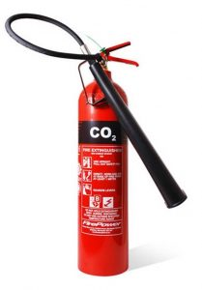
Fire Extinguisher
Operating a fire extinguisher typically involves the P.A.S.S. technique:
  Pull the pin,
  Aim the nozzle at the base of the fire,
  Squeeze the handle to discharge the agent, and
  Sweep from side to side to cover the fire.
Fire extinguishers should be strategically placed in accessible locations, visible and unobstructed.
Common placements include kitchens, hallways, workshops, and near exits.
Regular maintenance is crucial for ensuring the functionality of fire extinguishers.
Inspections, pressure checks, and timely refills or replacements are essential to keep them ready for use.
Users should be trained in the proper use of fire extinguishers, understanding the classes of fires and the appropriate extinguishing agents.
Figure: Fire Extinguisher (Humagain, 2019)

Slide 34
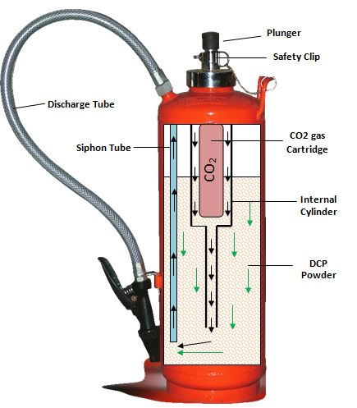
Fire Extinguisher
Fire extinguishers are portable and versatile, making them suitable for a wide range of environments, including homes, offices, vehicles, industrial facilities, and public spaces.
While fire extinguishers offer immediate response capabilities, they are often part of a broader fire safety strategy, complementing other active and passive fire protection measures.
Fire extinguishers play a crucial role in empowering individuals to take swift action during the early stages of a fire, preventing it from spreading and causing more extensive damage.
Their presence is a fundamental element of overall fire preparedness and safety in various settings.
Regular training, maintenance, and adherence to safety guidelines enhance the effectiveness of fire extinguishers as vital tools in firefighting.
Figure: Fire Extinguisher (Humagain, 2019)

Slide 35
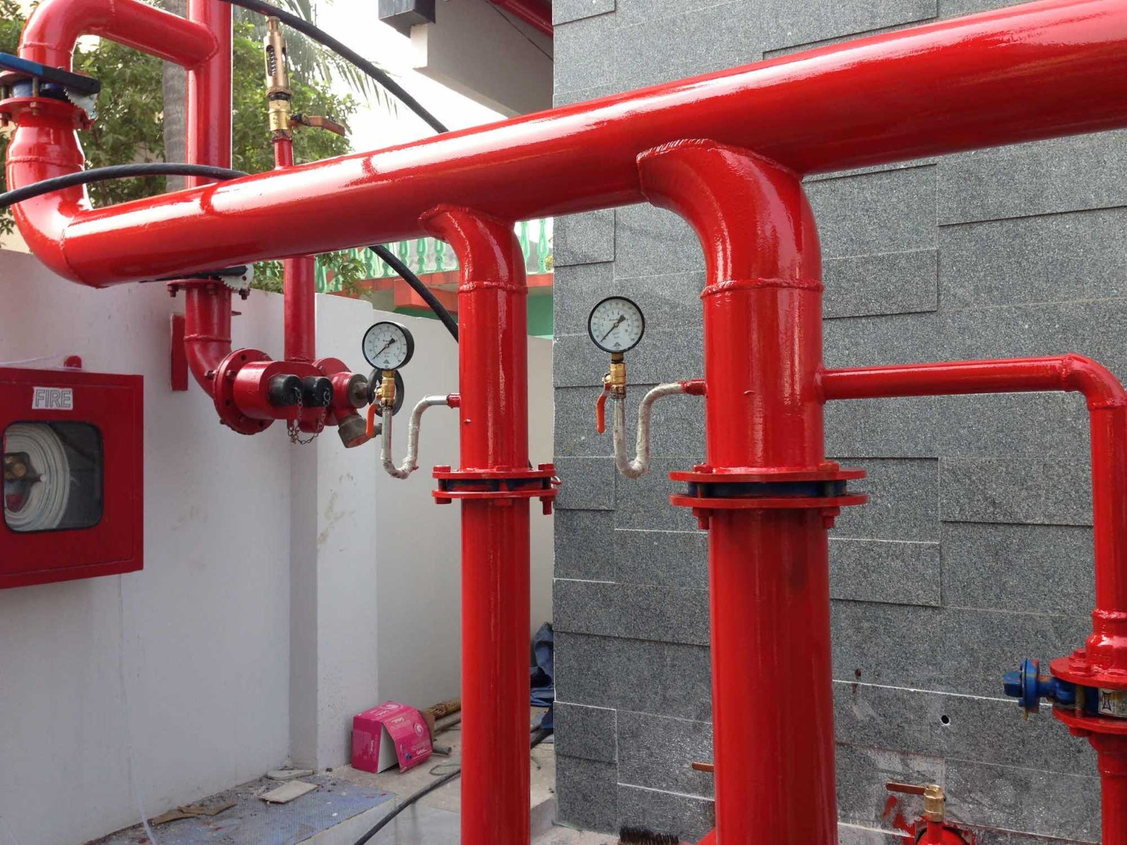
Fire Hydrant System
The hydrant system is an arrangement of pipes, valves, hose outlets and allied equipment.
The outlets are located strategically to cover a large area (arc of 18-30m) and thus put out the fire and hence protect both equipment and occupants.
Water is discharged in stream through hose and nozzles attached to such hose outlets.
Pumps are provided to supply water to the hose outlets.
Fire hydrants are outdoor fixtures connected to a water supply, typically a municipal water system.
They provide a ready and easily accessible source of water for firefighters to connect hoses during firefighting operations.
They are crucial for supplying large volumes of water quickly to extinguish a fire.
Figure: Hydrant system (Safety, 2023)

Slide 36
Fire Hydrant System
Hydrants are usually located outdoors along streets or in open areas.
They are strategically placed to provide convenient access for fire departments to connect hoses and draw water.
Fire hydrants do not have an automatic activation mechanism.
Hoses are manually connected to hydrants in case of a fire.
Fire hydrants are part of the external water supply infrastructure and play a role in providing the necessary water for firefighting efforts.

Slide 37
Hose Reels
Hose reels are important component of fire hydrant system.
Hose reels are used for prompt and easily deployable initial response method, working in coordination with other systems and utilized by the occupants of a building.
These reels are strategically positioned in clearly visible recesses along corridors to ensure that no area of the floor is more than 6 meters away from a nozzle when the 25 mm bore flexible hose is fully extended.
The coverage provided by a hose reel spans an arc of 18–30 meters from the reel, depending on the hose's length.
A 6 mm diameter nozzle requires a minimum water pressure of 200 kPa, generating an 8-meter horizontal jet or a 5-meter vertical one.

Slide 38
Hose Reels
Each nozzle must maintain a minimum water flow rate of 0.4 l/s, and the system's design should enable the simultaneous use of at least three hose reels, amounting to a flow rate of 1.2 l/s.
Local water supply authorities may permit a direct connection to the water main, potentially obviating the need for pressure boosting if there is sufficient main pressure.
The standby pump, which can be driven by external power source, must have a flow capacity of at least 2.5 l/s. Flow switches are employed to detect hose operation, triggering the pump accordingly (Chadderton, 2007).

Slide 39
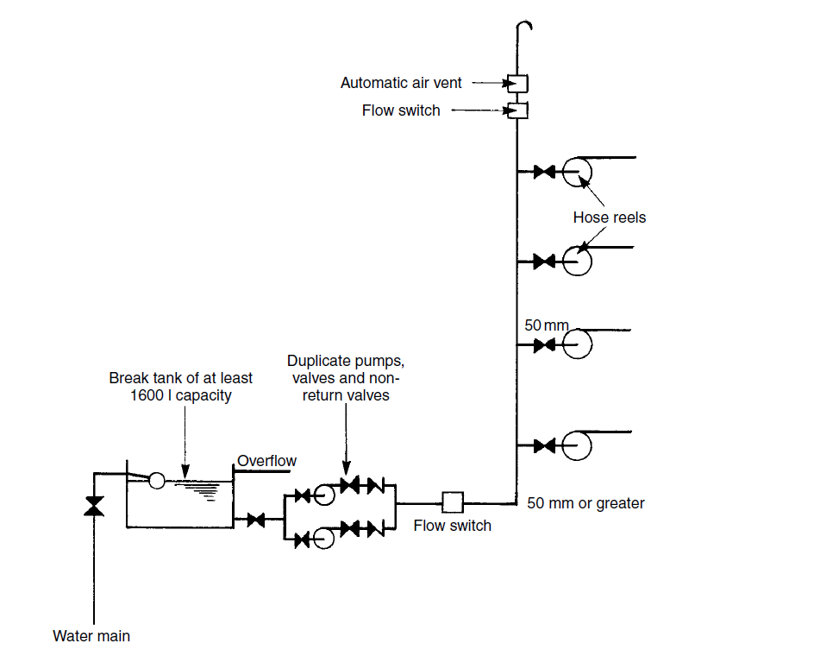
Figure: Typical Hose Reel Installation (Chadderton, 2007)

Slide 40
Types of Fire Hydrant Systems
Dry Hydrant System
A dry hydrant system is a type of fire hydrant that does not contain water under normal operating conditions.
Instead of being connected to a pressurized water supply, dry hydrants are installed near non-pressurized water sources, such as ponds, lakes, or cisterns.
The primary purpose of a dry hydrant is to provide a supplemental water supply for firefighting in areas where access to conventional pressurized water mains is limited or unavailable.
Pipes in dry hydrant system are not initially charged with water. The pump is used for water circulation incase of fire. It is suitable for cold climate.

Slide 41
Types of Fire Hydrant Systems
Wet Hydrant System
In wet hydrant system, pipe is permanently charged with water.
The term "wet hydrant system" typically refers to a traditional fire hydrant system where water is constantly present in the pipes, and it is ready for immediate use.
Unlike dry hydrant systems, wet hydrants are connected to a pressurized water supply, usually the municipal water system.
This ensures that water is readily available in the hydrant and can be quickly accessed by firefighters in case of a fire emergency.
It is not suitable for cold climate as water may freeze in pipe and block flow.

Slide 42
Fire Sprinkler System
A fire sprinkler system is an active fire protection measure designed to control or extinguish fires in buildings.
It consists of a network of pipes containing water or other fire-extinguishing agents, along with sprinkler heads strategically positioned throughout the building.
These sprinkler heads are heat-sensitive and automatically release water when a specified temperature is reached, typically indicative of a fire (Chadderton, 2007).

Slide 43
Components of
Fire Sprinkler System
The key components and features of a fire sprinkler system are:
Sprinkler Heads:
These are the visible components of the system, mounted on the ceiling or walls. Each sprinkler head is equipped with a heat-sensitive element that activates when exposed to a certain temperature. Only the sprinkler heads in the immediate vicinity of the fire are activated.
Piping System:
A network of pipes is installed throughout the building, connecting to a reliable water supply. In some cases, other fire-suppressing agents, such as foam or gas, may be used instead of water, depending on the nature of the fire and the contents of the building.

Slide 44
Components of
Fire Sprinkler System
Control Valve:
The system is equipped with a control valve that regulates the flow of water or fire-suppressing agents. This valve is typically connected to a fire detection system, which triggers the release of water or other agents when a fire is detected.
Alarm System:
Fire sprinkler systems often include an alarm system that alerts occupants and emergency services when the system is activated. The alarm can also be linked to the building's fire alarm system.

Slide 45
Components of
Fire Sprinkler System
Water Supply:
The system requires a reliable and sufficient water supply, which is usually provided by the municipal water mains. In some cases, a dedicated water tank or reservoir may be used as a backup or supplemental supply.
Backflow Prevention:
To ensure that water from the sprinkler system does not contaminate the main water supply, backflow prevention devices are often installed.

Slide 46
Types of Fire Sprinkler System
The types of fire sprinkler system are:
Wet pipe sprinkler system
Dry pipe sprinkler system
Pre-action sprinkler system
Deluge sprinkler system

Slide 47
Wet Pipe Sprinkler System
A wet pipe sprinkler system is a type of fire sprinkler system in which water is constantly present in the pipes, ready to be discharged immediately upon sprinkler activation.
It is the most common and straightforward type of sprinkler system, known for its simplicity and reliability.
In a wet pipe system, the pipes are filled with pressurized water at all times.
This water is directly supplied from a reliable source, such as a municipal water main or a dedicated water tank.
Sprinkler heads are distributed throughout the protected area, and each head is equipped with a heat-sensitive element.
When the ambient temperature around a sprinkler head reaches a specified threshold due to a fire, that individual sprinkler head activates. Wet pipe sprinkler systems are commonly used in heated buildings where the risk of freezing is minimal.
They are found in a wide range of occupancies, including commercial buildings, residential structures, and industrial facilities.

Slide 48
Wet Pipe Sprinkler System
The advantages of wet pipe system are:
Quick Response: Wet pipe systems are known for their rapid response. Since water is always in the pipes, there is no delay in delivering water to the affected area once a sprinkler is triggered.
Simple Design: Wet pipe systems have a relatively simple design compared to other types of sprinkler systems. This simplicity often makes them easier to install, maintain, and inspect.
Cost-Effective: Wet pipe sprinkler systems are generally cost-effective to install and maintain. The simplicity of the system contributes to lower installation costs.
Reliability: Since water is always ready to be discharged, wet pipe systems are considered highly reliable. They are well-suited for applications where a quick response to a fire is critical.
Despite their advantages, wet pipe sprinkler systems may not be suitable for environments where there is a risk of freezing, as water-filled pipes can be damaged by freezing temperatures. In such cases, dry pipe or pre-action systems, which do not contain water in the pipes until a fire is detected, may be more appropriate.

Slide 49
Dry Pipe Sprinkler System
A dry pipe sprinkler system is a type of fire sprinkler system where the pipes are not filled with water under normal operating conditions.
Instead, the pipes are filled with pressurized air or nitrogen, and water is held back by a valve known as a dry pipe valve.
When a fire is detected, the valve opens, allowing water to flow into the pipes and discharge through the sprinkler heads.
Unlike wet pipe systems where water is constantly present in the pipes, dry pipe systems have air or nitrogen filling the pipes. This prevents water from being in the pipes until the system is activated.
The dry pipe valve is a crucial component of the system. It is typically located in a heated space to prevent freezing.
The valve keeps water from entering the pipes until the system is triggered. Similar to wet pipe systems, dry pipe systems have sprinkler heads positioned throughout the protected area. Each sprinkler head is equipped with a heat-sensitive element.
Dry pipe systems are often employed in unheated buildings, parking garages, refrigerated storage areas, and other locations where the temperature may drop below freezing. When a fire occurs and a sprinkler head is activated due to heat, the dry pipe valve opens. This allows water to enter the pipes, and the water is then discharged through the activated sprinkler heads.

Slide 50
Dry Pipe Sprinkler System
The advantages of the dry pipe system are:
Freeze Protection: Dry pipe systems are commonly used in environments where freezing temperatures are a concern. By keeping water out of the pipes until needed, the risk of pipes freezing is reduced.
The limitation of the dry pipe system is:
Delay in Water Delivery: One potential drawback of dry pipe systems is that there can be a slight delay in water delivery compared to wet pipe systems. This delay is due to the time it takes for the dry pipe valve to open and for water to flow into the pipes.
Dry pipe sprinkler systems are effective in preventing pipes from freezing in cold environments and are suitable for certain applications where the benefits of freeze protection outweigh the slight delay in water delivery.

Slide 51
Pre-action Sprinkler System
A pre-action sprinkler system is an advanced fire protection system that combines elements of both dry and wet pipe systems.
In this system, pipes are filled with air, and water is held back by a pre-action valve.
Activation occurs in two stages: first, a fire detection system confirms the presence of a fire, and then the pre-action valve releases water into the pipes.
Individual sprinkler heads then discharge water only in areas where the fire is detected.
This two-step process minimizes the risk of accidental water discharge.
Pre-action sprinkler systems are commonly used in environments where water damage must be carefully controlled, such as data centers, museums, and archival storage facilities.
They provide a high level of protection against fire while reducing the potential for water-related damage in sensitive areas.

Slide 52
Deluge Sprinkler System
In Deluge Systems, water flows into the pipes upon activation by a heat or smoke detector, independent of the sprinkler heads.
There is also a manual option where pushing a button or pulling a cord initiates the system.
A deluge sprinkler system is a fire protection system where all sprinkler heads are open, and water is held back by a deluge valve.
In the event of a fire, the valve rapidly opens, releasing water through all sprinkler heads simultaneously.
Unlike standard sprinkler systems, deluge systems are not heat-activated individually; instead, they are manually or automatically triggered to respond to high-risk environments where rapid fire control is crucial.
Deluge systems are commonly used in high-hazard areas such as chemical storage facilities or spaces with highly flammable materials.
The quick and simultaneous discharge of water over the entire protected area is designed to suppress rapidly spreading fires, making deluge systems a robust choice for scenarios where a swift and aggressive response is essential.

Slide 53
Fire Detector
Ionization Smoke Detector
Photoelectric Smoke Detector

Slide 54
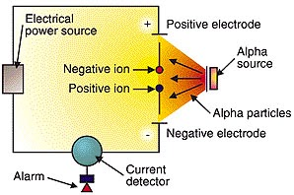
Ionization Smoke Detector
Ionization smoke detectors operate based on the principle of ionization, involving the electrical properties of air and the ionization process.
Ionization detectors feature an ionization chamber and a radiation source.
Within the chamber, two plates—one positively charged and one negatively charged—are positioned approximately one centimeter apart, and a voltage is applied to these plates by a battery.
The radiation source continually emits alpha particles, which ionize oxygen and nitrogen atoms in the chamber by displacing their electrons.
This ionization process creates a small electric current as positively charged atoms move toward the negative plate and electrons move toward the positive one.
If smoke enters the ionization chamber, the smoke particles adhere to the ions, neutralizing them and preventing them from reaching the plate.
This interruption in the current flow between the plates activates the alarm (FIREX, 2023)
Figure: Ionization smoke detector (FIREX, 2023)

Slide 55
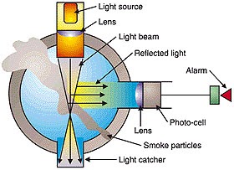
Photoelectric Smoke Detectors
In a photoelectric device, the presence of smoke can obstruct a light beam, leading to a decrease in the light reaching a photocell, which, in turn, activates the alarm.
Smoke particles scatter light on a photoelectric cell, initiating the alarm. This type of detector comprises a hollow T-shaped structure with a light-emitting diode (LED) projecting a light beam onto the crossbar of the T.
Positioned at the bottom of the T's vertical base, a photocell generates a current when exposed to light. When smoke is in the vicinity, the scattered light, including some directed down the vertical part of the T, reaches the photocell. Sufficient light striking the cell triggers the alarm (FIREX, 2023).
Photoelectric fire sensors are particularly effective at detecting slow-burning, smoldering fires, which can be critical for providing early warnings in certain situations. They are less prone to false alarms caused by non-fire-related particles, making them a reliable choice for many fire detection applications.
Figure: Photoelectric fire sensor (FIREX, 2023)

Slide 56
References
Chadderton, D. V. (2007). Building Services Engineering (5th Edition ed.). New York: Taylor and Francis Group.
FIREX. (2023). Smoke Alarms Guide. Retrieved October 12, 2023, from https://smokealarmsdetectors.blogspot.com/2012/10/how-smoke-detector-works.html
Fred Hall, R. G. (2007). Building Services Handbook (4th Edition ed.). Oxford, Burlington: Elsevier Limited.
GoN. (2015). Nepal National Building Code NBC 206:2015, Architectural Design Requirements. Government of Nepal, Ministry of Urban Development, Department of Urban Development and Building Construction.
Humagain, S. (2019, September 8). Online Science Notes. Retrieved October 29, 2023, from https://onlinesciencenotes.com/fire-extinguisher-and-its-working-mechanism/
Joseph B Wujek, F. R. (2010). Mechanical and Electrical Systems in Architecture, Engineering and Construction (5th Edition ed.). New Jersey: Pearson Education Inc.
NFPA. (2021). Fire Protection Handbook. National Fire Protection Authority.
Ogawa, A. (2012, May 2). Wikimedia Commons. Retrieved September 17, 2023, from https://upload.wikimedia.org/wikipedia/commons/1/1c/Psychrometric_chart.png
Pita, E. G. (2002). Air Conditioning Principles and Systems; An Energy Approach (4th Edition ed.). New York: Prentice Hall, Ohio.
Safety, S. (2023, October 29). Sure Safety: Complete safety solution. Retrieved from https://suresafety.com/fire-hydrant-system
Sarao, A. S. (2020). Refrigeration and AIr Conditioning. Satya Prakashan.

