Slide 1
Course: Building Services III
Lecture 10: solar pv systems, solar heating systems
Lecturer: Manchan Tiwari

Slide 2
Solar photovoltaics
Solar photovoltaics refers to utilization of solar radiation to generate electrical energy using conversion device such as solar photovoltaic (PV) cell.
The amount of electricity or electrical energy generated depends on intensity of solar radiation, size of solar cell, type of semiconductor material and ambient temperature (Sharma & Hasan, 2009).
Unlike most of the electricity generation systems, the solar PV cell does not need working fluid such as steam or air, or any mechanical cycle for the conversion of the primary solar energy into electricity.
Hence, a photovoltaic system is reliable, simple and convenient without any moving parts (Singal, 2011). Solar cell is a basic unit of a photovoltaic system.

Slide 3
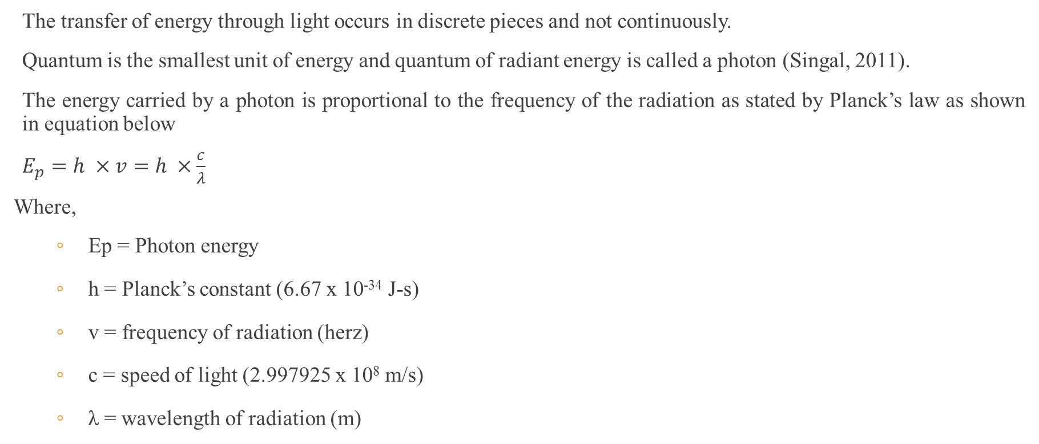
Energy in Light (photon energy)
The transfer of energy through light occurs in discrete pieces and not continuously.
Quantum is the smallest unit of energy and quantum of radiant energy is called a photon (Singal, 2011).
The energy carried by a photon is proportional to the frequency of the radiation as stated by Planck’s law as shown in equation below
$E_{p}=h ×v=h ×\frac{c}{λ}$
Where,
  Ep = Photon energy
  h = Planck’s constant (6.67 x 10⁻³⁴ J-s)
  v = frequency of radiation (herz)
  c = speed of light (2.997925 x 10⁸ m/s)
  λ = wavelength of radiation (m)

Slide 4
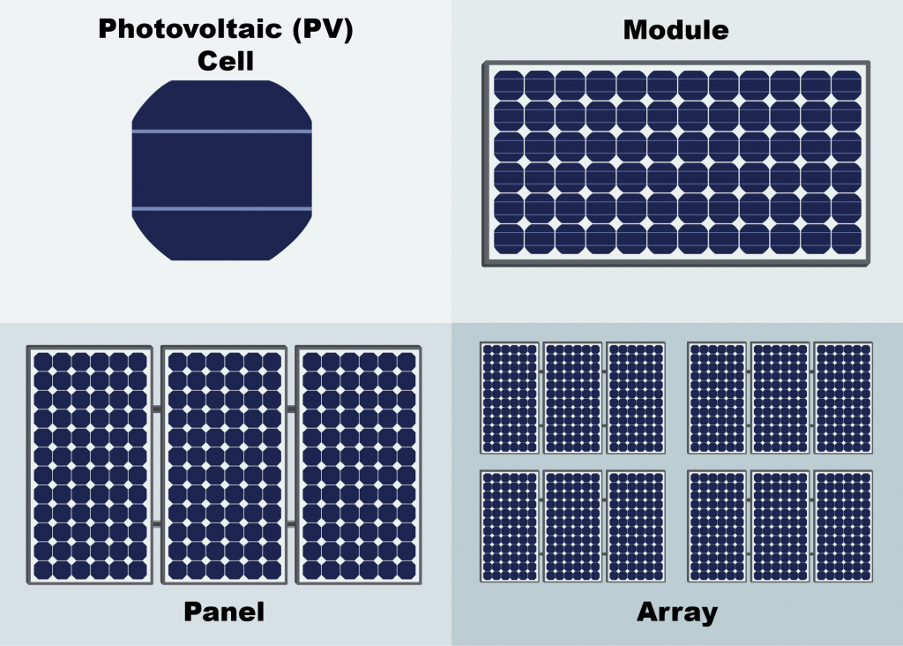
Solar cell
Solar cell is a photovoltaic device, composed of p-n semiconductor junction, which converts the light energy into electrical energy based on the principles of photovoltaic effect.
The photovoltaic effect is the creation of voltage or electric current in a material upon exposure to light.
The photovoltaic effect can be observed in nature in a variety of materials, but the materials that have shown the best performance in sunlight are the semiconductor.
When photons from the sun are absorbed in a semiconductor, they create free electrons with higher energy.
Once the electrons are created, there must be an electric field to induce these higher electrons to flow out of the semiconductor to do useful work.
Figure 1: Solar Cell, Panel and Array (FSEC, 2022)

Slide 5
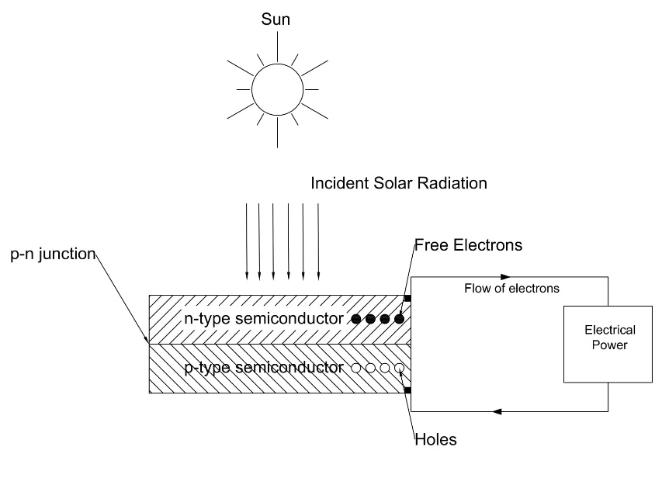
Working of a solar cell
A solar cell consists of P-type semiconductor and n-type semiconductor. Generally, n-type are made from crystalline silicon that has been doped with tiny quantities of impurities (usually phosphorus) such that it possesses a surplus of free electrons.
Figure 1: Working of Solar Cell

Slide 6
Working of a solar cell
P-type semiconductor are also made from crystalline silicon, but are doped with small amount of impurity (usually boron) which results in deficit of free electrons known are holes.
A p-n junction is created by joining the dissimilar semiconductors which sets up electric field in the region.
Although, the semiconductors can be made from other elements than silicon, we shall be considering semiconductors based on silicon for the purpose of simplicity.
Light can be considered as stream of tiny particles of energy, called photons.

Slide 7
Working of a solar cell
When the photons from the light fall within the p-n junction, they can transfer their energy to some of the electrons in the material so promoting them to higher energy level.
In their excited state the electron becomes free to conduct electric current by moving through the material (Boyle, 2013).
Due to the absorbed energy, the free electrons are liberated and when an external circuit is used, it produces the DC current.
The DC current is converted into 240 V AC current using an inverter for different applications.

Slide 8
Working of a solar cell
Over 95% of the solar cells produced worldwide are composed of semiconductor material Silicon (Si) (Boyle, 2013).
As abundantly found in earth’s crust, silicon has the advantage of being available in sufficient quantities.
A commercially available solar cell with the dimensions of 15.6 cm x 15.6 cm, the electricity output is more likely rated at 0.5 V with 7 A DC current. It can produce around 3-4 Watts.

Slide 9
Solar module and array
Number of solar cells are combined either in series or parallel to form a solar panel or module to operate at desired voltage and current output.
Standard module consists of 36 to 72 solar cells.
A P-V module is made of very thin silicon wafer of around 300 micro meter in size.
Figure 2: Solar Cell, Panel and Array (FSEC, 2022)

Slide 10
Solar module and array
As it is very fragile, the layer of the module is protected from damage by sealing it between layer of toughed glass and layers of EVA (Ethyl Vinyl Acetate (S. Hasan & Sharma, 2009).
Below the EVA layer, an insulating sheet is provided , while whole module is attached to an outer frame to provide strength to the module.
Solar Array is a group of similar modules connected in series and parallel to increase the power delivered by the PV system.

Slide 11
Solar module and array
To increase the system voltage maintaining the current, the panel are connected in series connection.
To further increase the power by increasing the system current, the panel are connected in parallel connection.

Slide 12
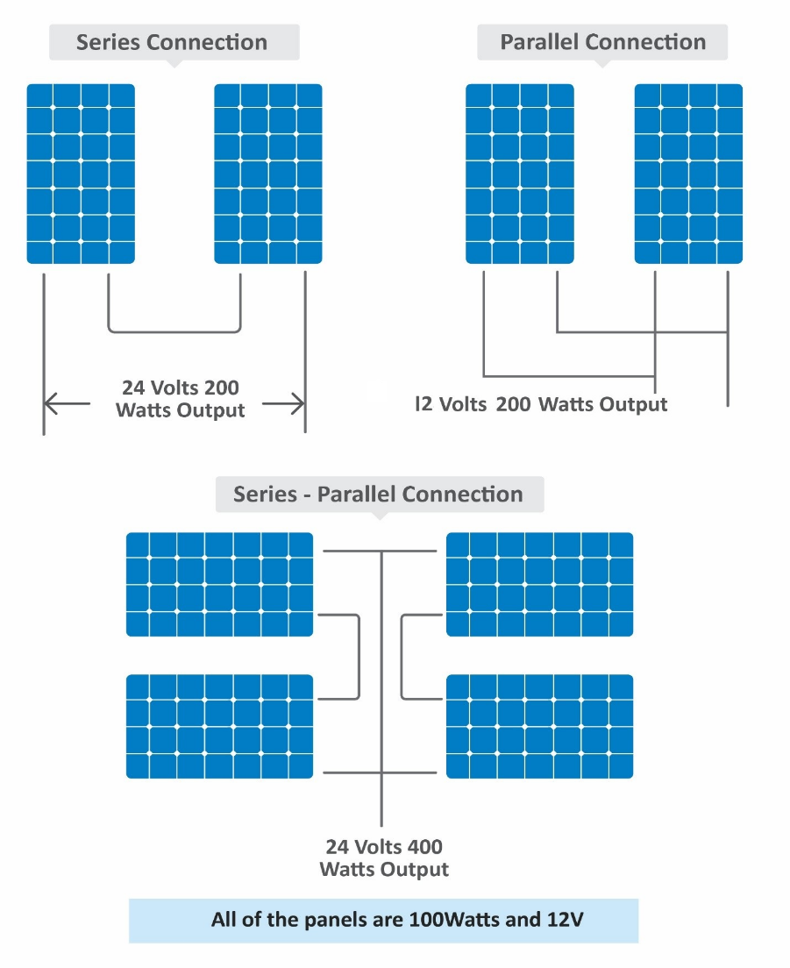
Solar module and array
As shown in the adjacent figure, series and parallel connection of various panel of same capacity of 100 Watts and 12 V is shown.
When two panels are used the power output is always 200 W, however the difference between series and parallel connection results in the change in output voltage hence varying the system voltage at which power generation takes place.
Figure 3: Series and Parallel Connection of Solar Panels (EPEVER, 2019)

Slide 13
Solar module and array
In series connection, two panel results in system voltage of 24 V where as in parallel connection, the output voltage is 12 V.
Consequently, the current rating of the system also changes which effects the wire sizing as well.
In series connection the current rating is fixed while the voltage rating of the system is increase while in parallel connection, the voltage rating is fixed while the current rating is increased for the system.

Slide 14
Types of solar cells
There are three types of solar cells
Monocrystalline PV Cell
Polycrystalline PV Cell
Amorphous PV Cell

Slide 15
Types of PV Cell
Monocrystalline PV Cell
Monocrystalline silicon is produced from polycrystalline silicon in the sophisticated and expensive process.
Due to which the monocrystalline cells are highly efficient but expensive.
It has appearance of uniform blue color.
These modules have efficiency in the range of 15% to 18% and are generally used in medium and large sized plants (Singal, 2011).

Slide 16
Types of PV Cell
Polycrystalline PV Cell
Polycrystalline PV cells are easier and cheaper to manufacture than the monocrystalline PV cells, but are less efficient.
Polycrystalline silicon essentially consists of small grains of monocrystalline silicon.
It has appearance of irregular blue color.
It has efficiency in the range of 12% to 14% (Singal, 2011).

Slide 17
Types of PV Cell
Amorphous PV Cell
In amorphous silicon (a-Si), the silicon atoms are much less ordered than in the crystalline forms described above.
Amorphous silicon cells are cheaper to produce than those made from crystalline silicon.
It is also better absorber of light, so thinner (therefore cheaper) films can be used.
The manufacturing process operates at lower temperature, hence less energy is required.
However, a-Si cells are less efficient. The efficiency achieved is around 5% to 8% (Singal, 2011).

Slide 18
Characteristics of solar cells
I-V and P-V characteristics at varying Irradiance levels
  At constant cell temperature, with the increase in Irradiance, the current produced is increased significantly, whereas the voltage produced is also increased by slight amount. Due to which, the increase in irradiance results in increase in power produced by the solar cell. This is represented in Figure 4.
I-V and P-V characteristics at varying temperature
  At constant value of Irradiance incident on the solar cell, with the change in cell temperature, the voltage drop is significant as compared to the increase in current. Increased temperature increases the heat which causes electrical resistance to the flow of electrons. Hence, increase in cell temperature results in decrease in power produced, at constant Irradiance. The figure 5 illustrates the characteristics at varying temperature

Slide 19
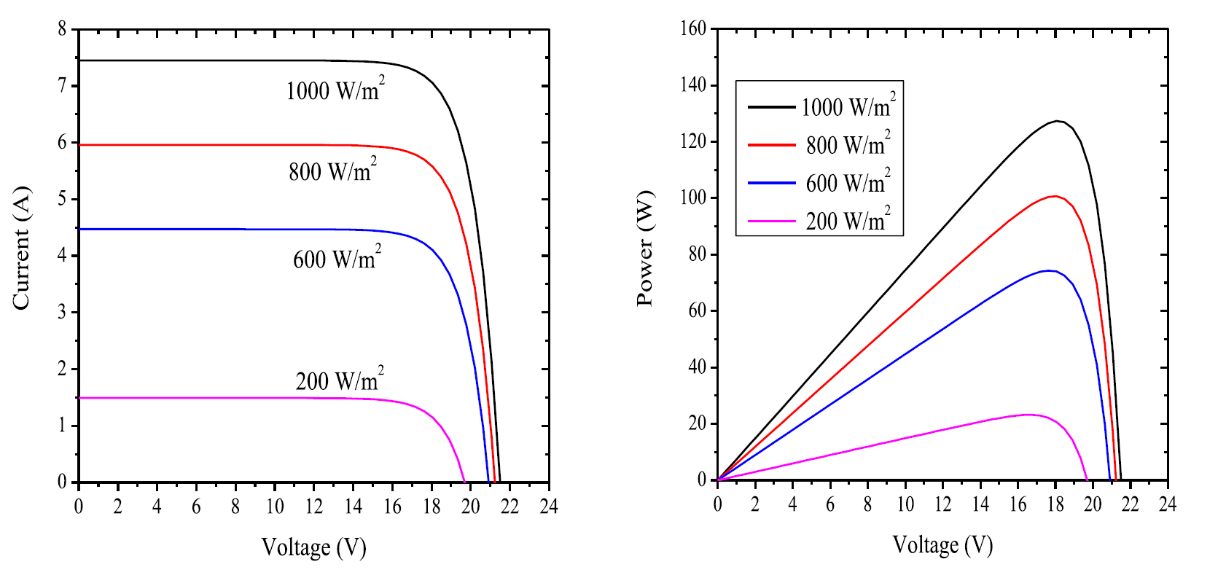
Characteristics of solar cells
Figure 4: I-V and P-V characteristics at varying Irradiance (Saharia, 2014)

Slide 20
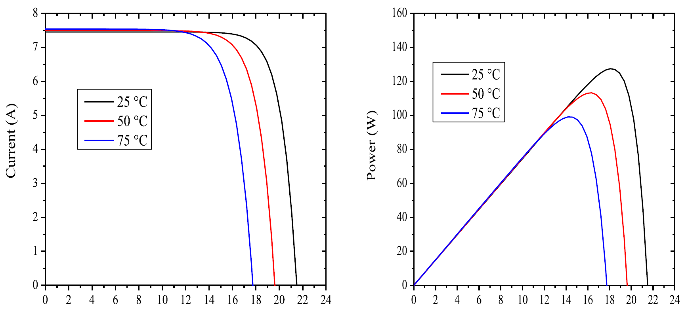
Characteristics of solar cells
Figure 5: I-V and P-V Characteristics at varying temperature (Saharia, 2014)

Slide 21
Solar PV terminologies
Open circuit voltage
Short circuit current
Voltage at maximum power
Fill factor
Efficiency

Slide 22
Solar PV terminologies
Open circuit voltage
  It is the maximum voltage generated by the cell under given conditions of light and temperature. V_{oc} is the voltage when the load is open circuited, ie. the output current is zero. The output power at this point is again essentially zero.
Short circuit current
  It is the maximum current (in A or mA) produced by the cell under given conditions of irradiance and surrounding temperature. I_{sc} is the current when the load is short circuited. The output power at this point is zero.

Slide 23
Solar PV terminologies
Voltage at maximum power
  The voltage that results in maximum power output of a solar cell is called voltage at maximum power. V_{mp} is also called “rated” voltage of the cell
Current at maximum power
  The current that results in maximum power output of a solar cell is called current at maximum power. I_{mp} is also called “rated” current of the cell.

Slide 24
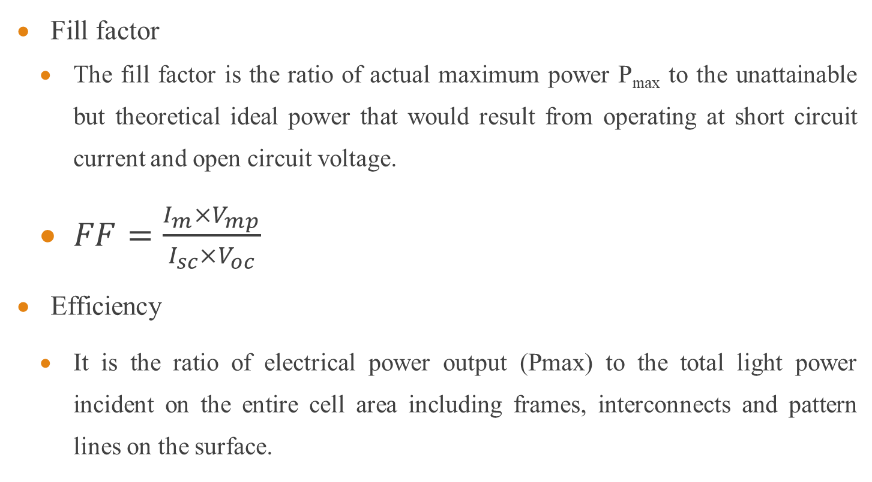
Solar PV terminologies
Fill factor
  The fill factor is the ratio of actual maximum power P_{max} to the unattainable but theoretical ideal power that would result from operating at short circuit current and open circuit voltage.
  $FF=\frac{I_{m}×V_{mp}}{I_{sc}×V_{oc}}$
Efficiency
  It is the ratio of electrical power output (Pmax) to the total light power incident on the entire cell area including frames, interconnects and pattern lines on the surface.

Slide 25
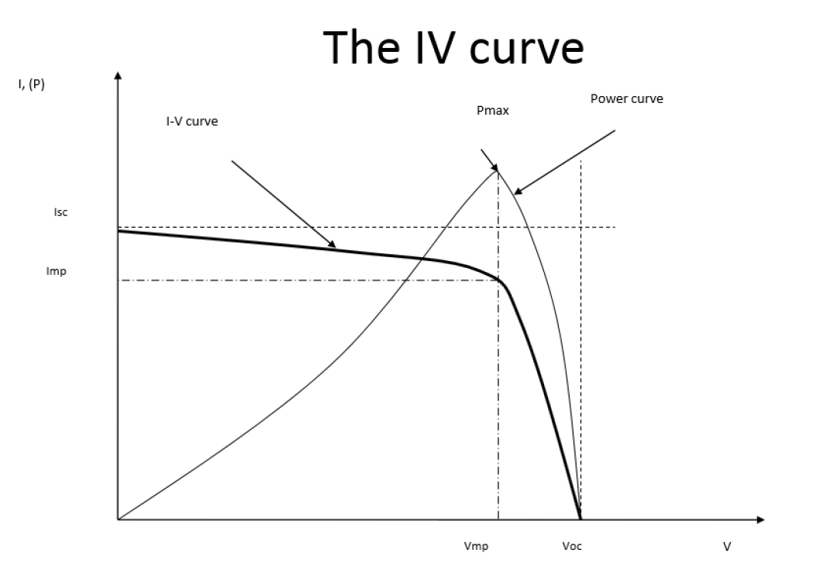
Solar PV terminologies
Figure 6: I-V characteristics of typical silicon PV cell under standard test conditions

Slide 26
Factors effecting durability of solar cells
Location
Maintenance
Soiling
Environment
Solar Cell Degradation
Interconnections Effects of Solar Cell/Module
Mismatch Effect
Hot Spot Heating

Slide 27
Factors effecting durability of solar cells
Location
Should be kept away from location that present the threat of damage from trees or falling rocks
Shadows should be avoided during peak sunlight hours
At output decrease is significant due to shading and can also cause hot spot heating, it is desirable to clear the surrounding area such that there is no shade on the panel.

Slide 28
Factors effecting durability of solar cells
Maintenance
Regular maintenance is required
Basic maintenance such as washing dust and bird toppings should be done regularly
Soiling
Airborne particles settle on the glass surface of the module.
The deposition of such particles on solar pv panel restrict the light reaching the module hence reducing the power produced.
Module installed in wet climate results in regular washing of dirt through rain as compared to that of the dry climate

Slide 29
Factors effecting durability of solar cells
Environment
Extreme weather conditions can compromise the solar panel’s durability
Weather condition such as violent storms can cause damage to solar pv panel.

Slide 30
Mismatch effect
When in a module the electrical parameter of a cell is altered from the rest of the cells, this results in mismatch effect.
Mismatch effect is mostly caused by varying of short circuit current or open circuit voltage of a cell even though any electrical parameters can cause the mismatch effect.
Mismatch effect results in power loss

Slide 31
Hot spot heating
Hot spot heating occurs when one of the cell in a module doesnot produce current due to either malfunctioning or shading
During such case, this results in power dissipation in the cell, due to which the cell overheats and results in formation of hot spots.
The shaded cell acts like a resistor, which rather than produce current dissipates the power produced and converts it into heat.

Slide 32
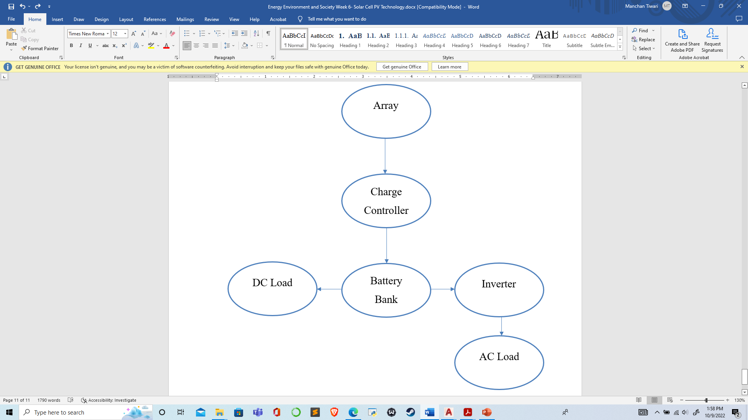
Solar PV systems
A typical solar PV system comprises of solar panels/array used to power a given load which can be village load in a community or a specific load for a system such as water pump used for irrigation.
The major components of a typical solar PV system are DC-AC power inverter, battery bank, system and battery controller (charge controller), auxiliary energy sources and sometimes specified electrical load.
Figure 7: A typical solar PV system

Slide 33
Solar PV Systems
Some of the types of PV systems are:
Grid Connected Photovoltaic systems
Stand Alone Photovoltaic System
Grid Connected Photovoltaic Systems
These type of PV systems are interconnected with electric utility grid and operates parallelly.
A power conditioning unit is the major component of such system which converts the DC power produced by the PV array into AC power consistent with the requirements of the electric grid.

Slide 34
Solar PV systems
Stand-Alone Photovoltaic Systems
This type of system operates independent of the electric utility grid and are designated to supply power to specific AC or DC load.
A simplest form of stand-alone PV systems is when the power produced from an array is directly used to operate DC load.
In such case, due to absence of storage device such as battery, the load can only be operated during sunshine hours.
However, many stand-alone PV systems use battery for storage of the power to operate the load outside of sunshine hours (Sharma & Hasan, 2009).

Slide 35
Advantages of Solar PV
Absence of moving parts
Direct conversion of light to electricity at room temperatures
Does not require constant attention and can function on its own
Low maintenance cost
No environmental pollution
Has very long life and is highly reliable
No cost of fuel
No starting time required
Solar PV system can be of varying size, used to operate small load, power a community of produce power in MW for a country
Limitations of Solar PV
High initial cost
Insolation is unreliable due to which storage devices are required
Requires very large land areas

Slide 36
Solar thermal systems (STE)
Solar thermal energy (STE) is a technology for harnessing solar energy for thermal energy.
The basic purpose of a solar thermal energy system is to collect solar radiation and convert it into useful thermal energy.
Most solar thermal systems are based on simple working principal and are effective for rural area where no source of electricity is available.

Slide 37
Solar energy scenario in nepal
Nepal has a high potential for harnessing solar energy being located in favorable latitude (WECS, 2010).
The solar insolation in Nepal varies from 3.6 to 6.2 kWh/m2/day and the sunshine is for about 300 days per year (WECS, 2010).
The monthly daily global solar radiation varies from 120 to 260 w/m² with the annual sun shine duration ranging from 1900 to 2500 hours

Slide 38
Solar energy scenario in nepal
As per report published by Alternative Energy Promotion Centre, Nepal under Solar and Wind Energy Resource Assessment in Nepal (SWERA), the commercial potential of solar power for grid connection is 21080 MW.
National average sunshine hours of 6.8 hrs per day and average solar insolation of about 4.7 kWh/m2/day, there is a huge potential for solar thermal devices such as Solar water Heaters, Solar Dryers, Solar Cookers.

Slide 39
Types of solar thermal systems
Solar collector
Solar pond
Solar dryer
Solar cooking system
Solar still
Solar swimming pool

Slide 40
Solar collectors
Solar collector is a device which absorbs the incoming solar radiation, converts it into heat, and transfers this heat to a fluid flowing through the collector.
Such converted heat can be used for heating purpose or for the purpose of electricity generation as well.
Solar collector can be either flat plate or evacuated tube type (non concentrating type) or concentrating (focusing) type.

Slide 41
Solar collectors
So, basically the solar collectors can be classified into three types:
Types of Collector
Flat Plate Collectors
Evacuated Tube Collectors
Stationary compound parabolic collectors

Slide 42
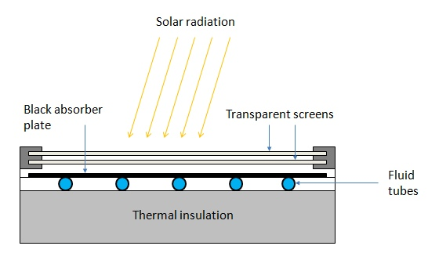
Flat plate collectors
Flat plate solar collector consists of an absorber plate, cover glass, insulation, housing and heat transfer fluid tube.
Absorber plate is generally made of metal to increase the absorption of solar radiation. A large portion of the incident energy is absorbed by the plate and then transferred to the transport medium in the fluid tubes.
Figure 1 Flat Plate Collector (PennState, 2022)

Slide 43
Flat plate collector
The cover glass or glasses are used to reduce convection and re-radiation losses from the absorber.
Insulation is used on the back edges of the absorber plate to reduce conduction heat losses.
The housing holds the absorber with insulation on the back and edges and cover plates.
The working fluid (water, air) is circulated through the absorber plate to carry the solar energy to its point of use.
It is used to achieve moderate temperature of up to 100 ⁰C.
It is used for building heating, industrial process heating

Slide 44
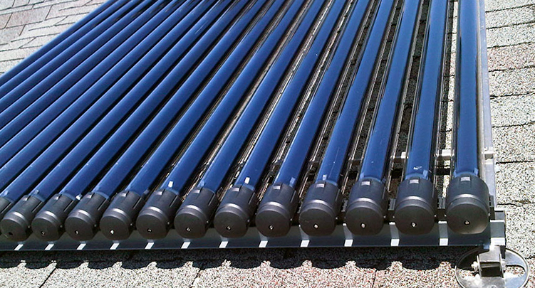
Evacuated tube collector
Evacuated tube collectors comprises of parallel rows of tubes containing water or fluid used for heating.
Each tube is made of metal tube surrounded by a larger glass tube.
The space between the tube and the glass tube is a vacuum, due to which very little heat is lost from the fluid.
Figure 2 Evacuated Tube Collector (Waterloo, 2022)

Slide 45
Evacuated tube collector
The vacuum ensures that there is negligible loss due to conduction or convection, which ensures that the collector can operate at higher temperature that the flat plate collectors.
Evacuated tube collectors are used for reduction of losses.
ETC can achieve water temperature of up to 250 ⁰C.

Slide 46
Concentrating collectors
These types of collectors are used for medium and high temperature applications.
It is made of a reflecting surface such as reflecting mirror or Fresnel lense which is used in concentrating device such that the solar radiation incident is reflected to a single point and focused on to the absorber.
Such concentrator are also rotated through tracking mechanism which helps to track the sun path for increase in the efficiency of the collector.
The performance of concentrating collectors is measured by concentration ratio which is the ratio of the aperture area of the concentrator to the area of the absorber.

Slide 47
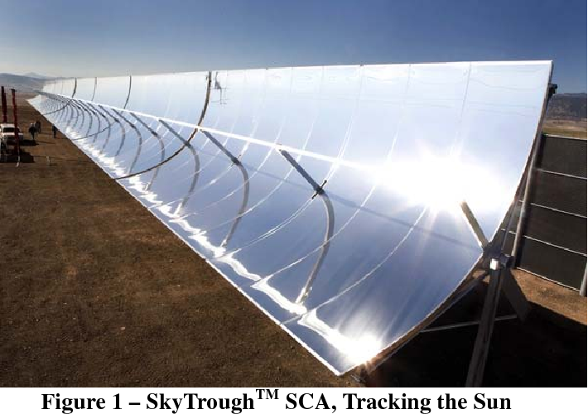
Concentrating collectors
The various types of concentrating collectors are:
  Parabolic Trough Concentrator
  Parabolic Disc Concentrator
  Fresnel Lens Concentrator
Parabolic Trough Concentrator
  It is a linear concentrator
  It has concentration ratio of around 20 to 100
Figure 3 Parabolic Trough Concentrator
Source: (Farr, 2010)

Slide 48
Concentrating collectors
Parabolic Disc Concentrator
  It is a point focus concentrator.
  It has concentration ratio of 100 to 4000 for parabolic and heliostat field concentrator.
  These are fixed collectors which uses parabolic shaped collectors. The parabolic shaped collectors are made from two sections of a parabola facing each other. These type of collectors can accept incoming radiation over a relatively wide range of angles, by using multiple internal reflections
Fresnel Lens Concentrator
  It is capable to achieve temperature as high as 1000 ⁰C.
  This type of concentrator is se for power generation and process heat supply.

Slide 49
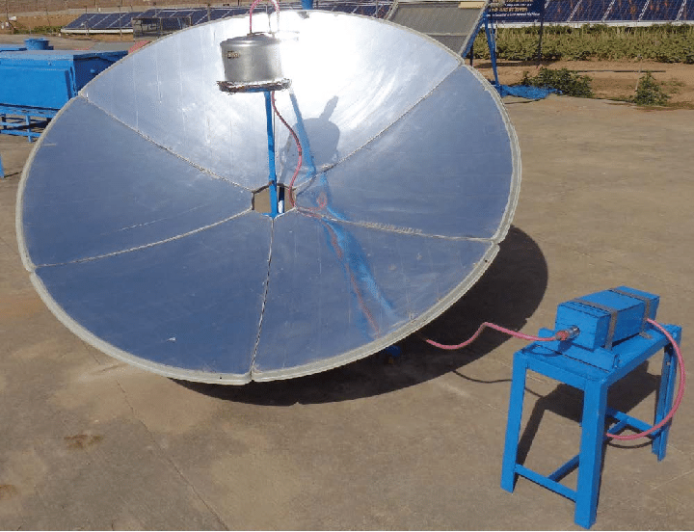
Concentrating collectors
Figure 4 Parabolic Disc Concentrator
Source: (Dr. Poonia, 2010)

Slide 50
Applications of flat plate collectors
The flat plate collector have many applications such as
Water heating
Space heating
Power generation

Slide 51
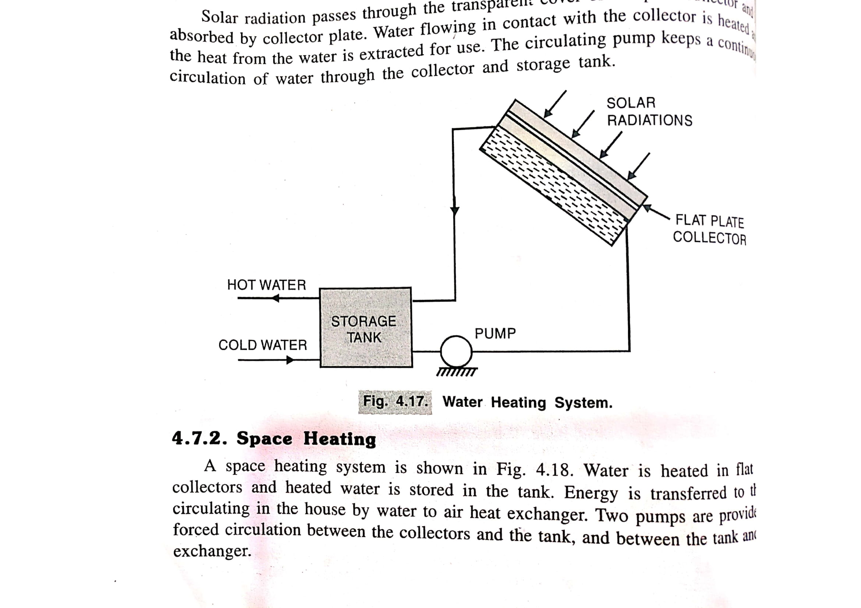
Applications of flat plate collectors
Water Heating
The radiation passing through the collector is absorbed by the collector plate which heats the water flowing in contact with the collector plate. Either thermosiphon effect or a pump circulates the water from storage tank to the collector.
Figure 5 solar water heater
Source: (Hasan & Sharma, 2009)

Slide 52
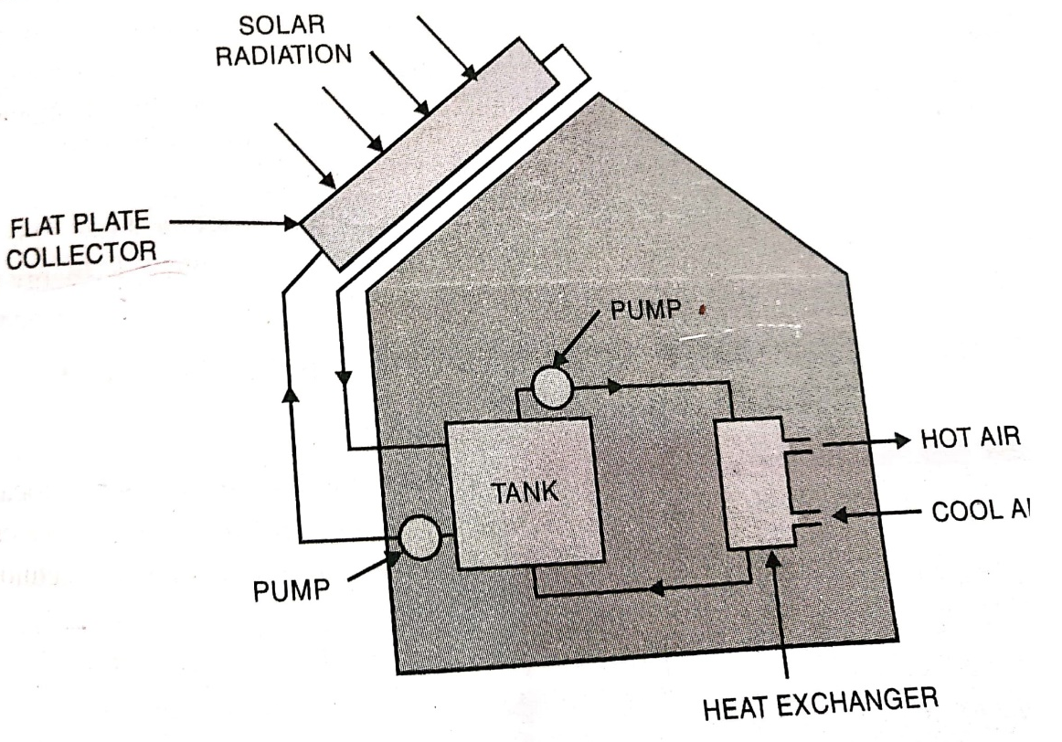
Applications of flat plate collectors
Space heating
Flat plate collector is initially used to heat water which is stored in a tank. The hot water is used to heat air being circulated by secondary pump which is then circulated to the space required to be heated.
Figure 6 solar space heating
Source: (Hasan & Sharma, 2009)

Slide 53
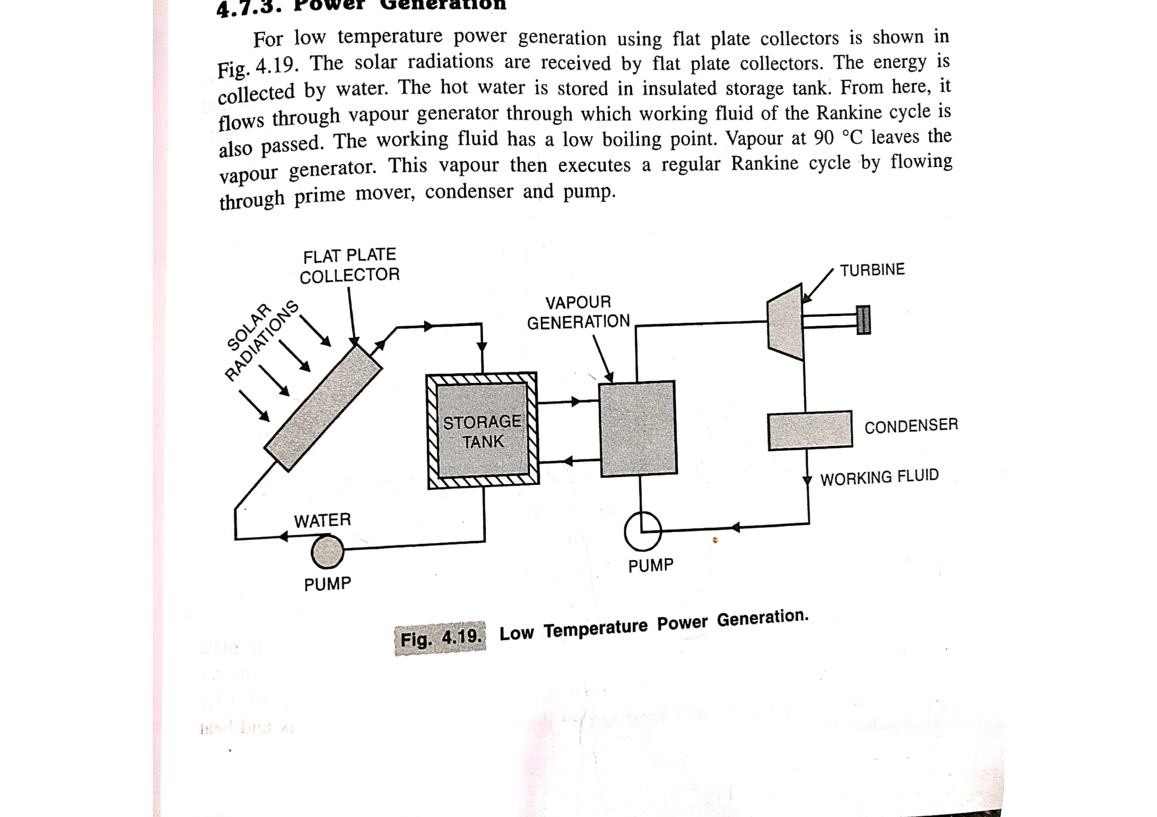
Applications of flat plate collectors
Power generation
The hot water generated from solar collector is used to convert a working fluid with low boiling point to vapor which then operates a rankine cycle to generate power.
Figure 7 solar power generation
Source: (Hasan & Sharma, 2009)

Slide 54
References
Boyle, G. (2013). Renewable Energy Power For A Sustainable Future (Vol. Third Edition). Oxford: Oxford University Press.
EPEVER. (2019, September 19). Retrieved October 9, 2022, from https://blog.epever.com/what-is-a-series-or-parallel-connection/
FSEC. (2022). Retrieved October 9, 2022, from Florida's Premier Energy Research Center at the University of Central Florida: https://energyresearch.ucf.edu/consumer/solar-technologies/solar-electricity-basics/cells-modules-panels-and-arrays/
Kalogirou, S. A. (2014). Solar Energy Engineering Processes and Systems (Second Edition ed.).
Koirala, D. R. (2019). Principals of Engineering Thermodynamics and Heat Transfer. Kathmandu: Shree Chandeswori Publication Pvt. Ltd. .
PennState. (2022). Retrieved October 8, 2022, from Pennsylvania State University: https://www.e-education.psu.edu/eme811/node/685

Slide 55
References
Ren, J. (Ed.). (2020). Renewable Energy Driven Future: Technologies, Modelling, Applications, Sustainability and Policies. Academic Press. doi:https://doi.org/10.1016/C2019-0-01298-8
S. Hasan, S., & Sharma, D. (2009). Non-Conventional Energy Resources. Delhi: S. K. Kataria and Sons.
Saharia, B. J. (2014). A comparative study on converter topologies for maximum power point tracking application in photovoltaic generation. Journal of Renewable and Sustainable Energy 6. doi:10.1063/1.4900579
Sharma, D., & Hasan, S. (2009). Non-Conventional Energy Sources (Second Edition ed.). Delhi: S.K. Kataria and Sons.
Singal, R. (2011). Non-Conventional Energy Resources (Vol. Third Edition). Delhi: S. K. Kataria and Sons.
WECS. (2010). Energy Sector Synopsis Report. Kathmandu, Nepal: Government of Nepal, Water and Energy Commission Secretariat.

