Slide 1
Atomic and Nuclear Physics
Week #2
Atomic Mass Unit and its relation with MeV
Lecturer: Jojo Panakal John
Professor of Applied Physics
Papua New Guinea University of Technology

Slide 2
Topics of discussion
Atomic Mass Unit (u)
Experimental methods to determine mass of particles
Relation between u and MeV
Numerical Problems

Slide 3
Mass of a body
Fundamental Property:
Mass is a fundamental property of substance.
It is an intrinsic property so that it is same everywhere in the universe.
For example, a body with one kilogram of matter on Earth will be same mass on the Moon.
While weights of a body will be different on earth and that on moon, because weight represents the force on it
Mass plays a fundamental role of the object's inertia by which it opposes the change in the state of rest or uniform motion.
Acceleration of a body by applying force depends on mass (Newton’s law)

Slide 4
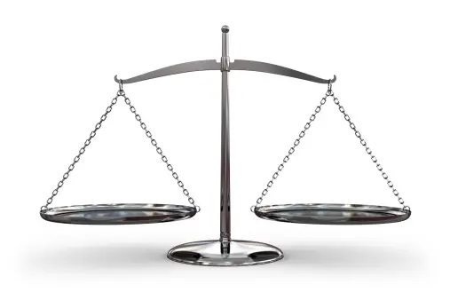

Quantifying mass
There are several experimental and theoretical methods to quantify mass
Balance Scales: work on the principle of equilibrium, where the mass being measured is balanced against a known mass
Weighing Scales: Weighing scales use load cells, strain gauges, or other sensors to measure the force exerted by the object due to gravity, and then they convert this
force into a mass reading.
Spring Scales: Spring scales use the deformation of a spring to measure the force exerted by an object due to gravity. The scale is calibrated to display the corresponding mass in units such as kilograms or grams.

Slide 5
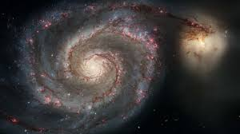
Gravimetry: In geophysics and Earth science, gravimetry is used to measure variations in the Earth's gravitational field, which can be related to the distribution of mass beneath the surface.
Astronomical Method: In astronomy, the mass of celestial objects like planets, stars, and galaxies is often determined through gravitational interactions with other objects, orbital dynamics, and astrophysical observations.

Slide 6
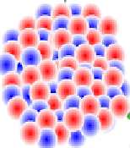
Magnetic Resonance Imaging (MRI): MRI can indirectly measure the mass of tissues in the body based on the interaction of hydrogen nuclei with magnetic fields.
Nuclear Physics: In nuclear physics and particle physics, mass spectrometers and particle detectors are used to measure the masses of subatomic particles and nuclei.
Therefore, determination of mass needs apt method and scale
to suite the substance

Slide 7
How we scale mass of atoms and subatomic particles ???
Need a suitable reference
Of comparable quantum
Should be reliable and stable
Should be easy to use
Should be versatile as well

Slide 8
The atomic mass unit (amu)
In modern Physics, the principle of mass energy equivalence says that mass has an equivalent amount of energy and vice – versa or they are interconvertible but this process is difficult to take place.
The principle argues that mass is concentrated energy.
Energy can be released through the process matter antimatter annihilation.
Since the amount of energy associated with matter is tremendous, subatomic (nuclear) reactions release great amount of energy as compared with chemical reactions.
Being the two forms same entity, we can express mass in energy units and energy in units of mass.

Slide 9
To represent the amount or scale mass of atoms we use a simple atom
The atom is relatively smaller with most of the atoms
The atom is stable and abundant
It is easy to use and apply
The atom we choose as a unit of mass for all atoms is Carbon-12
The unit is somewhat equal to mass of a nucleon

Slide 10
Atomic mass unit (AMU) (also called Dalton)
An atomic mass unit is equal to 1/12 the mass of a single atom of carbon-12
(Carbon has five isotopes – C¹⁰, C¹¹, C¹², C¹³ and C¹⁴).
Each isotope is found in a fixed percentage and the most abundant isotope of carbon is C¹² followed by C¹³.
The other three isotopes are negligible for detection.

Slide 11
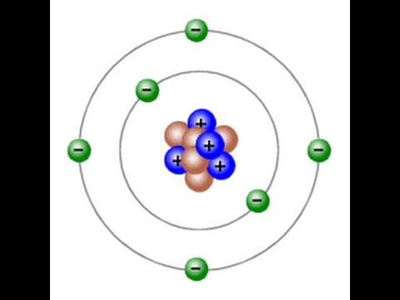
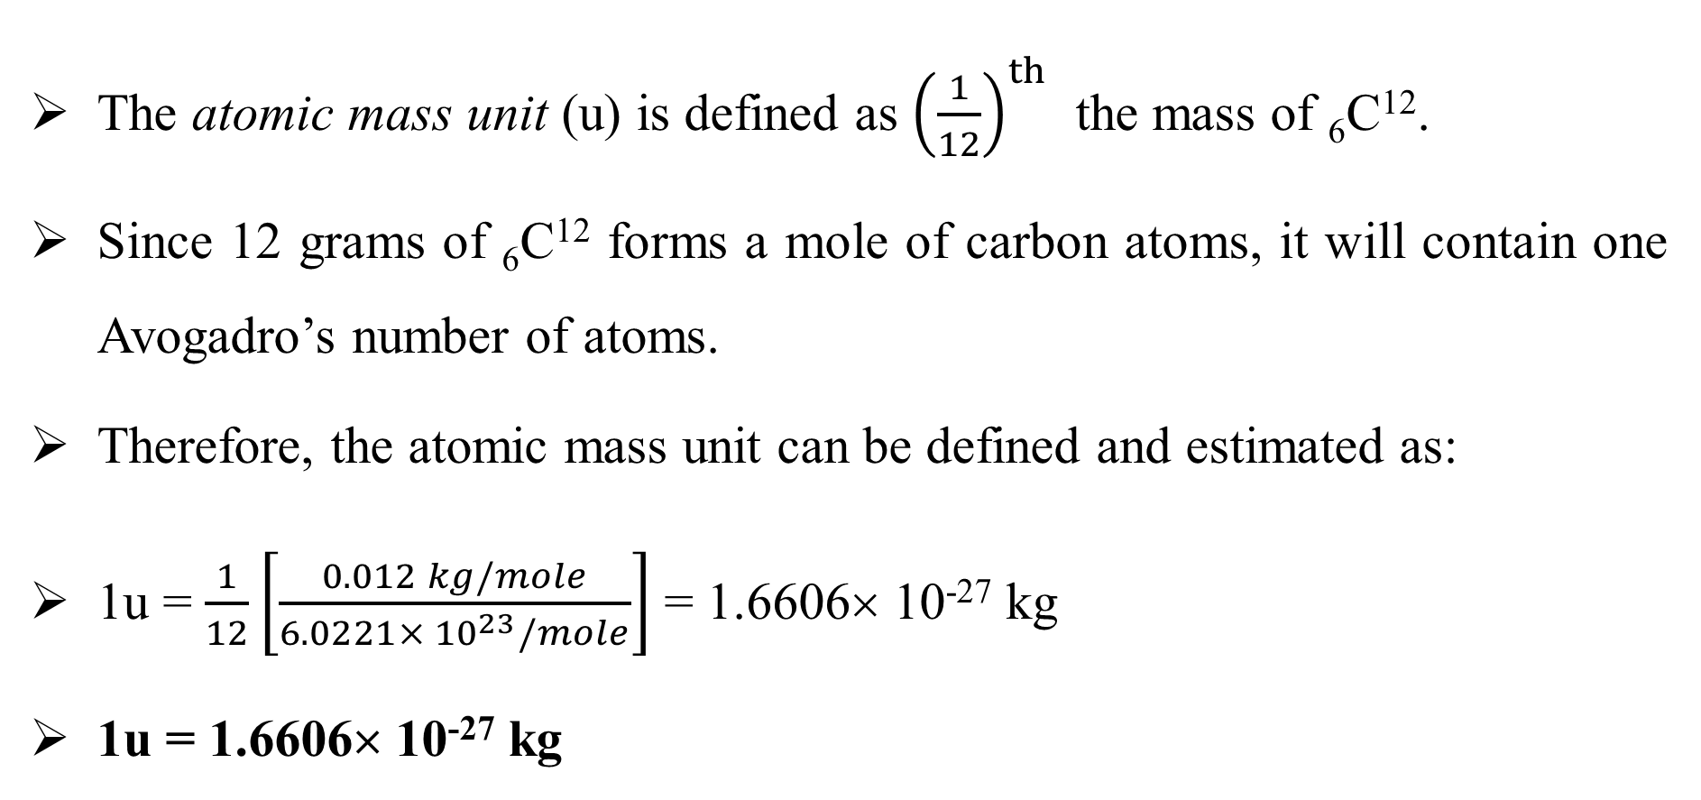
The atomic mass unit (u) is defined as ${\left(\frac{1}{12}\right)}^{th}$ the mass of ₆C¹².
Since 12 grams of ₆C¹² forms a mole of carbon atoms, it will contain one Avogadro’s number of atoms.
Therefore, the atomic mass unit can be defined and estimated as:
1u = $\frac{1}{12}\left[\frac{0.012 kg/mole}{6.0221× {10}^{23}/mole}\right]$ = 1.6606× 10⁻²⁷ kg
1u = 1.6606× 10⁻²⁷ kg
1u =
12

Slide 12
We have fixed that the atomic mass of ¹²C as 12 AMU = 1.660538921×10⁻²⁷ kg.
But, when we say atomic mass of carbon in general, it contains 2 isotopes of carbon.
Therefore, we take the weighted average of the isotopes of carbon in its natural form.
Let us calculate it:
The mass of ¹²C is 12 amu. Mass of ¹³C is 13.003355 amu. The natural abundance of ¹³C is 1.11%, and the natural abundance of ¹²C is 98.89%.

Slide 13
The mass of ¹²C is 12 amu. Mass of ¹³C is 13.003355 amu. The natural abundance of ¹³C is 1.11%, and the natural abundance of ¹²C is 98.89%.
The average atomic mass of Carbon is the weighted average of the masses of the two most abundant isotopes.
Therefore, average mass C = (0.9889 x 12 u) + (0.0111 x 13.00335) u
= 11.8668 + 0.144337
= 12.011137185
= 12.01 u
Therefore, average atomic mass of carbon is 12.01 amu

Slide 14
Example:
Determine the average atomic mass of oxygen using the following data:
Isotope Mass (amu) Abundance (%)
¹⁶O 15.99491 99.759
¹⁷O 16.99913 0.037
¹⁸O 17.99916 0.204
The average mass of O = (15.99491×0.99759) + (16.99913×0.00037) + (17.99916×0.00204)
= 15.956 + 0.0063 + 0.0367
= 15.999 amu

Slide 15
Using this principle, we can also evaluate the natural abundance of nuclei
Once we have the precise masses of two isotopes of a specific species, we can determine the nuclear abundance of the isotopes!!

Slide 16
Copper has two isotopes ⁶³Cu and ⁶⁵Cu. The atomic mass of copper is 63.54amu. If the atomic masses of ⁶³Cu and ⁶⁵Cu are 62.9296 and 64.9278 amu respectively, what is the natural abundance of each isotope?
Isotope Mass (amu) Abundance (%)
⁶³Cu 62.9296 x
⁶⁵Cu 64.9278 y
Here x and y are the abundance of isotopes. Evidently, x + y = 100% = 1
Further, mass of Cu = 63.54 = (62.9296× x) + (64.9278×y)
= (62.9296× x) + (64.9278×(1-x)) = 64.9278 + x (62.9296-64.9278)
= 64.9278 – x 1.9982
Solving for x , we get x = 0.6945 and hence y = 0.3055
Therefore, the natural abundance of ⁶³Cu and ⁶⁵Cu are 69.45% and 30.55% respectively.

Slide 17
Experimental methods to determine the mass of subatomic particles
We have defined a unit to represent the mass of atoms and subatomic particles
How to determine the mass experimentally?
Experimental determination of mass of atoms and subatomic particles is a vital part of experimental physics.
Several methods are there to experimentally measure the masses of subatomic particles with varying degrees of precision.
All methods are designed to determine the mass indirectly as in all other properties of microparticles.

Slide 18
Following are some of the most important experimental methods for estimating the mass of atoms and subatomic particles.
Among several methods, mass spectrometry is the most general experimental tool.
Various properties of the particles are utilised to determine their mass experimentally.

Slide 19
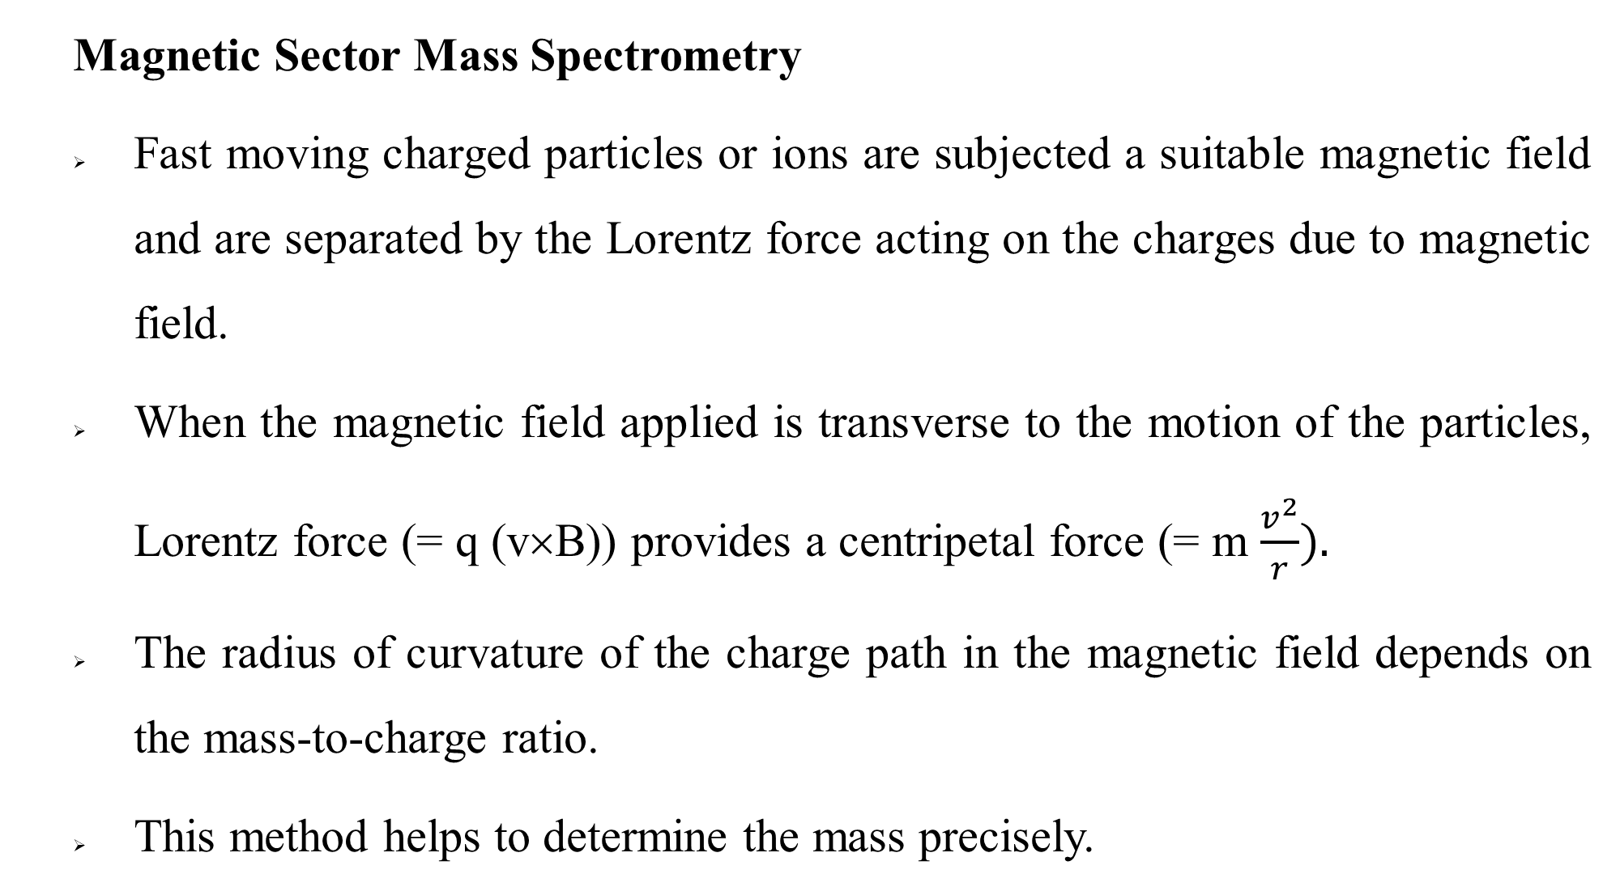
  Magnetic Sector Mass Spectrometry
  Fast moving charged particles or ions are subjected a suitable magnetic field and are separated by the Lorentz force acting on the charges due to magnetic field.
  When the magnetic field applied is transverse to the motion of the particles, Lorentz force (= q (v×B)) provides a centripetal force (= m $\frac{v^{2}}{r}).$
  The radius of curvature of the charge path in the magnetic field depends on the mass-to-charge ratio.
  This method helps to determine the mass precisely.

Slide 20
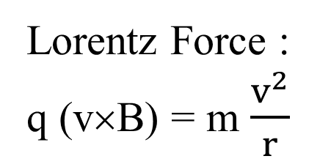
Magnetic sector
Lorentz Force :
q (v×B) = m $\frac{v^{2}}{r}$
Ion source
Ion accelerators
Particle detector

Slide 21
  Time-of-Flight Mass Spectrometry:
  Charged particles or ions accelerated using a known electrostatic field.
  The electrostatic field applied helps us to calculate the energy imparted to the particle.
  Measuring the time of flight of the particles between electrodes, mass-to-charge ratio of the charges can be determined.
electrostatic field

Slide 22
  Quadrupole Mass Spectrometry:
  The method also works with the principle of selecting ions based on their mass to charge ratio (m/q).
  Each of the two opposing rods are applied with equal potential (DC) superimposed with a high-frequency oscillating voltage.
  The voltages applied induce transverse oscillations to the ions traversing between the rods.
  The amplitudes of almost all oscillations intensify so that ultimately the ions will make contact with the rods.

Slide 23


  Quadrupole Mass Spectrometry:
Ions with a specific ratio of mass to charge (m/q) is in the resonance condition which allows passage through the system.
Ion beam
Selected ions
Atoms / molecules
-
+
+
-
source
Quadrupole ion analyser
Electron impact ionizer
Detector

Slide 24
  Penning Trap Mass Spectrometry:
  Penning trap method is a precise experimental technique used to measure the mass of charged particles, namely atomic ions or subatomic particles.
  It operates based on the principles of electromagnetic trapping and the measurement of the oscillations of these trapped particles.
  The applied electric field provides axial confinement (along the trap's central axis), while the simultaneously applied magnetic field confines the charged particles radially (perpendicular to the central axis).
  When a charged particle enters the trap, it orbits around the central axis of the trap, with a frequency that depends on its charge-to-mass ratio.

Slide 25
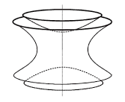
Penning Trap
V
Magnetron motion
Cyclotron motion
B

Slide 26
This frequency is called the cyclotron frequency.
The trapped particle's cyclotron frequency is measured by applying an oscillating electric field to the trap.
This oscillating field imparts energy to the trapped particle, causing it to move in response.
By carefully tuning the frequency of the applied electric field, we can drive the particle's motion at the cyclotron frequency.
The mass of the trapped particle can be determined from its cyclotron frequency and the known values of the charge of the particle and the strength of the magnetic field.

Slide 27
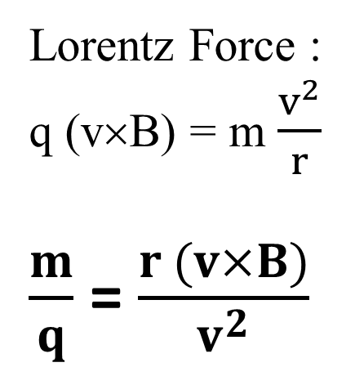
Cyclotron and Linear Accelerators:
Particle accelerators like cyclotron and linear accelerators can determine the mass-to-charge ratio of ions by accelerating them to known velocities and measuring their trajectories in magnetic fields.
This information can be used to calculate the mass.
Lorentz Force :
q (v×B) = m $\frac{v^{2}}{r}$
$\frac{m}{q}$ = $\frac{r (v×B)}{v^{2}}$
Ions from accelerators
Accelerator

Slide 28
Beta Spectroscopy:
This method is exclusively for the determination of the mass of electrons.
It involves measuring the energy spectrum of electrons emitted during beta decay processes.
The shape of the spectrum is related to the electron mass.

Slide 29
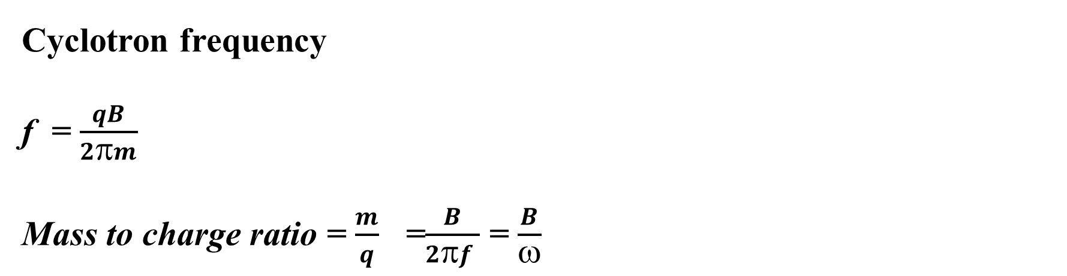
Electron Mass Spectrometry:
Here, the mass of electrons is determined by measuring their cyclotron frequency in a magnetic field.
The mass-to-charge ratio of electrons is calculated from this frequency.
Cyclotron frequency
f = $\frac{qB}{2πm}$
Mass to charge ratio = $\frac{m}{q}$ =$\frac{B}{2πf }$ = $\frac{B}{ω}$

Slide 30
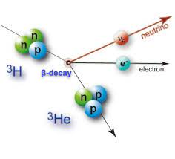
n
ν
Neutrino
n
p
e
₁H³
β⁻ decay
Electron
n
p
Neutrino Mass Measurements
Neutrino is an extremely light particle.
Therefore, detection of neutrino directly is very difficult.
Tritium beta decay experiments is used to measure the electron's energy spectrum to infer the neutrino mass through the conservation of energy and momentum.
p
₂He³

Slide 31
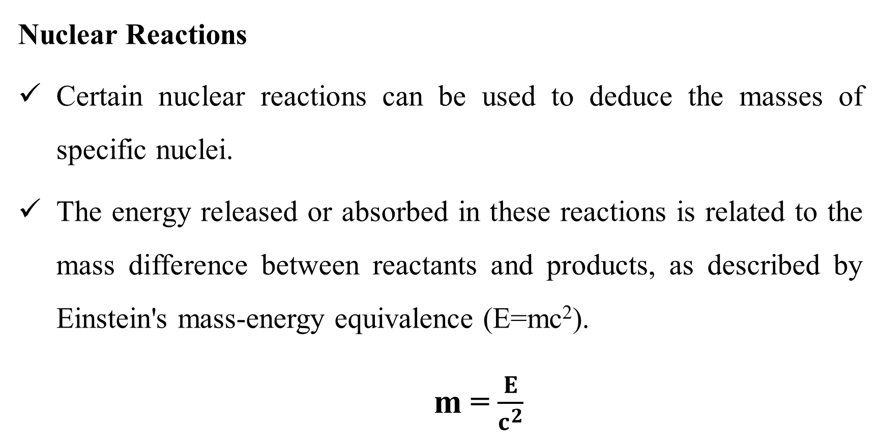
Nuclear Reactions
Certain nuclear reactions can be used to deduce the masses of specific nuclei.
The energy released or absorbed in these reactions is related to the mass difference between reactants and products, as described by Einstein's mass-energy equivalence (E=mc²).
m = $\frac{E}{c^{2}}$

Slide 32
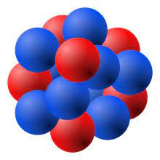
Muon and Electron Scattering
By scattering electrons or muons off atomic nuclei, researchers can obtain information about nuclear masses
The experimental methods describe vary in their precision and applicability to different particles
At the same time they allow scientists to determine the masses of atoms and subatomic particles with remarkable accuracy.

Slide 33
Relation between amu and MeV.
In modern Physics, the principle of mass energy equivalence says that mass has an equivalent amount of energy and vice – versa or they are interconvertible but this process is difficult to take place.
The principle reasons that mass is concentrated energy.
Energy can be released through the process matter antimatter annihilation.
Since the amount of energy associated with matter is tremendous, subatomic (nuclear) reactions release great amount of energy as compared with chemical reactions.

Slide 34
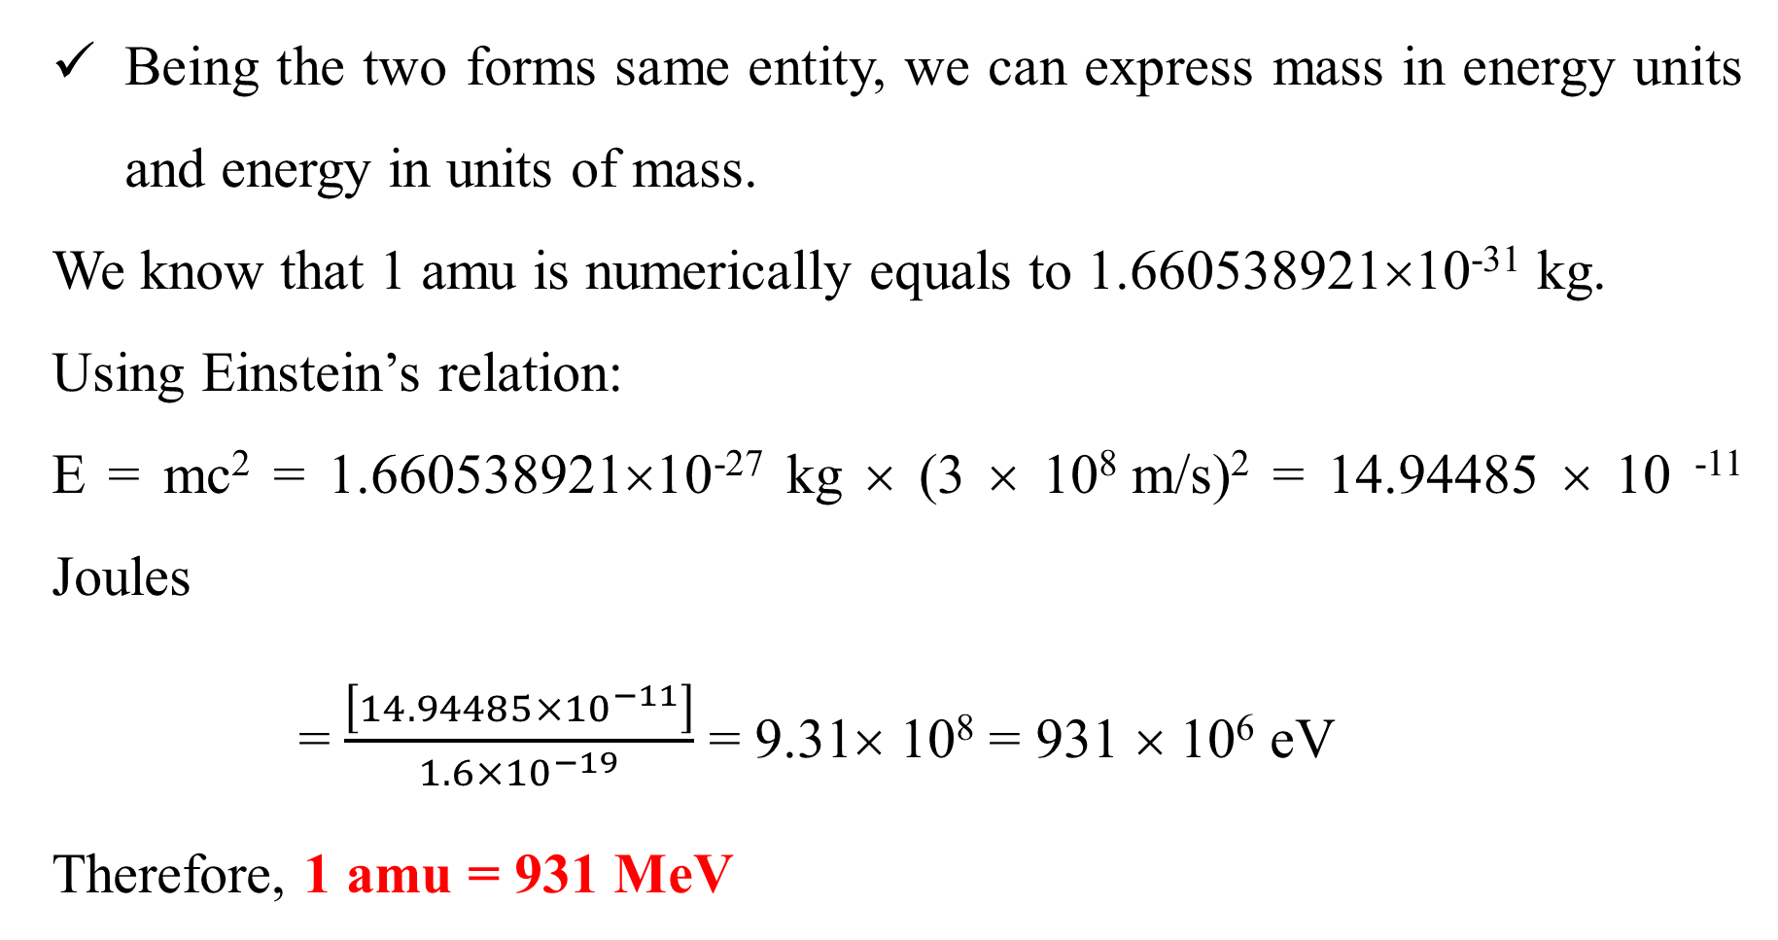
Being the two forms same entity, we can express mass in energy units and energy in units of mass.
We know that 1 amu is numerically equals to 1.660538921×10⁻³¹ kg.
Using Einstein’s relation:
E = mc² = 1.660538921×10⁻²⁷ kg × (3 × 10⁸ m/s)² = 14.94485 × 10 ⁻¹¹ Joules
= $\frac{\left[14.94485×{10}^{−11}\right]}{1.6×{10}^{−19}}$ = 9.31× 10⁸ = 931 × 10⁶ eV
Therefore, 1 amu = 931 MeV

Slide 35
Numerical Problems

Slide 36
Problem 1 Determine the average atomic mass of oxygen using the following data:
Isotope Mass (amu) Abundance (%)
₈O¹⁶ 15.99491 99.759
₈O¹⁷ 16.99913 0.037
₈O¹⁸ 17.99916 0.204
The average mass of O = (15.99491×0.99759) + (16.99913×0.00037) + (17.99916×0.00204)
= 15.956 + 0.0063 + 0.0367
= 15.999 u

Slide 37
Problem 2 Copper has two isotopes ₂₉Cu⁶³ and ₂₉Cu⁶⁵. The atomic mass of copper is 63.54amu. If the atomic masses of ₂₉Cu⁶³ and ₂₉Cu⁶⁵ are 62.9296 and 64.9278 amu respectively, what is the natural abundance of each isotope?
Isotope Mass (amu) Abundance (%)
₂₉Cu⁶³ 62.9296 x
₂₉Cu⁶⁵ 64.9278 y
Here x and y are the abundance of isotopes. Evidently, x + y = 100% = 1

Slide 38
Further, mass of Cu = 63.54 = (62.9296× x) + (64.9278×y)
= (62.9296× x) + (64.9278×(1-x))
= 64.9278 + x (62.9296-64.9278)
= 64.9278 – x 1.9982
Solving for x , we get x = 0.6945 and hence y = 0.3055
Therefore, the natural abundance of ₂₉Cu⁶³ and ₂₉Cu⁶⁵ are :
69.45% and 30.55% respectively.

Slide 39
Thank You

