Slide 1
Atomic and Nuclear Physics
Week #3
Atomic constituents, atomic models & hydrogen spectrum
Lecturer: Jojo Panakal John
Professor of Applied Physics
Papua New Guinea University of Technology

Slide 2
Over the slides
Atomic nuclear constituents
Plum pudding model of atom
Rutherford’s gold foil experiment
Origin of atomic spectra
Hydrogen spectrum

Slide 3
Atom – a brief history
Concept of indivisible ‘atom’ by Greek Philosophers (5th century BC) like Democritus –
Purely philosophical notion with no experimental evidence.
Idea of element – each element characterized by unique ‘Atom’ with specific masses (early 19th century) by John Dalton
Provided more scientific basis.
This theory laid the groundwork for modern atomic theory.

Slide 4
Discovery of Subatomic Particles (late 19th century) J.J. Thomson discovered the electron in 1897
Demonstrated that atoms are divisible
Put forward "plum pudding" model of the atom.
Nuclear Model (early 20th century) by Ernest Rutherford's famous gold foil experiment in 1909
Experimental confirmation for the nuclear model of the atom, with electrons orbiting the nucleus.

Slide 5
Quantum model of atom (1913) by Niels Bohr
Electrons move in discrete energy levels or orbits around the nucleus and can jump between these levels by emitting or absorbing energy in the form of photons.
This model explained the spectral lines of hydrogen and laid the foundation for quantum mechanics.
Neutrons were discovered (1932) by Chadwick while alpha particle interaction with Beryllium nucleus

Slide 6
Building blocks of atoms
Protons :
Charge : Positive
Mass ≈ 1 amu
Number of protons (or electrons) determines the chemical element –
The number is atomic number of the atom
+
Neutrons:
Charge : Nil
Mass ≈ 1 amu
Number of protons + neutrons determines the mass number
electrons :
Charge : Negative
Mass ≈ (1/1836) amu
Number of electrons ( or protons) determines the chemical element
-

Slide 7
Nucleus
10⁻¹⁰ meters
10⁻¹⁵ meters
Atom
Size of Atoms is a few angstrom (Å) 10⁻¹⁰ meters.
Size of Nucleus is a few femtometer (fm) 10⁻¹⁵ meters.

Slide 8
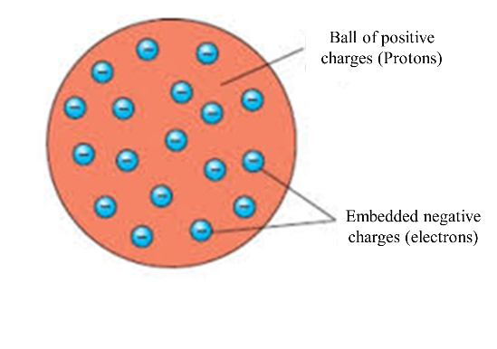
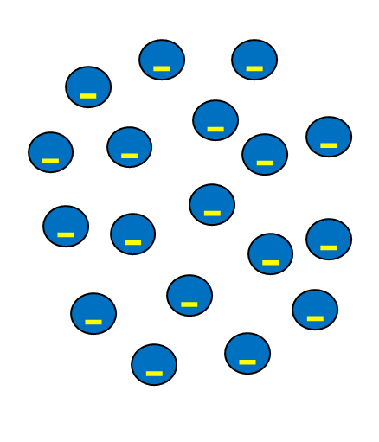
Plum pudding model of atom
Electrons embedded on the cloud of protons
J. J. Thompson’s atom model
Plum pudding model

Slide 9
Plum pudding model is built up with reason that atom is neutral
No evidence for clustering of positive or negative charges
No idea of free space within the atom
No other experimental evidence was available to refute the concept of ‘Plum pudding’ model
Rutherford’s plan was to verify these facts experimentally

Slide 10
The experiment was conducted by Ernest Rutherford in 1909 at the University of Manchester.
The prevailing model at that time was the Thomson model, suggesting that the atom was a "plum pudding" with positive charge spread evenly throughout.
Rutherford's experiment aimed to test this model and investigate the nature of the atomic structure.

Slide 11
Experimental Setup
Rutherford's team used a beam of alpha particles emitted from a radioactive source (uranium or radium).
The alpha particles were directed towards a thin gold foil.
Around the gold foil, they placed a circular fluorescent zinc sulfide screen to detect the scattered alpha particles.
According to Thomson's model, most alpha particles should pass through the gold foil with only minor deflections.
This is because the positive charge was believed to be spread uniformly throughout the atom.

Slide 12
Alpha detector
Alpha particle collimator
Undeflected beam
Small angle scattering
Alpha particle source
Gold foil
Large angle scattering
Wide angle scattering

Slide 13
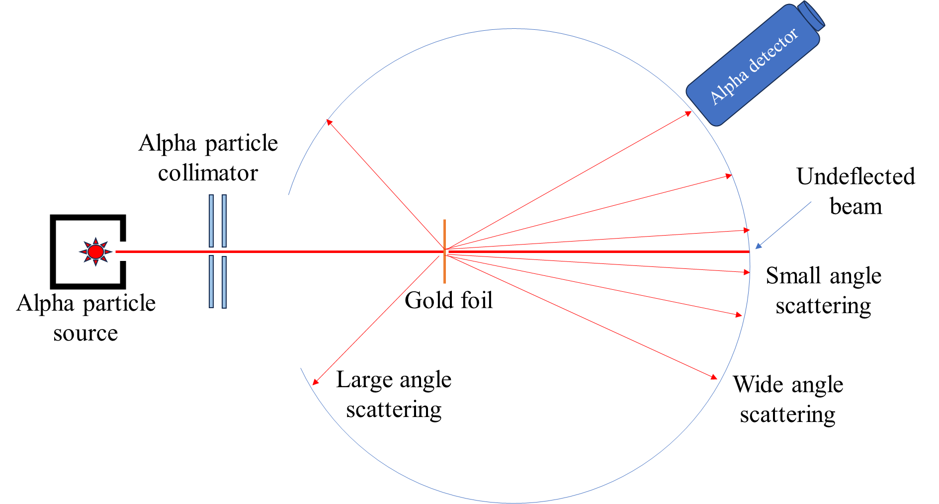
Rutherford expected only small angle scatterings from the gold foil, as the interaction would be purely week electrostatic.

Slide 14
What Rutherford expected
(from plum-pudding model)
Alpha particle collimator
Alpha detector
Small angle scattering
Alpha particle source
Gold foil

Slide 15
What Rutherford observed from experiment
Alpha detector
Alpha particle collimator
Undeflected beam
Small angle scattering
Alpha particle source
Gold foil
Large angle scattering
Wide angle scattering

Slide 16
Surprising Observations
The majority of alpha particles passed through the gold foil with little or no deflection.
However, a small fraction of alpha particles experienced large-angle deflections or even bounced back in the opposite direction.

Slide 17
Rutherford's Interpretation
Rutherford concluded that the alpha particles' deflections were due to a concentrated positive charge in the atom's center, which he called the "nucleus.“
He proposed that the nucleus was tiny compared to the entire atom's size.
This discovery led to the development of the nuclear model of the atom.

Slide 18

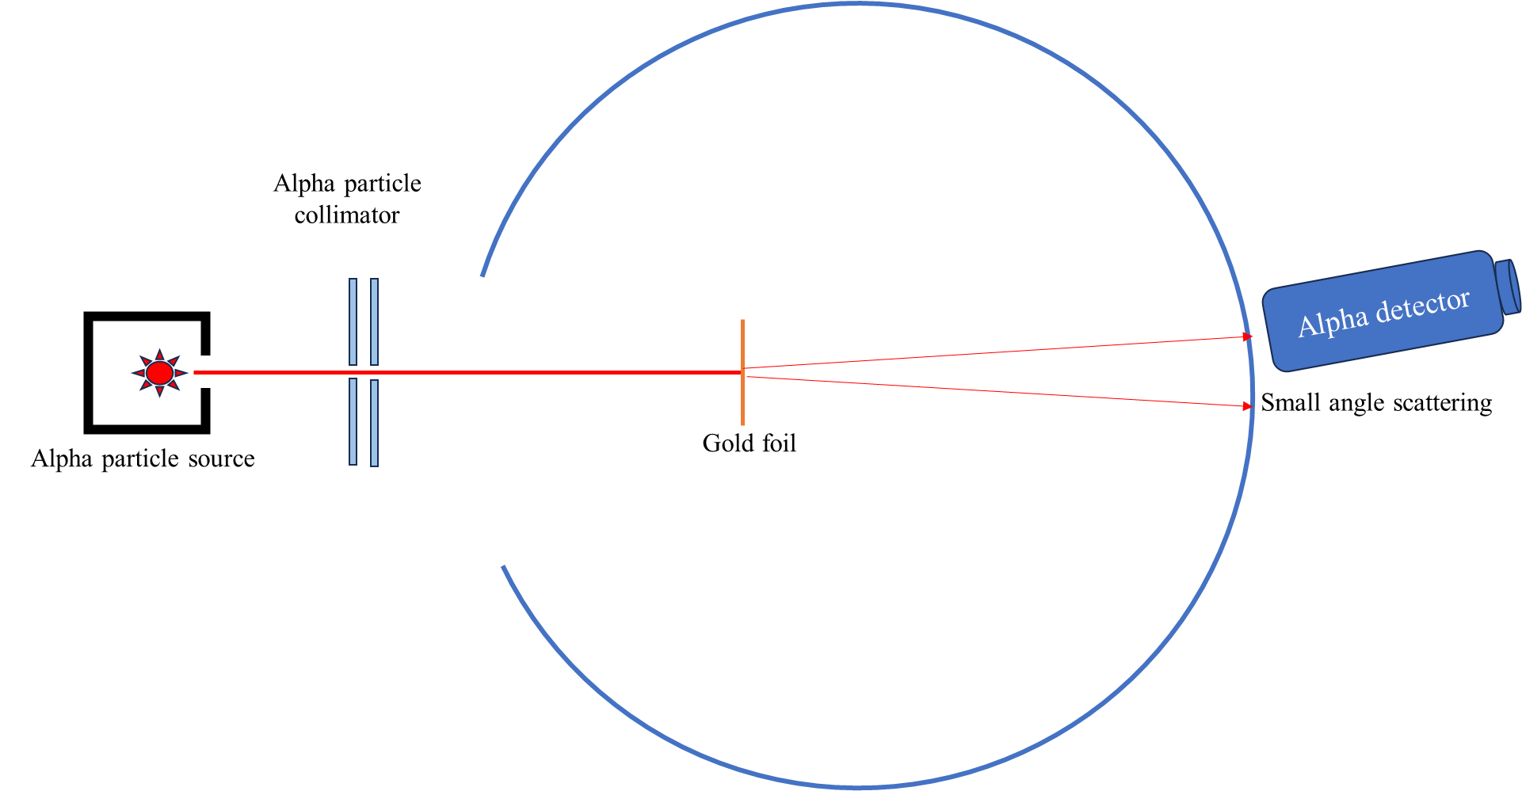
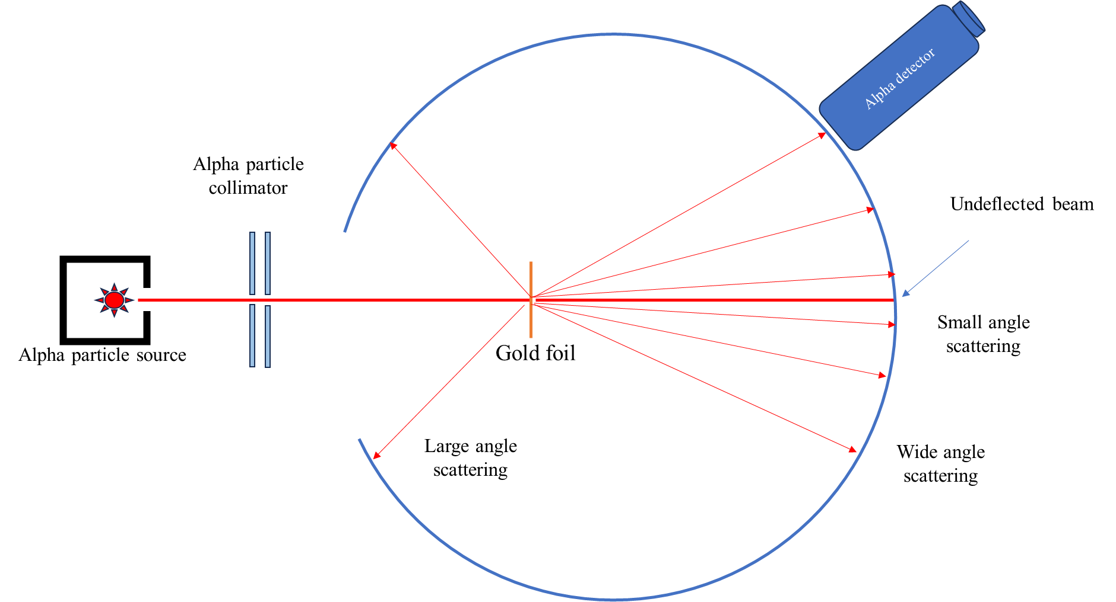
Plum pudding Model
Rutherford model
Expected result
Observed result

Slide 19
Conclusions from the experiment
The results of this experiment were not in agreement with the plum-pudding model of the atom as suggested by Thomson.
Since large number of alpha particles were passed un deflected, he concluded that a good amount of atom is empty.
For alpha particles to be deflected back, there should be a positively charged region producing large repelling force. Therefore, he concluded that the positive charges of the atom are concentrated in the centre.
He then suggested the ‘nuclear model of an atom’ wherein the entire positive charge and most of the mass of the atom is concentrated in the nucleus.

Slide 20
5. The alpha particles were deflected or scattered through a large angle on coming close to the nucleus.
6. Also, the electrons having negligible mass, do not affect the trajectory of these incident alpha particles.
7. Also, the electrons are moving in orbits around the nucleus similar to the planets and the sun.
8. Finally, from his experimental data, Rutherford concluded that the size of the nucleus is between 10⁻¹⁵ and 10⁻¹⁴m.

Slide 21
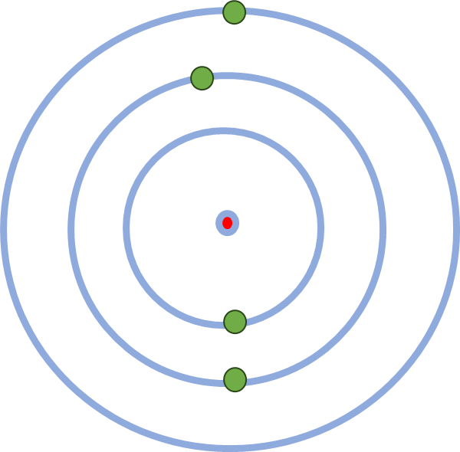
Atomic
spectra
When a substance absorbs energy and radiates, it occurs in the form of a spectrum
Absorption of photon by electrons
Emission of photon by electrons
Incoming photon
Incoming photon

Slide 22
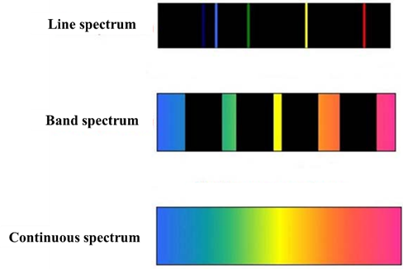
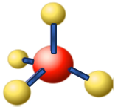
When atoms and molecules absorb energy from a source, they become excited and re-emit the absorbed energy in a very short period of time (typically in 10⁻⁸s).
The spectrum of emitted light is called emission spectrum.
Depending on the emitting substance medium, there can be line, band or continuous
Atomic system (Hydrogen) - line spectrum
Specific wave lengths will be seen as coloured lines.
For a molecular system (Benzene)
Emitted spectrum - broader lines - bands.
A hot cloud or incandescent lamp
Continuous display of colours - continuous spectrum is produced.

Slide 23
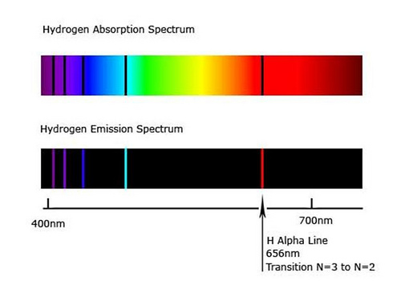

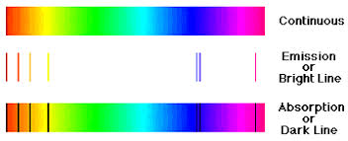
Emission & Absorption Spectra
Hydrogen Absorption Spectra
Dark lines
Hydrogen
Hydrogen Emission Spectra
Coloured lines
Hydrogen
Continuous
Emission
Absorption
400 nm
700 nm
656 nm
Hα line of Balmer series

Slide 24




Light source
Dispersing medium
Continuous spectrum
Emission source
Emission spectrum
Light source
Absorbing medium
Absorption spectrum

Slide 25
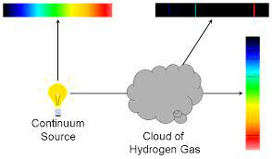
Continuous spectrum
Emission spectrum
Emission from hydrogen
Absorption
by
hydrogen
Absorption
spectrum
Continuum Source of light
Hydrogen gas

Slide 26

Sun
Absorption spectrum
Intensity
Continuous spectrum
Emission spectrum
Wave length
Intensity
Intensity
Wave length
Wave length

Slide 27
Hydrogen Spectrum
1.The electron in a hydrogen atom travels around the nucleus in a circular orbit.
2.The energy of the electron in an orbit is proportional to its distance from the nucleus.
3.Only a limited number of orbits with certain energies are allowed. In other words, the orbits are quantized.
4.The orbits that are allowed are those for which the angular momentum of the electron is an integral multiple of Planck's constant divided by 2π.
5.Light is absorbed when an atomic electron excites to a higher energy orbit and emitted when an electron de-excite to a lower energy orbit.
6.The energy of the light emitted or absorbed is exactly equal to the difference between the energies of the orbits.

Slide 28
Bohr theory and the hydrogen spectrum.
E₂
E₂
Emission
E₁
E₁
Absorption
Eo
Eo
hν = E₂-E₁
hν = E₂-E_{o}

Slide 29
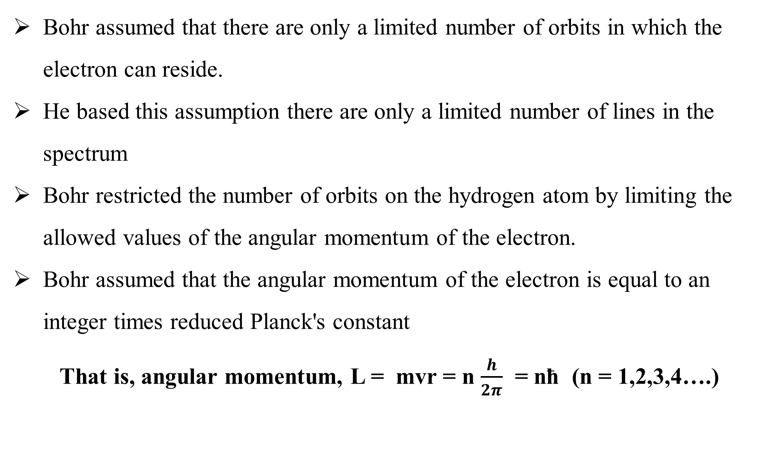
Bohr assumed that there are only a limited number of orbits in which the electron can reside.
He based this assumption there are only a limited number of lines in the spectrum
Bohr restricted the number of orbits on the hydrogen atom by limiting the allowed values of the angular momentum of the electron.
Bohr assumed that the angular momentum of the electron is equal to an integer times reduced Planck's constant
That is, angular momentum, L = mvr = n $\frac{h}{2π}$ = nħ (n = 1,2,3,4….)

Slide 30
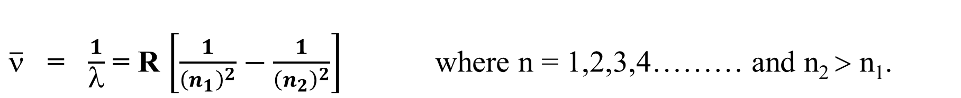
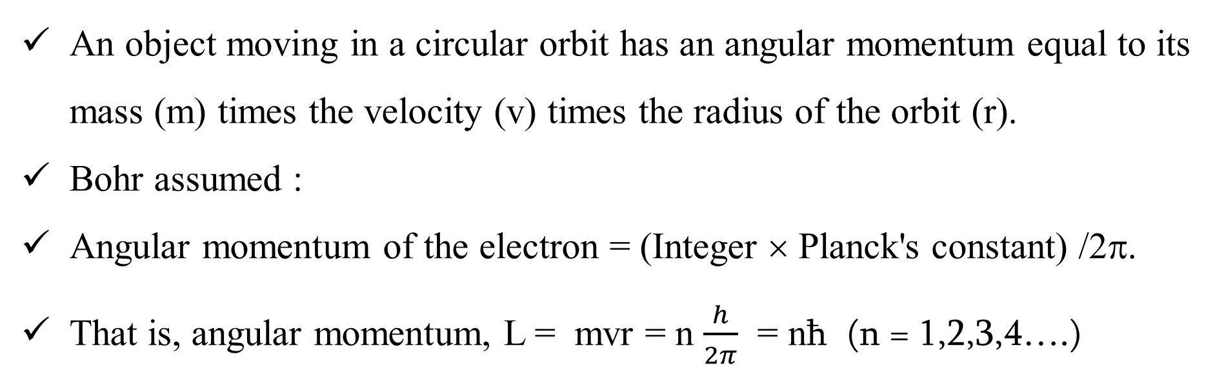
An object moving in a circular orbit has an angular momentum equal to its mass (m) times the velocity (v) times the radius of the orbit (r).
Bohr assumed :
Angular momentum of the electron = (Integer × Planck's constant) /2π.
That is, angular momentum, L = mvr = n $\frac{h}{2π}$ = nħ (n = 1,2,3,4….)
Rydberg (1890) found that all the lines of the atomic hydrogen spectrum could be fitted to a simple empirical formula:
$\overline{ν}$ = $\frac{1}{λ}$ = R $\left[\frac{1}{{\left(n_{1}\right)}^{2}}−\frac{1}{{\left(n_{2}\right)}^{2}}\right]$ where n = 1,2,3,4……… and n₂ > n₁.
R is the Rydberg constant =109,677 cm⁻¹ = 1.09×10⁷ m⁻¹.

Slide 31
Excited state
Hγ
Hβ
Excited state
Hα
Excited state
n=1
n=2
n=3
n=4
n=5
Excited state
Ground state
Lyman series
Ultra violet

Slide 32
Excited state
Excited state
n=5
Excited state
n=1
n=2
n=3
n=4
Excited state
Ground state
Balmer series
Visible / Ultraviolet

Slide 33
Excited state
Excited state
n=6
Excited state
n=1
n=2
n=3
n=4
n=5
Excited state
Excited state
Ground state
Near IR
Paschen series

Slide 34
n = α
n =7
n =6
n =5
n =4
n =3
n =2
n =1
90-120 nm
360-660 nm
820-1900 nm
1500-4050 nm
2200-7500 nm
λ
Lyman
Ultraviolet
10-400 nm
Balmer
Visible
400-700nm
Paschen
Near IR
750-2500 nm
Brackett
Far IR
Pfund
Far IR
3000-10000 nm

Slide 35
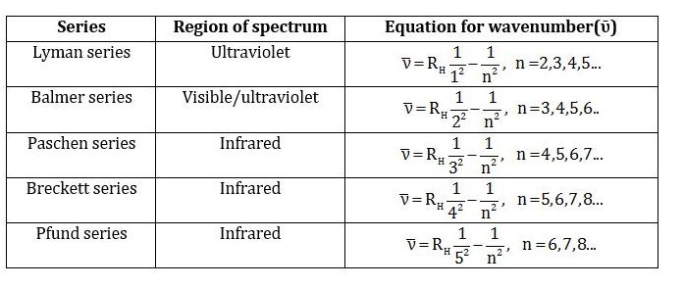
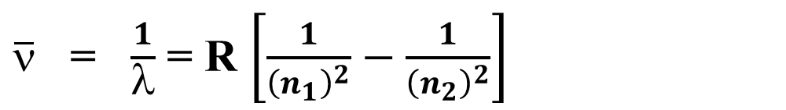
$\overline{ν}$ = $\frac{1}{λ}$ = R $\left[\frac{1}{{\left(n_{1}\right)}^{2}}−\frac{1}{{\left(n_{2}\right)}^{2}}\right]$

Slide 36
Numerical problems

Slide 37
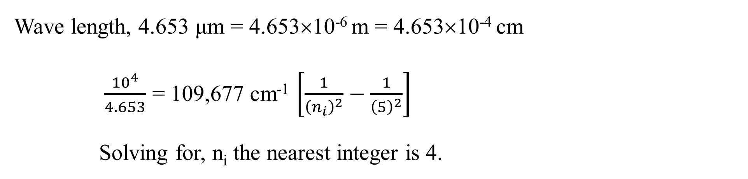
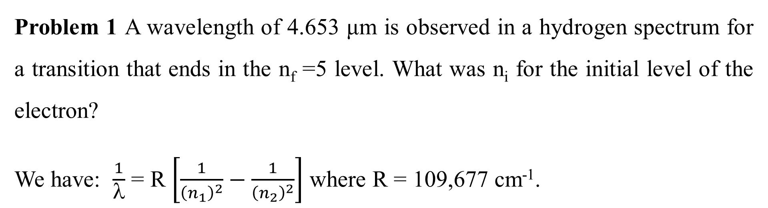
Problem 1 A wavelength of 4.653 μm is observed in a hydrogen spectrum for a transition that ends in the n_{f} =5 level. What was n_{i} for the initial level of the electron?
We have: $\frac{1}{λ}$ = R $\left[\frac{1}{{\left(n_{1}\right)}^{2}}−\frac{1}{{\left(n_{2}\right)}^{2}}\right]$ where R = 109,677 cm⁻¹.
Wave length, 4.653 μm = 4.653×10⁻⁶ m = 4.653×10⁻⁴ cm
$\frac{{10}^{4}}{4.653}$ = 109,677 cm⁻¹ $\left[\frac{1}{{\left(n_{i}\right)}^{2}}−\frac{1}{{\left(5\right)}^{2}}\right]$
Solving for, n_{i} the nearest integer is 4.

Slide 38
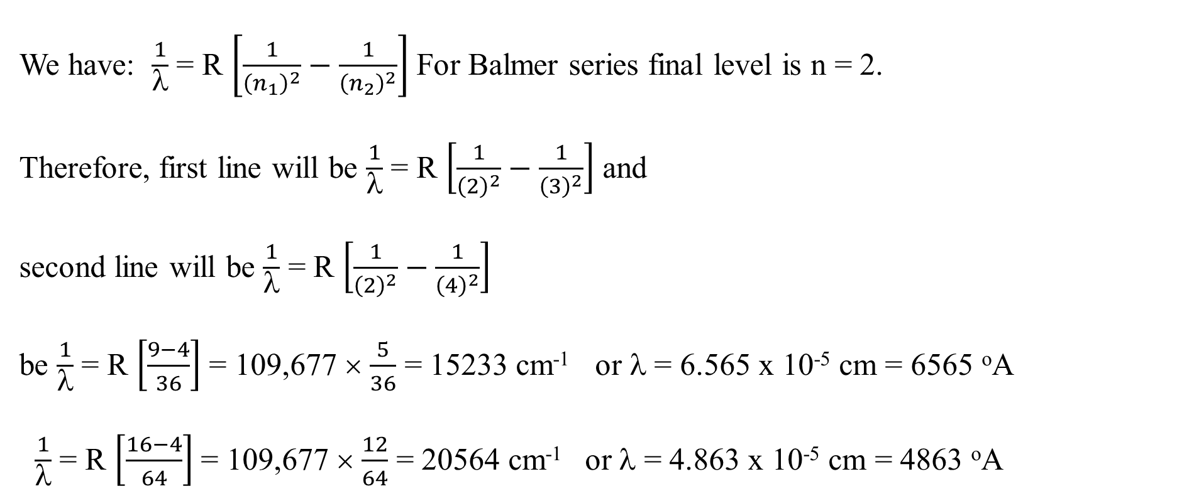
Problem 2. Calculate the wave lengths of first two lines of Balmer series in H spectrum?
We have: $\frac{1}{λ}$ = R $\left[\frac{1}{{\left(n_{1}\right)}^{2}}−\frac{1}{{\left(n_{2}\right)}^{2}}\right]$ For Balmer series final level is n = 2.
Therefore, first line will be $\frac{1}{λ}$ = R $\left[\frac{1}{{\left(2\right)}^{2}}−\frac{1}{{\left(3\right)}^{2}}\right]$ and
second line will be $\frac{1}{λ}$ = R $\left[\frac{1}{{\left(2\right)}^{2}}−\frac{1}{{\left(4\right)}^{2}}\right]$
be $\frac{1}{λ}$ = R $\left[\frac{9−4}{36}\right]$ = 109,677 × $\frac{5}{36}$ = 15233 cm⁻¹ or λ = 6.565 x 10⁻⁵ cm = 6565 ºA
$\frac{1}{λ}$ = R $\left[\frac{16−4}{64}\right]$ = 109,677 × $\frac{12}{64}$ = 20564 cm⁻¹ or λ = 4.863 x 10⁻⁵ cm = 4863 ºA

Slide 39
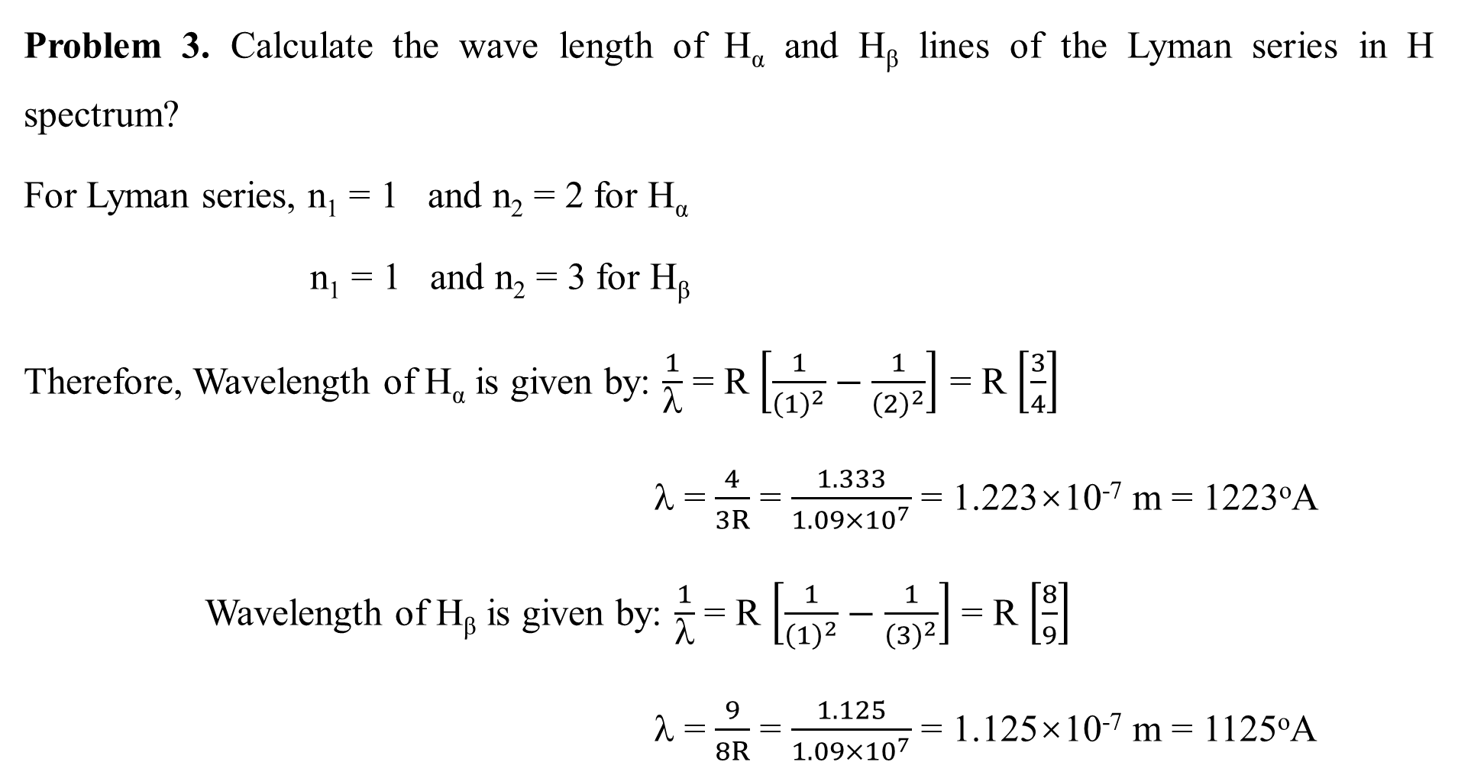
Problem 3. Calculate the wave length of H_{α} and H_{β} lines of the Lyman series in H spectrum?
For Lyman series, n₁ = 1 and n₂ = 2 for H_{α}
n₁ = 1 and n₂ = 3 for H_{β}
Therefore, Wavelength of H_{α} is given by: $\frac{1}{λ}$ = R $\left[\frac{1}{{\left(1\right)}^{2}}−\frac{1}{{\left(2\right)}^{2}}\right]$ = R $\left[\frac{3}{4}\right]$
λ = $\frac{4}{3R}$ = $\frac{1.333}{1.09×{10}^{7}}$ = 1.223×10⁻⁷ m = 1223ºA
Wavelength of H_{β} is given by: $\frac{1}{λ}$ = R $\left[\frac{1}{{\left(1\right)}^{2}}−\frac{1}{{\left(3\right)}^{2}}\right]$ = R $\left[\frac{8}{9}\right]$
λ = $\frac{9}{8R}$ = $\frac{1.125}{1.09×{10}^{7}}$ = 1.125×10⁻⁷ m = 1125ºA

Slide 40
Thank you

