Slide 1
Atomic and Nuclear Physics
Week #4
X-rays- nature, production and uses
Lecturer: Jojo Panakal John
Professor of Applied Physics
Papua New Guinea University of Technology

Slide 2

Contents
What are x-rays?
Properties of x-rays
Production of x-rays
X-ray diffraction
Moseley's work on x-rays
Compton scattering

Slide 3
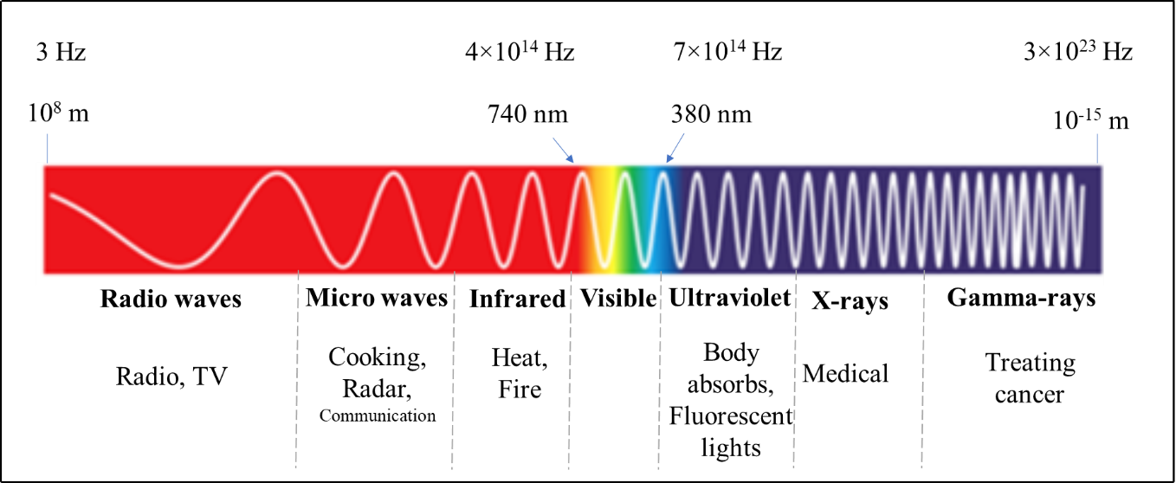
Electromagnetic spectrum
10⁻⁸ - 10⁻¹² m
10¹⁶ - 10²⁰ Hz

Slide 4
In 1895 Wilhelm Konrad Roentgen found that a highly penetrating radiation of unknown nature was produced when fast electrons impinged on certain matter.
He invented X-rays accidentally while he was testing whether cathode rays could pass through glass.
Properties of X-rays: X-rays are electromagnetic radiations of extremely short wavelength (10⁻⁸ to 10⁻¹² m) and high frequency (10¹⁶ to 10²⁰ Hz).

Slide 5


X rays were found to travel in straight lines
Unaffected by electric and magnetic fields
Pass through opaque materials
Cause phosphorescent substances to glow
Effect photographic plates
X-rays are ionizing radiations.
Velocity = c
E
B
e

Slide 6
When interacting with matter, they are energetic enough to cause neutral atoms to eject electrons and ionize.
When passing through living tissue, X-rays can cause harmful biochemical changes in genes, chromosomes, and other cell components.
The biological effects of ionizing radiation, which are complex and highly dependent on the length and intensity of exposure.
X-ray radiation therapies take advantage of these effects to combat the growth of malignant tumours.

Slide 7
Methods for production of X-rays
There are three common mechanisms for the production of X-rays.
Through the acceleration of a charged particle
Atomic transitions between discrete energy levels
The radioactive decay of some atomic nuclei. Each mechanism leads to a characteristic spectrum of X-ray radiation.

Slide 8
Mechanism of X-ray production
A beam of high-energy electrons impinges on a solid target
They interact with the electrons and nuclei of the target atoms
They are repeatedly deflected and slowed down.
During this abrupt deceleration, the beam of electrons emits bremsstrahlung—a continuous spectrum of electromagnetic radiation.
Radiation produced when rapidly moving electron suddenly decelerated produce bremsstrahlung (“braking radiation”).
Along with the continuous spectrum certain peaks of high intensity are also emitted (Characteristic X-rays).

Slide 9
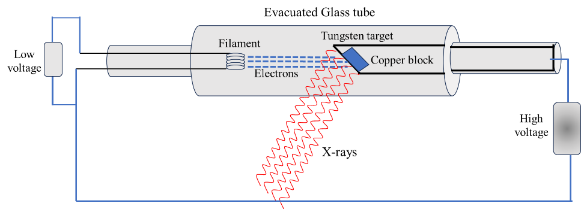
Figure 2 Production of X-rays

Slide 10

Bremsstrahlung Radiation
Retarded
electron
Bremsstrahlung radiation
Electron traveling near a nucleus
Projectile electron
Electron suffers sudden retardation
Nucleus
Bremsstrahlung
radiation

Slide 11
Radiation produced when rapidly moving electron suddenly decelerated produce bremsstrahlung (“braking radiation”).
Energy loss due to bremsstrahlung is more important for electrons than for heavier particles because electrons are more violently decelerated when passing near nuclei in their paths.
Greater energy of an electron and the greater atomic number target nuclei, more energetic will be the bremsstrahlung radiation.

Slide 12
The x-rays produced at a given accelerating potential V has a range of wavelengths
There is a minimum wavelength λ_{min}.
At a particular V, λ_{min} is the same for both the tungsten and molybdenum targets.
(2) Several electrons that strike the target undergo numerous glancing collisions and simply
produce heat.
(This is why the targets must have high melting-point metals such as tungsten)
A few electrons lose their energy in single collisions with target atoms.
This is the energy that becomes x-rays producing peaks as seen in the graph.

Slide 13
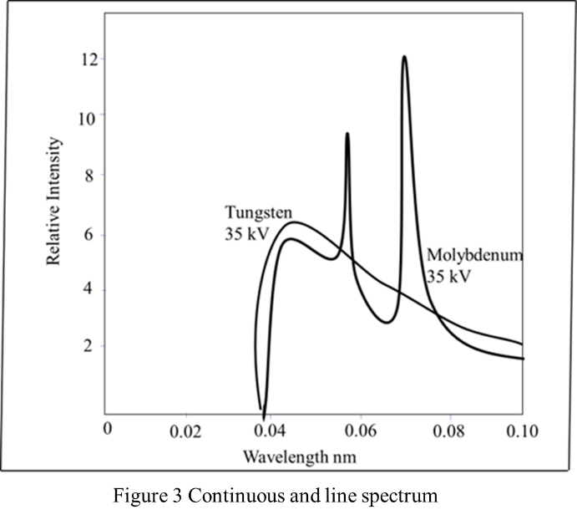

Slide 14
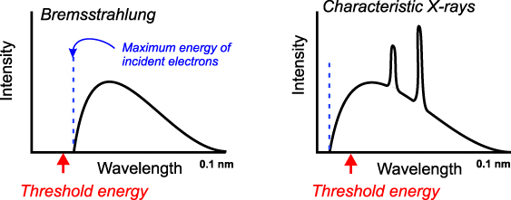
Bremsstrahlung
Characteristic x-rays
Max energy of incident electrons
Intensity
Intensity
Wavelength
Wavelength
Threshold energy
Threshold energy

Slide 15
High intensity peaks occur indicate the enhanced production of x-rays at specific wavelengths.
The peaks differ in wavelengths for each target material
The x-rays produced at a given accelerating potential V vary in wavelength, but none has a wavelength shorter than a certain value λ_{min}.
Increasing V decreases λ_{min}.
At a particular V, λ_{min} is the same for both the tungsten and molybdenum targets.
It was found experimentally that λ_{min} is inversely proportional to V.

Slide 16
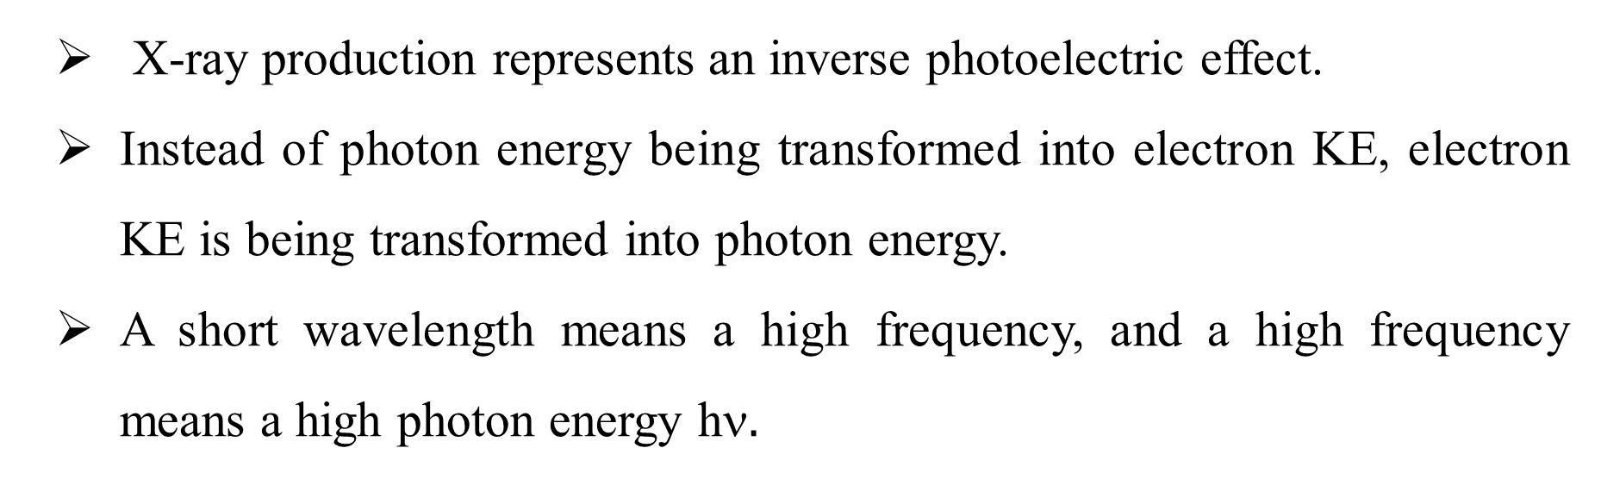
X-ray production represents an inverse photoelectric effect.
Instead of photon energy being transformed into electron KE, electron KE is being transformed into photon energy.
A short wavelength means a high frequency, and a high frequency means a high photon energy h$.$
Since work functions are only a few eVs
whereas the accelerating potentials in x-ray tubes are typically tens or hundreds of thousands of volts,
we can ignore the work function and assume that the entire eV is equal to the kinetic energy.

Slide 17
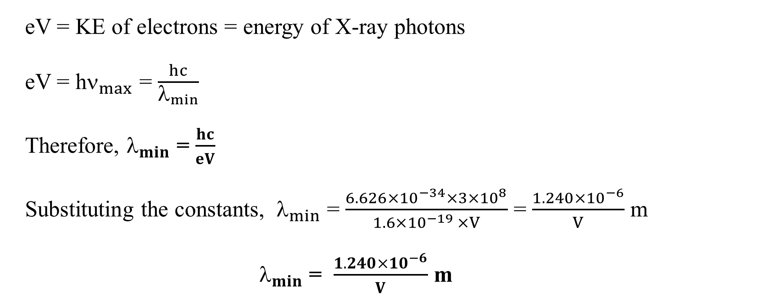
eV = KE of electrons = energy of X-ray photons
eV = h$_{max}$ = $\frac{hc}{λ_{min}}$
Therefore, $_{min}$ = $\frac{hc}{eV}$
Substituting the constants, $_{min}$ = $\frac{6.626×{10}^{−34}×3×{10}^{8}}{1.6×{10}^{−19 }×V}$ = $\frac{1.240×{10}^{−6}}{V}$ m
$_{min}$ = $\frac{1.240×{10}^{−6}}{V}$ m

Slide 18
Diffraction of x- rays
Diffraction is the change in direction of a wave that passes close to an object and changes its direction. Change in direction due to diffraction occurs at an angle less than 90º.
Screen
slit
Laser
Diffraction pattern

Slide 21
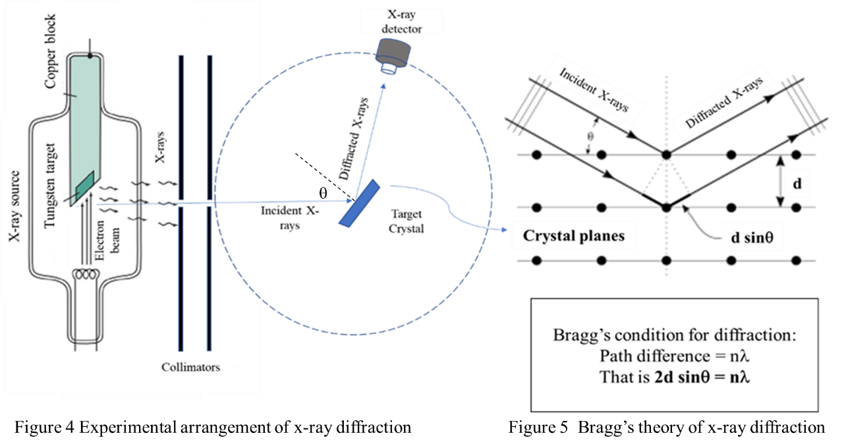
X-rays
X-ray tube
Experimental arrangement of X-ray diffraction
Bragg’s diffraction condition

Slide 22
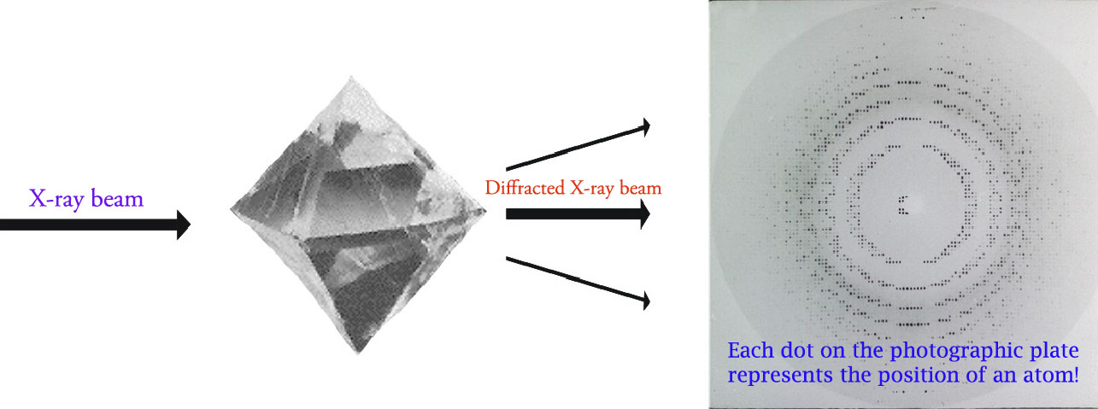
Diffraction in a crystal

Slide 23
Bragg, showed that constructive interference takes place only between those scattered rays that are parallel and with path difference by exactly λ, 2λ, 3λ, and so on.
The path difference must be nλ, where n is an integer.
Let us have an experiment with a monochromatic source of X-ray diffracted from a crystal.
An x-ray detector can detect the scattered (diffracted) rays from the crystal in 360 degrees.

Slide 24
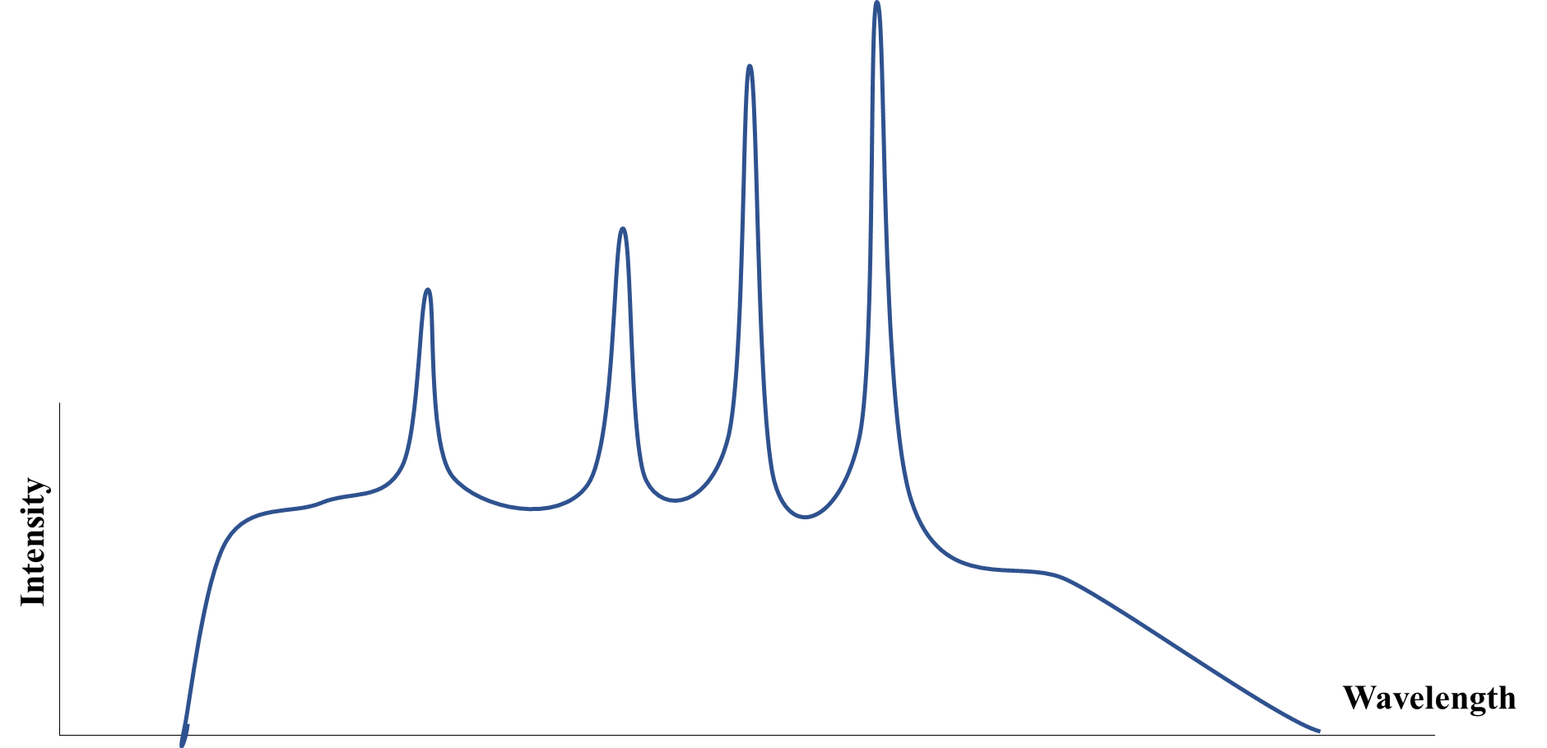
Moseley's work on x-rays and its significance.
There are narrow spikes along with continuous spectra.
The continuous x-ray spectrum is the result of the inverse photoelectric effect.
That is, kinetic energy of electrons is transformed into all possible photon energies.
The line spectrum, on the other hand, comes from electronic transitions within atoms that has taken place by the incident electrons.

Slide 25
Emitted electron
Characteristic X-ray
K_{α}
Incident electron
Relative energy
K_{β}
Continuous X-ray
Scattered electron
Wave length
Characteristic X-ray (Kα) emitted
Figure 7 (a) Characteristic X-ray emission

Slide 26
Out going
electrons
50 kV
40 kV
Continuous X-ray
emission due to Bremsstrahlung
Incident electrons
Relative energy
30 kV
20 kV
0.02
0.04
0.06
0.08
0.10
Continuous X-ray emission
Wave length (nm)
Figure 7 (b) Continuous X-ray emission

Slide 27
The transitions of the outer orbital electrons of atoms usually involve only a few electron volts (eV) of energy.
As we move to inner orbital electrons, of heavier elements the energy involved increases to a few tens or hundreds of eVs.
For example in sodium only 5.13 eV is needed to remove the outermost 3s electron
Whereas for the inner electrons 31 eV energy required for each 2p electron
63 eV for each 2s electron, and 1041 eV for each 1s electron.
Transitions that involve the inner most electrons in an atom give rise to x-ray line spectra because of the high photon energies.

Slide 28
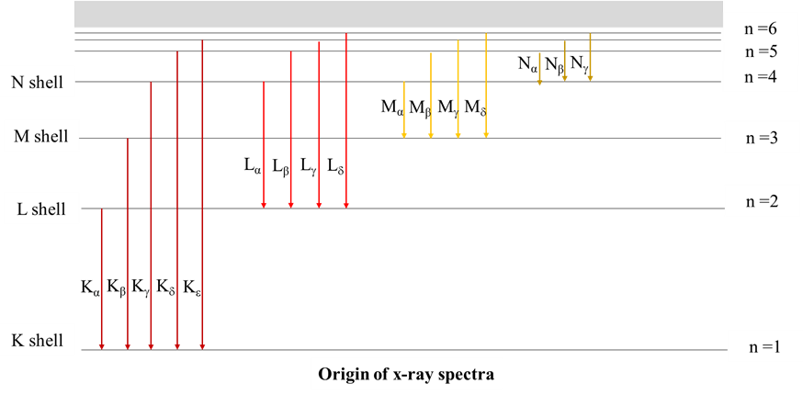
Intensity
Wavelength

Slide 29
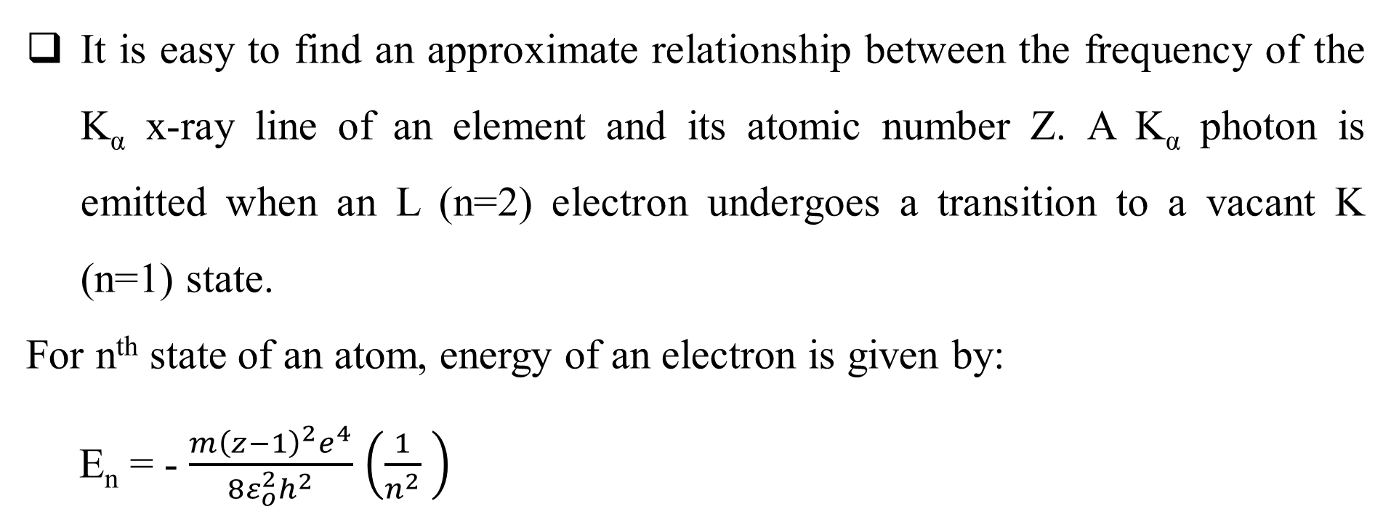
It is easy to find an approximate relationship between the frequency of the K_{α} x-ray line of an element and its atomic number Z. A K_{α} photon is emitted when an L (n=2) electron undergoes a transition to a vacant K (n=1) state.
For n^{th} state of an atom, energy of an electron is given by:
E_{n} = - $\frac{m{\left(z−1\right)}^{2}e^{4}}{8ε_{o}^{2}h^{2}}$ $\left(\frac{1}{n^{2}} \right)$

Slide 30
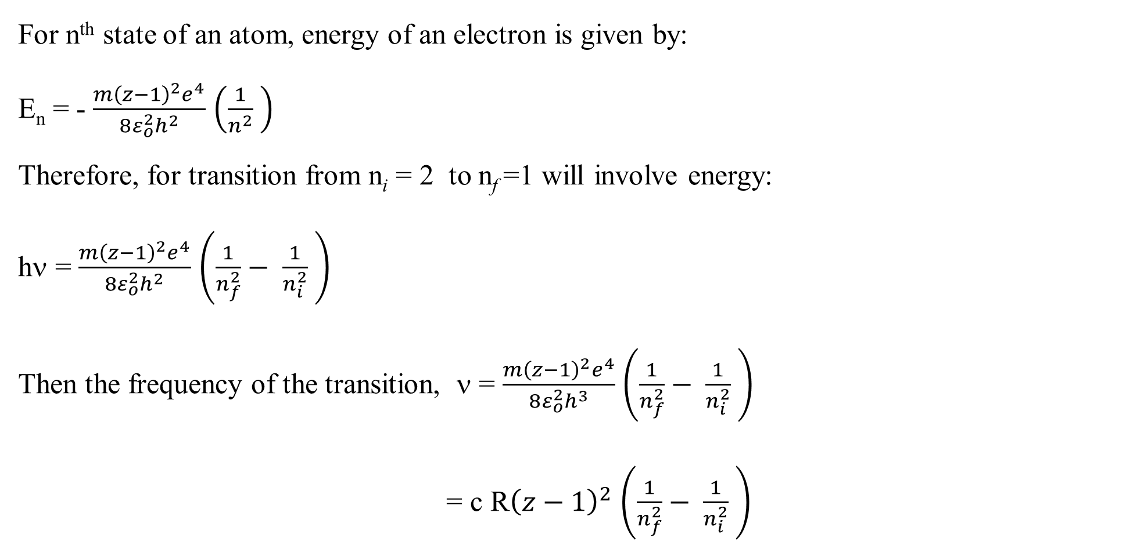
For n^{th} state of an atom, energy of an electron is given by:
E_{n} = - $\frac{m{\left(z−1\right)}^{2}e^{4}}{8ε_{o}^{2}h^{2}}$ $\left(\frac{1}{n^{2}} \right)$
Therefore, for transition from n_{i} = 2 to n_{f} =1 will involve energy:
hν = $\frac{m{\left(z−1\right)}^{2}e^{4}}{8ε_{o}^{2}h^{2}}$ $\left(\frac{1}{n_{f}^{2}}− \frac{1}{n_{i}^{2}} \right)$
Then the frequency of the transition, ν = $\frac{m{\left(z−1\right)}^{2}e^{4}}{8ε_{o}^{2}h^{3}}$ $\left(\frac{1}{n_{f}^{2}}− \frac{1}{n_{i}^{2}} \right)$
= c R${\left(z−1\right)}^{2}$ $\left(\frac{1}{n_{f}^{2}}− \frac{1}{n_{i}^{2}} \right)$

Slide 31
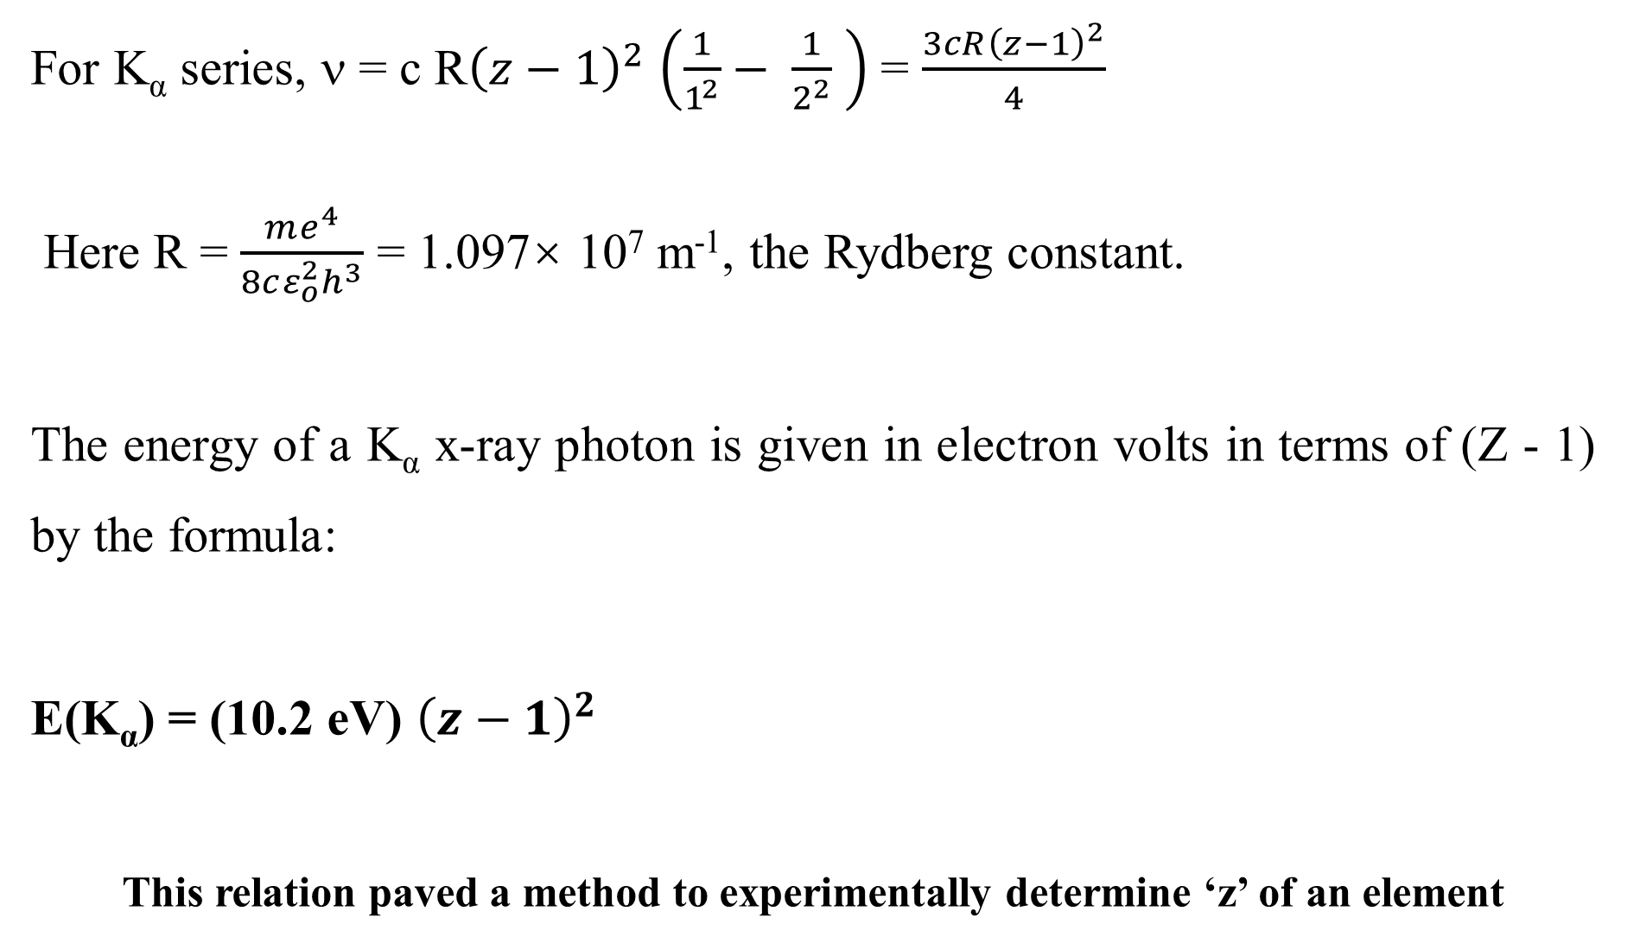
For K_{α} series, ν = c R${\left(z−1\right)}^{2}$ $\left(\frac{1}{1^{2}}− \frac{1}{2^{2}} \right)$ = $\frac{3cR{\left(z−1\right)}^{2}}{4}$
Here R = $\frac{me^{4}}{8cε_{o}^{2}h^{3}}$ = 1.097× 10⁷ m⁻¹, the Rydberg constant.
The energy of a K_{α} x-ray photon is given in electron volts in terms of (Z - 1) by the formula:
E(K_{α}) = (10.2 eV) ${\left(z−1\right)}^{2}$
This relation paved a method to experimentally determine ‘z’ of an element

Slide 32
The significance
It supports Bohr’s newly formulated atomic model
Moseley’s work provided a way to determine experimentally the atomic number Z of an element for the first time.
It helped to make correct sequence of elements in the periodic table
Moseley found gaps in the periodic table data that corresponded to Z = 43, 61, 72, and 75, which suggested the existence of hitherto unknown elements that were later discovered.
The first two, technetium and promethium, have no stable isotopes and were first produced in the laboratory many years later.
The last two, hafnium and rhenium, were isolated in the 1920s.

Slide 33
Uses of X-rays
Difficult to list out the applications of X-rays in science, technology and industry.
Their ability to penetrate substances and hence to provide images of internal structure in a non-invasive manner is the reason for most of their applications.
Medical imaging : Normal x-ray, Computed Tomography , Fluoroscopy, dental radiography are the major uses of x-rays in medical applications. While ordinary x-ray images are used for orthopaedic purposes, computed tomography creates cross-sectional images of the body for diagnosis and monitoring conditions like cancer, lung infections and neurological disorders. Real time x-ray imaging, Fluoroscopy helps in procedures like angioplasty, endoscopy and the like.

Slide 34
Industrial Testing and Inspection: Non-destructive testing to inspect the quality and structure of materials and machine parts are being used in automotive and aerospace machine components production. X-ray is also used widely for the quality check of welding in pipelines and machineries.
Research and Development: X-ray diffraction, crystallography, spectroscopy are major tools for characterisation and property studies of materials. X-ray diffraction (XRD) is used to determine the atomic and molecular structure of materials, including crystals and polymers, which is crucial in material science and chemistry It is difficult to enumerate the applications of x-rays in research.

Slide 35
Security screening: X-ray scanners are used very extensively in airports, seaports, institutions of importance, business installations mainly to inspect the luggage and cargo.
Food Inspection: X-ray inspection is used in the food industry to detect foreign objects, such as metal or glass, in packaged foods.
Environmental Monitoring: X-ray fluorescence (XRF) studies are used to analyze the elemental composition of natural samples of soil, water, and air samples, aiding in environmental studies and pollution monitoring.

Slide 36
Environmental Monitoring: X-ray fluorescence (XRF) studies are used to analyze the elemental composition of natural samples of soil, water, and air samples, aiding in environmental studies and pollution monitoring.
Astrophysics: X-rays from celestial objects provide valuable information about the universe. Observatories and telescopes equipped with X-ray detectors study phenomena such as black holes, neutron stars, and high-energy particles.
Security and Forensics: X-rays are used to inspect suspicious packages, identify concealed weapons or contraband, and analyse evidence in forensic investigations.
Archaeology and Art Conservation: X-rays are employed to examine the inner structures of archaeological artifacts and artworks non-invasively. This helps in restoration and preservation efforts

Slide 37
Problems

Slide 38
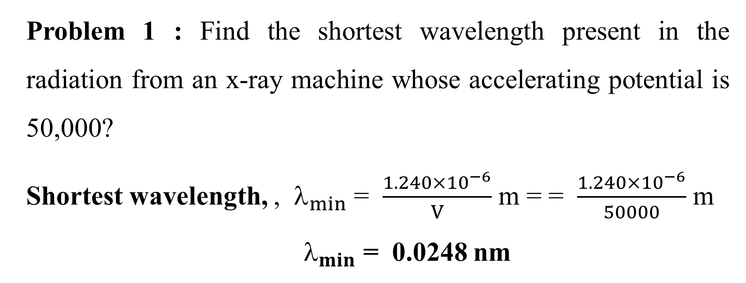
Problem 1 : Find the shortest wavelength present in the radiation from an x-ray machine whose accelerating potential is 50,000?
Shortest wavelength, , $_{min}$ = $\frac{1.240×{10}^{−6}}{V}$ m = = $\frac{1.240×{10}^{−6}}{50000}$ m
$_{min}$ = 0.0248 nm

Slide 39
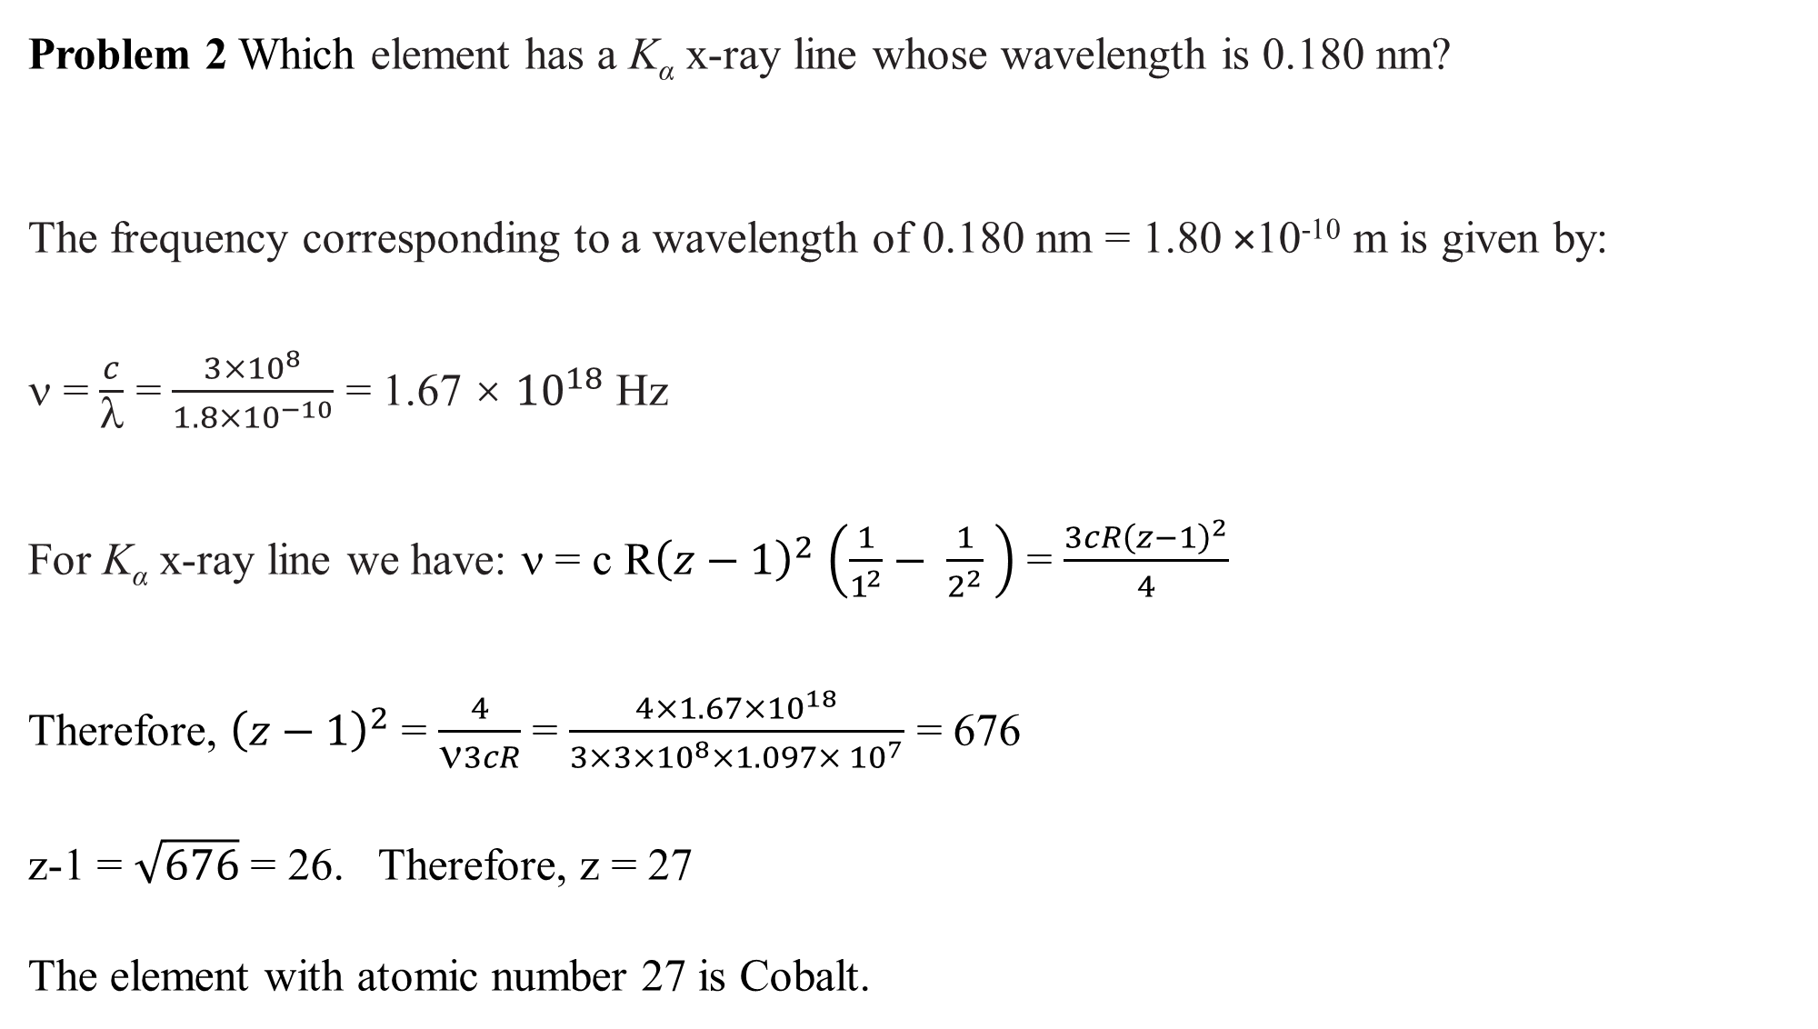
Problem 2 Which element has a K_{α} x-ray line whose wavelength is 0.180 nm?
The frequency corresponding to a wavelength of 0.180 nm = 1.80 ×10⁻¹⁰ m is given by:
ν = $\frac{c}{λ}$ = $\frac{3×{10}^{8}}{1.8×{10}^{−10}}$ = 1.67 × ${10}^{18}$ Hz
For K_{α} x-ray line we have: ν = c R${\left(z−1\right)}^{2}$ $\left(\frac{1}{1^{2}}− \frac{1}{2^{2}} \right)$ = $\frac{3cR{\left(z−1\right)}^{2}}{4}$
Therefore, ${\left(z−1\right)}^{2}$ = $\frac{4}{ν3cR}$ = $\frac{4×1.67×{10}^{18}}{3×3×{10}^{8}×1.097× {10}^{7}}$ = 676
z-1 = $\sqrt{676}$ = 26. Therefore, z = 27
The element with atomic number 27 is Cobalt.

Slide 40
Thanks a lot

