Slide 1
Atomic and Nuclear Physics
Week #5
Interaction of x-rays with matter and atomic nucleus
Lecturer: Jojo Panakal John
Professor of Applied Physics
Papua New Guinea University of Technology

Slide 2
Through the slides ….
Compton scattering
Atomic nucleus
Nucleons and nuclear forces
Nuclear mass and abundance

Slide 3
Compton scattering (A H Compton in 1922)
Scattering of X-rays from materials was one of the several efforts to study the interaction of x-rays with matter.
Intense characteristic x-rays from a Molybdenum Target were were allowed to fall on a graphite block to scatter in all directions.
The scattered x-rays from graphite were analyzed using a crystal spectrometer detector movable in a semi-circle.
Compton found that there is a shift in the wavelength of the scattered x-ray

Slide 4
Compton observed that the scattered x-rays were less penetrating than the incident K∞ x-rays
He found that there are two wave lengths emerging out
One was the incident wavelength (λ) and the other one with a longer wavelength (λ’) depending on the scattering angle, φ.
From further investigations, Compton found that the shift in wave length ( Δλ =λ’- λ) depends on the angle of scattering

Slide 5

Detector
Slit
λ’
λ
φ
Graphite Target
X-ray source
Figure 1 X-ray scattering with graphite

Slide 6
Detector
Slit
φ=0
Direct beam
λ
λ
Intensity
Only primary beam
φ=0
Graphite Target
X-ray source
λ
wave length
For φ=0, no shift in wave length

Slide 7
Detector
Slit
λ’
λ
φ=45º
Intensity
Small shift in wavelength
Graphite Target
X-ray source
For φ = 45 A small shift is in wave length
λ
λ’
wave length

Slide 8
Detector
Slit
λ’
φ =90º
φ =90º
λ
higher shift in wavelength
Intensity
Graphite Target
X-ray source
Scattering at 90º causes higher shift
λ
λ’
wave length

Slide 9
Detector
φ = 135º
Slit
λ’
Great shift in wavelength
φ = 135º
λ
Graphite Target
X-ray source
λ
λ’
Great change is scattering with graphite
wave length

Slide 10
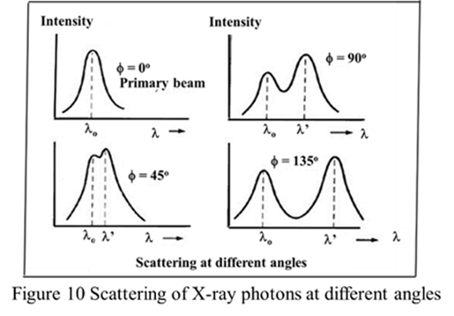
Compton measured the intensity of scattered x-ray for various scattering angles.
He found that one wavelength is same as the incident wavelength, λ and other one is shifted to a larger wavelength, λ’.
It can also be seen that the Compton shift Δλ = λ’ - λ varies with the angle.

Slide 11
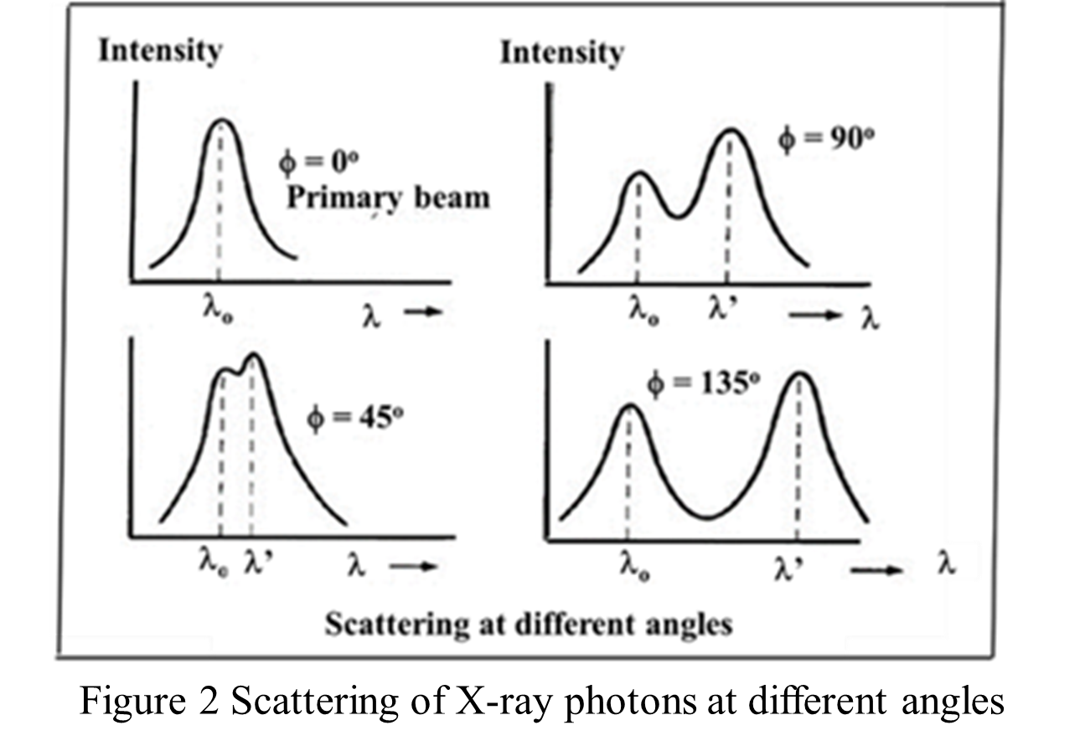

Slide 12
Compton interpreted his experimental results by postulating that the incoming x-rays are photons of energy E = hν
These photons collide with free electrons in the atoms of graphite.
Incident photons transfer some of its energy to the electrons with which they collide.
Therefore, the scattered photons will have a little energy less than the incident photon.
This causes quantitatively for the increase in wavelength ( Δλ =λ’- λ)

Slide 13
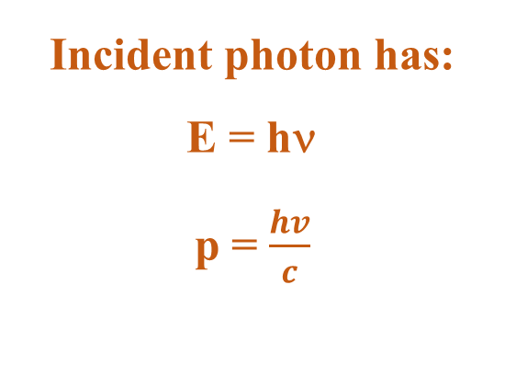
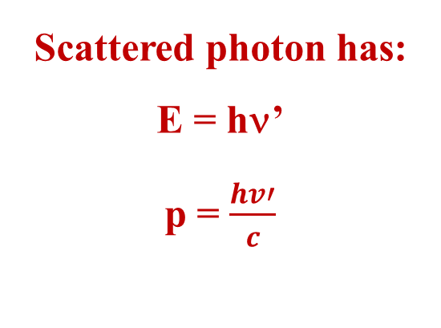
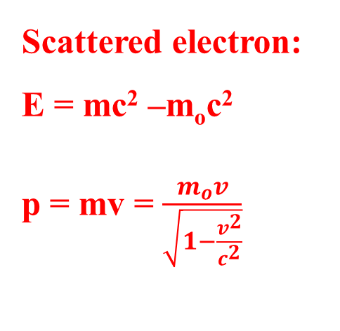
In Compton Effect we are dealing with high energy photons
Therefore, recoil electrons have relativistic velocity .
Photon as a particle has energy E and momentum p, related to the rest mass :
E² = p²c² + m_{o}²c⁴
Incident photon has:
E = hν
p = $\frac{hv}{c}$
Scattered photon has:
E = hν’
p = $\frac{hv′}{c}$
Scattered electron:
E = mc² –m_{o}c²
p = mv = $\frac{m_{o}v}{\sqrt{1−\frac{v^{2}}{c^{2}}}}$

Slide 14
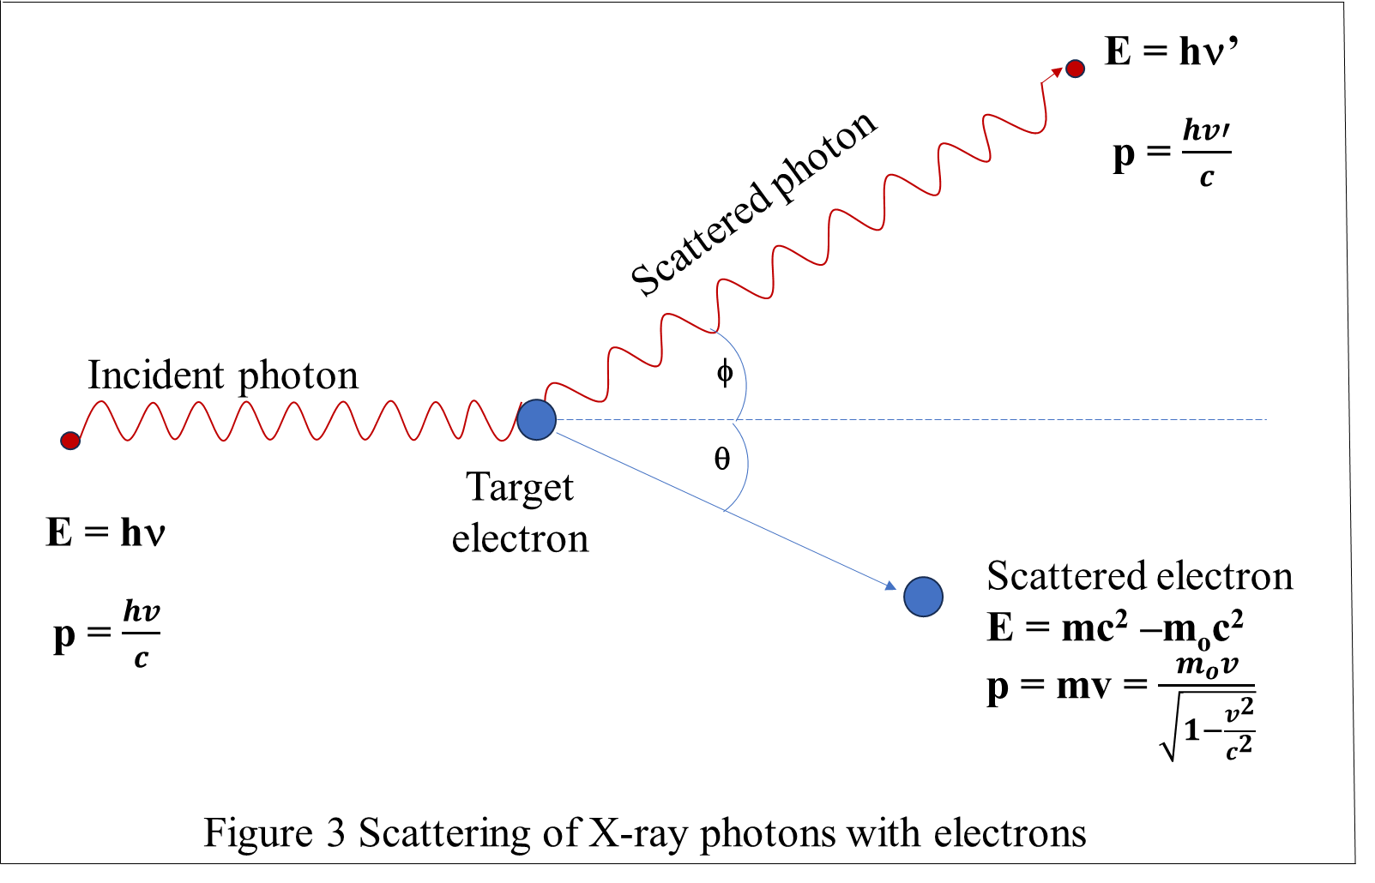

Slide 15
In Compton Effect we are dealing with high energy photons and corresponding high velocity recoil electrons.
Therefore, we need to take relativistic relations into account.
Taking photon as a particle of energy E and momentum p, total relativistic energy of the particle in terms of its rest mass, m_{o} and velocity v is:
E² = p²c² + m_{o}²c⁴

Slide 16
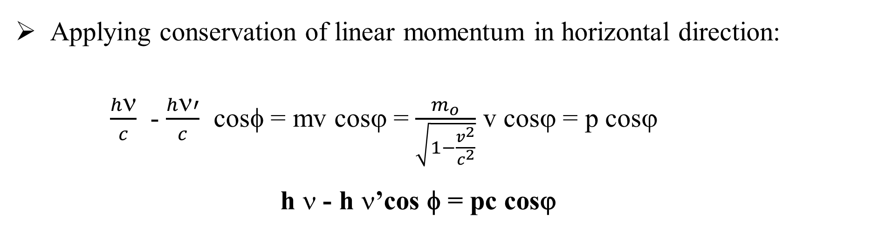
From the principle of conservation of energy, loss of energy of photon has to be equal to the gain of energy of electron. It follows that:
hν-hν’ = mc²-m_{o}c² = KE = pc
Applying conservation of linear momentum in horizontal direction:
$\frac{hν}{c}$ - $\frac{hν′}{c}$ cosφ = mv cosϕ = $\frac{m_{o}}{\sqrt{1−\frac{v^{2}}{c^{2}}}}$ v cosϕ = p cosϕ
h $$ - h $$’cos φ = pc cosϕ

Slide 17
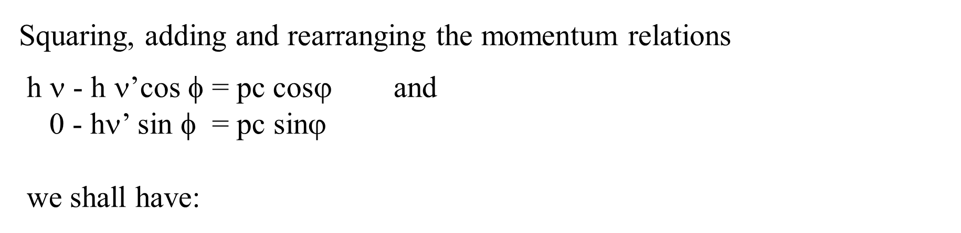
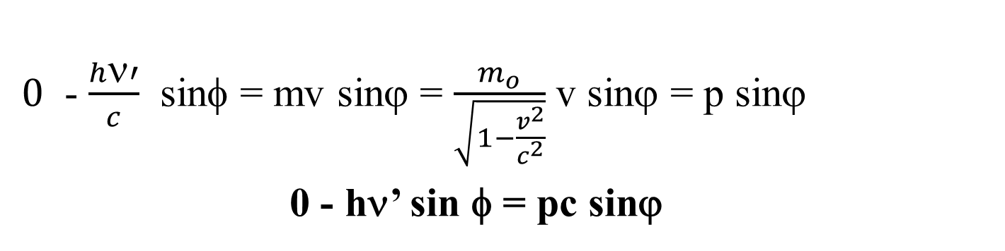
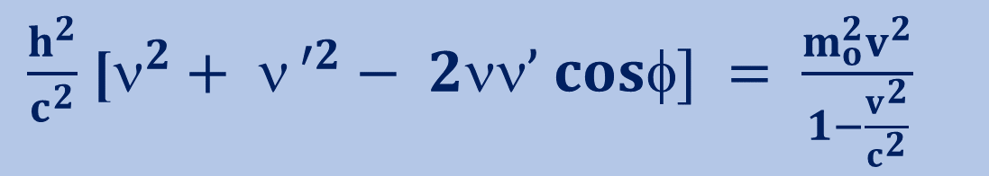
Applying conservation of linear momentum in vertical direction:
$0$ - $\frac{hν′}{c}$ sinφ = mv sinϕ = $\frac{m_{o}}{\sqrt{1−\frac{v^{2}}{c^{2}}}}$ v sinϕ = p sinϕ
0 - hν’ sin φ = pc sinϕ
Squaring, adding and rearranging the momentum relations
h $$ - h $$’cos φ = pc cosϕ and
0 - hν’ sin φ = pc sinϕ
we shall have:
$\frac{h^{2}}{c^{2}}$ [$^{2}+ ν^{ ′2}− 2νν’ cosφ] = \frac{m_{o}^{2}v^{2}}{1−\frac{v^{2}}{c^{2}}}$

Slide 18
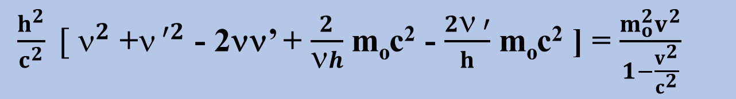
Now, the energy conservation relation for scattered photon and electron
Energy lost by the scattered photon = Recoil energy of the scattered electron
(hν-hν’) = (m-m_{o})c²
With certain mathematical manipulations, we can rewrite this equation as:
$\frac{h^{2}}{c^{2}} [$ $^{2}$ +$^{ ′2}$ - 2νν’ + $\frac{2}{νh}$ m_{o}c² - $\frac{2ν ′}{h}$ m_{o}c² ] = $\frac{m_{o}^{2}v^{2}}{1−\frac{v^{2}}{c^{2}}}$

Slide 19
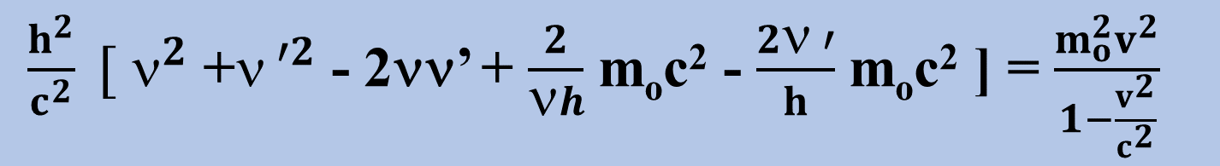
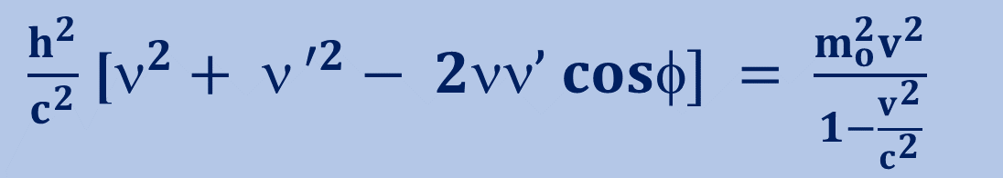

Now we have two equations –momentum and energy conservation equations:
$\frac{h^{2}}{c^{2}}$ [$^{2}+ ν^{ ′2}− 2νν’ cosφ] = \frac{m_{o}^{2}v^{2}}{1−\frac{v^{2}}{c^{2}}}$
$\frac{h^{2}}{c^{2}} [$ $^{2}$ +$^{ ′2}$ - 2νν’ + $\frac{2}{νh}$ m_{o}c² - $\frac{2ν ′}{h}$ m_{o}c² ] = $\frac{m_{o}^{2}v^{2}}{1−\frac{v^{2}}{c^{2}}}$
Equating the left hand sides of these equations and simplifying we shall have:
[ $^{′}$ - λ] = Δλ = $\frac{h}{m_{o}^{2}c}$ [1- $cos]$

Slide 20
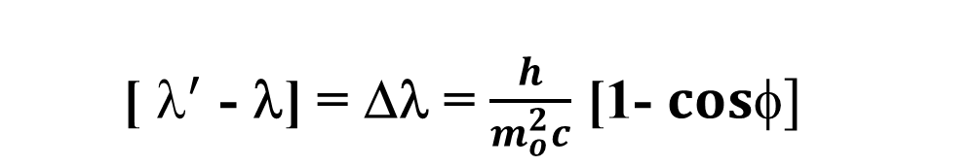
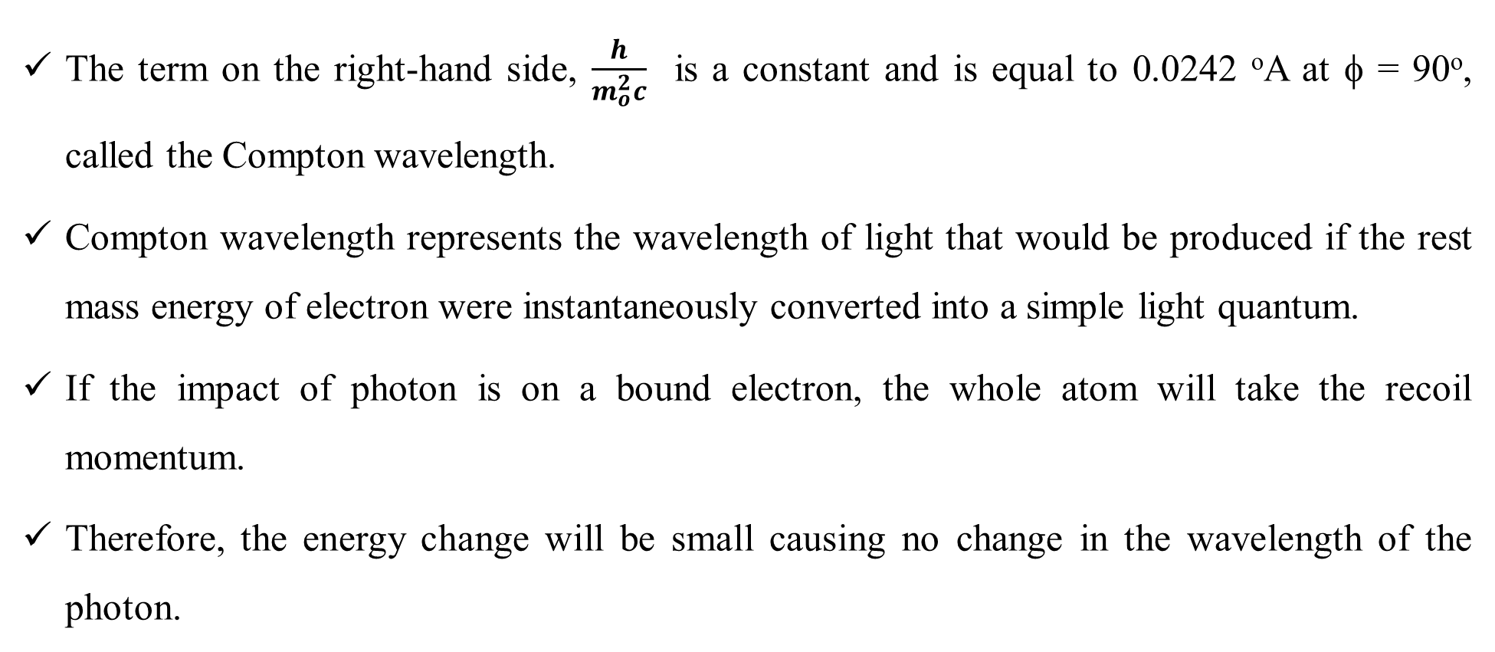
[ $^{′}$ - λ] = Δλ = $\frac{h}{m_{o}^{2}c}$ [1- $cos]$
The term on the right-hand side, $\frac{h}{m_{o}^{2}c}$ is a constant and is equal to 0.0242 ºA at φ = 90º, called the Compton wavelength.
Compton wavelength represents the wavelength of light that would be produced if the rest mass energy of electron were instantaneously converted into a simple light quantum.
If the impact of photon is on a bound electron, the whole atom will take the recoil momentum.
Therefore, the energy change will be small causing no change in the wavelength of the photon.

Slide 21
Atomic Nucleus
The atom consists of a dense nucleus of protons and neutrons surrounded by an equal number of electrons moving in discrete circular orbits (stationary states) at fixed distances from the nucleus, retaining their motion under the influence of the Coulomb force without emission of radiation.
The total number of protons is called the atomic number of the atom and is given the symbol Z.
The number of neutrons in a nucleus is known as the neutron number and is given the symbol N.

Slide 22
The mass number of the nucleus is the total number of protons and neutrons (called nucleons) in the nucleus.
The mass number is given the symbol A and can be found by the sum of Z + N = A.
Each type of atom that contains a unique combination of protons and neutrons is called a nuclide.
Not all combinations of numbers of protons and neutrons are possible, but a large number of specific nuclides with unique combinations of neutrons and protons have been identified.

Slide 23
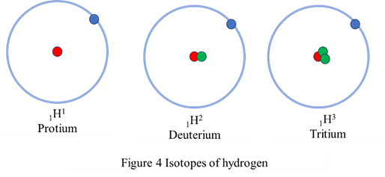
Isotopes are nuclides that have the same atomic number (same number of protons) and are therefore the same element but differ in the number of neutrons.
Most elements have a few stable isotopes and several unstable (radioactive) isotopes.
For example, oxygen has three stable isotopes that can be found in nature
Oxygen-16, oxygen-17, and oxygen-18 and eight radioactive isotopes.
Another example is hydrogen, which has two stable isotopes (hydrogen-1 and hydrogen-2) and a single radioactive isotope (hydrogen-3).

Slide 24
Isobars are nuclides with the same mass number (A), but different numbers of protons and neutrons (Z & N).
Examples are ₁₈Ar⁴⁰, ₁₉K⁴⁰ and ₂₀Ca⁴⁰.
A special case is when two isobars have proton and neutron numbers interchanged.
They are called mirror nuclides, e.g.,₁H³ and ₂He³, ₇O¹⁵ and ₈N¹⁵.
Isotones are nuclides with the same number of neutrons (N),
but different numbers of protons and mass numbers (Z & A).
₁₆S³⁶, ₁₇Cl³⁷, ₁₈Ar³⁸, ₁₉K³⁹ and ₂₀Ca⁴⁰ (20 neutrons each).

Slide 25
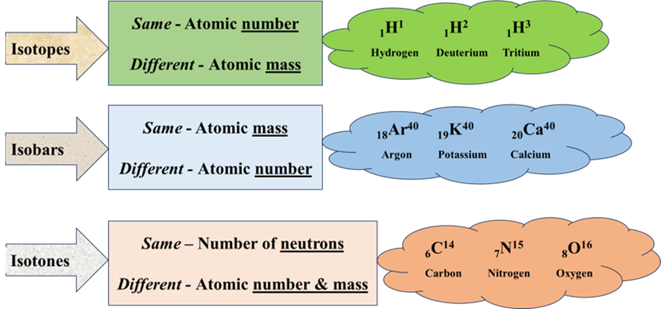

Slide 26
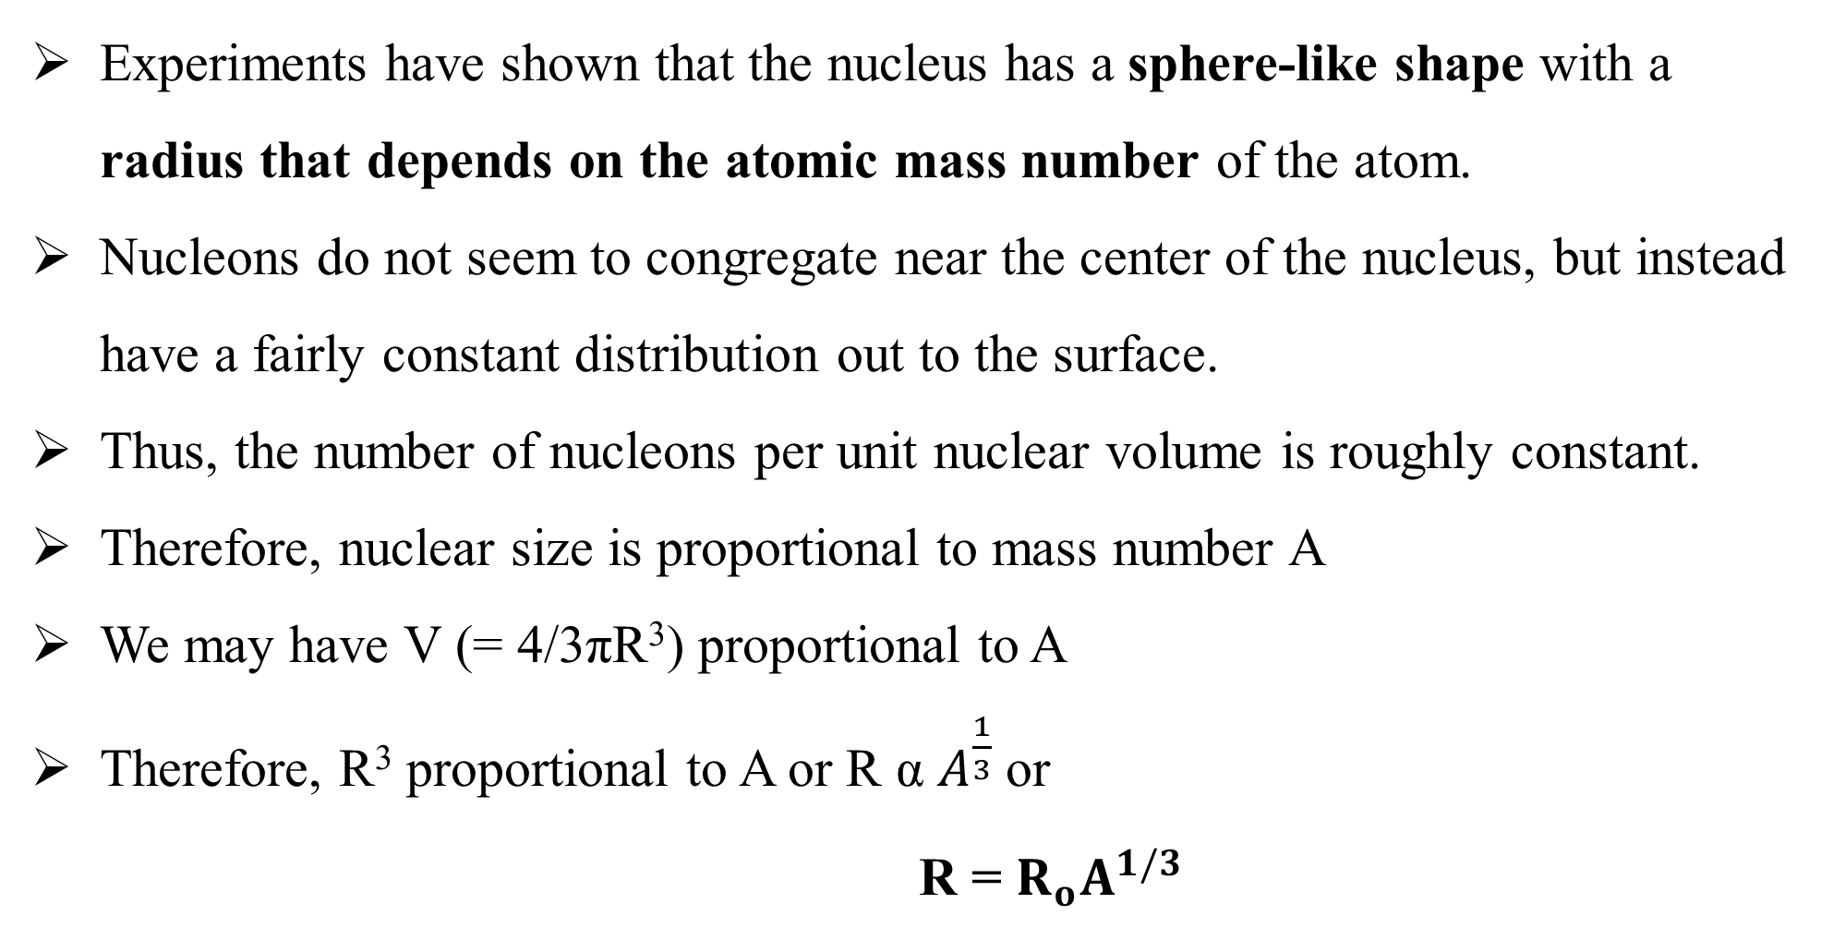
Radius of nucleus
Experiments have shown that the nucleus has a sphere-like shape with a radius that depends on the atomic mass number of the atom.
Nucleons do not seem to congregate near the center of the nucleus, but instead have a fairly constant distribution out to the surface.
Thus, the number of nucleons per unit nuclear volume is roughly constant.
Therefore, nuclear size is proportional to mass number A
We may have V (= 4/3πR³) proportional to A
Therefore, R³ proportional to A or R α $A^{\frac{1}{3}}$or
R = $R_{o}A^{1/3}$

Slide 27
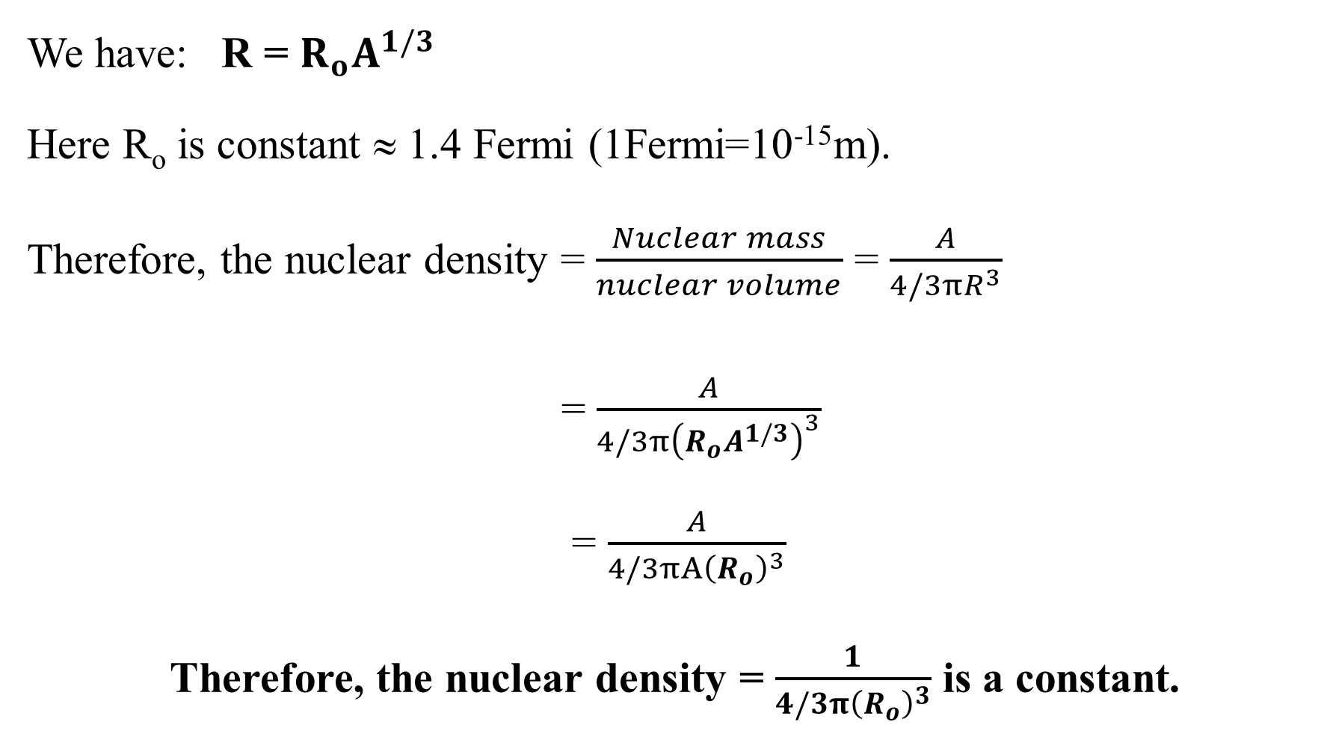
Nuclear density
We have: R = $R_{o}A^{1/3}$
Here R_{o} is constant ≈ 1.4 Fermi (1Fermi=10⁻¹⁵m).
Therefore, the nuclear density = $\frac{Nuclear mass}{nuclear volume}$ = $\frac{A}{4/3πR^{3}}$
= $\frac{A}{4/3π{\left(R_{o}A^{1/3}\right)}^{3}}$
= $\frac{A}{4/3πA{\left(R_{o}\right)}^{3}}$
Therefore, the nuclear density = $\frac{1}{4/3π{\left(R_{o}\right)}^{3}}$ is a constant.

Slide 28
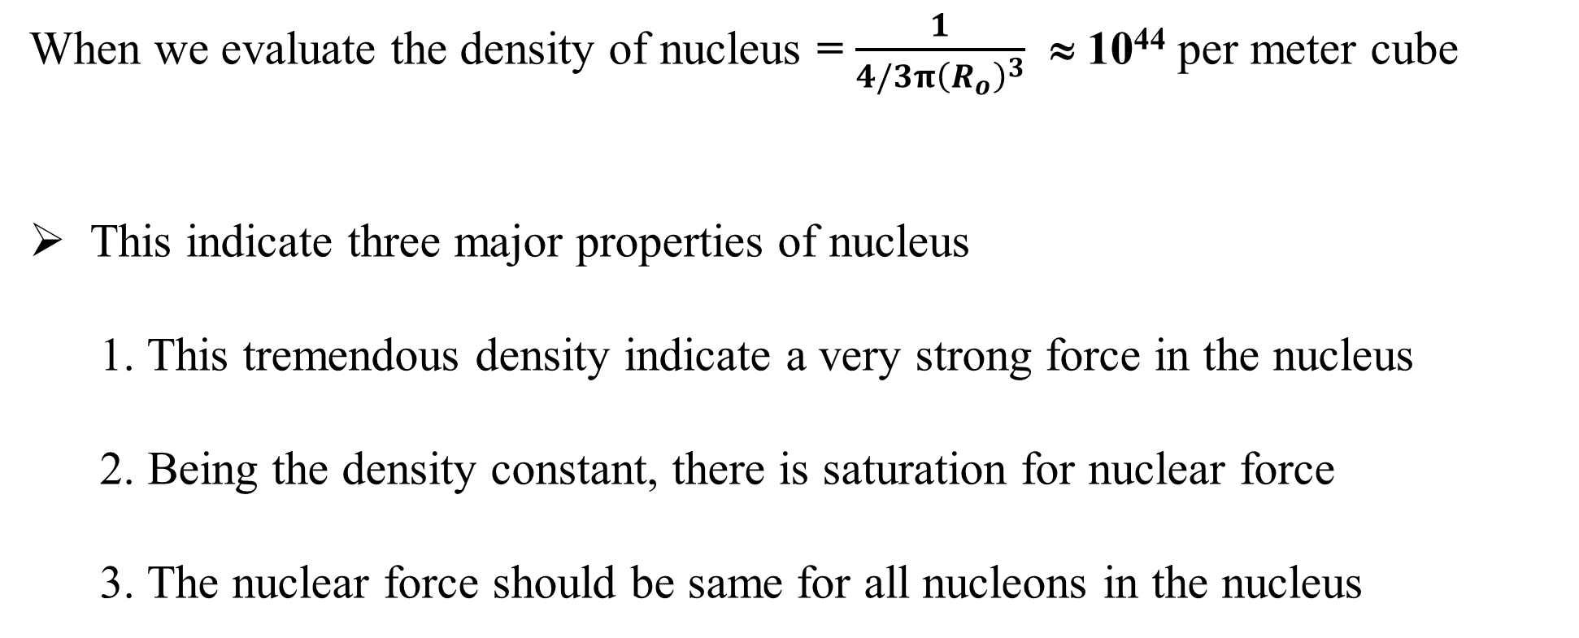
When we evaluate the density of nucleus = $\frac{1}{4/3π{\left(R_{o}\right)}^{3}}$ ≈ 10⁴⁴ per meter cube
This indicate three major properties of nucleus
1. This tremendous density indicate a very strong force in the nucleus
2. Being the density constant, there is saturation for nuclear force
3. The nuclear force should be same for all nucleons in the nucleus

Slide 29
It is known that a large number of nuclei, available in nature, are stable.
Except for hydrogen, all nuclei have more than one proton – the positively charged particle in the atom.
Therefore, there is a strong force in the nucleus that is strong enough to overpower the coulomb repulsion and hold the nucleons together.
The forces which hold the nucleons together are commonly called nuclear forces and are short-range.

Slide 30
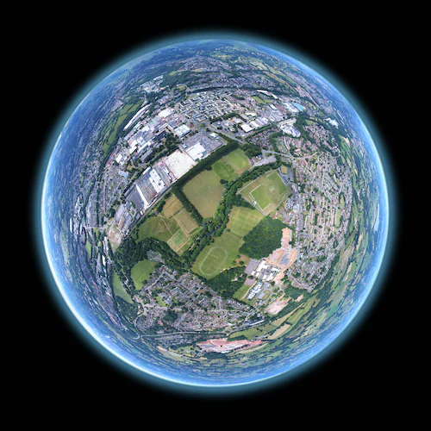
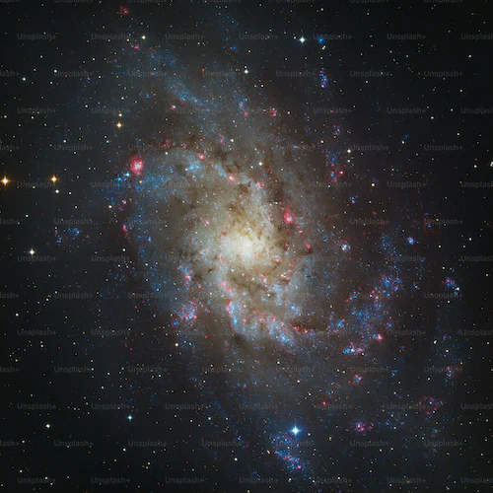
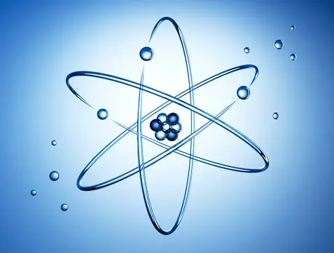
Forces inside nucleus
Apart from the electrostatic Coulomb force, there are two types of nuclear forces acting in the nucleus.
Strong Nuclear Force and Weak Nuclear Force.
Strong nuclear force is responsible for holding the nuclei of atoms stable.
The magnitude of Strong Nuclear Force is far greater than the electromagnetic and gravitational force.
Nuclear Force > Electromagnetic > Gravitation
Nucleus Nature Universe

Slide 31
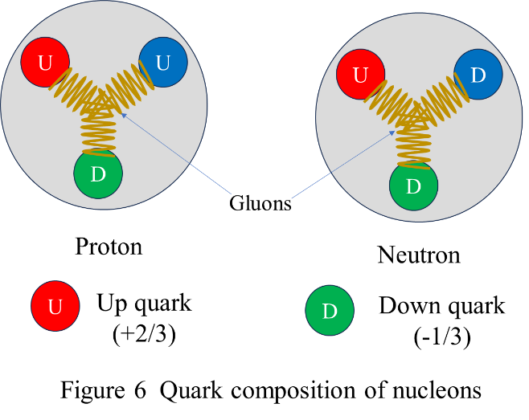
Weak nuclear force acts between the particles where radioactive decay occurs.
They change neutrons into protons in the process of nuclear decay
Weak force is neither attractive nor repulsive.
The exact nature of the forces can be detailed with quantum chromodynamics.

Slide 32
Following are the characteristics of nuclear force:
Nuclear force is strongest of all fundamental forces.
The nuclear force is short range. They are most effective only up to a distance of order of femtometre (fm) or less. Where 1fm = 10⁻¹⁵ meter. Nuclear forces become negligible beyond this distance. The distance is called nuclear range.
Not all the particles are subjected to the nuclear force (a notable exception are electrons)

Slide 33
The nuclear force does not depend on the particle charge (force is same for protons and neutrons).
Nuclear force is attractive in nature
When separation is more than 1 fm and repulsive in nature, that is it shows saturation.
The nuclear force does depend on spin of nucleons (as in the case of the deuteron).

Slide 34
Nuclear force is caused by the exchange of particles known as mesons.
A strong force between quarks, mediated by the exchange of gluons and holds the quarks together inside a nucleon.
exchange of particles
impart momentum
exchange of particles
impart momentum
Causes repulsion
Causes attraction

Slide 35
Nuclear mass
A nucleus consists of mass of protons (Z) and neutrons (N).
If we assume the nuclear mass to be a simple collection of Z protons and N neutrons, the mass of the nucleus M (Z, N) would be just the sum of the masses of these constituent nucleons.
M (Z, N) = Z×m_{p} + N×m_{n}
Where m_{p} is the mass of proton and m_{n} is that of neutron.

Slide 36
According to nuclear particle experiments, the total mass of a nucleus M (Z, N) is less than the sum of the masses of its constituent nucleons (protons and neutrons).
The mass of an individual nucleus is often expressed in atomic mass units (amu or simply u), where u = 1.66054 × 10⁻²⁷ kg.
In atomic mass units, the mass of a helium nucleus (A = 4) is approximately 4 u.

Slide 37
Nuclear abundance
We know, Isotopes are nuclides having the same atomic number (same number of protons) and but differ in the number of neutrons in the nucleus.
Isotopes of a given element exist in different proportions.
Mercury, has seven naturally occurring isotopes:
₈₀Hg¹⁹⁶, ₈₀Hg¹⁹⁸, ₈₀Hg¹⁹⁹, ₈₀Hg²⁰⁰, ₈₀Hg²⁰¹, ₈₀Hg²⁰², ₈₀Hg²⁰⁴ % natural abundances 0.146%, 10.02%, 16.84%, 23.13%, 13.22%, 29.80%, 6.85%, respectively.

Slide 38
Nuclear abundance for Helium
₂He⁴ and ₂He³
99.999866% and 0.000134%
Oxygen:
₈O¹⁶ ₈O¹⁷ ₈O¹⁸
99.757 % 0.038% 0.205%

Slide 39
When we name a nuclide, we generally mean the most abundant isotope.
Therefore, Mercury means ₈₀Hg^{202,}
Helium means ₂He⁴ and
Oxygen means ₈O¹⁶.
However, in certain cases, isotopic abundance ratios may vary with samples.

Slide 40
Numerical Problems

Slide 41
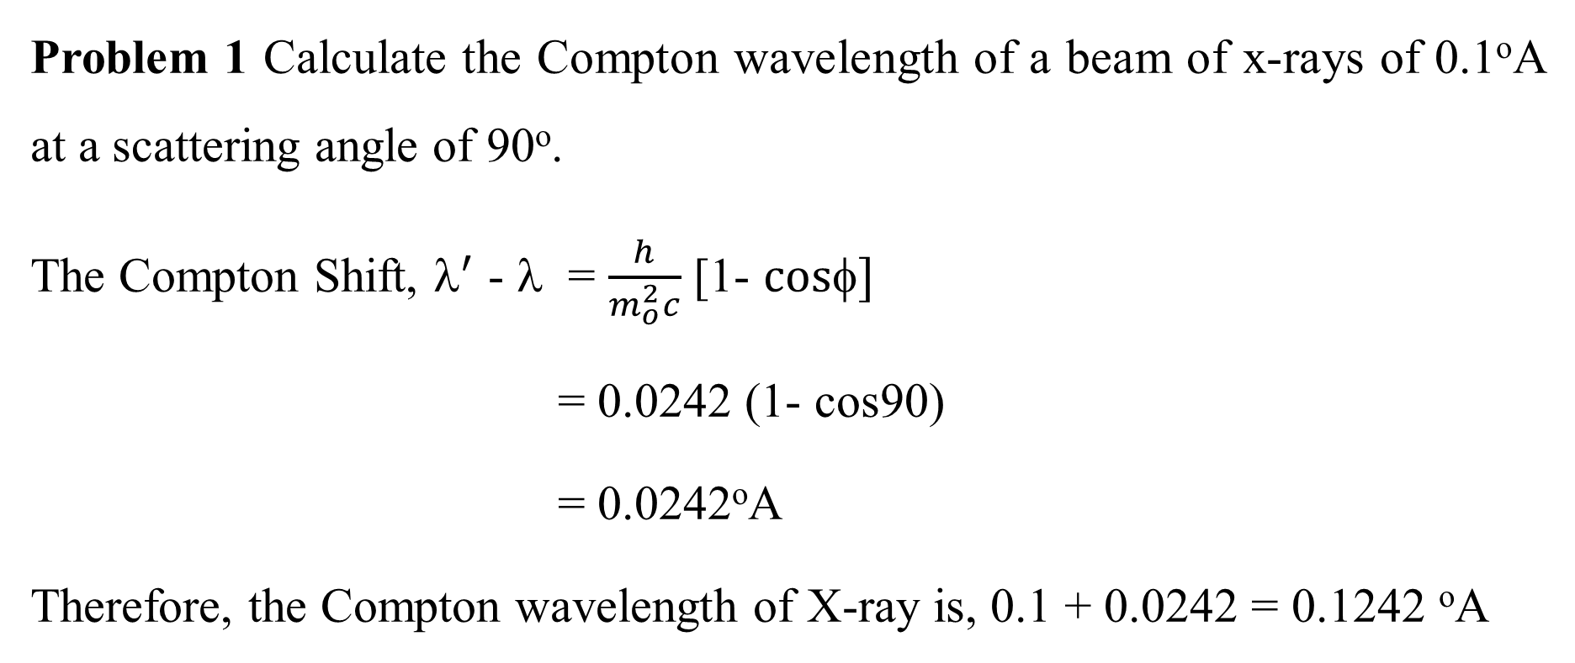
Problem 1 Calculate the Compton wavelength of a beam of x-rays of 0.1ºA at a scattering angle of 90º.
The Compton Shift, $^{′}$ - λ = $\frac{h}{m_{o}^{2}c}$ [1- $cos]$
= 0.0242 (1- cos90)
= 0.0242ºA
Therefore, the Compton wavelength of X-ray is, 0.1 + 0.0242 = 0.1242 ºA

Slide 42
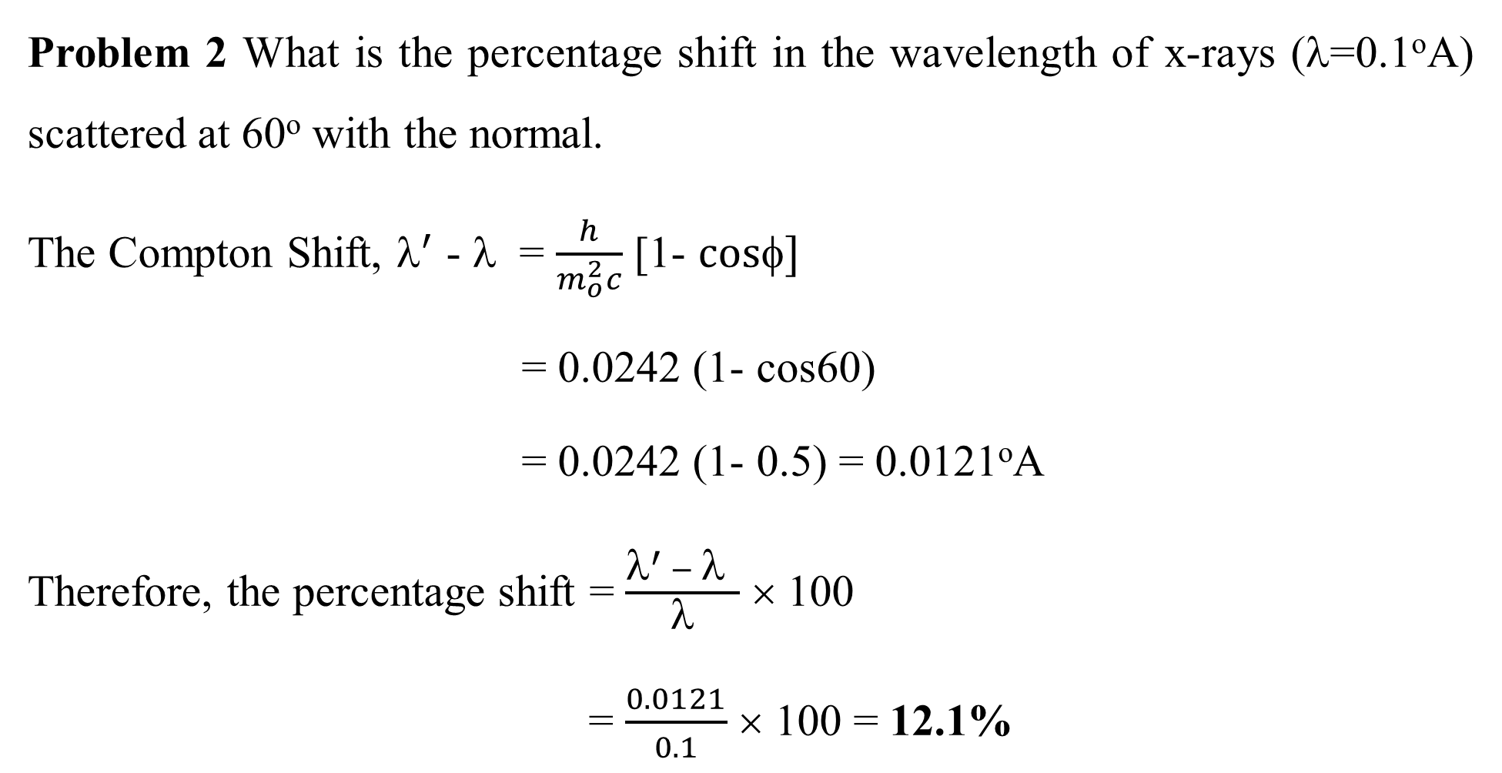
Problem 2 What is the percentage shift in the wavelength of x-rays (λ=0.1ºA) scattered at 60º with the normal.
The Compton Shift, $^{′}$ - λ = $\frac{h}{m_{o}^{2}c}$ [1- $cos]$
= 0.0242 (1- cos60)
= 0.0242 (1- 0.5) = 0.0121ºA
Therefore, the percentage shift = $\frac{λ^{′} − λ }{λ}$ × 100
= $\frac{0.0121}{0.1}$ × 100 = 12.1%

Slide 43
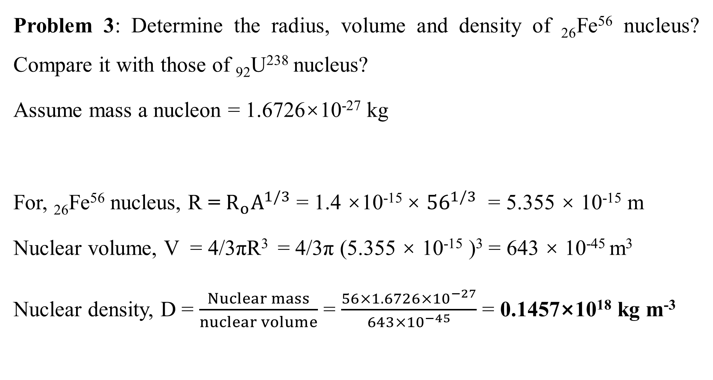
Problem 3: Determine the radius, volume and density of ₂₆Fe⁵⁶ nucleus? Compare it with those of ₉₂U²³⁸ nucleus?
Assume mass a nucleon = 1.6726×10⁻²⁷ kg
For, ₂₆Fe⁵⁶ nucleus, R = $R_{o}A^{1/3}$ = 1.4 ×10⁻¹⁵ × ${56}^{1/3}$ = 5.355 × 10⁻¹⁵ m
Nuclear volume, V = 4/3πR³ = 4/3π (5.355 × 10⁻¹⁵ )³ = 643 × 10⁻⁴⁵ m³
Nuclear density, D = $\frac{Nuclear mass}{nuclear volume}$ = $\frac{56×1.6726×{10}^{−27}}{643×{10}^{−45}}$ = 0.1457×10¹⁸ kg m⁻³

Slide 44
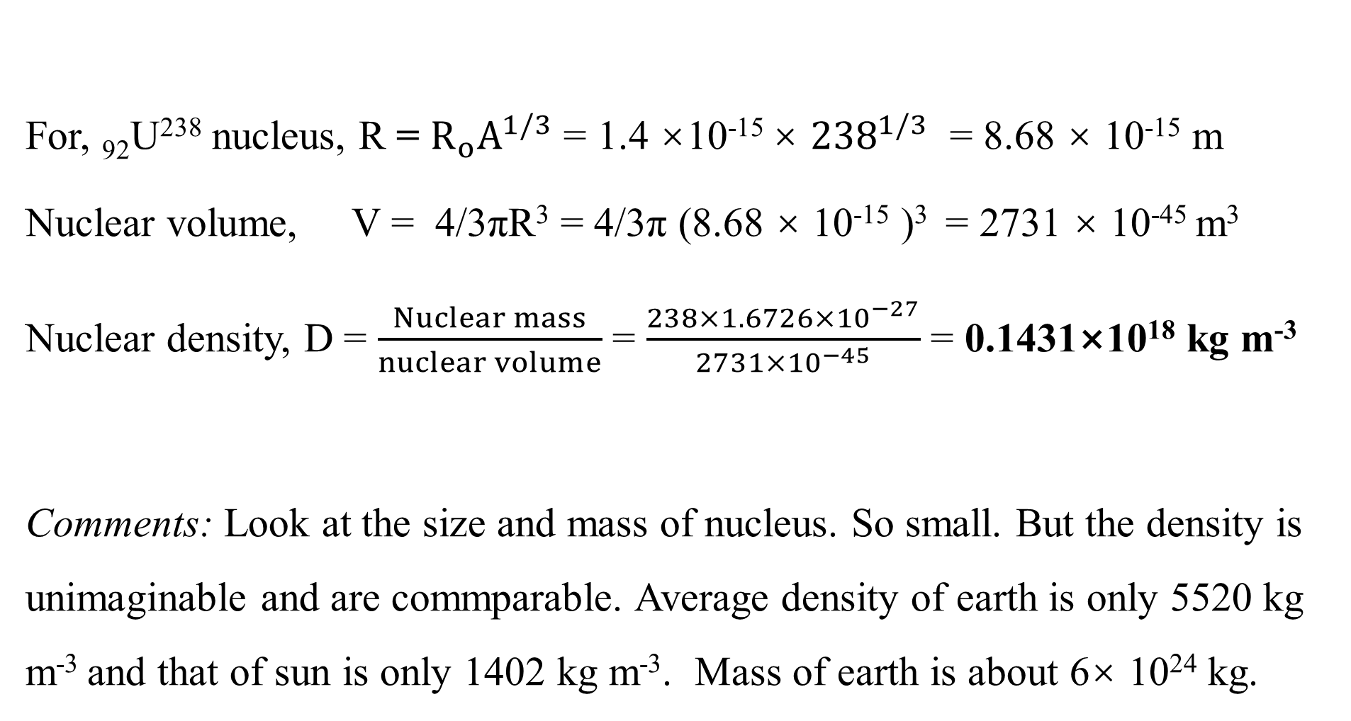
For, ₉₂U²³⁸ nucleus, R = $R_{o}A^{1/3}$ = 1.4 ×10⁻¹⁵ × ${238}^{1/3}$ = 8.68 × 10⁻¹⁵ m
Nuclear volume, V = 4/3πR³ = 4/3π (8.68 × 10⁻¹⁵ )³ = 2731 × 10⁻⁴⁵ m³
Nuclear density, D = $\frac{Nuclear mass}{nuclear volume}$ = $\frac{238×1.6726×{10}^{−27}}{2731×{10}^{−45}}$ = 0.1431×10¹⁸ kg m⁻³
Comments: Look at the size and mass of nucleus. So small. But the density is unimaginable and are commparable. Average density of earth is only 5520 kg m⁻³ and that of sun is only 1402 kg m⁻³. Mass of earth is about 6× 10²⁴ kg.

