Slide 1

FEASIBILITY STUDIES
General Format/Guidelines in Writing Feasibility Studies
Week 1
Lecturer:
Fidela Reyes Balajadia
Associate Professor 2
University of the Assumption, Philippines

Slide 2

TOPICS
Course Description
Course Goals and Objectives
Requirements for the Course
Criteria for Evaluating Feasibility Studies
Research Consultant
Composition of the Defense Panel
General Format/Guidelines in Writing Feasibility Studies

Slide 3
Course Description
This course primarily aims to guide the business students as they experience the actual writing of a feasibility study. A tangible feasibility study report is expected to be the output at the end of the course. The preparation of a feasibility study before opening a business endeavor has proven to provide more benefits and serve as a catalyst for business success.

Slide 4
Course Description
A lot of interrelated technical, marketing, and quantitative analyses are painstakingly undertaken to come up with the conclusion that the project may appear viable from all areas of the study. Higher order thinking skill is necessary in the preparation because of several analytical and planning tools adopted in the process.

Slide 5
Course Goals and Objectives
01
02
03
To articulate the need for understanding the rudiments of project management in the preparation of a Feasibility Study.
To create financial statements (Balance Sheet, Income Statement and Cash Flow Statement) based on the data and information given.
To analyze whether the company is performing or not based on the financial reports presented.

Slide 6
Course Goals and Objectives
04
05
06
To rationalize the importance of using research tools in gathering information.
To explain the relationship between business functions, business fields, business environments and the domain of a project.
To analyze and interpret the role of measurement in undertaking feasibility study.

Slide 7
Requirements for the Course
A. Attending the class religiously
B. Should not incur more than three (3) absences unless duly excused
C. Passing the preliminary examination - 100 items multiple choice
D. Submission of every chapter in a Feasibility Study (written evaluation)
E. Passing the Proposal (Manuscript 40%, Oral Defense 60%) and Final Oral (Manuscript
60%, Oral Defense 40%)
F. Oral title presentation/defense
G. Submission of the final manuscript (hardbound)

Slide 8
Criteria For Evaluating Undergraduate FEASIBILITY STUDIES

Slide 9
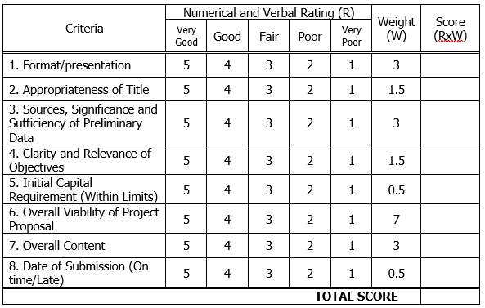
Evaluation of a Project Proposal
a) Manuscript
(40%)

Slide 10
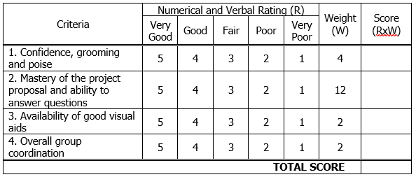
Evaluation of a Project Proposal
b) Oral Defense
(60%)

Slide 11
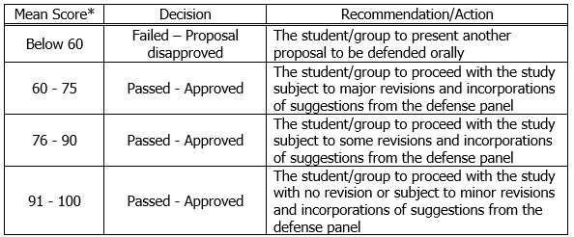
Evaluation of a Project Proposal
c) Decision Criteria

Slide 12
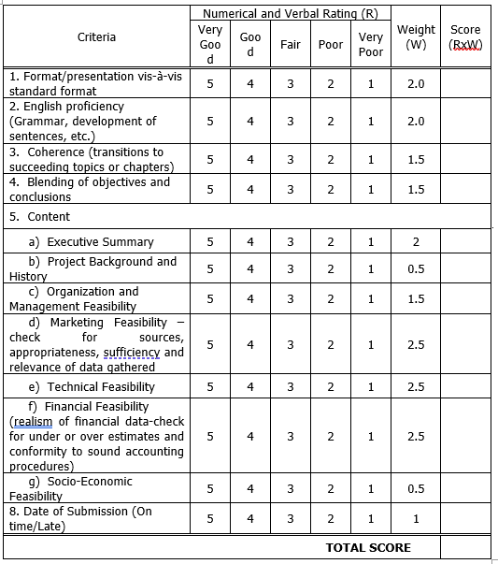
2. Final Evaluation of a Feasibility Study
a) Manuscript (60%)

Slide 13
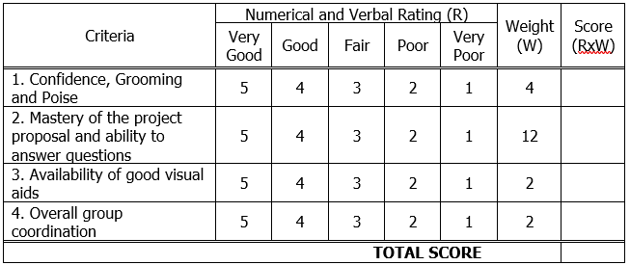
2. Final Evaluation of
a Feasibility Study
b) Oral Defense (40%)

Slide 14
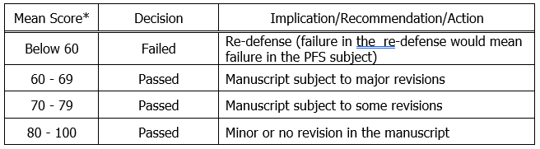
2. Final Evaluation of
a Feasibility Study
c) Decision Criteria

Slide 15
Research Consultant
Each research group shall have a consultant to be chosen from the roster of qualified UA faculty members and non-teaching personnel.
Qualifications of the Consultant
The consultant must possess at least one of the following qualifications, in the order of priority:
1 A Master’s or Doctorate Degree holder
2 A Bachelor’s Degree holder who has adequate experience in research (thesis or feasibility study, as the case maybe)
3 Practicing or professional in a field related to the group’s topic or area of study

Slide 16
Composition of the Defense Panel
The proposal and final defense panel shall have three (3) members composed of
the research (feasibility study) instructor acting as the chairman of the panel and,
(2) a dean/OIC, director, academic chair, coordinator, faculty member or non-teaching personnel who teaches research or who has adequate know-how or experience in the conduct of research
(3) the member must be an expert in a field related to the area of study who may be a UA faculty, non-teaching personnel or an outsider. Resumé of outside panelists must be presented to the Dean of the concerned College.

Slide 17

General Format/Guidelines in Writing Feasibility Studies

Slide 18
GUIDE
1.1 Margins: top, right, bottom = 1"; left = 1.5"
1.2 Font Size and Type of Text: 11-pt. Arial font
1.3 Font Size and Type of Chapter Numbers and Titles: 14-pt. Arial font
1.4 Spacing: One and a half (1.5) line spacing except for tables and figures
1.5 Paragraph Indentation: 7 spaces or ½ inch
1.6 Pagination: The page number appears at the middle one-half inch
(1/2”) from the bottom edge of each paper.

Slide 19
02 Cover
This is the outer protective structure of the bound research paper. The standard colors are navy blue for the cover and gold for the text. The front surface shall reflect the same text as in the title page.

Slide 20

Sample
Side Cover/
Spine

Slide 21
3. Preliminary Parts
3.1 Title Page
3.2 Approval Sheet
3.3 Acknowledgement Sheet
3.4 Executive Summary
3.5 Table of Contents
3.6 List of Tables
3.7 List of Figures

Slide 22
3.1 Title Page
(1) Project Title
(2) Classification of the paper
(3) Degree Program
(4) Researchers’ Names
(5) Date

Slide 23
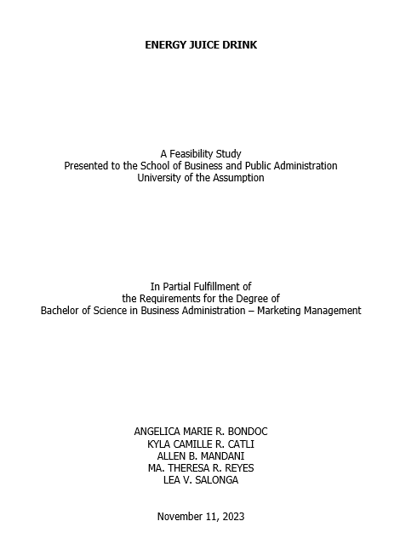
Sample
Title
Page

Slide 24
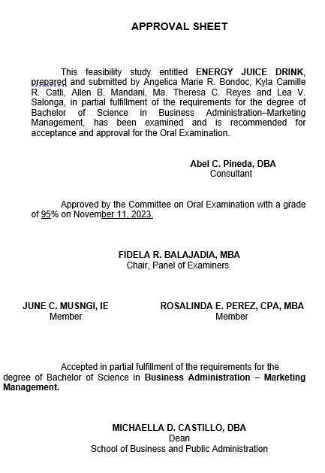
Sample
Approval
Sheet
The approval sheet follows immediately after the title page. Generally, it contains statements of recommendation and acceptance.

Slide 25
3.3 Acknowledgment Sheet
This page follows immediately the approval sheet. It reflects the researcher/s’
expression of appreciation for the assistance and encouragement extended to him
(her)/them in making the feasibility study.

Slide 26
3.4 Executive Summary
The Executive Summary is a brief comprehensive summary of the project study. It presents the entire feasibility study in capsule form.
- Name and Location of the Enterprise, and Brief Description of the project (1 paragraph)
- Major assumptions, summary of findings and conclusions on the following: (1 paragraph for each aspect)
Marketing Feasibility Management Feasibility Socio-Economic Feasibility
Production/Technical Feasibility Financial Feasibility
- Final Analysis and Overall Conclusion on the Feasibility of the Project (1 paragraph)

Slide 27
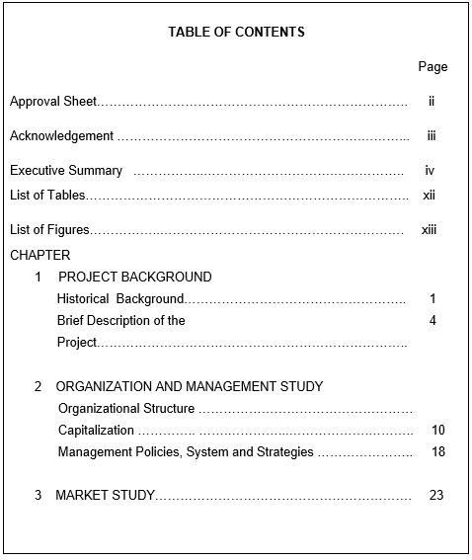
Sample Table of Contents for FS
The table of contents presents an orderly list of the preliminary parts, the chapter titles with the subsections of the body of research, the word “references”, “appendices” and the materials in the appendices for easy reference.

Slide 28
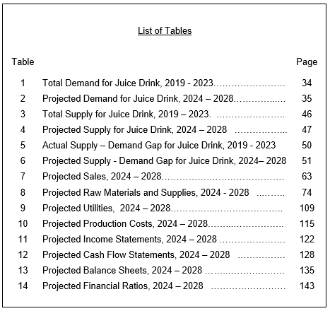
Sample
List of
Tables

Slide 29
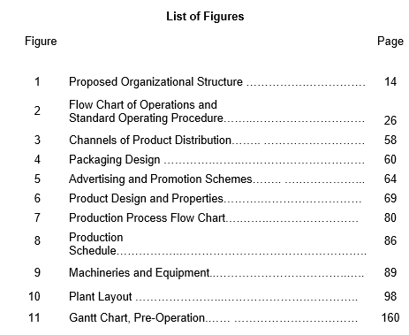
Sample
List of
Figures

Slide 30

4. Body of the Feasibility Study
The body consists of 7 main chapters. They include:
4.1 Project Background
4.2 Market Study
4.3 Technical Study
4.4 Organization and Management Study
4.5 Financial Study
4.6 Socio-Economic Study
4.7 Project Pre-operation Time Table

Slide 31
HEADINGS
Headings help the readers grasp the paper’s outline and the relative importance of its parts
o use bold centered uppercase and lowercase headings for chapter numbers, and uppercase headings for chapter titles
o use bold centered and underlined uppercase and lowercase headings for major topics in a chapter
o use bold flush left, uppercase and lowercase headings for topics under a major topic
o use bold indented, lowercase paragraph headings for subtopics within a topic

Slide 32
REFERENCES
· All sources included in the Reference section must be cited in the body of the research paper.
· The Reference section begins on a new page
· The heading References is typed centered on the first line below the manuscript page header.
· The entries (references), with hanging indentation, begin on the line following the References heading. Entries are organized alphabetically by surnames of first authors. Most reference entries have three components:

Slide 33
APPENDICES
A common use of appendices is to present unpublished tests, to describe complex equipment or stimulus or to present details relevant to the project study but were not included in the main body.
o each appendix begins on a separate page
o if there is more than one appendix, use Appendix A or B or C, etc
o if tables are to be included in an appendix, precede each appendix table number with a capital A (starting with Table A)

Slide 34
Textbook
Manual of standards for research, Balajadia, R. and Pangilinan, D. University of the Assumption 2016

Slide 35

Thanks!

