Slide 1

Feasibility Study
Lecture 8: Technical, Manufacturing (Production), or Operations Study Part 2
Lecturer: Fidela R. Balajadia
Associate Professor 2
University of the Assumption, Philippines

Slide 2
Lecture Learning Objectives:
At the end of the lecture, you will be able to:
1. Discuss the product(s) or service(s) and how they will be produced using the proponent’s own choice of location, production size (capacity) and layout
2. Identify the machineries and equipment, raw materials, and manpower requirements as well as a detailed civil engineering and lay-outing of the project
3. Discuss project’s utilities, waste management methods and the production system’s designs and forms
4. Prepare the total production cost based
on the actual business

Slide 3
The Technical Study identifies whether the process is capable of producing the product at the desired quality level with reasonable cost. To accomplish this, a detailed study of the following is essential. Where applicable and necessary, charts, plans, drawings, and layouts, drawn to scale, must be presented.

Slide 4
Machinery, equipment, and tools
This section of the technical study presents the type of machinery, equipment and related auxiliary tools needed in producing the goods, including the estimated acquisition and maintenance cost.

Slide 5
Machinery, equipment, and tools
It answers the following questions:
1. What is the model of the machinery and related equipment to be purchased, including the required specifications?
2. Who are the suppliers of these machineries and equipment?
3. Will the business buy a brand-new unit or a secondhand unit?
4. How much is the total
acquisition cost?

Slide 6
Following are the factors to be considered in selecting the necessary machinery and equipment:
1. Plant capacity and size of the machine
2. Model of the machinery and equipment
3. Production within the required time
4. Availability of spare parts and repair service
5. Cost and terms of payment
6. Plant location and layout

Slide 7
This section usually consists of schedules that show the different available machinery and equipment with the following additional information:
1. Machine capacity
2. Model and specifications
3. Name of supplier
4. Cost
5. Terms of payment
6. Estimated productive life
7. Annual depreciation

Slide 8
Building structures and other facilities
This section on buildings and other structures that need to be constructed should answer the following questions:
1. What is the size of the building to be constructed?
2. What type of building will be constructed?
3. Will it be a two-storey building?
4. How much is the estimated cost?

Slide 9
Buildings and related structures to be constructed include:
a. An administrative building
b. A manufacturing plant
c. Warehouse or storage facilities
d. Road network and pathways
e. A drainage and disposal system
f. A parking space

Slide 10
The different schedules should be included in this section, in tabular form, showing the following information:
1. Estimated cost of building structures and land
improvement
2. Estimated useful life
3. Estimated annual depreciation

Slide 11
Raw materials requirement
This section on the different types of raw materials or ingredients needed in manufacturing the product should answer the following questions:
1. What are the raw materials needed to produce the
goods?
2. Who are the existing and prospective suppliers of these
raw materials?
3. Are there enough available raw
materials for the product?
4. What is the proximity of the source of
raw materials to the processing plant?

Slide 12
Raw materials requirement
5. Are there raw materials to be imported?
6. Are there alternative raw materials?
7. What is the estimated cost of the raw materials?
8. What is the trend in the world market in terms of raw materials for the proposed product?

Slide 13

Direct labor requirement
One important concern that must be addressed squarely in a feasibility study is the availability of skilled workers. This section presents the direct labor requirements to produce the goods or to render the proposed services.

Slide 14
It should answer the following questions:
1. What specific direct labor requirements are needed to produce the goods or deliver the services?
2. Are there enough direct laborers to produce the goods?
3. How long will it take, in terms of the number of hours, to produce the goods?
4. How many workers are involved to produce the goods?
5. How much is the wage of every worker per day or per hour?
6. How much is the prevailing daily wage in
the community?
7. How much is the minimum wage in the
region where the business is located?

Slide 15

Utilities and other overhead requirements
This section on utilities and other overhead costs to manufacture the goods addresses the following questions:
1. Who are the utility providers (light and water)?
2. How much is the expected consumption for utilities?
3. Are there ways to reduce utility consumption?
4. What are the other types of overhead costs that have a material effect on the manufacture of the product?

Slide 16
Waste disposal system
This section describes the waste disposal system that may be adopted based on the type of waste it produces. However, it does not focus on the social responsibility of the business towards the community. Rather, it emphasizes the estimated cost that may be incurred relative to the disposal of waste matter.

Slide 17
This section of the technical study should answer the following questions:
1. What type of waste disposal system should be adopted?
2. What is the prevalent practice of the community in disposing of waste
or trash?
3. What is the expected volume of waste to be produced by the plant in
a month?
4. Is the industrial waste to be produced by the business recyclable?
5. How much is the estimated cost of disposing the garbage?

Slide 18
Total Production Costs
In this section of the technical study, the total requirement for production cost can be determined. This includes the costs of the following items:
a. Direct Labor (Wages + Workers’ Benefits)
b. Raw Materials (Direct and Indirect Materials)
c. Manufacturing Overhead
Rental Expense
Taxes
Depreciation of Machineries and Equipment
Utilities (water, electricity, gasoline, telephone, gas cylinder)
Factory/Manufacturing Supplies
Leasehold Improvement
Advertising

Slide 19
System and Forms Design
Inventory Slips or Records - used to determine your stocks of inventories
Bill of Materials – lists of all the component parts of an assembly i.e., the quantity requirements for each unit of the assembly and the source of each part
Manufacturing Requisition Slip – identifies the item/s to be produced and stipulates the quantities needed to be replenished
Machine Load Charts – contain a list of the operational details and requirements (capacity, use and schedule) of each of your machineries and equipment

Slide 20
In Summary, you have to prepare the following:
1. Introduction
2. Product or Service Description
This section describes the product(s) and their specifications in terms of their physical, mechanical, and chemical properties and quality. The uses of the product(s) are also presented. For service projects, the specific service you intend to do is elaborately described. Present some drawings, pictures, or photocopies of your intended products/services.
3. Standard Recipe/ Materials used to produce the product

Slide 21
In Summary, you have to prepare the following:
4. Nutritional Facts or Product Benefits
5. Procedure (from step 1 to end)
6. Process Flow Chart

Slide 22
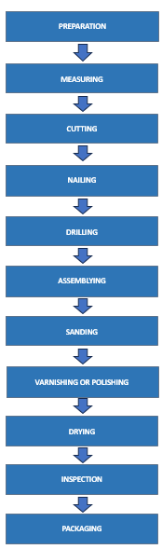

Slide 23
In Summary, you have to prepare the following:
7. Production / Manufacturing Process
- Intermittent
- Continuous
8. Production Design Symbols

Slide 24
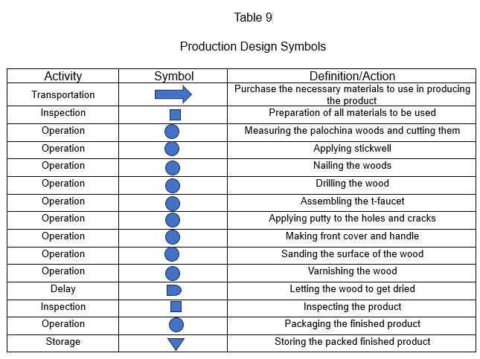

Slide 25
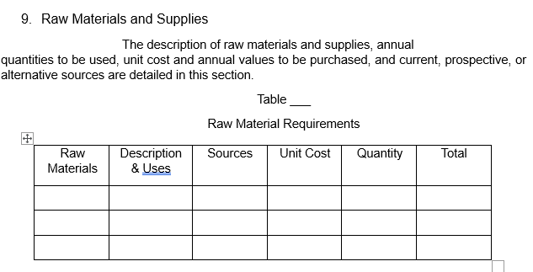

Slide 26
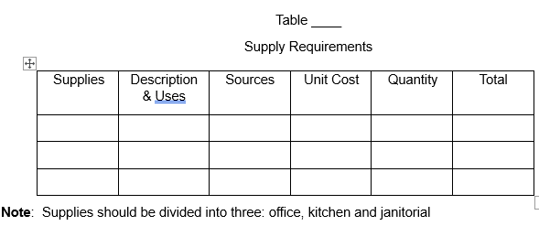

Slide 27
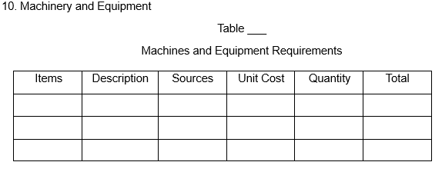

Slide 28
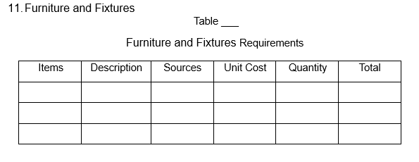

Slide 29
12. Plant size and Production Schedule
This section provides the rated annual and daily capacity per shift, the number of operating days per year and the factors used in determining plant size/capacity. It also presents the projected production volume for the next five years.
Example: The plant has a range and capacity of producing quality products. It has 60 square meters. The size or the width of the area is just right and it is free from hazardous pollution. The production will have a smooth and clean flow of processing.
The working hours will be eight (8) hours a day and 26 days a month, The production capacity of the plant is 15 pieces per day

Slide 30
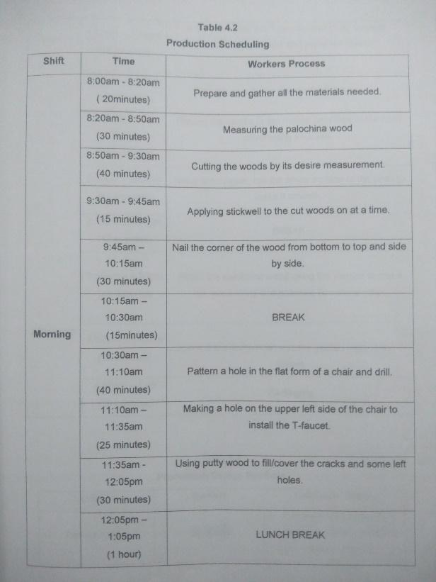
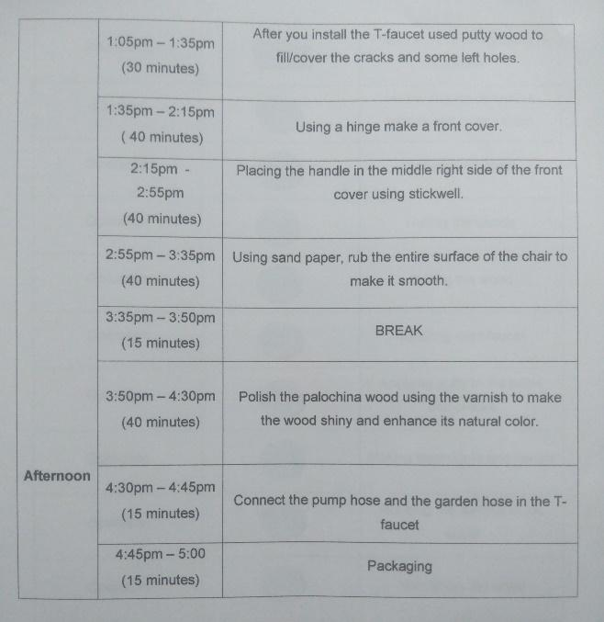
Quilala (2020)

Slide 31
13. Plant location/ Project Site
This section shows the location map of the plant and the desirability of the location/s in terms of distance to sources of raw materials and market, and other factors.

Slide 32
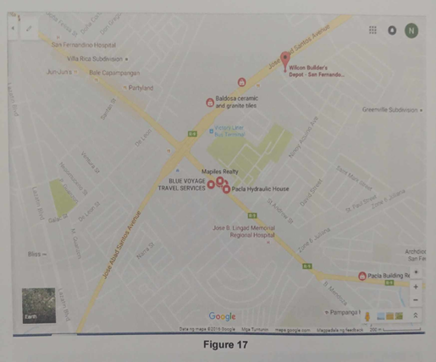
Quilala (2020)

Slide 33
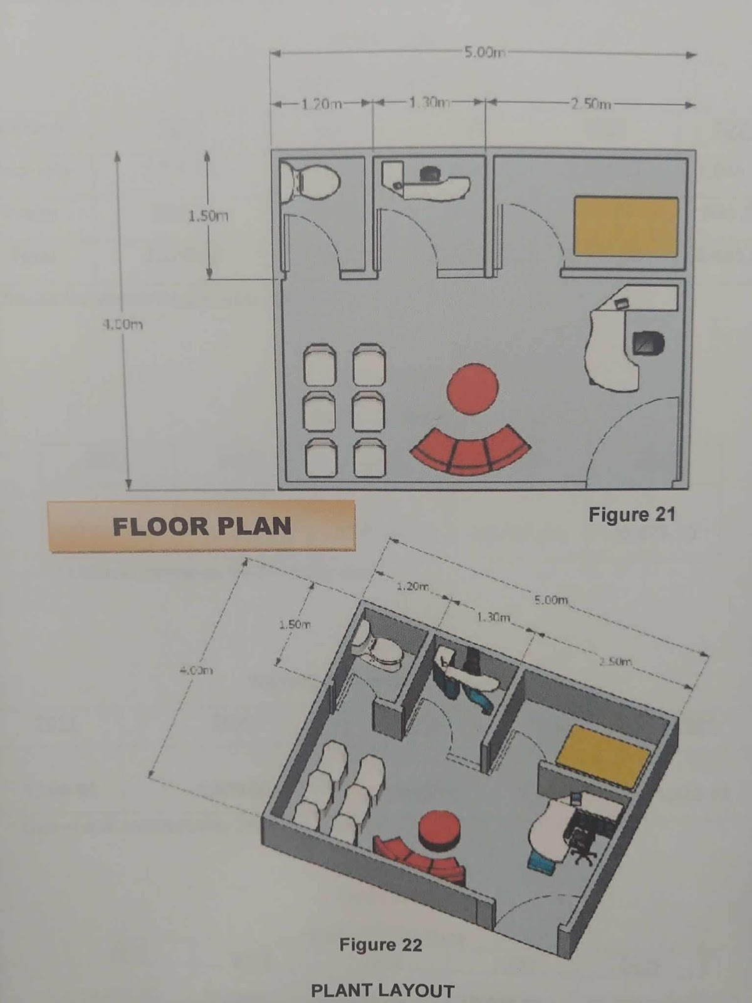
14. Floor Plan
This section describes in detail your project’s floor plan for each section and if possible, include a detailed drawing for each of your flow plans
Quilala (2020)

Slide 34
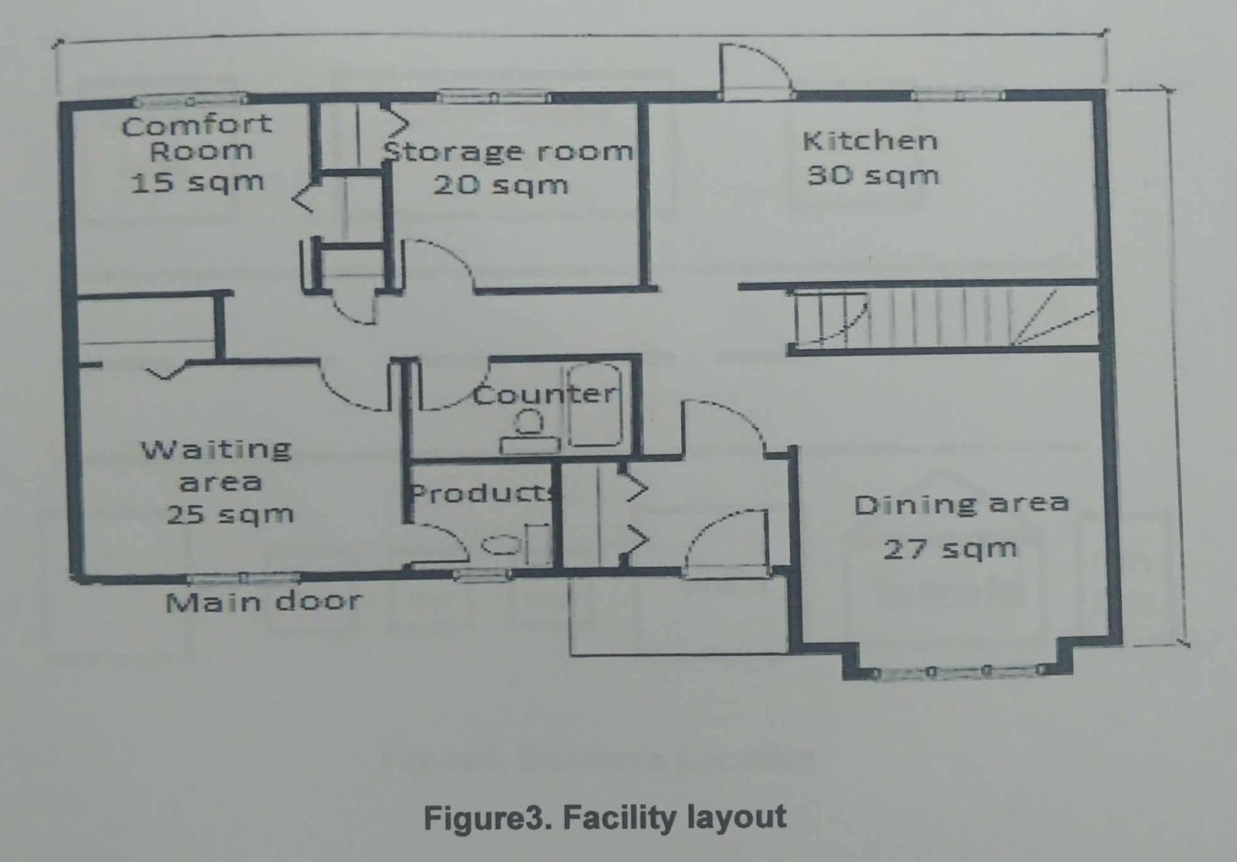
15. Plant layout
This section presents the general description of the plant
layout and the layout chart. It shows how the layout affects the materials flow,
materials handling and storage. Provisions for expansion are also specified.
Note: Draw the office area, production area, display area, etc.
Quilala (2020)

Slide 35
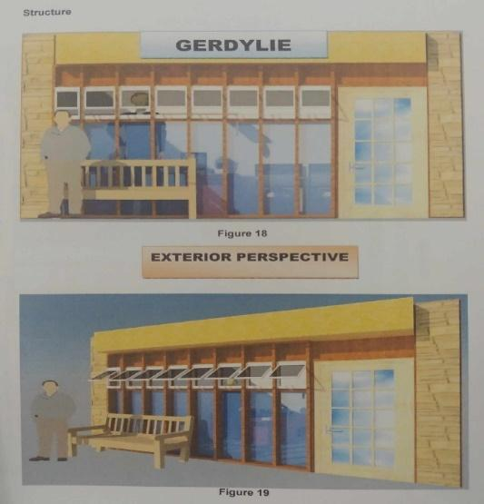
16. Structure/Building
Building and costs of erection are the main parts of this section. Other
structures and land improvements such as roads, drainage facilities, etc., and their respective
costs are also included.
Note: front elevation, rear elevation (back view),
right side elevation and left side elevation
Quilala (2020)

Slide 36
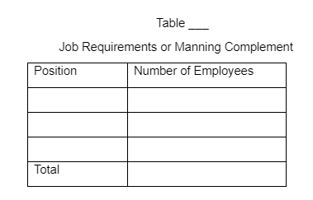
17. Labor Requirements
This section details total labor requirements from start of
operations until normal production capacity is attainable. It indicates the required number of workers according to skill, sex, and whether full-time / part-time / seasonal, at normal production capacity. Wage rates, salaries, fringe benefits, etc. are specified and details of special training programs, including costs, are set out.

Slide 37
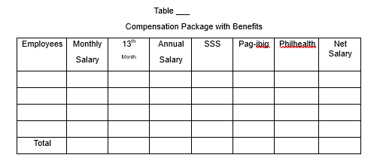

Slide 38
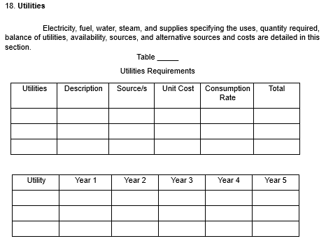

Slide 39
19. Waste disposal
This section provides a
description and the quantity of the waste to be disposed of, a description of the waste disposal methods vis-à-vis methods used in other plants and costs of waste disposal. Waste disposal methods must comply with legal requirements.

Slide 40
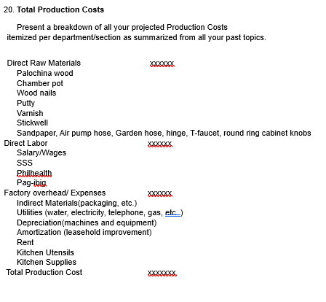

Slide 41
21. Forms Design
- Inventory Slips or Records
- Bill of Materials
- Manufacturing Requisition Slip
- Machine Load Charts

Slide 42
Textbooks:
A feasibility study guidebook for Students and Entrepreneurs, Jorge H. Cuyugan, Bright Concepts Printing House, 2020
Manual of standards for research, Balajadia, R. and Pangilinan, D. University of the Assumption 2016
Writing Project Feasibility Study, Nick L. Aduana, C & E Publishing, Inc. 2021
Pot De Chambre, Ardy E. Quilala,
UA, 2020

Slide 43
Credits
Special thanks to all the people who made and released these awesome resources for free:
3D illustrations by Alzea Arafat
Presentation template by SlidesCarnival
Photographs by Unsplash

