Slide 1

Feasibility Study
Lecture 11: Financial Study Part 2
Lecturer: Fidela R. Balajadia
Associate Professor 2
University of the Assumption, Philippines

Slide 2
Lecture Learning Objectives:
At the end of the lecture, you will be able to:
a. Discuss the Philippine Accounting terms
b. Identify who will be the project financiers
c. Explain the most adaptable financing scheme based on the financiers’ terms and conditions
d. Discuss the sources of financing
e. Develop financial soundness of the proposal
f. Discuss the assumptions of the financial projections
g. Discuss how much capitalization (total project cost) will be
needed to finance the study.
h. Present the projected financial statements and financial analysis,
financial ratios, break-even points, project rate of returns, sensitivity
analysis and the payback period

Slide 3
The Financial Study describes the overall
financial viability of the project by presenting the financial assumption, total project cost, projected financial statements and financial ratios.

Slide 4
Projected Financial Statements
The financial projections are the end product of the market, technical, and organization and management study, and the figures used in the financial projections are, therefore, in relation to and dependent on the results of the said aspects. This section provides:
§ Projected balance sheets for at least 5 years
§ Projected cash flow statements for at least 5 years
§ Projected income statements for at least 5 years

Slide 5
Projected Financial Statements
This section also sets up supporting schedules to the financial projections which include collection on sales, inventory levels, payment period for purchases and expenses, elements of production cost, selling, administrative and financial expenses.

Slide 6
The Basic Financial Statements
1
3
2
Balance Sheet or Statement of Financial Position
Income Statement of Statement of Comprehensive Income
Cash Flow or Statement of Cash Flow

Slide 7
(1) The Balance Sheet is a financial statement that presents all the assets of, and claims against or the liabilities and equity, of the firm at a particular period of time.
The Balance Sheet as summary of all the amounts and kinds of assets that the firm’s possesses, as well as the claims made against those assets by investors and creditors, include the following account concepts:
1. The total of the firm’s assets must equal the total value
of the claims against the firm.

Slide 8
The Balance Sheet is composed of:
ASSETS
1
2
3
Current Assets
INVESTMENTS
FIXED ASSETS

Slide 9
The Balance Sheet is composed of:
ASSETS
4
5
INTANGIBLE ASSETS
OTHER ASSETS
Organizational Costs
Deferred Charges

Slide 10
The Balance Sheet is composed of:
ASSETS
Current Assets
1
2
3
CASH
MARKETABLE SECURITIES
PROMISSORY NOTES

Slide 11
The Balance Sheet is composed of:
ASSETS
Current Assets
4
5
6
NOTES RECEIVABLES
INVENTORIES
PREPAID EXPENSES

Slide 12
Four Forms of Inventories:
FACTORY OR MANUFACTURING SUPPLIES
1
3
2
4
FINISHED GOODS
RAW MATERIALS
GOODS (WORK) IN PROCESS

Slide 13
Balance Sheet account concepts: cont.
2. The market value of the asset is the price the asset could command in the market, and the replacement cost is the price that would be required to replace the asset if it had to be acquired today.
3. The value of the assets shown in the financial reports and the books of the company, the book value, may differ from the market value of the assets. Assets that have become obsolete typically have market values below their book values, while the opposite condition holds for assets, such as land, that have appreciated in value.

Slide 14
The Balance Sheet is composed of:
LIABILITIES
DEFERRED REVENUES
1
3
2
4
CURRENT LIABILITIES
OTHER LONG-TERM LIABILITIES
LONG-TERM LIABILITIES

Slide 15
CURRENT LIABILITIES
NOTES PAYABLE
DIVIDEND PAYABLES
CUSTOMERS’ ACCOUNTS WITH CREDIT BALANCES
1
4
ACCOUNTS PAYABLE
ACCRUALS
2
5
TAXES PAYABLE
3
6

Slide 16
(2) LONG-TERM LIABILITIES
PREMIUMS ON BONDS PAYABLE
1
BONDS PAYABLE
2

Slide 17
(3) OTHER LONG-TERM LIABILITIES
1
PENSIONS
(4) DEFERRED REVENUES

Slide 18
The Balance Sheet is composed of:
STATEMENT OF OWNER’S EQUITY
1
2
3
SOURCES AND USES OF FUNDS
WORKING CAPITAL
CHANGE IN NET WORKING CAPITAL STATEMENT

Slide 19
STATEMENT OF OWNER’S EQUITY
STOCKHOLDERS EQUITY
01.
02.
PAID-IN CAPITAL
03.
CAPITAL STOCKS
04.
TREASURY STOCKS
05.
RETAINED EARNINGS
-UNAPPROPRIATED
-APPROPRIATED

Slide 20
CASH FLOW STATEMENT
MAJOR CORPORATE CASH FLOW
SOURCES OF CASH
The firm can obtain cash from issuing new stocks to owners, as stockholders or bonds to creditors, as bondholders.
a. Sales
b. Capital invested by stockholders
c. Debt funds raised from creditors

Slide 21

INCOME STATEMENT
01
02
03
SALES
COST OF GOODS MANUFACTURED AND SOLD
OPERATING EXPENSES
SELLING EXPENSES
ADMINISTRATIVE EXPENSES
OTHER INCOME
OTHER EXPENSES

Slide 22
Types of Funds:
Equity Capital
Creditor/s’ Capital

Slide 23
Sources of Funds:
Equity Capital
RETAINED EARNINGS
ADVANCED PAYMENT FROM CUSTOMERS
THE SALE OF STOCKS
ACCOUNTS RECEIVABLES
INVESTORS PERSONAL RESOURCES

Slide 24
Sources of Funds:
Creditors Capital
Banks - Pawn shops
Merchant Creditors - Individual Money Lender
Insurance Companies - Private Voluntary Org.
Mortgage Bankers - Savings & Loan Assoc.
Finance Companies

Slide 25
A List of Considerations, Requirements, and Procedures for Loan Applications
This contains a list of important items to consider in making loans. These items will be prepared during your inquiry from your financing source. These are:
A. Considerations:
When obtaining a loan, it is very important that you should consider the following, which are also valuable to your financial feasibility computations:
1. Source(s) of funds, supplier/s’ terms and conditions in your procurement of machineries and all other equipment and accessories
2. Debt-to equity requirements of your project
3. Your funding source/s’ collateral requirements and assessment
or appraisal methods and rates

Slide 26
A List of Considerations, Requirements, and Procedures for Loan Applications
A. Considerations:
4. In case of foreign funding, the currency of repayment
5. Interest rates
6. Maturity (Repayment) and amortization dates
7. Application and processing fees
8. Withholding taxes and tax exemptions if any
9. Processing time (up to loan release)
10. Deposit requirements if any

Slide 27
B. Requirements:
1. Real estate properties
2. Motorized vehicles
3. Machineries and equipment and accessories
4. Jewelries
5. Merchandise (goods, crops, etc.)
6. Stocks and bonds (corporate securities)
7. Instruments of ownership of commodities like bills of lading,
advance payment receipts, post dated checks, etc.
8. Personal belongings (for pawnshops)

Slide 28
C. Procedures:
Banking procedures vary. Depending on your study’s most practical financing scheme, why not get a copy of your alternative financing sources’ borrowing guidelines and their loan programs’ terms and conditions?
From these, you can make your analysis and personal decision which of them best suit your project’s financial requirements and considerations.

Slide 29
MAJOR FINANCIAL ASSUMPTIONS USED
1. Annually, production will increase by 2.21% due to population growth rate.
2. Raw materials costs will increase by 5% yearly due to inflation and changes in
market indexes.
3. Salaries will increase by 2% yearly.
4. Finished Goods Inventory, Ending is 4% for the regular sales and 3% for
consignment basis

Slide 30
MAJOR FINANCIAL ASSUMPTIONS USED
5. All other operating expenses except depreciation and rent are assumed to
increase annually by 5% due to inflation.
6. Rent, Electricity and Water Expenses are allocated as follows: office (20%)
and production (80%).
7. Depreciation is computed using the straight-line method.
8. Income tax is estimated at 30% per year.
9. The company’s market share increases 2.79% annually.

Slide 31
TOTAL PROJECT COST
State here your total investment costs by presenting all your project’s costs requirements from all your previous Lecture.
a. Direct & Indirect Labor (Salaries/Wages + Employees’ Benefits)
b. Raw Materials (Direct and Indirect Materials)
c. Manufacturing Overhead
Rental Expense
Taxes and Licenses
Depreciation of Machineries and Equipment
Utilities (water, electricity, gasoline, telephone, gas cylinder)
Factory/Manufacturing Supplies
Leasehold Improvement
Advertising

Slide 32
TOTAL PROJECT COST
d. Office Furniture and Fixtures
e. Machinery and Equipment
f. Delivery Van
g. Office Supplies
h. Kitchen Supplies
i. Janitorial Supplies

Slide 33
Financial Analyses
This section outlines the project’s ability to absorb loans, its repayment prospects, solvency, and overall financial viability by presenting relevant ratios
based on financial projections. It includes:
▪ Profitability ratios: calculating gross profit, operating profit and net profit
margins for each year, and average over the projected operating period.
▪ Liquidity ratios: calculating debt to equity ratio, and debt service coverage
for each year.
▪ Break-even and price analysis: calculating break-even price, volume, and
Capacity.
▪ Profitability evaluation and capital recovery: showing the return on
investment and return on equity, cash payback period,
discounted/internal rate of return and net present value.

Slide 34
FINANCIAL RATIOS
These are indices used in expressing financial data in such a way that it can be compared, and trends identified and thus questions can be raised.
Ratios should be used to build up and summarize the evidence available and to create a picture from which, not conclusions, but better questions can be drawn.
Primary Ratio considers the profit or return level of the business entity, normally for the
year, in relation to the capital employed or invested, or net assets during the same period.
This is the primary measurement for all investment anywhere and in business, where the money has gone to.

Slide 35
FINANCIAL RATIOS
Secondary Ratios are further investigation of primary ratio. These are ratios concerned with profitability – profit in relation to sales and the other is with activity
– sales in relation to capital employed or net assets.
Tertiary Ratios evaluate profitability of the business and analysis of activity. The profitability ratio can be assessed from the point of view of gross profit or contribution to sales as a percentage. Activity or use of assets ratio is an examination of activity by comparing sales separately with fixed assets and working capital.
Financial status ratios are those that help analyze a business’s financial standing in terms of its ability to pay liabilities and settle obligations.

Slide 36
FINANCIAL RATIOS
Liquidity ratio is the relationship of current assets to current liabilities. Also, acid test or quick test ratio can be used to measure liquidity.
Stock turnover, collection and payment ratios include stock turnover, collection period and payment period in conjunction with the liquidity ratios to evaluate whether stocks are being controlled and credit policies are enforced.
Solvency ratios calculate the ability of the business to meet the interest due from the profits available.
Investment ratios are intended to give investors the financial position of the business and the invested capital.

Slide 37
FINANCIAL RATIOS
Return on equity confines its view to the profits belonging to the shareholders – the profit after tax and interest – and its relationship to the shareholders’ funds.
Earnings per share is the central measurement of profitability from an investor’s point of view. This is the ratio of profit after tax and interest against numbers of issued shares.
Price/earnings ratio expresses the number of times the price of the share exceeds the earnings per share.

Slide 38
FINANCIAL RATIOS
Dividend yield reveals rewards to investors – the dividends paid to them, with the market price of their shares.
Dividend cover uncovers the generosity of the business, in terms of determining the proportion of the profits distributed to investors. The higher the dividend cover, the greater the retention; the lower, the greater the distribution.

Slide 39
Activity Ratios
Activity ratios are related to operations and operating efficiency because they measure how quickly the firm is converting assets into cash.
Inventory turnover measures how many times per period (usually a year) the firm sells through its inventory.
Accounts receivable turnover is the annual credit sales of the firm divided by the accounts receivable.
Average collection period is also called “days of sales outstanding”, the average collection period describes the average time it takes to collect accounts.
Inventory conversion cycle combines the days of sales in inventory and days
of sales in accounts receivable. It gives the company an idea as to how long it takes to convert inventory to accounts receivable and subsequently, into cash.

Slide 40
Activity Ratios
Asset turnover is concerned with efficient use of assets. The goal is not to sell through the fixed assets but to maximize the efficiency of those assets.
Fixed asset turnover looks at sales in comparison to the long-term assets of the firm, such as land, equipment, and plants.
Total asset turnover combines the effects of current asset management, the
conversion of inventory and accounts receivable into cash and fixed asset management. It allows the firm to compare how well it is managing each type of asset.

Slide 41
Leverage Ratios
It is the responsibility of the financial manager to determine the level of debt that
is appropriate for a firm. Debt or loan has a fixed value if the company is making regular payments.
Debt to equity ratio shows the relationship between debt and equity
Times-interest-earned ratio determines if the firm is capable of serving the
interest they have for debts and gives idea of whether additional interest expense could be added. Debt obliges the firm to make specified payments of both principal and interest at
regular intervals.
Times-interest-earned ratio = operating income (operating before int. & tax)
Interest

Slide 42
Profitability Ratios
Since the goal of most companies is to earn a profit, these ratios are the most important to financial managers.
Gross profit margin profitability is the broadest measure of the firm’s profit level.
Operating profit margin examines the income of the company before taking into account the interest and taxes.
Net profit margin demonstrates a better assessment of a firm’s profitability, particularly for a company who does owe interest and taxes.
Return on assets determines profitability in relation to assets management.
Return on equity evaluates whether the use of company assets contributes to the rate of return for stockholders’ investment.

Slide 43
Market Values
A firm’s value is related to what an investor will pay for its stock. If demand for
the stock increases, then its price will also increase, wherein its increase in share price can be tied to expectation of an increase in future earnings.
Book Value is the basis for fairly determining the worth of the assets in relation to a holders’ share, upon liquidation of the firm.
Book Value = Total Assets
Number of shares outstanding
Earnings per share aims to identify the valid earnings per share value, by
looking at trends over time or the earnings of other companies in the same industry.
Earnings per share = Net income –preferred dividends
Number of shares outstanding
Price earnings ratio = Market price of the stock
Earnings per share

Slide 44
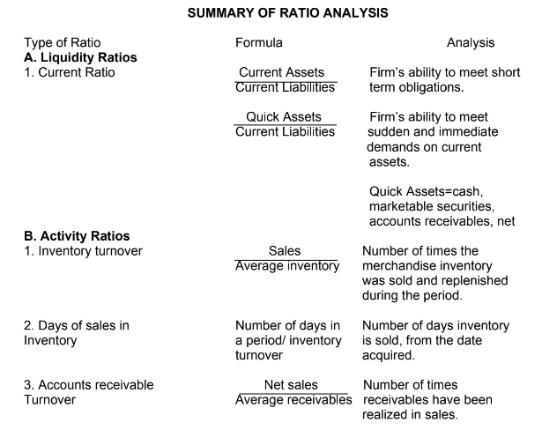
Cuyugan (2020)

Slide 45
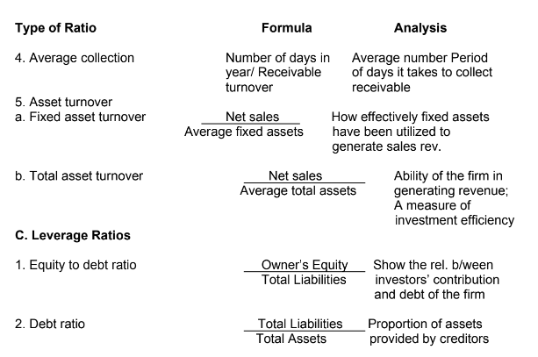
Cuyugan (2020)

Slide 46
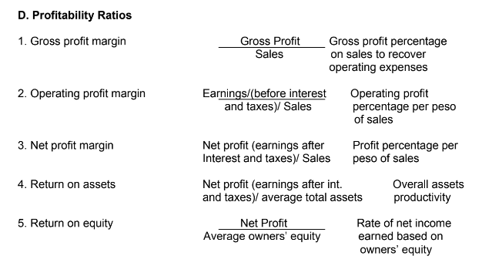
Cuyugan (2020)

Slide 47
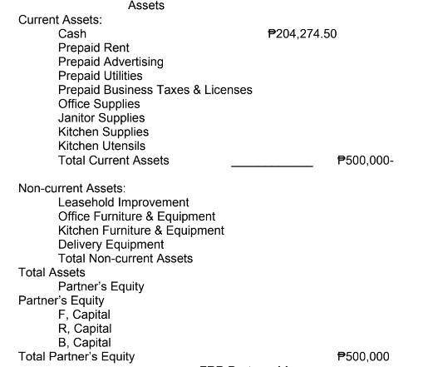
FRB Partnership
Pre-operating Statement of Financial Position
As of January 1, 2024

Slide 48
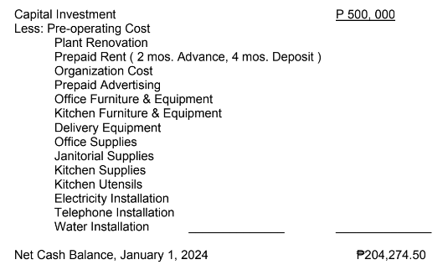
FRB Partnership
Pre-operating Cash Flow Statement
As of January 1, 2024

Slide 49
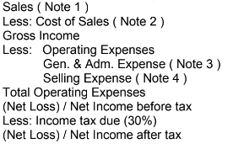
FRB Partnership
Comparative Statement of Comprehensive Income
For the year Ended, December 31, 2024-2028

Slide 50
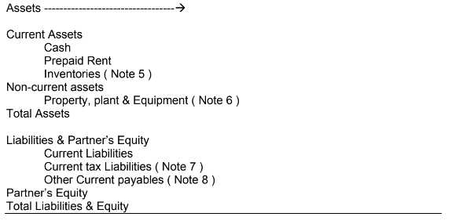
FRB Partnership
Comparative Statement of Financial Position
As of the year ended, December 31, 2024 – 2028

Slide 51
Notes 3 : General & Administrative Expenses
Salaries & Wages
Employee Benefit Expense
Utilities Expense
Electricity
Water
Telephone
Supplies Expense
Office Supplies
Janitorial Supplies
Bus. Tax & License
Rent Expense
Amortization Expense
Leasehold Improvement
Depreciation Expense
Office Furniture & Equipment
Total Gen. & Adm. Expenses
Note 1 : Sales
Consignment Sales
Regular Sales
Total Sales
Notes 2 : Cost of Sales
Total Production Costs
Less: Cost of Ending Inventory
Total Cost of Sales

Slide 52
Note 6 : Property, Plant and Equipment ( PPE )
Leasehold Improvement
Kitchen Furniture & Equipment
Office Furniture & Equipment
Delivery Equipment
Total PPE
Note 7 : Current Tax Liabilities
Income Tax Payable
W/holding Tax Payable
Total Current Tax Liabilities
Note 8 : Other Current Payables
SSS & EC Premium Payable
PhilHealth Premium Payable
Pag-ibig Premium Payable
Total Other Current Payables
Note 4 : Selling Expense
Salaries Expense ( Delivery man )
Employee benefit expense
Advertising Expense
Depreciation Expense
Delivery Equipment
Gasoline Expense
Commission Expense
Total Selling Expense
Note 5 : Inventories
Ending inventory
Cost per pack
Cost of ending inventories

Slide 53
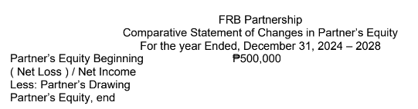

Slide 54
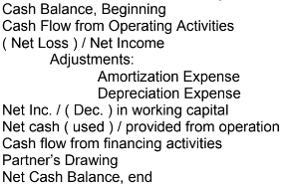
FRB Partnership
Comparative Statement of Cash Flow
For the year Ended, December 31, 2024 – 2028

Slide 55
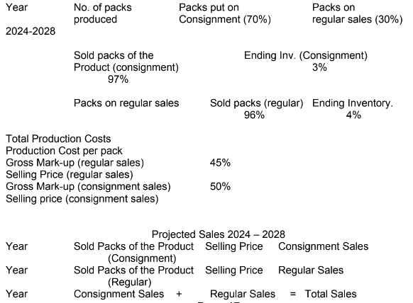

Slide 56
In Summary, you will be required to prepare the following:
1. Introduction
2. Major Financial Assumptions
3. Total Project Cost
4. Prepare the Financial Statements
(5 year- projection) with supporting schedules
5. Financial Ratios

Slide 57
Textbook:
A feasibility study guidebook for Students and Entrepreneurs, Jorge H.
Cuyugan, Bright Concepts Printing House, 2020

Slide 58

Thanks!
Please keep this slide for attribution

