Slide 1
CHANGE MANAGEMENT
Chapter 1
Process Models of Change
Lecturer: Dr. Michaella DeLeon Castillo
Philippines

Slide 2
LEARNING OUTCOMES
After studying this chapter, you should
Demonstrate an understanding of the key process theories of change: Students will be able to explain and differentiate between the four process theories of change, namely teleological, dialectical, life cycle, and evolutionary.
Construct a conceptual framework: Students will be able to create a conceptual framework that illustrates the interconnected nature of events, decisions, and actions within the context of these process theories of change.
Analyze the variance in change theories: Students will be able to critically analyze and compare the four process theories of change, highlighting the variations in how they depict change as a sequence of stages.
Evaluate the direction of change: Students will be able to evaluate whether the direction of change in these theories is constructed by human agency or predetermined by external factors.

Slide 3
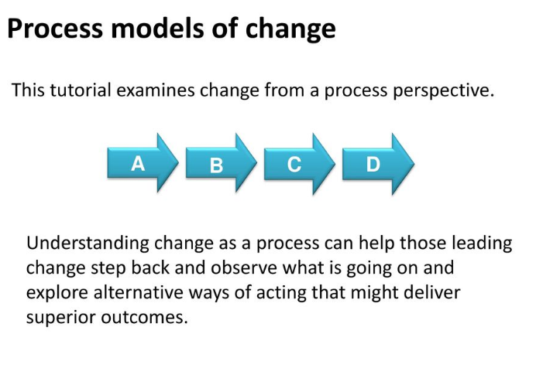
John Hayes (2014), The Theory and Practice of Change Management, 4th ed.
Online source https://slideplayer.com/slide/13711905/

Slide 4
John Hayes (2014), The Theory and Practice of Change Management, 4th ed.
Online source https://slideplayer.com/slide/13711905/

Slide 5
States and processes
State of alignment
Schneider et al. (2003, p. 125)
Miles and Snow (1984)
Barnett and Carroll (1995)
John Hayes (2014), The Theory and Practice of Change Management, 4th ed.
Online source https://slideplayer.com/slide/13711905/

Slide 6
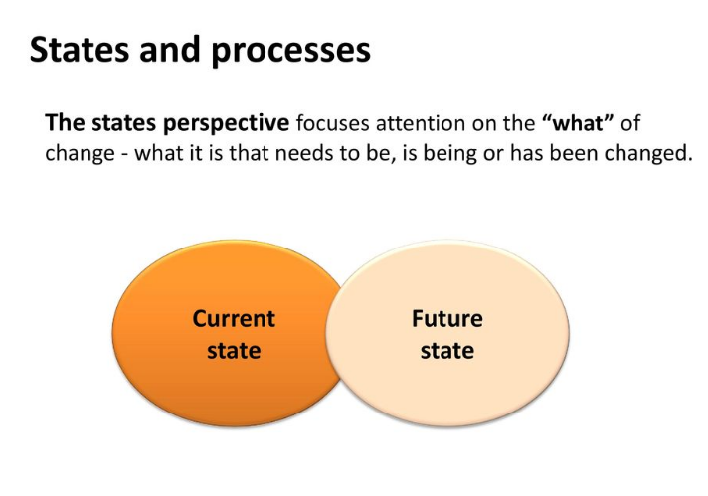
John Hayes (2014), The Theory and Practice of Change Management, 4th ed.
Online source https://slideplayer.com/slide/13711905/

Slide 7
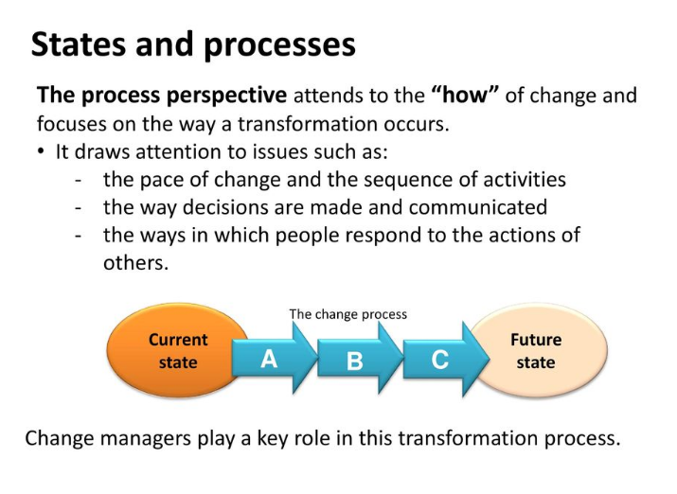
John Hayes (2014), The Theory and Practice of Change Management, 4th ed.
Online source https://slideplayer.com/slide/13711905/

Slide 8
John Hayes (2014), The Theory and Practice of Change Management, 4th ed.
Online source https://slideplayer.com/slide/13711905/

Slide 9
The Change Process
  Teleological theories
  Dialectical theories
  Life Cycle theories
  Evolutionary theories
John Hayes (2014), The Theory and Practice of Change Management, 4th ed.
Online source https://slideplayer.com/slide/13711905/

Slide 10
Teleological theories:
Purposeful and adaptive
Unfolding cycle of goal formulation
Modification of goals
John Hayes (2014), The Theory and Practice of Change Management, 4th ed.
Online source https://slideplayer.com/slide/13711905/

Slide 11
Dialectical theories:
Conflicting goals
Confrontation
John Hayes (2014), The Theory and Practice of Change Management, 4th ed.
Online source https://slideplayer.com/slide/13711905/

Slide 12
Life Cycle theories:
Cumulative
Final outcome
John Hayes (2014), The Theory and Practice of Change Management, 4th ed.
Online source https://slideplayer.com/slide/13711905/

Slide 13
Evolutionary theories:
Continuous cycle variations
Retention
John Hayes (2014), The Theory and Practice of Change Management, 4th ed.
Online source https://slideplayer.com/slide/13711905/

Slide 14
John Hayes (2014), The Theory and Practice of Change Management, 4th ed.
Online source https://slideplayer.com/slide/13711905/

Slide 15
John Hayes (2014), The Theory and Practice of Change Management, 4th ed.
Online source https://slideplayer.com/slide/13711905/

Slide 16
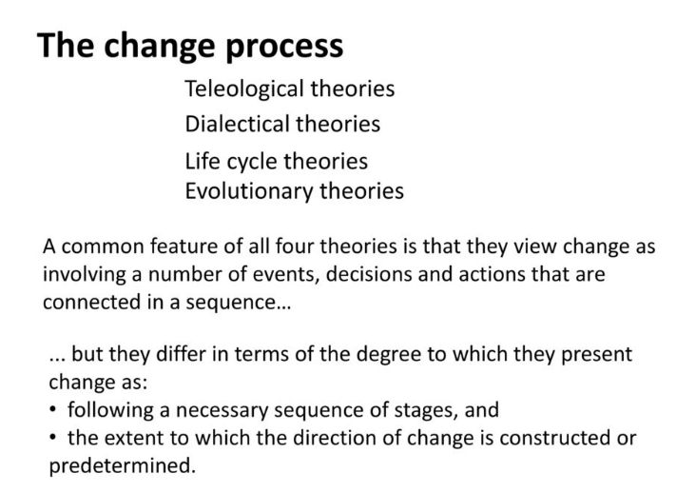
John Hayes (2014), The Theory and Practice of Change Management, 4th ed.
Online source https://slideplayer.com/slide/13711905/

Slide 17
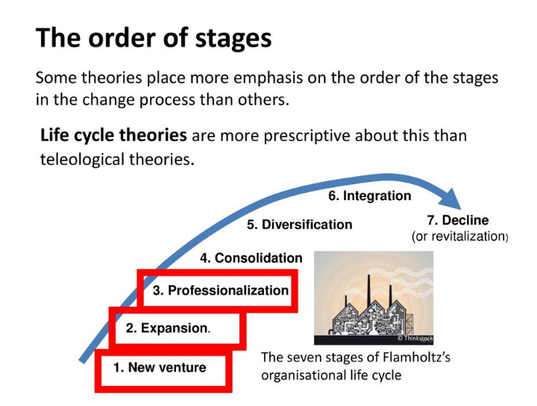
source: Hayes, John. The theory and practice of change management 4th edition. pp 32-33
John Hayes (2014), The Theory and Practice of Change Management, 4th ed.
Online source https://slideplayer.com/slide/13711905/

Slide 18
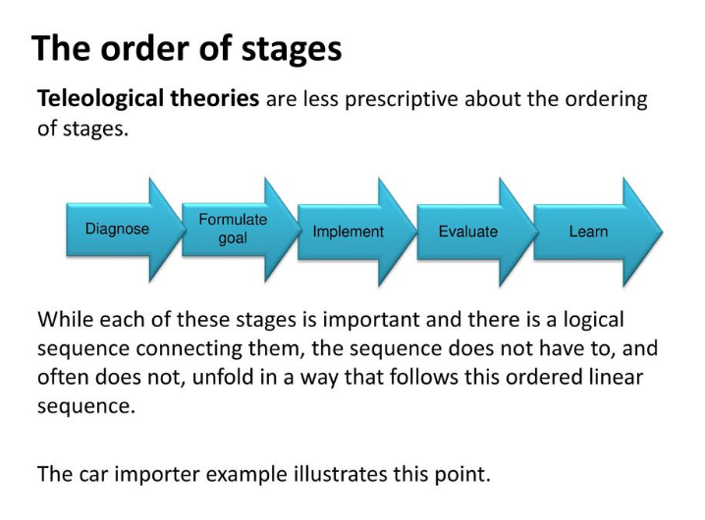
source: Hayes, John. The theory and practice of change management 4th edition. pp 33-34
John Hayes (2014), The Theory and Practice of Change Management, 4th ed.
Online source https://slideplayer.com/slide/13711905/

Slide 19
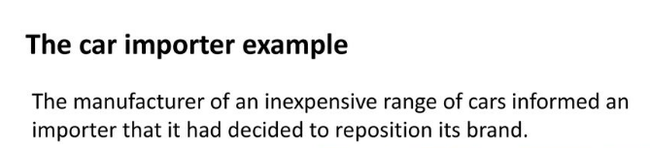
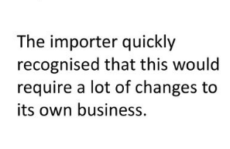
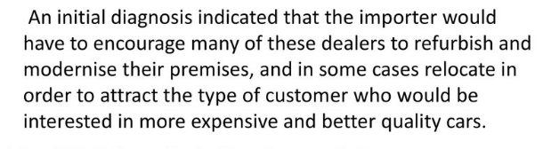
33
John Hayes (2014), The Theory and Practice of Change Management, 4th ed.
Online source https://slideplayer.com/slide/13711905/

Slide 20
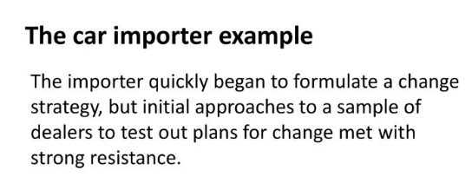
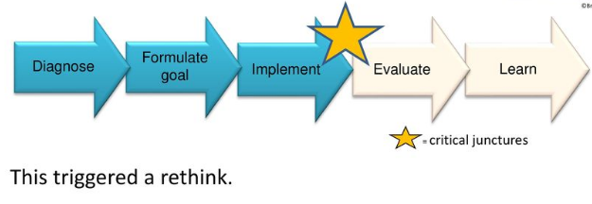
source: Hayes, John. The theory and practice of change management 4th edition. pp 33
John Hayes (2014), The Theory and Practice of Change Management, 4th ed.
Online source https://slideplayer.com/slide/13711905/

Slide 21
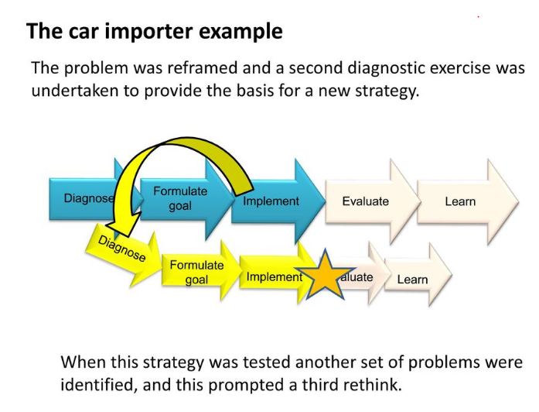
source: Hayes, John. The theory and practice of change management 4th edition. pp 33 - 34
John Hayes (2014), The Theory and Practice of Change Management, 4th ed.
Online source https://slideplayer.com/slide/13711905/

Slide 22
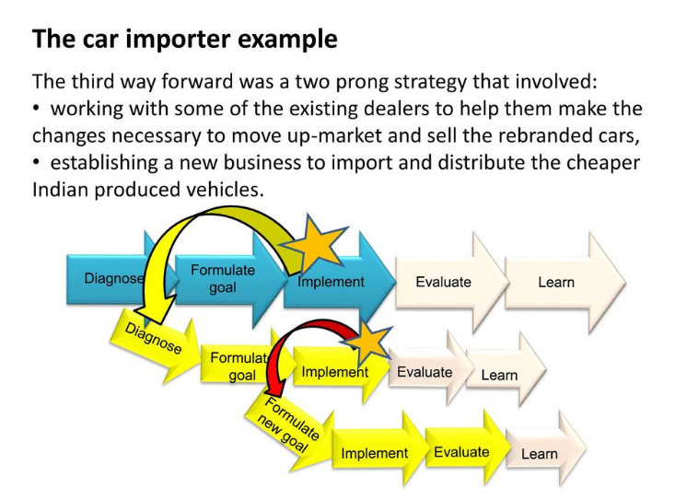
source: Hayes, John. The theory and practice of change management 4th edition. pp 33 – 34
John Hayes (2014), The Theory and Practice of Change Management, 4th ed.
Online source https://slideplayer.com/slide/13711905/

Slide 23
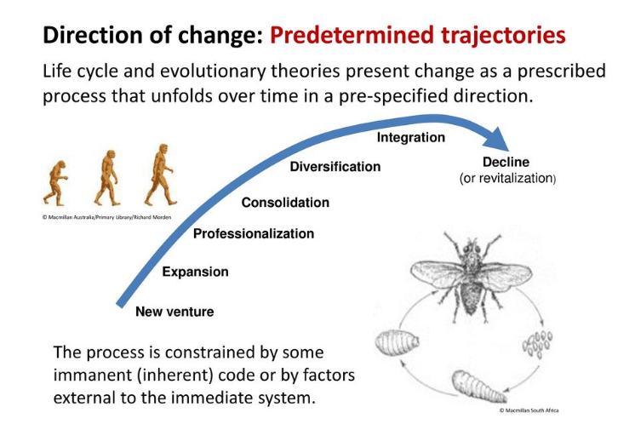
source: Hayes, John. The theory and practice of change management 4th edition. pp 33 – 36
John Hayes (2014), The Theory and Practice of Change Management, 4th ed.
Online source https://slideplayer.com/slide/13711905/

Slide 24
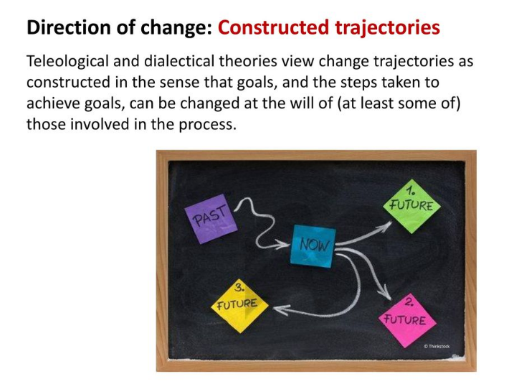
source: Hayes, John. The theory and practice of change management 4th edition. pp 35 – 37
John Hayes (2014), The Theory and Practice of Change Management, 4th ed.
Online source https://slideplayer.com/slide/13711905/

Slide 25
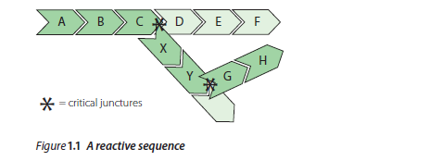
The impact of sequence on outcome
Reactive sequences
John Hayes (2014), The Theory and Practice of Change Management, 4th ed - pp 35
John Hayes (2014), The Theory and Practice of Change Management, 4th ed.
Online source https://slideplayer.com/slide/13711905/

Slide 26
Self-reinforcing sequences
Increasing returns
Psychological commitment to past decisions
Cognitive biases and interpretive frames
John Hayes (2014), The Theory and Practice of Change Management, 4th ed.

Slide 27
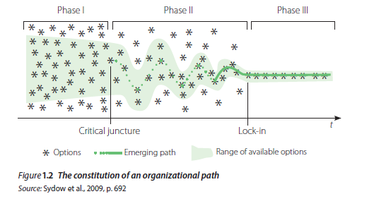
Path dependence
source: Hayes, John. The theory and practice of change management 4th edition. pp 41
John Hayes (2014), The Theory and Practice of Change Management, 4th ed.
Online source https://slideplayer.com/slide/13711905/

Slide 28
Minimizing the impact of reactive and
self-reinforcing sequences
Reactive sequences
Complex patterns
John Hayes (2014), The Theory and Practice of Change Management, 4th ed.

Slide 29
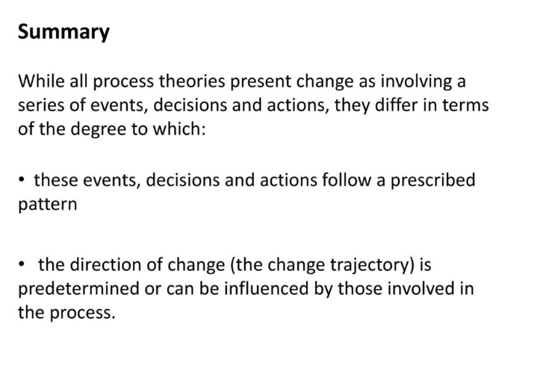

Slide 30
REFERENCES
Hayes, John (2022) The Theory and Practice of Change Management 6th Edition. Bloomsbury Publishing PLC.
Hayes, John (2014) The Theory and Practice of Change Management 4th Edition. Palgrave Macmillan. United Kingdom
Hayes, John (2010) The Theory and Practice of Change Management 3rd Edition. Palgrave Macmillan. United Kingdom
Kotter, John P. (1996) Leading Change. Harvard Business School Press. USA. ISBN 10: 0875847471 / ISBN 13: 9780875847474

Slide 31
Online Sources
Adapted from the book of Hayes, John (2022) The Theory and Practice of Change Management 4th Edition, https://slideplayer.com/slide/13711905/
Adapted from Milller, Kelsey. Management Essentials, Harvard Business School, Contributor https://online.hbs.edu/blog/post/change-management-process
Adapted from Making Change Work: Practical Tools for Overcoming Human Resistance to Change, ASQ Quality Press. https://asq.org/quality-resources/change-management
https://www.mindtools.com/ahpnreq/the-four-principles-of-change-management
Batti, Khadim, 8 Free Change Management Plan Templates (2023). October 10, 2022. https://whatfix.com/change-management/
Sirkin, Keenan, Jackson. The Hard Side of Change Management from the magazine (October 20025). A version of this article appeared in the October 2005 issue of Harvard Business Review. https://hbr.org/2005/10/the-hard-side-of-change-management
Written by Coursera • Updated on Jun 17, 2023. The Change Management Process: What is it and Who is it for?. https://www.coursera.org/articles/change-management-process
Everything you need to know about change management. Update August 2022. https://www.imd.org/reflections/change-management/

Slide 32
The End

