Slide 1
CHANGE MANAGEMENT
Chapter 2
Leading Change: A Process Perspective
Lecturer: Dr. Michaella DeLeon Castillo
Philippines

Slide 2
LEARNING OUTCOMES
After studying this chapter, you should
Demonstrate a deep understanding of key concepts, theories, and principles relevant to the subject matter.
Construct a conceptual framework: Students will be able to create a conceptual framework that illustrates the interconnected nature of events, decisions, and actions within the context of these process theories of change.

Slide 3
LEARNING OUTCOMES
After studying this chapter, you should
3. Analyze the variance in change theories: Students will be able to critically analyze and compare the four process theories of change, highlighting the variations in how they depict change as a sequence of stages.
4. Evaluate the direction of change: Students will be able to evaluate whether the direction of change in these theories is constructed by human agency or predetermined by external factors.

Slide 4
The intentional management of change
Lewin’s metaphor
John Hayes (2014), The Theory and Practice of Change Management, 4th ed.
Online source https://slideplayer.com/slide/13711905/

Slide 5

The intentional management of change
John Hayes (2014), The Theory and Practice of Change Management, 4th ed. pp - 23
John Hayes (2014), The Theory and Practice of Change Management, 4th ed.
Online source https://slideplayer.com/slide/13711905/

Slide 6
Lewin’s three-step process
unfreeze or unlock the existing level of behavior
move to a new level
refreeze behavior at this new level.

Slide 7
Stages in the process of managing change
Lippitt et al. (1958) expanded Lewin’s three-stage model
Egan (1996) developed a similar model based on Lewin’s three stages of unfreezing, moving and refreezing

Slide 8
Cont’…..
Stages in the process of managing change
3. Beckhard and Harris (1987) present a three-stage model that focuses on defining the present and the future, managing the transition, and maintaining and updating the change.

Slide 9
These models highlight the importance of:
Developing change relationships: between change agents and those affected by the change.
Diagnosis: change managers need to give attention to where the organization is now and to what a more desirable (and attainable) state would look like.

Slide 10
Cont’…..
These models highlight the importance of:
Strategies and plans: to move the organization towards the desired state.

Slide 11
Cont’…..
These models highlight the importance of:
Implementation: translating intentions (strategies and plans) into actual change efforts.
Maintaining the change: and holding on to gains.

Slide 12
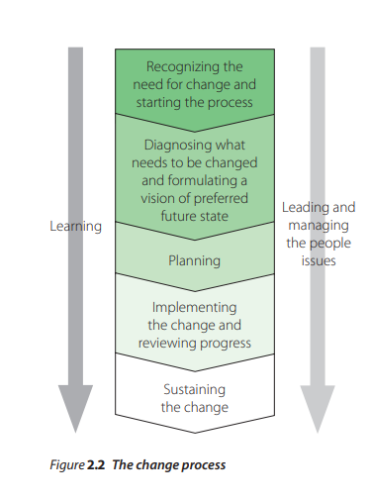
Key steps in the change process
John Hayes (2014), The Theory and Practice of Change Management, 4th ed. pp - 27

Slide 13
Recognizing the need for change and starting the change process
Starting the change
Diagnosing what needs to be changed
Reviewing the present state
Identifying the future state
Quality of the vision

Slide 14
Planning and preparing for change
Some questions that might help leaders reflect on how they are managing this stage of the process include:
Is the change strategy appropriate, for example push, pull or a blend of both?
Is it clear what needs to be done?
Is sufficient thought being given to the longer term implications of decisions?

Slide 15
Cont’…..
Planning and preparing for change
Some questions that might help leaders reflect on how they are managing this stage of the process include:
Is sufficient attention being given to anticipating how people may react to the change?
Is it clear what kind of intervention would be most effective?

Slide 16
Implementing change and reviewing progress
Some questions that might help leaders reflect on how they are managing this stage of the process include:
Do change managers communicate a compelling vision and set realistic goals?
Are stakeholders being managed effectively?
Is uncertainty managed in a way that maintains commitment?

Slide 17
Cont’…..
Implementing change and reviewing progress
Some questions that might help leaders reflect on how they are managing this stage of the process include:
Do change managers seek feedback in order to eliminate impediments to implementation?
Is there sufficient coordination between those involved in implementing the change?

Slide 18
Sustaining change Lewin (1951)
not enough to think of change
Attention needs to be given

Slide 19
Some questions that might help leaders reflect on how they are managing this stage of the process include:
Do change managers pursue a change strategy that wins long-term commitment?
Do they reinforce changes post-implementation?

Slide 20
Cont’…..
Some questions that might help leaders reflect on how they are managing this stage of the process include:
Do they avoid declaring victory too soon?
Is sufficient attention given to managing the consequences of churn?

Slide 21
Leading and managing the people issues
different goals and priorities
internal politics and the power of stakeholders to affect outcomes
the way leaders relate with the intended recipients of change
communication

Slide 22
Cont’…..
Leading and managing the people issues
trust
motivation and commitment
support for those who will be affected by the change.

Slide 23
Learning
Effective leaders are those who can learn from their experience and utilize this learning to modify their behavior in order to improve their performance.
Argyris and Schön (1978) distinguish between single-loop and double-loop learning.

Slide 24
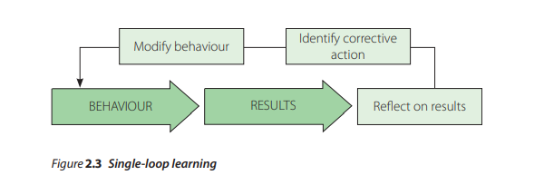
Single-loop learning
John Hayes (2014), The Theory and Practice of Change Management, 4th ed. pp - 36

Slide 25
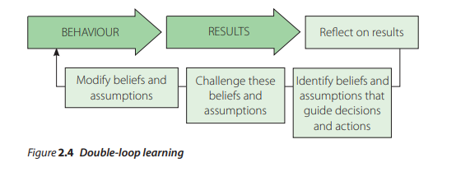
Double-loop learning
John Hayes (2014), The Theory and Practice of Change Management, 4th ed. pp - 37

Slide 26
Some questions that might help leaders reflect on how they learn from the process of managing change include:
Do those involved in the change anticipate how others will respond to events before deciding what to do?
Do they monitor the effects of their actions and use this information to guide future decisions?
Are they receptive to feedback from others?

Slide 27
Some questions that might help leaders reflect on how they learn from the process of managing change include:
To what extent do they view their own and others’ mistakes as opportunities for learning?
Do they attempt to identify and challenge the assumptions that underpin their behavior?
Are they aware of how decisions that produce positive outcomes in the short term may undermine performance over the long term?

Slide 28
Summary
Module 2 introduces a change management model based on teleological and dialectical theories. This model outlines seven core activities for effective change management:
Recognizing the need for change.
Diagnosing and envisioning the desired future state.
Planning for intervention.
Implementing and reviewing progress.
Sustaining the change.
Managing people-related issues.
Emphasizing continuous learning.

Slide 29
REFERENCES
Hayes, John (2022) The Theory and Practice of Change Management 6th Edition. Bloomsbury Publishing PLC.
Hayes, John (2014) The Theory and Practice of Change Management 4th Edition. Palgrave Macmillan. United Kingdom
Hayes, John (2010) The Theory and Practice of Change Management 3rd Edition. Palgrave Macmillan. United Kingdom
Kotter, John P. (1996) Leading Change. Harvard Business School Press. USA. ISBN 10: 0875847471 / ISBN 13: 9780875847474

Slide 30
Online Sources
https://slideplayer.com/slide/13711905/
https://online.hbs.edu/blog/post/change-management-process
https://asq.org/quality-resources/change-management
https://www.mindtools.com/ahpnreq/the-four-principles-of-change-management
https://whatfix.com/change-management/
https://www.michiganstateuniversityonline.com/resources/leadership/what-is-change-management/
https://hbr.org/2005/10/the-hard-side-of-change-management
https://www.shrm.org/resourcesandtools/tools-and-samples/toolkits/pages/managingorganizationalchange.aspx
https://www.coursera.org/articles/change-management-process
https://www.apm.org.uk/resources/what-is-project-management/what-is-change-management/
https://www.imd.org/reflections/change-management/

Slide 31
The End

