Slide 1
CHANGE MANAGEMENT
Chapter 3
Patterns of Change
Lecturer: Dr. Michaella DeLeon Castillo
Philippines

Slide 2
LEARNING OUTCOMES
After studying this chapter, you should
Demonstrate a deep understanding of key concepts, theories, and principles relevant to the subject matter.
Construct a conceptual framework: Students will be able to create a conceptual framework that illustrates the interconnected nature of events, decisions, and actions within the context of these process theories of change.

Slide 3
LEARNING OUTCOMES
After studying this chapter, you should
Analyze the variance in change theories: Students will be able to critically analyze and compare the four process theories of change, highlighting the variations in how they depict change as a sequence of stages.
Evaluate the direction of change: Students will be able to evaluate whether the direction of change in these theories is constructed by human agency or predetermined by external factors.

Slide 4
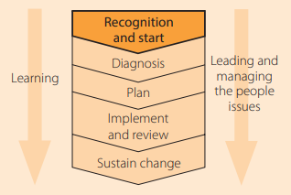
Patterns of Change
John Hayes (2014), The Theory and Practice of Change Management, 4th ed. pp - 46
John Hayes (2014), The Theory and Practice of Change Management, 4th ed.
Online source https://slideplayer.com/slide/13711905/

Slide 5
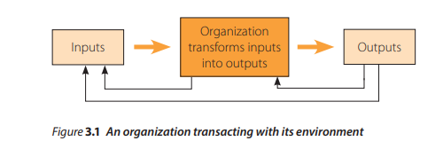
Patterns of Change
John Hayes (2014), The Theory and Practice of Change Management, 4th ed. pp - 46
John Hayes (2014), The Theory and Practice of Change Management, 4th ed.

Slide 6
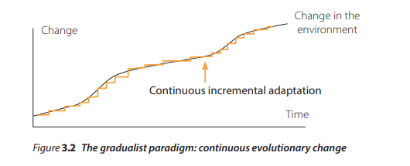
Adapting to change: the gradualist paradigm
John Hayes (2014), The Theory and Practice of Change Management, 4th ed. pp - 47

Slide 7
The three related processes
Improvising
Translation
Learning

Slide 8
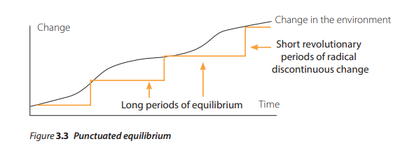
The punctuated equilibrium paradigm: an alternative view of how organizations change
John Hayes (2014), The Theory and Practice of Change Management, 4th ed. pp - 49

Slide 9
Deep structure
Gersick (1991, p. 16) refers to ‘deep structure’ as the fundamental choices an organization makes that determine the basic activity patterns that maintain its existence.

Slide 10
Recognizing the need for change and starting the change process
Starting the change
Diagnosing what needs to be changed
Reviewing the present state
Identifying the future state
Quality of the vision

Slide 11
Equilibrium periods
Gersick (1991, p. 16) introduces the analogy of a playing field and the rules of the game to describe an organization’s deep structure, and the game in play to describe activity during an equilibrium period

Slide 12
Revolutionary periods
Gersick (1991) asserts that the definitive element of the punctuated equilibrium paradigm is that organizations do not shift from one ‘kind of game’ to another through incremental steps.

Slide 13
Support for the punctuated equilibrium paradigm
Punctuated equilibrium paradigm

Slide 14
Support for the punctuated equilibrium paradigm
AT&T, General Radio, Citibank and Prime Computers

Slide 15
The nature of change confronting most organizations
There are three main categories of organizations that may not experience periods of discontinuous change:
The kinds of self-organizing and continuously changing learning organizations identified by Brown and Eisenhardt.
Companies operating in niche markets or slow-moving sectors where they have not yet encountered the kind of environmental change that requires them to transform their deep structures.

Slide 16
The nature of change confronting most organizations
3. Organizations that are able to continue functioning without transforming themselves because they have sufficient ‘fat’ to absorb the inefficiencies associated with misalignment.

Slide 17
According to the punctuated equilibrium paradigm, organizations experience two types of change:
Incremental change
Transformational change

Slide 18
Nadler and Tushman, 1995
Degree of regularity
Vary across sectors
All industries

Slide 19
The possibility of anticipating change
There is less time for planning
There is unlikely to be sufficient time to involve many people
There will be little time to experiment
Late movers may have little opportunity to influence shifts in markets and technologies

Slide 20
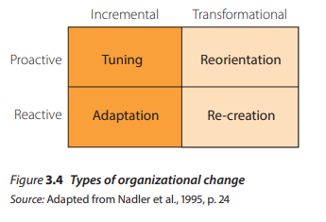
A typology of organizational change
John Hayes (2014), The Theory and Practice of Change Management, 4th ed. pp - 56

Slide 21
Nadler et al. (1995) identify four types of change:
Tuning: change that occurs when there is no immediate requirement to change.
Adaptation: an incremental and adaptive response to a pressing external demand for change.

Slide 22
Nadler et al. (1995) identify four types of change:
3. Adaptation: an incremental and adaptive response to a pressing external demand for change.
4. Reorientation: involves a redefinition of the enterprise.

Slide 23
Re-creation: a reactive change that involves transforming the organization through the fast and simultaneous change of all its basic elements.

Slide 24
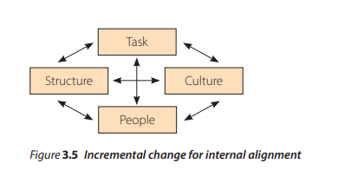
The focus for change efforts
John Hayes (2014), The Theory and Practice of Change Management, 4th ed. pp - 59

Slide 25
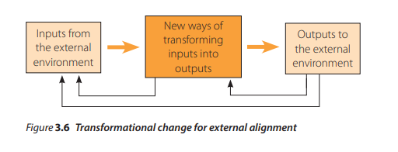
John Hayes (2014), The Theory and Practice of Change Management, 4th ed. pp - 59

Slide 26
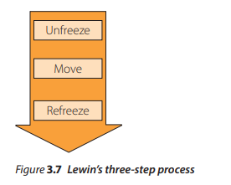
John Hayes (2014), The Theory and Practice of Change Management, 4th ed. pp - 59

Slide 27
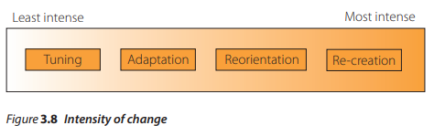
The locus for change
John Hayes (2014), The Theory and Practice of Change Management, 4th ed. pp - 60

Slide 28
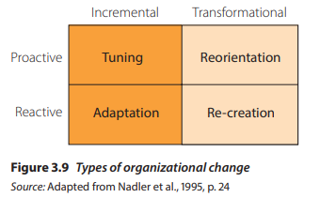
New patterns of change
John Hayes (2014), The Theory and Practice of Change Management, 4th ed. pp - 61

Slide 29
Summary
Ideal response to change: Continuous incremental adaptations (gradualist paradigm)
Reality for many organizations: Episodic change, alternating between tinkering and discontinuous shifts (punctuated equilibrium)
Early recognition of change is crucial for more management options
Four types of change identified by Nadler et al.: tuning, adaptation, reorientation, re-creation, impacting change management practices

Slide 30
REFERENCES
Hayes, John (2022) The Theory and Practice of Change Management 6th Edition. Bloomsbury Publishing PLC.
Hayes, John (2014) The Theory and Practice of Change Management 4th Edition. Palgrave Macmillan. United Kingdom
Hayes, John (2010) The Theory and Practice of Change Management 3rd Edition. Palgrave Macmillan. United Kingdom
Kotter, John P. (1996) Leading Change. Harvard Business School Press. USA. ISBN 10: 0875847471 / ISBN 13: 9780875847474

Slide 31
Online Sources
https://slideplayer.com/slide/13711905/
https://online.hbs.edu/blog/post/change-management-process
https://asq.org/quality-resources/change-management
https://www.mindtools.com/ahpnreq/the-four-principles-of-change-management
https://whatfix.com/change-management/
https://www.michiganstateuniversityonline.com/resources/leadership/what-is-change-management/
https://hbr.org/2005/10/the-hard-side-of-change-management
https://www.shrm.org/resourcesandtools/tools-and-samples/toolkits/pages/managingorganizationalchange.aspx
https://www.coursera.org/articles/change-management-process
https://www.apm.org.uk/resources/what-is-project-management/what-is-change-management/
https://www.imd.org/reflections/change-management/

Slide 32
The End

