Slide 1
CHANGE MANAGEMENT
Chapter 4
Recognizing a Need or Opportunity for Change
Lecturer: Dr. Michaella DeLeon Castillo
Philippines

Slide 2
Learning Objectives
Define the concept of change in organizational contexts, distinguishing between external and internal sources.
Apply the PEST acronym and Strebel's cycle of competitive behavior to identify external sources of change in a given business environment.
Explain the significance of discrepancies between actual and desired performance levels as indicators of the need for change, and discuss the challenges that can arise when such discrepancies go unrecognized.
List and describe key indicators that should be monitored to sense a need for change, including organizational purpose, stakeholder perspectives, assessment levels, alignment of indicators, time frames, benchmark standards, and constraints or enabling factors.
Discuss the role of senior managers in formulating the agenda for change and the potential contributions of individuals at various levels within the organization, while also recognizing the limitations associated with their involvement in this process.

Slide 3
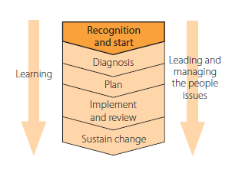
External sources of change
John Hayes (2014), The Theory and Practice of Change Management, 4th ed. pp - 68

Slide 4
PEST
Political factors
Economic factors
Sociocultural factors
Technological factors

Slide 5
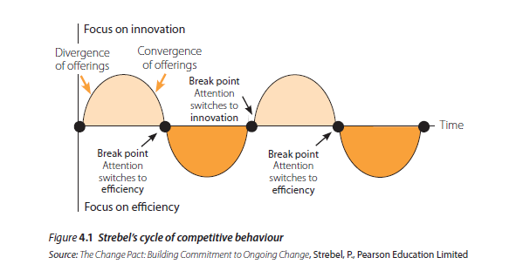
John Hayes (2014), The Theory and Practice of Change Management, 4th ed. pp - 70

Slide 6
Internal sources of change
The five phases are:
Growth through creativity leading to a crisis of leadership
Growth through direction leading to a crisis of autonomy
Growth through delegation leading to a crisis of control
Growth through coordination leading to a crisis of ‘red tape
Growth through collaboration

Slide 7
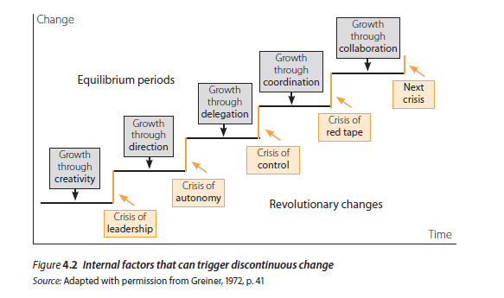
John Hayes (2014), The Theory and Practice of Change Management, 4th ed. pp – 72

Slide 8
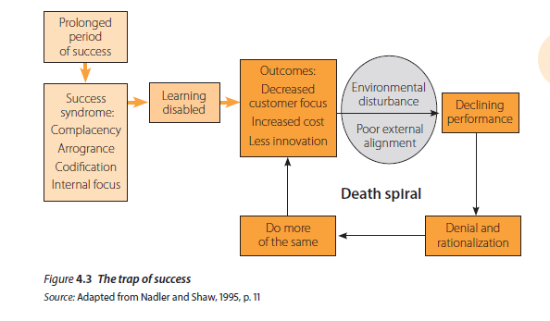
Recognizing the need for change
Organizational path dependence and the trap of success
John Hayes (2014), The Theory and Practice of Change Management, 4th ed. pp – 73

Slide 9
Improving the organization’s ability to sense the need for change
Attending to indicators of effectiveness
Some of the factors that managers might need to take into account when assessing performance include:
Purpose
Stakeholder perspective
Level of assessment
Alignment
Time perspective
Benchmarks
Constraining and enabling factors

Slide 10
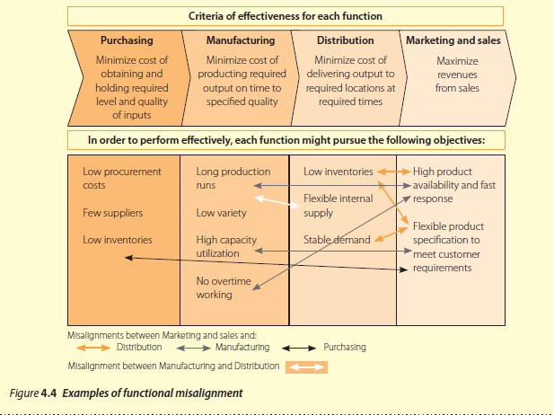
John Hayes (2014), The Theory and Practice of Change Management, 4th ed. pp – 76

Slide 11
Summarizing the discussion so far, those assessing effectiveness need to take account of:
purpose and desired outcomes
the stakeholder perspective from which the assessment is made
level of assessment
alignment of the various indicators used at different levels and across different
functions
specified time frame – short, medium or long term
benchmark standard
any special constraints or enabling factors that affect performance

Slide 12
The balanced scorecard
The scorecard approach enables managers to review performance from these four perspectives against short- and long-term objectives:
Financial perspective
Customer perspective
Internal process perspective
Learning and growth perspective

Slide 13
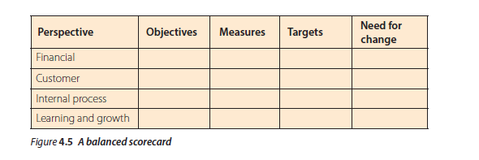
John Hayes (2014), The Theory and Practice of Change Management, 4th ed. pp – 78

Slide 14
Diversity in the top team
This kind of analysis can alert you to:
the need to reconsider the criteria you use to judge your own unit’s performance
changes that will improve the quality of the alignment between your unit and the ‘customers’ who receive whatever it is you export as outputs
changes you might need to negotiate with your suppliers to improve the value of the inputs you receive from them.

Slide 15
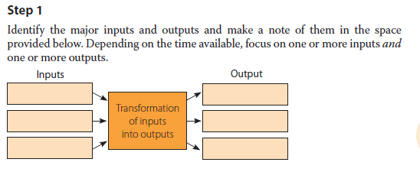
Change tool 4.1 Alignment check between your unit and your customers and suppliers
Think of your organization, department or work group in terms of a process that transforms inputs into outputs.
John Hayes (2014), The Theory and Practice of Change Management, 4th ed. pp – 79

Slide 16
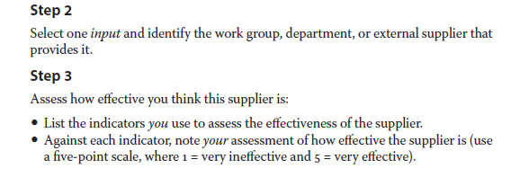
John Hayes (2014), The Theory and Practice of Change Management, 4th ed. pp – 79

Slide 17
John Hayes (2014), The Theory and Practice of Change Management, 4th ed. pp – 79

Slide 18
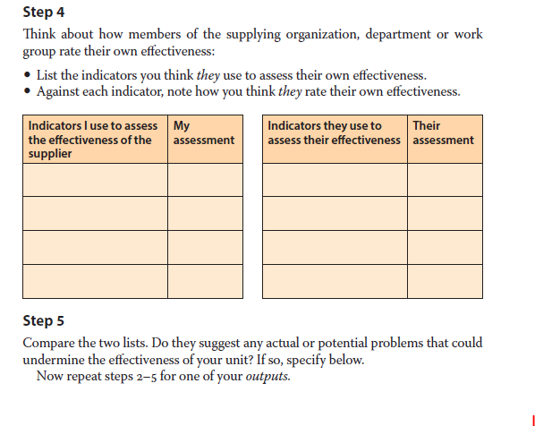
John Hayes (2014), The Theory and Practice of Change Management, 4th ed. pp – 79

Slide 19
John Hayes (2014), The Theory and Practice of Change Management, 4th ed. pp – 79

Slide 20
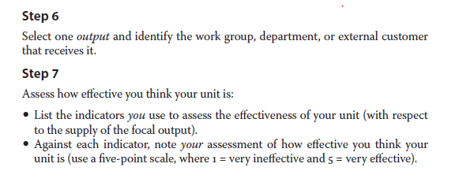
John Hayes (2014), The Theory and Practice of Change Management, 4th ed. pp – 80

Slide 21
John Hayes (2014), The Theory and Practice of Change Management, 4th ed. pp – 80

Slide 22
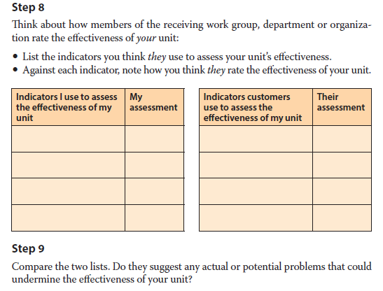
John Hayes (2014), The Theory and Practice of Change Management, 4th ed. pp – 80

Slide 23
John Hayes (2014), The Theory and Practice of Change Management, 4th ed. pp – 80

Slide 24
Shaping the agenda for change
According to Pitt et al. (2002) - Agenda for change
Pitt et al. (2002) - minimal level of collective attention

Slide 25
The role of playmakers
Based on a study in a manufacturing company, Pitt et al. (2002) identified a number of roles that people from various parts of the organization can play to influence the agenda for change. These are:
Upward-facing advocates

Slide 26
The role of playmakers
Based on a study in a manufacturing company, Pitt et al. (2002) identified a number of roles that people from various parts of the organization can play to influence the agenda for change. These are:
Upward-facing emotive champions

Slide 27
The role of playmakers
This approach can involve risks but the person quoted above felt so strongly about the issue that he was prepared to speak up.
Democratic brokers

Slide 28
Summary
These include:
Organizational purpose and desired outcomes
The stakeholder perspective from which the assessment is made
Level of assessment – total organization, department, work group or individual
The alignment of the various indicators used at different levels and across different functions
Specified time frame – short, medium or long term
Benchmark standard
Special constraints or enabling factors that affect performance.

Slide 29
REFERENCES
Hayes, John (2022) The Theory and Practice of Change Management 6th Edition. Bloomsbury Publishing PLC.
Hayes, John (2014) The Theory and Practice of Change Management 4th Edition. Palgrave Macmillan. United Kingdom
Hayes, John (2010) The Theory and Practice of Change Management 3rd Edition. Palgrave Macmillan. United Kingdom
Kotter, John P. (1996) Leading Change. Harvard Business School Press. USA. ISBN 10: 0875847471 / ISBN 13: 9780875847474

Slide 30
Online Sources
https://slideplayer.com/slide/13711905/
https://online.hbs.edu/blog/post/change-management-process
https://asq.org/quality-resources/change-management
https://www.mindtools.com/ahpnreq/the-four-principles-of-change-management
https://whatfix.com/change-management/
https://www.michiganstateuniversityonline.com/resources/leadership/what-is-change-management/
https://hbr.org/2005/10/the-hard-side-of-change-management
https://www.shrm.org/resourcesandtools/tools-and-samples/toolkits/pages/managingorganizationalchange.aspx
https://www.coursera.org/articles/change-management-process
https://www.apm.org.uk/resources/what-is-project-management/what-is-change-management/
https://www.imd.org/reflections/change-management/

Slide 31
The End

