Slide 1
CHANGE MANAGEMENT
Chapter 6
Building Change Relationships
Lecturer: Dr. Michaella DeLeon Castillo
Philippines

Slide 2
Learning Objectives
Intervention Purpose:
  Understand the primary goal of interventions in organizational change for achieving system-enhancing outcomes.
Intervention Modes:
  Differentiate between the five intervention modes: Advising, Supporting, Theorizing, Challenging, and Information Gathering.
Promoting Self-Sufficiency:
  Learn how to encourage client self-sufficiency and problem-solving abilities.
Respectful Interpersonal Skills:
  Develop interpersonal skills that demonstrate respect and suspend critical judgment during interventions.
Ethical Considerations:
  Explore ethical challenges and strategies for ethical intervention in change management.

Slide 3
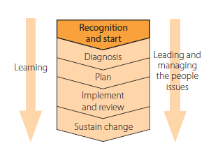
Building change Relationships
Five modes of intervening and discusses the importance of change agents demonstrating a genuine respect for the people they are working with.

Slide 4
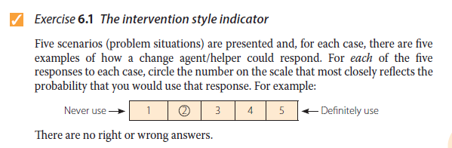
Intervention styles
John Hayes (2014), The Theory and Practice of Change Management, 4th ed. pp - 101

Slide 5
Scenario A

Slide 6
Scenario B

Slide 7
Scenario C

Slide 8
Scenario D

Slide 9
Scenario E

Slide 10
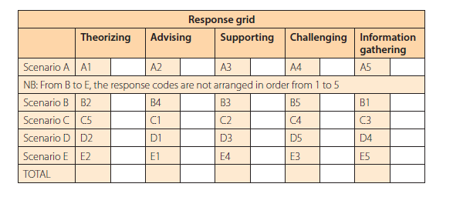
SCORING
John Hayes (2014), The Theory and Practice of Change Management, 4th ed. pp - 105

Slide 11
The goal of intervening
Blake and Mouton (1986)
Egan (2004

Slide 12
Prescriptive mode of intervening: advising
The mode of intervening referred to as ‘advising

Slide 13
Collaborative modes of intervening
The other four modes of intervening:
Supporting
Theorizing
Challenging
Information gathering

Slide 14
Supportive approach
Margerison (2000) refers to change agents helping clients to give themselves permission.

Slide 15
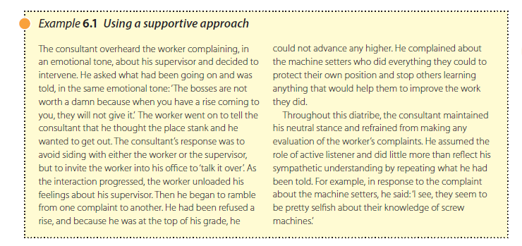
John Hayes (2014), The Theory and Practice of Change Management, 4th ed. pp - 109

Slide 16
Theorizing approach
The theorizing approach involves change agents identifying theories and conceptual models

Slide 17
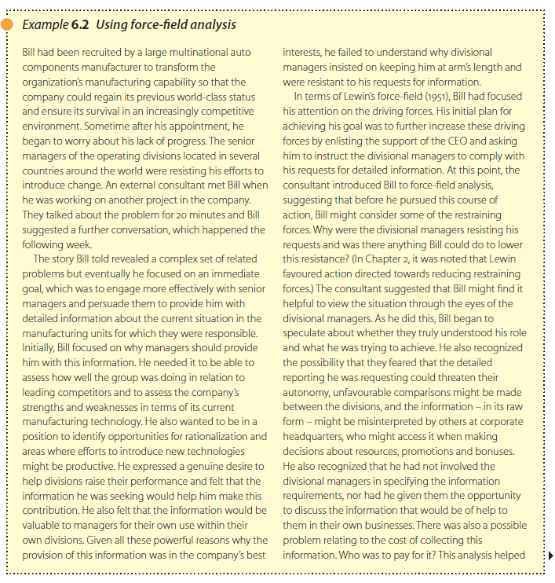
John Hayes (2014), The Theory and Practice of Change Management, 4th ed. pp - 111

Slide 18
Challenging approach
The challenging mode of intervening has great potential for facilitating change
It involves the change agent confronting the foundations of the client’s thinking in an attempt to identify beliefs, values and assumptions that may be distorting the way situations are viewed.

Slide 19
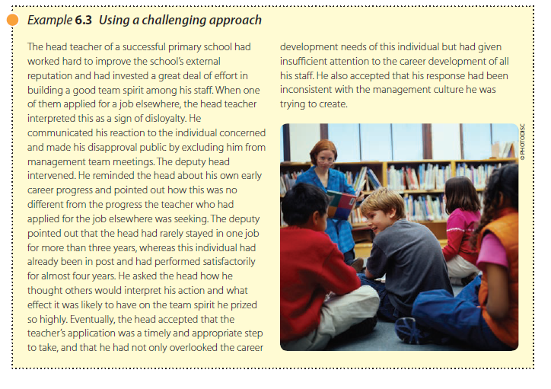
John Hayes (2014), The Theory and Practice of Change Management, 4th ed. pp - 112

Slide 20
Information-gathering approach
The information-gathering approach to helping involves change agents assisting clients to collect data they can use to evaluate and reinterpret a problem situation.

Slide 21
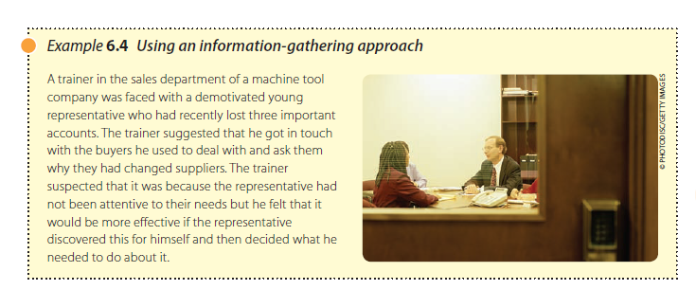
John Hayes (2014), The Theory and Practice of Change Management, 4th ed. pp - 113

Slide 22
Developing collaborative relationships
Signal that the other’s viewpoint is worth listening to
Suspend critical judgement

Slide 23
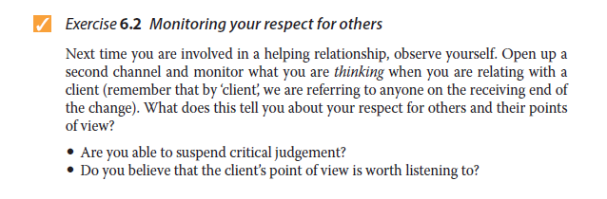
John Hayes (2014), The Theory and Practice of Change Management, 4th ed. pp - 114

Slide 24
Prescriptive versus collaborative modes of intervening
It has been argued that the most effective way of helping others is to help them to help themselves, and that this will normally involve adopting a collaborative mode of intervening.

Slide 25
Mode of intervening and the stage of the helping relationship
The most effective mode of intervening can vary over the course of a helping relationship.
The supportive mode that involves the use of empathetic listening to help clients develop a new level of understanding might be especially effective at the beginning of the helping process.

Slide 26
Helping skills
Helping involves the appropriate use of a wide range of ‘everyday and commonly used’ interpersonal skills. Some of these are:
self-awareness
establishing rapport and building relationships
empathy
listening to facts and feelings

Slide 27
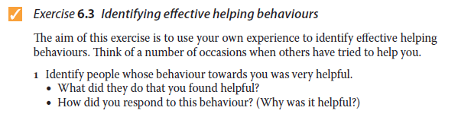
John Hayes (2014), The Theory and Practice of Change Management, 4th ed. pp - 115

Slide 28
Cont’….. Helping skills
Helping involves the appropriate use of a wide range of ‘everyday and commonly used’ interpersonal skills. Some of these are:
probing for information
identifying themes and seeing the bigger picture
giving feedback
challenging assumptions.

Slide 29
Summary
Intervening aims to achieve system-enhancing outcomes, like innovation and better problem-solving. Five modes of intervention are Advising, Supporting, Theorizing, Challenging, and Information gathering. Advising, while useful, may create dependency, so empowering clients to solve problems themselves is emphasized. Effective helpers show respect by listening and suspending judgment, using interpersonal skills as needed.

Slide 30
REFERENCES
Hayes, John (2022) The Theory and Practice of Change Management 6th Edition. Bloomsbury Publishing PLC.
Hayes, John (2014) The Theory and Practice of Change Management 4th Edition. Palgrave Macmillan. United Kingdom
Hayes, John (2010) The Theory and Practice of Change Management 3rd Edition. Palgrave Macmillan. United Kingdom
Kotter, John P. (1996) Leading Change. Harvard Business School Press. USA. ISBN 10: 0875847471 / ISBN 13: 9780875847474

Slide 31
Online Sources
https://slideplayer.com/slide/13711905/
https://online.hbs.edu/blog/post/change-management-process
https://asq.org/quality-resources/change-management
https://www.mindtools.com/ahpnreq/the-four-principles-of-change-management
https://whatfix.com/change-management/
https://www.michiganstateuniversityonline.com/resources/leadership/what-is-change-management/
https://hbr.org/2005/10/the-hard-side-of-change-management
https://www.shrm.org/resourcesandtools/tools-and-samples/toolkits/pages/managingorganizationalchange.aspx
https://www.coursera.org/articles/change-management-process
https://www.apm.org.uk/resources/what-is-project-management/what-is-change-management/
https://www.imd.org/reflections/change-management/

Slide 32
The End

