Slide 1
CHANGE MANAGEMENT
Chapter 7
Diagnosis
Lecturer: Dr. Michaella DeLeon Castillo
Philippines

Slide 2
Learning Objectives
Understand the concept of Organizational Diagnosis as a research process for improving organizational functioning.
Recognize the role of implicit models in Organizational Diagnosis and assess their influence on how organizations are evaluated for change.
Differentiate between Component Models and Holistic Models in Organizational Diagnosis and comprehend their respective areas of focus.

Slide 3
Learning Objectives
Explain the importance of using Holistic Models as an initial assessment before addressing specific organizational issues and the limitations of relying solely on Component Models.
Familiarize yourself with four key Holistic Models: Kotter's Integrative Model, McKinsey 7S Model, Weisbord's Six-Box Model, and the Burke-Litwin Causal Model, and understand their applications in organizational diagnosis.
Develop the ability to analyze your own diagnostic approach and compare it to the presented Holistic Models, seeking insights for improving the organizational diagnosis process.

Slide 4
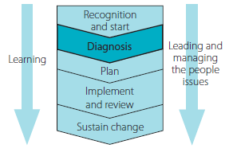
Organizational Diagnosis
John Hayes (2014), The Theory and Practice of Change Management, 4th ed. pp - 122

Slide 5
Using Models to Aid Diagnosis
Key Elements
Causal Relationships
Outputs

Slide 6
We all develop our own implicit theories or conceptual models about how organizations function, and we use these models to:
guide the kind of information that we attend to
interpret what we see
decide how to act.

Slide 7
Exercise. Raising awareness of your implicit model of organizational
functioning

Slide 8
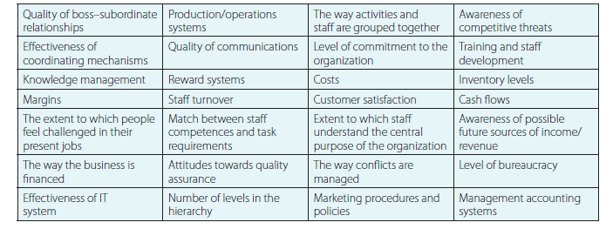
Step 1 Assess the current state of your organization
Step 2 Identify the information you used to make this assessment
Table 7.1 Examples of the kind of information that might be attended to
John Hayes (2014), The Theory and Practice of Change Management, 4th ed. pp - 126

Slide 9
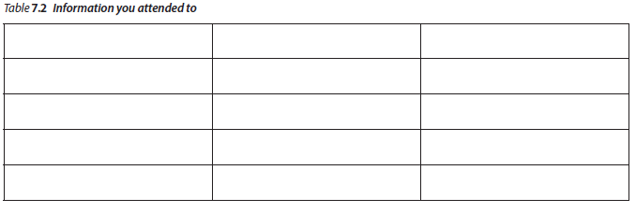
John Hayes (2014), The Theory and Practice of Change Management, 4th ed. pp - 127

Slide 10
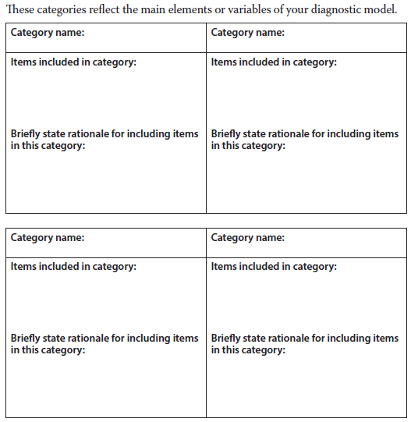
Step 3 Developing categories for organizing your diagnostic
information
John Hayes (2014), The Theory and Practice of Change Management, 4th ed. pp - 127

Slide 11
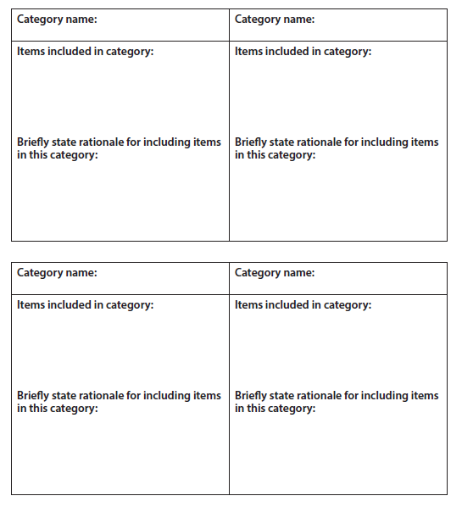
John Hayes (2014), The Theory and Practice of Change Management, 4th ed. pp - 128

Slide 12
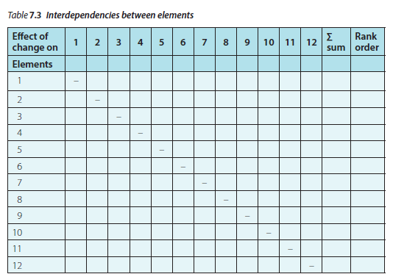
Step 4 Specifying relationships between categories/elements
John Hayes (2014), The Theory and Practice of Change Management, 4th ed. pp - 129

Slide 13
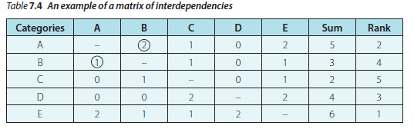
John Hayes (2014), The Theory and Practice of Change Management, 4th ed. pp - 129

Slide 14
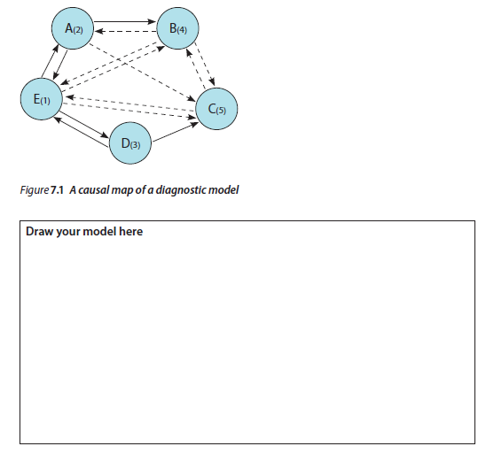
John Hayes (2014), The Theory and Practice of Change Management, 4th ed. pp - 130

Slide 15
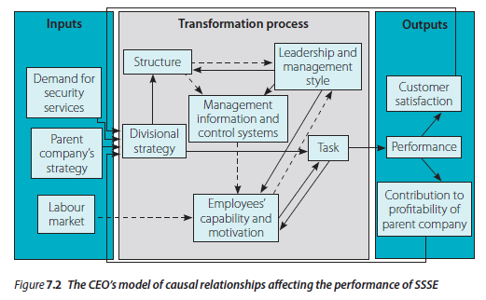
Component versus holistic models
John Hayes (2014), The Theory and Practice of Change Management, 4th ed. pp - 131

Slide 16
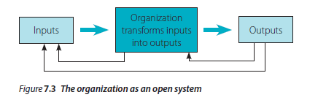
Open systems theory
Embedded within a larger system
Able to avoid entropy
John Hayes (2014), The Theory and Practice of Change Management, 4th ed. pp - 132

Slide 17
Regulated by feedback
Subject to equifinality
Cyclical in their mode of functioning
Equilibrium seeking
Bounded

Slide 18
Four holistic (total system) models that have been widely used for diagnosing the need or opportunity for change:
1 Kotter’s integrative model of organizational dynamics
2 The McKinsey 7S model
3 Weisbord’s six-box model
4 The Burke-Litwin causal model of organizational performance and change

Slide 19
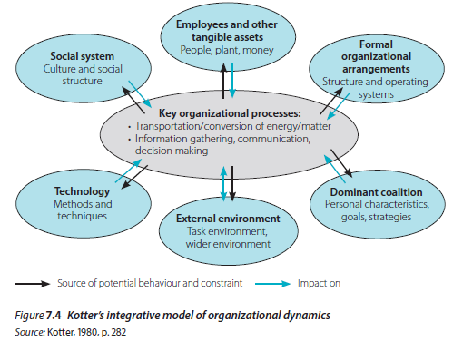
Kotter’s integrative model of organizational dynamics
John Hayes (2014), The Theory and Practice of Change Management, 4th ed. pp - 134

Slide 20
The six structural elements in Kotter’s model are:
External Environment
Employees and Other Tangible Assets
Formal Structures
Social System
Technology
Dominant Coalition

Slide 21
A distinguishing feature of this model is that it highlights which aspects of organizational functioning impact effectiveness over the short, medium and long term.
Short Term
Medium Term
Long Term

Slide 22
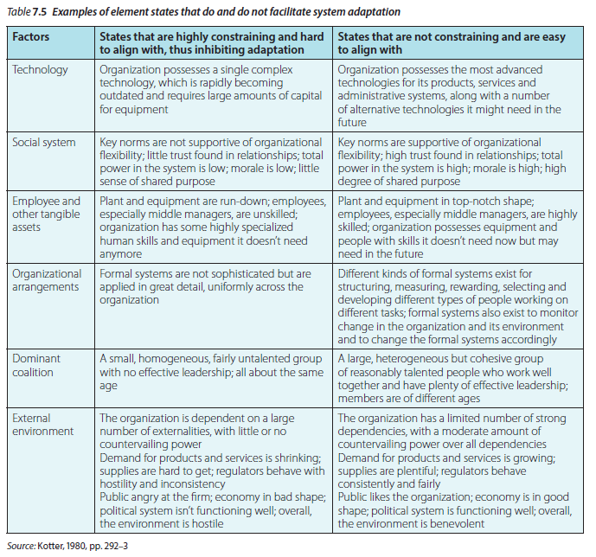
John Hayes (2014), The Theory and Practice of Change Management, 4th ed. pp - 136

Slide 23
The McKinsey 7S model
Strategy
Structure
System
Staff
Style
Share Values and Superordinate goals
Skills

Slide 24
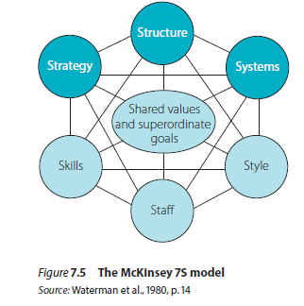
John Hayes (2014), The Theory and Practice of Change Management, 4th ed. pp - 137

Slide 25
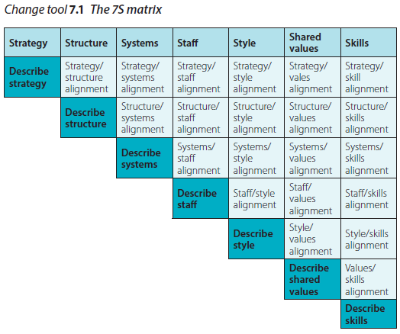
Weisbord’s six-box model
John Hayes (2014), The Theory and Practice of Change Management, 4th ed. pp - 138

Slide 26
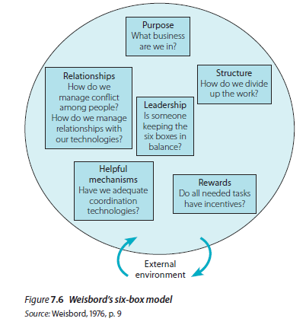
John Hayes (2014), The Theory and Practice of Change Management, 4th ed. pp - 139

Slide 27
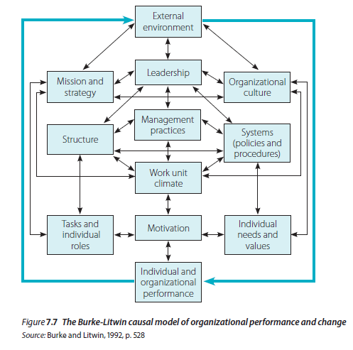
The Burke-Litwin causal model of organizational performance and change
John Hayes (2014), The Theory and Practice of Change Management, 4th ed. pp - 140

Slide 28
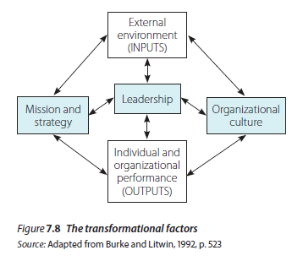
John Hayes (2014), The Theory and Practice of Change Management, 4th ed. pp - 141

Slide 29
Revising your personal model of organizational functioning
Three characteristics of ‘good’ diagnostic models are that they:
1. are relevant to the particular issues under consideration
2. help change agents to recognize cause-and-effect relationships
3. focus on elements they can influence.

Slide 30
Summary
Organizational diagnosis is a research process to recommend improvements. It emphasizes the role of models, including component and holistic ones. Holistic models offer a comprehensive view of an organization, whereas component models focus on specific aspects. Starting with holistic models is recommended, as relying solely on component models can be limiting. Four key holistic models are introduced: Kotter's, McKinsey 7S, Weisbord's, and the Burke-Litwin causal model, each providing unique insights. It's valuable to compare these models with one's own approach to enhance the diagnostic process.

Slide 31
REFERENCES
Hayes, John (2022) The Theory and Practice of Change Management 6th Edition. Bloomsbury Publishing PLC.
Hayes, John (2014) The Theory and Practice of Change Management 4th Edition. Palgrave Macmillan. United Kingdom
Hayes, John (2010) The Theory and Practice of Change Management 3rd Edition. Palgrave Macmillan. United Kingdom
Kotter, John P. (1996) Leading Change. Harvard Business School Press. USA. ISBN 10: 0875847471 / ISBN 13: 9780875847474

Slide 32
Online Sources
Miller, Kelsey. (March 19, 2020). % Critical Steps in the Change Management https://online.hbs.edu/blog/post/change-management-process
Adapted from: Making Change Wworrk: Practical Tools for Overcoming Human Resistance to Change, ASQ Quality Press. https://asq.org/quality-resources/change-management
Sirkein, H.L., Keenan, P., & Jackson, A. (2005). The Hard Side of Change Management. https://hbr.org/2005/10/the-hard-side-of-change-management
Courrsera. (June 17, 2023). The Change Management Process: Is it and Who is it for? https://www.coursera.org/articles/change-management-process
Bloomfire. (Jan. 12, 2023). The Importaance of Change Management in an Organization. https://bloomfire.com/blog/importance-of-change-management/
IMD. (August, 2022). Know About Change Managemen. https://www.imd.org/reflections/change-management/

Slide 33
The End

