Slide 1
CHANGE MANAGEMENT
Chapter 8
Gathering and Interpreting Information
Lecturer: Dr. Michaella DeLeon Castillo
Philippines

Slide 2
Learning Objectives
Understand the importance of conceptual models in the diagnostic process.
Evaluate the suitability of conceptual models for specific organizational issues.
Identify information needs for assessing organizational performance.

Slide 3
Learning Objectives
Explore various data collection methods, including interviews, questionnaires, and observations.
Understand both qualitative and quantitative analytical techniques for data interpretation.
Learn to identify and address political issues that may impact data collection and data interpretation.

Slide 4
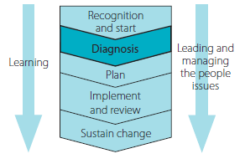
John Hayes (2014), The Theory and Practice of Change Management, 4th ed. pp - 144

Slide 5
Selecting a diagnostic model
Components Models
Conceptual Models

Slide 6
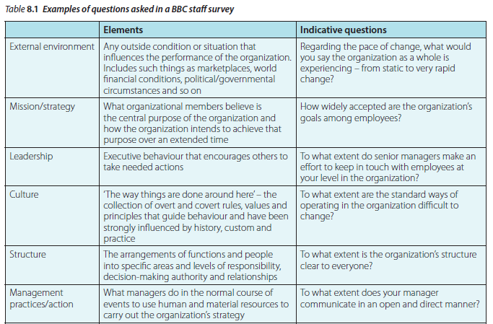
Clarifying information requirements
John Hayes (2014), The Theory and Practice of Change Management, 4th ed. pp - 146

Slide 7
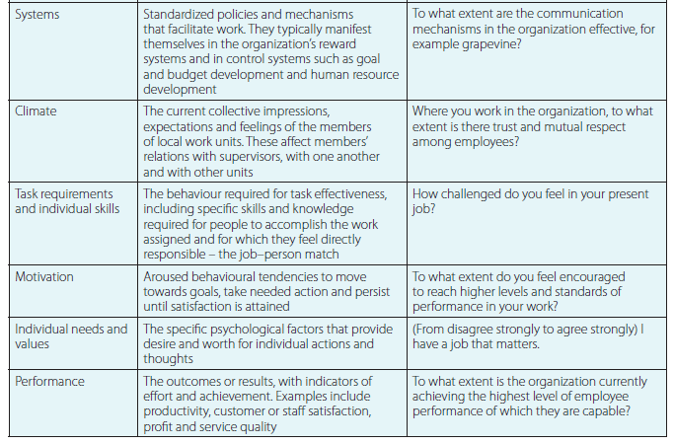
Cont’………
John Hayes (2014), The Theory and Practice of Change Management, 4th ed. pp - 146

Slide 8
Information Gathering
Interviews
Questionnaires
Projective Methods

Slide 9
Cont………Information Gathering
Observations
Unobtrusive Measures
Sampling

Slide 10
Analysis
Qualitative techniques
Content Analysis

Slide 11
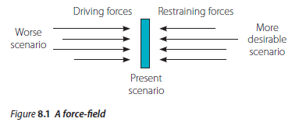
Cont……….
Force-field analysis
John Hayes (2014), The Theory and Practice of Change Management, 4th ed. pp - 152

Slide 12
Cont……….
Quantitative Techniques

Slide 13
Interpretation
Conceptual models provide a basis for interpreting diagnostic information and identifying what needs to be changed to achieve a more desirable state of affairs.

Slide 14
Political considerations
power and influence
link between performance and rewards.

Slide 15
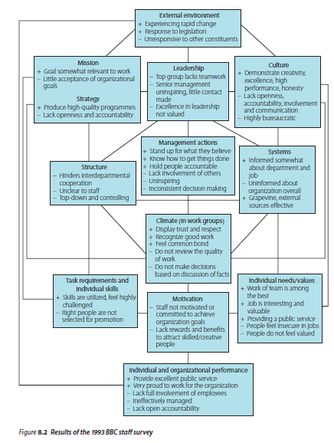
Political considerations
John Hayes (2014), The Theory and Practice of Change Management, 4th ed. pp - 153

Slide 16
Using diagnostic information to develop action plans
Using a SWOT analysis
The PRIMO-F framework
PEST

Slide 17
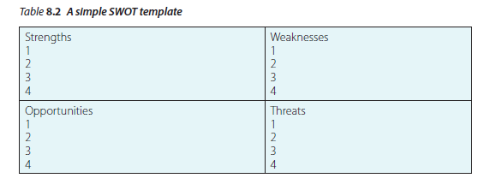
Using diagnostic information to develop action plans
Using a SWOT analysis
John Hayes (2014), The Theory and Practice of Change Management, 4th ed. pp - 155

Slide 18
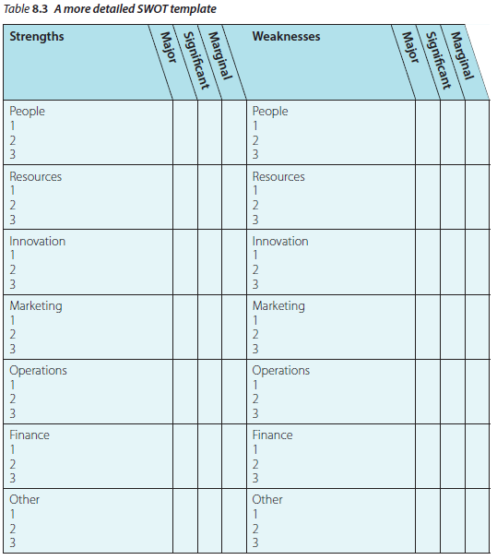
John Hayes (2014), The Theory and Practice of Change Management, 4th ed. pp - 156

Slide 19
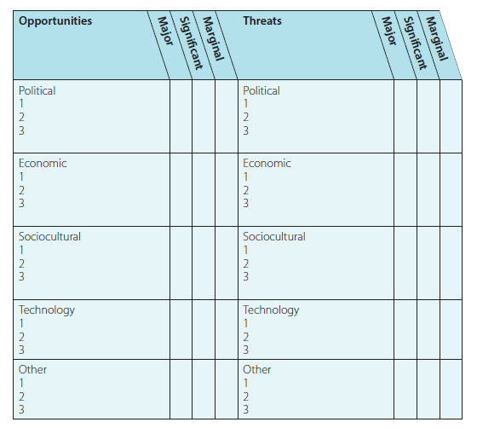
John Hayes (2014), The Theory and Practice of Change Management, 4th ed. pp - 156

Slide 20
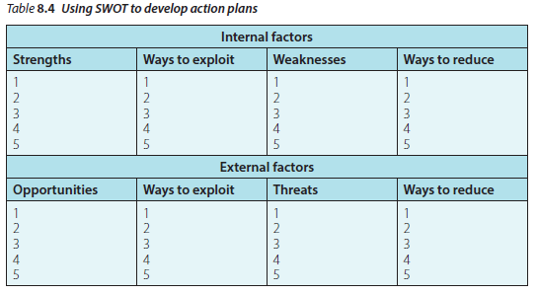
John Hayes (2014), The Theory and Practice of Change Management, 4th ed. pp - 156

Slide 21
The danger of those at the top adopting a blinkered approach is illustrated by the rise and fall of the building society Northern Rock

Slide 22
A force-field approach to opportunity development or problem management

Slide 23
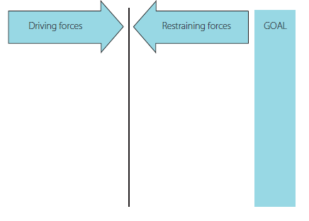
John Hayes (2014), The Theory and Practice of Change Management, 4th ed. pp - 159

Slide 24
Driving forces
Restraining forces

Slide 25
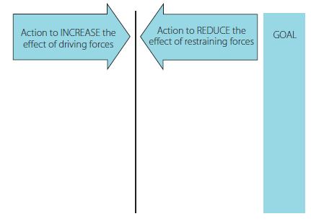
John Hayes (2014), The Theory and Practice of Change Management, 4th ed. pp - 159

Slide 26
Evaluating your use of diagnostic information

Slide 27
Summary
Discusses the process of gathering and interpreting information for organizational diagnosis in five steps. First, it emphasizes selecting a relevant conceptual model to guide the diagnosis, aligning it with specific issues like market share loss or conflict. Then, it stresses the importance of clarifying information requirements for assessing unit or work group performance. The chapter also covers various data collection methods, from interviews to questionnaires. It briefly addresses qualitative and quantitative analytical techniques. Finally, it underscores the challenge of interpreting data due to potential political issues tied to data collection that can affect the accuracy of organizational assessments.

Slide 28
REFERENCES
Hayes, John (2022) The Theory and Practice of Change Management 6th Edition. Bloomsbury Publishing PLC.
Hayes, John (2014) The Theory and Practice of Change Management 4th Edition. Palgrave Macmillan. United Kingdom
Hayes, John (2010) The Theory and Practice of Change Management 3rd Edition. Palgrave Macmillan. United Kingdom
Kotter, John P. (1996) Leading Change. Harvard Business School Press. USA. ISBN 10: 0875847471 / ISBN 13: 9780875847474

Slide 29
Online Sources
Miller, Kelsey. (March 19, 2020). % Critical Steps in the Change Management https://online.hbs.edu/blog/post/change-management-process
Adapted from: Making Change Wworrk: Practical Tools for Overcoming Human Resistance to Change, ASQ Quality Press. https://asq.org/quality-resources/change-management
Sirkein, H.L., Keenan, P., & Jackson, A. (2005). The Hard Side of Change Management. https://hbr.org/2005/10/the-hard-side-of-change-management
Courrsera. (June 17, 2023). The Change Management Process: Is it and Who is it for? https://www.coursera.org/articles/change-management-process
Bloomfire. (Jan. 12, 2023). The Importaance of Change Management in an Organization. https://bloomfire.com/blog/importance-of-change-management/
IMD. (August, 2022). Know About Change Managemen. https://www.imd.org/reflections/change-management/

Slide 30
The End

