Slide 1
CHANGE MANAGEMENT
Chapter 9
The Role of Leadership in Change Management
Lecturer: Dr. Michaella DeLeon Castillo
Philippines

Slide 2
Learning Objectives
Understand Change Leadership: Learn the seven essential tasks of leadership in change, like making sense of situations, creating a vision, and maintaining momentum.
Effective Vision Communication: Develop skills to communicate a vision for change effectively and respond to feedback.
Address Stakeholder Concerns: Learn how to recognize and address concerns of those affected by change.

Slide 3
Learning Objectives
Distributed Leadership: Understand leadership in situations where power is distributed rather than held by a single leader.
Unified Collective Leadership: Recognize the importance of a unified leadership group when leading change efforts.
Dealing with Leadership Challenges: Understand the fragility of leadership in complex situations and how to handle challenges like disconnections and alignments.

Slide 4
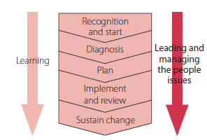
John Hayes (2014), The Theory and Practice of Change Management, 4th ed. pp - 167

Slide 5
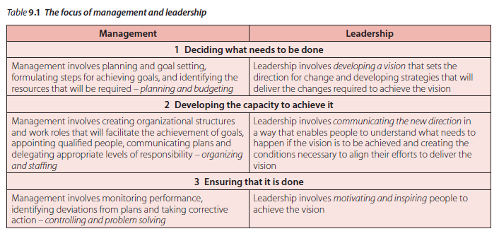
Management and leadership
Managerial work, in times of change, is increasingly a leadership task
John Hayes (2014), The Theory and Practice of Change Management, 4th ed. pp - 168

Slide 6
Kotter (1999) argues that managers are the people who are in the best position to provide the leadership required to ensure that a change will be successful.

Slide 7
The role of leadership
Higgs and Rowland (2000, 2011), after reviewing earlier work, report five behaviors associated with successful change implementation:
1 creating the case for change
2 ensuring that change is based on an in-depth understanding of the issues
3 engaging others and building commitment
4 developing effective plans and good monitoring practices
5 facilitating and developing the capability of those involved.

Slide 8
Cont’…..The role of leadership
Inventing involves conceiving, designing, and putting into practice new ways of working. Yates (2009) offers a 4E framework:
1 envisioning a values-driven set of goals and strategies
2 enabling their achievement by selecting appropriate methods, tools and people
3 empowering others by developing trust and interdependence between leaders and followers
4 energizing everybody to drive the change.

Slide 9
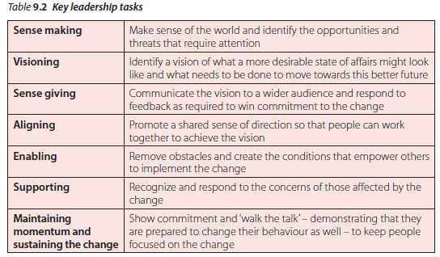
What managers (and others) do when leading change
John Hayes (2014), The Theory and Practice of Change Management, 4th ed. pp - 170

Slide 10
Sense making
Colville et al. (2013, p. 1213) - context of counterterrorism
Näslund and Pemer (2012) - ‘dominant stories’
Ancona et al. (2007, p. 95) - seeking data from multiple sources

Slide 11
Visioning
According to Kotter (1996), a good vision needs to be:
imaginable: conveys a picture of what the future will look like
desirable: appeals to the long-term interests of employees, customers, shareholders and stakeholders
feasible: comprises realistic, attainable goals

Slide 12
Cont’…….. Visioning
According to Kotter (1996), a good vision needs to be:
focused: clear enough to provide guidance in decision making
flexible: general enough to allow individual initiatives and alternative responses in light of changing conditions
communicable: easy to communicate; can be successfully explained within five minutes.

Slide 13
Interpretation
Conceptual models provide a basis for interpreting diagnostic information and identifying what needs to be changed to achieve a more desirable state of affairs.

Slide 14
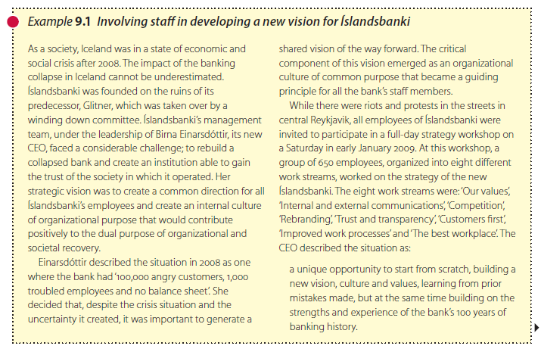
John Hayes (2014), The Theory and Practice of Change Management, 4th ed. pp - 171

Slide 15
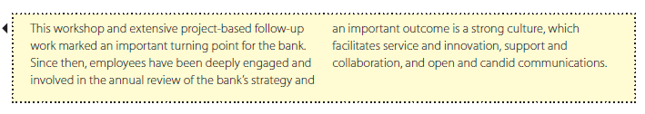
John Hayes (2014), The Theory and Practice of Change Management, 4th ed. pp - 172

Slide 16
Sense giving
Shaping the vision: reciprocal cycle of sense making and sense giving
Translating the vision into a desire for change
              Winning trust
              Highlighting benefits
              Promoting perceptions of competence
              Demonstrating that the status quo is unsustainable

Slide 17
Aligning
An important aspect of sense giving is communicating in a way that promotes a shared sense of direction and aligns people so that they can work together to achieve the vision.

Slide 18
Enabling
Leaders can enable people to deliver change by:
Everybody is clear
Creating clear structures and frameworks
Designing and delegating tasks
Designing work for teams
Providing access to information
Developing feedback mechanisms
Encouraging those involved
Creating alignment at the top

Slide 19
Supporting others during the change
It is easier for leaders to identify and communicate benefits
Providing opportunities for dialogue
Providing training opportunities

Slide 20
Maintaining momentum and sustaining the change
Leaders need to be careful to act
Managers and supervisors at all levels need to be committed and equally involved

Slide 21
Managing change in practice 9.1
Jo North: Start with the end in mind

Slide 22
Leadership style
Charismatic leadership highlights the power of the emotional interaction between leaders and followers.

Slide 23
Distributed leadership
Even in traditional hierarchical organizations, leadership, at least to some extent, has to be cascaded down the hierarchy

Slide 24
The collective nature of leadership
Coherence
Collective leadership offers the possibility of bringing together the range of skills and experience required to formulate an acceptable vision as well as the ability to influence others in a manner perceived to be legitimate.

Slide 25
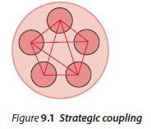
Cont’……The collective nature of leadership
Fragility
1 Strategic coupling:
John Hayes (2014), The Theory and Practice of Change Management, 4th ed. pp - 182

Slide 26
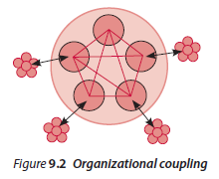
Cont’……The collective nature of leadership
Fragility
2 Organizational coupling:
John Hayes (2014), The Theory and Practice of Change Management, 4th ed. pp - 182

Slide 27
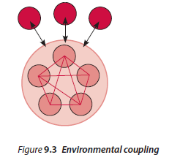
Cont’……The collective nature of leadership
Fragility
3 Environmental coupling:
John Hayes (2014), The Theory and Practice of Change Management, 4th ed. pp - 183

Slide 28
Research report 9.1 Collective leadership and strategic change in healthcare organizations
Method
The research process

Slide 29
Exercise 9.2 Profiling effective leader behaviour

Slide 30
Summary
The chapter outlines seven key tasks for successful change leadership, including creating a vision, effective communication, and addressing concerns. It also highlights the importance of collective leadership in organizations with diffused power, emphasizing the need for unity and addressing potential fragility in leadership structures.

Slide 31
REFERENCES
Hayes, John (2022) The Theory and Practice of Change Management 6th Edition. Bloomsbury Publishing PLC.
Hayes, John (2014) The Theory and Practice of Change Management 4th Edition. Palgrave Macmillan. United Kingdom
Hayes, John (2010) The Theory and Practice of Change Management 3rd Edition. Palgrave Macmillan. United Kingdom
Kotter, John P. (1996) Leading Change. Harvard Business School Press. USA. ISBN 10: 0875847471 / ISBN 13: 9780875847474

Slide 32
The End

