Slide 1
CHANGE MANAGEMENT
Chapter 10
Power, Politics and Stakeholder Management
Lecturer: Dr. Michaella DeLeon Castillo
Philippines

Slide 2
Learning Objectives
Understand the concept of organizations as a collection of constituencies with distinct objectives and the dynamic of individuals and groups influencing each other in pursuit of self-interest.
Recognize that conflicts of interest within organizations are often resolved through power and influence, rather than logical or rational arguments.
Comprehend the critical importance of securing support from powerful stakeholders and building a critical mass of support for successful organizational change.

Slide 3
Learning Objectives
Define stakeholders as individuals or groups who can affect or are affected by a change, and grasp the heightened intensity of political behavior during times of change.
Appreciate the significance of assessing power dynamics, understanding relative dependencies, and leveraging them to shift the balance of power in favor of change leaders.
Distinguish between the normative and instrumental approaches to stakeholder management, and understand the fundamental principles of Jawahar and McLaughlin's instrumental theory, including resource dependence, prospect theory, and the impact of organizational life cycle stages on stakeholder management strategies.

Slide 4
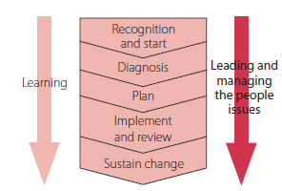
John Hayes (2014), The Theory and Practice of Change Management, 4th ed. pp - 190

Slide 5
What leaders can do to increase their ability to influence others.
Identifying which stakeholders should be taken into account by those leading the change.
Ethical considerations.
A conceptual framework, based on life cycle, resource dependence and prospect theory, that leaders can use to decide how best to manage stakeholders.
The stakeholder grid, a useful tool for mapping the power of stakeholders and their predisposition to support or oppose the change

Slide 6
Organizations as political arenas
Leaders need to understand and manage the politics of organizational change.
Change managers need to be alert to these political dynamics, especially the possibility that others may be motivated to act in ways that undermine their efforts to bring about change.

Slide 7
Power and influence
McClelland (1975) defines power as the ability to change the behavior of others.

Slide 8
Exercise 10.1 Sources of power and influence
the power to control or influence the other resides in control over the things he values, which may range all the way from oil resources to ego support. In short, power resides implicitly in the other’s dependence.

Slide 9
Acquiring and exercising power and influence
Promoting their reputation
Increasing others’ dependence on the leader
Increasing others’ sense of dependence

Slide 10
Cont’…. Acquiring and exercising power and influence
Minimizing leaders’ dependence on those they are seeking to influence
Building collaborative relationships
Negotiating advantageous agreements

Slide 11
Improving your ability to influence others
Exercise 10.2 Checklist for the acquisition and exercise of power
John Hayes (2014), The Theory and Practice of Change Management, 4th ed. pp - 195

Slide 12
Stakeholders
Stakeholders who can influence the outcome of the change.

Slide 13
Which stakeholders should be taken into account by those leading change?
Ethics-based theories
Reputational capital
Instrumental theories
Balancing corporate interests and stakeholder concerns

Slide 14
A life cycle approach to stakeholder management
The contribution of resource dependence theory
      1 Being proactive
      2 Accommodating
      3 Defending
      4 Ignoring

Slide 15
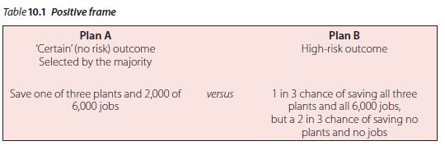
Cont’… A life cycle approach to stakeholder management
The contribution of prospect theory
John Hayes (2014), The Theory and Practice of Change Management, 4th ed. pp - 200

Slide 16
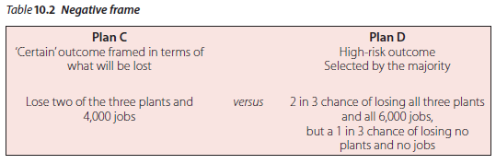
Cont’… A life cycle approach to stakeholder management
The contribution of prospect theory
John Hayes (2014), The Theory and Practice of Change Management, 4th ed. pp - 200

Slide 17
Cont’… A life cycle approach to stakeholder management
The contribution of prospect theory
Stakeholder theory by proposing two theorems:
1. ‘gain frame’
2. ‘loss frame’

Slide 18
Cont’… A life cycle approach to stakeholder management
The contribution of organizational life cycle models
Jawahar and McLaughlin’s stakeholder theory

Slide 19
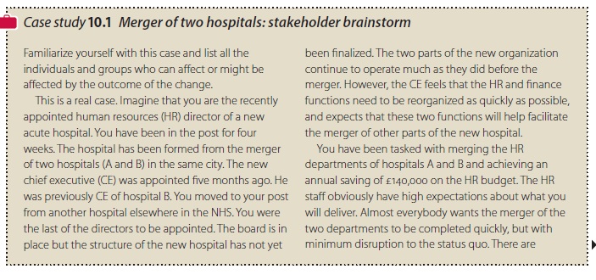
Managing stakeholders
John Hayes (2014), The Theory and Practice of Change Management, 4th ed. pp - 201

Slide 20

Cont’….. Managing stakeholders
John Hayes (2014), The Theory and Practice of Change Management, 4th ed. pp - 202

Slide 21
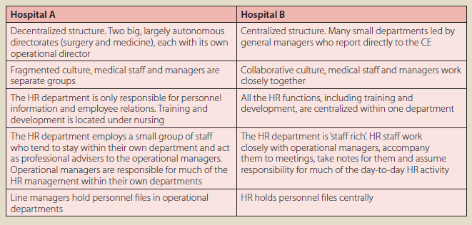
Cont’….. Managing stakeholders
John Hayes (2014), The Theory and Practice of Change Management, 4th ed. pp - 202

Slide 22

Cont’….. Managing stakeholders
John Hayes (2014), The Theory and Practice of Change Management, 4th ed. pp - 203

Slide 23
Cont’….. Managing stakeholders
Identifying the power and commitment of stakeholders
Grundy (1998) outlines three steps for identifying the power and commitment of stakeholders:
He refers to the first step as the ‘stakeholder brainstorm’.
The second step involves assessing how much power and influence each group of stakeholders has.
The third step involves assessing stakeholders’ attitudes towards the proposed change.

Slide 24
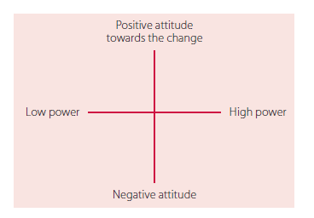
Change tool 10.1 Stakeholder grid
John Hayes (2014), The Theory and Practice of Change Management, 4th ed. pp - 205

Slide 25
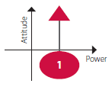
Influencing stakeholders to support the change
The second part of the process described by Grundy (1998) involves the change manager acting in ways that will ensure maximum support for the change. This might involve:
1. Winning the support of those who oppose the change and have the power to influence the outcome
John Hayes (2014), The Theory and Practice of Change Management, 4th ed. pp - 205

Slide 26
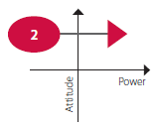
Influencing stakeholders to support the change
The second part of the process described by Grundy (1998) involves the change manager acting in ways that will ensure maximum support for the change. This might involve:
2. Increasing the influence of already supportive stakeholders:
John Hayes (2014), The Theory and Practice of Change Management, 4th ed. pp - 205

Slide 27
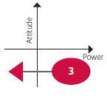
Influencing stakeholders to support the change
The second part of the process described by Grundy (1998) involves the change manager acting in ways that will ensure maximum support for the change. This might involve:
3. Reducing the influence of powerful blockers:
John Hayes (2014), The Theory and Practice of Change Management, 4th ed. pp - 205

Slide 28
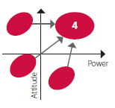
Influencing stakeholders to support the change
The second part of the process described by Grundy (1998) involves the change manager acting in ways that will ensure maximum support for the change. This might involve:
4. Building a coalition of supportive stakeholders who will be prepared to work together to support the change:
John Hayes (2014), The Theory and Practice of Change Management, 4th ed. pp - 205

Slide 29
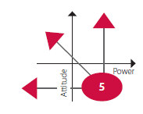
Influencing stakeholders to support the change
The second part of the process described by Grundy (1998) involves the change manager acting in ways that will ensure maximum support for the change. This might involve:
5. Fragmenting existing coalitions who are antagonistic towards the change
John Hayes (2014), The Theory and Practice of Change Management, 4th ed. pp - 206

Slide 30
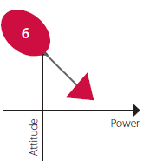
Influencing stakeholders to support the change
The second part of the process described by Grundy (1998) involves the change manager acting in ways that will ensure maximum support for the change. This might involve:
6. Bringing new sponsors or champions into play:
John Hayes (2014), The Theory and Practice of Change Management, 4th ed. pp - 205

Slide 31
Managing relationships between stakeholders
There is evidence suggesting that the way one set of stakeholders is managed can affect how other stakeholders will react to a change.

Slide 32
Summary
Organizational change involves politics and the crucial support of key stakeholders. Stakeholders, including self-interested groups, influence change through power dynamics rather than logic. Effective change management requires gaining support from influential stakeholders. Two approaches to stakeholder management exist: normative (morally driven) and instrumental (self-interest-driven). Jawahar and McLaughlin's instrumental theory combines resource dependence and prospect theory. It offers two theorems for addressing stakeholder concerns based on the presence or absence of threats. Assessing the importance of stakeholders at different project stages and using tools like the stakeholder grid can help navigate these dynamics effectively.

Slide 33
REFERENCES
Hayes, John (2022) The Theory and Practice of Change Management 6th Edition. Bloomsbury Publishing PLC.
Hayes, John (2014) The Theory and Practice of Change Management 4th Edition. Palgrave Macmillan. United Kingdom
Hayes, John (2010) The Theory and Practice of Change Management 3rd Edition. Palgrave Macmillan. United Kingdom
Kotter, John P. (1996) Leading Change. Harvard Business School Press. USA. ISBN 10: 0875847471 / ISBN 13: 9780875847474

Slide 34
The End

