Slide 1
CHANGE MANAGEMENT
Chapter 11
Communicating Change
Lecturer: Dr. Michaella DeLeon Castillo
Philippines

Slide 2
Learning Objectives
Explain the impact of effective communication on change program success, including its role in recognizing the need for change and supporting collective learning.
Describe the concept of directionality in change communication and its relevance, especially in top-down communication processes.
Analyze how organizational roles influence the nature and content of communication in a change program.

Slide 3
Learning Objectives
Discuss the importance of considering both internal and external information in change communication to facilitate organizational learning.
Explore how interpersonal relations within an organization can shape information sharing and its effects on change efforts.
Identify the significance of selecting appropriate communication channels for effective change communication.

Slide 4
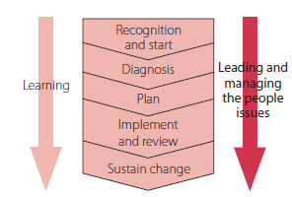
John Hayes (2014), The Theory and Practice of Change Management, 4th ed. pp - 212

Slide 5
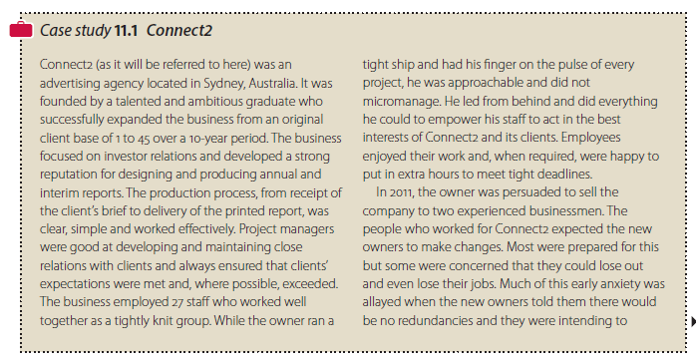
Case Study 11.1 Connect2
John Hayes (2014), The Theory and Practice of Change Management, 4th ed. pp - 212
John Hayes (2014), The Theory and Practice of Change Management, 4th ed. pp - 212

Slide 6

Cont’…..Case Study 11.1 Connect2
John Hayes (2014), The Theory and Practice of Change Management, 4th ed. pp - 213

Slide 7
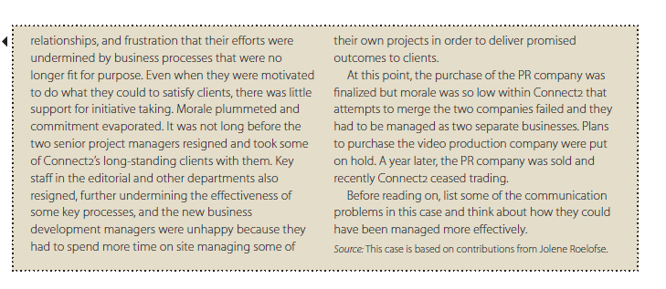
Cont’…..Case Study 11.1 Connect2
John Hayes (2014), The Theory and Practice of Change Management, 4th ed. pp - 214

Slide 8
The Need for a Communication Strategy
For example, those leading change can:
Communicate about anything but, because of time constraints and perceptions about the sensitivity of certain pieces of information, they cannot communicate
Unconsciously act in ways that impact on the shape of communication networks.

Slide 9
Directionality
1. Directionality and Content

Slide 10
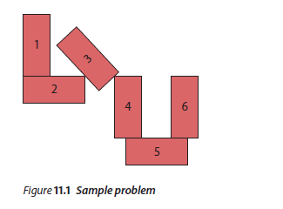
Cont’…… Directionality
2. Directionality and accuracy, confidence and time
John Hayes (2014), The Theory and Practice of Change Management, 4th ed. pp - 216

Slide 11
Cont’…… Directionality
3. Lateral Communication and Performance
4. Organizational Silence and a Lack of Upward Communication

Slide 12
Cont’…… Directionality
According to Morrison and Milliken (2000), a climate of silence in organizations will develop when:
Leaders fear negative feedback from subordinates and try to avoid it or, if this is not possible, dismiss it as inaccurate or attack the credibility of the source.
Senior managers hold a particular set of implicit beliefs about employees and the nature of management that make it easy for them to ignore or dismiss feedback.

Slide 13
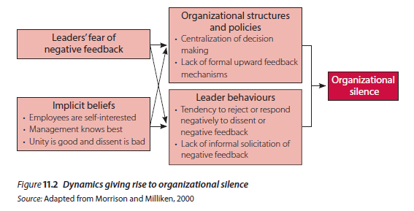
Cont’…… Directionality
John Hayes (2014), The Theory and Practice of Change Management, 4th ed. pp - 218

Slide 14
Cont’…… Directionality
5. Effect of these beliefs and the fear of feedback on structures, policies and practices
Examples of structures and policies that inhibit upward communication include:
centralized decision-making procedures that exclude most employees
an absence of formal feedback mechanisms for soliciting employee feedback on decisions after they have been made.

Slide 15
Cont’…… Directionality
5. Effect of these beliefs and the fear of feedback on structures, policies and practices
Examples of leader behaviors that have a similar effect include:
a tendency to reject employees’ concerns about a proposed change because they are viewed as ‘resistance’ motivated by self-interest rather than a true concern that the change may be bad for the organization
a general unwillingness on the part of managers to seek informal feedback from subordinates, for reasons that include those discussed above.

Slide 16
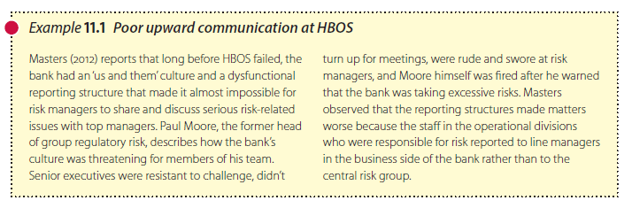
Cont’…… Directionality
6. The implications of organizational silence
John Hayes (2014), The Theory and Practice of Change Management, 4th ed. pp - 219

Slide 17
Role
Isolates
Boundary Spanners
Gatekeepers

Slide 18
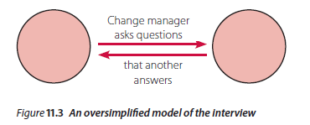
Cont’….. Role
Playmakers
The effect of trust on the quality of interpersonal communication
John Hayes (2014), The Theory and Practice of Change Management, 4th ed. pp - 222

Slide 19
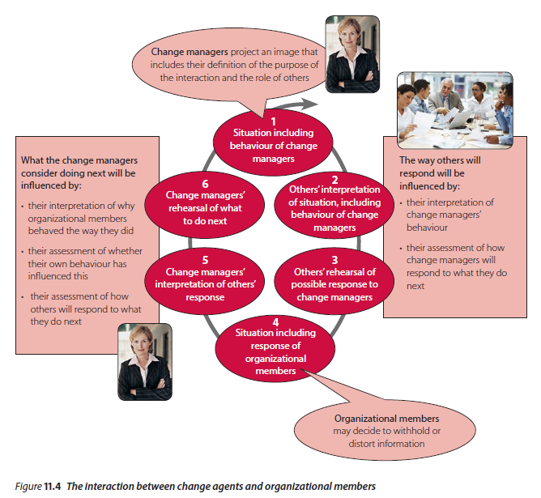
Cont’….. Role
John Hayes (2014), The Theory and Practice of Change Management, 4th ed. pp - 222

Slide 20
Content
Unfamiliar Content
Perceptions of Fairness and Justice

Slide 21
Channel
Information and meaning can be communicated in many different ways:
Written communication via hard copy
electronic communication via email
texts
Tweets
blogs

Slide 22
Channel
Information and meaning can be communicated in many different ways:
videoconferencing,
telephone,
face-to-face communication on a one-to-one,
one-to-group or group-to-group basis

Slide 23
Communication Strategies
The five basic strategies are:
Spray and pray
Tell and sell
Underscore and explore
Identify and reply
Withhold and uphold

Slide 24
Auditing the effectiveness of the communication strategy
Some of the questions they might need to ask are:
Who is communicating with whom?
What issues are they talking about?
Which issues receive most attention and arouse most anxiety?
Do people receive all the information they require?

Slide 25
Auditing the effectiveness of the communication strategy
Some of the questions they might need to ask are:
Do people understand and use the information they receive?
Do people trust and have confidence in the information they receive?
From what sources do people prefer to get their information?
Which channels are most effective?

Slide 26
A life cycle approach to stakeholder management
The contribution of resource dependence theory
      1 Being proactive
      2 Accommodating
      3 Defending
      4 Ignoring

Slide 27

Case study 11.2 provides an opportunity for you to explore the relevance of the ideas discussed in this chapter.
John Hayes (2014), The Theory and Practice of Change Management, 4th ed. pp - 230

Slide 28
Summary
This chapter underscores the crucial role of effective communication in the success of change programs. It explores communication networks, strategies, and factors affecting access to key information for change managers. Key features discussed include directionality (top-down communication), role-based communication, content relevance, and channel selection. The chapter stresses the need for continuous monitoring and evaluation of communication strategies by change leaders to enhance change implementation.

Slide 29
REFERENCES
Hayes, John (2022) The Theory and Practice of Change Management 6th Edition. Bloomsbury Publishing PLC.
Hayes, John (2014) The Theory and Practice of Change Management 4th Edition. Palgrave Macmillan. United Kingdom
Hayes, John (2010) The Theory and Practice of Change Management 3rd Edition. Palgrave Macmillan. United Kingdom
Kotter, John P. (1996) Leading Change. Harvard Business School Press. USA. ISBN 10: 0875847471 / ISBN 13: 9780875847474

Slide 30
The End

