Slide 1
CHANGE MANAGEMENT
Chapter 12
Motivating Others to Change
Lecturer: Dr. Michaella DeLeon Castillo
Philippines

Slide 2
Learning Objectives
Understand the impact of organizational commitment on new initiative support.
Explore how past experiences shape commitment and change readiness.
Recognize the significance of the psychological contract in fostering trust and reciprocity.

Slide 3
Learning Objectives
Analyze challenges when job satisfaction conflicts with change commitment.
Identify determinants of change resistance, and view it as feedback.
Learn strategies to reduce resistance and apply expectancy theory to assess motivation for change support or resistance.

Slide 4
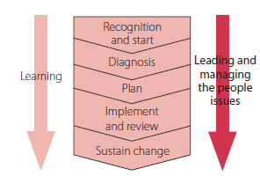
John Hayes (2014), The Theory and Practice of Change Management, 4th ed. pp - 233

Slide 5
This Chapter will:
Consider some of the factors that can influence whether or not individuals and groups will support change.
Explore the benefit of viewing resistance as valuable feedback rather than an unwelcome threat that has to be managed.

Slide 6
Cont’ ….. This Chapter will:
Review some of the steps that change leaders can take to motivate others to change.
Draw on expectancy and equity theories to provide a change tool that leaders can use to help them achieve this.

Slide 7
Organizational Commitment and Support for Change
Organizations may expect employees to:
be loyal
keep trade secrets
work hard and do their best for the organization.

Slide 8
Cont’….. Organizational Commitment and Support for Change
In return, employees may expect that they will:
receive an equitable level of remuneration
be treated fairly and with dignity
have some level of security of employment
have some level of autonomy
have an opportunity to learn and develop.

Slide 9
Exercise 12.1 Violations of the psychological contract
Think of an incident at work or university when the organization/management fell short of what might have been reasonably expected of them in their treatment of you or another individual or group of employees/students.

Slide 10
Illustrates how easily managers can, sometimes
unintentionally, damage the psychological contract.
Commitment to a job and the willingness to support change
What leaders see as resistance others might interpret as support

Slide 11
Factors that can undermine support for change
Low trust
Low tolerance for change
Different assessments
Parochial self-interest

Slide 12
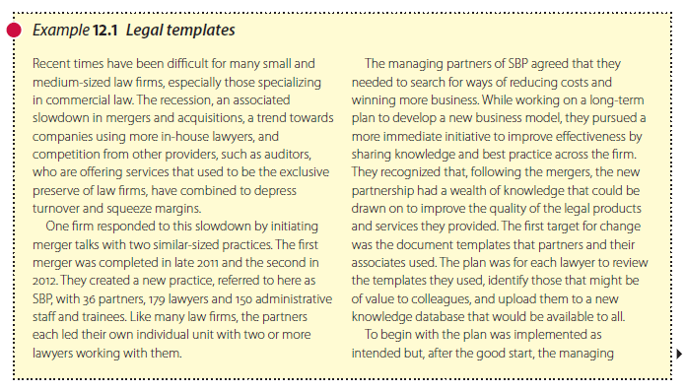
John Hayes (2014), The Theory and Practice of Change Management, 4th ed. pp - 238

Slide 13
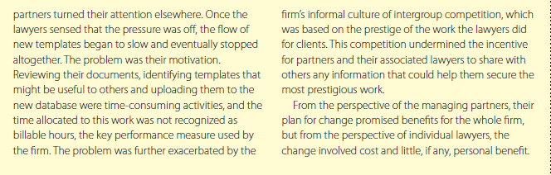
John Hayes (2014), The Theory and Practice of Change Management, 4th ed. pp - 239

Slide 14
Resistance and the need to motivate people to change
Education and persuasion
Involvement
Facilitation and support
Negotiation

Slide 15
Cont’…… Resistance and the need to motivate people to change
Manipulation and co-option
Explicit and implicit coercion
Goal setting

Slide 16
Expectancy theory and the motivation to support or resist change
Expectancy theorists (for example Vroom, 1964; Porter and Lawler, 1968) argue that behavior is a function of two factors:
  Attractiveness of Outcomes
Expectancies about the achievement of valued outcomes

Slide 17
Cont’….. Expectancy theory and the motivation to support or resist change
Outcomes – Valence
Expectancies – Valued outcomes in practice

Slide 18
Cont’….. Expectancy theory and the motivation to support or resist change
The theory focuses attention on two expectancies about the future:
Effort to performance expectancy
Performance to outcome expectancy

Slide 19
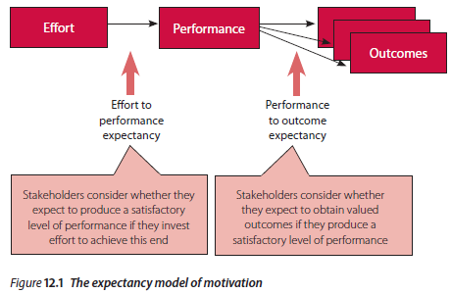
Cont’….. Expectancy theory and the motivation to support or resist change
John Hayes (2014), The Theory and Practice of Change Management, 4th ed. pp - 245

Slide 20
Cont’….. Expectancy theory and the motivation to support or resist change
Equity of treatment
Understanding and competence

Slide 21
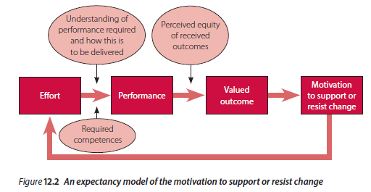
Cont’….. Expectancy theory and the motivation to support or resist change
John Hayes (2014), The Theory and Practice of Change Management, 4th ed. pp - 246

Slide 22
Using expectancy theory to enhance motivation and support for change
Assessing the availability of valued outcomes
Change manager needs to:
be aware of the kinds of
the extent to which the current situation provides these outcomes
extent to which valued outcomes will be (at least potentially) available in the changed situation.

Slide 23
Cont’ …… Using expectancy theory to enhance motivation and support for change
Expectancies about effort–performance and performance–outcome relationships and equity of net benefits
Anticipate stakeholder effort–performance expectancies

Slide 24
Cont’ …… Using expectancy theory to enhance motivation and support for change
Anticipate stakeholder performance–outcome expectancies
Anticipate stakeholder perceptions of equity

Slide 25
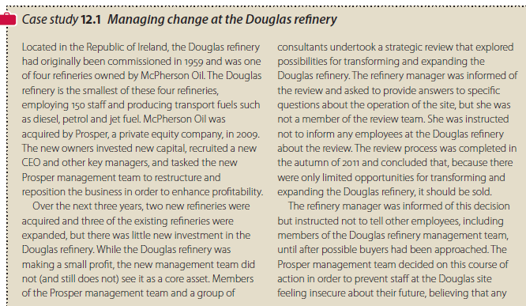
Translating theory into practice
John Hayes (2014), The Theory and Practice of Change Management, 4th ed. pp - 251

Slide 26
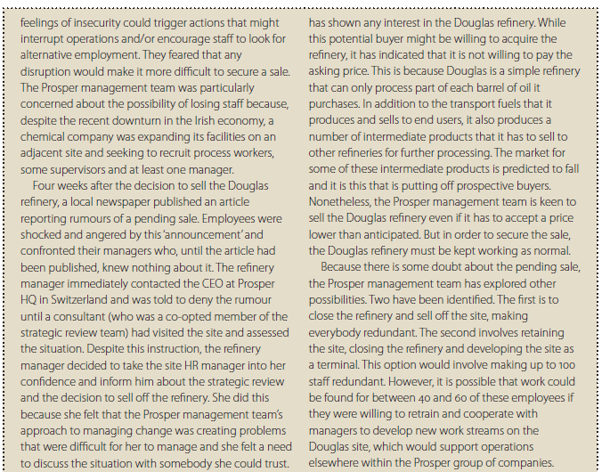
Cont’….. Translating theory into practice
John Hayes (2014), The Theory and Practice of Change Management, 4th ed. pp - 252

Slide 27
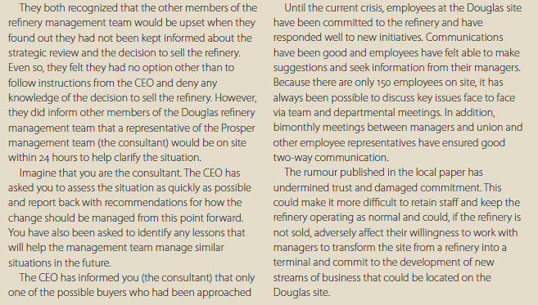
Cont’….. Translating theory into practice
John Hayes (2014), The Theory and Practice of Change Management, 4th ed. pp - 252

Slide 28
Summary
This chapter examines the impact of organizational commitment on supporting new initiatives. It discusses how past experiences with change and the psychological contract influence commitment and willingness to embrace change. Resistance to change can offer valuable feedback, and various factors, including trust and self-interest, affect support for change. The chapter suggests strategies for reducing resistance and introduces expectancy theory to assess motivation for change support or resistance.

Slide 29
REFERENCES
Hayes, John (2022) The Theory and Practice of Change Management 6th Edition. Bloomsbury Publishing PLC.
Hayes, John (2014) The Theory and Practice of Change Management 4th Edition. Palgrave Macmillan. United Kingdom
Hayes, John (2010) The Theory and Practice of Change Management 3rd Edition. Palgrave Macmillan. United Kingdom
Kotter, John P. (1996) Leading Change. Harvard Business School Press. USA. ISBN 10: 0875847471 / ISBN 13: 9780875847474

Slide 30
The End

