Slide 1
INTRODUCTION TO PROGRAMMING AND PROBLEM SOLVING
WEEK 1: INTRODUCTION TO DIGITAL COMPUTER
LECTURER: LEMI AGREY OLIVER
DEPARTMENT OF INFORMATION TECHNOLOGY
KUMI UNIVERSITY

Slide 2
Outline
Course description
Learning outcome
Text books
Introduction to digital computer,
Von Neumann Concept ,
Hardware and Software,
Programming Languages
Operating Systems etc

Slide 3
Course description
This course will provide students with a fundamental foundation in programming and problem-solving.
Its primary goal is to equip students with a solid understanding of problem-solving through coding.
The curriculum encompasses essential topics such as computer system basics, problem-solving methodologies, an introduction to Python programming,

Slide 4
Course description+
Python programming fundamentals, operators and expressions, decision statements, loop control statements, functions, strings, lists, list searching, sorting, object-oriented programming, sets, tuples, dictionaries, as well as creative applications of Turtle graphics for drawing, accompanied by practical skills in file handling.

Slide 5
Learning outcome
By the end of this course, students should be able to:
Comprehend the fundamentals of a computer system.
Acquire knowledge in problem-solving strategies and algorithms.
Understand programming concepts and various programming languages.

Slide 6
Learning outcome+
Define and employ functions to execute specific tasks, enhancing code modularity.
Manipulate lists, tuples, and dictionaries to store, retrieve, and modify data.
Apply algorithmic thinking to address fundamental programming challenges by breaking them down into logical steps.

Slide 7
Text books
Introduction to Programming and problem solving with python, Ashok N. Kamthane, Amit A. Kamthane, McGraw Hill Education (India) Private Limited,2018
Introduction to computing and problem-solving using python, E Balagurusamy, McGraw Hill Education (India) Private Limited, 2016

Slide 8
Introduction to digital computer
A digital computer also known as computer is an electronic device that takes in data, processes it into information, stores and output the information to the user whenever required
A computer can also be defined as an electronic device which accepts data from a user, processes the data for calculations specified by the user and generates an output [1]
It normally understands binary values which are represented by 0s and 1s.

Slide 9
Introduction to digital computer+
It’s a versatile machine with ability to perform variety of tasks including calculations, data manipulation, multitasking, simulations and many others.
A computer is a very complex system that consist of several components that work together to accomplish a task such as data processing and information storage.

Slide 10
Components of a computer
Central Processing Unit (CPU), The CPU is the brain of the computer. It performs instructions, calculations, and manages data processing. It consists of the control unit and the arithmetic logic unit (ALU).
Memory (RAM), Random Access Memory (RAM) is a type of volatile memory that temporarily stores data and instructions that the CPU is actively using. It allows for quick data access and retrieval.

Slide 11
Components of a computer+
Storage Devices, These are devices used for permanent storage of data and they includes, Hard Disk Drives (HDD) Solid-State Drives (SSD), Optical Drives, USB Flash Drives, and many others
Motherboard, the motherboard is the main circuit board of the computer. It houses the CPU, memory, and other essential components, and it provides connectivity for peripherals.

Slide 12
Components of a computer++
Output Devices, output devices present data to the user. Examples of output devices are Monitor/Display, Printer, Speakers
Expansion Cards, These are optional cards that can be added to the motherboard to provide additional functionality. Examples include graphics cards (GPU), sound cards, and network interface cards (NIC).

Slide 13
Components of a computer+++
Power Supply Unit (PSU), The PSU provides electrical power to the computer. It converts electrical energy from an outlet into the voltage levels required by various components.
Cooling System, Computers generate heat during operation, so cooling components are essential to prevent overheating. This includes fans, heat sinks, and sometimes liquid cooling systems.

Slide 14
Components of a computer++++
Cables and Connectors, Cables and connectors are used to link various components within the computer and connect external peripherals. Examples include SATA cables, USB connectors, and power cables.
Operating System (OS), The operating system is software that manages hardware resources and provides services to applications and users. Common operating systems include Windows, macOS, Linux, and various mobile OSs.

Slide 15
Components of a computer+++++
Input Devices, input devices allow users to interact with the computer. They includes, Keyboard, Mouse, Touchpad, Touchscreen, Scanner, Microphone, Webcam
Software Applications, Software applications are programs that users run to perform specific tasks. Examples include word processors, web browsers, games, and productivity software.

Slide 16
Components of a computer++++++
BIOS/UEFI, The Basic Input/Output System (BIOS) or Unified Extensible Firmware Interface (UEFI) is firmware that initializes hardware components and loads the operating system during startup
Network Interface, A network interface for example Ethernet or Wi-Fi adapter, allows the computer to connect to networks and the internet.

Slide 17
Components of a computer+++++++
Graphics Processing Unit (GPU), A GPU, often integrated into the CPU or as a separate card, handles graphics rendering and acceleration tasks. It's crucial for gaming and graphics-intensive applications.

Slide 18
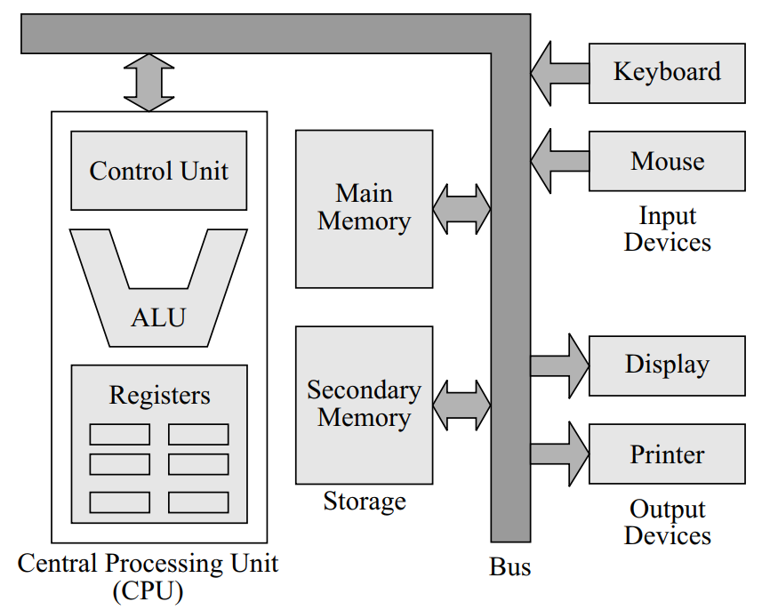
Figure showing the components of the digital computer
Figure 1.1 Components of Computer[2]

Slide 19
Characteristics of Digital computers
Computers possess the following characteristics[1]
A computer can perform millions of calculations in a second.
A computer works with precision every time.
A computer can store billions of bytes of information.
A computer can work continuously without getting tired.

Slide 20
Characteristics of Digital computers+
A computer can be used to perform various tasks concurrently.
A computer will remember the information stored for as long as is required.

Slide 21
Von Neumann Concept
The Von Neumann concept/architecture also known as stored program is a fundamental concept in computing.
In this concept both data and instruction are stored in the same memory which allows computers to perform several operations within a less time
The Von Neuman Architecture was proposed by mathematician and computer scientist John Von Neumann in the 1940s

Slide 22
Principles of the Von Neumann concept
Central Processing Unit (CPU), The CPU is the core component of the computer. It performs arithmetic and logical operations, executes instructions, and controls the overall operation of the computer
Memory Unit, the memory unit is used to store both data and instructions (programs) that the CPU operates on. In the von Neumann architecture, the same memory unit is used to store data and program code. This concept is often referred to as the "stored-program" concept.

Slide 23
Principles of the Von Neumann concept+
Control Unit, the control unit is responsible for fetching instructions from memory, decoding them, and executing them in the appropriate order. It also manages the flow of data between the CPU, memory, and input/output devices.
Arithmetic Logic Unit (ALU), the ALU performs arithmetic (e.g., addition, subtraction, multiplication) and logical (e.g., AND, OR, NOT) operations on data. It is a fundamental component for performing calculations and making decisions in the computer.

Slide 24
Principles of the Von Neumann concept++
Input/Output (I/O) Devices, the Input and output devices, such as keyboards, displays, and storage devices, are used for communication between the computer and the external world. These devices allow users to input data and receive output from the computer.
Instruction Set, computer's instruction set is a predefined set of instructions that the CPU can understand and execute. Instructions are typically represented in binary code and are stored in memory.

Slide 25
Principles of the Von Neumann concept+++
Program Counter (PC), the program counter is a register that keeps track of the memory address of the next instruction to be executed. It ensures that instructions are executed sequentially.
Fetch-Decode-Execute Cycle, the von Neumann architecture operates in a cyclical manner known as the "fetch-decode-execute cycle." In this cycle, the CPU fetches the next instruction from memory,

Slide 26
Storage
Storage is the act of storing or keeping something in some sort of container safely
In computing, storage is the memory that is used for retaining programs and data for future use.
A memory is measured in bytes
A single byte is 8 bits

Slide 27
Storage+
A bit is the smallest unit of memory
It’s worth noting that after a byte, the next unit of memory is kilobyte which is 1024 bytes, followed by a megabyte which translates to 1024 Kilobytes, then a Gigabyte which is 1024 Megabytes ,a Terabyte which is 1024 Gigabytes etc.

Slide 28
Storage++
Storage is divided into internal, primary and secondary storage
Secondary storage is the memory where data or programs are stored permanently
There are many examples of secondary storage among them are flash drive, DVD, Floppy disk, Hard Disk Drive, Solid State Drive and many others.

Slide 29
Storage+++
The internal memory is a set of registers which holds temporary programs/data during the computation process.
The registers are within the central processing unit(CPU)

Slide 30
Primary storage
The primary memory is also called main memory and is divided into Random Access Memory(RAM), Read Only Memory(ROM) and Cache memory.
The Random access memory is a volatile memory that stores all the current programs.
Volatile means it stores data or programs until power is turn off then everything will disappear and will not recalled ever having known such data.

Slide 31
Primary storage+
RAM is the working memory of the computer
The size of the RAM is a contributing factor to how fast your computer response especially in a situation where you are running several programs at the same time,
A larger amount of RAM allows the computer to store more data in memory. When you run applications or load files, they are typically loaded into RAM for faster access.

Slide 32
Primary storage+
If your RAM is too small to accommodate the data and programs you are using, the computer will rely more on slower storage devices like hard drives or solid-state drives (SSDs) for temporary data storage. This can result in slower performance as accessing data from storage is significantly slower than accessing it from RAM.
Read Only Memory(ROM)
The ROM which is Read Only Memory is the type of memory that does not permit writing into but rather reading from only

Slide 33
Read Only Memory(ROM)
It is where part of the operating system resides in the computer
Information in the ROM can neither be change nor lost when the computer is powered off unlike the RAM which loses all its data once the computer is turned off
Due to its non volatile nature, it is the most ideal for storing secure and critical code such as the bootloader and cryptographic keys

Slide 34
Cache Memory
Cache Memory, this is the memory that is located between the CPU and the primary memory
It stores recently accessed data and instructions to speed up subsequent memory accesses.
Cache Hit: A cache hit occurs when the CPU requests data or an instruction, and the requested data is found in the cache.
This means that, the data is present in the cache, and the CPU can quickly access it without having to fetch it from the slower main memory

Slide 35
Cache Memory+
Cache hits result in faster data retrieval and improved system performance.
Cache Miss: A cache miss occurs when the CPU requests data that is not present in the cache. This means the data is not stored in the cache memory, and the CPU must fetch it from the main memory.

Slide 36
Cache Memory++
Cache misses introduce additional latency and can slow down the execution of programs because the CPU has to wait for the data to be fetched from a slower memory source.
Hit ratio, is the ratio of cache hits to the total number of memory access operations. It indicates how often the requested data is found in the cache.
Hit Time: The time it takes for the CPU to access data that is already present in the cache is known as the hit time.

Slide 37
Cache Memory+++
This time is very short compared to accessing data from main memory.
Miss Penalty: The miss penalty is the time it takes to fetch data from the main memory and load it into the cache after a cache miss.
This time is significantly longer compared to a cache hit due to the slower access times of main memory.

Slide 38
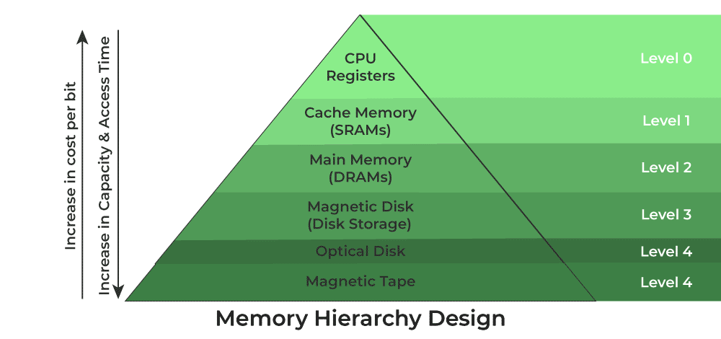
Memory Hierarchy
The computer memory hierarchy is a hierarchical structure of various types of memory in a computer system, ranked by their speed, capacity, and proximity to the central processing unit (CPU). This hierarchy is essential for efficiently managing data and instructions as they are processed by the CPU.
Figure 1.2 Memory hierarchy [6]

Slide 39
Memory Hierarchy+
The goal of the memory hierarchy is to manage the flow of data between different levels of memory, ensuring that the most frequently used data is stored in the faster but smaller caches, while less frequently used data is stored in larger but slower memory levels.
This approach optimizes the overall performance of the computer system by reducing the time the processor spends waiting for data to be fetched from slower memory sources.

Slide 40
Memory Hierarchy++
In figure 1.2 we show that the memory hierarchy has five levels
The cost of the memory decreases as you moved from level 0 to level 4 while the speed of the memory increases as you move from level 4 to level 0
Level 0 are the registers which are found within the central process unit(CPU).

Slide 41
Memory Hierarchy+++
They are used to hold data that is being actively worked on by the CPU.
Registers store data that is frequently accessed by the CPU for arithmetic operations, logical comparisons, and other computations.
It is the fastest memory in terms of access speed and the most expensive memory

Slide 42
Memory Hierarchy++++
The speed of the CPU is affected by the number of registers it has.
It’s size ranges from 16 bits to 64 bits
Level 1 is the cache memory which is responsible for the storage of the segments of programs/data that are frequency accessed by the processor.
In case of a need to run a process, the processor first checks the cache before reaching out to the main memory

Slide 43
Memory Hierarchy+++++
Level 2 is the main memory which is also known as the Random Access Memory(RAM). It is where all running programs are kept. This memory can be directly access by the CPU
It communicates with the CPU and other peripheral devices through the Input/Output processor.
It is larger than cache memory but slower to access.
The main memory has two types and these are

Slide 44
Memory Hierarchy++++++
Static RAM: This stores the binary information in flip flops and information remains valid until power is turned off. It has a faster access time and is used in implementing cache memory. [7]
Dynamic RAM: It stores the binary information as a charge on the capacitor. It requires refreshing circuitry to maintain the charge on the capacitors after a few milliseconds. It contains more memory cells per unit area as compared to SRAM.[7]

Slide 45
Memory Hierarchy+++++++
Level 3: Secondary Storage, this includes storage devices like hard drives (HDDs) and solid-state drives (SSDs). While they offer significantly larger capacity than main memory, they are much slower to access.
The secondary memory is used for long-term storage of programs, data, and the operating system.

Slide 46
Memory Hierarchy++++++++
Level 4: Tertiary Storage, this level includes storage solutions with even larger capacity but slower access times, such as network-attached storage (NAS), tape drives, and cloud storage.
This storage is used for keeping copies of the data or programs for the purposes of data backup

Slide 47
Hardware and software
A computer system is a combination of both hardware and software
The hardware are the physical parts of the computer that can be touched and seen while the software is the set of instructions that enables the computer hardware to execute a specific task for the user
The hardware part of the computer includes Input devices, Output devices, Central Processing Unit(CPU), Primary storage device, Secondary storage, mother board, etc

Slide 48
Software
Computer software is a collection of programs used to manage the entire file system of the computer. It is also necessary for the running of computer hardware [2]
Software is divided into System software and Application software
A System software is the set of programs that gives the computer hardware an ability to interact with the user as well as other applications.

Slide 49
System Software+
It is the bloodline of the computer hardware. System software can further be divided into drivers, utility software and operating system
Drivers are software that allows the computer to be able to interact with hardware devices for examples for one to be able to print a document from a printer, one must first install the drivers for that particular printer on his or her computer

Slide 50
System Software++
Utility Software, is a type of software which is used to analyze and maintain a computer. This software is focused on how Operating System works, on that basis it performs tasks to enable the smooth functioning of the computer. This software may come with OS like windows defender and disk cleanup tools. Antivirus, backup software, file manager, and disk compression tool all are utility software. [5]

Slide 51
System Software+++
Operating System, this is a system software which acts as an intermediary between the computer hardware and the application software.
It is the base on which application software sits.
There are many types of operating system among them are windows OS, Linux, Macintosh, Parrot Security and many others

Slide 52
Functions of operating system
Process Management
Process Creation and Termination, The OS is responsible for the creation , scheduling and termination of process as well as management of the resources. It allocates CPU time to multiple processes, ensuring fairness and efficiency.
Memory Management
Memory Allocation, the OS assigns and tracks memory space for processes, optimizing memory usage.

Slide 53
Functions of operating system+
Virtual Memory, it provides an abstraction of physical memory, allowing for larger address spaces and efficient use of RAM and secondary storage.
File System Management
File Creation, Deletion, and Access, The OS handles file operations, ensuring data integrity and security.
Directory Structure, It organizes files into directories or folders for ease of navigation and management.

Slide 54
Functions of operating system++
Device Management:
Device Recognition, the OS identifies and manages hardware devices, such as printers, keyboards, and storage devices.
Device Drivers, it uses device drivers to facilitate communication between software and hardware components.
Security and Access Control
User Authentication, the OS authenticates users and enforces access control policies to protect data and resources.

Slide 55
Functions of operating system+++
File Permissions, it regulates who can read, write, or execute files and directories.
Networking
Network Configuration, the OS manages network connections, IP addresses, and communication protocols.
Data Transfer, it facilitates data exchange between computers over networks.

Slide 56
Functions of operating system++++
User Interface
Graphical User Interface (GUI) Many modern OSs provide a GUI for user-friendly interaction with the system and applications.
Command-Line Interface (CLI) They also offer a text-based interface for advanced users and automation.

Slide 57
Functions of operating system+++++
Error Handling
Error Detection, the OS identifies and reports hardware and software errors, striving to maintain system stability.
Error Recovery, it may attempt to recover from errors, such as by restarting failed processes.
Resource Allocation
CPU Scheduling, the OS determines how CPU time is allocated among processes, optimizing performance and responsiveness.

Slide 58
Functions of operating system++++++
I/O Management, it manages input and output operations to prevent bottlenecks and ensure efficient data transfer.
Backup and Recovery, some Oss provides facilities for backup and system restoration to a previous state should the system experienced failure.
System Monitoring and Performance Tuning
The OS monitors system performance and provides tools for analysis and it also offers mechanisms to adjust system parameters for optimal performance.

Slide 59
Functions of operating system+++++++
Inter-Process Communication (IPC)
Data Sharing: The OS facilitates communication and data exchange between processes, such as through pipes or message passing.
Time Management
Clock and Timer Services: It keeps track of time and manages timers for scheduling and synchronization.

Slide 60
Application Software
An application software is the software that is designed to performed specific task for the end users.
The application software maybe web based, desktop or mobile applications. They can either be generic software that are design to meet the needs of diverse users or custom software that are made with a specific user or groups in mind.
Examples of application software includes word processors, spreadsheet, video editors and many others.

Slide 61
Programming Language
A programming language is an agreed system of rules(syntax) that are used to write instructions that the computer can understand
Those using the programming languages to write instructions for the computer are called programmers or software developers.
There are basically two types of computer programming languages which are high level language and Low level language

Slide 62
Programming Language+
A high level language is a language that can be understood by the human while a Low level language is the language language that can be understood by machines
There are many examples of High level languages among them we have Java, python, C, C#, C++, Dart, JavaScript, PHP, FORTRAN, COBOL etc
On the other hand, a low level language is divided into Machine language and Assembly language.

Slide 63
Characteristics of a programming Language
Syntax, Programming languages have a specific syntax, which is a set of rules that dictate how code should be written. Syntax includes rules for statements, variables, data types, and control structures.
Data Types, Programming languages support various data types, such as integers, floating-point numbers, strings, and arrays, which allow developers to work with different kinds of data.

Slide 64
Characteristics of a programming Language+
Variables, variables are used to store and manipulate data within a program. They have names and data types associated with them.
Control Structures, programming languages provide control structures like loops(while, for etc) and conditional statements (if-else statements) to control the flow of a program's execution.

Slide 65
Characteristics of a programming Language+
Functions and Procedures, functions and procedures allow developers to encapsulate and reuse blocks of code. Functions return values, while procedures perform actions without returning a value.
Libraries and Frameworks, programming languages often come with standard libraries and frameworks that provide pre-built functions and tools for common tasks, making development more efficient.

Slide 66
Characteristics of a programming Language+
Compiled or Interpreted, Some languages are compiled, which means the code is translated into machine code before execution C++). Others are interpreted, where the code is executed line by line by an interpreter
Portability, some languages are designed to be highly portable, meaning code written in one environment can run on multiple platforms with minimal modification while others are platform-specific or dependent so to say.

Slide 67
Characteristics of a programming Language+
Interoperability, some programming language are capable of working with other programming languages and system making integration into some software easy.
Paradigms, programming languages are categorized according to the different paradigms. A paradigm is a style of writing code. Examples of programming paradigms includes , Object Oriented Programming, Structured programming, Functional Programming, Declarative Programming etc.

Slide 68
Characteristics of a programming Language+
Scalability, scalability in the context of a programming is the ability of the language to develop programs that can easily adapt to new realities such increased numbers or a much higher value of work.
Typing, typing is the way of determining how different languages implements data types. Some programming languages requires that a variable declaration must be preceded by a data type for example Java, C etc
While others allows dynamic assignment of the datatypes, for example Python, JavaScript and many more

Slide 69
Translators
A translator is a computer program that can instantly translate between different languages. In the context of programming, it converts high-level programming languages into machine-level code for the purpose of debugging and program execution [4].
Translators are typically categorized into three main types: Compiler, Assembler, and Interpreter.

Slide 70
Translators+
A compiler is a program that translates the source code into low-level machine code after thoroughly checking for errors within the code. Notably, a compiler does not report errors until it has analyzed the entire program.
An example of a language that uses a compiler is C.

Slide 71
Translators++
On the other hand, an interpreter, similar to a compiler, translates high-level code into machine code. However, the key distinction is that an interpreter processes the code line by line and executes it.
It terminates its execution upon encountering an error within the code.

Slide 72
Translators+++
Interpreters are generally slower than compilers because they need to convert each line of code into machine code and execute it before moving to the next line. An example of a language that uses an interpreter is Python
Assembler, this is a software program that converts source code written in an assembly language into a machine language also know as binary(0s and 1s) before executing it.

Slide 73
Summary of week 1
Dear viewers, we have come to the end of our lecture, now let us look at a brief summary of what we have so far covered.
In this chapter, we have learned about what a digital computer is and discussed its various components, which include input/output devices, Central Processing Unit, and many others. We also delved into the characteristics of computers, such as speed, accuracy, and diligence.

Slide 74
Summary of week 1
We then proceeded to discuss the types of computer software, identifying two main categories: system software and application software.
Additionally, we explored the Von Neumann Concept, an architecture where both data and instructions are stored in the same memory to enable faster access.

Slide 75
Summary of week 1
Furthermore, we delved into different programming languages, classifying them into high-level languages and low-level languages.
We also acknowledged that programming languages can be categorized based on various paradigms, including Object-Oriented Programming and Structured Programming, among others.

Slide 76
Summary of week 1
Finally, we discussed translators, which are programs that convert source code into machine code. We outlined three types of translators: compilers, assemblers, and interpreters
In our next lecture we shall now delve into Problem solving strategies. I hope to see you there!

Slide 77
References
[1] Programming and problem solving with python, Ashok N. Kamthane, Amit A. Kamthane, McGraw Hill Education (India) Private Limited,2018, page 2.
[2] Introduction to computing and problem-solving using python, E Balagurusamy, McGraw Hill Education (India) Private Limited, 2016, page 14.
[3] Introduction to computing and problem-solving using python, E Balagurusamy, McGraw Hill Education (India) Private Limited, 2016, page 5.
[4] Introduction to computing and problem-solving using python, E Balagurusamy, McGraw Hill Education (India) Private Limited, 2016, page 12.
[5] (2023, July 5). Utility Software. Geekforgeeks. Retrieved September 11, 2023, from https://www.geeksforgeeks.org/utility-software/
[6] (2023, June 19). Memory Hierarchy Design and its Characteristics. GeeksforGeeks. Retrieved September 11, 2023, from https://www.geeksforgeeks.org/memory-hierarchy-design-and-its-characteristics

