Slide 1

AVTOMOBILLARDA TASHISH VA HARAKAT XAVFSIZLIGINI TASHKIL ETISH ASOSLARI
11 – Mavzu: Bir tomonlama mayatnik marshrutining ish hisobi.
[Organizing vehicle transportation and traffic safety] week11 - Work calculation of one-way shuttle pendulum route.
Prof. Nurdinov Murodali
AndMI 2023-2024

Slide 2

Tayanch so‘z va iboralar: nolinchi qatnov, yuk hajmi, ikki tomonlama yukli qatnovchi mayatnikli marshrut, teskari yoʻnalish, harakat tezligi, avtomobilning ish vaqti, yuk ortish vaqti, yoʻldan foydalanish koeffitsiyenti, avtomobillar saroyi, shaxarlararo tashish, xalqaro tashish.
Rеja:
11.1. Mayatnik marshrutlar turlari.
11.2. Bir tomonlama yukli qatnovchi mayatnik marshrutda transport vositalari ish hisobi.
11.3. Ikki tomonlama yukli qatnovchi mayatnikli marshrutda transport vositalari ish hisobi.
Henderson K. (Published on November 5, 2015). Pink Japanese truck. Free to use under the Unsplash License https://unsplash.com/photos/Pj6TgpS_Vt4

Slide 3
11.1. Mayatnik marshrutlar turlari
Mayatniksimon marshruti - bu ikki nuqta orasidagi harakat ko‘p marta takrorlanadigan marshrut. Mayatniksimon marshrutlari uch xil: teskari bo‘shashmasdan; teskari to‘liq yuklanmagan kilometr bilan; ikki tomonga ham yuklangan masofa bilan.
Henderson K. (Published on November 5, 2015). Pink Japanese truck. Free to use under the Unsplash License https://unsplash.com/photos/Pj6TgpS_Vt4

Slide 5
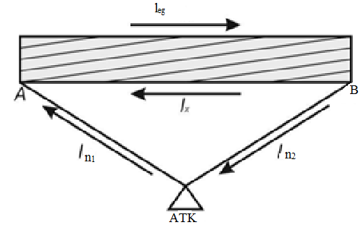
Orqaga bo‘sh harakat bilan qaytish oddiy mayatniksimon marshrut deb ataladi (1-rasm).
1-rasm. Orqaga bo‘sh harakat bilan mayatniksimon marshrut diagrammasi.
Oddiy mayatnikli marshrutda ishlaganda mashina A nuqtada yuklanadi va yukni B nuqtaga masofadan leg masalan. B nuqtasida mashina yukni tushiradi va 1-sonli bo‘sh harakatni A nuqtasiga qaytaradi. Bunday marshrut maqsadga muvofiq emas, chunki u ustida ishlaganda bitta aylanada yuk bilan bitta sayohat amalga oshiriladi. Qatnashlardan foydalanish koeffitsienti oddiy mayatniksimon marshrutida 0,5 ga teng, chunki leg = lX.

Slide 6

Qaytib to‘liq yuklanmagan yurish bilan mayatniksimon marshruti bo‘ylab transport vositalarining harakatini tashkil qilishda, yo‘lning bir yo‘nalishida (qoida tariqasida, teskari yo‘nalishda) bir qismi transport vositasi yuk bilan, bir qismi esa yuksiz harakatlanadi. Shu munosabat bilan ushbu yo‘nalish turli xil sxemalarga ega bo‘lishi mumkin.
Bunday marshrutda ishlaganda bitta aylanishda ikkita sayohat qilinadi. Ushbu yo‘nalishda harakatlanuvchi tarkibning yurish masofasidan foydalanish 50% dan ortiq, ammo 100% dan kam, ya'ni. 0,5 < s < 1.
CHUTTERSNAP. (Published on May 10, 2017). Busy cargo port.
Free to use under the Unsplash License. https://unsplash.com/photos/eqwFWHfQipg

Slide 7
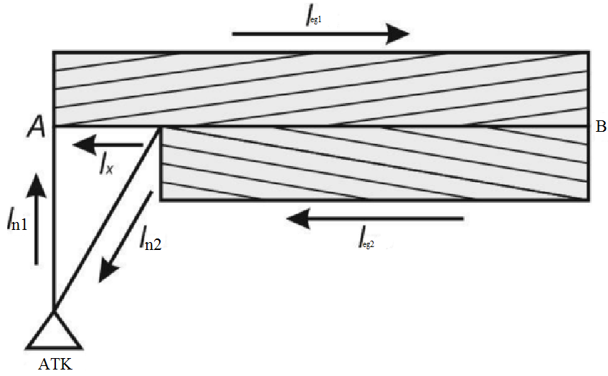
Orqaga yuklangan marshruti harakatlanuvchi tarkibning to‘liq ishlatilishini ta'minlaydi: yuk marshrutda ham A nuqtadan B nuqtaga va orqaga, ya'ni A va B nuqtalar bu holatda ham yuklash joylari, ham tushirish punktlari hisoblanadi. Oldinga va teskari yo‘nalishdagi masofa bir xil, bu harakatlanuvchi tarkibning yurish masofasidan to‘liq foydalanishni ta'minlaydi, ya'ni. s = 1. Bitta aylanishda ikkita sayohat amalga oshiriladi.
3-rasm. Orqaga to‘liq yuklanmagan mayatniksimon marshrutining sxemasi

Slide 8
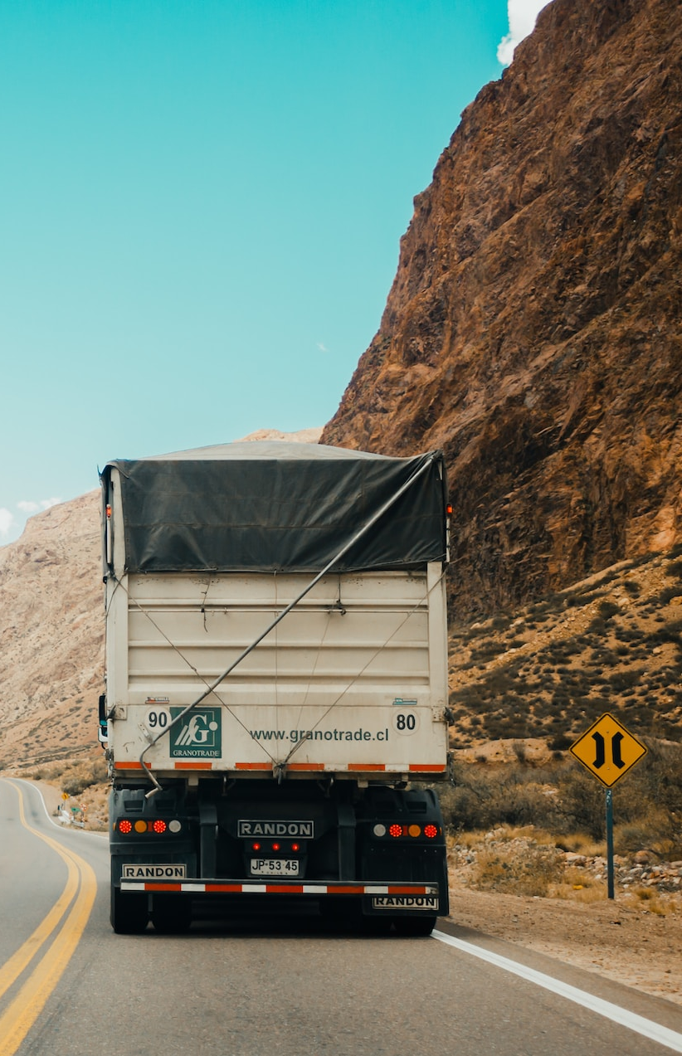
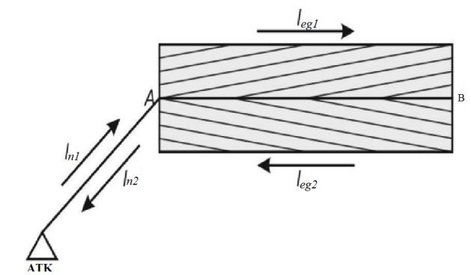
Abreu R. (Published on February 19, 2018). truck in between the mountains. Free to use under the Unsplash License. https://unsplash.com/photos/lq9PxpwDZUk
4-rasm. Ikkala yo‘nalishda ham yuklangan
harakatlanuvchi mayatniksimon marshrutining sxemasi

Slide 9
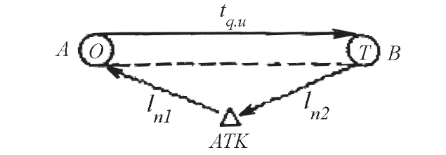
11.2 Bir tomonlama yukli qatnovchi mayatnik marshrutda
transport vositalari ish hisobi
6 - rasm. Yuk tashish tasviri
Berilgan:
l_{n1} = 4 km, l_{n2} = 8 km, l_{qu} = 10km
Q_{reja} = 30000 t, tashish muddati K_{t} = 30 kun, yuklar ISUZU avtomobilida tashiladi, v_{t} = 20km/soat, t_{o-t} = 0.8 soat, γ_{s} = 1,0, T_{i} = 14 soat, β_{q} = 0,5 soat

Slide 10
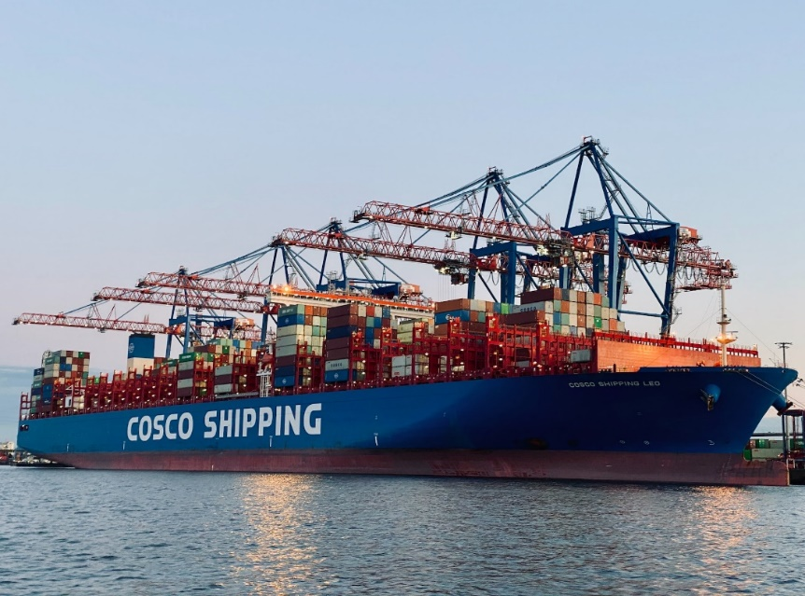

Yechish:
1. Qatnov vaqtini aniqlaymiz:
$T_{q} = \frac{l_{qu}}{b_{q}u_{t}}+ t_{o−t}= \frac{l_{y}}{{bu}_{t}}+t_{o−t}= \frac{10}{0.5∗20}+0.3=1.8$
Bunda: l_{qu} = l_{yu}
2. Yo‘nalish vaqtini aniqlaymiz.
$T_{y}=T_{i}−\frac{l_{n1}+l_{n2}}{u_{t}}=14−\frac{4+8}{20}−14−0,6−13,4$
3. Bir ish kunidagi qatnоvlar sоnini aniqlaymiz.
$n_{q}= \frac{T_{y}b u_{t}}{l_{y}+b u_{t}t_{o−t}}= \frac{T_{y}}{t_{q}}= \frac{13,4}{1,8}$ = 7,44
Bu sоnni yaхlitlaymiz. n_{q ≈} 7
Meissner J. (Published on July 28, 2020). Outer Harbor, Hamburg, Germany. Free to use under the Unsplash License. https://unsplash.com/photos/oGafvInnHlY

Slide 11

4. Avtоmоbilning yo‘nalishdagi va ish vaqtidagi qatnоvlar sоnini yaхlitlash оrqali qaytadan aniqlaymiz:
$T_{i}^{`}=t_{q}∗n_{q}^{`}=1,8∗7=12,6$
$$T_{i}^{`}=T_{y}^{`}+ \frac{l_{n1}+l_{n2}}{u_{t}}−12,6+\frac{4+8}{20}− \frac{10}{20}=12,7$$
5. Bir kunlik tashilgan yuk hajmi va yuk aylanishini aniqlaymiz:
$$Q_{k}=q_{n}γ_{s}{n`}_{q}=4∗1∗7=28 t$$
$$P_{k}=q_{n}γ_{d }l_{qu}{n`}_{q}=Q_{k}l_{qu}=28∗10=280 t∗km$$
6. Tashish rеjasini bajarish uchun zarur avtоmоbillar sоnini aniqlaymiz.
$$A_{c}= \frac{Q_{reja}}{K_{t }Q_{k}}=\frac{30000}{30∗28}=36 avtomobil$$

Slide 12
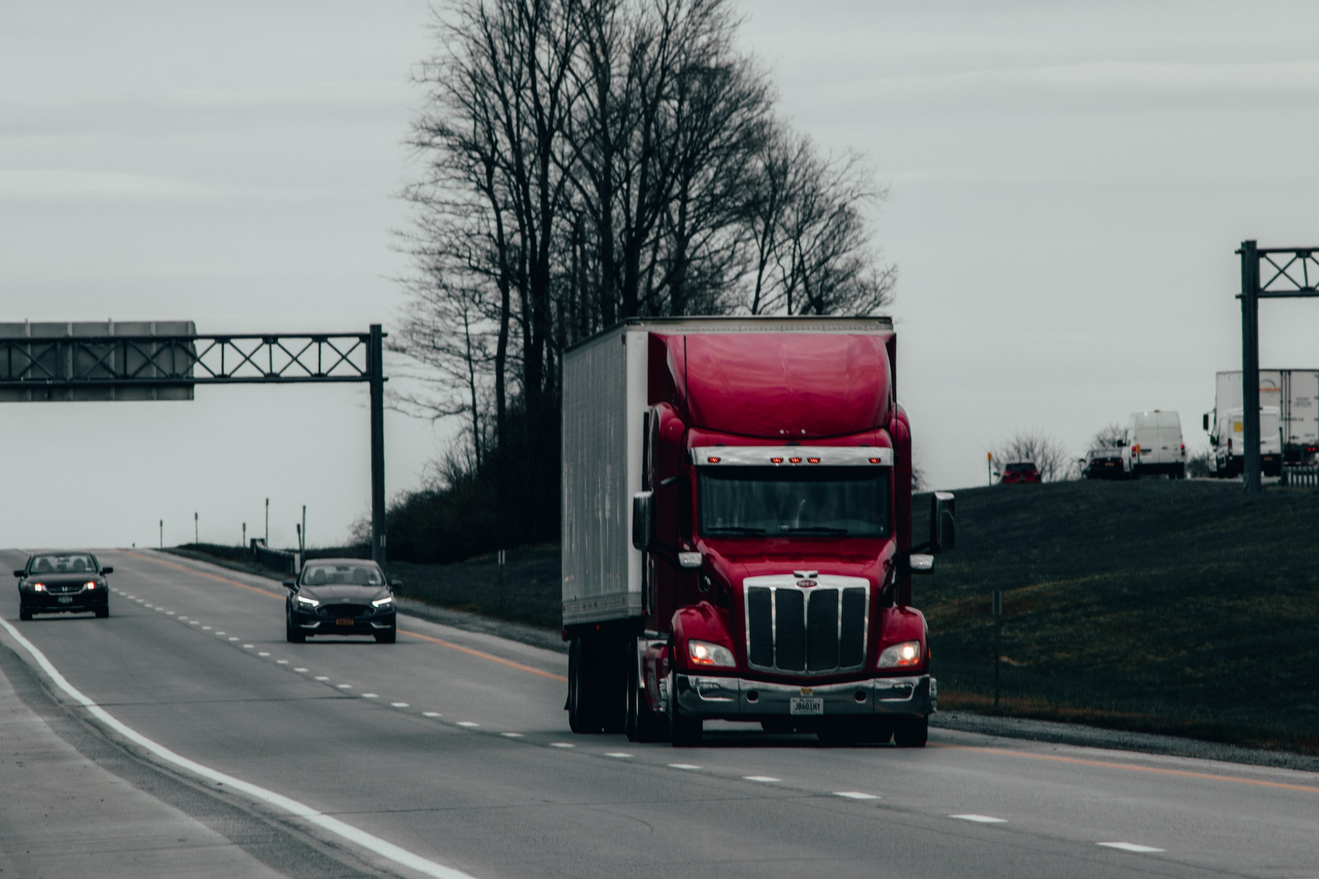

7. Avtоmоbilning sutkada yurish masоfasini aniqlaymiz:
$l_{y}$ = $\frac{n_{q}∗l_{qu} }{b_{q}}$ - $l_{b}+\left(l_{n1}+l_{n2}\right)= \frac{7∗10}{0,5}−10+\left(4+8\right)=142 km$
8. Ish kunida avtоmоbilning masоfadan fоydalanish kоeffitsiеntini aniqlaymiz.
$$b= \frac{l_{yu}}{l_{u}}= \frac{n_{q}∗l_{qu} }{l_{u}}= \frac{7∗10}{142}=0,49$$
Khalfalli Y. (Published on April 14, 2020). Truck.
Free to use under the Unsplash License https://unsplash.com/photos/xmWlqeYtcQQ

Slide 13
11.3. Ikki tomonlama yukli qatnovchi mayatnikli
marshrutda transport vositalari ish hisobi
Orqa yo‘nalishda ham yuk bilan qatnaydigan mayatnikli marshrut (8-rasm) dagi yuk tashuvchi transport vositalari ishini hisoblashda quyidagi birlamchi ko‘rsatkichlarni olamiz: l_{yuq}=10km, nolinchi qatnovlar l_{o}¹=l_{o}¹¹=4km, transport vositasining ishda bo‘lish vaqti T_{ish} = 16 soat, A nuqta (joy)dan B nuqtagacha tashiluvchi yuklar hajmi Q_{AB}=20000t. B nuqtadan A nuqtagacha (orqaga) tashiluvchi yuklar hajmi Q_{BA}=20000t. ikkala tomonga ham tashiluvchi yuklar 1-sinfga mansub, ya`ni γ_{st} =1.0 ga teng. tashish muddati 20 kun. Ishlovchi avtomobil ISUZU (q_{n}=4t). Harakat tezligi V_{T} =25km/soat, har bir yukli qatnovda ortish-tushirishda turish vaqti t_{o-t} =0.6soat.

Slide 14
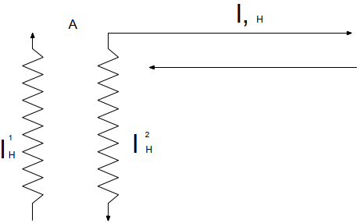
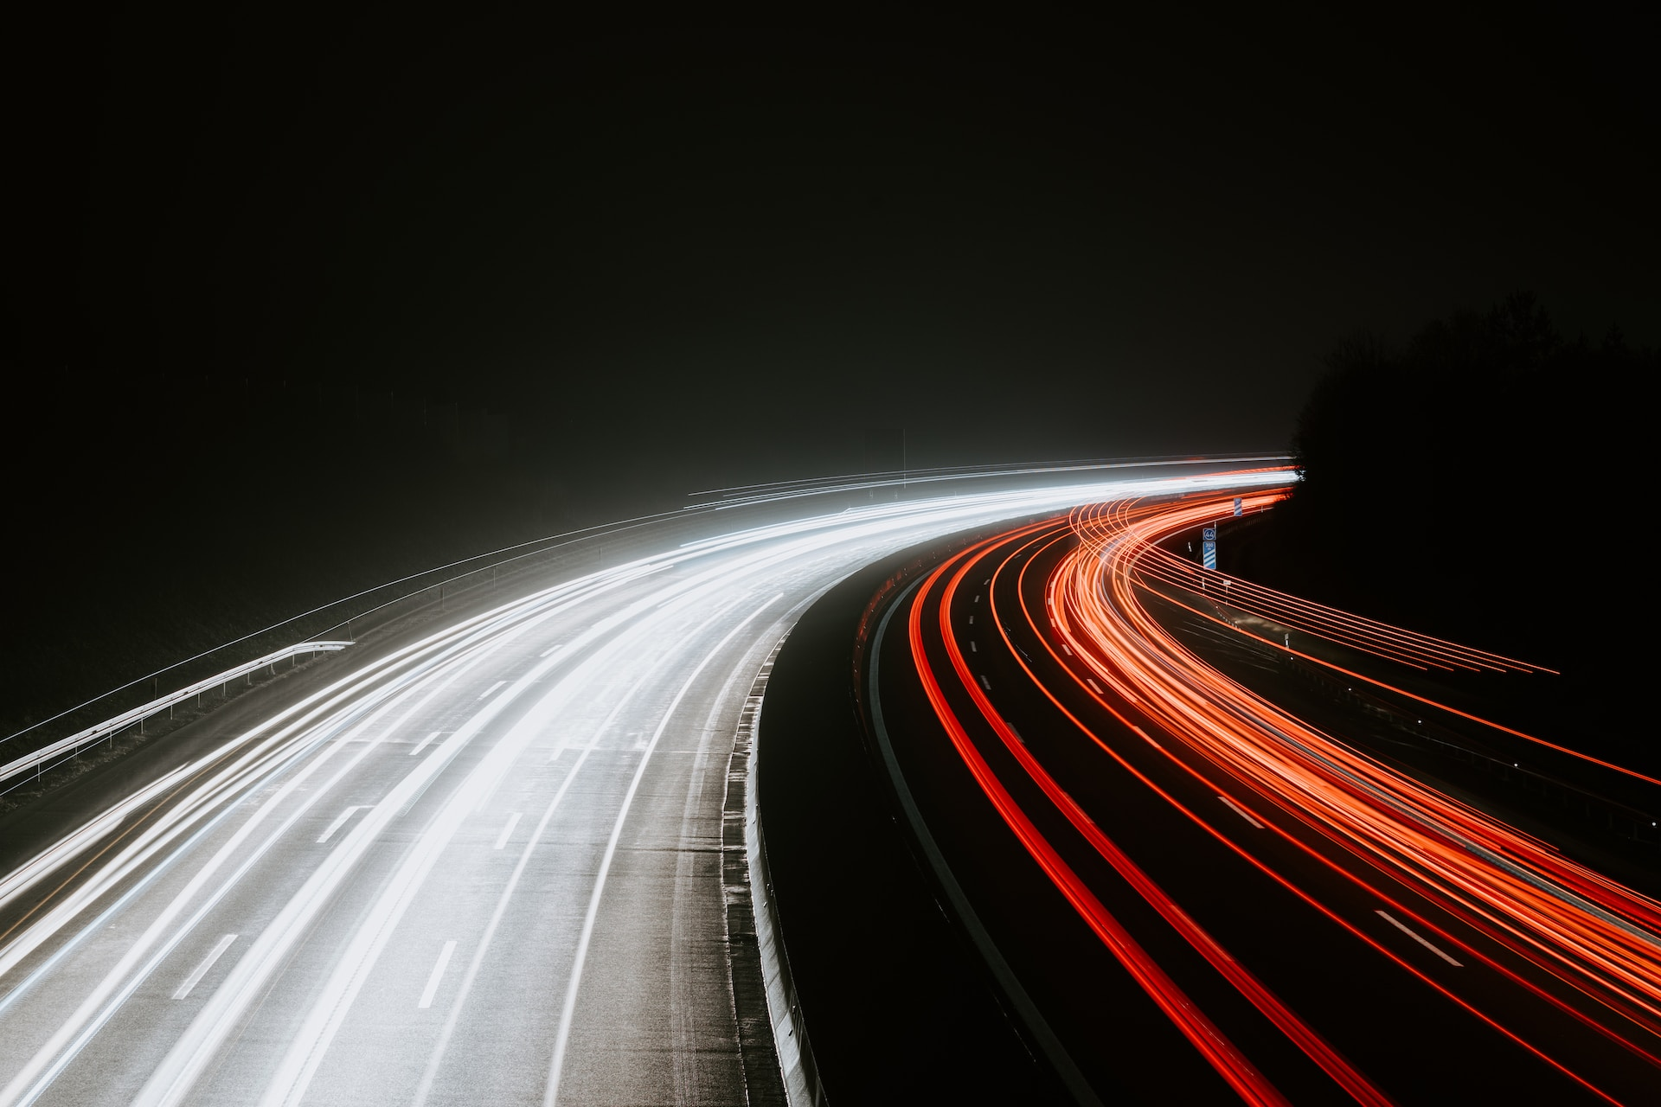
7-rasm. Orqa yo‘nalishda ham yuk bilan qatnaydigan mayatnikli marshrut
Hochgesang J. (Published on January 14, 2020). Highway. Free to use under the Unsplash License. https://unsplash.com/photos/3-y9vq8uoxk

Slide 15

Hisoblash tartibi:
1.Marshrut ichi yoʻldan foydalanish koeffitsiyenti β_{m} =1,0 ekanligini nazarda tutib, avtomobilning marshrutda ishlash vaqtini aniqlaymiz:
T_{M}=T_{ish}-t_{o}=T_{ish} - $\frac{l_{o}^{1}+l_{o}^{11}}{V_{T}}$= 16-$\frac{4+4}{25}$=15.68
2.Avtomobilning bir kundagi yukli qatnovlarini hisoblaymiz:
Z_{yuq} = $\frac{T_{M}β_{M}V_{T}}{l_{yuq}{+β}_{M}V_{T}t_{o−t}}$ = $\frac{15.68∙1.0∙25}{10+1.0∙25∙0.6}$ = 15.68
Qatnovlar sonini yaxlitlab (16 ga keltirib), marshrutdagi vaqtni qayta hisoblaymiz:
$T_{M}^{1}$= $\frac{Z_{yuq }^{1}(l_{yuq}{+β}_{M}V_{T}t_{o−t})}{β_{M}V_{T}}$ = $\frac{16(10+1.0∙25∙0.6)}{1.0∙25}$ = 16 soat
Ish vaqti esa:
$T_{ish}^{1}$ = $T_{M}^{1}$ +t_{o} = 16+0.32=16.32 soat bo‘ladi

Slide 16

3.Avtomobilning bir kunlik ish unumi:
tonnada
Q_{K} = q_{n} γ_{st} Z_{yuq} = 4*1.0*16 = 64 t
tonna kilometrda:
P_{K} = q_{n} γ Z_{yuq} l_{yuq} = 4.0*1.0*16*10 = 640tkm
Tashish rejasini bajarish uchun zarur avtomobillar soni:
A_{E}=$\frac{Q_{AB}+Q_{BA}}{K_{ish}Q_{K}}$= $\frac{20000+20000}{2∗64}$ = 31
4. Avtomobilning kunlik qatnov masofasi:
L_{sut} = $Z_{yuq }^{1}$ l_{yuq} + ($l_{o}^{1}+l_{o}^{11}$) = 16*10+(4+4) = 168 km
Kun davomida avtomobilning yo‘ldan foydalanish koeffisienti:
$β$= $\frac{Z_{yuq }^{1}l_{yuq}}{L_{sut}}$ = $\frac{10∗16}{168}$ = 0.95

Slide 17


Agar ikkala yoʻnalishdagi yukli qatnovlarda ham har xil sinfga mansub yuklar tashilsa, yaʼni yuk koʻtaruvchanliklardan foydalanish koeffitsiyentlari birlamchi va orqa yoʻnalishda oʻzaro teng boʻlmaganda transport vositasining tonnada oʻlchanuvchi ish unumi quyidagicha aniqlanadi:
Q_{K} = (q_{n} γ_{AB +} q_{n} γ_{BA}) = $\frac{Z_{yuq }^{1}}{2}$, (53)
bunda q_{n} ni qavsdan chiqarsak,
Q_{K} = q_{n} (γ_{AB +} γ_{BA}) = $\frac{Z_{yuq }^{1}}{2}$, (54)
Le J. (Published on June 10, 2020). Truck driving on the road. Free to use under the Unsplash License. https://unsplash.com/photos/mVqTumQH-c0

Slide 18
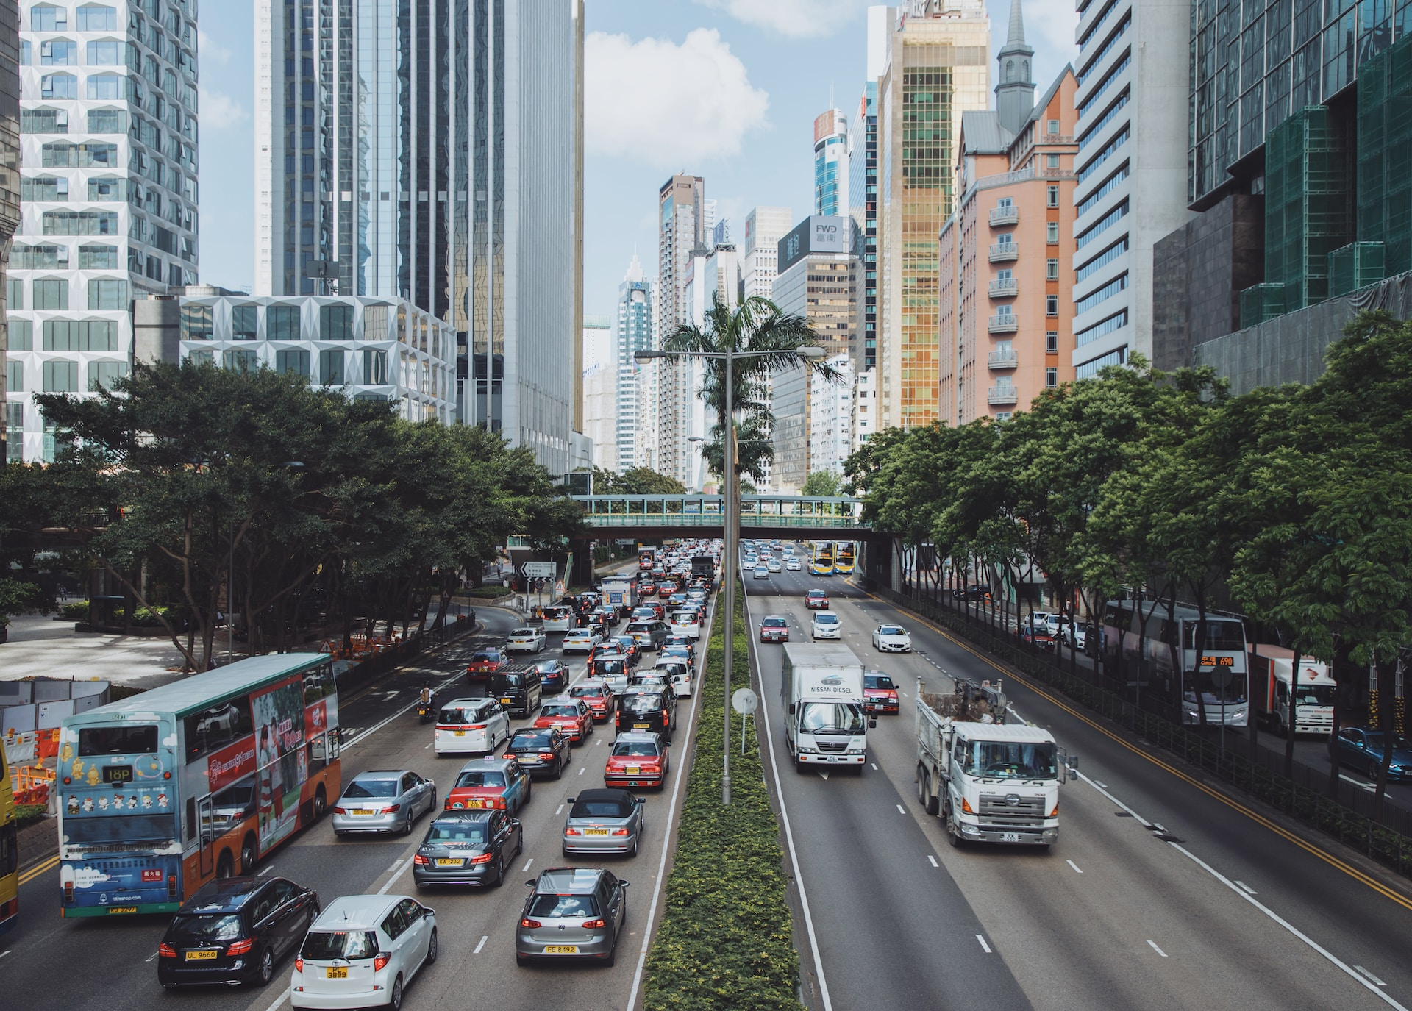

Wang C. (Published on July 23, 2018). Central, Hong Kong. Free to use under the Unsplash License https://unsplash.com/photos/3ttFTqPQs5A
Ayni shartga koʻra transport vositasining tonna-kilometrdagi ish unumi quyidagicha:
P_{K} = (q_{n} γ_{AB} l_{yuq +} q_{n} γ_{BA} l_{yuq}) = $\frac{Z_{yuq }^{1}}{2}$* l_{yuq} (55)
yoki P_{K} = Q_{K} l_{yuq} bo‘ladi. Qolgan hisoblarda o‘zgarishlar bo‘lmaydi.

Slide 19
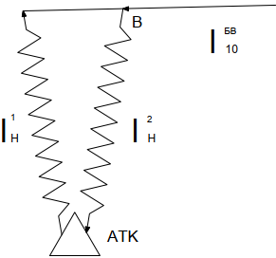
Orqa yo‘nalishda qisman yukli mayatnik
marshrutda transport vositalari ish hisobi
Mazkur mayatnikli marshrutda yuk tashuvchi transport vositalarini hisoblashda quyidagi birlamchi ko‘rsatkichlardan foydalanamiz.
8-rasm. Orqaga to‘liq bo‘lmagan yukli mayatnikli qatnov

Slide 20


Avtomobilning ishda bo‘lish vaqti T_{ish}=12 soat AB birlamchi (toʻgʻri) yoʻnalishda tashiluvchi yuklar hajmi 200 000 t, birinchi sinfli yuk ($γ$=1,0 ), marshrutning teskari yoʻnalishdagi BV boʻlagida tashiluvchi yuklar hajmi 180 000 t boʻlib, yuk koʻtaruvchanlikdan foydalanish koeffitsiyenti β_{BV}=0,9. Tashiluvchi yuklar uyulib tashiluvchi va sochiluvchan boʻlganligi uchun ularni yuk koʻtaruvchanligi 4,5t li samosval avtomobillarda tashish moʻljallangan. Yukni ortish uchun zarur vaqt t_{o} = 0,15 soat, tushirish vaqti t_{T}= 0,1 soat. Tashish muddati 120 kun. Avtomobilning harakat tezligi V_{T} = 24 km/soat.
Meissner J. (Published on July 28, 2020). Outer Harbor, Hamburg, Germany. Free to use under the Unsplash License. https://unsplash.com/photos/oGafvInnHlY

Slide 21

Hisoblash tartibi:
1 . Avtomobilning marshrutda ishlash vaqtini topamiz:
T_{M} = T_{ish} - $\frac{l_{o}^{1}+l_{o}^{11}}{V_{T}}$= 12 - $\frac{5+5}{24}$ = 11.58
avtomobilning marshrutdagi bir aylanish vaqtini aniqlaymiz:
t_{ayl} = ∑t_{x} + ∑_{to-t} = $t_{o}^{A}$ + $t_{h}^{AB}$ + $t_{t}^{B}$ + $t_{o}^{B}$ + $t_{h}^{BV}$ + $t_{t}^{V}$ + $t_{h}^{VA}$ ;
t_{ayl} = $t_{o}^{A}$+ $\frac{l_{yuq}^{AB}}{V_{T}}$ + $t_{t}^{B}$ + $t_{o}^{B}$ + $\frac{l_{yuq}^{BV}}{V_{T}}$ + $t_{t}^{V}$ + $t_{bq}^{VA}$ = 0.15+$\frac{12}{24}$ +0.1+.015+ $\frac{8}{24}$ + 0.1 + $\frac{4}{24}$ = 1.5 soat
2. Avtomobilning marshrutdagi bir kunlik aylanishlar soni:
Z_{ayl} = $\frac{T_{M}}{t_{ayl}}$ = $\frac{11.58}{1.5}$ = 7.7
Aylanishlar sonini yaxlit 8 ga keltirib, vaqtlarni qayta hisoblaymiz:
marshrutdagisi
$T_{M}^{1}$ = $Z_{ayl}^{1}$ t_{ayl} = 8 1.5=12 soat
Ishdagisi
$T_{ish}^{1}$ = $T_{M}^{1}$ + t_{o} = 12+0.42 = 12.42 soat

Slide 22

3. Avtomobilning bir kunlik ish unumini hisoblaymiz:
tonnada
Q_{K} = (q_{n} γ_{AB} + q_{n} γ_{BV} ) Z¹_{ayl} = q_{n} (γ_{AB} + γ_{BV} ) = 4.5 (1.0+0.9) 8 = 64.6 t
tonna – kilometrda
P_{K} = (q_{n} γ_{AB} $l_{yuq}^{AB}$+ q_{n} γ_{BV} $l_{yuq}^{BV}$ ) Z¹_{ayl} tkm
yoki
P_{K} = (q_{n} γ_{AB} $l_{yuq}^{AB}$+ q_{n} γ_{BV} $l_{yuq}^{BV}$ ) Z¹_{ayl} =4.5 (1.0*12+.9*8) 8 = 584.8 tkm
Yuklarni tashish uchun zarur bo‘lgan avtomobillar soni:
L_{sut} = (l_{AB}+l_{BV}+l_{BA})*Z + (l_{o}¹+l_{o}¹¹)-l_{BA} = (12+8+4)*8 + (5+5) – 4 = 198 km
Kun davomida avtomobilning yo‘ldan foydalanish koeffisienti
$β$ = $\frac{{(l}_{yuq}^{AB}+l_{yuq}^{BV}) Z_{ayl}}{L_{sut}}$ = $\frac{\left(12+0.8\right)∗8}{198}$ = 0.81

Slide 23

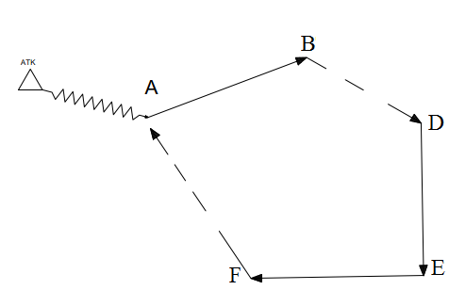
Halqasimon marshrutda transport vositalari ish hisobi
Halqasimon marshrutda yuk tashuvchi avtomobilning ishini hisoblashda (9-rasm) quyidagi birlamchi koʻrsatkichlardan foydalanamiz.
9-rasm. Halqasimon marshrut
Ruiter C. (Published on March 22, 2021). Sunset on Semi Truck. Free to use under the Unsplash License.
https://unsplash.com/photos/EmEQ6kK_5P0

Slide 24
Abreu R. (Published on February 19, 2018). truck in between the mountains. Free to use under the Unsplash License. https://unsplash.com/photos/lq9PxpwDZUk

Slide 25

Hisoblash tartibi:
1. Avtomobilning marshrutda ishlash vaqtini topamiz:
T_{M}=T_{ish} - $\frac{l_{o}^{1}+l_{o}^{11}}{V_{T}}$= 16-$\frac{6+6}{20}$=15.4
Avtomobilning marshrutda toʻliq bir aylanishida harakatlanish va ortish-tushirishda turish vaqtlarining jami:
t_{ayl} = $∑t_{x}$+ $∑t_{o−t}$ , soat (56)
jumladan,
$∑t_{x}$ = $t_{h}^{AB}$ + $t_{h}^{BV}$+$t_{h}^{VG}$+$t_{h}^{GD}$+ $t_{h}^{DA}$ = $\frac{l_{yuq}^{AB}}{V_{T}}+ \frac{l_{yuq}^{BV}}{V_{T}}+ \frac{l_{yuq}^{VG}}{V_{T}}+ \frac{l_{yuq}^{GD}}{V_{T}}+\frac{l_{yuq}^{DA}}{V_{T}}$ = $\frac{10}{24}+\frac{4}{22}+\frac{14}{22}+\frac{12}{24}+\frac{6}{20}$ = 2.04 soat
$∑t_{o−t}$ = $t_{o}^{A}$+${ t}_{t}^{B}+t_{o}^{V}+t_{t}^{G}+t_{o}^{G}+t_{G}^{D}$ = 0.5 + 0.3 + 0.5 + 0.3 + 0.5 + 0.3 = 2.4 soat
U holda:
t_{ayl} = 2.04+2.4=4.44soat

Slide 26


2. Avtomobilning marshrutdagi bir kunlik aylanishlar soni:
Z_{ayl} = $\frac{T_{M}}{t_{ayl}}$ = $\frac{15.4}{4.44}$ = 3.4
Aylanishlar sonini yaxlit 3 ga keltirib, vaqt sarflarini qayta hisoblaymiz:
marshrutdagi vaqt
$T_{M}^{1}$ = t_{ayl} $Z_{ayl}^{1}$ = 4.44 3.0=13.32 soat
ishda bo‘lish vaqti
T_{ish} = $T_{M}^{1}$ + t_{o} = 13.32+0.6=13.92 soat
Le J. (Published on June 10, 2020). Truck driving on the road. Free to use under the Unsplash License. https://unsplash.com/photos/mVqTumQH-c0

Slide 27

3. Avtomobilning bir kunlik ish unumini hisoblaymiz:
tonnada
Q_{K} = (q_{n} γ_{AB +} q_{n} γ_{VG}+ q_{n} γ_{GD} ) $Z_{ayl }^{1}$= q_{n} (γ_{AB +} γ_{VG}+ γ_{GD} ) $Z_{ayl }^{1}$ = 5 (1+0.8+0.6)*3=36 t
tonna-kilometrda
P_{K} = (q_{n} γ_{AB} $l_{yuq}^{AB}$ ₊ q_{n} γ_{VG} $l_{yuq}^{VG}+$q_{n} γ_{GD} $l_{yuq}^{GD}$ ) $Z_{ayl }^{1}$= q_{n} (γ_{AB} $l_{yuq}^{AB}$ ₊ γ_{VG} $l_{yuq}^{VG}+$γ_{GD} $l_{yuq}^{GD}$ ) $Z_{ayl }^{1}$= 5 (1*10+0.8*14+0.6*12)*3 = 426 tkm
Yuklarni tashish uchun zarur bo‘lgan avtomobillar soni
A_{E} = $\frac{Q_{AB}+Q_{VG}{+Q}_{GD}}{K_{E}Q_{K}}$ = $\frac{200000+160000+120000}{360∗36}$ = 37

Slide 28

4. Avtomobilning bir kunlik umumiy qatnov masofasi:
L_{sut} = L_{ayl} $Z_{ayl }^{1}$ + l_{o} + l_{bq} =( $l_{yuq}^{AB}$+$l_{bq}^{BV}$+$l_{yuq}^{VG}$+$l_{yuq}^{GD}$+$l_{bq}^{DA}$)$Z_{ayl }^{1}$ + l_{o} + l_{bq} =
=(10+14+12+4+6)*3+(6+6)-6=144km
Yo‘ldan foydalanish koeffisienti:
β = $\frac{l_{yuq.ayl}Z_{ayl}^{1}}{L_{sut}}$ = $\frac{\left(l_{yuq}^{AB}+l_{yuq}^{VG}+l_{yuq}^{GD}\right)Z_{ayl}^{1}}{L_{sut}}$ = $\frac{\left(10+14+12\right)∗3}{144}$ = 0.75
Ruiter C. (Published on March 22, 2021). Sunset on Semi Truck. Free to use under the Unsplash License.
https://unsplash.com/photos/EmEQ6kK_5P0

Slide 29

E`tiboringiz uchun rahmat!
Fewings N. (Published on March 9, 2018), aerial photography of gray concrete roads. Free to use under the Unsplash License. https://unsplash.com/photos/br9D5K3UTRQ

