Slide 1
Renewable Energy and Distributed Generations
Lecture 3
Introduction on Renewable Energy (RE)Technology
Lecturer: Teshome Goa (Assist. Prof.)
Lecture learning outcomes:
At the end of this lecture, you will be able to:
Define the Renewable Energy Generation
Understand the global Trends in Renewable energy
Identify the Way Forwards for Energy Transitions

Slide 2
Outlines
1. Introduction
1.1 Global energy Trends
1.2 Energy and Climate
1.3 Alternative energy solution
1.4 Way Forewords to net-zero carbon emission
1.5 Higher institutions (HI) motivation towards RE Transitions
Summary

Slide 3
1. Introduction: Renewable Energy & Distributed Generations
Energy is what makes you able to work. It’s the driving force for modern industrial applications
Energy is one of the most crucial elements of the economic infrastructure.
The two categories of energy sources based on the rate at which they can be replenished are:
i. Conventional energy resources (CER)
CER uses fossil fuel for energy generation, which is matured type of generation with limited resources and non-renewable

Slide 4
Introduction Cont.….
ii. Renewable Energy Resources (RE):
RE is derived from renewable energy resources, abundant availability and renewable
Renewable energy is derived from unlimited, naturally regenerating resources like the sun, tides, water, biomass and wind.
Distributed generation(DG): one of the RE generation, which is generating energy in small amount near to the demands
DG is very important, especially for rural electrification and supplying customers who live in unfavorable demography

Slide 5
Introduction Cont.….
They often leave little to no carbon emission to the environment and are self-replenishing and natural.
The production of electricity, heating and cooling of spaces and water, and transportation and others are done with renewable energy.
In contrast, non-renewable energy is derived from limited resources like oil, natural gas, and coal.
Which pollutes the environment and adversely affects our environment

Slide 6
Introduction Cont.….
By granting people access to inexpensive, safe, dependable, and clean energy, renewable power generation can assist nations in achieving their SDGs.
Nowadays, the bulk of power producing capacity additions come from renewable energy sources.
Tens of Gig watts of wind, hydropower and solar photovoltaic capacity are installed worldwide every year in a renewable energy market that is worth more than a hundred billion USD annually.
Other renewable power technology markets are also emerging.

Slide 7
1. 1 Global Energy Trends(GET)
The UN-2030 agenda, Goal-7 that targets to provide clean and affordable energy to all society is on GET Starting point [1].
Electricity generation is the driving point of modern civilization of humankinds
Thus, our modern industries, vehicles and other loads needs energy, means we need energy for sustainable development goal(SDGs).
Currently the power generation is the largest source of carbon dioxide (CO2) emissions in the world as observe in Figure 1[2].
It’s observed that the generation sector is contributing 41.5GT CO₂ to the environment, in 2022, which needs to be addressed

Slide 8
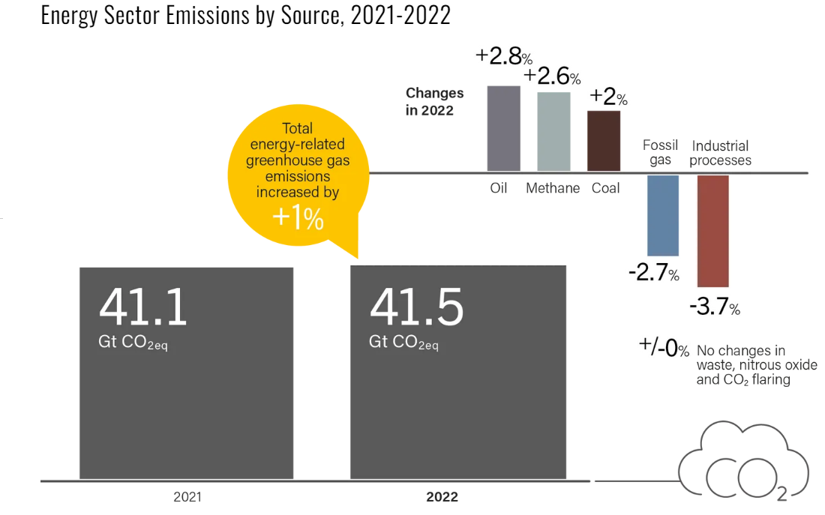
Figure1. The CO2 emissions in the world. Source: REN21. 2023

Slide 9
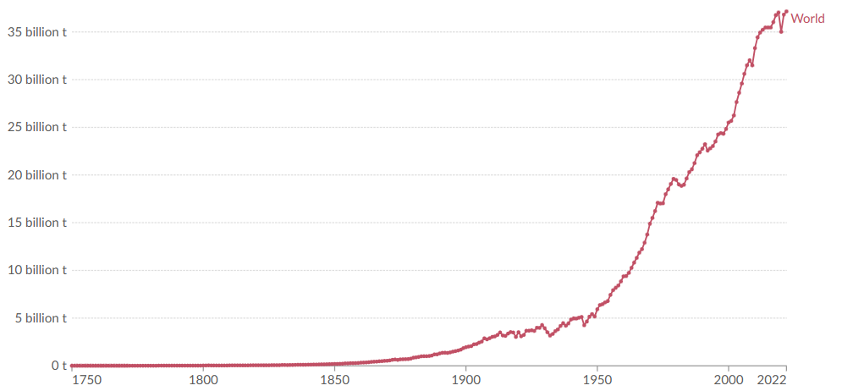
37.15BT
25.5BT
Figure1. Carbon dioxide (CO₂) emissions from fossil fuels and industry.
Land-use change is not included[3]. Source: https://ourworldindata.org

Slide 10
GET Cont.….
In contrast, the transition to net zero emissions by 2050 G.C based on Paris agreement has contributed the rapid growth in RE sectors[4].
Expansion of renewable energy sources such as solar , wind power , hydro and others are needed to come up with the carbon emission free environment by 2050.
The global electricity generation review of 2023 based on data from 78 countries(contributes 93% of global energy demand& top 10 CO₂ emitting that accounts 80% global CO₂ emission ) indicates there is significant improvement in renewable energy generation.

Slide 11
GET Cont.….
The total energy generation of 2023 report indicates that there are 28,430 TWh of generation from different energy shares[5] as indicated in Fig.2
Figure 2. Global Electricity Trends 2023. Source: ember-climate.org

Slide 12
GET Cont.….
As indicated in the global electricity trends, the global electricity demand is 28,510 TWh.
The developed countries are the one who consumes most.
On average worldwide, the per capita demand was 3.6 MWh.
This necessitates, working towards achieving the exponential growth demand as per the UN-Agenda 2030 and Paris Agreement for better SDGs.

Slide 13
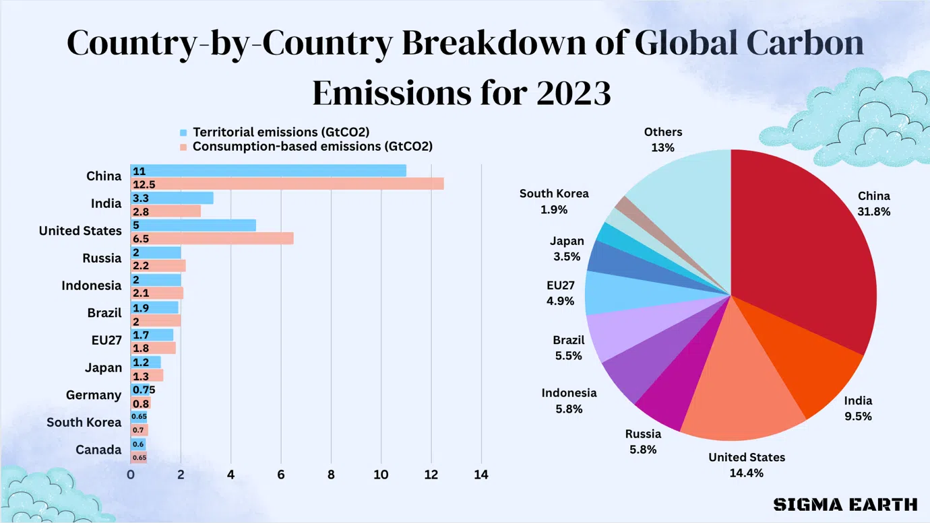
1.2 Energy and climate (E&C)
Limiting global warming to 1.5°C requires cutting carbon dioxide (CO₂) emissions by around 40 Giga-tonnes (Gt) from 2022 levels and achieving net-zero emissions in the energy sector by 2050.
Source: sigmaearth.com

Slide 14
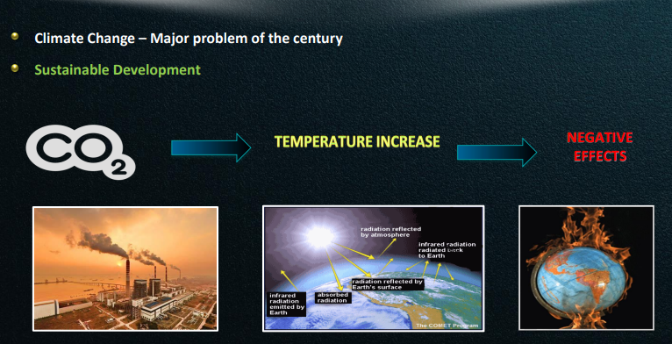
E&C Cont.…
Figure 3. Emissions Gap Report 2023[6]. Source: www.unep.org

Slide 15
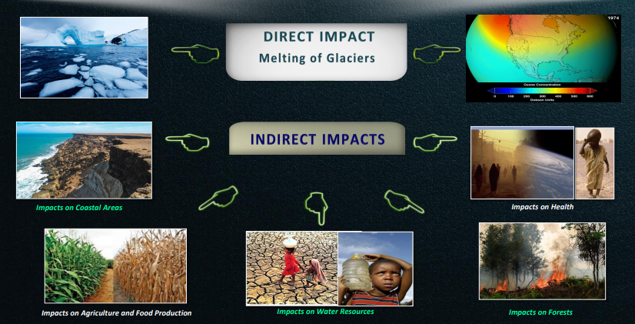
E&C Cont.….
Figure 4. Climate impact on environment. Source: europeansting.com

Slide 16
1.3 Alternative energy solution(AES)
To avoid the worst impacts of climate change, emissions needs to be reduced by almost half by 2030 and reach net-zero by 2050.
To mitigate the CO₂ emission to our environment and hence to achieve the sustainable development goal, it’s advisable to use RE technologies
Renewable energy sources are the least expensive options in boosting electricity access, reducing air pollution and cutting carbon dioxide emissions worldwide
It includes natural gas and renewable energy sources such as wind, solar, geothermal, and hydropower.

Slide 17
AES Cont.….
Five reasons why accelerating the transition to clean energy is needed;
Renewable energy sources are available all over the world
80% of the world population lives (>6 B peoples) in countries that are net-importers of fossil fuels.
By contrast, renewables are available in all countries, offering a way out of import dependency and allowing them to enhance their economies through natural gifts[7]
ii. Reduced price/ cheaper : The cost of electricity from solar power fell by 85 percent between 2010 and 2020.
Costs of onshore and offshore wind energy fell by 56 percent and 48 percent respectively.

Slide 18
AES Cont.….
Iii. RE is very friendly for the society or healthier
According to WHO, around 99% of people in the world breathe air that exceeds air quality limits and more than 13 million deaths around the world each year are due to avoidable environmental causes, including air pollution[8].
iv. RE creates job opportunity
Three times as many jobs are produced a single dollar invested in renewable energy as in the fossil fuel sector.
By 2030, it's predicted that the production of fossil fuels would lose 5 million jobs, while the clean energy sector would add 14 million jobs, for a net increase of 9 million.

Slide 19
AES Cont.….
Till now, 13.7 million people were employed both directly and indirectly by the worldwide RE sector [9].
V. Economic stability [10]
In 2022, subsidies for fossil fuels were worth $7 trillion globally. Its negative effects on the environment and human health that were not factored in.
This expense results from the restricted supply of fossil fuels throughout the majority of the nation.
However, in order to achieve net-zero emissions by 2050, over $4 trillion must be invested annually in renewable energy sources until 2030.
By 2030, the world may save up to $4.2 trillion only by reducing pollution and the effects of climate change.

Slide 20
AES Cont.….
Globally, 77 countries 10 regions and more than 100 cities announced their commitment to net-zero carbon emission by 2050 considering the following advantage:
Clean environment
Unlimited supply
Zero GHG emission
Decentralization
provides rural and island electrification
Employment opportunity
Societal impact

Slide 21
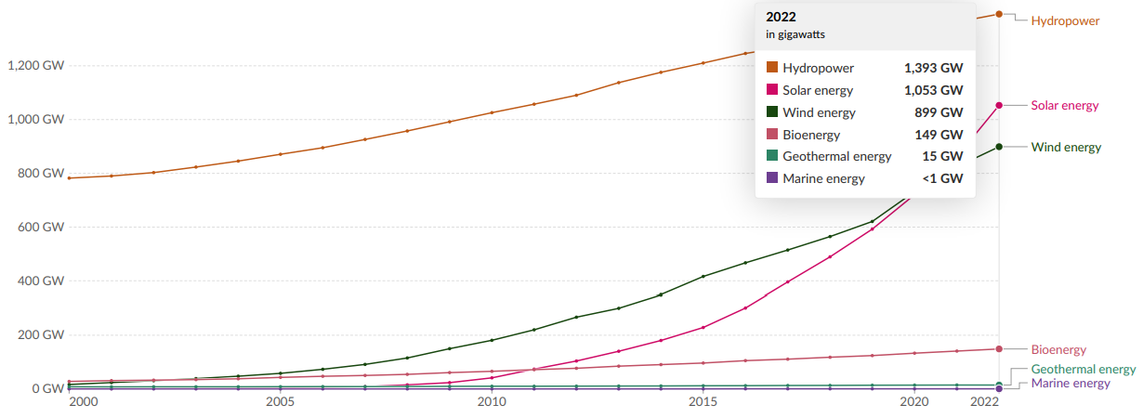
AES Cont.….
Figure 4. Global RE installed capacity in 2022
Source : International Renewable Energy Agency (2023)

Slide 22
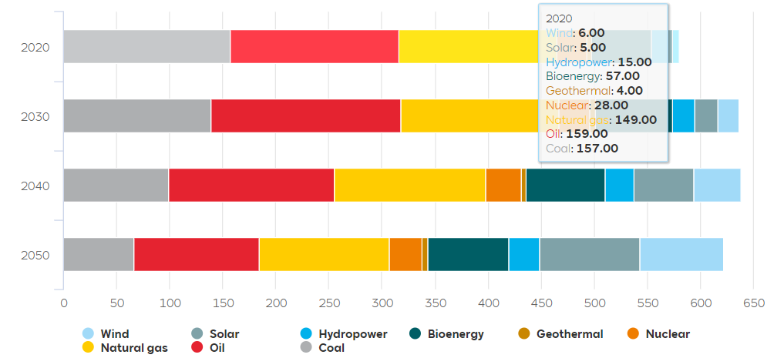
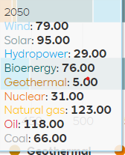
Energy consumption will be doubled between 2015-2050
Energy consumption will be doubled between 2020 to 2050 as presented in Fig. 5[11],
Fig.5 World primary energy supply by source in 2020 until 2050in EJ/yr. Source: DNV

Slide 23
1.4 Way Forewords to net-zero carbon emission
a. The governments and Policy makers has to actively participate in the transitions[11]
In order to implement cohesive, transnational policies, governments need to work together in a productive and rewarding manner.
To scale up clean technology, national markets must be connected through international standard creation, coordination, and innovation acceleration.
It will be more difficult and costly for many wealthy countries to reach net-zero emissions without international cooperation.
Many emerging nations are unsure about how to reach net zero without assistance from other nations.
Technical and financial support are needed to ensure the deployment of crucial

Slide 24
Way forewords Cont.….
The amount of RE capacity added globally reached 473 GW in 2023, an estimated 36% increase[12].
Thirty-one countries promised to double the yearly pace of energy efficiency improvements by 2030.
USA initiated more than 250 clean energy manufacturing projects, and EU introduced the first phase of the Carbon Border Adjustment Mechanism and the Net-Zero Industry Act in 2023.
About 13.7 million jobs in the renewables industry in 2022, an 8% growth in employment.
Globally people without access to electricity decreased from756 million in 2022 to 745 million in 2023

Slide 25
Way forewords Cont.….
b. Private sectors should involve
Financing the green energy transition
Decarbonizing the industries
Digitizing industries
c. Higher institutes should highly involve on working towards the SDGs:
Through researches
Innovation
Policy creation
Doing feasibility analysis, constructing power plants and consultant of energy generation
The higher institution (HI) or researchers should do motivation
towards the transition of RE & DGs as follows:

Slide 26
1.5 HI motivation towards RE Transitions
The first motivation: promoting and teaching the stockholders regarding the RE as
It is clean energy , free from emission and can be harnessed in MW
Generation in large GW is possible
Reduce the dependence on oil/fuel in energy sector that lead to economic inflations

Slide 27
HI Motivation to RE Cont.…
2nd motivation is reduction in cost: that the recent years have seen dramatic reductions in renewable energy technologies’ costs as a result of R&D and accelerated deployment.
However , the policy-makers are often not aware of the latest cost data.
International Renewable Energy Agency (IRENA) Member Countries have asked for better and cost effective design and installation of renewable energy technologies.

Slide 28
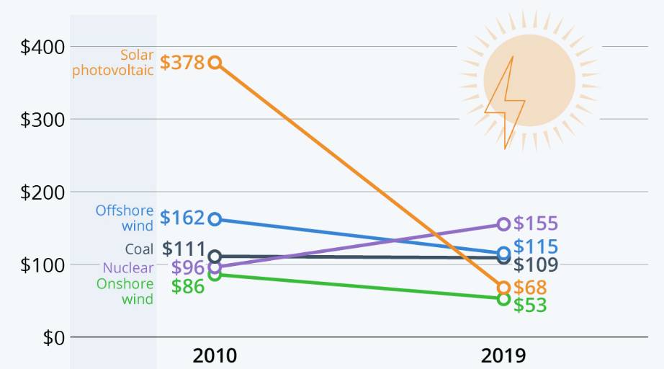
Figure 4. Generation cost per megawatt by sources [13]. Source: OurWorldindata.org

Slide 29
HI contribution to RE Cont.…
3rd Motivation: Abundance of RE.
The sun radiate 1,5 * 1018x10¹⁸ kWh energy to the Earth for per year
2% of this solar energy is converted into flow of energy
The total energy demand of people:91 * 1012x10¹² kWh for a year
0,006% of the radiated energy would be enough

Slide 30
HI contribution to RE Cont.…
Worldwide wind energy potential = 30 * 1015x10¹⁵ kWh
But, useable only about 3% (Heights, Distances between units10-40 times the rotor radius) = 0,9 * 1015x10¹⁵ kWh
Most of the countries have also an ample resources in other RE like hydro, biomass, geothermal etc.

Slide 31
HI contribution to RE Cont.…
4th Motivation: the integration concern with other energy sources based on:
Variable Power
Uncertain Power
Geographic Diversity,
Size, and Distance from Load
Standardized Power Purchase Agreement with Guaranteed Interconnection and Priority Dispatch
Wind Turbine Generators

Slide 32
HI contribution to RE Cont.…
RE integration to grid needs some critical analysis in terms of:
Planning
Physical Connection, grid integration
System Operation
Therefore, the planning of RE generations(wind, solar, hydro, biomass), operation and grid integration scenarios has to be addressed.

Slide 33
Summary
In conclusion, the renewable energy generation over conventional energy is needed to achieve net-zero carbon emission transition by 2050.
The climate change due to the conventional energy resources, which is due to exponential increasing carbon emission needs to be mitigated.
Clean energy resources like wind, solar and hydro should be built to provide affordable and clean energy
The policy makers, private sectors and higher institutions should enhance their contributions towards net-zero carbon mission of Paris agreement.
Research's, knowledge transfer and importance of RE technology , and its application should be further improved

Slide 34
References
[1]. United Nations, The 2030 Agenda and the Sustainable Development Goals: An opportunity for Latin America and the Caribbean (LC/G.2681-P/Rev.3), Santiago, 2018
[2]. REN21. 2023. Renewables 2023 Global Status Report Collection, Global Overview
[3]. Hannah Ritchie (2022) - “CO₂ emissions dataset: our sources and methods” Published online at OurWorldInData.org. Retrieved from: 'https://ourworldindata.org/co2-dataset-sources
[4]. M., Mounia; C., Philippe; j., Matthe, and etl. ‘’ Greenhouse gas emissions and their trends over the last 3 decades across Africa’’. Earth Syst. Sci. Data, 16, 245–275, 202. doi.org/10.5194/essd-16-245-2024
[5]. W., Małgorzata. Global Electricity Review. 2023
[6]. United Nations Environment Programme (2023). Emissions Gap Report 2023: Broken Record – Temperatures hit new
highs, yet world fails to cut emissions (again). Nairobi. https://doi.org/10.59117/20.500.11822/43922..
[7]. IRENA. ‘’ Energy Transition Holds Key to Tackle Global Energy and Climate Crisis’’. Press Releases. March, 2022.
[8]. IRENA and ILO (2023), Renewable energy and jobs: Annual review 2023, International Renewable Energy Agency, Abu Dhabi and International Labor Organization, Geneva.
[9]. IRENA and ILO (2023), Renewable energy and jobs: Annual review 2023, International Renewable Energy Agency, Abu Dhabi and International Labour Organization, Geneva.
[10]. Black, Simon, Antung Liu, Ian Parry, and Nate Vernon, 2023. “IMF Fossil Fuel
Subsidies Data: 2023 Update.” Working paper, IMF, Washington, DC.
[11]. IEA. Net Zero by 2050 :A Roadmap for the Global Energy Sector, May 2021.
[12]. REN21. 2024. Renewables 2023 Global Status Report Collection, Global Overview
[13]. OurWorldinData.org.

Slide 35
Thank you !

