Slide 1
Renewable Energy and Distributed Generations
Lecture 4
Wind Energy Conversion System (WECs)
Lecturer: Teshome Goa (Assist. Prof.)
Lecture learning outcomes:
At the end of this lecture, you will be able to:
Understand the wind energy conversion system(WECs)
Identify the types of wind power plants
Identify the classification of wind turbines
Know the operating characteristics of WECs

Slide 2
Content
Introduction
Types of Wind Power Plants(TWPP)
Classification of Wind Turbines(CWT)
Major Components of Wind Turbines (MCWT)
Operating Characteristics of wind turbines
Summary
References

Slide 3
1. Introduction
1.1 Wind: Wind is created by uneven heating of the earth's surface by the sun.
During the day, air above land heats up faster than air above water, whereas, during night the air above water heats up faster than that of the day. This creates wind pressure
Because, the earth's surface is made up of different types of land and water, the earth absorbs the sun's heat at different rates.
One example of this uneven heating is the daily wind cycle.
The surface of the earth heats and cools unevenly, creating atmospheric pressure zones that make air flow from high- to low-pressure areas as presented in Fig.1.

Slide 4
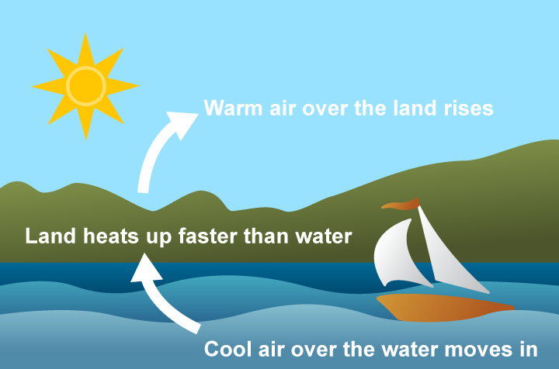
Introduction Cont.…
Figure 1: Formation of wind speed
Source: www.eia.gov/energyexplained/wind/

Slide 5
Introduction Cont.…
Wind patterns are influenced by vegetation, mountains, bodies of water, seasons, topography, and demography of areas, which affect wind speed[1].
Thus, some places are more suitable for the production of wind energy than others.
Using wind turbines, wind energy can be converted into mechanical or electrical energy
The kinetic energy of the wind is transformed into mechanical power by wind turbines.
Electricity can be produced from mechanical power using a generator.
Certain operations, like pumping water, can also be performed directly with mechanical power.

Slide 6
Introduction Cont.…
The mechanism used to convert air motion into electricity is referred to as a wind turbine.
The power in the wind is extracted by allowing it to blow past moving blades that exert torque on a rotor
The rotor turns the drive shaft, which turns an electric generator.
The amount of power transferred is dependent on the rotor size and the wind speed, air density (as a function of temperature, pressure, and humidity), wind direction, wind speed, and turbine parameters.
The overall output power extracted is also depends on the types of turbine, rotor performance, type of generator and other electromechanical systems[2].

Slide 7
Introduction Cont.…
1.2 Wind energy conversion:
Wind is used to produce electricity by converting the kinetic energy of air in motion into electricity.
In modern wind turbines, wind rotates the rotor blades, which convert kinetic energy into rotational energy as presented in Fig.2.
This rotational energy is transferred by a shaft to the generator, thereby producing electrical energy.
Wind is air in motion that having air mass.
A mass in motion has a momentum(see eqns.(1)-3) , which is analogous with energy

Slide 8
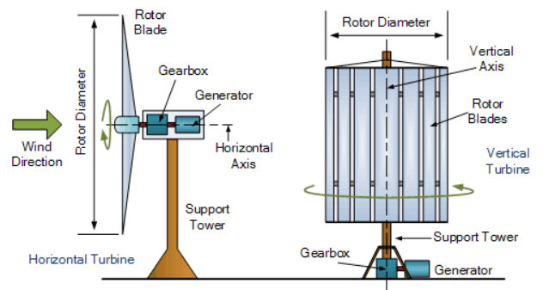
Figure 2: Wind energy conversion system. Source: www.alternative-energy-tutorials.com

Slide 9
Introduction Cont.…
Momentum is a form of energy that can be harvested based on the energy conversion principles as given by:
Eq.(1)
Where, P is the power , E is energy and t is the time.
For wind power generation, E is equivalent to the kinetic energy, which is as a function of air mass(m) and the square of wind speed as given by:
Eq.(2)
Then, the power extracted from wind is given by:
Eq.(3)

Slide 10
2. Types of Wind Power Plants(TWPP)
Utility-scale wind: Wind turbines that range in size from 100 kilowatts to several megawatts
Onshore wind energy: It’s the power that’s generated by wind turbines located on land driven by the natural movement of the air
Offshore wind: Wind turbines that are erected in large bodies of water, usually on the oceans, its turbine is larger than onshore wind turbine and generate larger power
Distributed wind power plant: Single small wind turbines below 100 kilowatts that are used to directly power a home, farm or small business and are not connected to the grid.

Slide 11
TWPP Cont.…
Windmills: it generate mechanical energy directly and people have been using windmills for centuries to grind grain, pump water, and do other work.
Wind Turbines: In contrast to windmills, modern wind turbines are highly evolved machines with more than 8,000 parts that harness wind's kinetic energy and convert it into electricity.
Wind farm: Oftentimes a large number of wind turbines are built close together, which is referred to as a wind project or wind farm.
A wind farm functions as a single power plant and sends electricity to the grid.

Slide 12
TWPP Cont....
Advantages of onshore wind power:
Reduced influence on the environment
Reduced cost
Easy for Installation and maintenance compared to offshore wind farm
Creation of jobs
Disadvantages of onshore wind power:
Volatile wind speeds due to demographic effect and variation of wind direction
Effects on people and nature. Noise
Lesser power generation compared to offshore wind farm

Slide 13
TWPP Cont....
Advantage of offshore wind power plant
The efficiency of offshore wind turbines is higher.
In order to generate the same amount of energy as onshore wind farms, offshore facilities need fewer turbines due to higher wind speeds and direction stability.
less of an influence on the environment
Offshore turbines are farther away from the community because they are located far from the coast.
Large available space for construction
Disadvantage of offshore wind power plant
Higher cost
Difficult for Maintenance and repairs
Reduced involvement in the community

Slide 14
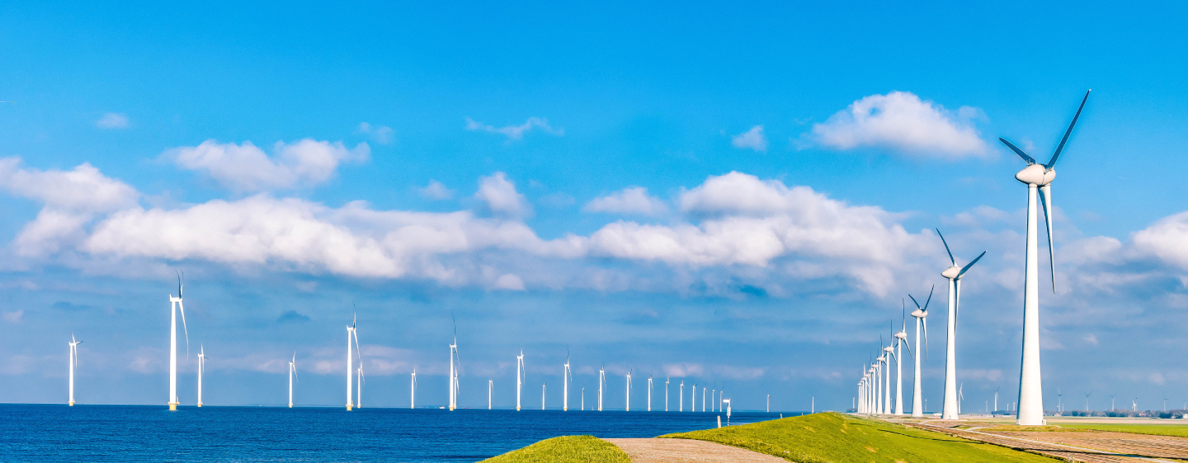
Figure 3: Onshore and Offshore wind power plant
Source: hitachienergy.com/ca/en

Slide 15
3. Classification of Wind Turbines(CWT)
There are two basic types of turbines based on the orientation of the rotor axis[3]:
Vertical axis wind turbine (VAWT)
Horizontal axis wind turbine (HAWT)
In a VAWT, the blades rotate on an axis perpendicular to the ground, while in a HAWT, the blades rotate parallel to the ground.
Both have a variety of designs to choose from, and each has pros and cons of its own.
Nevertheless, there are far fewer commercially produced vertical axis machines than horizontal axis machines

Slide 16
CWT Cont.…
Advantage of VAWT
Compared to HAWT, VAWT have fewer parts.
That implies there will be fewer parts to deteriorate and wear out.
Additionally, since the generator and gearbox are close to the ground, the tower's supporting strength is not as great.
There is no requirement for the pitch and yaw control parts.
As a result, both steady and gusty winds can be employed to create power with this technology.
less expensive to produce, easier to install and transport , and uses low-speed blades, reducing the danger to people and birds compared to HAWT

Slide 17
CWT Cont..
Disadvantage of VAWT
The VAWT do not capture the higher wind speeds that are frequently present at higher heights since they are located lower to the ground.
Sometimes vibration is a problem; it can even make the turbine noisier.
Ground-level air movement can amplify turbulence, which in turn amplifies vibration.
In order to get superior wind speed at a specific height above the ground for improved power harvesting, the majority of current wind power plants use HAWT rather than VAWT

Slide 18
CWT Cont…
HAWT advantage and disadvantage
Its blades are designed aerodynamically, rotate by the aerodynamic lift of force.
The upward and lower faces of the turbine blades produce the pressure differential.
A region of low pressure is produced at the front of the blade due to the fast air speed passing past it.
However, a high-pressure area is formed on the backside where there is little airspeed.
The high-pressure area's air pushes the blades upward, creating an aerodynamic lift.
The overview of both VAWT and HAWT is presented in Fig.4

Slide 19
CWT Cont..
HAWT advantages
High Power Output
High Efficiency
High Reliability
High Operational Wind Speed
HAWT disadvantages
Difficult to Transport, Install, and Maintain
Create Negative Environmental Impact
Strict Regulations for Installation
Needs Yawing

Slide 20
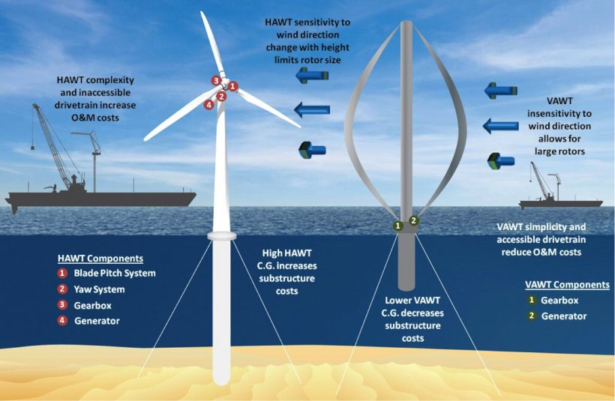
Figure 4. Types of wind Turbines. Source: www. energy.gov

Slide 21
4. Major Components of Wind Turbines (MCWT)[4]
Rotor
Blades
Low speed shaft
Gear Box
High speed shaft
Generator
Brakes
Controller
The MCWT is presented in Fig.5.

Slide 22
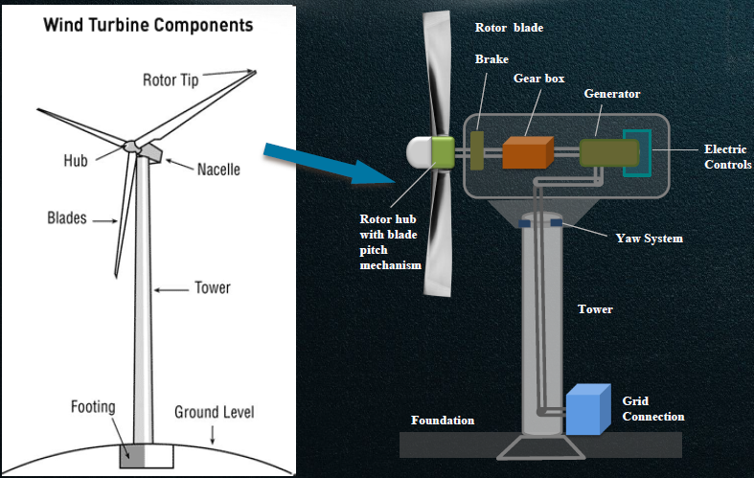
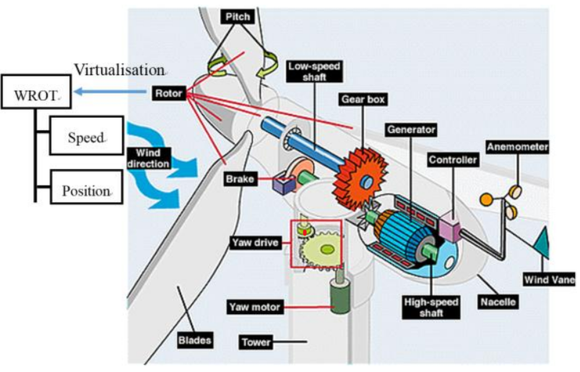
MCWT Cont.…
Figure 5. Typical HAWT components. Source :IEC 61400-25

Slide 23
MCWT Cont.…
Rotor:
The rotor of a wind turbine is the part that harnesses the energy of the wind.
Typically, the rotor is made up of two or more metal, fiberglass, or wooden blades.
Blades : The blades are attached to the hub, which in turn is attached to the main shaft
Usually composed of fiberglass, turbines feature three blades.
A typical modern land-based wind turbine has blades that are more than 52 meters in height, while the size of the blades varies.
When wind flows across the blade, the air pressure on one side of the blade decreases.

Slide 24
MCWT Cont.…
The design of the wind rotor blades(WRB) must include the following features.
Good mechanical strength, low density, and long fatigue life
strong resistance to corrosion
High strength to weight ratio, material qualities that can be tailored,
Forming an aerodynamic shape is simple.
The adaptability of the fabrication methods
Reduced expenses, resonance-prevention stiffness, and aero-elastic stability

Slide 25
MCWT Cont.…
The lift and drag forces are produced due to air pressure differences on the two sides of the blade.
The rotor rotates because the lift force is greater than the drag force.
The blade's airfoil structure is appropriate for producing lift and drag forces.
For designing WRB that can withstand wind loads, there are several elements to consider, including strength, stiffness, weight, durability, and cost.
The ability of a blade to resist breaking under extreme pressure, such as heavy winds or storms, is known as its strength one of the main design features.
As a result, two sources of aerodynamic loads—wind pressure (P) and shear stress (т)—are taken into account.

Slide 26
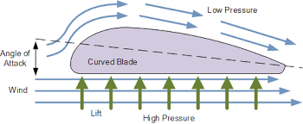
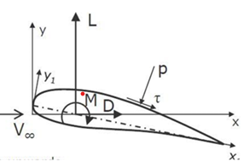
MCWT Cont.…
Then, the airfoil loads is decomposed into lift and drag
forces as given by:
Lift(L)=normal to velocity of airfoil, V
Drag (D)=Parallel to V
Moment(M)=+Ve nose up, is typically is quarter chord(c/4)
Figure 6: Airfoil structure of wind turbine. Source: www.pengky.cn

Slide 27
MCWT Cont.…
The same concept that makes airplanes, kites, and birds fly is also used in the design of the lift blades.
A pressure and wind speed differential between the upper and lower blade surfaces is produced as air passes by the blade.
The blade is "lifted" because of the increased pressure at the bottom surface.
The lift is converted into rotational motion when blades are fastened to a central axis.
Lift-powered wind turbines are ideal for producing electricity since they rotate at substantially faster speeds than drag-style wind turbines

Slide 28
MCWT Cont.…
Tip Speed Ratio:
The tip-speed is the ratio of the rotational speed of the blade to the wind speed. Electricity generation requires high rotational speeds.
The larger this ratio, the faster the rotation of the wind turbine rotor at a given wind speed
The number of blades that make up a rotor and a total area they cover affect wind turbine performance
For lift-type rotor to function effectively, the wind must flow smoothly over blades avoiding turbulence.
To avoid turbulence, spacing between blades should be great enough so that one blade will not encounter the disturbed, weaker air flow caused by the blade which passed before it.

Slide 29
MCWT Cont.…
Generator:
The generator is what converts the turning motion of a wind turbine's blades into electricity.
Inside this component, coils of wire are rotated in a magnetic field to produce electricity.
Different generator designs are used in Wind power, Type 1-Taype 5
The generator's rating, or size, is dependent on the length of the wind turbine's blades because more energy is captured by longer blades.
It is important to select the right type of generator to match intended use;

Slide 30
MCWT Cont.…
Gear Transmission(GT):
The number of revolutions per minute (rpm) of a wind turbine rotor is very small, depending on the model and the wind speed.
Mechanical Energy available at a low rpm – needs to be step
up to higher rpm suitable for generators.
Wind turbine converts, wind energy into electrical energy(KE-ME-P_{E}) equivalent to:
As a result, GT is used to step up the speed of rotor rotation to a speed suitable for the generator.
Some DC-type wind turbines do not use transmissions, which reduces wind turbine complexity and maintenance requirements.

Slide 31
MCWT Cont.….
Typically, a wind turbine gearbox uses parallel axis gears, such as external spur, helical, or annulus (internal) gears, to attain the higher speed.
The simplest configuration inside a stage is known as a "parallel shaft" and consists of two exterior gears meshing with one another.
A ring of planet gears meshing with an annulus gear on the outside and a sun gear on the inside that is installed on a planet carrier. - "Earthly" or "epicyclical"
The annulus, with its teeth on the inside, is an internal gear; the sun and planets are external gears as given by Fig.7.

Slide 32
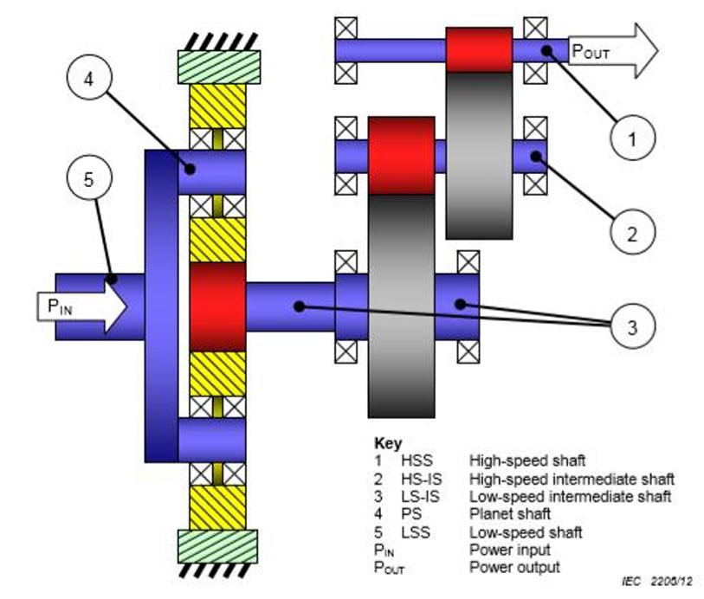
Figure 7. Gear Transmission box: Source: IEC 61400-4

Slide 33
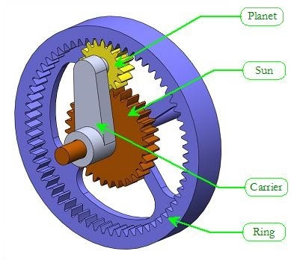
MCWT Cont.….
Three primary parts make up any planetary gear set: the sun gear, the planet gears and carrier, and the ring gear.
Unlike other gears that come in and out of mesh, they are always in mesh and cannot "clash."
As a result, the forces are shared among numerous teeth and the rotational speed is given by:
Figure 8: Planetary gear section. source: www.iqsdirectory.com

Slide 34
MCWT Cont.….
Tower:
In addition to providing support/stability, the wind turbine tower limits the amount of energy that may be harvested.
Most of the time, the maximum tower height is not required, unless there are zoning constraints.
The cost of using taller towers in comparison to the value of the increased energy output that results from their use will determine which height tower is used.
Bigger wind turbines are typically installed on towers that are between 40 and 70–150 meters high.
The tower and wind turbine in general needs carefully designing as it weights several tons as given
in Fig.9

Slide 35
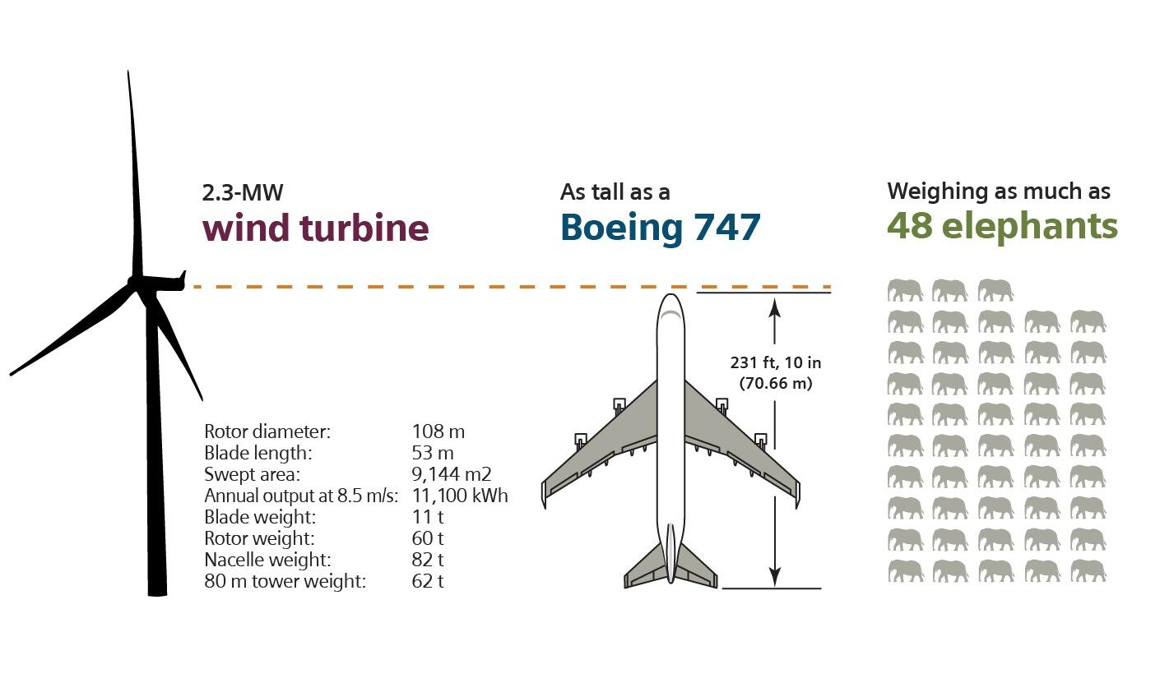
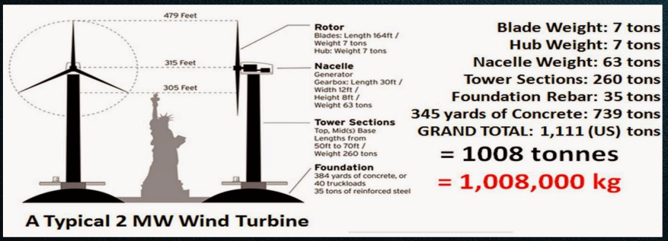
MCWT Cont.….
Figure 9. The weight of wind turbine. Source: ffden-2.phys.uaf.edu & Siemens Energy

Slide 36
5. Operating Characteristics of wind turbines
Wind machines share certain operating characteristics such as cut-in, rated and cut-out wind speeds
Cut-in Speed: Cut-in speed is the minimum wind speed at which the blades will turn and generate usable power.
This wind speed is typically between 10 and 16 km/h.
Rated Speed: The rated speed is the wind speed at which the wind
turbine will generate its designated rated power.
For example, a "10 kilowatt" wind turbine may not generate 10 kilowatts until wind speeds reach 40 k/h
Rated speed for most machines is in the range of 40 to 55 km/h

Slide 37
OCWT Cont.…
At wind speeds between cut-in and rated, the power output from a wind turbine increases as the wind speed increases.
The output of most machines levels off above the rated speed.
Most manufacturers provide graphs, called "power curves,“ showing how their wind turbine output varies with wind speed.
Cut-out Speed: At very high wind speeds, typically between 72 and 128 km/h, most wind turbines cease power generation and shut down.
The wind speed at which shut down occurs is called the cut-out speed.
The operating characteristics of wind turbine is presented in Fig.10

Slide 38
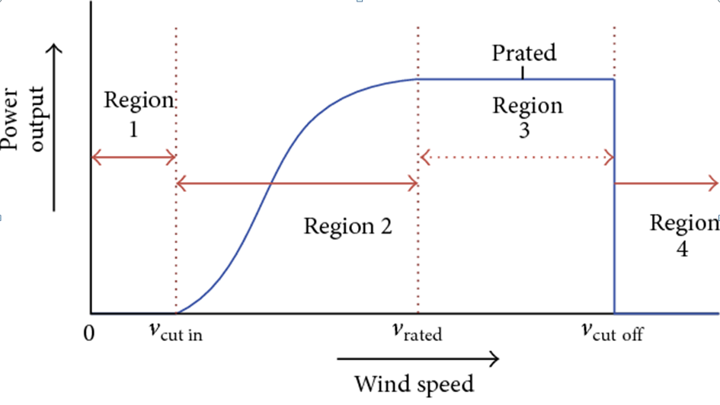
OCWT Cont.…
Power curve
Figure 10. The power curve. source :www.mdpi.com

Slide 39
OCWT Cont.…
Having a cut-out speed is a safety feature which protects the wind turbine from damage.
Shut down may occur in one of several ways. In some machines an automatic brake is activated by a wind speed sensor.
Some machines twist or "pitch" the blades to spill the wind.
Normal wind turbine operation usually resumes when the wind drops back to a safe level
Betz Limit: It is the flow of air over the blades and through the rotor area that makes a wind turbine function. Which is the maximum power harvesting limit of wind power.
The wind turbine extracts energy by slowing the wind down

Slide 40
OCWT Cont.…
The theoretical maximum amount of energy in the wind that can be collected by a wind turbine's rotor is approximately 59%.
This value is known as the Betz limit. If the blades were 100% efficient, a wind turbine would not work because the air, having given up all its energy, would entirely stop.
In practice, the collection efficiency of a rotor is not as high as 59%.
A complete wind energy system, including rotor, transmission, generator, storage and other devices, which all have less than perfect efficiencies

Slide 41
Summary
In conclusion, the wind power plant is one of most emerging and harnessed renewable energy technology in recent years, environmental friendly, clean and cheap energy source compared to conventional energy sources.
The two types of wind power plant based on their arrangement, namely vertical axis and horizontal axis wind turbine is presented.
It’s noted that horizontal axis wind turbine is widely used over VAWT due to its high height advantage for harvesting more power.
The performance of each wind component of wind turbine has an impact on the power harvesting from wind power
In addition, wind power operates based on the four operating region.

Slide 42
References
[1]. S., Dan; Z., Xu; Z., Xin and etl. ‘’ Influences of wind direction on the cooling effects of mountain vegetation in urban area’’. ELSEVIER: Building and Environment. V.209(1), 2022. Doi.org/10.1016/j.buildenv.2021.108663.
[2]. D., Rishabh and K. Tripathi. ‘’ Maximum Power Extraction Schemes & Power Control in Wind Energy Conversion System’’. International Journal of Scientific & Engineering Research. V.3(6), 2012.
[3]. A., Winslow. "Urban Wind Generation: Comparing Horizontal and Vertical Axis Wind Turbines’’. International Development, Community and Environment (IDCE), 2017.
[4]. A., Eberle; C., Aubryn; W., Julien and etl. ‘Wind Energy Technologies: Quantities and Availability for Two Future Scenarios. Golden, CO: National Renewable Energy Laboratory. NREL/TP-6A20-81483.2023.

Slide 43
Thank you !

