Slide 1
Renewable Energy and Distributed Generations
Lecture 5
Modeling of Wind Energy Conversion System
Lecturer: Teshome Goa (Assist. Prof.)
Lecture learning outcomes:
At the end of this lecture, you will be able to:
Know the modeling of wind power plant
Understand the maximum efficiency of wind power generation
Identify the wind power controlling techniques

Slide 2
Outlines
1. Modeling of Wind Power
2. Speed Ratio: Tip-Speed Ratio(TSR)
3. Optimal Rotor-Tip Speed Ratio(OR-TSR)
4. Wind Power Regulation and Control
Summary
References

Slide 3
1. Modeling of Wind Power (MWP)
The wind power is generated due to the motion of wind , which in turn is converted into kinetic energy as presented in Fig.1.
Then, electric energy is generated through end-to-end connected, wind blades, turbine and generator as given by;
eq.(1)
Where, P is power, ρ is air density in kg/m³ , A is swept rotor area
in m² and V is wind speed in m/s.
The density and sweat area of rotor is also given by as given by eq.(2) and 3, respectively ;
eq.(2)
eq. (3)
Where, P_{air} is air pressure (Pa), R is specific gas constant (287 J/kgK) & T is air temperature (K)
Notes:
3

Slide 4
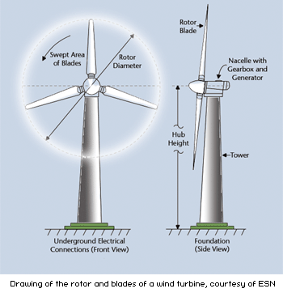
MWP Cont.….
  It’s observed that wind power depends on: A, V & ρ
  At sea level air density is equivalent to: 1.2kg/m³
  Which means, the power density (P_{ρ}) is equivalent as;
  eq.(4)
R
Figure 1. swept area of wind power generation.
Source: daviddarling.info
Notes:
4

Slide 5
MWP Cont.…
  With each wind speed cube, wind energy rises.
  30% more electricity is produced for every 10% increase in wind speed.
  An increase in wind speed of twice results in an increase in electricity generated by eight times.
  Wind energy rises to 1/7 power with height.
  Due to the high density of the cold air that helps move the blades as tower height grows, the height increases by 10.4% twice.
Notes:
5

Slide 6
MWP Cont.…
Air density increases in direct proportion to wind energy.
The air density in humid regions is higher than in dry climates.
The air density is higher at lower elevations than it is at higher heights.
Wind energy rises in direct proportion to the blades' swept area.
The blades resemble the wings of an airplane.
21% more swept area is produced for every 10% increase in swept diameter.
Notes:
6

Slide 7
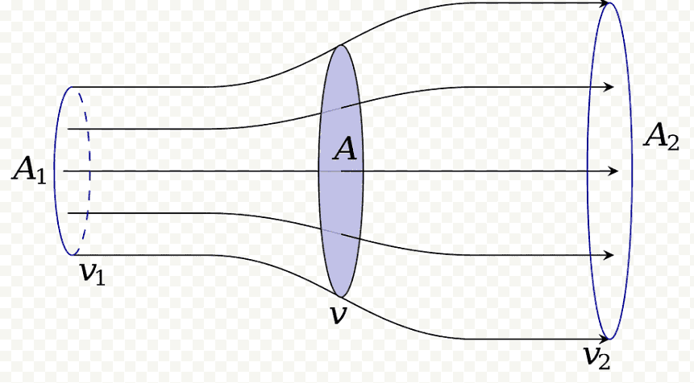
MWP Cont.…
Conservation of Mass: assume all the air that enters at A₁ leaves from A₂ as presented in Fig.2.
Fluid flow is stream lined and there is no loss of mass from the surface of the control volume. Fluid is incompressible, that is, there is no change in density.
Figure 2. Control volume air follows streamlines that pass through the rotor. Source: www.pngwing.com
Assume v₁ is the upstream wind speed, v is rotor speed and v₂ is downstream wind speeds, whereas as A₁,A, A₂ are upstream, rotor, and downstream cross-sectional areas. Then, based on mass conservation, m is given by;
eq.(5)

Slide 8
1.1 Efficiency of Wind Power (EWP)
As per the conservation of mass, momentum, and energy, Betz limit postulated that a wind turbine with a disc-like rotor cannot capture more than 59% of energy contained in a mass of air that will pass through the rotor.
Accordingly, within the control volume A₁, A, and A₂ for constant density, eq.(5) is rewritten as ;
eq.(6)
Then, applying the Newton’s second law , force exerted on rotor of wind turbine is:
eq.(7)
The force exerted on the rotor is also because of the pressure difference across the rotor:
eq.(8)
Which implies the force,
eq.(9)

Slide 9
EWP Cont.…
Bernoulli’s law is next applied in two volumes:(a)Flow along stream lines from A₁ to the front face of the rotor; and (b) flow from the back surface of rotor to A₂.
eq.(10)
Then; eq.(11)
Relating Force F with respect to area in consideration of the Force eqn.(9) and above one gives:
eq.(12)
Then, the rotor speed (v) and output speed v₂ are related with input speed(v₁) and given as;
eq.(13)

Slide 10
EWP Cont.….
Finally, the power maximum delivered to the idealized rotor based on eqns.(11) &13 is given by:
eq.(14)
The change in power with respect to change in rotor speed is should be equal to zero for maximum power extraction and given by;
eq.(15)

Slide 11
EWP Cont.…
Then, the maximum power extracted from the rotor by substituting eq.(15) into eq.(14) is given by;
eq.(16)
It’s observed that , the total input wind energy cannot be all converted to mechanical power or recovered in a wind turbine. If constant air density is considered, the power density is=0.36
because the output wind velocity is reduced due to loss in wind turbine components.

Slide 12
EWP Cont.….
The ideal, or maximum, theoretical efficiency η_{max} ( also called the power coefficient) of a wind turbine is the ratio of the maximum power obtained from the wind to the total power of the wind
eq.(17)
Wind turbine is capable of converting less than 60 percent of the total power of a wind to useful power.
Because a wind turbine wheel cannot be completely closed and other effects, Practical turbines achieve some 30 to 70 percent of the ideal efficiency.

Slide 13
Example: Let us construct a chart relating the wind speed to the power density and the output of the wind turbine assuming the efficiency of turbine based on eqns-4 and 16 as shown in the following Table
Wind Speed kmph | Wind speed m/s | Eq.(4): Power Density W/m² | Eq.(16) Power density(W/m² ⁾considering turbine efficiency | Power density(W/m² considering Generator efficiency(95%)
1 | 0.278 | 0.013 | 0.0077 | 0.0073
10 | 2.778 | 12.860 | 7.718 | 7.33
15 | 4.17 | 43.51 | 26.10 | 16.695
40 | 11.11 | 822.79 | 493.68 | 468.9
80 | 22.22 | 6582.4 | 3949.4 | 3,751.9
90 | 25 | 9,375 | 5625 | 5,343.75
120 | 33.33 | 22,215.56 | 13,329.33 | 12,662.9

Slide 14
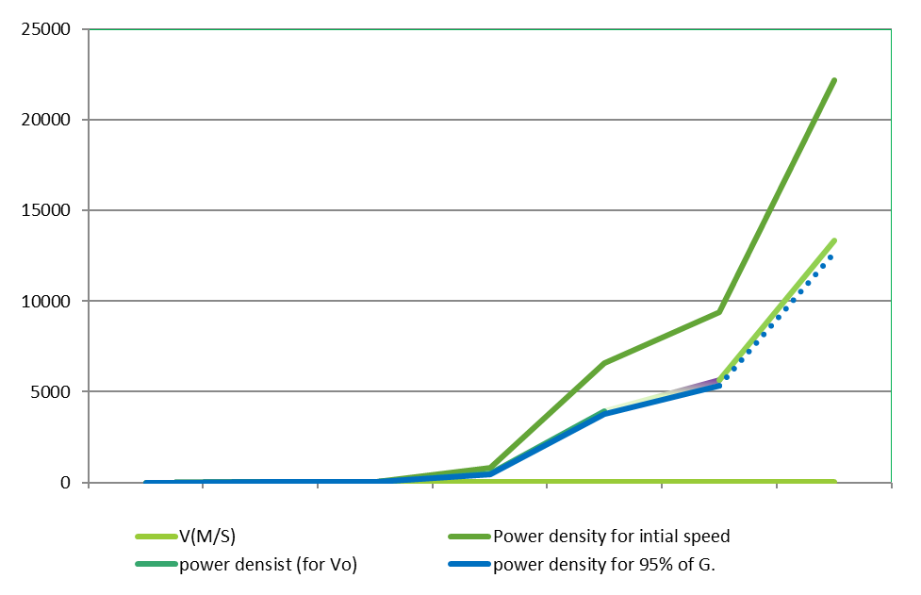
WPE Cont.…
Then, the relationship between wind speed in m/s , power density (for initial speed and output speed), and the power density for 95% generator efficiency is given in Fig.3.
Figure 3. Wind speed vs power density

Slide 15
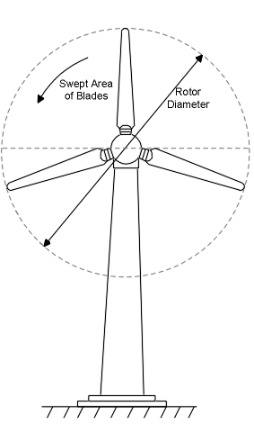
2. Speed Ratio: Tip-Speed Ratio(TSR)
It is observed that the infinite input wind speed not fully converted into rotational energy.
There is an optimum angle of attack which creates the highest lift to drag ratio to create maximum power.
The angle of attack is dependant on wind speed, there is an optimum tip-speed ratio .
Tip-speed ratio is the ratio of the speed of the rotating blade tip to the speed of the free stream wind.
eq.(18)
ΩR
R
Where, ω is rotational speed in radians /sec, r is rotor radius and v is the wind “Free Stream” Velocity
Notes:
15

Slide 16
TSR Cont.….
It is necessary in the design of wind turbines to match the angular velocity of the rotor to the wind speed
If the rotor of the wind turbine turns too slowly, most of the wind will pass untouched through the openings between the blades with little power extraction.
On the other hand, if the rotor turns too fast, the rotating blades act as a solid wall blocking the wind flow, again reducing the power extraction.
Wind turbines must be designed to operate at their optimal wind tip speed ratio in order to extract optimal power from the wind stream.
For grid connected wind turbines with three rotor blades the optimal wind tip speed ratio is reported as 7, with values over the range 6-8.

Slide 17
TSR Cont.….
Example 1: the tip-speed ratio, at a wind speed of 12 m/sec, blade radius of 11 m, rotating at 1 rotation per second is:
eq.(`19)
Example 2: The Suzlon S.66/1500, 1.5 MW rated power at 13 m/s rated wind speed of wind turbine design has a rotor diameter of 68 meters and a rotational speed of 13.5 to -22 rpm. Determine: the angular speed and the tip-speed operating region of the turbine.

Slide 18
TSR Cont.….
Solution :
eq.(20)
Then, the range of its rotor’s tip speed can be estimated as:
eq.(21)
Accordingly, the tip-speed ratio given as;
eq.(22)

Slide 19
3. Optimal Rotor-Tip Speed Ratio(OR-TSR)
By comparing the time it takes for the interrupted wind to reestablish itself (t_{w}) to the time it takes for a rotor blade with a rotational frequency of ὠ to move into the position held by its predecessor (t_{s}):
The ideal tip speed ratio for maximum power extraction is determined:
The time it takes a blade on a rotor with ‘n’ blades to advance to the position of its predecessor is given by:
eq.(23)

Slide 20
If the length of the strongly disturbed air stream upwind and downwind of the rotor is s, then the time period for the wind to return to normal is given by;
eq.(24)
If t_{s} > t_{w}, then some wind is unaffected and for t_{w} > t_{s}, then some wind is not allowed to flow through the rotor
The maximum power extraction occurs when these two time periods are about equal:
eq.(25)

Slide 21
OR-TSR Cont.…
From which the optimal rotational frequency is:
eq.(26)
Consequently, for optimal power extraction, the rotor blade must rotate at a rotational frequency that is related to the speed of the incoming wind.
This rotor rotational frequency decreases as the radius of the rotor increases and can be characterized by calculating the optimal tip ratio as:
eq.(27)

Slide 22
OR-TSR Cont.…
Effect of the number of rotor blades
The optimal tip speed ratio depends on the number of blades, n of the wind turbine.
The smaller the number of blades, the faster the wind turbine has to rotate to extract maximum power from the wind.
For an n bladed machine it has been empirically observed that s is equal to about half a rotor radius ; or the ratio (s/r) is approximately equal to 0.5, thus we can write:
eq.(28)
For n = 2, 3 and 4 bladed rotor, the maximum power extracted from the wind at C_{p,max} occurs at tip-speed ratio of 6.283, 4.19 and 3.14159, respectively
If the airfoil is designed with care, the optimal tip speed ratios may be about 25- 30 percent above these optimal values.

Slide 23
4. Wind Power Regulation and Control (WPRC)
The maximum achievable power factor is 59.26 percent, and is designated as the Betz limit.
In practice, values of obtainable power coefficients are in the range of 45 percent as indicated in Fig.4.
This value below the theoretical limit is caused by the inefficiencies and losses attributed to different configurations, which needs regulation and control of:
Rotor blades type, its designing and modeling
Modeling and control of wind speed itself
Convertors design and control
Electromechanical systems control/regulation

Slide 24
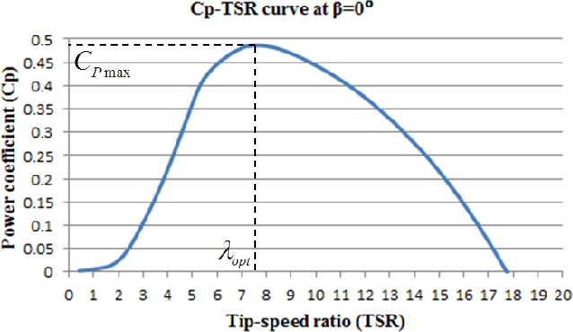
WPRC Cont.….
Figure.4. Power coefficient as a function of tip speed ratio
Maximum power extraction occurs at the optimal tip speed ratio[1].
The uncaptured power is caused by the fact that the tip speed ratio is not constant as well as the inherent inefficiencies and losses in different turbine designs.

Slide 25
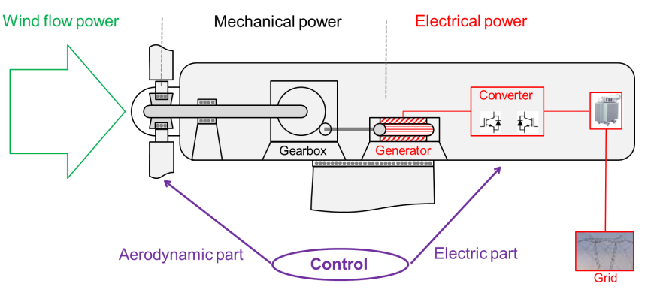
WPRC Cont.…
,
Figure 5. Wind power regulation system. Source: IEC

Slide 26
WPRC Cont.….
As presented in Fig.5., the wind power regulation needs to control:
a. Aerodynamic Power/mechanical systems like;
Aerodynamic efficiency (Betz Limit), Pitch angle control
Rotor speed control
b. Electrical parts like :
Power convertors
Grid islanding
Losses
Grid synchronizations

Slide 27
Types of wind power control
1. wind blade control
a. Fixed blade angle control: passive stall wind turbine control
b. variable blade angle control
Pitch control wind turbine (positive blade angle control)
Active stall wind turbine control (negative blade angle control)
2. Rotor speed control
Fixed speed control
Variable speed control

Slide 28
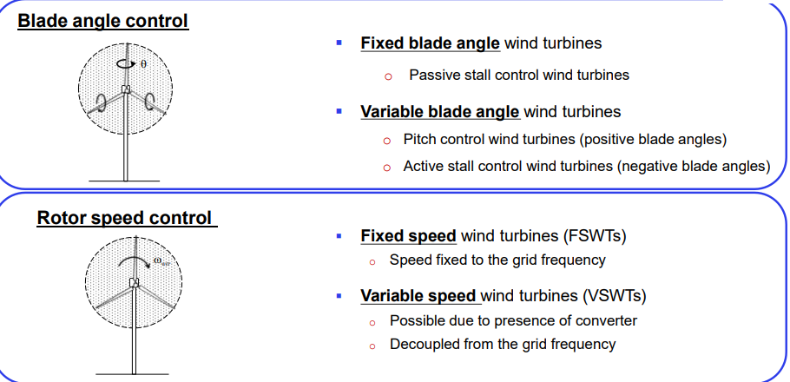
WPRC Cont.….
Fixed Blade angle wind turbines:
Passive stall control wind turbines
Variable blade angle wind turbines
  Pitch control wind turbines (positive blade angles )
  Active stall control wind turbines (negative blade angles
Fixed speed control wind turbines (FSWTs)
Speed fixed to the grid frequency
Variable speed wind turbine (VSWTs)
  Possible due to the presence of convertors
  Decoupled from the grid frequency
Source : IEC

Slide 29
WPRC Cont.….
Pitch regulation is accomplished by twisting the turbine hub's blades around their own axes using pitching mechanisms.
In terms of the incoming wind, an electronic system is in charge of monitoring wind speed, output power, and blade position (angle).
Pitch-regulated wind turbines need a very precise design in order to guarantee proper placement of the blades.
Longer turbine lives are an advantage of this method since dynamic loads are decreased.
Because the ideal incidence angle can be used at any time, improved performance is also attained. Lastly, regimes with low wind speeds can also be used.

Slide 30
WPRC Cont.….
Stall regulation: it involves adjusting the wind turbine blades such that the airfoil produces less aerodynamic force at high wind speeds and finally stalls, which lowers the torque produced by the turbine.
This method is straightforward, affordable, and reliable.
Active stall-controlled power regulation:
The pitch of the blades is adjusted to achieve maximum efficiency.
The blades are spun in the opposite direction to raise the angle of attack and force the blade to stall region when the wind speed exceeds the rated velocity.

Slide 31
WPRC Cont.….
Several control strategies can be applied to maximize or restrict power production.
A wind turbine may be managed by varying the generator speed, adjusting the blade angle, and rotating the entire machine.
Pitch and yaw control are other names for turbine rotation and blade angle adjustment, respectively. The wind power is regulated based on the operating characteristics of wind power as presented in Fig.6[2].

Slide 32
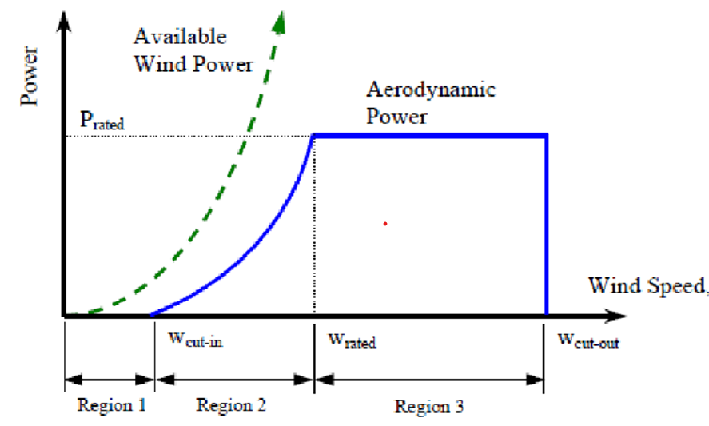
Figure 6. wind power operating regions. Source: www. semanticscholar.org

Slide 33
WPRC Cont.….
Fixed speed wind turbine
Directly connected to the grid and its frequency is fixed with the grid
The rotational speed is fixed based on the grid synchronous frequency
Since the speed range of the induction generator is very small, it is referred to as a ‘fixed speed wind turbine’.
The power can be limited aerodynamically either by stall control, active stall or pitch control.
The basic configuration of the fixed speed system is given in Fig.7.

Slide 34
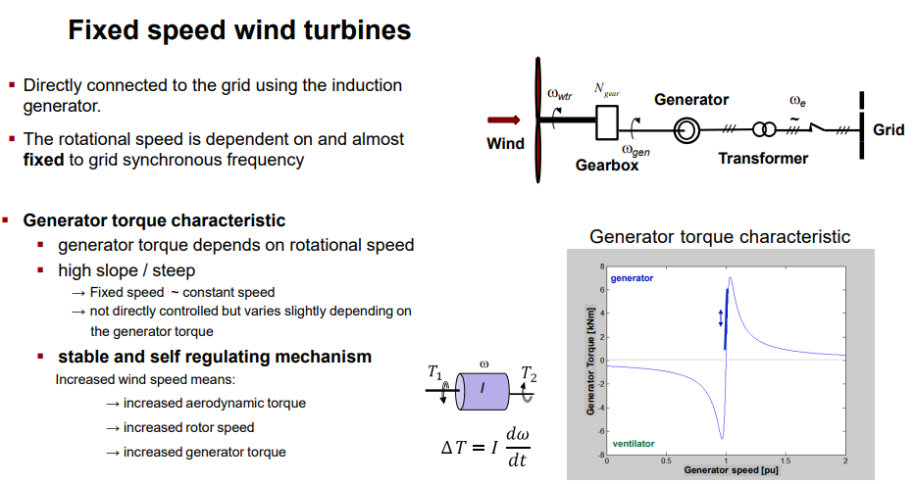
WPRC Cont.….
Figure 7. Fixed speed wind turbine. Source: https://www.sciencedirect.com

Slide 35
WPRC Cont.….
Variable speed wind Turbine
Modern wind turbines are operating in variable wind speed, at different frequency
Increased energy capture, better power quality, and less mechanical stress on the wind turbine
However, there is power electronics losses, the need for additional components, and higher equipment costs as a result of the power electronics.
The variable speed wind Turbine is presented in Figure 8.

Slide 36
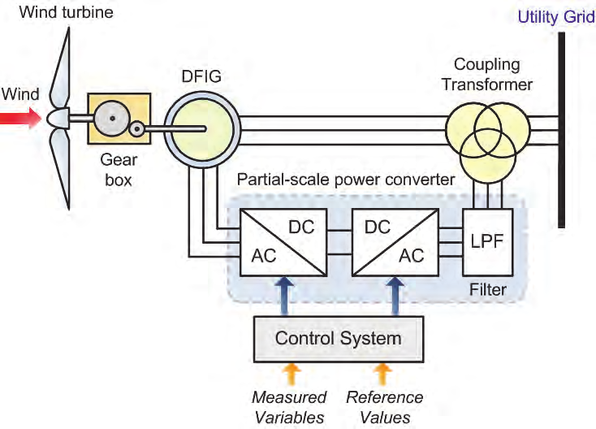
Figure 8. Variable speed (DFIG ) wind power control. Source :https://www.researchgate.net

Slide 37
Summary
In concussion, the maximum power output from wind turbine is highly depends on the wind speed passes through the rotor(directly proportional to V³)
It’s also observed that the maximum power efficiency of wind turbine is always less than 60%
However, the maximum practically harvesting power efficiency is between 45-55% due to losses in turbine, gearbox and converters
In line with this, there are different power controlling mechanisms (pitch angle control, generator speed control and other electromechanical system controls applied so far for enhancing the power coefficient (up to Cp)
Tip-speed ratio is also employed to enhance power harvesting efficiency

Slide 38
References
[1]. B., Aamer and l., Xiaodong. ‘’Online Estimation of Wind Turbine Tip Speed Ratio by Adaptive Neuro-Fuzzy Algorithm’’. International Journal of Advanced Computer Science and Applications. V.9(2018). DOI:10.14569/IJACSA.2018.090306
[2]. M., Adel; S., Jogendra and J., Jason. ‘’Torque and pitch angle control for variable speed wind turbines in all operating regimes’’. 10th International Conference on Environment and Electrical Engineering. 2011

Slide 39
Thank you !

