Slide 1
Renewable Energy and Distributed Generations
Lecture 6
Operating Principle of Variable and Fixed Type WECs
Lecturer: Teshome Goa (Assist. Prof.)
Lecture learning outcomes:
At the end of this lecture, you will be able to:
Know the Operating Principle of Variable and Fixed WECs
Understand the Voltage & Reactive Power Control of Variable and Fixed WECs
Understand the Fault Raid Capability of Each WECs

Slide 2
Outlines
1. Operating Principle of WECs(OP-WECs)
2. Fixed Speed Wind Generator(FSWG)
3. Variable Speed Wind Generator(FSWG)
4. Voltage Control Capabilities of WECs
5. Reactive Power Control Capabilities of WECs
6. Behavior of the WECs During Grid Fault
Summary
References

Slide 3
1. Operating Principle of WECs(OP-WECs)
The turbine blades' speed is determined by the wind speed.
The blades will spin more quickly in relation to the wind speed.
There are two primary methods for regulating/Controlling the rotational speed of the turbine:
1. Fixed Speed Wind Generator(FSWG)
2. Variable Speed Wind Generator (VSWG)
FSWT regulates the turbine's speed with a governor hub[1].
Its speed is fixed with respect to the grid-frequency
Whereas, the VSWG operates in wide range of frequency (sub-synchronous , synchronous and super-synchronous )

Slide 4
(OP-WECs) cont.….
Based on their frequency operation, the WECs can be classified as:
Type-1 WECS: Fixed speed wind energy conversion system (FSWECs)
Type -2 WECs: Limited Variable wind energy conversion system(LVWECs)
Type-3 WECs: Variable wind energy conversion system (VWECs)
Type-4 WECs: Variable wind energy conversion system(VWECS)

Slide 5
2. Fixed Speed Wind Generator(FSWG)
Type-1 WECs: Type-1 WECs is also known as fixed speed WECs, some times
It uses the Squirrel-cage Induction Generator (SCIG), which is directly connected to the grid through step up transformer.
The rotation speed of Type-1 WECs is fixed and determined by the grid frequency, as well as by the gear box and the number of poles of the generator.
The fixed-speed wind energy systems can be divided into two:
Single Fixed-speed WECS and Two Fixed-speed WECS
2.1. Single-speed WECS : the generator operates only at one fixed speed

Slide 6
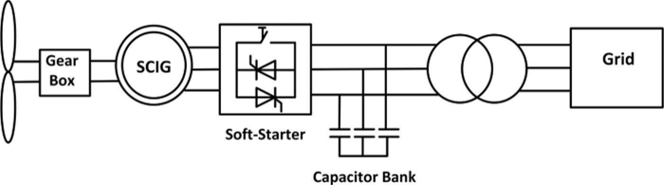
FSWG Cont.….
Figure 1: Typical configuration of Fixed-speed wind energy Conversion system. Source: https://ebrary.net
The soft starter is used to reduce the required starting inrush currents
It which is essentially a three-phase AC voltage controller composed of three pairs of bidirectional
thyristor switches. as presented in Fig.1.
To start the system, the firing angle of the thyristors is gradually adjusted such that the voltage applied to the generator is increased gradually from zero to the grid voltage level.
As a result, the stator current is effectively limited.

Slide 7
FSWG Cont.….
The soft starter is bypassed by a switch after start-up process is over.
The power factor correction capacitor is used to overcome the inductive property of IM and hence to improve the Power factor.
Generally, compensator is composed of multiple capacitor banks, which can be switched ON or OF individually to provide optimal solutions.
Due to the use of a cost-effective and robust squirrel-cage induction generator with inexpensive soft starter;
The fixed-speed WECS features simple structure, low cost, and reliable operation.

Slide 8
FSWG Cont.….
Example: For HAWT type with three rotor blades rotating 30 rpm as rated speed, determine the gear ratio. Assume a 4 pole squirrel cage induction generator(SCIG) is used to convert mechanical energy into electrical energy , which is connected to 50Hz grid.
Solution :
For grid frequency of (f=50Hz), the revolution per minute of four pole SCIG based eqn.(1) should be:
eqn.(1)
In addition, it’s observed that the blades rotate at 30 rpm, which is not matching with the SCIM speed.
Accordingly, the gear with ratio of at least 50:1 should be used.

Slide 9
FSWG Cont.….
The Drawbacks of Single Fixed-Speed SCIG-WECs;
It is noted that the grid frequency determines the frequency of single-fixed speed SCIM's.
Since it can only reach its maximum efficiency at a single wind speed, it has a lower energy conversion efficiency than the variable-speed WECS.
Limited control of reactive power
Subjected to voltage stability problems
External power factor correction capacitor is needed
This has necessitated the improvement of Single-Speed- Fixed SCIG to
Two-speed-SCIG Type-WECs

Slide 10
FSWG Cont.…
2.2 Two-Speed WECS[2]: The generator can operate at two fixed speeds
The two speed operation can be achieved by either;
An induction generator with two distinct winding configurations(different poles) or Two induction generators with different rated speeds can be driven by a dual output drive train
The working of Cp will change dramatically if the wind speed varies across a larger range.
Though the dual-speed mode produces less energy than the variable-speed mode, it is still a better option than operating at a single Fixed-speed because it catches more energy.

Slide 11
FSWG Cont...…
2.2.1 Two-Speed Operation by Changing Number of Poles;
Two-speed SCIG wind energy systems have been created in order to increase the energy conversion efficiency.
The number of stator poles affects the generator's speed.
The speed loss that results from moving from a four-pole to a six- or eight-pole arrangement is one-third or half, respectively.
By rearranging the stator winding and connecting the stator coils in the proper parallel and series configuration, the number of poles can be altered.
A generator connected to a 50 Hz grid can run at somewhat higher speeds of 1000 and 1500 rpm, respectively, with the number of poles adjusted from six to four.

Slide 12
FSWG Cont.…
This system can increase energy efficiency by capturing the highest power at two different wind speeds.
The squirrel-cage rotor is coiled for an arbitrary number of poles.
It produces the same number of poles as a stator winding, hence the only configuration required for a squirrel-cage motor is to alter the stator's pole count.
The complexity of a wound-rotor motor increases when the number of poles on the rotor needs to be changed.
Therefore, this pole-changing induction motor technology can only be used to regulate high-speed squirrel-cage motors.

Slide 13
FSWG Cont.…
2.2.2 Two-Speed Operation by Two alternators;
It is also possible to achieve two-speed operation by mechanically connecting two different generators to a single shaft.
One is a partially rated low-speed generator (six or eight poles), and the other is a completely rated high-speed generator (four poles).
By using switch "S," you can choose the generators.
Switch "S" is in Position 1, which connects the high-speed generator to the grid, during high wind speeds
Then move from Position 1 to Position 2 occurs when the wind speed reaches a specified threshold.
After selection, the low-speed generator powers the grid.

Slide 14
FSWG Cont..
Another way to achieve the two-speed operation is to use a split gearbox, which has two shafts as presented in Fig.2[3].
Each shaft is linked to a different SCIG, and both shafts have the same gear ratio.
A fully rated four-pole generator is selected at high wind speeds, much like the single-shaft version, while a partially rated six- or eight-pole generator is turned on at low wind speeds.
Off-the-shelf generators can be utilized, however a specific gearbox is needed for this setup.
Two generators are needed for the single-and dual-shaft WECS variants, which raises the system's weight and cost in addition to adding complexity to the mechanical parts.
Consequently, they have discovered few real-world uses.

Slide 15
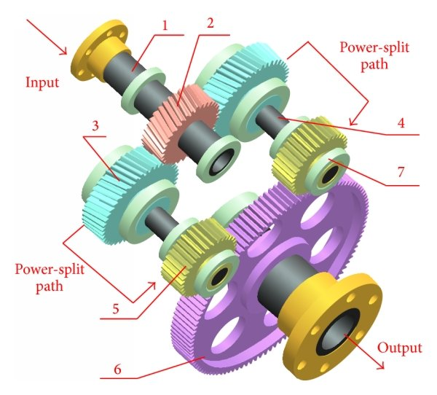
Figure 2. Two shaft split-gearbox for WECs. Source: www.researchgate.net

Slide 16
3. Variable-Speed Wind Generators (VSWG)
The VSWG are generators that generates different frequencies or speeds (Sub-Synchronous, Synchronous and super-Synchronous) with the aid modern power convertors. They are classified as:
Type-2 WECs : Wound-Rotor Induction Generator with External Rotor Resistances.
Type-3 WECs: Doubly Fed Induction Generator WECS
Type-4 WECs: SCIG Wind Energy Systems with Full-Capacity Power Converters

Slide 17
VSWG Cont.….
3.1 Type-2 WECs: It uses the wound rotor induction generators , which is directly connected to the grid through step-up transformer in a fashion similar to Type-1, see Fig.3
The machines stator includes variable resistor in the rotor circuit unlike Type-1.
This can be accomplished with a set of resistors and power electronics external to the rotor with currents flowing between the resistors and rotor via slip rings.
The variable resistors controls the rotor currents quite rapidly, keep constant power even during gusting conditions, and influence the machine’s dynamic response during grid disturbances.

Slide 18
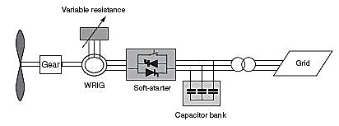
VSWG cont.….
Figure 3: Type-2 WECs: Limited Variable Speed.
Source: www.researchgate.net/figure/Type-2-Semi-variable-speed

Slide 19
VSWG Cont.…
3.2 Type-3 WECs: Variable Speed
Type 3 turbine is commonly known as the Doubly Fed Induction Generator (DFIG) or Doubly Fed Asynchronous Generator (DFAG),
It takes the Type-2 design to the next level, adding variable frequency AC excitation instead of resistance to the rotor circuit.
Additional rotor excitation is supplied via slip rings by a current regulated, voltage-source converter, which can adjust the rotor currents’ magnitude and phase nearly instantaneously as presented in Fig.4(a)
This rotor-side converter is connected back-to-back with a grid side converter, which exchanges power directly with the grid.

Slide 20
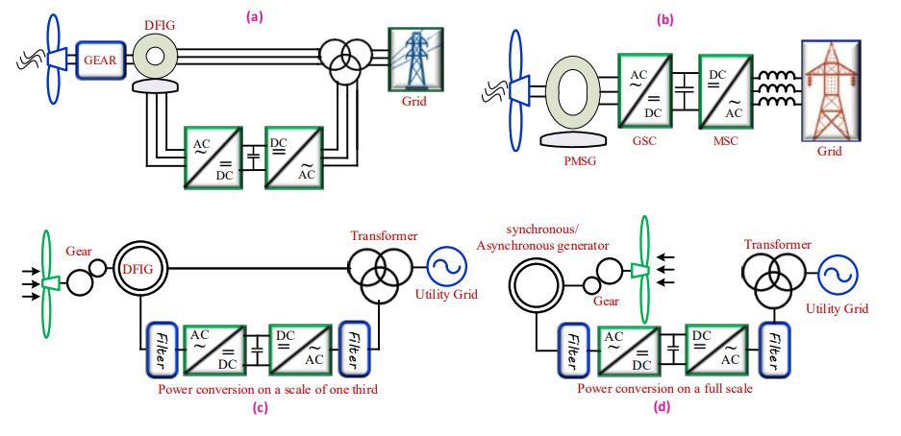
Figure 4. Variable Speed wind generator. Source: www.windustry.com

Slide 21
VSWT Cont.…
3.3 Type-4 WECs: Variable Speed
One type of variable speed WEC system that provides greater flexibility is Type-4, which is based on full power electronics conversion.
A full-scale back-to-back frequency converter is used to send the spinning machine's output to the grid, allowing for a considerable level of design and operational flexibility.
When the turbine is let to spin at its maximum aerodynamic speed, the machine produces an AC output.
Furthermore, the gearbox could be removed, allowing the machine to run at a modest turbine speed and produce electricity at a frequency that is significantly lower than the grid.

Slide 22
VSWT Cont.…
These kinds of rotating machines are built as wound rotor synchronous machines, which resemble traditional hydroelectric plant generators that have control over the high pole and field current.
By successfully severing the generator's connection to the grid, it enhances fault response.
It enhances the ability to capture electricity from the wind by enabling the turbine to run over a large speed range.

Slide 23
VSWT Cont.…
The converter that connects the turbine to the grid must manage the whole generator's output, as opposed to a DFIG turbine, which only needs the converter to manage 30% to 40% of the generator's output.
This makes the converter more expensive and loss, but it also gives the grid more headroom to receive
reactive electricity.
In contrast, the permanent magnet alternator (PMA) itself has no rotor windings, which lowers excitation losses and reduces the size of the generating unit.
The need for maintenance is decreased when rotor slip rings are absent

Slide 24
4. Voltage Control Capabilities of WECs
A wind turbine's ability to control voltage varies depending on the type of turbine;
Type-1 and Type 2 WECs usually aren't able to do so.
Rather, these WECs usually employ power factor correction capacitors (PFCCs) to keep the machine's low-voltage terminals' reactive power output or power factor at a predetermined level.
Their power efficiency is also minimum compered modern variable speed WECs

Slide 25
Voltage Control cont.…
Voltage can be managed by WECs of types 3 and Type 4.
Voltage control is made possible by these WECs ' ability to change the reactive power at a given active power and terminal voltage
Usually, the voltage at the main bus or on the high side of the main power transformer is controlled by the individual WECs ' voltage control capabilities.
Typically, a centralized wind farm controller will communicate with each individual WECs to handle voltage control.

Slide 26
5. Reactive Power Control Capabilities
The reactive power control capabilities of modern WECs is highly significant as most grid codes require the WECs
Which is to have reactive power capability at the point of interconnect over a specified power factor
(PF) range,
Usually, the PF ranges from 0.95 leading (inductive) to 0.95 lagging (capacitive).
Type-1 and Type-2 WECs typically use PFCCs to maintain the power factor or reactive power of the machine to a specified set point.
The PFCCs may be sized to maintain a slightly leading (inductive) power factor of around 0.98 at rated power output.
This is often referred to as no-load compensation.

Slide 27
Reactive Power Control Cont.….
For type-1 and 2, With full-load compensation, the PFCCs are sized to maintain unity power factor
In some cases, a slightly lagging (capacitive) power factor at the machine’s rated power output.
The PFCCs typically consists of multiple stages of capacitors switched with a low-voltage AC contactor.
These makes the controlling, switching and maintenance of more difficult

Slide 28
Reactive Power Control Cont.….
Type 3 (DFIG) WECs typically have a reactive power control capability corresponding to a power factor of 0.95 lagging (capacitive) to 0.90 leading (inductive) at the terminals of the machines.
The voltage and reactive power is easily controlled
Type-4 WECs can vary the grid side converter current, allowing control of the effective power factor of the machines over a wide range.
Reactive power limit curves for different terminal voltage levels are typically provided.

Slide 29
6. Behavior of the WECs During Grid Fault
The response of WECs to faults on the grid depends largely on the type of WECs.
The response of Type-1 and Type-2 WECs are essentially similar to that of large induction machines used in industrial applications
The response of Type-3 and Type-4 is commonly managed by the WECs controlling units. In fault calculations:
Type-1 WECs can be represented as a voltage source in series with the direct axis sub-transient inductance.
Type-2 WTGs employing limited speed control via controlled
For type-2 the external resistance should be also considered

Slide 30
WECs During Grid Fault Cont.….
For Type-3. the rotor power controller remains active, the machine stator currents is limited between 1.1 to 2.5 p.u. of the machine rated current.
For Type-4, the turbines using full-rated power converters which is connected to the grid, the fault current is easily limited while rated current is violated .
But, the limitation due to power converter control, especially switching problem and need critical protection the power semiconductor switches.
For grid connected wind farms, the WTGs must obey the grid code based on the dynamic and static requirements[4]

Slide 31
WECs During Grid Fault Cont.…..
The steady state behavior and the power flow to the transmission grid are covered in the static requirements.
Accordingly, the following points are recommended for the operation of WTGs during steady state and contingency, faults at PCC.
Area A: The WTG must remain connected to the grid and maintain regular power production if the bus voltage is between 0.95 and 1.05 Per unit voltage
Area B: The WTG must remain connected to the grid for 0.625 second when the grid voltage dropped to 15% of its nominal value, 0.2 Per unit voltage during contingency cases.
Area C: The WTG should be disconnected from the grid if the voltage is less than 0.2 Per unit voltage for any time sequences

Slide 32
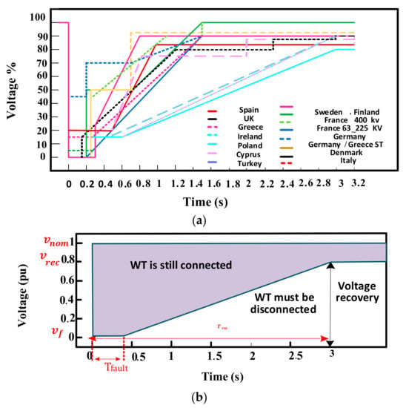
Figure 5. FRT requirements: (a) most GCs; and (b) universal FRT requirements.
Source: www.mdpi.com

Slide 33
Summary
It is observed that there are two types WECS based on their operational frequency or speeds: Fixed
and Variable Speed WECs
The frequency of Fixed WECS is fixed based on the grid frequency
But, modern WECs are operates in wide range of frequencies (DFIG)
Especially, Type-3 and Type-4 wind turbines are more suitable for the control of voltage, reactive power and better fault raid through capability compared to Fixed speed wind energy conversion systems

Slide 34
References
[1]. A., Furqan; T., Muhammad and K., Sung. ‘’Robust Frequency and Voltage Stability Control Strategy for Standalone AC/DC Hybrid Micro-grid’’. Energies . 2017. V.10(760). doi:10.3390/en10060760
[2]. E., Muljadi; .P., Butterfieldand D. Handman. ‘’Dual-Speed Wind Turbine Generation’’. REL, USA
[3]. H., Dong; D., Ling-ling and z.,Jun-an. ‘’Load-Sharing Characteristics of Power-Split Transmission System Based on Deformation Compatibility and Loaded Tooth Contact Analysis’’. International Journal of Aerospace Engineering. V.7(2015) DOI: 10.1155/2015/305808
[4]. M., Aye; A., Moheb and El-Hay. ‘’Comprehensive Review on Fault Ride-Through Requirements of Renewable Hybrid Micro-grids’’ Energies 2022, 15(18). Doi.org/10.3390/en15186785

Slide 35
Thank you !

