Slide 1
Renewable Energy and Distributed Generations
Lecture 7
Grid Integration of WECs
Lecturer: Teshome Goa (Assist. Prof.)
Lecture learning outcomes:
At the end of this lecture, you will be able to:
Know the grid integration of Variable and Fixed WECs
Understand the modeling of grid connected WECs
Understand the grid code requirements

Slide 2
Outlines
Introduction
Grid connected Induction generators operation
Grid Connected Variable Speed Wind Operation
Modeling of DFIG
Grid connected Permanent Magnet Synchronous Generator
Grid Code Requirements
Summary
References

Slide 3
1. Introduction
The grid and wind turbines are connected at varying voltage levels for WECS
The types of wind turbine affects the grid integrations
One of the difficulties in connecting to the grid that system operators face in order to maintain a balanced and stable power system is the uncontrollable and variable nature of wind energy.
Furthermore, the significant penetration of wind power has an impact on stability, power quality, and economics, among other aspects of the power system functioning.
Thus, it needs to know the operation of grid connected wind power and the technical features of Integration of Wind turbines to the grid

Slide 4
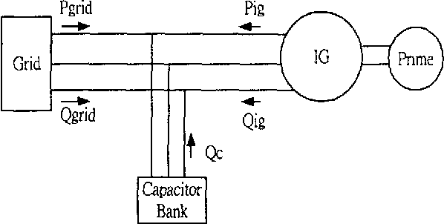
2. Grid connected Induction Generators Operation(GCIGO)
The operation of Grid Connected Induction Generators schematic diagram is shown in the Fig. 1
Here, the stator terminals are directly connected to the bus and the rotor is driven by a Prime mover at speeds higher than the Synchronous speed.
Figure - 1: Grid Connected Induction Generator[1]. URL={https://api.semanticscholar.org/CorpusID:110948876/DOI:10.1109/PESW.2002.985033

Slide 5
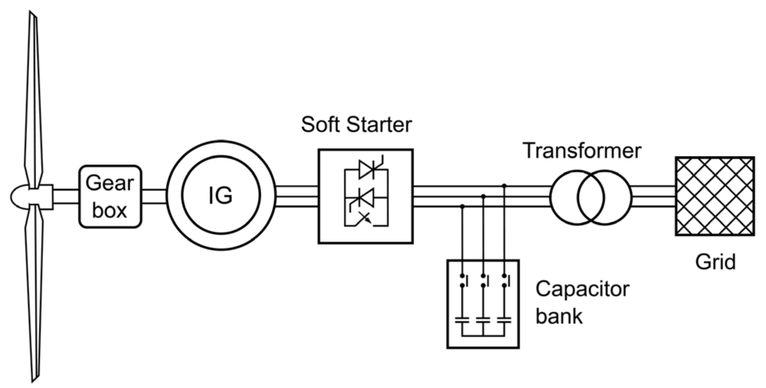
GCIGO Cont.…
2.1 Fixed-Speed Grid Connected Wind Generation Operation(FSGCO)
It implies that the use of a Squirrel Cage Induction Generator (SCIG), which provides the power output only through the stator winding.
Fig.2 illustrates the configuration of Squirrel Cage IG
Induction Generator coupled to a turbine through a gear box. The gear box steps up the rotor speed to a value matching a 50 or 60 Hz utility network. (1500 or 1800 RPM for a 4 pole machine)
Figure 2: Grid connected Fixed Speed Wind Turbine system[2].
url:https://www.researchgate.net/publication/336086471

Slide 6
FSGCO Cont.…
The speed varies within a very narrow range above synchronous speed, typically 1%, due to its coupling to the grid.
The system is referred to as a fixed-speed system because of the minimal speed change.
When the wind speed deviates from the rated wind speed, the rotor efficiency decreases because the tip speed ratio, or "λ," fluctuates over a large range in an inverse relationship to the wind speed.
Capacitors are utilized to make up for the Induction Generator's constant pull on reactive power from the network. This causes the VAR to lag.
If appropriate precautions are not followed, these capacitors could cause the induction machine to self-excite, which could result in over-voltages when the wind generator is disconnected from the grid.

Slide 7
FSGCO Cont.…
In order to achieve the best "C_{p}" for the most frequent wind speed, the gear box ratio is chosen.
Over the course of a year, fixed-speed operation in a well-designed system can harvest around 80% of the energy available from a completely variable speed system.
To limit the power at high wind speeds, fixed-speed wind turbines use either stall regulation or blade pitch regulation.
This is required because the system will become unstable if the mechanical power input exceeds the power equal to the pull-out torque.

Slide 8
It takes a lower rotor speed to produce noticeable amounts of energy at low wind speeds
An induction generator of the cage type with two speeds and a stator winding configuration for two distinct numbers of poles can be used to accomplish this.
When the wind speed is low, there are more poles; when the wind speed is high, there are fewer poles.
Up to 90% of the energy available from a 100% variable-speed system can be extracted over the course of a year by a well-designed two-speed system.
A two-speed method reduces audible noise at lower wind speeds.
FSGCO Cont.…

Slide 9
FSGCO Cont.…
Induction machines are typically accelerated to synchronous speed by the turbine through the use of wind energy.
Then, it will be connected to the grid through step up transformers
This is especially problematic for low fault tolerance electrical networks when an induction machine is connected directly to the supply, as it results in excessive inrush current.
Moreover, torque pulsations from such a connection may harm the gear box.
Phase-controlled anti parallel thyristors or voltage controllers are commonly used in soft-start circuits to regulate the applied stator voltage when the induction machine is connected to the network.
This reduces the magnetizing current surge

Slide 10
FSGCO Cont…
A few seconds later, when normal current is established, these starting devices are bypassed.
Such AC voltage controllers can also be used for connecting the machine to the grid during acceleration from zero speed to the operating speed.
Advantages: its lower capital cost, Simple System configuration, and robust mechanical design.
Disadvantages: As the rotor speed is nearly constant, fluctuations in wind-speed result in torque-excursions, which may lead to grid voltage fluctuation
Wind gusts in particular lead to large-torque-variations.

Slide 11
3. Grid Connected Variable Speed Wind Operation (GCVSWO)
The wound rotor induction machine, commonly known as the Doubly Fed Induction Generator (DFIG) is more adopted, particularly in large-mega-watt power of variable-speed WECs.
When compared with motoring operation, the power handling capability of a wound rotor Induction machine as generator theoretically becomes nearly double.
The rotor of generator is coupled to the turbine shaft through a gear box so that a standard (1500/1800 rpm) wound rotor induction machine can be used.
The gear ratio is selected that the machine’s synchronous speed falls nearly in the middle of the allowable optimal speed range.
Above the rated wind speed, power is limited to the rated value by pitching the blades.

Slide 12
GCVSWO Cont.…
The basic operation of DFIG is explained with the help of the power flow diagram shown in Fig.3.
As we know, in an Induction Machine, when the Rotor is moved at a super synchronous speed, the slip ’s’ is negative and the machine works as a Generator.
In this mode, the air gap power |P_{g}| is less than the input mechanical Power |P_{m}|.
As can be seen from the power flow diagram below, the input mechanical power P_{m} gets split into air gap power P_{g} and slip power s.P_{g}.

Slide 13
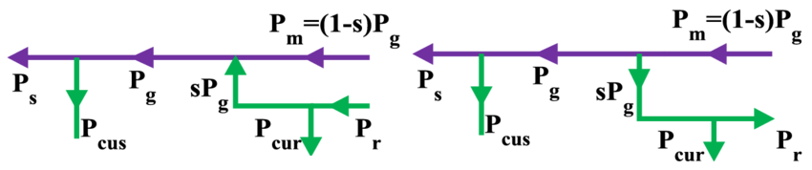
GCVSWO Cont.…
Air gap power, after meeting stator copper losses P_{cus} goes out through stator as output power P_{s}.
Figure.3 : Power Flow Diagram in a Double Fed Induction Generator[3]. url: https://www.researchgate.net/publication/277860225

Slide 14
GCVSWO Cont.…..
In Squirrel Cage Induction Generator, the slip power s.P_{g} gets wasted as heat.
But, in wound rotor Induction generator, the slip power after meeting Rotor copper losses P_{cur ,}can be taken as output power, P_{r} from Rotor side and fed into the Grid in which case it is called a
DFIG.
With a slip-ring induction machine, power can be fed into the supply system over a wide speed range by appropriately controlling the rotor power from the variable-frequency slip power.

Slide 15
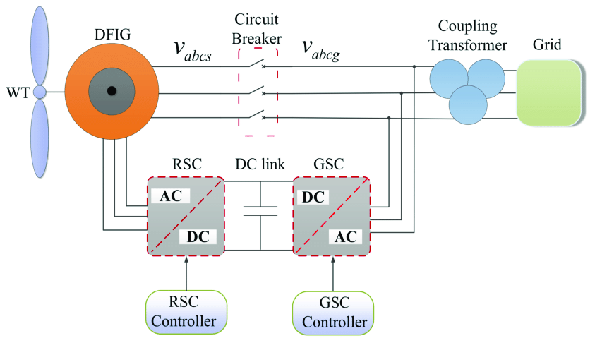
GCVSWO Cont.…..
The provision for bidirectional flow of power through the rotor circuit is achieved using a slip-ring induction motor with an AC/DC/AC converter connected between the slip-ring terminals and the utility grid.
The system is known as a DFIG because power can be fed both from both the Stator and Rotor.
Figure 4 shows the main components of a solid-state system for the controlled flow of slip power at variable speed through a current source converter/inverter.
Figure . 4: Double Output Induction Generator with Current Source Inverter[4]. URL: https://www.intechopen.com/books/148.

Slide 16
GCVSWO Cont.…..
The stator is directly connected to the fixed-frequency utility grid while the rotor collector rings are connected via back-to back current source inverters and a transformer/filter to the same utility grid.
As the rotor power is a fraction of the total power of the generator, a rotor converter rating of nearly 35% of the rated turbine power is sufficient.
For the transfer of electrical power from the rotor circuit to the supply, converters I and II are operated, respectively, in rectification and inversion modes.
,

Slide 17
GCVSWO Cont.…..
For maximization of the power output, in converter-I ‘α₁’ should be set at 0⁰ (rectification mode) in the super synchronous region above the rated speed n_{r} to draw power out of the rotor.
The grid-side converter-II enables power flow to the grid, keeping DC-link voltage level constant by controlling its firing angle ‘α₂’.
The intermediate smoothing reactor is needed to maintain current continuity and reduce ripple in the link circuit.
The step-down transformer between converter-II and the supply extends the control range of the firing delay angle ‘α₂‘ of converter-II.

Slide 18
4. Modeling of DFIG(M-DFIG)
The model supplies through the rotor and stator connections to the grid.
The stator is directly linked to the grid, and the two electrical converters that are back-to-back coupled are connected to the rotor.
The two converters are grid-side and rotor converters, depending on the position of the connections.
Additionally, a DC link capacitor is positioned between the two converters to prevent voltage fluctuation and store energy.
The torque, speed, and power factor at the stator terminals of the DFIG are all controlled by RSC.
The function of GSC is to keep the DC-bus voltage (V_{bus}) referred to the stator constant.

Slide 19
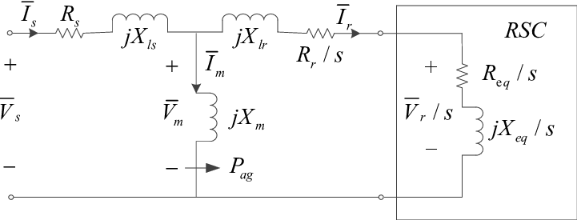
M-DFIG Cont.…
A. Steady State modeling of DFIG with rotor side converter
Fig.5. shows the equivalent circuit of the doubly-fed induction generator, Including the magnetizing losses.
Figure 5. Equivalent circuit of double feed Induction Generator[5]. url: https://www.researchgate.net/publication/307946917
For the transfer of electrical power from the rotor circuit to the supply, converters I and II are operated, respectively, in rectification and inversion modes.

Slide 20

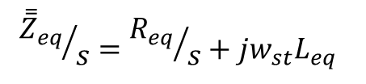
M-DFIG Cont.…
Where, Pag is the air gap power and , the converter's equivalent impedance is given as [6] :
eqn.(1)
Where, ω_{st} is the angular sleep speed and L_{eq} is the RSC equivalent inductance.
The impedance should be separated by slip s. Then, the stator side impedance is calculated as:
eqn.(2)
If the stator operates at a unity power factor, one can calculate the generator's air-gap power.
eqn.(3)
$${{\overset{̿}{Z}}_{eq}}/s={R_{eq}}/s+{jw_{st}L}_{eq}$$
$$P_{ap}=3\left(v_{s}−I_{s}R_{s}\right)I_{s}$$

Slide 21
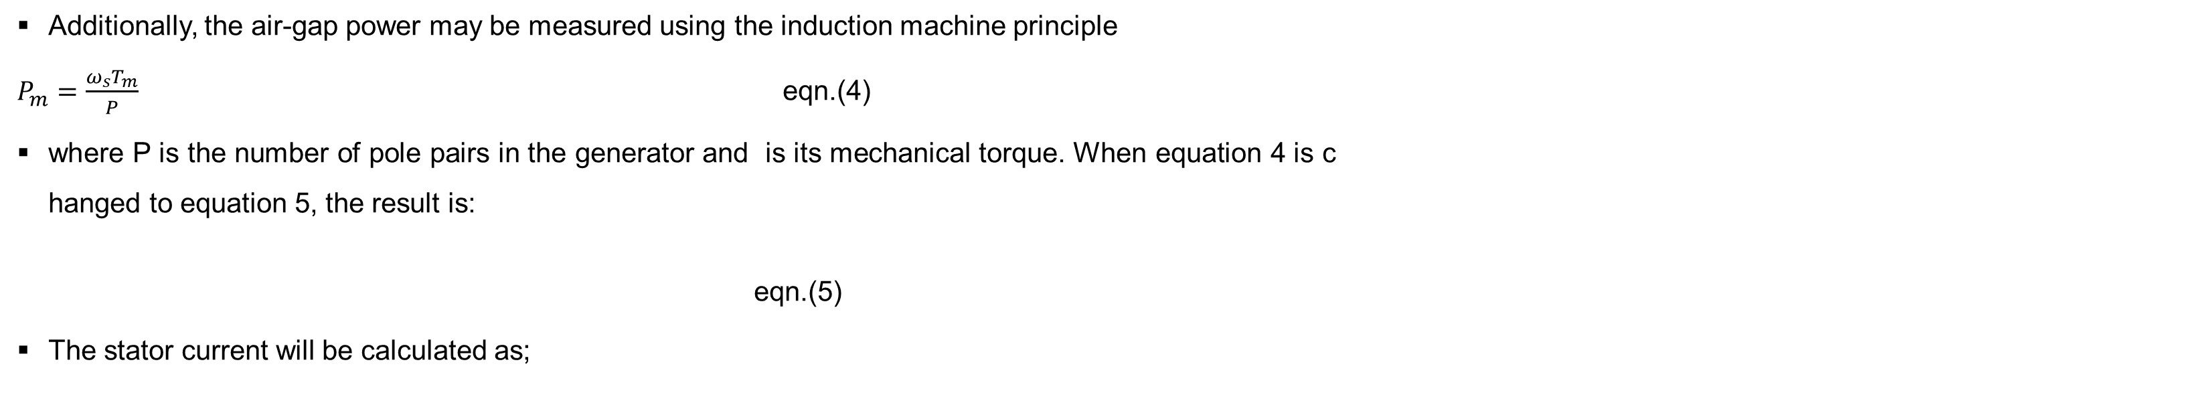
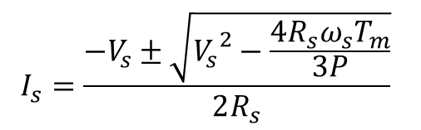
M-DFIG Cont.….
Additionally, the air-gap power may be measured using the induction machine principle
$P_{m}=\frac{ω_{s}T_{m}}{P}$ eqn.(4)
where P is the number of pole pairs in the generator and is its mechanical torque. When equation 4 is changed to equation 5, the result is:
eqn.(5)
The stator current will be calculated as;
$$\frac{ω_{s}T_{m}}{P}=3\left(v_{s}−I_{s}R_{s}\right)I_{s}$$
$$I_{s}=\frac{−V_{s}±\sqrt{{V_{s}}^{2}−\frac{4{R_{s}ω}_{s}T_{m}}{3P}}}{2R_{s}}$$

Slide 22
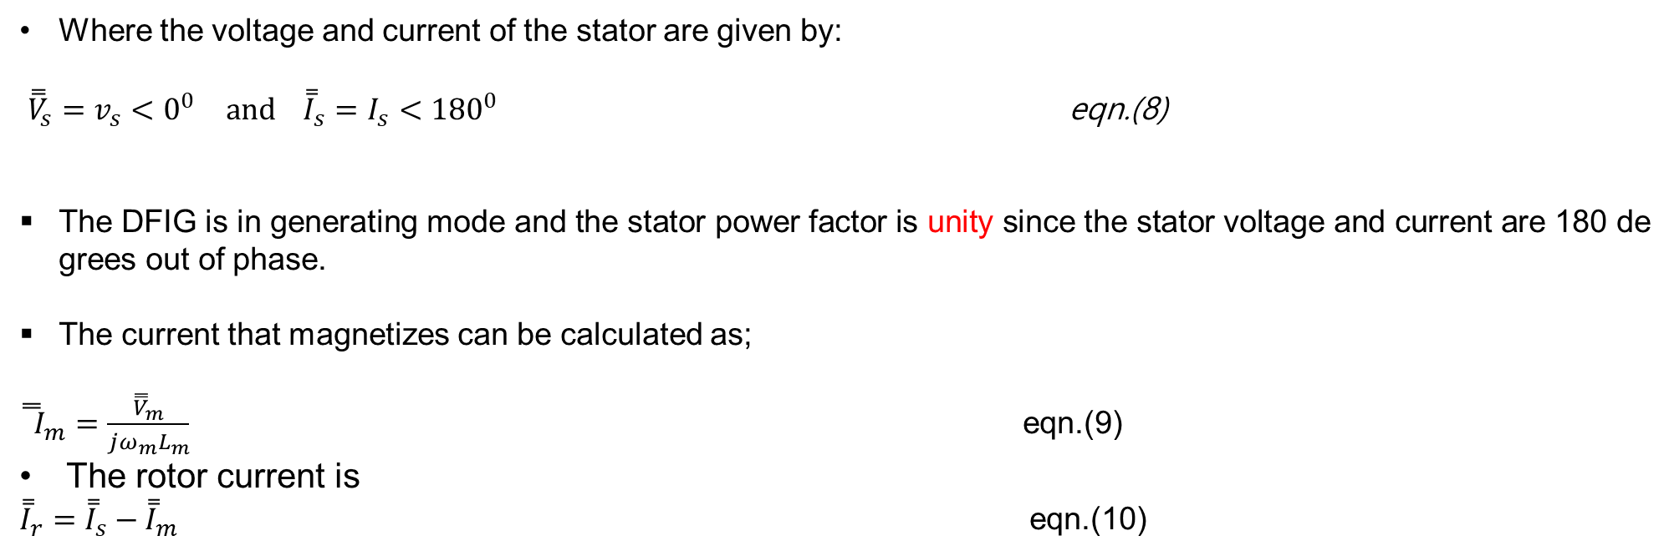
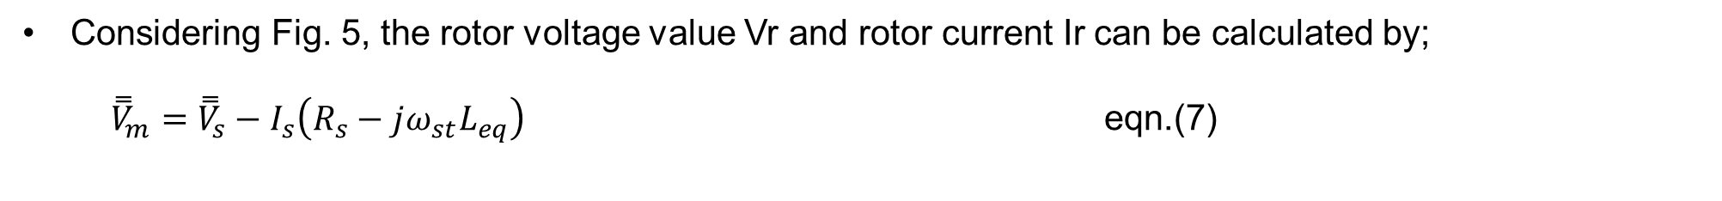
M-DFIG Cont.….
Considering Fig. 5, the rotor voltage value Vr and rotor current Ir can be calculated by;
${\overset{̿}{V}}_{m}={\overset{̿}{V}}_{s}−I_{s}\left(R_{s}−{jω_{st}L}_{eq}\right)$ eqn.(7)
Where the voltage and current of the stator are given by:
${\overset{̿}{V}}_{s}=v_{s}<0^{0 }and {\overset{̿}{I}}_{s}=I_{s}<{180}^{0}$ eqn.(8)
The DFIG is in generating mode and the stator power factor is unity since the stator voltage and current are 180 degrees out of phase.
The current that magnetizes can be calculated as;
${\overset{̿}{ I}}_{m}=\frac{{\overset{̿}{V}}_{m}}{{jω_{m}L}_{m}}$ eqn.(9)
The rotor current is
${\overset{̿}{I}}_{r}={\overset{̿}{I}}_{s}−{\overset{̿}{I}}_{m}$ eqn.(10)

Slide 23
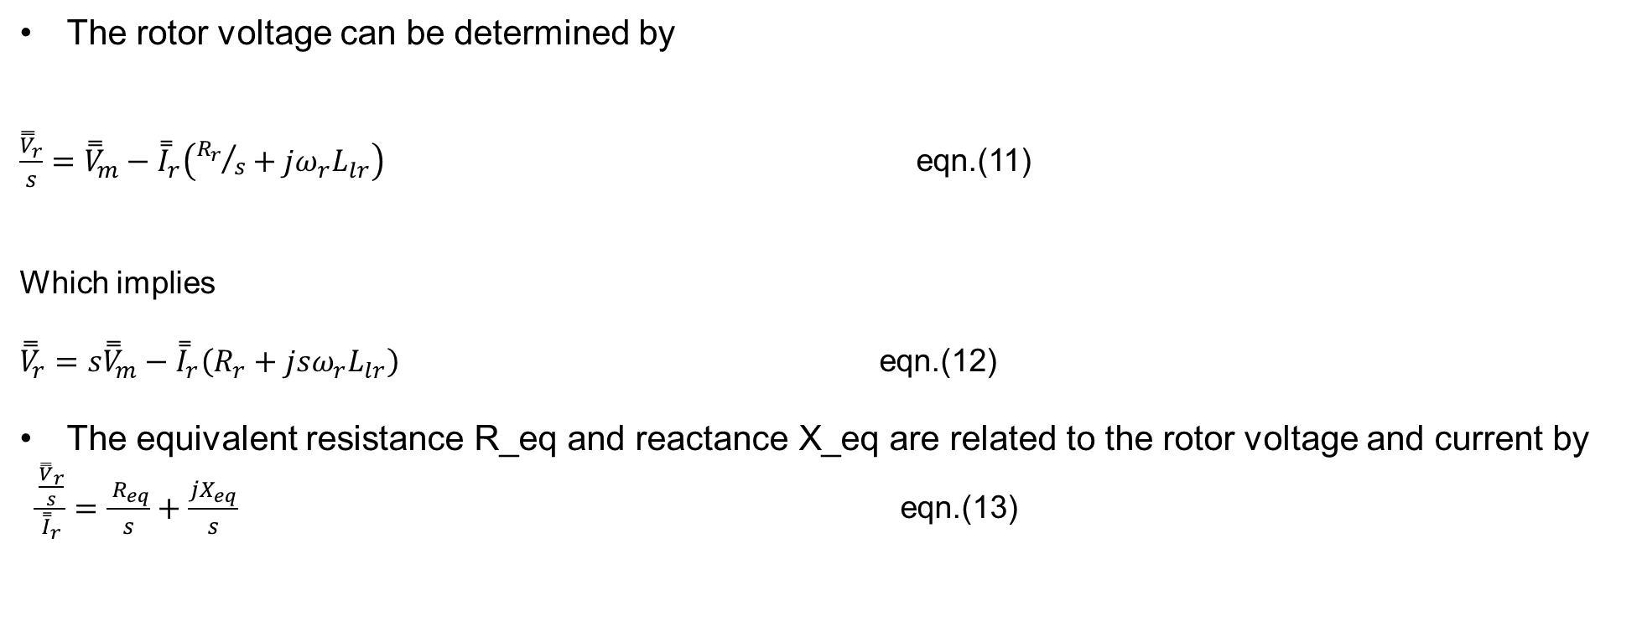
M-DFIG Cont.….
The rotor voltage can be determined by
$\frac{{\overset{̿}{V}}_{r}}{s}={\overset{̿}{V}}_{m}−{\overset{̿}{I}}_{r}\left({R_{r}}/s+{jω_{r}L}_{lr}\right)$ eqn.(11)
Which implies
${\overset{̿}{V}}_{r}=s{\overset{̿}{V}}_{m}−{\overset{̿}{I}}_{r}\left(R_{r}+{jsω_{r}L}_{lr}\right)$ eqn.(12)
The equivalent resistance R_eq and reactance X_eq are related to the rotor voltage and current by
$\frac{\frac{{\overset{̿}{V}}_{r}}{s}}{{\overset{̿}{I}}_{r}}=\frac{ R_{eq}}{s}+\frac{jX_{eq}}{s}$ eqn.(13)

Slide 24
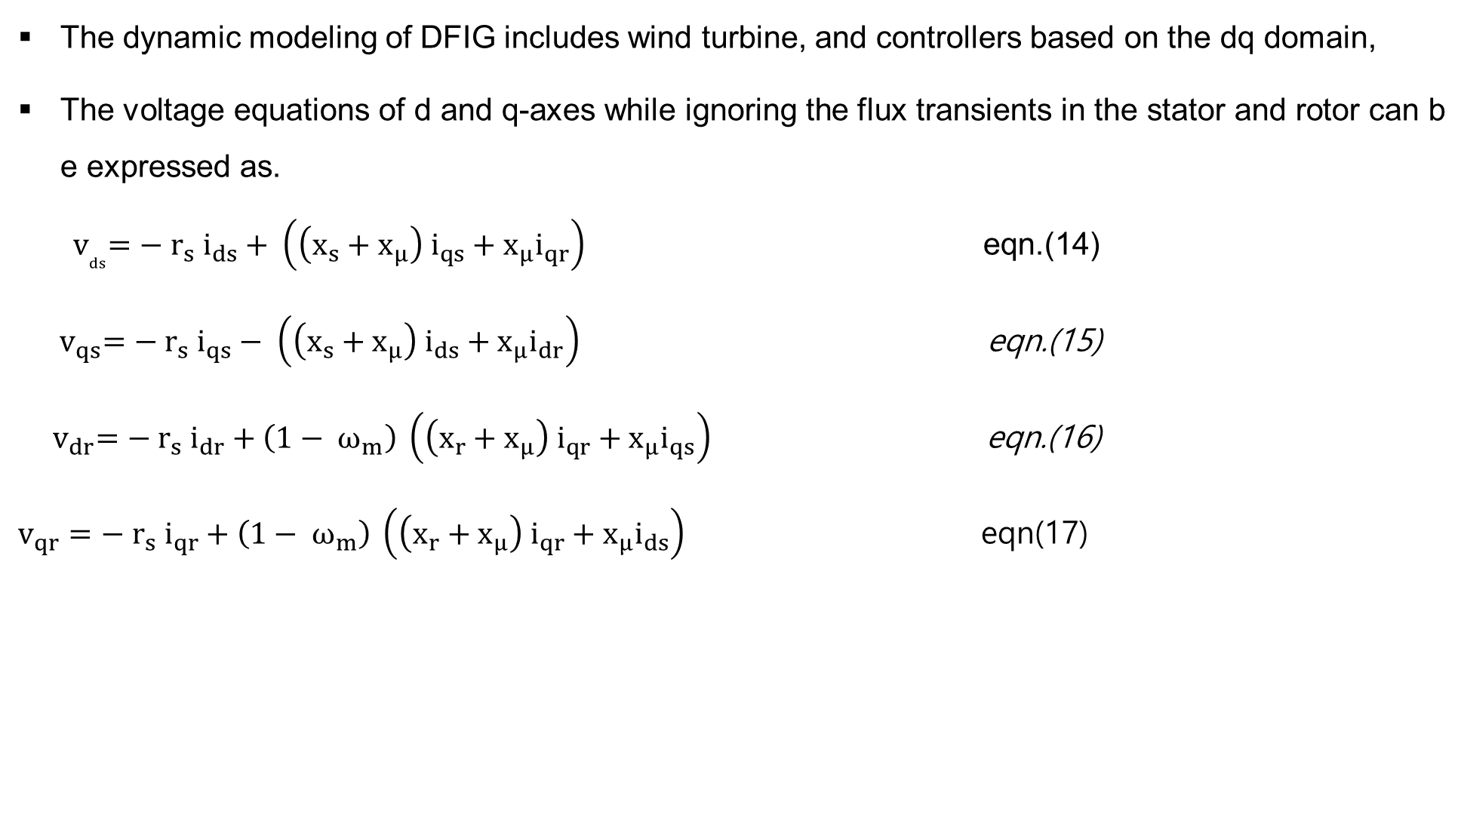
b. Dynamic Modeling of DFIG
M-DFIG Cont.….
The dynamic modeling of DFIG includes wind turbine, and controllers based on the dq domain,
The voltage equations of d and q-axes while ignoring the flux transients in the stator and rotor can be expressed as.
${ v}_{ds}=− r_{s} i_{ds}+ \left(\left(x_{s}+x_{μ}\right) i_{qs}+x_{μ}i_{qr}\right)$ eqn.(14)
${ v}_{qs}=− r_{s} i_{qs}− \left(\left(x_{s}+x_{μ}\right) i_{ds}+x_{μ}i_{dr}\right)$ eqn.(15)
${ v}_{dr}=− r_{s} i_{dr}+\left(1− ω_{m}\right) \left(\left(x_{r}+x_{μ}\right) i_{qr}+x_{μ}i_{qs}\right)$ eqn.(16)
$v_{qr}=− r_{s} i_{qr}+\left(1− ω_{m}\right) \left(\left(x_{r}+x_{μ}\right) i_{qr}+x_{μ}i_{ds}\right)$ eqn(17)

Slide 25

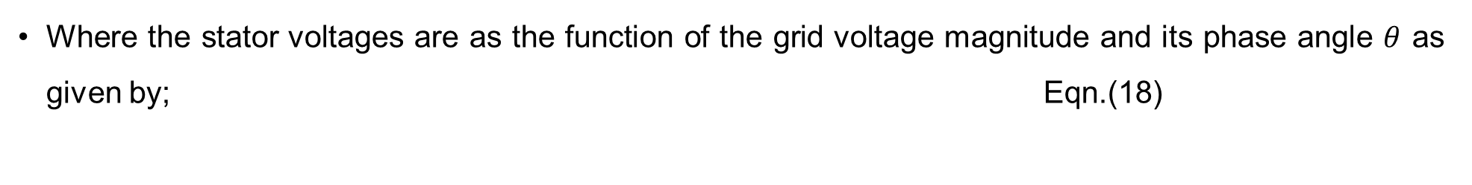

M-DFIG Cont.….
Where the stator voltages are as the function of the grid voltage magnitude and its phase angle $θ$ as given by; Eqn.(18)
$${ v}_{ds}= −v\sin{θ}$$
$${ v}_{qs}= v\cos{θ }$$
Then, the active and reactive powers that generated by DFIG that depends on the stator and converter current is given as;
Eqn.(19)
$$p=v_{ds}i_{ds}+v_{qs}i_{qs}+v_{dc}i_{dc}+v_{qc}i_{qc }$$
$$q=v_{qs}i_{ds}−v_{ds}i_{qs}+v_{dc}i_{dc}−v_{qc}i_{qc}$$
Where, $i_{dc}$,$i_{qc}$ are the grid side converter d and q-axis currents

Slide 26




M-DFIG Cont.…
Input power to the grid is expressed as a function of rotor and stator current, which are provided by:
Eqn.(20)
$${ p}_{c}= v_{dc}i_{dc}+v_{qc}i_{qc}$$
$${ q}_{c}= v_{qc}i_{dc}−v_{dc}i_{qc}$$
Whereas, on the rotor side: Eqn.(21)
$${ p}_{r}= v_{dr}i_{dr}+v_{qr}i_{qr}$$
$${ q}_{r}= v_{qr}i_{dr}−v_{dr}i_{qr}$$

Slide 27




M-DFIG Cont.…
If the converter is a loss-less model, then pc = pr, since the converter's active power and the rotor's active power match.
If stator resistance is ignored and the d-axis aligns with the stator flux maximum, one can approximate the reactive power injected into the grid. Next, the grid's injected real and reactive powers are listed as;
$$p=v_{ds}i_{ds}+v_{qs}i_{qs}+v_{dr}i_{dr}+v_{qr}i_{qr}$$
$q= −\frac{x_{μ}vi_{dr}}{x_{s}+x_{μ}}−\frac{v^{2}}{x_{μ}}$
Eqn.(22
The generator motion equation is represented as a single shaft under the assumption that the converter controls can filter shaft dynamics.
For the same reason, this model does not account for the tower shadow effect. Hence, the rotor speed changed to [7]: Eqn.(23)
$$ω_{m}={\left(T_{m}−T_{e}\right)}/{2H_{m}}$$
$${ T}_{e}=ψ_{ds}i_{qs}− ψ_{qs}i_{ds}$$
Where, $ω_{m}$is the rotor speed, $T_{m}$ is mechanical torque, $T_{e}$is the electrical torque and $H_{m}$ is the rotor inertia

Slide 28


M-DFIG Cont..
The generator motion equation is represented as a single shaft under the assumption that the converter controls can filter shaft dynamics.
For the same reason, this model does not account for the tower shadow effect. Hence, the rotor speed changed to [3]: Eqn.(24)
$$ω_{m}={\left(T_{m}−T_{e}\right)}/{2H_{m}}$$
$${ T}_{e}=ψ_{ds}i_{qs}− ψ_{qs}i_{ds}$$
Where, $ω_{m}$is the rotor speed, $T_{m}$ is mechanical torque, $T_{e}$is the electrical torque and $H_{m}$ is the rotor inertia

Slide 29
5. Grid connected Permanent Magnet Synchronous Generator(PMSG)
Normally, the wind turbines run at low speeds, 25-50rpm.
A speed- increasing gear box is required to run induction machines, DFIG and conventional Synchronous machines either to 1500 rpm or 1800 rpm as per the grid frequency for operation with the utility network.
This leads to additional cost, weight, power loss, regular maintenance, and noise generation with the gear box that required to increase the speed.

Slide 30
PMSG Cont.…
There are two ways to avoid having to use the gear box.
A power electronic converter, also known as an inverter or converter, must be utilized if a standard generator with, say, four poles is to be used.
This converter must first convert the low frequency AC from the generator to DC (i.e., 1 Hz with P = 4 and Ns = 30 rpm), and then it must convert the DC to 50 Hz AC.
If not, a synchronous generator needs to have more poles, 240 to produce 50 Hz of electrical output that can be linked directly to the utility grid at an input synchronous speed of 25 rpm.

Slide 31
PMSG Cont.…
A wide diameter generator is necessary due to the fact that synchronous machines cannot be constructed with pole pitches smaller than 150 mm because of the enormous number of poles.
Due to the extremely huge and heavy weight and size that will result, it is not realistically possible to fit in the Nacelle.
Therefore, external stimulation is not necessary with PMSGs, or low-speed, direct-coupled generators.
As a result, during variable-speed operation, the output voltage fluctuates in both frequency and magnitude.
The dc-link voltage fluctuates uncontrollably as a result.
As a result, the control is implemented on the grid side using a dc/ac converter, or inverter, as seen in Fig. 6.

Slide 32
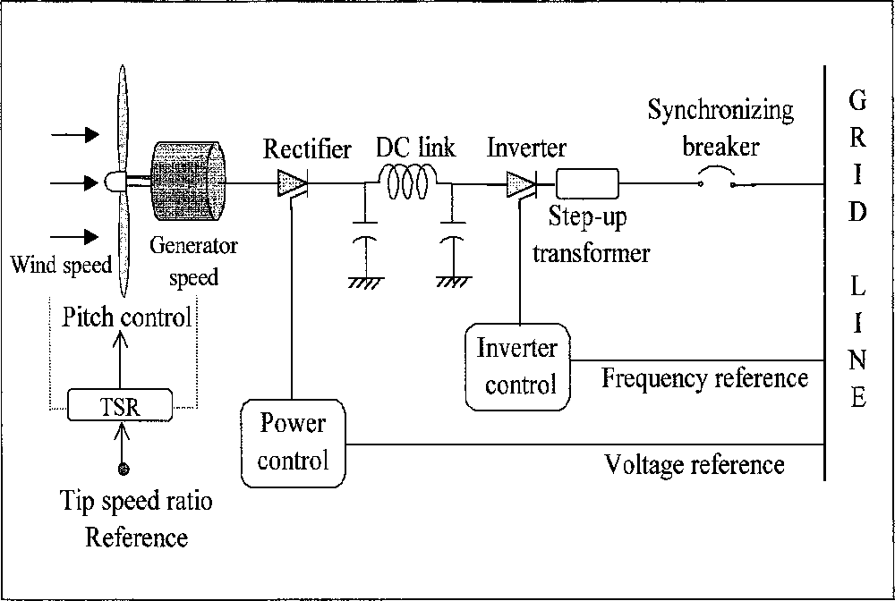
PMSG Cont.…
Figure - 6: Operation of grid connected Permanent Magnet generator[8]. url: https://ebrary.net/197885/engineering/grid_connected_systems

Slide 33
PMSG Cont.…
The fundamental requirements on the site voltage for interfacing with the grid are as follows:
The voltage magnitude and phase must equal
The voltage is controlled by the transformer turn ratio and/or the rectifier/ inverter firing angle in a closed- loop control system.
The frequency must be exactly equal to that of the grid, or else the system will not work.
To meet the exacting frequency requirement, the only effective means is to use the utility frequency as a reference for the inverter switching frequency.
In the wind system, the synchronous generators of the grid system supply magnetizing current to the Induction Generator.

Slide 34
PMSG Cont.…
The synchronizing switch is needed for synchronization with Grid
The synchronizing breaker has internal voltage and phase angle sensors to monitor the site and grid voltages and signal the correct instant for closing the breaker. As a part of the automatic protection circuit, any attempt to close the breaker at an incorrect instant is rejected by the breaker.
Four conditions which must be satisfied before the synchronizing switch will permit the closure are as follows:
The frequency must be as close as possible with the grid frequency.
The terminal voltage magnitude must match with that of the grid, preferably a few percent higher.
The phase sequence of both the three-phase voltages must be same.
The phase angle between the two voltages must be within 5 degrees.

Slide 35
6. Grid Code Requirements (GCRs)
Grid code for interconnection is a guidelines that specifies properties that generators and other equipment should satisfy in order to connect to the grid.
The goal of the grid code is to ensure reliable and safe operation of the grid as well as the turbine
What makes unique about integrating wind energy to grid?
Variability of wind
Uncertainty
Geographic diversity, size and distance from the grid
Standardized Power Purchase Agreement with Guaranteed Interconnection and Priority Dispatch
Wind Turbine Generators type

Slide 36
GCRs Cont.…
Grid integration of wind energy is simply a collection of all activities related to connecting WPPs to the grid. It has three stages[9]:
Planning
Physical connection
System operations
Activities prior to Integration:
Power flow
short-circuit
system stability studies
During integration:
Connecting lines from WPP to substation
Connection at substation
After integration:
Unit commitment
Economic load dispatch
Wind energy forecasting

Slide 37
GCRs Cont.….
The majority of grid-connected wind turbine systems are sizable power plants intended for utility use.
Figure 5 depicts a typical electrical system layout for these types of plants. Typical technical characteristics of a wind farm or power plant of this type include:
Through the use of a transformer, the wind generator's output—which is normally 440/690 volts AC—is boosted to grid voltage.
Next, two substations are connected by an overhead transmission line.
The actual numbers within a wind farm are contingent upon various factors such as the overall number of wind turbines, their aggregate power output, and site-specific variations.
In order to integrate energy supplies and meet demand, the grid code must provide continuous and dependable operations

Slide 38
GCRs Cont.….
Thus, grid codes are needed in order to maintain the following things:
Frequency and voltage tolerance
Fault ride through
Reactive power and voltage control capability
Operating margin and frequency regulation
Power ramping
Power system stabilizer
Wind farm control

Slide 39
GCRs Cont.….
a. Frequency and Voltage operating range
The behavior of power network, in terms of frequency and voltage, due to its dynamic nature is continuously changing.
Since, the changes occur in very small quantities, it is required that users of the transmission system are able to continue operating in a normal manner over a specified range of frequency and voltage conditions.

Slide 40
GCRs Cont.….
For 50Hz system, this would be in the range of 49 to 51Hz.
With respect to voltage, this range could be +/-10% of the nominal voltage.
However, at times the ranges could be wider, although it would normally be expected that the user would continue operating under an extreme condition for a defined period of time.
For example, 47 Hz for 15 seconds or 20% of the nominal voltage for 1 hour.
Beyond these extremes, the user would normally be required to disconnect from the system.

Slide 41
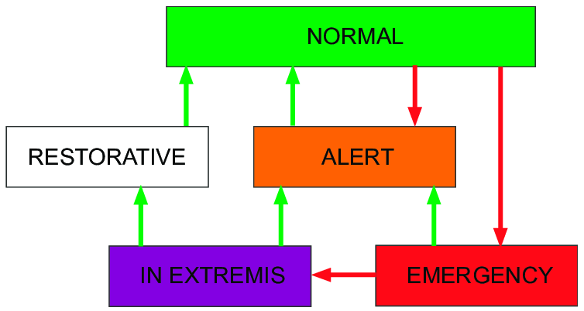
GCRs Cont.….
Normally, there are five operating regions of power networks as is presented in Fig.7.
Figure 7. Classification of power system operating states[10]. url: https://www.researchgate.net/publication/349249145

Slide 42
GCRs Cont.….
In the normal state, a power system satisfies the power demand of all the customers, all the quantities important for power system operation values are within their technical constraints, and the system is able to withstand any credible contingencies.
The alert state arises when some quantities that are important for power system operation: frequency, line currents or voltages exceed their technical constraints due to an unexpected rise in demand or a severe contingency, but the power system is still intact and supplies its customers.
In that state a further increase in demand or another contingency may threaten power system operation and preventive actions must be undertaken to restore the system to its normal state.

Slide 43
GCRs Cont.….
In the emergency state the power system is still intact and supplies its customers, but the violation of constraints is more severe.
The emergency state usually follows the alert state when preventive actions have not been undertaken or have not been successful.
A power system may assume the emergency state directly from the normal state following unusually severe contingencies like multiple faults.
When a system is in the emergency state, it is necessary to undertake effective corrective actions leading first to the alert state and then to the normal state.

Slide 44
GCRs Cont.….
A power system can transpose to the in extremis state from the emergency state if no corrective actions have been undertaken.
In this case, the system is no longer intact due to a reduction of power supply following load shedding or when generators are tripped because of a lack of synchronisms.
The extreme variant of that state is a partial or complete blackout.
To return a power system from an in extremis state to an alert or normal state, a restorative state is necessary in which power system operators perform control actions in order to reconnect all the facilities and restore all system loads.

Slide 45
GCRs Cont.….
b. Reactive Power and Voltage Control Capability
For reduced losses and maintain high levels of efficiency, it is preferable that voltage and current of the network should operate in phase, unity power factor
But, in practice this will not happen due to the network characteristics
Reactive power control: the wind turbine is required to produce or absorb a constant specific amount of reactive power.
Automatic voltage control: the voltage in the wind turbine point of common coupling (PCC) is controlled
This implies that the wind farm can be ordered to produce or absorb an amount of reactive power.
The range, for example, could be from 0.95 leading to 0.95 lagging.

Slide 46
Summary
In conclusion, the general, modeling and controlling of grid connected WECs is well discussed in this lecture.
  The detailed schemes with both Squirrel Cage and Wound Rotor Induction Machines, whose stator windings are directly connected to the grid have been presented and explained.
  The near-synchronous-speed squirrel cage induction generator, driven by a wind turbine via a gear box, prevails dominantly (more than 80%) over the other types of generators in the wind power market.
  It’s observed that the operation and control of fixed and variable speed WECs;S are different

Slide 47
Summary Cont.…
it is possible to control the frequency and speeds of VSWT in wide range, whereas the speed and frequency of FSWT is fixed with respect to grid frequency.
In addition, the VSWT are better in terms of power, speed and torque controls compared to FSWT
This lecture also comprises the brief information of Grid codes, for better reliability and operation of both grids , WTS within the acceptable limits.

Slide 48
Project assignment 1:
Model the existing power network of your countries or standard system using any standard power system modeling and operation software's. Then:
a. Observe the behavior of entire network with and without the wind power integration.
B. Apply, either three phase or SLG fault at PCC of wind farm and observe the effect on entire network stability.
c. Develop the fault ride through capability of the system using FACTS system designing

Slide 49
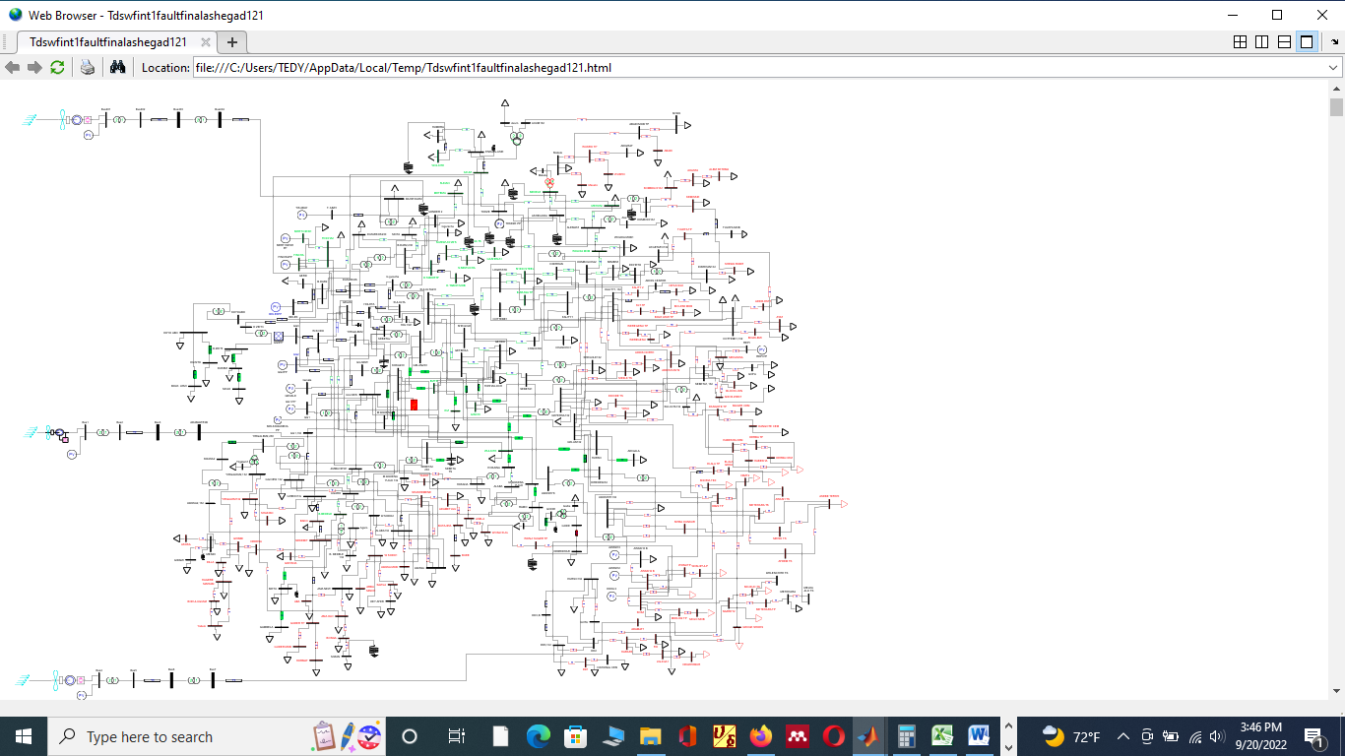
Solution: In case of Ethiopian network:
a.. Network model is given as:

Slide 50
Cont.…
b. Then, the steady state network voltage is observed as:

Slide 51
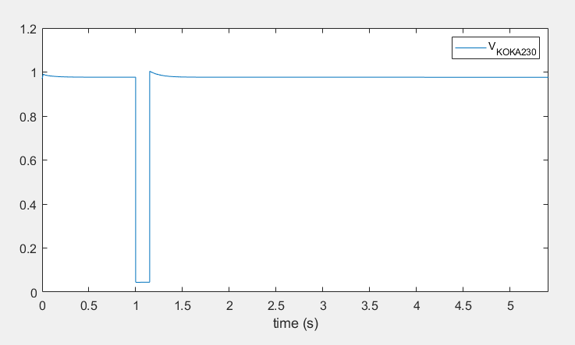
c. The network voltage during three phase fault is observed as;
The fault is applied for a time steps of 0.05, until a pre-defined stopping time, 20 second is reached
The voltage at -point of common connection for PCC is reduced to 0.0445 p.u during three phase fault applied as observed in figure below.
The p.u. bus voltage values at PCC of Adama-II wind power during fault scenario

Slide 52
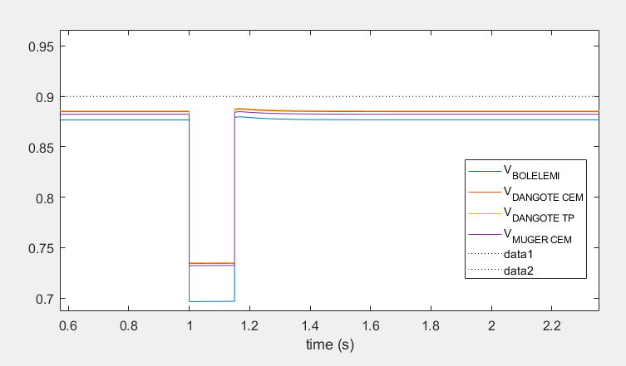
The p.u. bus voltage reduction in nearby buses,
It shows that the p.u voltages are below 0.95 p.u voltage
Voltages are reduced up to a 0.696 p.u. during faults and returns to original state after fault clearance.

Slide 53
References
[1]. L., Wang; Y., Ya-Feng and , S. Kuo. ‘’Analysis of grid-connected induction generators under three-phase balanced conditions’’. IEEE Power Engineering Society Winter Meeting. Conference Proceedings . V.(1), DOI:10.1109/PESW.2002.985033
[2].G., Isyaku and A., Garba Abdullah. ‘’Review of wind power and its impacts on a distribution system’’. International Journal of Engineering, Science and Mathematics, 2015.
[3]. Ch., Satish . ‘’Performance Analysis of Doubly-fed Induction Generator in Wind Energy Conversion System’’. National Institute of Technology Rourkela. 2011. https://www.researchgate.net/publication/277860225.
[4]. G., Marcelo and G., Juan. ‘’Technical and Regulatory Exigencies for Grid Connection of Wind Generation’’. 2011. DOI: 10.5772/16474
[5]. J. Tian; D., Zhou; , C. Su and etl. ‘’Reactive Power Dispatch Method in Wind Farms to Improve the Lifetime of Power Converter Considering Wake Effect’’. EEE Transactions on Sustainable Energy, 2016. DOI: 10.1109/TSTE.2016.2607146
[6]. B., Kouro. Power-Conversion-and-Control-of-Wind-Energy-Systems. New jersey: A John Wiley and Sons; Inc., 2011.

Slide 54
References Cont.….
[7]. J. G. Slootweg, H. Polinder, and W. L. Kling, “Dynamic modelling of a wind turbine with doubly fed induction generator,” Proc. IEEE Power Eng. Soc. Transm. Distrib. Conf., vol. 1, no. 644–649, 2001, doi: 10.1109/pess.2001.970114
[8]. system. ‘’’Wind and Solar Power Systems: Design, Analysis, and Operation. https://ebrary.net/197885/engineering/grid_connected_systems
[9]. J., Pramod and W., Priyantha. ‘’ ADB Sustainable Development Working Paper Series No. 43: Grid Integration of Wind Power: Best Practices for Emerging Wind Markets’’. Asian Development Bank. 2016.
[10].B., Hrvoje; F.,Dubravko and V., Sasa Vlahinic. ‘’Enhanced Contingency Analysis—A Power System Operator Tool’’. MDPI:energies, 2021. https://doi.org/10.3390/en14040923

Slide 55
Thank you !

