Slide 1
Renewable Energy and Distributed Generations
Lecture 8
Solar Energy Conversion System
Lecturer: Teshome Goa (Assist. Prof.)
Lecture learning outcomes:
At the end of this lecture, you will be able to:
Understand the solar energy conversion system(WECs)
Identify the potential of solar power per country
Identify the classification of solar energy conversion systems and their principles
Know the challenges and limitation of SECs

Slide 2
Content
Introduction
Solar energy Resources Per country
Motivation behind why we need SECs
Types of Solar energy conversion Principles
Global scenario of Solar PV Generations
Challenges and limitation of Solar PV system
Summary
References

Slide 3
1. Introduction
The word Solar Energy Conversion System (SECS) refers to a device that transforms solar energy into work that is valued by society.
The useful energy could be either thermal or electrical, known as solar energy conversion systems or PVs.
The sun provides majority of energy used by the Earth.
This energy system can be used as an environmental or ecosystems technology.
which would allow it to constructively interact with natural patterns.

Slide 4
Introduction Cont.…
The process requires engineers and designers to incorporate all the components necessary for a conversion system to operate correctly.
At the Earth's surface, not all of the sunlight that reaches the top of the atmosphere gets transformed into energy.
Thus, new scientific method of harvesting solar energy should be needed
The policy makers, industries and RD institute contribution should be needed
About half of the incoming solar energy reaches Earth as presented in Fig.1.

Slide 5
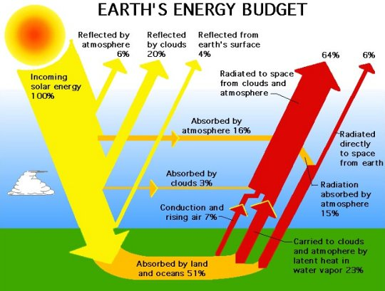
Introduction Cont.…
Figure 1: Solar energy reaching the earth in per unit area(W/m²)[1].
Url: https://www.quora.com/What-are-some-factors-that-affect-the-amount-of-solar-energy-that-reaches-the-Earths-surface

Slide 6
2. Solar Energy Resources Per country (SERPC)
Everywhere on Earth experiences sunshine for a minimum of part of the year.
Accordingly, the surface of the Earth experiences different levels of solar radiation as presented in Fig.2 based on the following factors:
Geographic location
Time of the day
Seasonality
Local landscape
Local weather

Slide 7
SERPC Cont.….
The sun strikes the surface of the spherical Earth at varying angles, from 0° (just above the horizon) to 90° (straight overhead).
The Earth's surface receives most energy when the sun's beams are directed vertically
Accordingly, some of the area has less potential, whereas the other area may have good Solar energy potentials
This necessitates developing, strategies to enhance power harvestings

Slide 8
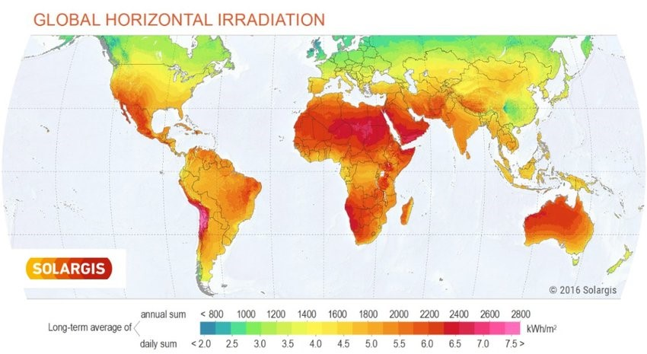
Figure 2. Global distribution of solar radiations[2]. https://www.researchgate.net/figure/Global-irradiance-distribution-source-wwwsolargiscom_fig2_322690355

Slide 9
3. Motivation behind why we need SECs
It’s clean, emission free and stable
Environmental friendly and reduce the cost of traditional energy resources importing's
Naturally gifted and highly feasible
Reduction in the cost of solar systems, its transportation and installation from year to year
Longer life span
Scalable and modular
Grid integration concerns

Slide 10
Motivation Cont.…
Environmentally friendly - It has zero raw fuel costs, unlimited supply and no environmental issues such as transport, storage, or pollution.
No solar energy resource importing and exporting cost
Reliability - With no fuel supply required and no moving parts, solar power systems are among the most reliable electric power generators
Wide application area that capable of powering the most sensitive applications, from space satellites to microwave stations in the mountains and other remote harsh environments.
Long life span(time), 20-25 years or more.

Slide 11
Motivation Cont.…
Scalable and modular- Solar power products can be deployed in many sizes and
configurations
Can be installed on a building roof or lands of field, satellite system, wind power, EV and others providing wide power-handling capabilities, from microwatts to megawatts.
Low Maintenance Cost – For most power plants, it is expensive to transport materials and personnel to remote area’s as for equipment maintenance
However, the solar power require only reduced cost for the periodic inspection and occasional maintenance
Cost advantages - Solar power systems lower your utility bills and protect you from utility rate hikes and price volatility due to fluctuating energy prices.
The overall, solar systems installation, maintenance and other per year is given in Fig. 3&4.

Slide 12
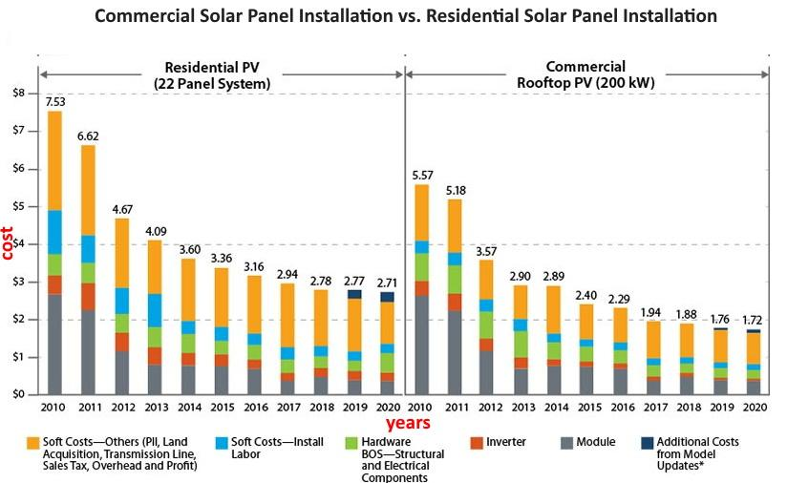
Motivation Cont.…
Figure 3 Solar systems cost per parts per year[3]. https://sgp.fas.org/crs/misc/R46196.pdf

Slide 13
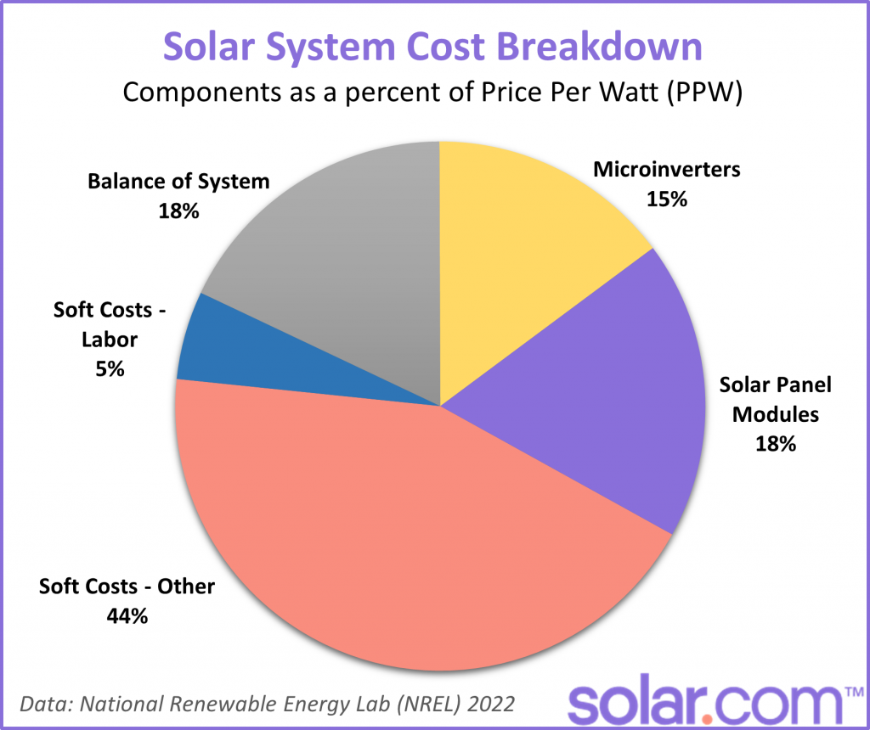
Motivation Cont.…
Figure 4. The percentage price breakdown share of solar systems per component's /watt[4]. url: https://www.nrel.gov/docs/fy22osti/83586.pdf.

Slide 14
4. Types of Solar Energy Conversion Principles (TSECP)
There are two basic types Solar energy Conversion systems (SECs): Solar thermal and solar photovoltaic (PV).
Solar Thermal energy conversion: utilizes the solar thermal technology, heat is captured from the sun.
Concentrated solar energy uses this heat directly or converts it into electricity.
Low-temperature solar thermal energy uses this heat directly, while concentrated solar power (CSP) transforms it into mechanical energy and then into electricity.
The application of solar thermal technology are: drying, distillation and desalination, air conditioning, hot water, industrial process heat, space heating, and electrical power as presented in Fig.5.
Photovoltaic solar technology: uses semiconductor-cell-based panels to directly convert sunlight into power.

Slide 15
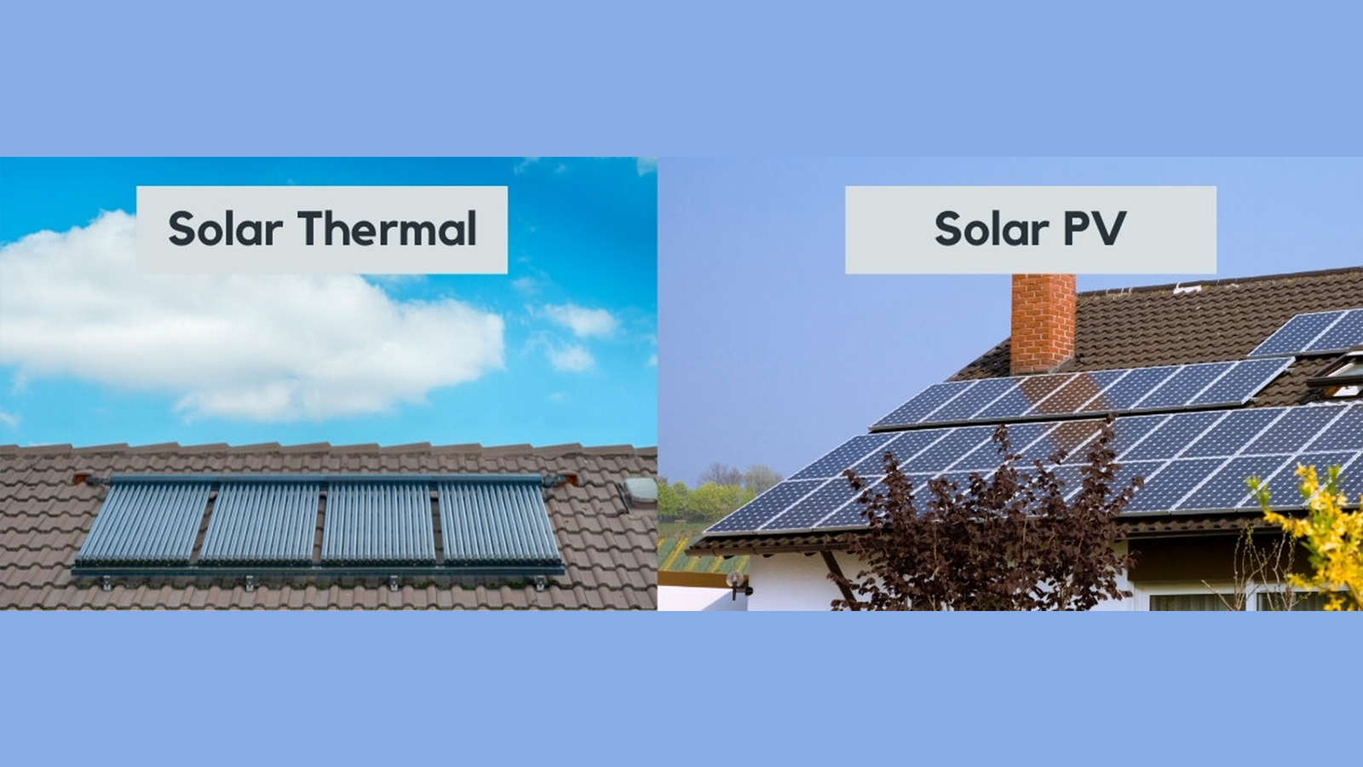
TSECP Cont.….
Figure 5. The application of solar Thermal and solar PV.
url: https://www.maysunsolar.com/blog-what-is-the-difference-between-solar-thermal-and-solar-pv-photovoltaic/

Slide 16
TSECP Cont.…..
4.1 The Difference Between Solar Thermal and Solar PV
Through the conversion of solar energy into high-temperature heat, concentrated solar thermal systems produce electricity.
This specific technology works by using several reflectors to focus solar energy, which is then used to power heat engines and electrical generators.
The two sections of the system's plant are responsible for collecting solar energy and converting it into heat and electricity, respectively.
Since concentrated solar thermal systems produce the alternating current indirectly, it may be distributed throughout the grid with ease.

Slide 17
TSECP Cont.…
In contrast, solar PV system are completely different
It directly converts the light into energy when solar PV cells absorb light, causing electrons to become free.
The current generated by the flow of free electrons is captured and transferred to the conductor and creates the direct current.
Once the DC power is generated, it is usually converted to AC using an inverter to distribute it throughout the grid.
In most cases, Solar thermal captures heat while panels generate electricity.

Slide 18
TSECP Cont.…..
4.2 Application of solar PV and Solar thermal systems
The application of solar thermal systems
Water heating: one of the common traditional application by directly converting solar light into heat(could be high or low based on application)
Concentrating solar power plants: the thermal energy with temperatures up to 500 °C is produced using solar radiation.
Then, electricity is generated by utilizing the heat stored in the working fluid of the receiver.
This approach has no very complex technical issues , but low service life and impossible to provide a long-term power supply.
Solar chimneys

Slide 19
TSECP Cont.…
b. Application of solar PV
Rooftop photovoltaic power generation
For agriculture application
EV applications
Off-grid and grid connected Mega power generations
Modern and global carbon emission reduction
For sustainable development goals
Others

Slide 20
4.3 Comparison of The Solar Thermal and Solar PV Energy conversion
Both use solar energy, solar PV and solar thermal energy serve distinct functions.
Solar radiation is immediately converted into electrical power by photovoltaic (PV) systems, whilst thermal systems provide thermal energy for home heating appliances like space heaters and water heating
The factor that separates them is how they use sunlight to generate energy.
When solar energy is captured by photovoltaic panels and transformed into DC electricity, PV systems produce electricity.
Thermal panels, which transport the sun's thermal energy to a heat-transfer fluid, are how thermal systems collect solar heat.

Slide 21
Comparison Cont.….
Based on their work principle
a. Solar Thermal[5]
A few distinct types of thermal systems exist, depending on the intended use.
A heat-transfer fluid (air or water) gathers solar energy in all solar thermal systems.
After that, the heated fluid is used directly to heat the area or it can generate steam to provide mechanical energy.
Flat-plate collectors are used in the majority of home systems.
The thermal panel is made up of a flat, dark surface that is enclosed in a box with thermal insulation. The panel's dark hue facilitates greater absorption of energy

Slide 22
Comparison Cont.….
Components used in Solar Thermal System
Most thermal systems share a few components, though specific systems may differ as presented in Fig.6
In a thermal system, solar thermal collectors serve as the "panels, which converts solar energy into heat and are typically mounted on a home's roof.
Heat is transferred to the other components of the system by the heat transfer fluid passing through a thermal collector.
The heat transfer fluid is dispersed throughout the system by the pump station.
A controller keeps an eye on and controls the transfer procedure.
It maintains safe and dependable functioning by controlling the other system elements.

Slide 23
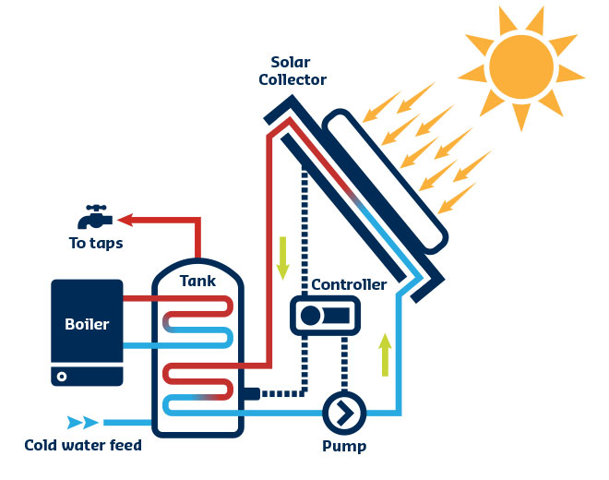
Comparison Cont.….
Then, a hot water tank is integrated into the design if the thermal system is for heating household water
Figure 6. Solar thermal systems components. url: https://bascottrenewables.co.uk/solarThermal.html

Slide 24
Comparison Cont.….
The STs is efficient, renewable and reduces heating bills from power utility side.
However, it is applicable for limited applications (even in home), volatile and not applicable for grid applications
b. PV system working principle [6]
Materials used in photovoltaic panels are semiconductors (typically silicon).
Photons of sunlight are absorbed by the semiconductor on the surface of a photovoltaic panel.

Slide 25
Comparison Cont.….
Electrons are freed from their atomic bonds by that process.
An electric current is produced when it causes an electron flow.
Direct current (DC) is the form of electric current that is generated. To enable usage of the electricity for the majority of domestic appliances and the electrical grid, the DC power must be converted into alternating current (AC) using an inverter.
The main components of solar PV system are:

Slide 26
Comparison Cont.….
PV systems are interconnected from various components as presented in Fig.7 that work together to provide electric power based on the need of customers ,and their applications given as:
Photovoltaic Panels
Charge Controller
Solar Battery Bank
Inverter
Utility Meter
Electric Grid

Slide 27
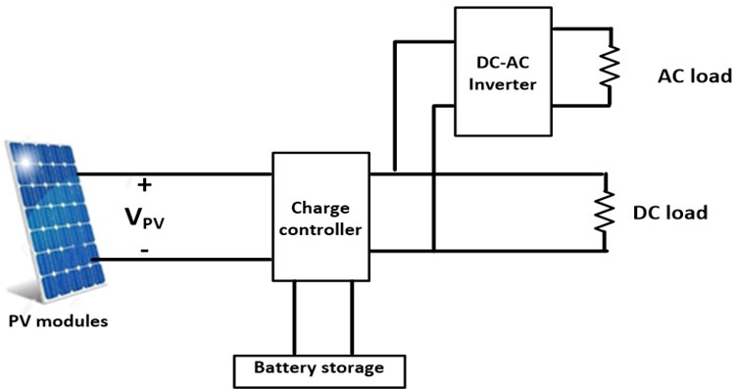
Comparison Cont.….
Figure 7. Solar systems components[7]. url: https://yjes.scholasticahq.com/article/33236?attachment_id=84676

Slide 28
Comparison Cont.….
Since off-grid systems don't use electric grids or utility meters, they simply need the first four parts.
The initial (and most crucial!) part of your system are the solar panels.
They directly interact with solar radiation, turning photons into electrical energy.
Direct current (DC) electricity is changed into alternating current (AC) electricity via an inverter.
Since most home appliances and electrical systems run on AC electricity, the inverter is essential because PV panels provide DC electricity.
String, micro, and hybrid inverters are examples of common inverter types

Slide 29
Comparison Cont.….
In a PV system, the charge controller comes next.
This device controls the flow of electricity between the batteries and photovoltaic panels. It is positioned between them.
The battery bank receives an electrical current from the charge controller, which also guards against overcharging.
Electricity is stored in a battery bank for later use.
It is useful on overcast days or in the winter when your photovoltaic array produces less power. It is also known as a solar battery.
An integral component of any grid-tied system are utility meters. These gadgets track the amount of electricity that moves between your house's solar energy system and the electrical grid.
A home's electricity production and consumption are monitored by a utility meter.

Slide 30
Comparison Cont.….
Advantage:
Whole-home power supplies
sustainable energy source that helps users become less dependent on utility providers and fossil fuels.
Reduced Electricity Bills: Photovoltaic can completely do away with or significantly lower your monthly electricity expense.
Supports the SDGs
Disadvantages
Cost Up Front: The initial outlay for a photovoltaic system may reach tens of thousands. Over the course of the system's lifetime, this expense can be easily recovered.
A solar array may not be visually pleasing to all homeowners or business owners.
Space limitations

Slide 31
5. Global Trends Solar PV Generations (GTSPG)
From 2000 G.C to 2022, there was significant growth of RE (except hydro) technology, 6.5% to 13.6%.
Thus, the solar, wind, and biomass energy, which were 1% share of energy consumption in year 2000 and grew to account for 6.8% of the total energy consumed in 2022.
Generally, coal stands as the foremost contributor, constituting 36% of the total electricity generated in 2022.
Followed by the natural gas (23%), hydropower (15%), and nuclear (9%).
Finally, wind, solar, and biomass collectively generated 4,204 TWh in 2022, constituting 7%, 5%, and 3% of the global electricity generation, respectively
Specifically, the solar PV generation is exponentially growing as presented in Fig.8

Slide 32
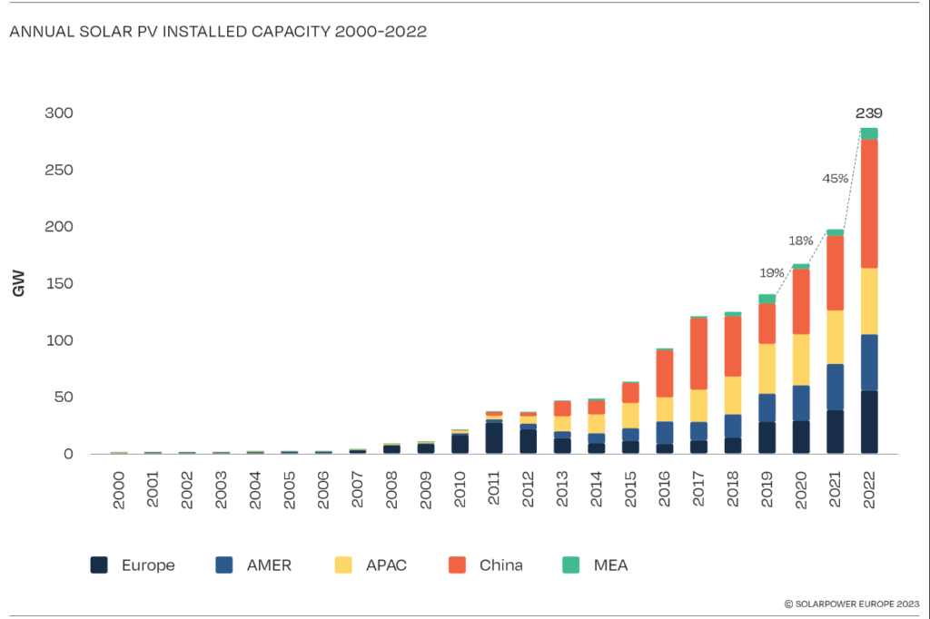
GTSPG Cont.…..
Figure 8. The global overview of solar PV system per area[8]. https://www.sustainabilityenvironment.com/2023/06/13/global-market-outlook-expected-up-to-402-gw-of-new-solar-capacity-in-2023/

Slide 33
6. Challenges and limitation of Solar PV system
The main challenges or constraints to approach PV project are
Budget constraints: Build a system within your target budget.
Space constraints: Build a system that is as space efficient as possible.
Energy offset: Build a system that offsets a certain percentage of your energy usage
Seasonality and sun light dependence
Power storage: storing excess energy can be a challenge, as it often comes at an additional cost.
Reduced Efficiency compared to other RE resources

Slide 34
Summary
In conclusion, the solar energy conversion that the solar thermal and solar PV system is presented in this lecture
It is observed that both Solar Thermal and Solar PV uses solar radiation as an input for energy conversion.
The solar thermal uses direct heat transfer or concentrator to convert energy into usable forms
Whereas, solar PV uses semiconductor material to convert the solar radiation into DC electricity
Besides this, the motivation behind using solar power is also well discussed.
It’s also presents the challenges of solar energy conversions

Slide 35
References
[1]. T. Jerry. ‘’What are some factors that affect the amount of solar energy that reaches the Earth's surface’’.
[2]. FX. Teddy. ‘’Tropical X-Y transformation design for building courtyard integrated photovoltaic’’. 2nd international Tropical Renewable Energy Conference (i-TREC) ,2017. doi :10.1088/1755-1315/105/1/012080.
[3]. J., Ashley; F., Molly; S., Manpreet and etl ‘’Solar Energy: Frequently Asked Questions’’. CRS Report: Congressional Research Service, 2023. https://sgp.fas.org/crs/misc/R46196.pdf.
[4]. D., Feldman; R., Vignesh; F., Ran and etl. ‘’U.S. Solar Photovoltaic System Cost Benchmark: Q1 2020. Golden, CO. National Renewable Energy Laboratory. NREL/TP-6A20-77324. https://www.nrel.gov/docs/fy21osti/77324.pdf
[5].K., Ravi; Ch., Krishna and N., Solar thermal energy technologies and its applications for process heating and power generation – A review. ELSEVIER: Journal of Cleaner Production. V.282(1), 2021.
[6]. A. Haque and Zaheeruddin. Research on Solar Photovoltaic (PV) energy conversion system: An overview. Third International Conference on Computational Intelligence and Information Technology (CIIT 2013), Mumbai, 2013, pp. 605-611, doi: 10.1049/cp.2013.2653.
[7]. M. Mohamed I. ‘’Grid-Connected PV System Statistics and Evaluation; Review’’. YJES, 2022. https://doi.org/10.53370/001c.33236
[8]. International solar Alliance. ‘’WORLD SOLAR MARKET REPORT 2023’’. ur[l: https://isolaralliance.org/uploads/docs/a85d84a7a402f9209262f855b273da.pdf

Slide 36
Thank you !

