Slide 1
Renewable Energy and Distributed Generations
Lecture 9
Off-Grid Solar Energy Conversion System
Lecturer: Teshome Goa (Assist. Prof.)
Lecture learning outcomes:
At the end of this lecture, you will be able to:
Define the Off-Grid solar power systems
Understand the basic components of Off-Grid PV systems
Identify the factors affecting Off-Grid PV system
Know how to size the Off-Grid PV systems

Slide 2
Outlines
Introduction
Off-Grid Solar PV systems(OG-PVs
Factors Affecting PV Module Performance
PV Array Power Calculation
Sizing Off-Grid Solar PV System (S-OG-PVs)
Summary
References

Slide 3
1. Introduction
Photovoltaic power systems are generally classified according to their functional and operational requirements, their component configurations, and how the equipment is connected to other power sources or electrical loads .
The two principal classifications of PV systems are Off-grid connected system and grid connected solar PV systems.
Off-grid/ stand alone systems systems are designed to operate independent of the utility grid, and sized to supply certain DC and AC electrical loads
Whereas, the utility- interactive PV systems are designed to operate interconnected with the electricity utility grid

Slide 4
2. Off-Grid Solar PV systems(OG-PVs)
Off grid PV system is usually installed in remote areas where utility grids are not readily available.
Off grid or stand alone system is the one that can be considered as a more common application of PV technology.
This system does not have a utility connection, long transmission lines and grid synchronization is not required.
An off-grid solar system provides an alternative to traditional energy sources, offering energy independence and sustainability.
By maximizing the sun's energy, this system presents an opportunity for eco-friendly living, even in areas where conventional power grids are unavailable

Slide 5
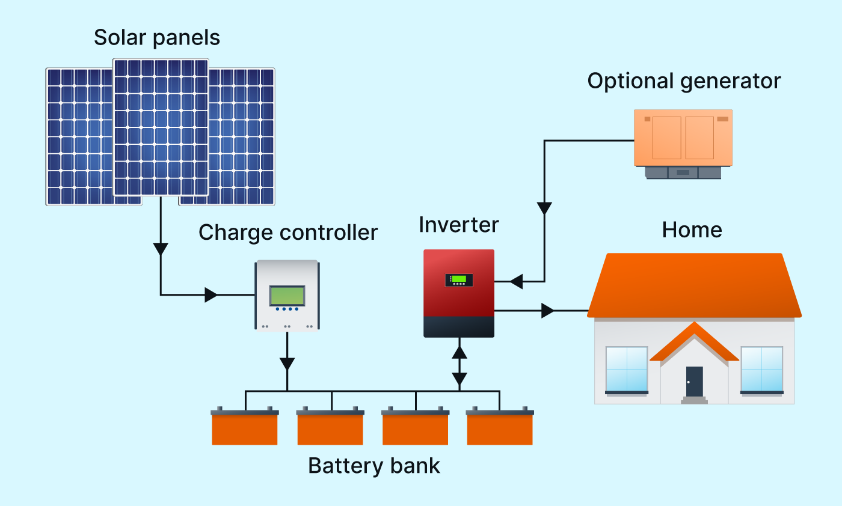
OG-PVs Cont.….
The simple block diagram of off grid system presented in Fig.1.
Figure 1. The stand alone off-grid system.
url: https://medium.com/@umangotsolar20/benefits-of-an-off-grid-solar-system-d63e3996086f

Slide 6
OG-PVs Cont.….
Fig.1 shows the configuration of a system that provides DC &AC power to the demands.
The naturally range from 100Wp to 1 kWp of solar modules (smaller or larger). For all sizes, the principles of design are the same.
It is observed that the main component of stand alone PV system is begin with the solar module as given by:
Direct current (DC) is produced by off-grid solar panels by absorbing and retaining sunlight.
Solar cells, particularly those formed of semi-conductor materials, typically include solar panels..

Slide 7
OG-PVs Cont.….
a. Solar Panel [1]
Solar panels, also known as photovoltaic (PV) panels, are gadgets that harness solar radiation to power your house.
Installing solar panels will provide you with free, low-carbon electricity. Sell the excess electricity to the grid or store it for later use.
The fundamental component of a photovoltaic system is the solar cell, which is derived from N-solar cells.
Since a typical silicon solar cell may only produce about 0.5 volts, many cells are connected in series to form larger units known as PV modules, as shown in Fig. 2.
The modules are usually enclosed in a clear cover, usually made of glass, and a waterproof backing sheet.

Slide 8
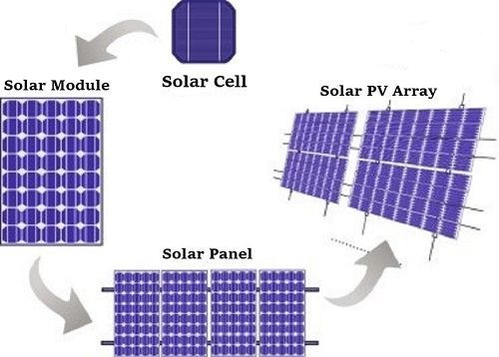
OG-PVs Cont.….
Figure 2. The solar photovoltaic (PV ) array configuration.
https://www.pinterest.jp/pin/understanding-solar-cells-and-solar-panels--895653444622833201/

Slide 9
OG-PVs Cont.….
The modules can exist in different standard sizes
Individual modules can be connected in series, parallel, or both to increase the output power.
When number of module is connected in series, it is called a PV string/Panel as presented in Fig.2.
In series connection, the negative-terminal of one module is connected to the positive terminal of the next module.
In this connections, voltage adds up and the current remain constant.
Eq.(1)
V _{Total} = V₁ + V₂+ ... + Vn
I _{Total} = I₁ = I₂ = … = I_{n}
Opposite happens when they are connected in parallel, current adds up and voltage remains constant.
V _{Total} = V₁ = V₂ = ... = V_{n} Eqn.(2)
I _{Total} = I₁ + I₂ + … +I_{n}

Slide 10
OG-PVs Cont.….
a. solar array is made up of several parallel PV strings, which is given in Fig.2.
Since a single module's power output is rarely sufficient to suit a home or business's needs, the modules are connected to form an array.
Therefore, in order to achieve the appropriate voltage, the modules in a PV array are often first connected in series.
The individual strings are then connected in parallel to enable the system to produce more current, allowing for the generation of enough power.
Because, the electrical power produced by solar arrays is usually measured in watts, kilowatts, or even megawatts.

Slide 11
OG-PVs Cont.….
PV Module Rating:
It is crucial to remember that, under standard test conditions (STC), a PV module's wattage rating is established by assuming 1000 W/m² of solar radiation at 77°F (25°C).
However, the module rating needs to be changed because of the high temperatures prevalent on rooftops or because the modules are heated by sunlight for several hours.
In the industry, the peak power rating of a solar panel is sometimes abbreviated as kWp.

Slide 12
OG-PVs Cont.….
which is the maximum power of a photovoltaic module or system under specific Standard Test Conditions (STC) and is the energy output of a system obtained under full sun radiation.
The following parameters are considered standard: a solar spectrum air mass of 1.5, a module temperature of 25°C, and 1,000 W/m2 of solar radiation..
This is commonly known as a "full sun" condition[2].

Slide 13
OG-PVs Cont.….
Accordingly, the conversion efficiency varies with the types of module and the material used.
The efficiency of each PV product is specified by the manufacturer.
The percentage of incident solar energy that is transformed to electricity is known as the PV conversion efficiency.
Researchers have created PV cells with efficiencies close to 50%, despite the fact that the majority of commercial panels have efficiencies between 17% and 20%.
Commonly used PV module efficiencies range is presented in Table 1

Slide 14
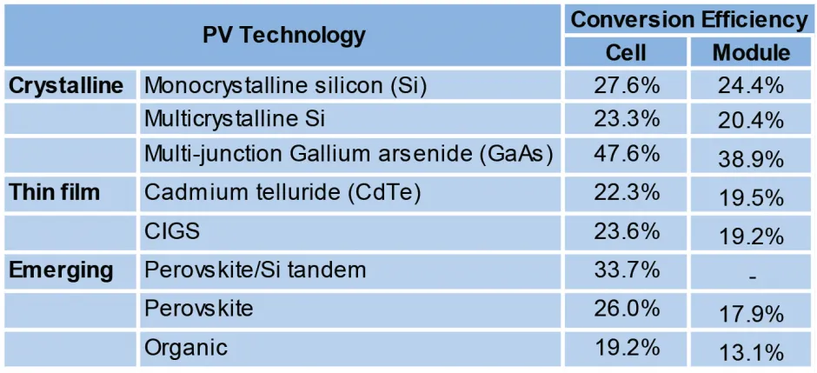
OG-PVs Cont.….
Table 1. The conversion efficiency of different PV modules[3].
URL: https://css.umich.edu/sites/default/files/2023-10/Photovoltaic%20Energy_CSS07-08.pdf

Slide 15
3. Factors Affecting PV Module Performance (FA-PV-MP)
While some of problems are specific to the module, others are more environment and location-related like;
solar radiation
Material deterioration
module temperature
parasitic resistances
fill factor, shading, soiling, PID, tilt angle, and etc

Slide 16
FA-PV-MP Cont.….
i. Change in Solar Radiations:
The performance of PV modules for varying light conditions differ significantly, which has severe impact on the yield of PV systems.
Deviations in the intensity of solar radiation falling on a PV module affect many of its performances , including I_{sc}, V_{oc}, power, FF and efficiency.
Fig.3 shows the effect of change in solar radiation in PV modules performances.
The I-V and P-V curves are developed based on the PV power harvesting equations that given in Eqn.3 and Eqn. 4.
Thus, the electricity generation Vs solar irradiances is affected by several factors.

Slide 17
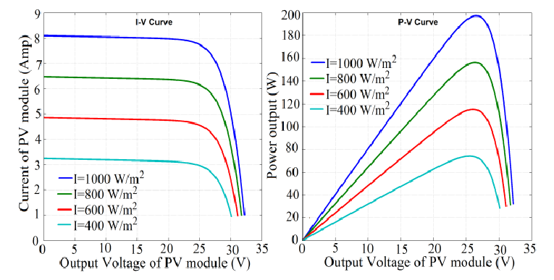
FA-PV-MP Cont.….
Figure 3. I-V-and-P-V-curve-of-200-W-at-different-Irradiance-and-constant-temperature-of-25ºC STC[4]. url: https://www.researchgate.net/publication/304039382

Slide 18
FA-PV-MP Cont.….
Factors influencing the power harvesting of solar PV when the module is exposed are:
seasonality
weather conditions
Fixed mountings vs. trackers
Location and angle of PV array

Slide 19
FA-PV-MP Cont.….
Most photovoltaic solar cells produce a “no load” open circuit voltage of about 0.5 to 0.6 volts when there is no load[3].
This output voltage, V_{out} depends on the load current ‘I’ or demands of the PV cell.
For example, on very cloudy day the current demand would be low and so the cell could provide the full output voltage, V_{out} but at a reduced output current.
But, as the current demand of the load increases a brighter light is needed at the junction to maintain a full output voltage, V_{out}.
However, there is a physical limit to the maximum current that a single photovoltaic solar cell can provide no matter how intense or bright the suns radiation is.
This is called the maximum deliverable current and is symbolized as I_{max}

Slide 20
FA-PV-MP Cont.….
The I_{max} value of a single photovoltaic solar cell depends upon:
The size or surface area of the cell, the amount of direct sunlight hitting the cell and the efficiency of converting this solar power into a current limits the current
In addition, type of semiconductor material that the cell is manufactured
Most commercially available photovoltaic solar cells have solar power ratings which indicate the maximum deliverable solar power, P_{max} is given by
Eqn.(3)

Slide 21
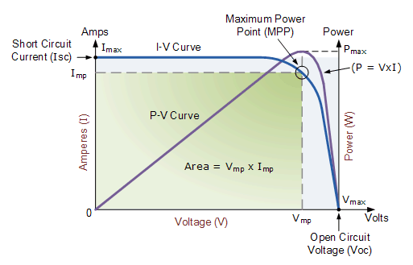
FA-PV-MP Cont.….
PV manufacturers normally provides the current-voltage (I-V) curves, which gives the current and voltage at which the photovoltaic cell generates the maximum power output
Which is based on the standard temperature, sunlight and no-shading condition as presented in Fig.4
Figure 4. The I-V curve for maximum power generations. url: https://renewableenergysuperpower.com/what-are-the-characteristics-of-renewable-energy-photovoltaic-cells/

Slide 22
FA-PV-MP Cont.….
A photovoltaic module produces maximum current when there is no resistance in the circuit.
This would be a short circuit between its positive and negative
terminals. and this maximum current is called the short circuit current (I_{sc}).
This value is higher than I_{max ,} which relates to the normal operating conditions.
Under this condition the resistance is zero and the voltage in the circuit is zero.
Then, the ideal maximum power is developed in the short circuit mode and open circuit conditions

Slide 23
FA-PV-MP Cont.….
Then, the fill factor is the ratio of the maximum power output to the ideal power, which is the product of the open-circuit voltage and the short-circuit current, (V_{oc} x I_{sc}). The relationship is:
Eqn.(4)
The fill factor gives an idea of the quality of the array.
The closer the fill factor to unity, the more power that the array can provide.
Typically, FF values are between 0.7 and 0.8

Slide 24
FA-PV-MP Cont.….
b. Temperature
PV cell performance declines at higher cell temperatures.
The operating voltage reduces with increasing the cell temperature.
In full sun the output voltage reduces by about 5% for every 25°C increase in cell temperature.
Then, it is recommended to use photovoltaic panels with more solar cells for very hot climates than the colder environment in order to reduce power losses due to this high temperatures.
The effect of temperature in power output performance of PV is given in Fig.5.

Slide 25
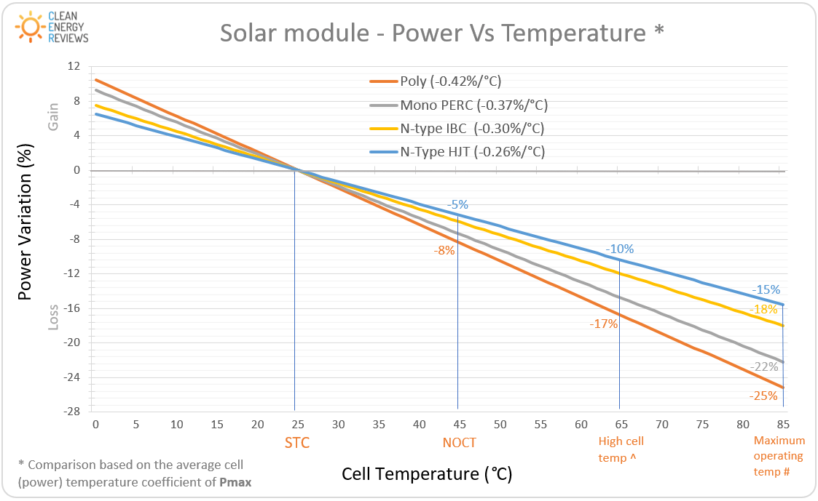
FA-PV-MP Cont.….
Figure 5. PV power vs cell temperature. url: https://homesolarsimplified.com/most-efficent-solar-panels-for-2023/

Slide 26
FA-PV-MP Cont.….
De-rating Factor: The de-rating factor is one of the other factor that affects the performances of PV output power.
It is defined as the scaling of the output power of PV to consider:
the wire losses
losses due to dust particles
increased temperature
any other thing that deviates the output power of the solar panel from the expected value.
The standard recommendation of total De-rating factor recommended up to 0.6.

Slide 27
Applicable Codes and Standards
a. NEC Article 690 – Solar Photovoltaic Systems. Article 690 addresses safety standards for
the installation of PV systems.
b. Uniform Solar Energy Code – ICC
c. Building Codes – ICC, ASCE 7-05
d. UL Standard 1703, Flat-plate Photovoltaic Modules and Panels
e. IEEE 1547, Standard for Interconnecting Distributed Resources with Electric Power
Systems
f. UL Standard 1741, Standard for Inverters, Converters, Controllers and Interconnection
System Equipment for Use with Distributed Energy Resources PV Systems and the NEC

Slide 28
FA-PV-MP Cont.….
Performance degradation over: life cycle
The performance of a PV module will decrease over time.
The degradation rate is typically higher in the first year upon initial exposure to light and stabilizes.
Factors affecting the degree of degradation include the quality of materials used in manufacture, the manufacturing process, the quality of assembly and packaging of the cells into the module, as well as maintenance levels employed at the site.
Generally, degradation of a good quality module is about 20% during the module life of 25 years @ 0.7% to 1% per year

Slide 29
4. PV array Power
PV Array Sizing : The size of the solar array required in kWp is calculated by dividing energy required in kWh/d to the mean daily solar irradiation (kWh/m².d).
This is then adjusted for efficiency including array mismatch and sub system efficiency.
Eqn.(5)
Where:
P_{SAR}= The solar array power required (kWp)
Eh= energy required (kWh/day)
I_{AVS}= Av. daily solar irradiation (kWh/m²/day)
F = array mismatch factor = 0.85 on average (a safety factor for real panel performance in hot sun and after 10-20 years) and
E = daily subsystem efficiency = 0.25 - 0.6

Slide 30
5. Sizing Off-Grid Solar PV System (S-OG-PVs)
Steps needed are:
Sizing stand-alone PV systems begins with determining the electrical load, and then sizing the battery and PV array to meet the average daily load during the critical design month
Determine the monthly average energy usage from your energy bill, month with the highest load to solar insolation ratio.
Identify the daily average energy usage, which is the monthly usage per number of days in a month.
Determine the daily average peak sun hours of your specific location, use NASA data
Calculate the overall system power (AC) to generate 100% of your consumption, use eqn. 5.
For well-designed solar system consider 86% efficiency and determine the number panels, divide step 4 by the nominal power of selected solar module

Slide 31
S-OG-PVs Cont.….
The System Sizing is given by: generally, involves a five-step which will allow the photovoltaic system designer
Estimating the Electric Load
Sizing and Specifying Batteries
Sizing and Specifying an Inverter,
Sizing and Specifying an Array and specifying Controller
Sizing of cables and wiring

Slide 32
S-OG-PVs Cont.….
Battery Sizing
The total amount of rated battery capacity required depends on the following:
The desired days of storage to meet system loads with no recharge from PV
allowable depth-of-discharge
Battery temperature its discharge rates
System losses and efficiencies
System voltage that defines the number of series-connected battery cells required.
Total capacity needed defines the number of parallel battery strings required

Slide 33
S-OG-PVs Cont.….
Factors Affecting Battery Sizing
The specified autonomy and maximum allowable depth of discharge (DOD) defines the total amount of battery capacity required for a given system load.
Greater autonomy periods increase the size of the battery and increase availability and decrease average daily depth-of- discharge.
Greater allowable DOD provides greater system availability, but at the expense of
battery health.
Rated battery capacity is affected by temperature, discharge rate and age of the battery

Slide 34
S-OG-PVs Cont.….
PV Array Sizing: It is determined using the following parameters:
should be sized to meet the average daily load, critical design month should be considered.
Solar insolation received
System losses, soiling and higher operating temperatures are factored in estimating
array output.
Types of the PV modules
The system voltage determines the number of series-connected modules required per source circuit
The system power and energy requirements determine the total number of parallel
source circuits required

Slide 35
S-OG-PVs Cont.….
Selecting an Inverter:
It is required to convert DC into AC:
Stand-alone inverters are typically voltage-specific, i.e the inverter must have the same nominal voltage as your battery
The inverter is rated in Watts.
The rating of inverter should be greater than the total watt of the
The inverter should be ideally 25-30% higher than the rated wattage of your appliances.

Slide 36
S-OG-PVs Cont.….
Sizing of Controller: it’s used to regulate your batteries bank charging based on the power from your solar panel array and prevent overcharging and reverse current flow at the night.
The Pulse width modulation (PWM) and Maximum power point tracking (MPPT) are mostly used
The controller make to control the solar irradiances and Temperature for marinating stable voltage based on the reference voltage.
Modern AI based control is also applied

Slide 37
S-OG-PVs Cont.….
Cable sizing: here, the size of wiring system is estimated as:
Wire or cable between PV modules and Batteries
wire/cable between the Battery Bank and the Inverter
Cable between the Inverter and Load are determined using Eqn.(7)
Eqn.(7)

Slide 38
Summary
In summary, the off-grid solar PV system is discussed well in the lecture.
It is observed that the off-grid system comprises solar pane, battery backups, its controller and inverter based on the requirement of demand.
The solar panel is one of fundamental component in solar PV power system
The main factors that affect PV power performances are solar irradiation and Temperature
Then, the sizing of off-grid system based on the daily energy demand, day autonomy of battery, inverter sing and cable designing is well discussed .

Slide 39
References
[1].A., Singh and R., Gupta. Accurate Analysis of Solar PV Module. 2018 International Conference on Computing, Power and Communication Technologies (GUCON), Greater Noida, India, 2018, pp. 467-471: doi: 10.1109/GUCON.2018.8674893.
[2]. Center for Sustainable Systems, University of Michigan. 2023. “Photovoltaic Energy Factsheet.” Pub. No. CSS07-08.
[3]. S., Malik and A. Swarup. ‘’Fuzzy logic based adaptive perturbation and observation MPPT for photovoltaic system’’.2015. https://www.researchgate.net/publication/304039382
[3]. H., Olfa and H., Marwa. Enhancement of a commercial PV module performance under Low Concentrated Photovoltaic (LCPV) conditions: A numerical study. Renewable Energy Focus. V.41, 2022, Pp. 258-267.
[4]. Q., Boyuan and W., Jizheng. Open-circuit voltage in organic solar cells. Journal of Materials Chemistry. V. 46, 2012.

Slide 40
Thank you !

