Slide 1
Renewable Energy and Distributed Generations
Lecture 10
Grid-Connected Solar Energy Conversion System
Lecturer: Teshome Goa (Assist. Prof.)
Lecture learning outcomes:
At the end of this lecture, you will be able to:
Understand the grid connect solar conversion system(WECs)
Know the advantage of Grid-Connected solar PV system
Understand the operating principles and basic components of Grid-connected solar PV system
Know the controlling of Grid connected solar PV system

Slide 2
Content
Introduction
Grid-connected PV system
Operation of Gird-Connected PV System
Grid-connected PV System Modeling
Summary
References

Slide 3
1. Introduction
Grid-connected PV systems are solar PV systems that are connected to the grid.
As a result, the PV system harvests solar energy, connects to the grid, and meets the needs of various household appliances.
The system supplies energy to both residential and commercial loads. The bidirectional energy meter then feeds any excess power generated back into the grid.
Fig. 1& 2 shows the basic grid-connected photovoltaic system.

Slide 4
2. Gird-Connected PV System(G-CPVs)
The utility power grid and the grid-connected system are intended to work in tandem for :
commercial
industrial, and residential purposes
Private and governmental development
It is typically used for commercial and residential applications to balance the average yearly energy expenses.
The PV system array can be installed in many locations, such as an open area or on top of a roof.

Slide 5
G-CPVs Cont.…
There are typically two types of grid-connected small, medium-scale to large systems that are used.
Systems shown in Figs. 1 and 2 that are integrated with and without batteries to the grid.
Figure 1and 2 shows the systems with energy storage and those that are connected to the utility power grid but do not have battery bucking capacity
It typically consists of:
solar panels
inverter
a charge controller
a monitoring system, and
electrical distribution panel.

Slide 6
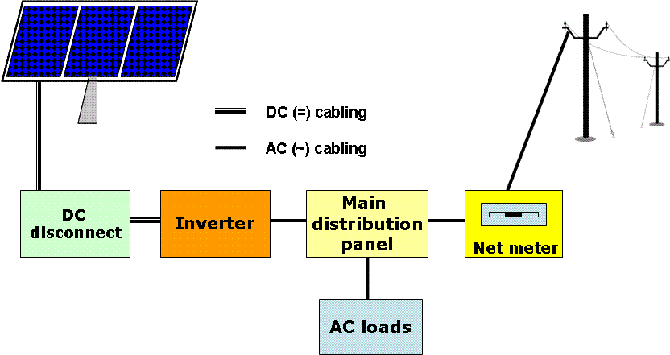
G-CPVs Cont.…
Figure 1:. Grid connected system without battery backups[1] .
https://DOI URL: http://dx.doi.org/10.21474/IJAR01/3423

Slide 7
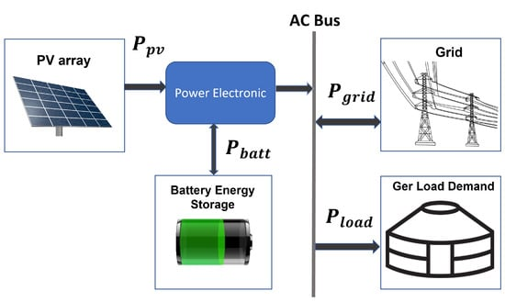
G-CPVs Cont.…
Figure 2: Grid connected system with battery backups[2].
Source: https://www.mdpi.com/1996-1073/15/5/1892

Slide 8
2.1 Advantage
G-CPVs Cont.…
A grid connected PV system has many benefits. Some of them are as follows:
Reduced maintenance cost.
Reducing the cost of energy billing and easy for installation
Environmentally friendly and carbon emissions free.
Majority of grid connected models of PV system do not need additional batteries like off-grid system that reduces battery cost
It can be installed in vacant roof space without requiring any additional land.
It’s quite reliable.
It can be can used in commercial establishments, industrial units, and educational institutions.

Slide 9
2.2 Disadvantages
G-CPVs Cont.…
It cannot work without a grid.
If the grid fails, the system is not working.
The initial installation cost maybe high.
If the system is modeled without a battery backup it will not provide electricity during power outages
Needs skilled personnel for maintenance, control and synchronization

Slide 10
3. Operation of Gird-Connected PV System(O-GC-PVs
Grid-connected photovoltaic (PV) energy is one of the fastest growing and most promising renewable energy sources in the world.
In fact, it has increased over 10 times in the last two years alone.
Although, the core of a PV system is the PV cell (also known as a PV generator), power electronics plays a fundamental role as an enabling technology for an efficient PV system control and interface to transfer the generated power to the grid.
An overview of a generic power converter interface for grid-connected PV systems is shown in Fig. 3

Slide 11
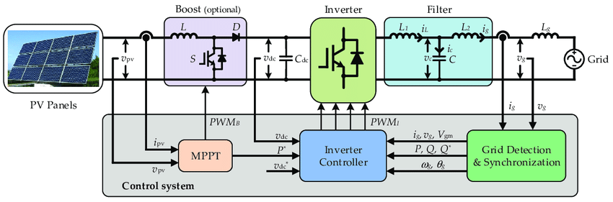
O-GC-PVs Cont.……
Figure 3: Overview of a generic grid-connected PV energy conversion system[3].
Source: https://www.mdpi.com/2076-3417/7/4/315

Slide 12
O-GC-PVs Cont.……
The functions of the power converter stage of a PV system include is the backbone of SECs
It comprises the maximum power point tracking (MPPT), DC-to-AC power conversion, grid synchronization, grid code compliance of power quality, active and reactive power control and anti-islanding detection.
Figure 3 comprises the PV generation system, which can be: a single module,
a string of series-connected modules, or
an array of parallel-connected strings.

Slide 13
O-GC-PVs Cont.……
The PV system is followed by a filters, a passive input filter, which is a capacitor that is used to decouple the input voltage and current from the subsequent power stages
The filter reduces the current and voltage ripple
It also control the reactive power at the PV side.
The DC–DC stage, which is generally used to perform the MPPT of the PV system
Thus, the boost converter elevate its output voltage and in some occasions also provide galvanic isolation using DC–DC converters with high-frequency (HF) transformers
It also controls the reactive power and makes the DC-link voltage constant

Slide 14
O-GC-PVs Cont.……
The DC–DC stage is connected through a DC link to the grid-tied DC–AC converter, referred as the PV inverter.
In PV systems where no DC–DC stage is used, the input filter is equivalent to the DC-link capacitor as shown in Fig.3
The AC filter provides the harmonic mitigation and assists the converter–grid interface control.
The grid-tied converter also includes a grid monitoring and interaction unit, with circuit breaker and fuse to disconnect the system when required, such as during the night, grid faults, or islanding operation.

Slide 15
O-GC-PVs Cont.……
The feedback for the control system is composed of several current and voltage sensors at the PV input side for:
MPPT, DC-link stage or for DC-link voltage control and
grid side for grid synchronization and active/reactive power control.
The control system is further composed of :
analog-to-digital signal converters, digital microprocessors (or equivalent) and gate drive units to control the semiconductor devices of the different power stages.

Slide 16
4. Grid-connected PV System Modeling (GC-PVM)
Electrical Model of a PV Cell
The electrical characteristics of a PV module or cell are nonlinear and are highly dependent on solar irradiation and temperature.
The PV cell can be electrically modeled by an equivalent circuit such as the one shown in Fig.4 with a photocurrent source in parallel with a diode, a shunt resistance R_{sh} and a series resistance R_{s}.
The model in Fig.4 can be mathematically described by Eqn.1[4].

Slide 17
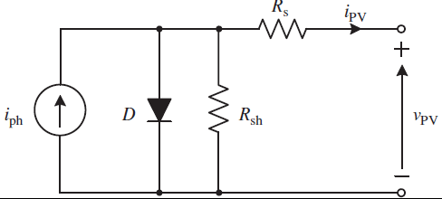
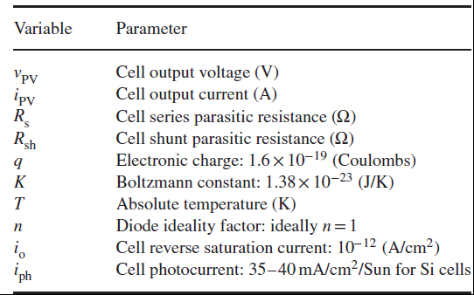

GC-PVM Cont.….
Figure 4, PV cell electrical model[5]. Source: https://www.mdpi.com/1996-1073/16/4/2018
eqn.(1)
where i_{PV} is the output current of the PV cell, which is a function of its output voltage v_{PV}, and a number of variables.

Slide 18
GC-PVM Cont.….
4.1 Photovoltaic Module I–V and P–V Curves
Typically the I-v and P-V curves represents the variation in voltage , current and hence the power with respect to temperature and solar radiations.
Typical PV module’s current–voltage (I–V) curves and power–voltage (P–V) curves are presented in Fig.5
From the I–V curves, it can be seen that the PV module behaves as a DC current source that remains almost constant even if the PV module is connected to different output voltage potentials.
When the voltage across the module gets higher, the free electrons start recombining and do not generate current.

Slide 19
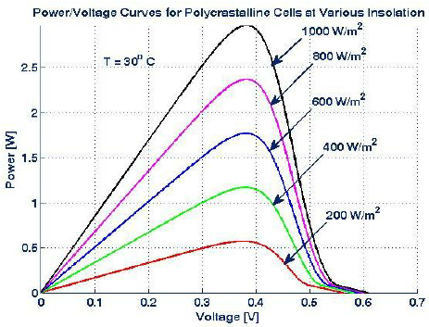
GC-PVM Cont.….
Figure 5, I-V Curves for different irradiances with constant standard temperature[6] : source : https://www.researchgate.net/figure/I-V-curves-of-solar-cell-at-various-irradiances_fig13_282755961. License: CC BY-NC-ND 4.0

Slide 20
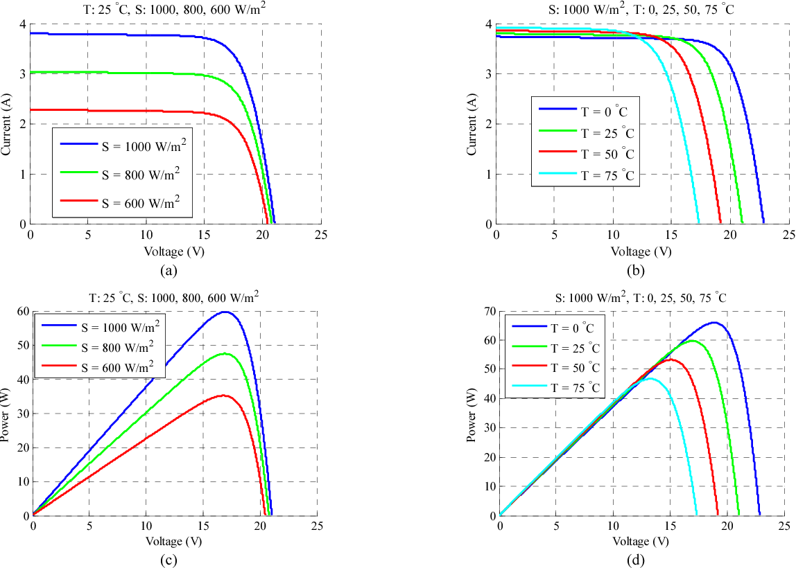
GC-PVM Cont.….
Figure 6, I-V Curves for different irradiances and temperature condition[7]: source s: https://doi.org/10.1016/j.enconman.2020.113521

Slide 21
GC-PVM Cont.….
This effect is not linear with respect to the voltage and it cuts off abruptly
When all electrons are recombined and no current is produced, the module is operating at an open-circuit voltage v_{oc}.
This voltage varies slightly for different levels of solar irradiation (at the same temperature), as it can be seen .
This necessitates the voltage controlling with respect to temperature, solar radiations and other variables

Slide 22
GC-PVM Cont.….
In contrast, when short circuited”
the module produces the largest current, short-circuit current i_{sc}, which is very linearly dependent on the solar irradiation
The more photons, the more free electrons and more current can flow .
Consequently, the P–V curves obtained by multiplying the axes of the I–V curve.
Thus, the PV module will be composed dp/dv=0 segment corresponding to the MPP for that given irradiation.

Slide 23
GC-PVM Cont.….
The voltage at which the MPP is obtained is known as the maximum power voltage v_{mp}.
The slopes of the I–V curve can be adjusted by the shunt resistance R_{sh} and series resistance R_{s} in the PV cell model to better represent the real PV cell.
Accordingly, the PV system voltage can be controlled easily
As the operating conditions of irradiation and temperature are inherently time variant, the instantaneous v_{mp} is unknown (unless irradiation and temperature are measured, which is expensive).

Slide 24
GC-PVM Cont.….
The control techniques used for such task are known as maximum power point tracking (MPPT) methods.
The MPPT algorithm generates the voltage reference to be controlled by the converter.
The same applies to PV arrays formed by parallel-connected strings.
In these cases, the I–V curve has several local MPPs and one global MPP, making it more difficult to achieve a true MPPT.

Slide 25
GC-PVM Cont.….
4.2 Conversion and Power Electronic Technology
Several inverter systems convert or transform the DC into AC for grid-connected PV systems.
Penetration of PV into the smart grid requires studies in variability and conversion technology.
The mathematical models and probability density used to model PV behavior include Beta and Rayleigh density functions.
The tracking method based on fuzzy/GA technologies is able to obtain enough power points for effective delivery.
Siting and sizing of PV uses classical and computational intelligence methods that involve decisions based on real - time data.

Slide 26
GC-PVM Cont.….
4.3 Control of Grid-Connected PV Systems
According to the previous sections, grid-connected PV systems can be composed of one or two power conversion stages (DC–DC and DC–AC) and different converter topologies.
Therefore, the control system and modulation schemes depend on the topology and vary from one topology to another.
Nevertheless, the main control objectives are universal and include MPPT of the PV system, grid synchronization, DC-link voltage control, active and reactive power control and grid monitoring including anti-islanding detection.

Slide 27
GC-PVM Cont.….
Following the analysis of the power curves of PV modules presented before, it is clear that to maximize the energy output of a PV system, it should be operating around the MPP.
The MPP depends on the solar irradiation and temperature of the module, which are variable in time.
The MPP is achieved by controlling the load curve of the PV module or string, making it to intersect the I–V curve where i_{PV} × v_{PV} is maximal.
As defined before, the voltage at which this occurs is known as the maximum power voltage v_{mp} which should be considered as the reference voltage for the control system v∗PV = v_{mp}.

Slide 28
GC-PVM Cont.….
This voltage could be obtained through direct measurement of the solar irradiation and the module temperature, which are used to compute v_{mp} from the PV module physical model.
However, solar irradiation sensors (pyranometers), in particular, are very expensive.
Therefore, numerical methods based on electrical variable measurements (already needed for the converter control) are used to search for the MPP.

Slide 29
GC-PVM Cont.….
Since this task is performed online and updated periodically over time, they are known as MPP tracking (MPPT) methods.
There are several MPPT methods found in practice and in the literature that can reach up to 99% of the MPP efficiency.
A classification of the most common MPPT methods is given.

Slide 30
Summary
In conclusion, the grid-connected solar energy conversion is well discussed here.
It is observed that the grid connected system comprises PV module, DC-DC converter, DC-Link, Inverter, switches and other grid synchronizing
The controlling approach, specifically, MPPT is also discussed.
In addition, the importance of controlling the temperature and solar radiation in maximum power harvesting or P-V curve is observed

Slide 31
References
[1]. B., Shweta; K.,Sandee; S., Sanket and etl. ‘’Solar PV system using microcontroller’’. International Journal of advanced research, 2017. DOI:10.21474/IJAR01/3423
[2]. B., Erdenebat; U., Naomitsu and S., Byambaa. ‘’A Strategy for Grid-Connected PV-Battery System of Mongolian Ger’’. Energies. V.(15), 2022. https://doi.org/10.3390/en15051892.
[3]. Z., Zhen; Y., Yongheng; M., Ruiqing and B., Frede. ‘’Zero-Voltage Ride-Through Capability of Single-Phase Grid-Connected Photovoltaic Systems’’. MDPI: Applied Sciences. 2017. doi:10.3390/app7040315
[4]. M. Azzouzi and M. Bouchahdane. Modeling of Electrical Characteristics of Photovoltaic Cell
Considering Single-Diode Model. Journal of Clean Energy Technologies. V.4(6), 2026.
[5]. N., Torres; R., Marques; B., Correia V.; H., Veiga and etl. ‘’A Discrete Electrical Model for Photovoltaic Solar Cells—d1MxP. Energies ,2023, V.16. https://doi.org/10.3390/en16042018
[6]. M., Ibrahim; B., Musa; M., Dikwa and etl. ‘’Performance evaluation of polycrystalline solar photovoltaic module in weather conditions of Maiduguri, Nigeria’’. Arid Zone Journal of Engineering, Technology and Environment. V.(9). 2013
[7]. C., Zhicong;L., Yueda; W., Lijun Wu and etl. ‘’Development of a capacitor charging based quick I-V curve tracer with automatic parameter extraction for photovoltaic arrays’’. ELSEVIER:Energy Conversion and Management. 2020. https://doi.org/10.1016/j.enconman.2020.113521

Slide 32
Thank you !

