Slide 1
Renewable Energy and Distributed Generations
Lecture 11
Grid-Connected PV System Configurations
Lecturer: Teshome Goa (Assist. Prof.)
Lecture learning outcomes:
At the end of this lecture, you will be able to:
Understand the configuration of Grid connected PV systems
Identify the modeling of PV generators and its importance in MPPT
Identify some controlling approach of boost converters for maximum power harvesting
Know the Grid code and Regulation of PV system

Slide 2
Outlines
Grid-Connected PV System Configurations
Controlling Of Grid Connected PV systems
Photovoltaic Generator Model
Modeling & Control of grid connected Converters
Control Strategy of Grid Connected PV Inverter
Grid Codes and Regulations
Summary
References

Slide 3
1. Grid-Connected PV System Configurations( GCPVC )
Solar panels or arrays that are connected to the utility grid via a power inverter unit enable them to function in parallel with the electric utility grid.
Grid-connected PV energy conversion systems can be grouped into four different types of configurations:
  Centralized configuration for large-scale PV plants , specifically for 3-phase
  String configuration for small and medium-scale PV systems , common for single-phase &3-phase systems
  Multi-string configuration for small- to large-scale systems
  AC-module configuration for small-scale systems (commonly single phase).
Simplified diagrams of each of these configurations are given in Fig.1.

Slide 4
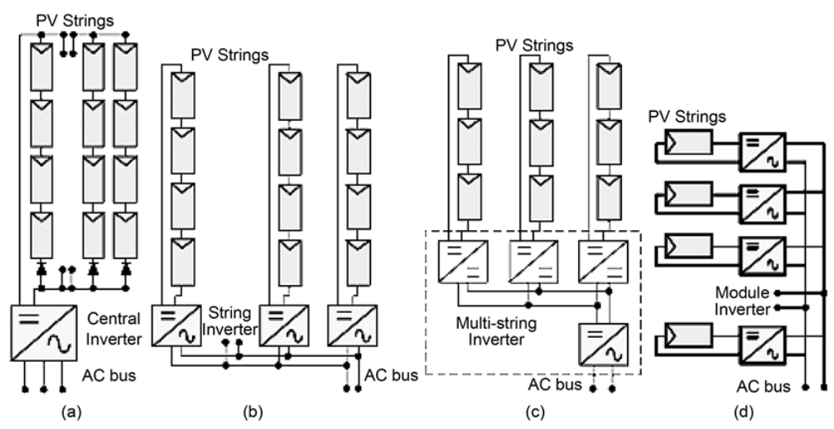
GCPVC Cont.…
Figure 1. Grid-connected PV system configurations[1]: a. Centralized configuration b. String Configuration c. Multi-string configuration d. AC-module configuration.
https://www.scirp.org/journal/paperinformation?paperid=72028

Slide 5
GCPVC Cont.…
The centralized topology uses a single three-phase voltage source inverter (VSI) to connect the whole PV plant to the grid as presented in Fig.1.a
Here, as presented earlier, the PV system is formed by the series connection of modules or string to reach the desired output power.
The advantages of this configuration is that its simple structure, single transformer and single control system that needs single set of sensors, control platform and grid monitoring unit.
This comes at the expense of reduced power generation because of a single MPPT algorithm for the whole PV system. Also, diode conduction losses are introduced by the string series blocking diodes.
Currently, the central configuration is the most widely used topology for large-scale PV plants.

Slide 6
GCPVC Cont.…
The string configuration presented in Fig.1.b uses one inverter per PV string; hence there is no need for a series blocking diode.
In addition, for a PV plant consisting of several string inverters instead of a single central inverter, there will be more individual MPPT available, increasing the total energy yield.
Partial shading and mismatch are reduced at a string level and not at an array level.
The string configuration also increases modularity, since additional PV strings and string inverters can be added to the power plant without affecting existing strings.

Slide 7
GCPVC Cont.…
However, compared to a central inverter, the string configuration has:
A higher component count, multiple transformers if isolation is required and a need for several individual grid control systems
Thus, it needs several number of the sensors, control platforms, grid monitoring units and others for a power plant of the same size of centralized inverter type PV systems
Accordingly, for the large PV plants, the investment cost of a string inverter configuration can reach up to 60% higher than that of a central inverter configuration.
Therefore, the string topology is widely adopted as a solution for small- and medium-scale PV systems like rooftop and residential systems.

Slide 8
GCPVC Cont.…
Figure 1.c presents the multi-string configuration of grid connected PV system, which merges the benefits of the centralized and string systems.
It introduces the distributed MPPT capability of the string configuration through individual DC–DC converters interfacing each string to the centralized inverter
The DC–DC stage also serve for voltage elevation and isolation
Accordingly, the system utilizes the major benefits centralized structure of the grid connected system like simple structure and single grid-side control system
But, the multi-string structure gains higher energy yield and modularity compared to the central topology

Slide 9
GCPVC Cont.…
In terms of component count: the multi-string configuration is above the central topology, because of additional DC–DC converters, and below the string inverter, since the DC–DC stage requires fewer components compared to the grid-tied inverters.
Among the disadvantages are higher DC-cable losses, which are necessary to connect smaller parts of the PV system and DC–DC converters to the central inverter
The multi-string configuration is popular for small- and medium-scale PV systems such as rooftop ones
More recently, it has also been introduced for large- or utility-scale PV plants.

Slide 10
GCPVC Cont.…
Finally, the AC-module or module-integrated topology, commonly referred to as micro-inverter is presented in Fig.1.d
Which is the most distributed power converter architecture for grid-connected PV systems, since it features one inverter per PV module.
Therefore, it has the best MPPT capability of all configurations.
Because PV modules usually generate a low voltage, which is less than 50 V, voltage elevation is required for grid connection of this configuration.
Generally, AC-module topologies usually include a DC–DC boosting stage to elevate the voltage of the module.
Therefore, this topology is intended for small-scale PV systems and more domestic use.

Slide 11
2. Controlling Of Grid Connected PV systems(CGCPVs)
Controlling of grid connected PV system is mandatory for all the configurations though the controlling parameters, number of variables and method of controlling varies with the configuration.
The increased number of grid connected PV inverters gave rise to problems concerning the stability and safety of the utility grid, as well as power quality issues. The main problems in all configuration of grid connected systems are:
Voltage rise problem
Frequency
Increased harmonics
Increased voltage unbalance
Anti-islanding

Slide 12
CGCPVs Cont.….
Voltage raise[2]:
The integration of large amounts of PV systems in the LV networks increases the generation of active power leading to voltage rise along the feeders though it’s playing a bigger role in the electricity market because of its capacity to reduce greenhouse gas emissions, support the grid, and provide stand-alone power.
The typical LV grid's behavior has been impacted by protection concerns, higher losses, transformer and cable rating issues, unexpected voltage rises, and reverse power flow.
In order to reduce voltage rise issues, communication with PV and voltage control devices must be incorporated.
The negative effects of high PV penetration have compromised the operation of on load tap changers (OLTC) and automatic voltage regulation.
At the moment, the voltage rise should not exceed the 2% limit imposed by the old GC

Slide 13
CGCPVs Cont.…
The volatile characteristic of PV type renewable energy sources' power production leads to the grid frequency problems.
In particular, frequency variation is caused by a temporal disparity between generation and demand brought on by the typical volatility of PV power output though the super-capacitors and other frequency control is adopted
As a result, it is now essential to take the grid's frequency into account at high PV penetration levels.
Accordingly, it’s better to control the grid-connected photovoltaic system, frequency regulation like battery storage and others. Thus, it’s important to maintain the energy balance

Slide 14
CGCPVs Cont.….
A small PV system linked to the LV grid side must function correctly within the frequency range of 59.3 Hz (98.83%) - 60.5 Hz (100.83%) based on a nominal frequency of 60 Hz, per IEEE 929-2000[3],[4].
Accordingly, when the frequency falls to 59.2 Hz (98.66%) or rises to 60.6 Hz (101%), the PV plant must trip.
Within six cycles, the inverter shall stop energizing the utility wires when the frequency drops below the permitted range.
However, according to IEC 61727, the frequency range is 49 Hz (98%) to 51 Hz (102%) based on a system frequency of 50 Hz[5].
Means, the PV system must be unplugged within 0.2 Hz if the system frequency falls outside of these bounds.

Slide 15
CGCPVs Cont.…..
While the PV system is connected to the power grid side, the frequency deviation is required to meet the requirements.
For instances , the Germany, France and Spain grid codes for frequency is presented in Table.1
Table 1. grid connected PV system frequency tolerances[5]
Country | Germany | France | Spain
Frequency tolerance | 47.5 < f < 51.5 | 48 < f < 51 | 47.5 < f < 52
Over frequency trip time (sec.) | 10 cycles | N/A | N/A
Under-frequency trip time(sec.) | 10 cycles | N/A | N/A

Slide 16
CGCPVs Cont.….
Accordingly, controlling several grid connected systems, from PV up to Grid is needed to maintain the network stability and reliability
Thus, the penetration of PV into the smart grid rand vice versa requires studies in variability and conversion technology.
Needs the mathematical modeling of PV systems , converters and controlling devices
The tracking method based on modern AI based mechanisms to obtain enough power at PV systems and its delivery to grid is needed.
The control system and modulation schemes depend on the topology and vary from one topology to another.
Nevertheless, the main control objectives are universal and include MPPT of the PV system, grid synchronization, DC-link voltage control, active and reactive power control and grid
Monitoring including anti-islanding detection.

Slide 17
3. Photovoltaic Generator Model(PVGM)
Models of photovoltaic cells have long been used to describe the behaviors of photovoltaic cells.
The single diode circuit model, which is shown in Fig.2, is the most often used model for predicting energy generation in solar cell modeling.
A current source/photon current I_{ph} is included in this model; it is dependent on cell temperature and solar radiation.
A diode in which, after accounting for resistive losses, the inverse saturation current I₀ depends mostly on the operating temperature, a series resistance R_{s}, and a shunt resistance R_{sh}. .
The current–voltage relationship of a photovoltaic cell is given by:
eqn.(1)

Slide 18
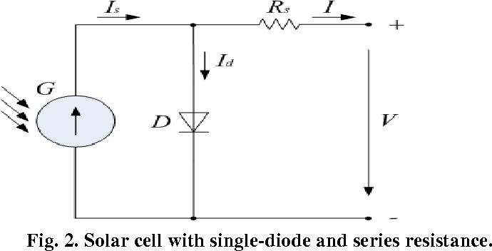
PVGM Cont.….
This eqn.1 can be solved by different iterative mechanisms.
Where, A = nkT/q modified ideality factor, n the diode ideality factor, k the Boltzmann constant (1.38 *10 -23 JK -1), q the electronic charge (1.602* 10 -19 C), T the cell temperature (K), Vt the thermal voltage (Vt = kT/q, V), Rs the series resistance (Ω) and Rsh is the shunt resistance (Ω).
Figure 2. The single diode circuit model representation PV system[7] .
URL. https://api.semanticscholar.org/CorpusID:14288298

Slide 19
PVGM Cont.….
The cell temperature, the incident solar irradiance, and their reference values are the three factors that affect the five parameters in Eqn.(1).
PV module manufacturers typically supply these reference values for specific operating conditions like STC.
The standard conditions and real operating conditions are never the same, and mismatch factors may also have an impact on the real values of these mean parameters.
Therefore, it is crucial to assess the five characteristics under actual working conditions in order to produce a mathematical model of a PV module that is accurate.
The above reference value can be changed using different operating conditions as given by[8]:
eqn.(2)

Slide 20
PVGM Cont.….
A. short circuit condition
Thus, at short ckt condition I=I_{sc} and V=0, then eqn.2 is rewritten as:
eqn.(3)
B. open circuit condition
I=0, and V= open circuit voltage (V_{0C}), Then:
eqn.(4)
C. at maximum power point (MPP), V=V_{max} and I=I_{max}). Then:
eqn.(5)

Slide 21
PVGM Cont.….
Then, the derivation of original eqn., eqn.1 at V=V_{oc(ref)} and I=I_{sc(ref),} respectively is given as :
eqn.(6)
eqn.(7)
Where, R_{s0} and R_{sh0} are the slops of the I-V curve in open circuit and short circuit points, respectively
Thus, the series and shunt resistances of the semiconductor can be easily determined using the above equations for initial conditions.

Slide 22
PVGM Cont.….
Normally, the outdoor measurements of multiple I-V curves for a standard module can be combined to determine I_{sc(ref),} V_{oc(ref)} , I_{m(ref)} and _{Vm(ref)}. This can be expressed mathematically as;;
eqn.(8)
eqn.(9)
eqn.(10)
eqn.(11)
Where, G_{ref} and G_{mes} are the reference and measured radiances, α is the temperature coefficient of the short circuit current, T_{ref} and T_{mes} are the reference and measured Temperature,
β is the temperature coefficient of the module Voltage

Slide 23
PVGM Cont.….
Then, by introducing the parameters from eqn. 8 to eqn.11 into eqn.2 , the five reference parameters are determined as;
eqn.(12)
eqn.(13)
eqn.(14)
eqn.(15)
eqn.(16)

Slide 24
PVGM Cont.….
B. Then, for real conditions, the equations can be rewritten as;
Model ideal factor:
eqn.(17)
Saturation current of the diode:
eqn.(18)
where, Eg is the band-gap energy of semiconductor and Ns is the total number of cell connected radial
Photo current is:
eqn.(19)
Series resistance is:
eqn.(20)

Slide 25
PVGM Cont.….
Shunt resistance is:
eqn.(21)
Short circuit current and open circuit voltage at any operating condition is given by:
eqn.(22)
The current and voltage at maximum power point are given by:
eqn.(23)

Slide 26
4. Modeling & Control of grid connected Converters (MCGC)
The significant advancements in the photovoltaic industry have presented novel obstacles for inverters, which are now expected to enhance grid stability through the provision of support functions[9]. The main challenges which inverters faces are:
Stage 1: Current control, harmonics, synchronizations and voltage unbalance
Stage 2:Power control(active and reactive power) and power quality
Stage 3:Grid Interaction with optimal support of power interaction
As observed in Fig. 3, controlling stage one leads to controlling stage 2 and the grid integration comes after stage three.
Figure 4 . The PV system Inverter control parts[1]

Slide 27
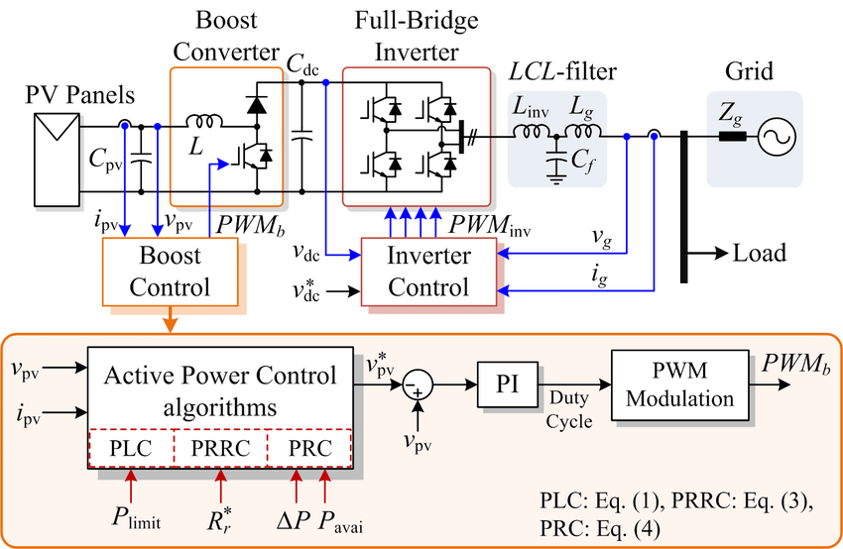
MCGC cont.…
Figure 3. Grid connected configuration and control scheme of PV system with active power control strategies [10]. Url: https://www.researchgate.net/publication/318762121

Slide 28
MCGC cont.…
For example, as observed in Fig.3, harmonics and overall power of the system is easily controlled while integrating with grid using chopper based on the three principles:
1. Power Limiting Control (PLC) Algorithm
2. Power Ramp-Rate Control (PRRC) Algorithm
3. Power Reserve Control (PRC) Algorithm
In this control scheme, the PV power extraction is controlled by the boost converter through the regulation of PV voltage V_{pv} while the full-bridge inverter transfers the extracted PV power to the AC grid by regulating the dc-link voltage V_{dc} to be constant.

Slide 29
MCGC cont.…
The active power control strategy is then implemented in the boost stage, which is achieved by determining an appropriate reference PV voltage V_{pv} for a certain active power control strategy: power limiting control(PLC), power ramp-rate control(PRRC), power reserve control(PRC) as presented below[11]:
Power Limiting Control (PLC) Algorithm.
Regulating the operating voltage of the PV arrays V_{pv} along the PV voltage (Horizontal line) is necessary to limit the PV output power to a specific level P_{limit}.
As shown in Fig. 4, the reference PV voltage V_{pv} is constantly perturbed towards the left side of the MPP during the power limiting operation (i.e., P_{pv} > P_{limit}) until Ppv = P_{limit}.
The PV system injects the maximum amount of power into the grid if the PV output power falls below the power limit level (Ppv <P_{limit}).
The reference PV voltage, Vpv, is determined by the MPPT algorithm,
which is based on P&O.

Slide 30
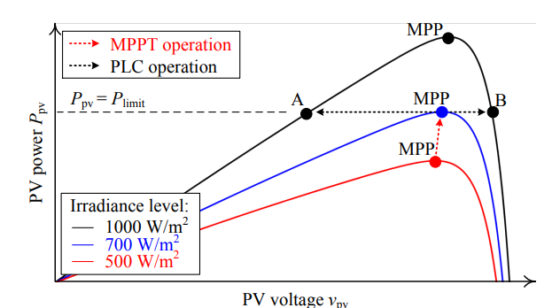
MCGC cont.…
Figure 4. Operating principle of the PLC algorithm. https://www.researchgate.net/figure/Operational-principle-of-the-Power-Limiting-Control-PLC-algorithm-where-the_fig4_327509824

Slide 31
MCGC cont.…
b. Power Ramp-Rate Control (PRRC) Algorithm: The principle of PRRC is similar to the PLC.
In this case, the criterion to curtail the PV power is coming from the change rate of the PV power, instead of an absolute PV power.
Specifically, the PV power ramp-rate R_{r(t}) is first calculated as:
eqn.(24)
Then, if the change rate of the PV power R_{r(t}) is above a certain limit R_{r}, the PV voltage V_{pv} is perturbed towards the left side of the MPP, in order to reduce the change rate of the PV power to a certain value ; R_{r(t}) = R_{r}).
The operational principle of the PRRC algorithm is given in Fig.5

Slide 32
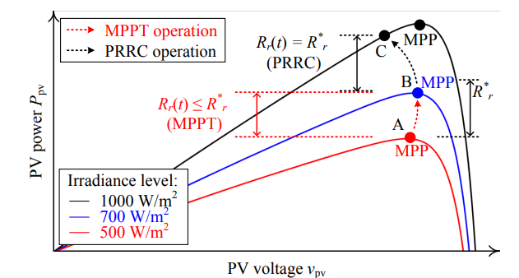
MCGC cont.…
Figure 5. Operational principle of the Power Ramp-Rate Control (PRRC) algorithm: MPPT mode (A to B) and PRRC mode (B to C), where Rr(t) is the PV power ramp-rate and Rr is the ramp-rate limit. https://www.researchgate.net/figure/Operational-principle-of-the-Power-Ramp-Rate-Control-PRRC-algorithm-the-operating_fig5_327509824

Slide 33
MCGC Cont.…
c. Power Reserve Control (PRC) Algorithm
PV power must be regulated below the MPP with a specific power reserve level P in order to implement power reserve control.
This control functionality can actually be thought of as a specific instance of power limiting control, in which a predetermined power reserve level P is attained by dynamically varying the power limit level P_{limit} during operation.
As a result, to determine the power limit level P_{limit}, deduct the required amount of power reserve from the available PV power P_{avai}, using the formula P_{limit} = P_{avai *}P.
Fig. 6 illustrates the power reserve control strategy's working theory.

Slide 34
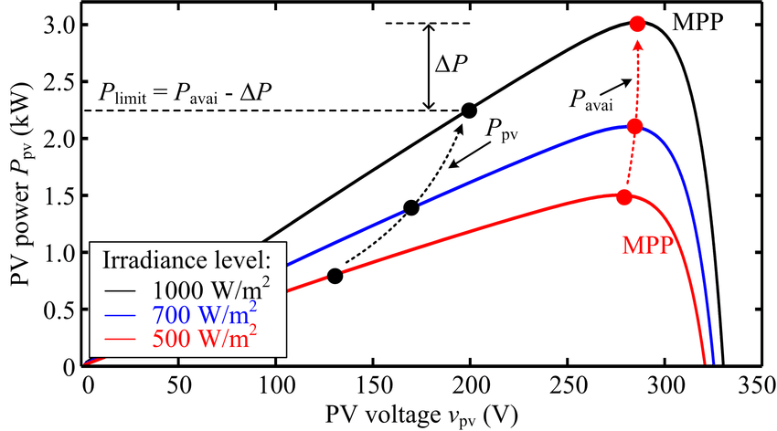
MCGC Cont.….
Figure 6. Operational principle of the Power Reserve Control (PRC) algorithm. https://www.researchgate.net/figure/Operational-principle-of-the-Power-Reserve-Control-PRC-algorithm-where-P-avai-is-the_fig4_318762121

Slide 35
5. Control Strategy of Grid Connected PV Inverter (CSGCPVI)
The equivalent circuit, output voltage and current relationship of PV module is expressed in previous eqns.
One of the essential device in CSGCPVI control strategy is given in in the Fig.6
The control circuit is divided into two control loops named as an inner current loop for controlling duty ratio and outer voltage loop to track the maximum power point to stabilize DC-link voltage
Two currents are involved in inner loop control: active current (I_{d}) and reactive current (I_{q}).
In normal operation, the output of the voltage loop (active current, I_{dr}) used as a reference while reference of reactive current (I_{qr}=0).
Therefore, CSGCPVI operates at a nearly unity power factor.
To control the grid current and dc-link voltage typical different control approach are utilized.

Slide 36
CSGCPVI Cont.…….
For the generation of inverter switching pulses, it is necessary to produce active reference and the reactive reference voltage from the inner loop, and these are transformed into V_{dq} ,and then to V_{abc}.
The obtained V_{abc} is applied to PWM generator to produce required switching pulses to an inverter
The mathematical modeling of three phase grid connected PV system as follows for conventional inverter model.
eqn.(25)
By rearranging the state space and time variant analysis the real and reactive power can be given by:
eqn.(26)

Slide 37
6. Grid Codes and Regulations
The primary goal of connecting large number of renewable energy devices to the grid in recent years has been to boost the output of renewable energy contribution to the environment, economy and SDGs.
However, due to the imperfections in the utility grid and volatile characteristics of RE , it is possible for the grid's voltage and frequency to surpass the established boundaries, which is unwanted and intolerable.
Maintaining the voltage and frequency regulation, power quality enhancement, and energy balancing are necessary for the effective and dependable operation of electrical power networks.
The grid operator of a power system is in charge of ensuring proper functioning and has the ability to buy auxiliary services straight from the PV generators. Until recently, inverters had to disconnect and wait for the fault to clear in the event of unexpected grid circumstances or breakdowns.

Slide 38
Summary
In conclusion, the grid connected configuration PV systems based on their advantage and disadvantage, application and control strategies are well discussed in this lecture
The modeling of grid connected system, specifically the power generation takes paramount for better harvesting of power from PV system.
In line with this, controlling the current and voltage of PV generator is the dominant factor in harvesting maximum power.
Besides, different controlling strategies of boost converter for MPPT is observed in this lecture.
Finally, the grid code for better synchronization of power between grid and PV is also discussed.

Slide 39
References
[1]. K. ,Kirubasankar and . A. Senthil Kumar. ‘’Inverter Power Stage Connected with PV-Grid“. Circuits and Systems. Vol.7 (13), 2016.
[2]. K.,Ainah and F., Komla. ‘’Voltage Rise Issue with High Penetration of Grid Connected PV’’. IFAC Proceedings . V.47(3).2014. https://doi.org/10.3182/20140824-6-ZA-1003.01989
[3]. "IEEE Recommended Practice for Utility Interface of Photovoltaic(PV) Systems," IEEE Std 929-2000 , vol., no., pp.i,, 2000
[4] . International Electrotechnical Commission, "IEC 61727 -Photovoltaic (PV) systems – Characteristics of the utility interface",2004.
[5] B. Crăciun. "Overview of Recent Grid Codes for PV Power Integration," 13th International Conference on Optimization of Electrical and Electronic Equipment (OPTIM), pp. 959-965, 2012.
[6]. H., Khairy; M., EL-Shimy and G. Hashem. ‘’Overview of Grid Code and Operational Requirements of Grid-connected Solar PV Power Plants’’. Industry academia collaboration conference(IAC). 2015. Egypt.
[7]. B.Jitendra; P.,Surya and R., Ankita R. Joshi. ‘’Modeling and Simulation of PV Cell using One-diode model’’. International Journal of Scientific and R search Publications. V. 3(10,), 20123. https://api.semanticscholar.org/CorpusID:14288298.
[8]. Ch., Aissa; S., Santiago; S., Nawel and etl. ‘’Modeling and simulation of a grid connected PV system based on the evaluation of main PV module parameters’’. Simulation Modelling Practice and Theory. V.20(2012).
[9]. B.I. Craciun, E.A. Man, V.A. Muresan, D. Sera, T. Kerekes, and R. Teodorescu, Improved Voltage Regulation Strategies by PV Inverters in LV Rural Networks, accepted for publication, The 3rd International Symposium on Power Electronics for DistributedGeneration Systems, Aalborg June 2012, Denmark
[10]. Sangwongwanich, A., Yang, Y., & Blaabjerg, F. (2017). Development of Flexible Active Power Control Strategies for Grid-Connected Photovoltaic Inverters by Modifying MPPT Algorithms. In Proceedings of IFEEC 2017 -ECCE Asia (pp. 87-92). IEEE Press. http://dx.doi.org/10.1109/IFEEC.2017.7992423
[11]. K. Rajasekhara Reddy; V.Nagabhaskar Reddy; M.Vijaya Kumar and etl. ‘’Configurations and Control Strategy of a Single Stage Grid Connected PV System’’. E3S Web of Conferences , ICMED 2020. https://doi.org/10.1051/e3sconf/202018401074

Slide 40
Thank you !

