Slide 1
Renewable Energy and Distributed Generations
Lecture 12
Sizing and Designing the Off-grid and Grid Connected PV System
Lecturer: Teshome Goa (Assist. Prof.)
Lecture learning outcomes:
At the end of this lecture, you will be able to:
Understand the sizing and designing of off-grid and grid connected PV systems
Identify how to estimating an electric load
Knows the software application on grid connected and off-grid PV systems
Develop design project using Homer optimization

Slide 2
Outlines
1. Sizing and Designing the Grid Connected System
2. Designing and sizing Off-grid system
3. Estimating an Electric load
4. Software's used for PV/RE simulation
5. Design Project Example
6. Solution of the Design Project
Summary
References

Slide 3
1. Sizing and Designing the Grid Connected System
The following steps are needed:
1. Select site, efficiency of PV modules used, array layout and budget.
Determining the maximum array power output.
2. Selecting one or more inverters with a combined rated power output 80% to 90% of the array maximum power rating at STC.
3. Inverter string sizing determines the specific number of series-connected modules permitted in each source circuit to meet voltage requirements.
4. The inverter power rating limits the total number of parallel source circuits.
5. Estimating system energy production based on the local solar resource and weather data.
6. The sizing of interactive PV systems is centered on the inverter requirements

Slide 4
The solar modules constitute the input of your solar system; therefore, you need to include the system inefficiencies in order to estimate the number of solar panels you need.
Normally, a common grid-tie solar system may have losses about 14-22%.
Accordingly, consider these losses while designing your system .
Thus, calculate the number of solar panel needs the following things:
Considering a well-designed solar system with good efficiency >85%, divide the solar system size (AC) in step 4
Select the solar module with standard nominal name plate from manufacturer
If the power calculated at step 4 is known and calculate the number of panels using power output dived by the selected panel rating
In this case, number of modules should cover 100% of your energy needs.

Slide 5
2. Designing and sizing Off-grid system
The main objective of sizing stand-alone PV system is: a critical balance between energy supply and demand.
It involves the following key steps[1]:
Determine the average daily load requirements of each month
Conduct a critical design analysis to determine the month with the highest load to solar insolation ratio
Size the battery banks for system voltage and required energy storage capacity
Size PV array to meet the average daily load requirements for the period with lowest sunlight and highest load (usually winter)

Slide 6
Designing Cont.…
Calculate the necessary energy before establishing a solar PV system, it is necessary to calculate the total energy requirements of all applications that the system will need to power.
Every day, determine how many watt-hours each piece of equipment uses. For the purpose of calculating the total Watt-hours that is added to the Watt-hours needed for all of the equipment taken together, which can be supplied to the goods.
Determine the number of Watt-hours that the solar system generates on a daily average.
The daily total of equipment Watt-hours must be divided by to get the amount of electricity that the panels must produce.

Slide 7
Designing Cont.…
The System Sizing is given by: generally, involves a Six-step process which will allow the photovoltaic system designer:
Estimating the Electric Load
Sizing and Specifying Batteries
Sizing and Specifying an Inverter
Sizing and Specifying an Array and specifying A Controller
Sizing the cablings between each PV components

Slide 8
Designing Cont.…
Thus, the following steps help you determine the array size for your off-grid or grid tie solar photovoltaic stem
Find you monthly average electricity usage from your energy bill: This is the total kWh you pay for in a single month.
Find your daily average electricity usage: Divide your monthly average kWh found in step 1 by 30 days.
Find the daily average peak sun hours for your location : it’s also possible to visit NASA data
Calculate the solar system size (AC) to generate 100% of your electricity consumption : can be achieved by dividing the daily average energy usage by the average sun peak hours in your location.

Slide 9
3. Estimating an Electric load(EEL)
Power calculation: the total power or energy requirement that needs to design the PV system depends on your daily energy requirements and future energy requirements
To determine the daily energy requirement, it’s recommended to fill out the load sizing worksheet, considering the standard efficiency and voltage of Inverter and battery as presented in Table.1
Table. 1 Battery voltage and Inverter efficiency[2]
A | Inverter efficiency | 0.88 to 0.98
B | Battery bus voltage | 12V, 24V, 48V
C | Inverter AC Voltage | 120V or 408 V

Slide 10
EEL Cont.….
Table. 2 the electric load datasheet
D= Rating of each Item (I). (W) | I.1 I. 2 I.3 I.4……………………………………………..I.n
E=Adjustment factor(A.F) | A.F=1 for DC item | A.F=A for AC | <=1
F_{i}=Adjusted rating of each appliance | D/E |  | In watt
G= operating time of each item per day | Number of hours |  | Hrs.
H_{i}=Energy usage per day/item | F*G |  | Watt-hr.
I=total energy in Watt-hours | Summation of the total item energy in Watt-hours= sum(Hi), i=1…..n |  | Watt-hr.
J= Total Amp-hr./day | I/B |  | Amp-hr
K= Maximum AC power requiring | Sum (Fi), i=1…..n(for AC only) |  | Watt
L= Maximum DC power requiring | Sum (Fi), i=1…..n(for DC only) |  | Watt
M= total Power | K+L |  | Watt

Slide 11
Battery Rating/sizing
EEL Cont.….
The battery capacity required depends on the following:
a. Desired days of storage to meet system loads with no recharge from PV
b. Maximum allowable depth-of-discharge
c. Temperature and discharge rates
d. System losses and efficiencies
e. The system voltage defines the number of series-connected battery cells required.
f. The number of parallel battery strings required

Slide 12
EEL Cont.….
Table 3. Standard worksheet for Battery Sizing is given by:
Items | Parameters | Required values | Description
B.1 | Day of storage | Days | It is required to provide power (3-5 days is recommended )
B.2 | Depth discharge | 0.8 | Maximum fraction of capacity that can be withdrawn from battery
B.3 | Required Battery capacity (A-hrs.) | (J*B.1)/B.2 | It is the product of total A-hrs per day and day of autonomy per depth of discharge
B.4 | Amp-hr. capacity of selected battery | Select the battery type | The battery cell can be selected from different manufacturer

Slide 13
EEL Cont.….
B.5 | Number of battery in Parallel | B.3/B.4 | The sum of batter in parallel =total amp-hr
B.6 | Battery in series | B/selected battery Volt. | Batteries achieve maximum required voltage by connecting N-Batteries -radial
B.7 | Total number of Batteries | B.5*B.6 | Parallel battery *series Batteries
B.8 | Total Amp-hr. capacity | B.4*B.6 | Battery Amp-hr. capacity

Slide 14
EEL Cont.….
C. PV Array Sizing
Solar array size is determined by the following parameters:
a. The PV array for stand-alone systems is sized to meet the average daily load during the critical design month.
b. Solar insolation received in the site
c. System losses, soiling and higher operating temperatures are factored in estimating
array output.

Slide 15
EEL Cont.….
d. Characteristics of the PV modules
e. The system voltage determines the number of series-connected modules required per source circuit
f. The system power and energy requirements determine the total number of parallel source circuits required
g. Then, knowing the requirements of the load and the output of a single module, the array can be size
h. Higher system availability can be achieved by increasing the size of the PV array and/or battery

Slide 16
EEL Cont.….
Table 4. The Sample Worksheet for PV Array sizing
Item | Parameter | Value | Description
C1 | Total energy demand per day(watt-hrs.) | I | The energy demand per hour (watt-hrs.)
C2 | Battery round trip efficiency | 0.7-0.85 | Use 0.85 if selected battery is efficient
C3 | Required solar array output power | C1/C2 | Divide the total energy demand per day by the battery trip efficiency
C4 | Select the PV module max- power voltage at stc(Volt) | P_{max}*0.85 | Which is determined from the manufacturer data sheet
C5 | PV guaranteed output power | Refer manufacturer data | Refer the manufacturer data sheet based on the module type selected

Slide 17
EEL Cont.….
C6 | Peak-sun hour at designed tilt for designed months | Hours | It’s a peak sun hour at optimal tilt. Normally determined from the solar radiation data of a given location based on the average-day of lowest month
C7 | Energy output per module per day | C5*C6 | The energy determined per-array for worst months
C8 | Module energy output at operating temperature (watt-hrs.) | DF*C7 | Consider the effect of constraints. It’s different for hot and cold days . 0.8 for hot and critical, whereas 0.9 is considered for moderate
C9 | Number of module required for required energy | C3/C8 | Divide the required power per day by the module energy o/p

Slide 18
EEL Cont.….
C10 | Number of module required per string | B/C4 | Divide the battery bus voltage by the module operating voltage
C11 | Number of sting required in parallel | C9/C10 | Refer the manufacturer data sheet based on the module type selected
C12 | Number of module to be purchased | C10*C11 | It’s a peak sun hour at optimal tilt. Normally determined from the solar radiation data of a given location
C13 | Nominal rated PV O/P power | Manufacturer data | Select your PV type
C14 | Nominal array output power | C12*C13
,,

Slide 19
EEL Cont.….
D. Sizing the Charge Controller:
The function of a charge controller is to regulate the charge going into your batteries bank from your solar array and prevent overcharging and reverse current flow at the night.
Most used charge controllers are Pulse width modulation (PWM) or Maximum power point tracking (MPPT)
The voltage at which PV module can produce maximum power is called maximum power point (or peak power voltage).
Maximum power varies with solar radiation, ambient temperature and solar cell temperature.
Typical PV module produces power with maximum power voltage of around 17V when measured at a cell temperature of 25°C, it can drop to around 15V on a very hot day and it can also rise to 18V on a very cold day

Slide 20
EEL Cont.….
MPPT solar charge controller allows users to use PV module with a higher voltage output than the operating voltage of battery system.
If PV module has to be placed far away from charge controller and battery, its wire size must be very large to reduce voltage drop.
With a MPPT solar charge controller, users can wire PV module for 12,24 or 48 V and bring power into 12, 24 V or 48 V battery system.
Which reduces the wire size needed while retaining full output of PV module.
The charge controller current input rating is equal to the product of the short circuit current of the PV module, number of PV modules in parallel, and safety factor, where safety factor, normally 1.25.
eqn.(1)

Slide 21
EEL Cont.….
e. Selecting an Inverter sizing
It is required to convert direct current to alternating current based on the demand.
Stand-alone inverters are typically voltage-specific, the inverter must have the same nominal voltage as your battery
The input rating of the inverter should never be lower than the total watt required power, inverter capacity > P_{t}
The input rating of the inverter should be ideally 25-30% more than the rated wattage of your appliances
Then, you can select the inverter specifications from manufacturing data

Slide 22
EEL Cont.….
f. Cable Sizing
It is required to estimate the size and the type of wire that needs to connect;
between PV modules and Batteries
between the Battery Bank and the Inverter
between the Inverter and Load. The equation needs to determine the size is given by:
eqn.(2)
The voltage V_{d} is typically:
a. For cabling between PV modules and Batteries = 12V, 24 V or 48V
b. For cabling between the Battery Bank and the Inverter = 12V, 24V or 48V
c. For cabling between the Inverter and Load is equivalent to the load voltage

Slide 23
4. Software's used for PV/RE simulation
There are many software's that have been used for optimal renewable energy, generation, operation and control , and hence its integration to the Grid.
Some of commonly used software's are :
1. HOMER Micro grid and Hybrid Power Modeling Software
2. PSAT
3. Windographar
4. Renewable Resource Assessment Platform
5. Data Management Dashboard

Slide 24
Software's Cont.…
4.1 HOMER optimization
HOMER[3] the micro-power optimization model, simplifies the task of evaluating designs of both off-grid and grid-connected power systems for a variety of applications.
When you design a power system, you must make many decisions about the configuration of the system:
What components does it make sense to include in the system design?
How many and what size of each component should you use?
The large number of technology options and the variation in technology costs and availability of energy resources make these decisions difficult.

Slide 25
Software's Cont.…
HOMER's optimization and sensitivity analysis algorithms make it easier to evaluate the many possible system configurations.
To use HOMER, you provide the model with inputs, which describe technology options, component costs, and resource availability
How does HOMER work?
Simulation
Optimization
Sensitivity analysis . The steps are:
Step one: Formulate a question that HOMER can help answer
HOMER can answer a wide range of questions about the design of small power systems.

Slide 26
Software's Cont.…
It is useful to have a clear idea of a question that you want HOMER to answer before you begin working with HOMER.
kinds of questions that HOMER can answer are:
Is it cost-effective to add a wind turbine to the diesel generator in my system?
How much will the cost of diesel fuel need to increase to make photovoltaic cost effective?
Will my design meet a growing electric demand?
Is it cost-effective to install a system to produce electricity and heat for my grid-connected system?

Slide 27
Software's Cont.…
How does new model work
Steps to do new model are:
1. install the HOMER software using installation guideline
2. open the software after installation
3. go to file and open new model
4. Click Add/remove
5. Select the component and loads based on the design , which is given in Fig.1
6. select the don’t model the grid for off-grid system and select the system with grid connected system for grid integration
7. Then, select compare the stand alone with grid extension for comparing tow systems

Slide 28
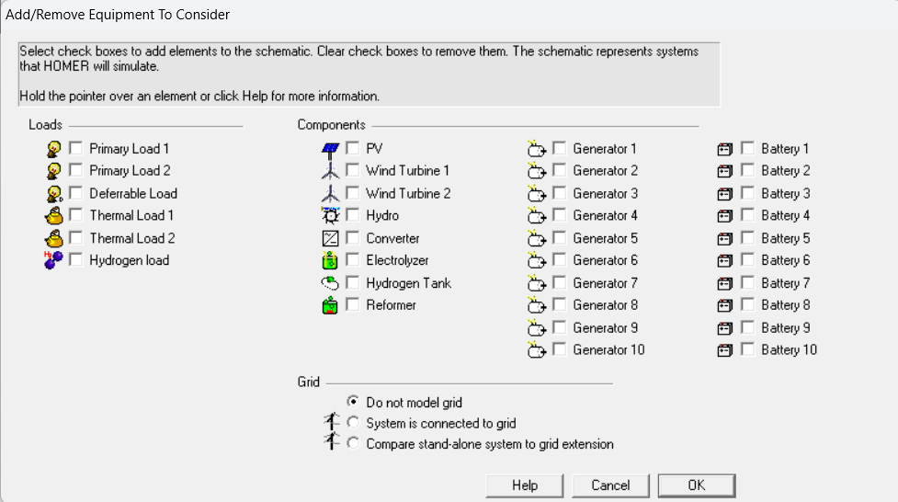
Software's Cont.…
Figure 1. Developing the new model using HOMER software

Slide 29
Software's Cont.…
Then, select the types of wind turbine, solar PV , hydro-turbine etc by clicking each parameter.
Insert resources : Solar, wind, Hydro, and others
Provide other necessary data based on your system model and you will get the sample model as given in Fig.2.
Then, you will get the sample results in Fig.3 while clicking the calculate

Slide 30
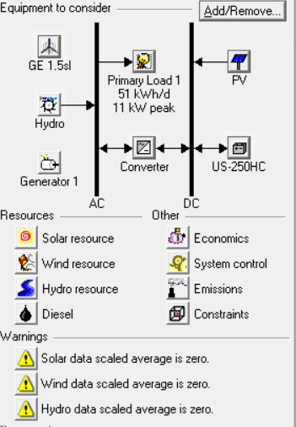
Software's Cont.…
Figure 2. Sample Off-grid RE model using HOMER

Slide 31
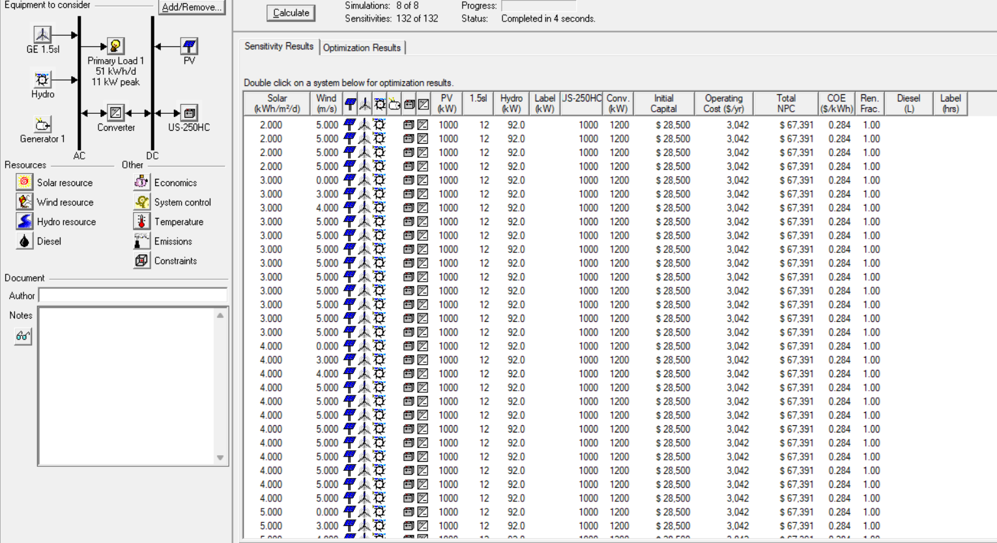
Software's Cont.…
Figure 3. Sample results using HOMER software

Slide 32
5. Design Project Example
1. Assume University K is constructing three big hostels that aims to accommodate the postgraduate students so that they can only concentrate on their education while living in the proposed hostels. The load data per hostel is given in Appendix A. As an Energy engineer, the University needs you to design the required system from the off-grid and grid connected PV energy systems. Accordingly;
A. Design the off-grid solar photovoltaic system that needs to satisfy the required demand using: hand-calculation and Homer optimization software. Then, compare the results and give your engineering conclusion. NB: you are recommended to extract the solar resource data from NASA, IAEA, World Bank or other necessary data resource sites.

Slide 33
Design Project Cont.…
b. Design the optimal Grid connected PV systems with all necessary components. Extract the results, discus it and compare it with the results extracted in case-a.
Hint: For hand calculation use the following steps:
Estimate the Electric Load
Compute the total connected watts for both AC and DC.
Compute the Average Daily Load for Both AC and DC
Compute the Total AC connected watts.
Specify an Inverter to supply the AC Total connected watts.

Slide 34
Design Project Cont.…
Battery Sizing
5. Establish the Inverter Losses.
6. Divide the AC Average Daily Load by the Inverter efficiency.
7. Add the result in 6 to the DC Average Daily Load.
8. Divide the result in 7 by system voltage to get ‘Average Amp-hr. day load’.
9. Divide the result in 8 by the Days of Autonomy.
10. Divide the result In 9 to get the’ Total Amp Hour Capacity’ of the System.
11. Specify a battery and divide the Total Connected watts by the battery’s rated its Amp-hour to get the Batteries needed to be connected in Parallel.

Slide 35
Design Project Cont.…
12. Divide the DC system voltage by the battery voltage to get the batteries wired in series.
13. Take the product of 11 and 12 to get the total number of batteries needed.
Array Sizing
14. Establish the battery energy efficiency.
15. Divide the Amp hour day Load by the battery efficiency.
16. Divide the result in (15) by the ’Peak Sun Hours’ to get ‘Total Array Peak Amps’.

Slide 36
Design Project Cont.…
17. Specify a module and divide the Array peak amps by the Peak amps produced by each module to get the Modules needed in parallel.
18. Divide the Dc system voltage by the nominal module voltage to get the Modules in Series.
19. Multiply the results of 17 and 18 to get the total number of modules.
Specifying a Controller
20. Multiply the module short circuit current by the total number of module to get the minimum Amp rating for the Charge Controller.

Slide 37
6. Solution of the Design Project
A. solution of Hand-calculation:
Steps from 1-20 are used to come up with the hand calculation design. Then, the result is given in Table 5.
Table 5. Electrical load estimation results
 | A | Inverter efficiency |  |  |  | 0.85
 | B | Battery bus voltage |  |  |  | 24
 | C | Inverter AC voltage |  |  |  | 120
No. | Appliance | Unit (Watt) | Adjustment factor | Adjusted power | usage (hr.) | Energy usage /day/item
1 | Coffee pot | 200 | 0.85 | 235.29 | 0.25 | 58.82
2 | coffee maker | 800 | 0.85 | 941.18 | 0.25 | 235.29
3 | Toaster | 1150 | 0.85 | 1352.94 | 0.25 | 338.24
4 | Blender | 300 | 0.85 | 352.94 | 0.15 | 52.94

Slide 38
Load Estimation Result Cont.…
No. | Appliance | Unit (Watt) | Adjustment factor | Adjusted power | usage (hr.) | Energy usage /day/item
5 | Microwave | 1050 | 0.85 | 1235.29 | 0.3 | 370.59
6 | hot plate | 1200 | 0.85 | 1411.76 | 0.3 | 423.53
7 | washing machine automatic | 500 | 0.85 | 588.24 | 0.25 | 147.06
8 | washing machine manual | 300 | 0.85 | 352.94 | 0.25 | 88.24
9 | vacuume cleaner upright | 450 | 0.85 | 529.41 | 0.25 | 132.35
10 | vacuume cleaner hand | 100 | 0.85 | 117.65 | 0.25 | 29.41
11 | sewing machine | 100 | 0.85 | 117.65 | 0.25 | 29.41

Slide 39
Load estimation Result Cont.…
12 | Iron | 1000 | 0.85 | 1176.47 | 0.25 | 294.12
13 | Clothes dryer electric | 400 | 0.85 | 470.59 | 0.25 | 117.65
14 | water pump | 375 | 0.85 | 441.18 | 0.25 | 110.29
15 | cealing fan | 30 | 0.85 | 35.29 | 0.25 | 8.82
16 | table fan | 17.5 | 0.85 | 20.59 | 0.25 | 5.15
17 | Electric blanket | 200 | 0.85 | 235.29 | 0.25 | 58.82
18 | Blow dryer | 1000 | 0.85 | 1176.47 | 0.25 | 294.12

Slide 40
Load estimation Result Cont.…
19 | Shaver | 15 | 0.85 | 17.65 | 0.15 | 2.65
20 | Computer Laptop | 35 | 0.85 | 41.18 | 5 | 205.88
21 | Computer Pc | 115 | 0.85 | 135.29 | 5 | 676.47
22 | Computer Printer | 100 | 0.85 | 117.65 | 0.25 | 29.41
23 | Typewriter | 140 | 0.85 | 164.71 | 0.3 | 49.41
24 | TV 25'' Color | 150 | 0.85 | 176.47 | 4 | 705.88
25 | TV19'' Color | 70 | 0.85 | 82.35 | 4 | 329.41

Slide 41
Load estimation Result Cont.…
26 | 1 TV 2'' B&W | 20 | 0.85 | 23.53 | 4 | 94.12
27 | VCR | 40 | 0.85 | 47.06 | 0.2 | 9.41
28 | Clock Radio | 1 | 0.85 | 1.18 | 0.3 | 0.35
29 | Sateliite Dish | 30 | 0.85 | 35.29 | 2 | 70.59
30 | CB Radio | 5 | 0.85 | 5.88 | 0.3 | 1.76
31 | Electric Clock | 3 | 0.85 | 3.53 | 24 | 84.71
32 | Light : 100w Incadescent | 100 | 0.85 | 117.65 | 4 | 470.59

Slide 42
Load estimation Result Cont.…
33 | Light : 25w Compact Florescent | 28 | 0.85 | 32.94 | 4 | 131.76
34 | Light : 50w Dc Incandescent | 50 | 1 | 50.00 | 4 | 200.00
35 | Light : 40w Dc Halogen | 40 | 1 | 40.00 | 4 | 160.00
36 | Light : 20w Compact Florescent | 22 | 0.85 | 25.88 | 4 | 103.53
37 | Compact Florescent Incandescent 40w equivalent | 11 | 0.85 | 12.94 | 4 | 51.76
38 | Compact Florescent Incandescent 60w equivalent | 16 | 0.85 | 18.82 | 4 | 75.29
39 | Compact Florescent Incandescent 75w equivalent | 20 | 0.85 | 23.53 | 4 | 94.12
40 | Compact Florescent Incandescent 100w equivalent | 30 | 0.85 | 35.29 | 4 | 141.18

Slide 43
Load estimation Result Cont.…
41 | 1/4'' Drill | 250 | 0.85 | 294.12 | 4 | 1176.47
42 | 1/2'' Drill | 750 | 0.85 | 882.35 | 4 | 3529.41
43 | 1'' Drill | 1000 | 0.85 | 1176.47 | 0.5 | 588.24
44 | 9'' Disc Sander | 1200 | 0.85 | 1411.76 | 0.5 | 705.88
45 | 3'' Belt Sander | 1000 | 0.85 | 1176.47 | 0.5 | 588.24
46 | 12'' Chain Saw | 1100 | 0.85 | 1294.12 | 0.5 | 647.06
47 | 14'' Band Saw | 1100 | 0.85 | 1294.12 | 0.5 | 647.06
48 | 7-1/4'' circular Saw | 900 | 0.85 | 1058.82 | 0.5 | 529.41
49 | 8-1/4'' circullar Saw | 1400 | 0.85 | 1647.06 | 0.5 | 823.53

Slide 44
Load estimation Result Cont.…
50 | Refrigerator/Freezer 20cf 1.8Kwh per day | 540 | 0.85 | 635.29 | 15 | 9529.41
51 | Refregerator/Freezer 16cf 1.6Kwh per day | 475 | 0.85 | 558.82 | 13 | 7264.71
52 | Sun frost 16cf Dc | 112 | 1 | 112.00 | 7 | 784.00
53 | Sun frost 12cf Dc | 70 | 1 | 70.00 | 7 | 490.00
54 | Freezer 14cf | 440 | 0.85 | 517.65 | 15 | 7764.71
55 | Freezer 14cf | 350 | 0.85 | 411.76 | 14 | 5764.71
56 | Sun Frost-Freezer 19cf | 112 | 0.85 | 131.76 | 10 | 1317.65

Slide 45
Load estimation Result Cont.…
57 | Energy demand (W.hr./d) | Total energy demand per day | 48633.62
58 | Amp-hr. | Total amp-hour demand per day | 2026.40
59 | AC- power(W) | Maximum Ac Power requiremen | 20530.5
60 | DC-power (W) | Maximum Dc Power requirement | 182

Slide 46
Battery Sizing Result
Table 6. Battery sizing Results
Item | Parameters | Value
B.1 | Day of storage desired/required(autonomy) | 3 day
B.2 | Allowable depth of discharge limit(decimal) | 0.8
B.3 | Required battery capacity(amp-hour) | (Amp.hr*B.1)/B.2=(2026.40*3)/0.8= 17731.00
B.4 | Amp-hour capacity of selected battery | 478
B.5 | Number of battery in parallel | B.3/B.4=37
B.6 | Number of battery in series | B(Buttery bus voltage)/selected battery voltage=24/12=2
B.7 | Total number of battery | B.5*B.6=37*2=74
B.8 | Total battery amp-hour capacity | B.5*B.4=478*37=17686

Slide 47
PV Array Sizing Result
Table 7. PV array sizing Results
Item | Parameter | value
C.1 | Total energy demand per day(w/day ) | 48633.62
C.2 | Battery round trip efficiency | 0.85
C.3 | Required array output per day(Amp-hr.) | C.1/C.2=57216.02
C.4 | Selected PV module Max power voltage at STC(V) | Vmax*0.85=14.8
C.5 | Selected Pv module max guaranteed power output at STC(watt) | 53*.9= 47.7
C.6 | Peek sun hours at design tilt fo design month | 3.62
C.7 | Energy output per module per day (watt-hour) | C.5*C.6=173

Slide 48
PV Array Sizing Result Cont.…..
C.8 | Module energy output at operating temperature(watt-hour) | DF*C.7=156
C.9 | Number of modules required to meet energy requirements(module) | C3/C8=366.769
C.10 | Number of modules required per string rounded to the next highest integer | B/C.4=2
C.11 | Number of strings in parallel rounded to the next higher integer | C.9/C.10=226.17
C.12 | Number of module to be purchased | C.10*C11=358
C.13 | Nominal rated PV module output(watt) | 53
C.14 | Nominal rated array output(watt) | C.12*C.13=18874

Slide 49
Summery of Hand calculation results
Value
Step 1 :- Electrical load
Total energy demand per day = 48633.62 Wh
Total amp-hour demand per day = 2026.40 Ah
Maximum Ac Power requirement = 20530.5w
Maximum Dc Power requirement =182w
Total power per day = 20712.5w
Step 2 :- Battery Selection
Total required battery capacity = 17686Ah
Number of battery = 74
Step 3:- Solar panel selection
Power required from solar panel = 18874w
Number of solar panel required = 358
Nominal module rating =53 W
Step 4:- Inverter selection
Total power required per day = 20712.5w
The required inverter power = (Total power required per day * safety factor )/(inverter efficiency) = 20712.5*1.25/0.85 = 30,459.55 W Approximate 30.5KW
Step 5:- Charger Controller Selection Charge controller current = (total solar panel power )/( Battery bank voltage) = 18874/24 = 786 A

Slide 50
A.2 Homer Optimization Design(HOD)
Here, the calculated data are used as an input for HOMER optimization and Addis Ababa, Ethiopia is considered to extract the solar resource data extraction, which is an input for solar PV panel.
The solar radiation data of Addis Ababa, Ethiopia is given by:
Project: Addis Ababa, Ethiopia
Geographical coordinates: 9.035829°, 38.752413° (09°02'09", 038°45'09")
Generated by: Global Solar Atlas
Map link https://globalsolaratlas.info/map?s=9.035829,38.752413,10
Accordingly, the solar radiation data of Addis Ababa (A.A) is presented in Table 8

Slide 51
HOD Cont.….
Table 8: Monthly and Daily energy solar irradiation data of A.A
Months | Monthly data energy (kWh/m²) | Daily data energy (kWh/m²)
Jan | 208.9 | 6.96
Feb | 193.1 | 6.44
Mar | 168.8 | 5.67
Apr | 126.3 | 4.21
May | 121.4 | 4.05
Jun | 80 | 2.67
Jul | 53.2 | 1.77
Aug | 56.4 | 1.88
Sep | 73.7 | 2.46
Oct | 158.3 | 5.28
Nov | 203.3 | 6.78
Dec | 223.7 | 7.46

Slide 52
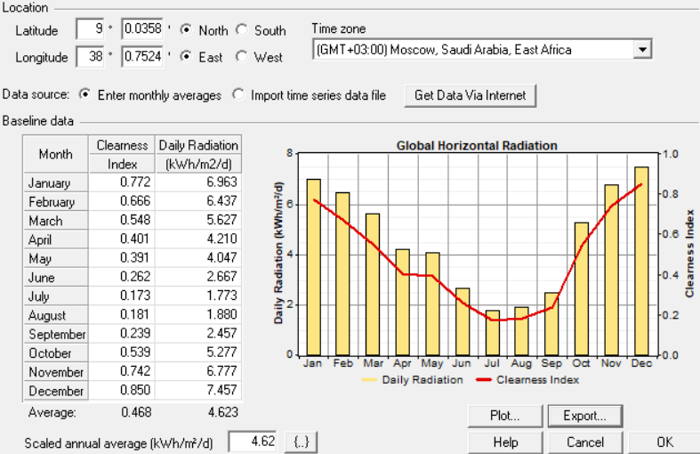
HOD Cont.….
The daily radiation in kwh/m2.day for A.A using the radiation and coordinate data presented above is given in Fig.4
Figure 4. The daily radiation in kwh/m2/day of A.A with cleanness index

Slide 53
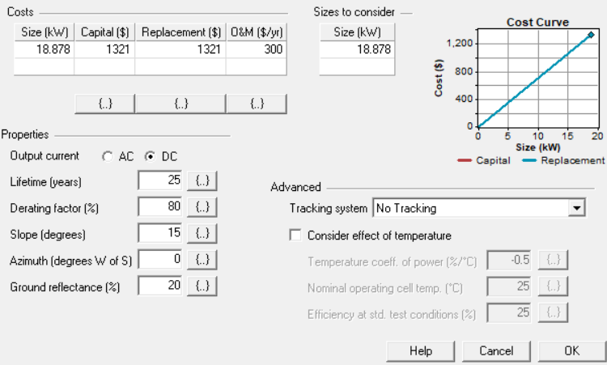
HOD Cont.….
Therefore, the cost of designed maximum power for the required 18.878 kw is presented in Fig.5
Figure 5. The input data for PV cost for the required demand.

Slide 54
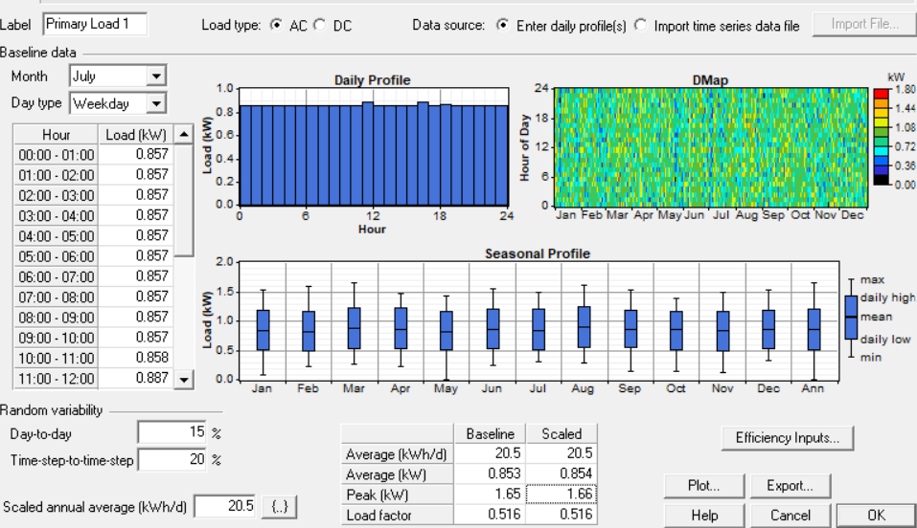
HOD Cont.….
The AC load input data based on the given input in kw/day is presented in Fig.6
Figure 6. The AC load input data in kw/day

Slide 55
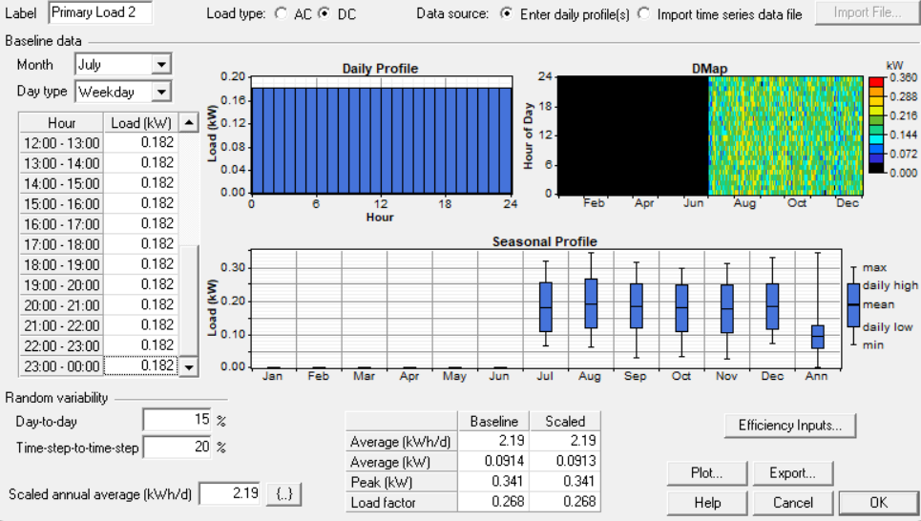
HOD Cont.….
The DC load input data based on the given input in kw/day is presented in Fig.7
Figure 7. The DC load input data in kw/day

Slide 56
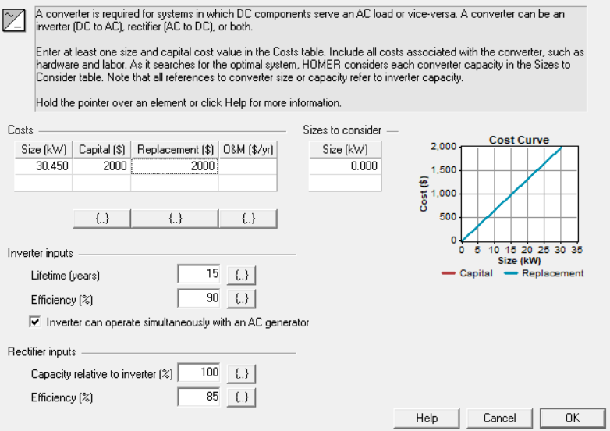
HOD Cont.….
Then, the converter cost data based on the rated capacity and market value is presented in Fig.8
Figure 8 The Converter rating and its cost in kw/day

Slide 57
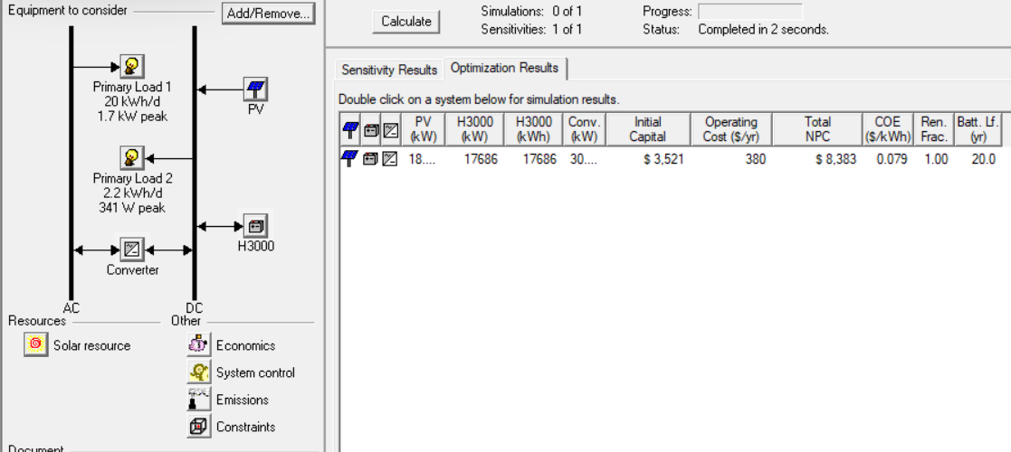
HOD Cont.….
Finally, the homer optimization overall model and results for initial estimation is given in Fig.9
Figure 9 The overall HOMER model and results for initial case

Slide 58
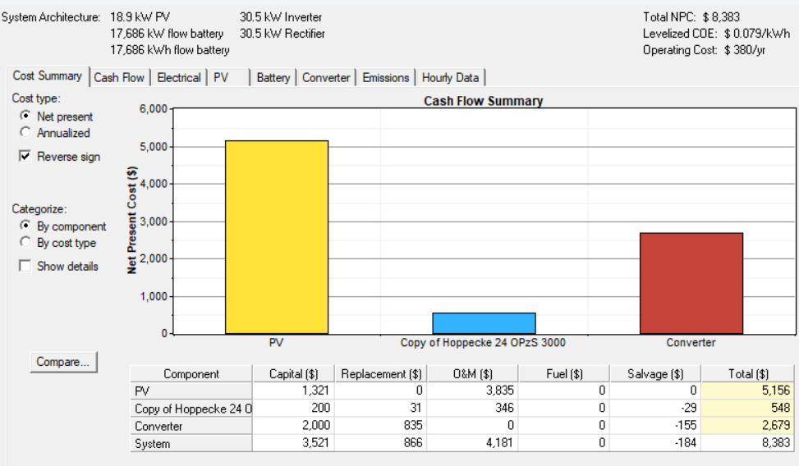
Homer optimization Solution(HOS)
a. Optimal Cost summary. The optimal cost summary is presented in Fig.10
Figure 10 Cost summary of Off-grid PV system

Slide 59
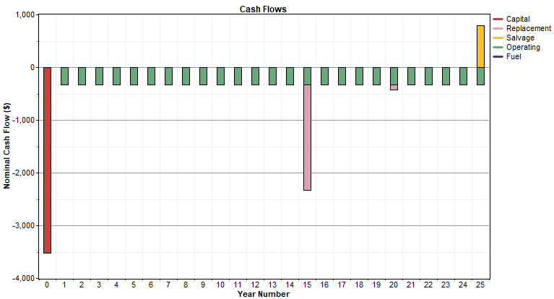
HOS Cont.…..
b. Cash flow summary of life span. The cash flow summary is presented in Fig.11
Figure 11 Cash flow summaries of Off-grid system

Slide 60
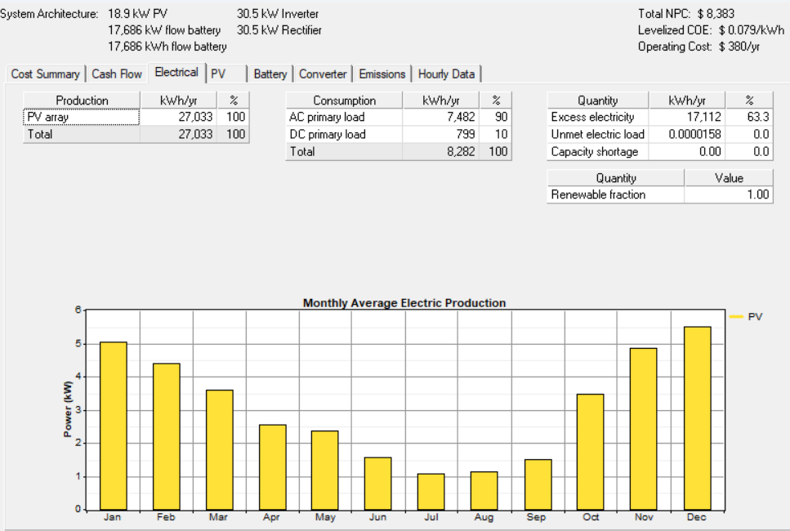
HOS Cont.…..
The monthly average electricity production is presented in Fig.12
Figure 12. Monthly Average Electricity Production

Slide 61
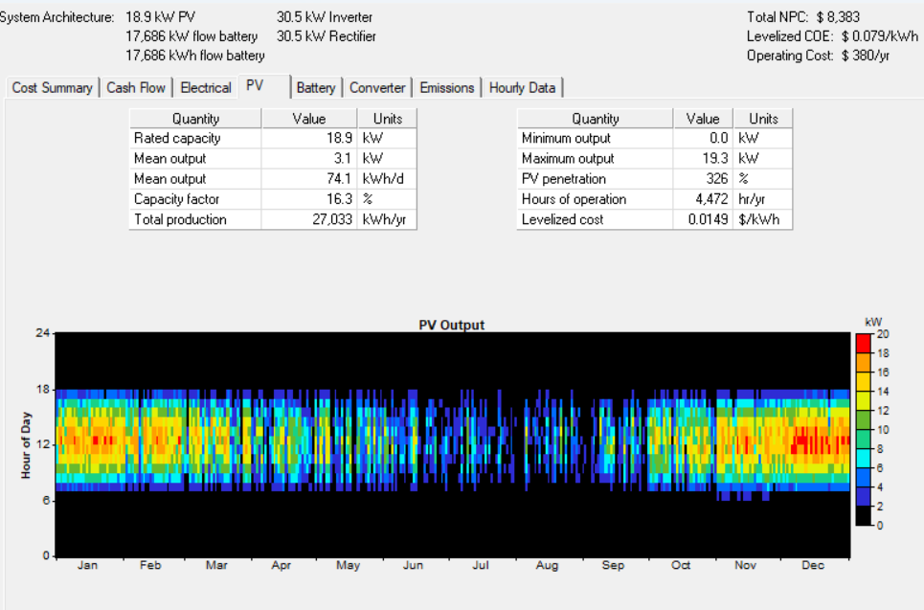
HOS Cont.…..
The PV output data is presented in Fig.13
Figure 13. PV output power

Slide 62
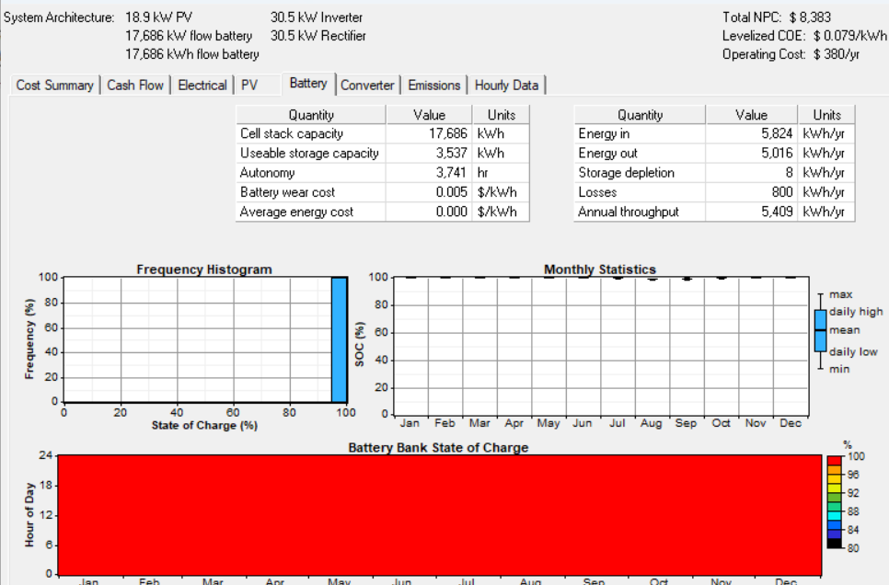
HOS Cont.…..
The battery status during operating condition is presented in Fig.14
Figure 14. Battery status during operating condition

Slide 63
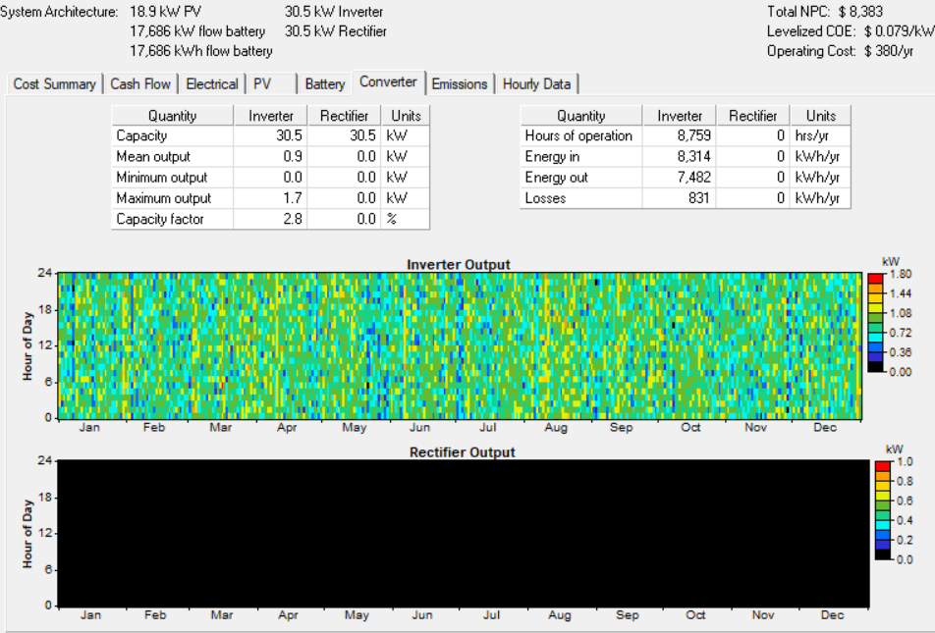
HOS Cont.…..
The converter status during operating condition is presented in Fig.15
Figure 15 Converter status during Operating condition

Slide 64
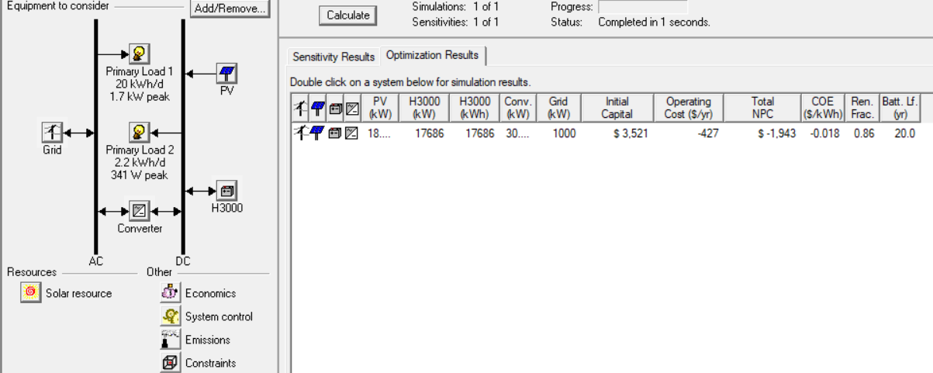
C. Homer solution for Grid connected system(HSGS)
The model of Grid-connected PV system for selected system is presented in Fig.16
Figure 16. grid connected PV system model

Slide 65
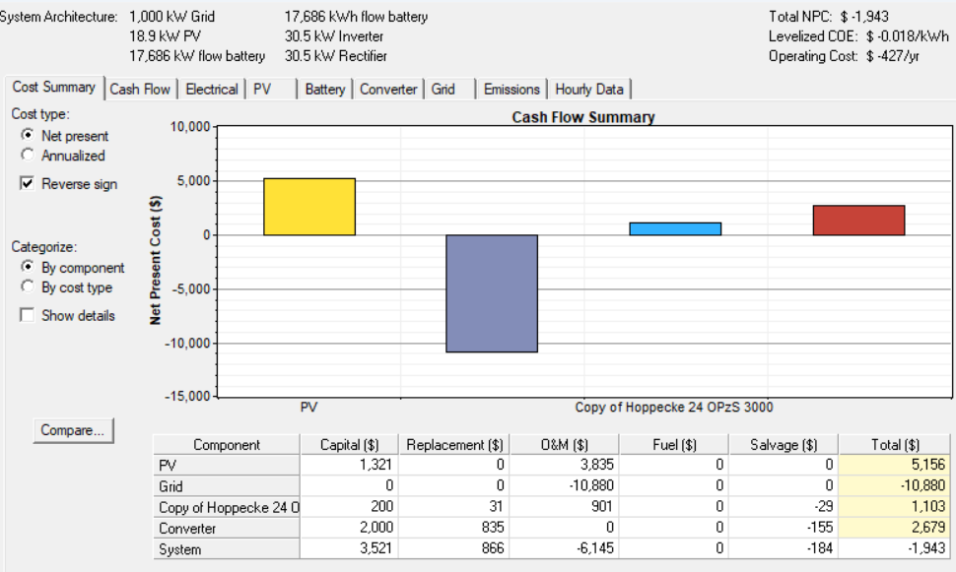
HSGS Cont.….
The cost of Grid-connected PV system for the same energy requirement is system is presented in Fig.17
Figure 17 cost summary of Grid connected PV system

Slide 66
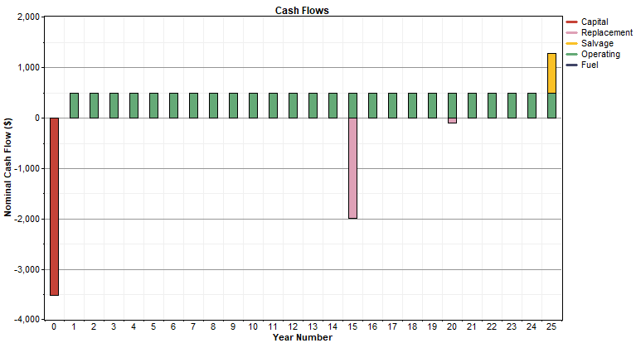
HSGS Cont.….
The cash flow based on the system life span is presented in Fig.18
Figure 18 cash flow summary of Grid-connected PV system

Slide 67
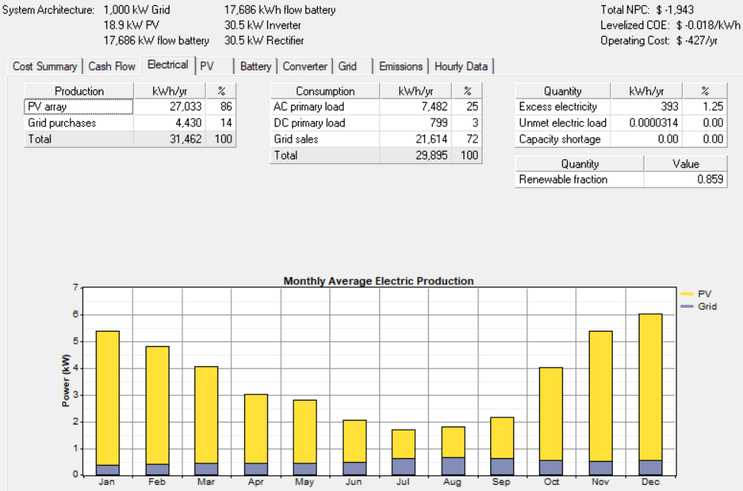
HSGS Cont.….
The monthly average energy production is presented in Fig.19
Figure 19 Monthly average electricity production of PV vs Grid

Slide 68
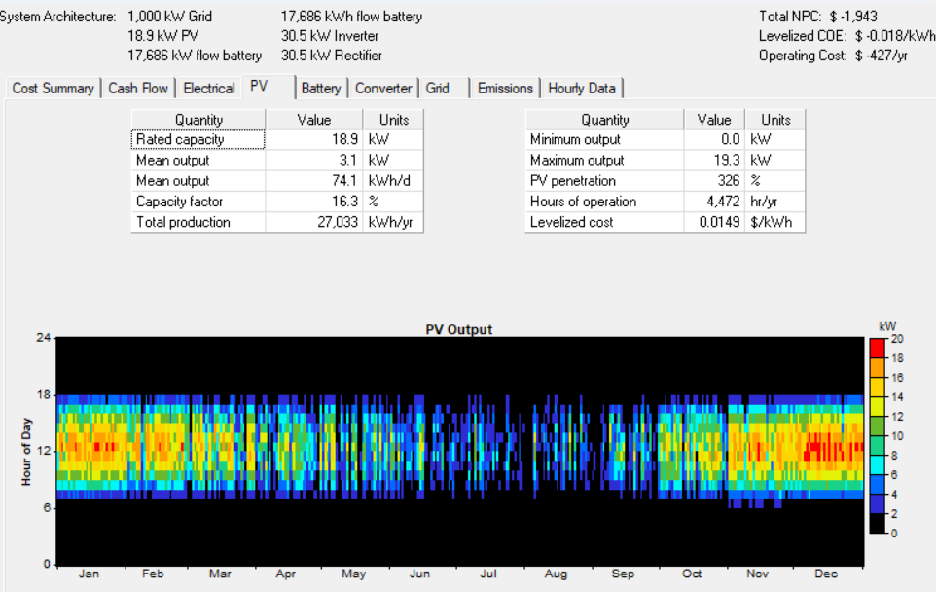
HSGS Cont.….
The PV output operation is given in Fig.20
Figure 20 PV output operation data

Slide 69
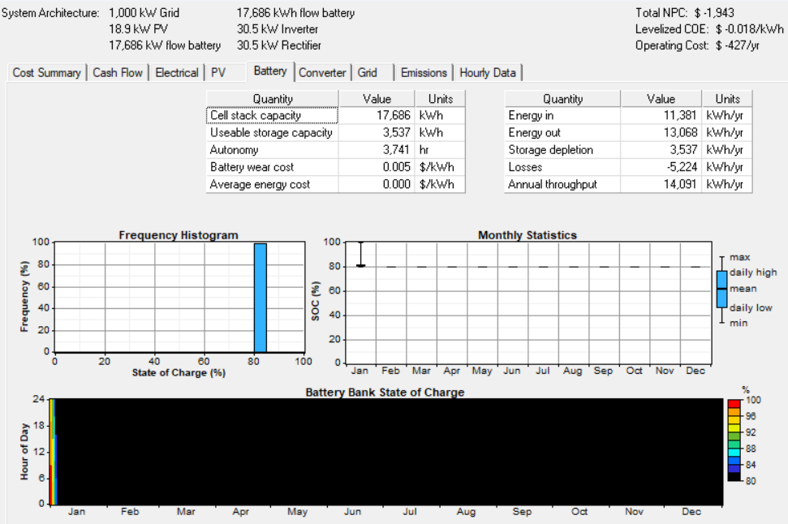
HSGS Cont.….
The operation of Grid connected PV system battery is given in Fig.21
Figure 21 the operation of Grid connected PV system batter

Slide 70
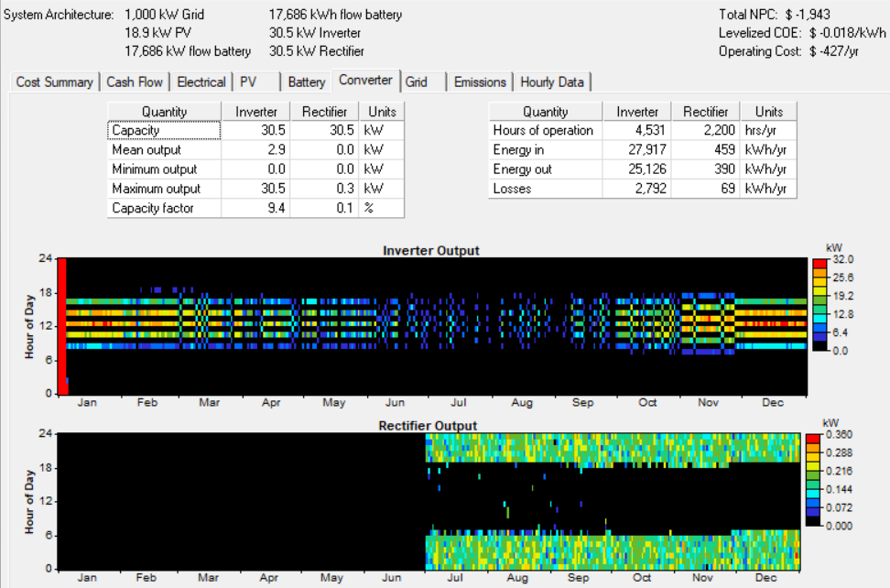
HSGS Cont.….
The operation of Grid connected PV system converter is given by:
Figure 22. The operation of Grid connected PV system converter

Slide 71
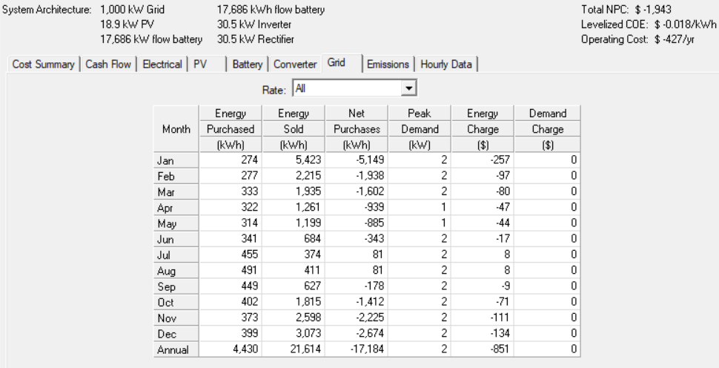
HSGS Cont.….
Energy flow data between grid and PV is given in Fig.23
Figure 23. Energy flow data between grid and PV

Slide 72
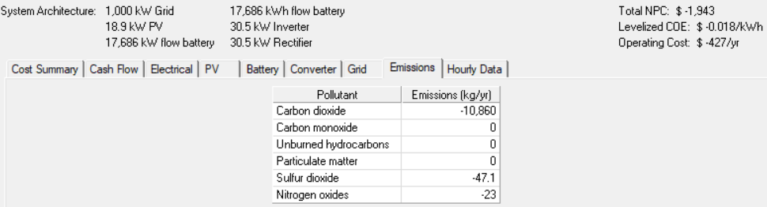
HSGS Cont.….
The environmental effect of grid-connected PV system is given in Fig.24
Figure 24 : Emission reduction data

Slide 73
HSGS Cont.….
Summary of Homer optimization: This interesting project presents a comparative study of the stand-alone and grid connected PV systems, one connected to the local grid (on-grid) and the other is standalone (off-grid), without taking the influence of sensitive variables into consideration.
The simulation results reveal that the local grid is most cost-effective than off-grid design for the similar load.
It also gives the optimal solution for off-grid and grid connected system, where the homer optimization solution provides better optimal solution compared to the hand based solution.
Besides this, the importance of connected RE to grid in terms of carbon emission reduction, bidirectional flow of energy and energy billing reduction are clearly indicated in Grid-connected systems.

Slide 74
Summary
This lecture note comprises the designing methods of off-grid and grid connected system.
The software application on designing and optimization of PV system is discussed.
Different software application on RE system, specifically the Homer optimization software is discussed.
The project design of Off-grid and Grid connected PV system using hand-calculation and Homer optimization is also discussed
The importance of charge controller/battery in off-grid and grid connected system is also observed from the design project

Slide 75
References
[1]. A.,Mustafa Yaseen; A., Mohammed Hasan and h., Maher Alwan. ‘’Estimation of loads for off-grid solar photovoltaic systems’’. International Journal of Power Electronics and Drive Systems (IJPEDS). V.13(2). 2022.
[2].H., Meg; Q., Tom; R., Kristen and etl. ‘’Requirements and Guidelines for Installation of Off-Grid Solar Systems for Public Facilities’’. https://www.lightingglobal.org/wp-content/uploads/2021/05/QualityAssurance-OffGridSolar-PublicFacilities-Nov2020.pdf
[3]. NREL. Getting Started Guide for HOMER Version 2.1. National Renewable Energy Laboratory. 2005. www.nrel.gov

Slide 76
Thank you !

Slide 77
Appendix A: Typical Power Consumption Demands of Various Appliances
Typical Power Consumption Demands | Wattage/appliance’s | Daily use (hours) | Daily Energy Use (watt hours)
Appliance | Watts
Coffee Pot | 200 | 0.25
Coffee Maker | 800 | 0.25
Toaster | 800-1500 | 0.25
Blender | 300 | 0.15
Microwave | 600-1500 | 0.3
Hot Plate | 1200 | 0.3
Washing Machine Automatic | 500 | 0.25
Washing Machine Manual | 300 | 0.25
Vacuum Cleaner Upright | 200-700 | 0.25
Vacuum Cleaner Hand | 100 | 0.25
Sewing Machine | 100 | 0.25
Iron | 1000 | 0.25
Clothes Dryer Electric | 400 | 0.25
Clothes Dryer Gas heated | 300-400 | 0.25
Water Pump | 250-500 | 0.25
Ceiling Fan | 10-50 | 0.25

Slide 78
Appendix A Cont.…
Table Fan | 10-25 | 0.25
Electric Blanket | 200 | 0.25
Blow Dryer | 1000 | 0.25
Shaver | 15 | 0.15
Computer Laptop | 20-50 | 5
Computer PC | 80-150 | 5
Computer Printer | 100 | 0.25
Typewriter | 80-200 | 0.3
TV 25" Color | 150 | 4
TV 19" Color | 70 | 4
1TV 2" B&W | 20 | 4
VCR | 40 | 0.2
Clock Radio | 1 | 0.3
Satellite Dish | 30 | 2
CB Radio | 5 | 0.3
Electric Clock | 3 | 24
Lights: 100W Incandescent | 100 | 4
Lights: 25W Compact Fluorescent | 28 | 4
Lights: 50W DC Incandescent | 50 | 4
,

Slide 79
Appendix A Cont.…
Lights: 40W DC Halogen | 40 | 4
Lights: 20W Compact Fluorescent | 22 | 4
Compact Fluorescent Incandescent: 40- watt equivalent | 11 | 4
Compact Fluorescent Incandescent: 60- watt equivalent | 16 | 4
Compact Fluorescent Incandescent: 75- watt equivalent | 20 | 4
Compact Fluorescent Incandescent: 100- watt equivalent | 30 | 4
1/4" Drill | 250 | 4
1/2" Drill | 750 | 4
1" Drill | 1000 | 0.5
9" Disc Sander | 1200 | 0.5
3" Belt Sander | 1000 | 0.5
12" Chain Saw | 1100 | 0.5
14" Band Saw | 1100 | 0.5
7-1/4" Circular Saw | 900 | 0.5
8-1/4" Circular Saw | 1400 | 0.5
Refrigerator/Freezer 20cf 1.8Kwh per day | 540 | 15
Refrigerator/Freezer 16cf 1.6Kwh per day | 475 | 13
Sun frost 16cf DC | 112 | 7
Sun frost 12cf DC | 70 | 7
Freezer 14cf | 440 | 15
Freezer 14cf | 350 | 14
Sun frost Freezer 19cf | 112 | 10

