Slide 1
Renewable Energy and Distributed Generations
Lecture 13
Mini/micro-Hydro Power Operation and Design
Lecturer: Teshome Goa (Assist. Prof.)
Lecture learning outcomes:
At the end of this lecture, you will be able to:
Understand the sizing and designing of hydropower plant
Identify the classification and Operation of hydropower
Knows the main component of hydropower plants
Estimate hydropower plant and select Turbines

Slide 2
Outlines
1. Introduction
2. Small Hydropower Plant
3. Classification of Hydropower Plants (CHPP)
4. Operation of Hydropower Plant
5. Main Component of Hydropower Plant
6. Estimating Hydropower Plant Power Capacity
7. Causes of Failure of Hydropower Plant Project
8. Turbine Modeling (Cross Flow Turbine)
Summary
References

Slide 3
1. Introduction
Water runs through a pipe, or penstock, at hydropower plants, where it presses up against and rotates turbine blades, spinning a generator to create energy.
It utilizes the turbines and generators, hydropower transforms kinetic energy into electrical power that powers homes, businesses, and industries by feeding it into the electrical grid.
A sustainable energy source called hydroelectricity uses the kinetic energy of flowing water to create electricity.
Building dams or other water control structures is necessary to direct water through turbines, which generate electricity.
Hydroelectric energy has benefits and drawbacks, despite being a plentiful source of energy

Slide 4
Introduction Cont.…
1. 1 Motivation behind using hydropower
Environmentally friendly
It’s a renewable energy source
Easily integrate with other renewables
Reliable and efficient: One of the world's most efficient energy sources compared to coal-fired (40%), wind, solar and etc.
Can meet peak electricity demand
Flexible and constant power generation to meet the demand

Slide 5
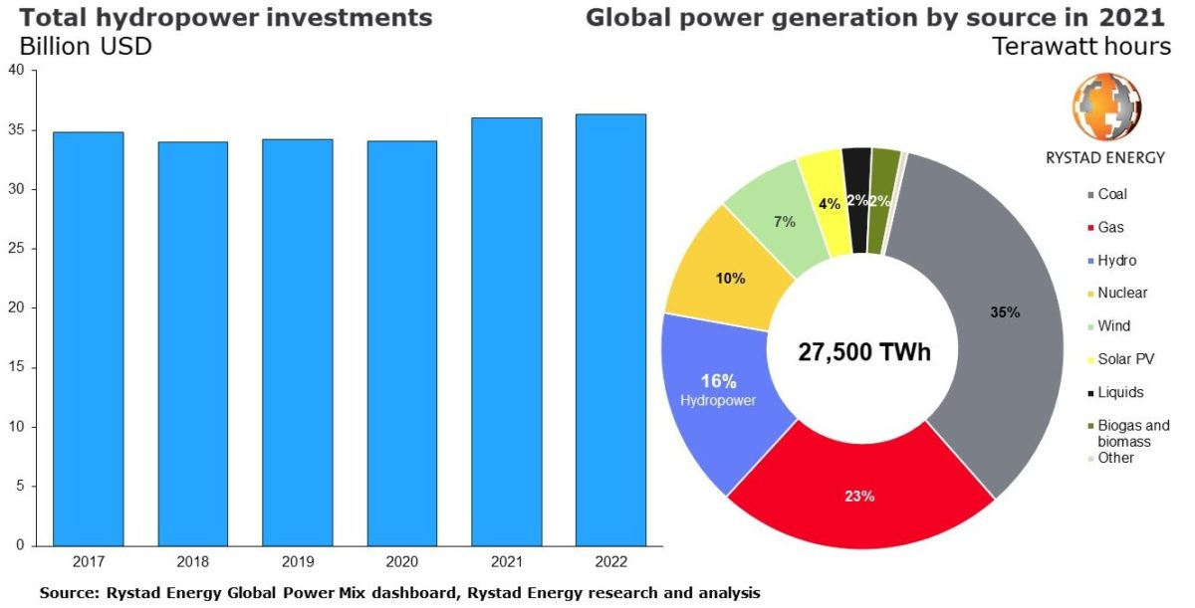
Introduction cont.….
Since ancient times, hydro-power has been used for irrigation, power houses and other applications.
Hydroelectricity is providing more than 16% of the world’s electric power consumption from both large and small hydro power plants as observed in Fig.1.
Figure 1. Global energy generation share. https://www.hydroreview.com/hydro-industry-news/new-development/installed-global-hydropower-capacity-could-reach-1200-gw-in-2022-report-says/#gref

Slide 6
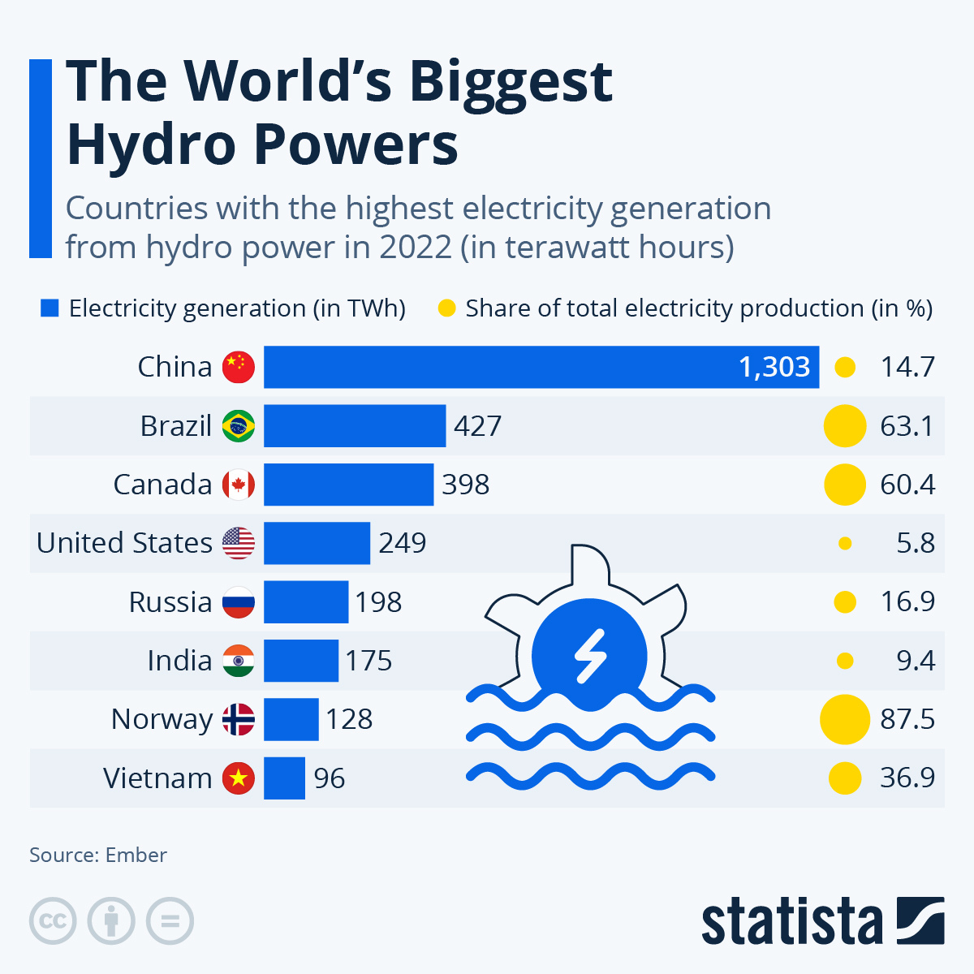
Introduction cont.….
China, Brazil, United States, Canada and Norway generate large quantities of electric power from very large hydroelectric facilities, which is presented in Fig.2[1].
Figure 2. Countries with the largest hydropower generation. https://cdn.statcdn.com/Infographic/images/normal/32027.jpeg

Slide 7
Introduction cont.….
On the other hand, there are numerous regions of the world that have a huge number of Small Hydropower plants(SHP) in service.
The report of global installed SHP capacity (up to 10 MW) is estimated at 78 GW in 2019
which represents an increase of 4.7% from the 2016 and around 10% over data from2013 as indicated in the same report[2].
Similarly, there has been a noteworthy 30% increase in SHP potential since 2013 up to 2019 as indicated by reference 2.
The installed SHP installed capacity and potentials are presented in Fig.3

Slide 8
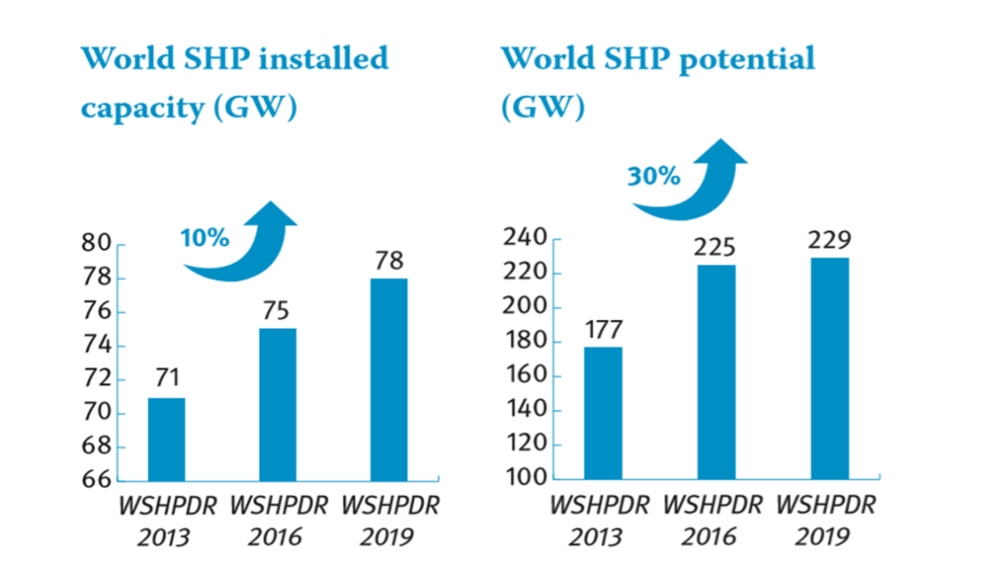
Introduction cont.….
Accordingly, Asia and Europe have the largest increases in installed SHP capacity, at 5.2%.
A minor decline in the Americas, while updates and natural disasters are to blame for the decrease in Oceania. Only 1.5% more was added to Africa in comparison to the previous edition.
Figure 3. SHP Installed capacity and Potentials
https://www.unido.org/our-focus-safeguarding-environment-clean-energy-access-productive-use-renewable-energy-focus-areas-small-hydro-power/world-small-hydropower-development-report

Slide 9
2. Small Hydropower Plant
The term "small hydro power plant," which can refer to an electric power production ranging from a few kilowatts to 50 megawatts or more.
Hydropower facilities classified as "small" internationally typically have a capacity between 1 and 50 MW.
Hydropower plants with a capacity between 100 kW and 1 MW are commonly referred to as "mini" hydro plants
Hydropower plants with a capacity less than 100 kW are called "micro" hydro power plants.
Installed capacity, however, isn't usually a reliable gauge of the scope of the project.
A 20 MW low-head hydro power station, for example, is not modest since, in contrast to high-head facilities, low-head hydro facilities often require bigger water volumes and hydro turbines.

Slide 10
3. Classification of HydroPower Plants (CHPP)
Hydropower plants can be classified according to parameters and schemes used to design
But, the familiar categorizations are based on:
Head availability
Operation
Size.

Slide 11
CHPP Cont....
a. Classification according to Head
Head is the difference in elevation between the intake water and trail water, thus hydropower plants are commonly categorized based on their head as follow:
a. High Head: if the head is more than 100m
b. Medium Head: if the head is between 30m and 100m
c. Low Head: if the head is lower than 30m

Slide 12
CHPP Cont....
The most prevalent and sizable hydroelectric facilities currently in use worldwide are high-head facilities[3].
A dam is typically used in this kind of hydropower plant in order to store water at a higher elevation.
When a dam is used to store water for a hydroelectric plant, it is also possible to collect water during the rainy season and release it during the dry season, when energy is not required, or when demand for electricity is higher.
This option leads to a steady and dependable supply of electricity that can meet demand when needed.
Electric utilities greatly value high-head hydropower projects with storage facilities because they can be easily altered to fit peak hour energy demand.

Slide 13
CHPP Cont....
b. Classification based on Operation are:
Based on how they operate and the amount of discharge that is available at the project site, hydropower plants are categorized into three groups, which are:
Run-of-river: an approach that uses the incoming water immediately to create energy with either very little or no storage.
Storage: a plan that creates a reservoir upstream of a dam structure to store water, especially during dry spells, so the reservoir can be used all year round.
Pumped storage: is a plan that allows water to be stored for use during periods of peak energy demand by pumping it from a river or lower reservoir to a reservoir at a higher elevation.

Slide 14
CHPP Cont....
c. Classification based on size are:
Hydropower plants are generally categorized based on their installed capacity, though there is some variance in the threshold dividing different classes.
Large HPP: it’s connected to expansive grids and have installed capacities more than 100 MW.
Medium HPP: it feeds into the grid and has a capacity of 15–100 MW.
Small HPP: it consists of 1–50 MW and can be standalone for certain locations or feed into the grid.
Mini HPPs: are typically standalone and range in power from 100KW to 1 MW.
Micro HPP: utilized as a standalone unit, it has a capacity of 5 to 100 KW.
Pico HPP: it can operate independently in remote locations and has an installed capacity of less than 5KW.

Slide 15
4. Operation of Hydropower Plant (OHPP)
A form of energy produced by water that is dependent on both volume and elevation differential between the source and the outflow is called hydroelectricity.
To put it another way, the fact that water circulates under the initial force and uses turbines and generators to create electricity makes hydroelectricity, which is sustainable renewable energy source.
The principle of electricity generation is similar irrespective of the size of the hydropower plant.
Thus, stored water at higher elevation has a potential energy due to gravity and when this water is allowed to fall down a given head, potential energy will be converted into kinetic/pressure energy forms.
The kinetic and pressure energy can be converted into mechanical energy using hydraulic turbines.

Slide 16
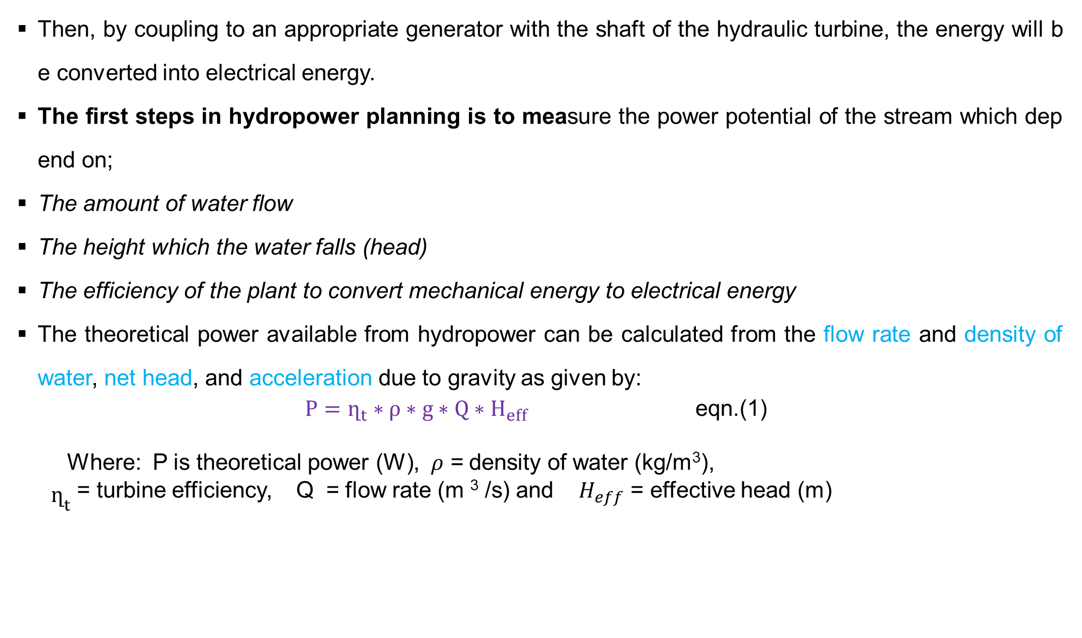
OHPP Cont.….
Then, by coupling to an appropriate generator with the shaft of the hydraulic turbine, the energy will be converted into electrical energy.
The first steps in hydropower planning is to measure the power potential of the stream which depend on;
The amount of water flow
The height which the water falls (head)
The efficiency of the plant to convert mechanical energy to electrical energy
The theoretical power available from hydropower can be calculated from the flow rate and density of water, net head, and acceleration due to gravity as given by:
$P=ղ_{t}∗ρ∗g∗Q∗H_{eff}$ eqn.(1)
Where: P is theoretical power (W), 𝜌 = density of water (kg/m³),
${\begin{aligned} \\ ղ\end{aligned}}_{t}$ = turbine efficiency, Q = flow rate (m ³ /s) and${ H}_{eff}$ = effective head (m)

Slide 17
OHPP Cont.….
a. Site Selection of Hydroelectric Power Plants(HPP): While selecting the site for HPP the following should be considered
Excess water availability
High gross head
Water storage reservoir
Cost of transmission lines
Accessibility of the site to transport equipment.

Slide 18
PHPO Cont.….
i. Stream Flow Measurement
Consider seasonality effect. Stream flow varies greatly from season to season and depending on the nature of the topography.
Thus, field data must be gathered many times throughout the year.
No power can be generated during low-flow periods without reservoir storage.
The flow may be calculated by precisely measuring the depth of water flowing over the crest of the dam.

Slide 19
PHPO Cont.….
The selected references give more detail on how to measure stream flow by the Bucket Method, weir or float method.
Bucket Method : This is a simple method for measuring a very small flow of less than 5 l/s with very high accuracy.
Use 10 bucket, 1-litre volume each, so it holds 10 liters. Using one bucket after the other, catch all the water flowing through the pipe for 1 minute, 60 sec.
Then, count how many buckets you can fill during that time and calculate the total water flow (l/s).

Slide 20
PHPO Cont.….
Measuring speed float
Stream flow is measured by calculating the volume of water that passes a particular point in a stream within a specified amount of time.
To calculate flow you must know two things: how much water a section of stream holds (volume), and how fast that water is moving (velocity).
Stream flow can be determined by measuring the velocity of water and the cross sectional area of the stream.
The formula to use when calculating stream flow is:
eqn.(2)
No matter what method of flow measurement is used,
it is very important to measure stream flow many times over a year or more.

Slide 21
5. Main Component of Hydropower Plant(MCHPP)
The hydropower plant consists of different electro-mechanical equipment and civil structures.
The water accumulate in the reservoir by the help of the dam and passes through the intake structure and keep going via the penstock to the hydraulic turbine, where the energy exploiting carried out.
Figure 4 illustrates a generalized hydropower schematic diagram which shows main parts of hydropower plant.
The components for electricity generation are almost similar for all kinds and sizes of the hydropower plants
But, some components which are needed in bigger hydropower plants may not be required in the smaller ones such as; dam, surge shaft tunnel, surge tank and others.

Slide 22
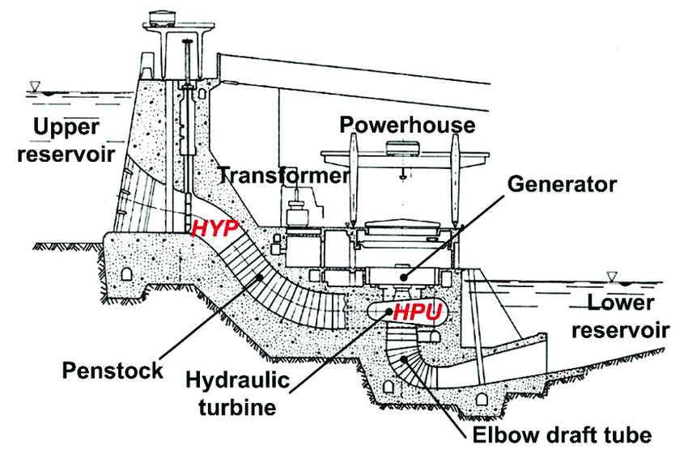
MCHPP Cont.….
Figure 4: Generalized Hydropower Schematic Diagram[4].
https://www.researchgate.net/figure/Schematic-view-of-a-hydroelectric-power-plant-Hydro-Power-Unit-HPU-and-Hydraulic_fig1_358764424

Slide 23
MCHPP Cont.….
Dams:
Water must fall in order to generate power from a stream.
In most cases, the fall is enhanced and increased by constructing a dam which creates a head.
The head is the vertical distance from the surface of the water at the dam down to the water in the stream below where the turbine is located.
The higher the dam or head, the greater the power a given amount of water will produce.
A dam also provides a storage basin to regulate stream flow and thereby increases power potential.
Before dam construction, you should consider the following points:

Slide 24
MCHPP Cont.….
a. Technical viability: Collect extensive field data to choose the best site and design a safe dam.
b. Multidisciplinary professionals are required: professional engineer can best advise you on construction of a safe dam for your particular site.
c. Permits from different sectors: Get permits size and resize the streams.
d. Know the right and responsibility as laws vary from state to state
e. Flood controlling: In the event of dam failure, you will be responsible for all downstream damage.

Slide 25
MCHPP Cont.….
f. Obey international law of water: respect the rights of others stream use outside of your property.
g. conflict resolution: You may face conflict from nearby landowners and narrow-minded groups or individuals.
h. Optimal cost estimation: solid cost estimates for the dam construction. Costs vary widely, depending on the particular site, but it is reasonable to assume that the construction of any worthwhile dam will run to several thousand dollars.
i. Perform cost-benefit analysis

Slide 26
MCHPP Cont.….
Diversions tunnels;
Because, legal requirements and high costs restrict new dam construction, other methods of water development is more suitable.
In some places only a round concrete box structure is needed to divert part of the flow of a stream through a pipe to a downstream turbine.
On any given stream, the best site for a diversion is usually quite obvious: a natural waterfall, a swift current or a steep slope.
The topography should be steep enough (10% slope or more) so the diversion pipe doesn’t have to be too long to obtain sufficient head.
Because a diversion has no backup storage for periods of low flow, potential power is sometimes calculated by determining the runoff in a year of normal rainfall which is exceeded on half the days of the year.

Slide 27
MCHPP Cont.….
Spillways: it provides passage for excess water from the reservoir to the downstream.
There are different types of spillways such as overflow, side channel, shaft and others which are according to the local topography and dam type.
Fore-bay Tank: the fore-bay is a basin of enlarged water that links channel and the penstock.
Its main role is to permit the last particles to settle down before the water enters the penstock.
Based on its size, it can also serve as a reservoir to store water.
Intake: it provides mouth for the delivery of water towards the hydraulic turbines and should be constructed in a way to minimize:
The head losses, no formation of vertices, minimum entry of sediments
and floating materials into the penstock.

Slide 28
MCHPP Cont.….
Penstock: it is a pressurized conduit which helps to convey the water towards the turbines.
Penstock is designed based on hydropower plant topography and principle of operation.
Power House: it is a place where the energy conversion to electrical energy is carried out using respective electro-mechanical equipment such as; hydraulic turbines, generators, transformers and others.
The power house will be in underground or in the surface depending on the geographic location of the site.

Slide 29
6. Estimating Hydropower Plant Power Capacity (EHPPC)
The power equation is mainly depends on the net head and flow rate as given by:
eqn.(3)
Where, ‘P’ is power measured in Watts (W), ‘m’ is mass flow rate in kg/s, the same as the flow rate in liters/second that 1 liter of water weighs 1 kg, ‘g’ is the gravitational constant, which is 9.81m/s², H_{net} is the net head.
The net head is less than a gross head physically measured at the site because of losses.
To keep things simple head losses can be assumed to be 10%, H_{net}=H_{gross} x 0.9
‘η’ is the product of all of the component efficiencies, product of turbine, drive system and generator
Thus, the friction, generator losses and turbine losses reduce the efficiency of a power plant.

Slide 30
EHPPC Cont.….
For a typical small-hydro power system, the turbine efficiency would be 85%, drive efficiency 95% and generator efficiency 93%, so the overall system efficiency would be[5].
Five to ten kilowatt plants may be 60 to 70% efficient when operating at full capacity.
eqn.(4)
Table 1 lists the water flow and head needed to run various small hydroelectric plants operating at 0.751 efficiency.
Manufacturers of hydroelectric plants also list power outputs of their units at various flows and heads.

Slide 31
EHPPC Cont.….
Table 1. Power estimation of hydropower plant.
https://renewablesfirst.co.uk/renewable-energy-technologies/hydropower/hydropower-learning-centreold/head-and-flow-detailed-review/
 | Maximum power output(W)
 | 5 | 10 | 25 | 50 | 100
Head (m) | Flow(m3/sec)
2 | 0.340 | 0.680 | 1.699 | 3.398 | 6.796
5 | 0.136 | 0.272 | 0.680 | 1.359 | 2.718
10 | 0.068 | 0.136 | 0.340 | 0.680 | 1.359
50 | 0.014 | 0.027 | 0.070 | 0.136 | 0.272
100 | 0.006 | 0.014 | 0.034 | 0.068 | 0.136

Slide 32
EHPPC Cont.….
Hydraulic Turbines: hydraulic turbine is a rotary machine that converts the potential energy of the water into mechanical energy.
The Hydraulic turbine has vanes, blades or buckets that rotate around an axis by the action of the water, the rotating part is called runner.
Based on principle of operation, there are two kinds of turbines; impulse and reaction turbines.
Impulse Turbine: the impulse turbine converts the potential energy of water in to kinetic energy in a jet issuing from nozzle and directed tangentially onto the buckets of the runner which rotates in the air.

Slide 33
EHPPC Cont.….
Impulse turbines are more widely used for micro-hydro applications as compared to reaction turbines because they have several advantages such as;
Simple design, it is easier to fabricate and to maintain, greater tolerance towards sand and other particles in the water, and better part-flow efficiencies.
Pelton, Cross-flow, and Turgo are some of impulse type hydraulic turbines.
Pelton Turbine: a Pelton turbine consists of a set of specially shaped buckets mounted on a periphery of a circular disc.

Slide 34
EHPPC Cont.….
It is turned by forced jets of water which are discharged from one or more nozzles and impinge on the buckets.
The resulting impulse, spins the turbine runner, imparting energy to the turbine shaft.
The buckets are split into two halves so that the central area does not act as a dead spot incapable of deflecting water away from the oncoming jet.
The micro hydro turbine could be selected either using the specification presented in Table 2. or Fig.5

Slide 35
EHPPC Cont.….
Table 2: Classification of micro hydro turbines according to head, flow rate and power output. https://supernnsk.life/product_details/91379253.html
Type | Slop | Discharge | Power on the shaft
 | (m) | (m3/s) | (MW)
Pelton Turbine | 50-12000 | 0.1-50 | <300
Kaplan turbine (with vertical axis) | 8-80 | 5-1000 | <200
Pipe kaplan turbine | 1.5-25 | 5-1200 | <50
Propeler turbine (with open chamber) | 1.5-25 | 1.5-100 | <10
Pipe turbine (with propeller type rotor ) | 1.5-25 | 1.5-100 | <10
Francis turbine | 10-600 | 0.5-1000 | <850

Slide 36
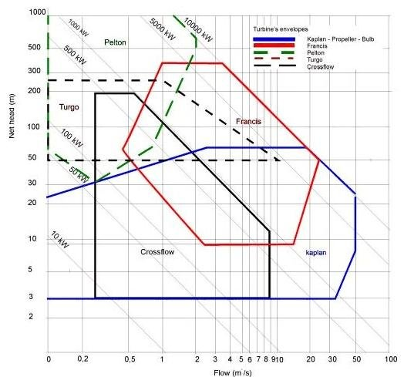
EHPPC Cont.….
Figure: 5 Turbine selection chart[6].
https://www.researchgate.net/figure/Turbine-selection-chart-based-on-head-and-flow-rate-1_fig2_292726939

Slide 37
7. Causes of Failure of Hydropower Plant Project
The main reasons for lack of success with small water power developments are:
If the full field data is not properly collected for the HPP design.
homemade equipment problems and their failure due to some junked parts.
Over-estimating the stream flow.
Small size of Penstocks to allow the plant to operate, specifically at full capacity.
Failure to anticipate the expense of keeping trash racks clear and machinery in good repair.
Failure to design and plan for seasonality
Over or under estimation of a proposed plant’s capability.

Slide 38
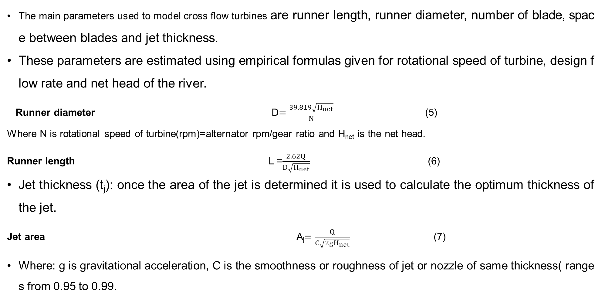
8. Turbine Modeling (Cross Flow Turbine)
The main parameters used to model cross flow turbines are runner length, runner diameter, number of blade, space between blades and jet thickness.
These parameters are estimated using empirical formulas given for rotational speed of turbine, design flow rate and net head of the river.
Runner diameter D$=\frac{39.819\sqrt{H_{net}}}{N}$ (5)
Where N is rotational speed of turbine(rpm)=alternator rpm/gear ratio and H_{net} is the net head.
Runner length L =$\frac{2.62Q}{D\sqrt{H_{net}}}$ (6)
Jet thickness (t_{j}): once the area of the jet is determined it is used to calculate the optimum thickness of the jet.
Jet area A_{j}$=\frac{Q}{C\sqrt{2gH_{net}}}$ (7)
Where: g is gravitational acceleration, C is the smoothness or roughness of jet or nozzle of same thickness( ranges from 0.95 to 0.99.

Slide 39
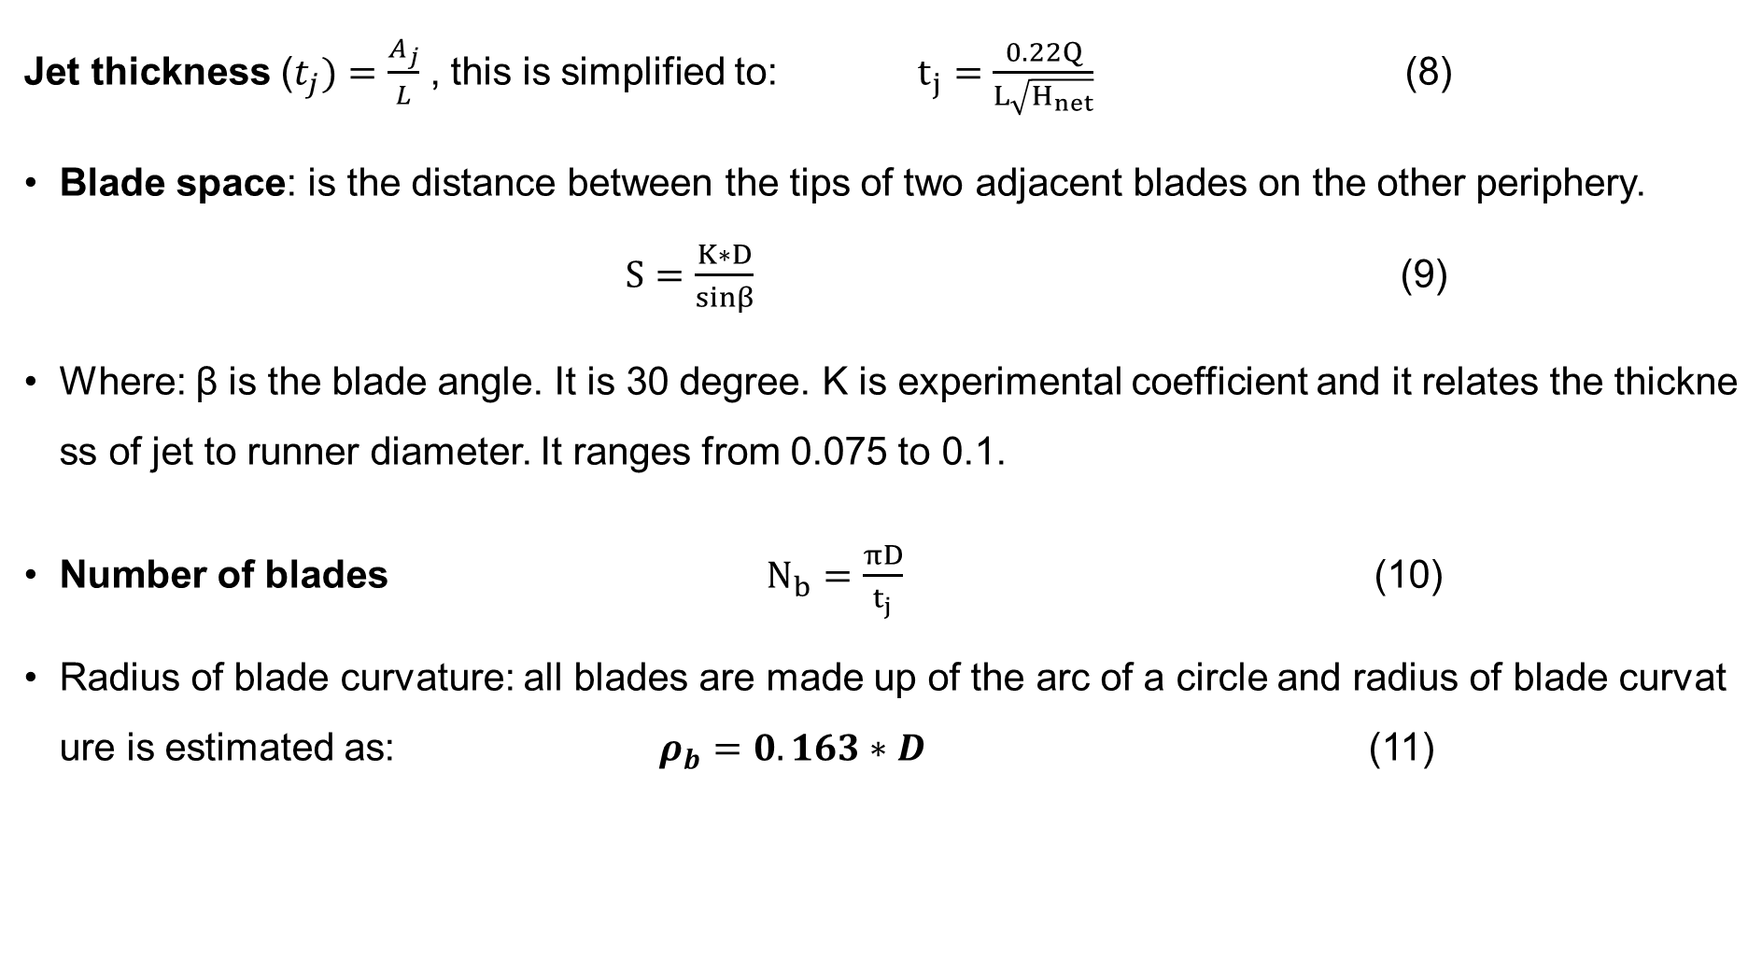
Turbine Modeling Cont.…..
Jet thickness ($t_{j})=\frac{A_{j}}{L}$ , this is simplified to: $t_{j}=\frac{0.22Q}{L\sqrt{H_{net}}}$ (8)
Blade space: is the distance between the tips of two adjacent blades on the other periphery. $S=\frac{K∗D}{sinβ}$ (9)
Where: β is the blade angle. It is 30 degree. K is experimental coefficient and it relates the thickness of jet to runner diameter. It ranges from 0.075 to 0.1.
Number of blades $N_{b}$ $=\frac{πD}{t_{j}}$ (10)
Radius of blade curvature: all blades are made up of the arc of a circle and radius of blade curvature is estimated as: $ρ_{b}=0.163∗D$ (11)

Slide 40
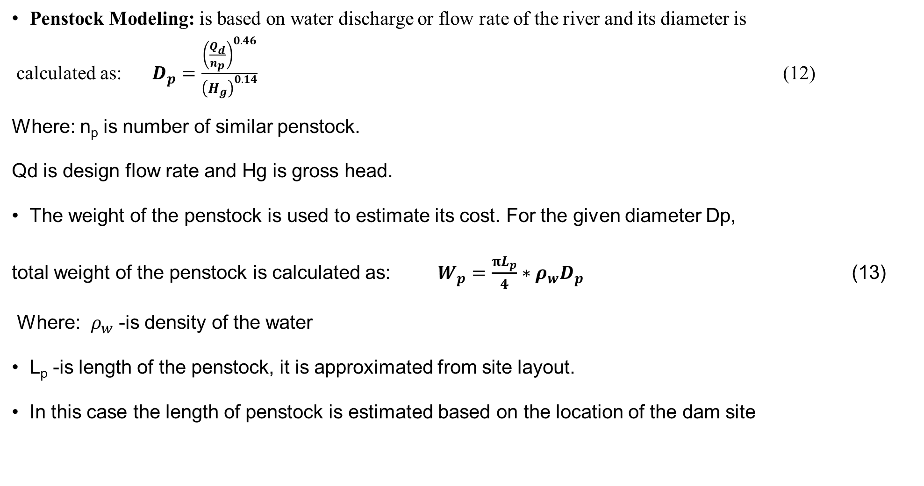
Turbine Modeling Cont.…..
Penstock Modeling: is based on water discharge or flow rate of the river and its diameter is
calculated as: $D_{p}=\frac{{\left(\frac{Q_{d}}{n_{p}}\right)}^{0.46}}{{\left(H_{g}\right)}^{0.14}}$ (12)
Where: n_{p} is number of similar penstock.
Qd is design flow rate and Hg is gross head.
The weight of the penstock is used to estimate its cost. For the given diameter Dp,
total weight of the penstock is calculated as: $W_{p}=\frac{πL_{p}}{4}∗ρ_{w}D_{p}$ (13)
Where: $ρ_{w}$ -is density of the water
L_{p} -is length of the penstock, it is approximated from site layout.
In this case the length of penstock is estimated based on the location of the dam site

Slide 41
Summary
In conclusion, the hydropower plant principle, operation and modeling is discussed in this lecture material.
The classification of hydropower plant based on their head, operation and size is also discussed in detail.
Besides this, the importance of each hydropower plant components, their principal operation and efficiency is also covered in this lecture note.
On top it, the dominant factors while sizing the hydropower plant is discussed. It’s observed that discharge and net head are the two dominant factors while designing HPP.
Finally, the turbine selection and its efficiency based on the size, head requirement and flow rate is also summarized in this lecture

Slide 42
Reference
[1]. F., Anna. ‘’The World’s Biggest Hydro Powers HYDRO POWER’’. Apr 5, 2024. https://cdn.statcdn.com/Infographic/images/normal/32027.jpeg.
[2]. UNIDO. ‘’World Small Hydropower Development Report (2013-2019)’’. https://www.unido.org/our-focus-safeguarding-environment-clean-energy-access-productive-use-renewable-energy-focus-areas-small-hydro-power/world-small-hydropower-development-report
[3] M.,Jorge. ‘’The use of hydropower for electricity generation’’. Non-Conventional Energy in North America, 2022. https://doi.org/10.1016/B978-0-12-823440-2.00010-X
[4]. S., Lupa; M., Gagnon; S., Muntean and etl. ‘’The Impact of Water Hammer on Hydraulic Power Units’’. Energies. 2022, V.(15), 1526. https://doi.org/10.3390/en15041526
[5]. B., Siddhartha and S., Jothibasu. ‘’Optimization of Annual Energy Generation in run of the River of Hydro Power Plants’’. The Journal of CPRI. V.8(4), 2012.
[6]. S., Saurabh G,, Arpit and K.,Dinesh Kumar. ‘’ Review of Optimal Selection of Turbines for Hydroelectric Projects’’. International Journal of Emerging Technology and Advanced Engineering V.3(3). 2013.

Slide 43
Thank you !

