Slide 1
Renewable Energy and Distributed Generations
Lecture 14
Geothermal Energy Resources
Lecturer: Teshome Goa (Assist. Prof.)
Lecture learning outcomes:
At the end of this lecture, you will be able to:
Understand the types of Geothermal Power Plant (GPP)
Knows motivation behind using Geothermal Power plant
Identify the component of GPP
Knows the Operation GPP
Understand the operation and factors affecting GPP

Slide 2
Outlines
1. Introduction
2. Types of Geothermal Power Sources
3. Motivation behind using Geothermal energy
4. Geothermal Energy system components
5. Operation of Geothermal Power Plant
6. Advantage and Disadvantage of GPP
7. Factors Affecting GPP Operation
Summary
References

Slide 3
1. Introduction
Geo (earth) + thermal (heat) equals geothermal energy, which is heat energy from the earth
Hot water reservoirs at different temperatures and depths below the earth's surface that are naturally occurring or created by humans are known as geothermal resources[1].
The fact that heat is constantly generated inside the earth makes geothermal energy a renewable energy source.
Steam is used in geothermal power plants to generate energy.
The steam originates from hot water reservoirs located several miles below the surface of the earth.
Steam drives a turbine, which in turn turns on a generator to produce power as presented in Fig.1.

Slide 4
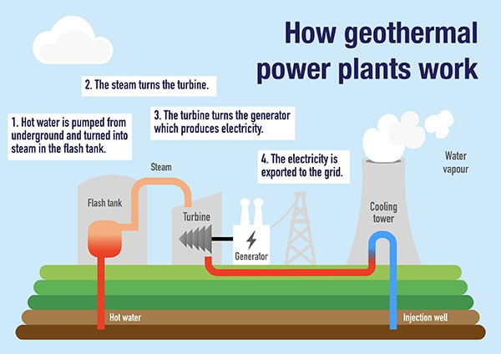
Introduction Cont.….
Figure 1. Geothermal power Plant working principle.
https://amigoenergy.com/blog/understanding-geothermal-energy/

Slide 5
Introduction Cont.….
Earth has a heat content of 10³¹ joules.
This heat naturally flows to the surface by conduction at a rate of 44.2 terawatts, (TW,) and is replenished by radioactive decay at a rate of 30 TW.
These power rates more than double the amount of energy that humans now use (15 TW ) from primary sources, however the majority of this power is too diffuse (on average 0.1 W/m²) to be retrieved.
To release the heat underneath, the earth's crust needs to be punctured by fluid conduits, such as water or magma.
The crust functions as a thick insulating blanket.

Slide 6
Introduction Cont.….
Between 45 and 90 percent of the heat that leaves earth is thought to come from the radioactive decay of atoms, mostly found in the mantle
Gravitational potential energy is further subdivided as follows:
a. release during earth's formation.
b. Heat produced as the numerous heavy metals like copper, nickel, and iron that sank to the earth's core during differentiation.
Geothermal heat is naturally occurring heat that rises to higher levels of the earth's crust as a result of radioactive materials in the crust decaying.

Slide 7
Introduction Cont.….
Hydro-geothermal energy is the accumulation of interior earth energy in gasses and water
whereas petro-thermal energy is the retention of that energy in solid rocks
Petro-thermal energy has just lately been employed for building heating and cooling, but hydro-geothermal energy has been used for decades, either directly or to generate heat and electricity.
The most common phrase used to describe the production of electricity from hydro-geothermal energy is geothermal energy.
The global installed capacity of geothermal energy is a combined capacity of 16,318 MW in 2023[2].
The installed capacity per country is given Fig.2
7

Slide 8
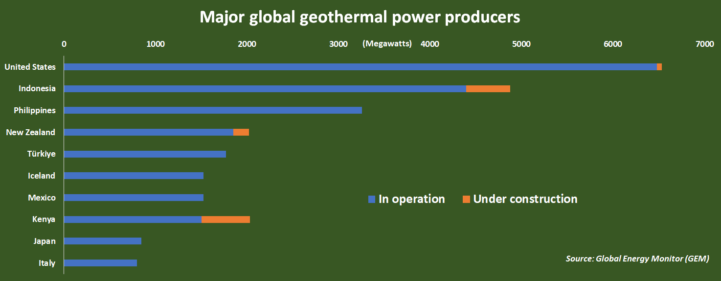
Introduction Cont.….
Figure 1. Global Geothermal Power producer[3]. https://www.reuters.com/markets/commodities/kenya-steps-up-global-geothermal-powerhouse-2023-10-05/

Slide 9
Introduction Cont.….
The majority of this hot geothermal water remains underground, locked in fissures and porous roc
It can occasionally surface as hot springs or geysers.
It’s known that this naturally occurring hot water gathering as a geothermal reservoir.
Accordingly, this naturally existing energy should be harnessed and different techniques should be applied to produce these energy
Its efficient uses based on the types of resources is also needed

Slide 10
2. Types of Geothermal Power Sources
Hot Water Reservoirs: The hot underground water reservoir is used as input for producing energy
The large number hot water reservoir exist in different regions
Natural Steam Reservoirs: this needs the deep dug-holes into the ground that can causes steam flow to the surface.
Geo-pressured Reservoirs: it uses the salt-water , which is completely saturated with different natural gas in stored under pressure from the weight of overlying rock.
Can be used for different applications like heat and natural gas.
Normal Geothermal Gradient
Molten Magma:

Slide 11
3. Motivation behind using Geothermal energy
Environmentally friendly
Reliable and doesn’t dependent on weather condition
Easily integrated with the Grid
Naturally abundant
Possibility of generating in large Giga-watt
It is an exceptionally constant source of energy , it is not dependent on neither wind nor sun, and available all year long

Slide 12
Motivation cont.…..
High efficiency : Geothermal heat pump systems uses 25% to 50% less electricity than conventional systems for heating or cooling, and
Flexible design they can be adjusted to different situations, requiring less
Little to No Geothermal System Maintenance
Reliable and Long life span , 20-50 years as presented in Fig.2
Minimal Land Use Compared to Other Energy Sources

Slide 13
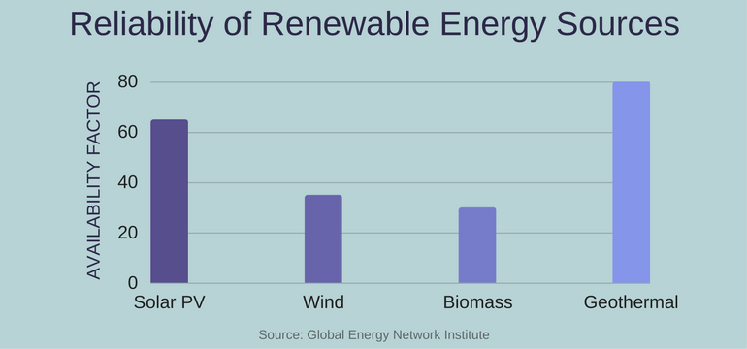
Motivation cont.…..
Figure 2. the Reliability of Geothermal energy Vs OTHER RE resources. https://www.greenmatch.co.uk/blog/2014/04/advantages-and-disadvantages-of-geothermal-energy

Slide 14
Motivation cont.…..
Geothermal energy is used for:
Used as electricity generations
Work as direct uses for the commercial, industrial, and residential heating purposes
For efficient home heating and cooling through geothermal heat pumps[4]:
For indirect uses drilling wells are needed then hot water will flow into a geothermal reservoir.
a temperature above 150°C is needed for indirect use and for the direct use it is generally around 80°C.
Then, the water go to the surface through wells and then its heat energy will be converted into electricity at a geothermal power plant.
14

Slide 15
4. Geothermal Energy System Components(GESC)
A geothermal system is composed of three main elements:
Heat Source
Reservoir
Fluid
The geothermal energy is transferred from interior towards the surface by conduction as presented in Fig.4.
It can be explained as follows: "convicting water in the earth's upper crust transfers heat from a heat source to a heat sink, usually the free surface, in a confined space"

Slide 16
GESC Cont.…….
Three primary components comprise a geothermal system: a reservoir, a heat source, and a fluid that acts as a heat carrier.
The heat source may be the earth's normal temperature, which rises with depth of a temperature (> 600 °C) magmatic incursion that has reached relatively shallow depths (5–10 km).
The heated permeable rocks serve as the reservoir, where heat is extracted by the circulating fluids
If the hot rocks are not permeable, it is necessary to fracture them

Slide 17
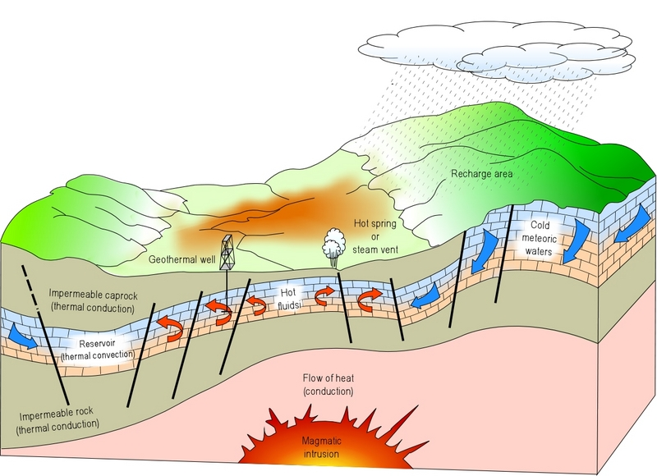
Figure 3. The formulation of Geothermal Energy[5]. https://www.researchgate.net/figure/Representation-schematique-dun-systeme-geothermique-ideal-5_fig2_267724906

Slide 18
5. Operation of Geothermal Power Plant(OGTPP)
There are four commercial types of geothermal power plants[6]:
flash power plants
dry steam power plants
c. binary power plants
d. flash/binary combined power plants
18

Slide 19
OGTPP Cont.……
a. Flash Steam Power Plant
Under intense pressure, the hot water is forced to the surface.
Because the water contains contaminants like salt, it is frequently referred to as "brine."
Some of the water turns into steam when it reaches the surface because of the drop in pressure as presented in Fig.4.
This creates a steam blast, which rotates the turbine and then create electricity. Operates at higher temperature, greater than 182 ⁰_{C}
The cooled water is put back into the reservoir so that geothermal rocks can warm it once more.

Slide 20
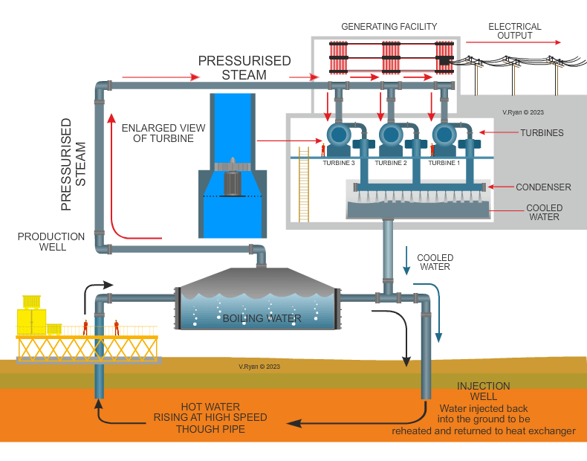
OGTPP Cont.……
Figure 4. Flash Steam Power Plant operation. https://technologystudent.com/energy1/geo4.htm
20

Slide 21
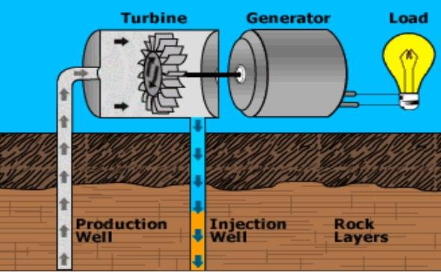
OGTPP Cont.….
b. Dry Steam Power Plant: Generator turbines in dry steam plants are powered by steam extracted directly from a geothermal reservoir[7].
An electrical generator is powered by the steam, which is brought straight to a turbine, which is presented in Fig.5.
Figure 5. Dry Steam Power Plant operation.
https://www.researchgate.net/figure/Dry-steam-power-plant_fig6_359577886
21

Slide 22
OGTPP Cont.….
The purpose of the cooling tower is to make the steam exiting from the turbine as cool as possible, so that it has low pressure;
This leads to make more energy or electricity to be extracted from the turbine.
The cooling tower produces cool water by pushing evaporation of some of the water that is fed to it.
Some of the water may lost through evaporation needs to be continuously replaced.
Accordingly, the cooling towers are used in coal and nuclear power plants, which also have steam turbines

Slide 23
OGTPP Cont.….
c. Binary Power Plant:
When the source contains minerals or chemicals, or when the geothermal resources are not hot enough to generate steam, a binary cycle power plant is utilized.
In binary-cycle power plants, heat from geothermal hot water is transferred to another liquid.
The heat causes the second liquid to become steamy, which drives a generator turbine.
23

Slide 24
OGTPP Cont.….
Typically, the Organic rankine Cycle like isobutane or other organic fluids like penta-fluoropropane, which boils at a lower temperature than water, is heated by the geothermal water.
A heat exchanger is used to transport the heat energy from the geothermal water to the working fluid, keeping the two liquids entirely apart.
There is a gaseous vaporization of the secondary fluid.
Similar to steam, the force of the expanding vapor drives the turbines that run the generators as presented in Fig.6

Slide 25
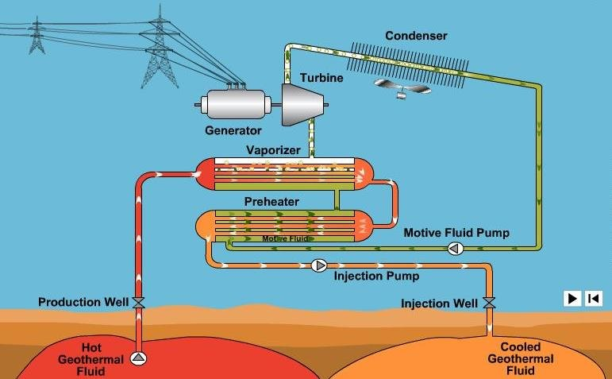
OGTPP Cont.….
Figure 6. Binary Power Plant operation. https://www.researchgate.net/figure/Binary-cycle-power-plant_fig7_359577886
25

Slide 26
OGTPP Cont.….
d. Flash/Binary Combined Cycle:
This type of plant, which uses a combination of flash and binary technology, has been used effectively to take advantage of the benefits of both technologies.
In this type of plant, the portion of the geothermal water which “flashes” to steam under reduced pressure is first converted to electricity with a back pressure steam turbine and the low-pressure steam exiting the back pressure turbine is condensed in a binary system.
In addition to different power plant technologies in use today, additional applications and technologies continue to emerge.
26

Slide 27
6. Factors Affecting GPP Operation
Water must exist in an underground reservoir. Plenty of water that steadily recharges to prevent depletion of the reservoir.
It must be really hot in the water. Warm enough to support the practical production of energy.
Drilling must be done at an economical depth.
Costs associated with the exploration, drilling wells, plants and equipment and costs of operation ,and maintenance should be minimized
A geothermal plant's price is highly site-specific.

Slide 28
Factors Affecting GPP Cont.…
The average cost of a geothermal power plant is estimated to be between USD 1870 and USD 5050 per kW[8],[9].
Generally speaking, flash and direct dry steam plants are less expensive than binary plants.
While a depth of 10 km is feasible, the economical depth may only go as deep as 6 km.
An additional aspect raising the overall price is the cost of exploration.
There will be a trade-off: drilling deeper wells will be more expensive, but the deeper wells will draw hotter water, increasing the efficiency of producing power and, ultimately, lowering the cost per unit.

Slide 29
7. Advantage and Disadvantage of GPP
Advantage
Important minerals be extracted from the underground water.
Creates jobs and reduce resilience on oil .
Could be online for long time without failures, 90 to 100% of the time compared to others like coal and nuclear plants .
coal and nuclear plants operates 75 % and 65%, respectively per their life time
Flash and Dry Steam Power Plants emit 1000x to 2000x less carbon dioxide than fossil fuel plants, no nitrogen oxides and little SO₂.
Binary and Hot Dry Rock plants have no gaseous emission at all.
Reduced land requirement for power plant
Reduced carbon emission compared to others as presented in Fig.7

Slide 30
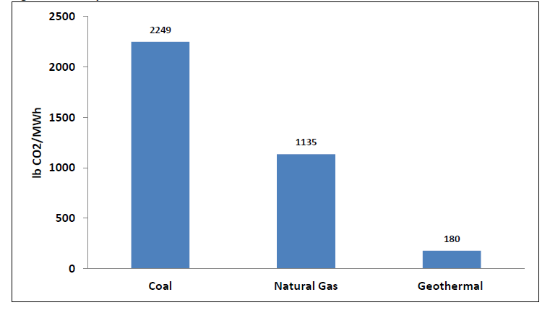
Advantage and Disadvantage of GPP Cont.….
For geothermal power generation no need of burning fuel, but they may release small amounts of SO₂and CO₂
Geothermal power plants emit 97% less acid and about 99% less carbon dioxide than fossil fuel power plants of similar size[10]
Figure 7. Emission Compression GPP and others . https://www.researchgate.net/figure/Comparison-of-coal-natural-gas-and-geothermal-CO2-emissions-GEA-2012_fig5_338384566

Slide 31
Advantage and Disadvantage of GPP Cont.….
Disadvantages
High start-up cost
Increased billing cost to consumer
Water can be corrosive to plant pipes, equipment
Mineral and solid waste can be produced
Gasses are smelly, like ammonia
Brine/salt-water can salient soil if the water is not properly injected back into the reserve after the heat is extracted.
Noise pollution during drilling

Slide 32
Summary
In conclusion, the geothermal renewable energy is well discussed in this session.
The three common operation of geothermal power generation like flash steam, dry steam and binary steam is well discussed.
In line with this, the versatile advantage of geothermal energy in terms of environmental friendly, its efficiency and emission reduction compared other resources is also discussed.
Besides this, the application of geothermal power plant is also discussed.
The total installed capacity and potentials of geothermal power plant is also discussed.

Slide 33
References
[1]. A., Austin and R., Behnaz.‘’Geothermal technology: Trends and potential role in a sustainable future’’. Elsevier: Applied Energy. V.248(2019).
[2]. Luis C. A. Gutiérrez‑Negrín. ‘’ Evolution of worldwide geothermal power 2020–2023’’. Springer: Gutiérrez‑Negrín Geothermal Energy. https://doi.org/10.1186/s40517-024-00290-w
[3]. M., Gavin. ‘’Kenya steps up as global geothermal powerhouse’’. 2023.
[4]. D., Ibrahim Dincer and F., Muhammad. ’’ Renewable Energy Production’’. Comprehensive Energy Systems. V.3(2018). https://doi.org/10.1016/B978-0-12-809597-3.00310-2
[5]. A., Lala . ‘’Caractéristiques générales des systèmes et des régions géothermiques
de Madagascar ‘’. V.2(2011).
[6]. M., Fallah; R. ,Akbarpour and N. Hasani. ‘’ A comprehensive comparison among different types of geothermal plants from exergy and thermoeconomic points of view’’. Thermal Science and Engineering Progress (2017), doi: https://doi.org/10.1016/j.tsep.2017.10.017
[7]. A., Muhammad and B., Firman. ‘’Dry steam power plant: Thermodynamic analysis and system improvement’’. Thermodynamic Analysis and Optimization of Geothermal Power Plants, 2021. https://doi.org/10.1016/B978-0-12-821037-6.00015-9
[8]. IRENA (2017), Geothermal Power: Technology Brief, International Renewable Energy Agency, Abu Dhabi
[9]. P.,Eko. ‘’ASSESSMENT OF EXPLORATION STRATEGIES, RESULTS AND COSTS OF GEOTHERMAL FIELDS IN INDONESIA’’. UNU-GTP Report, 2019.
[10]. M.,Mark; P., Martin and W., Frank. ‘’Geothermal Energy Electricity Generation in Australia: Recent Developments and Future Potential’’. Australian Geothermal association. 2019

Slide 34
Thank you !

