Slide 1
Renewable Energy and Distributed Generations
Lecture 15
Biomass Energy Resources
Lecturer: Teshome Goa (Assist. Prof.)
Lecture learning outcomes:
At the end of this lecture, you will be able to:
Understand the basics of biomass energy
Knows motivation behind using biomass energy
Identify the source of biomass energy
Knows the biomass energy conversion process

Slide 2
Outlines
1. Introduction
2. Motivation Behind Using Biomass Energy.
3. Utilization and Conversion of Biomass Energy sources
4. Biomass Energy Conversion Methods (BECM)
5.Summary
References

Slide 3
1. Introduction
Biomass is renewable organic material that comes from plants and animals.
it contains stored chemical energy from the sun that is produced by plants through photosynthesis.
Biomass can be burned directly for heat or converted to liquid and gaseous fuels through various processes
Humans use biomass energy for many things including food and fuel.
In recent world, the mix of biomass energy and the different forms of biomass energy ,and the considerations that go into making fuel from biomass has been applied .

Slide 4
Introduction cont.…
Biomass energy is harnessed from different resources like
Dedicated energy crops
Agricultural crop residues
Forestry residues algae,
Wood processing residues,
Municipal waste, and wet waste

Slide 5
Introduction cont.…
Renewable organic material derived from plants and animals is called biomass.
The chemical energy that plants make during photosynthesis is stored in biomass.
Various techniques can be used to convert biomass into liquid and gaseous fuels, or it can be burned directly for heating.
In many nations, biomass is a vital fuel, particularly in underdeveloped countries where it is used for heating and cooking.
Energy found in biomass was initially obtained from the sun:

Slide 6
Introduction cont.…
Through a process called photosynthesis, plants transform carbon dioxide and water into nutrition (carbohydrates) and absorb solar energy.
These organisms' energy can be converted, both directly and indirectly, into useful energy.
The general cycle of biomass energy production is shown in Fig.1
It is estimated that most of the developed countries will use biomass waste to meet more than 50% of their net energy needs by 2050[1].
Agricultural biomass is rich in cellulosic raw materials, which are important in the production of biofuels, thereby reducing waste and meeting energy needs with no risk of losing valuable food

Slide 7
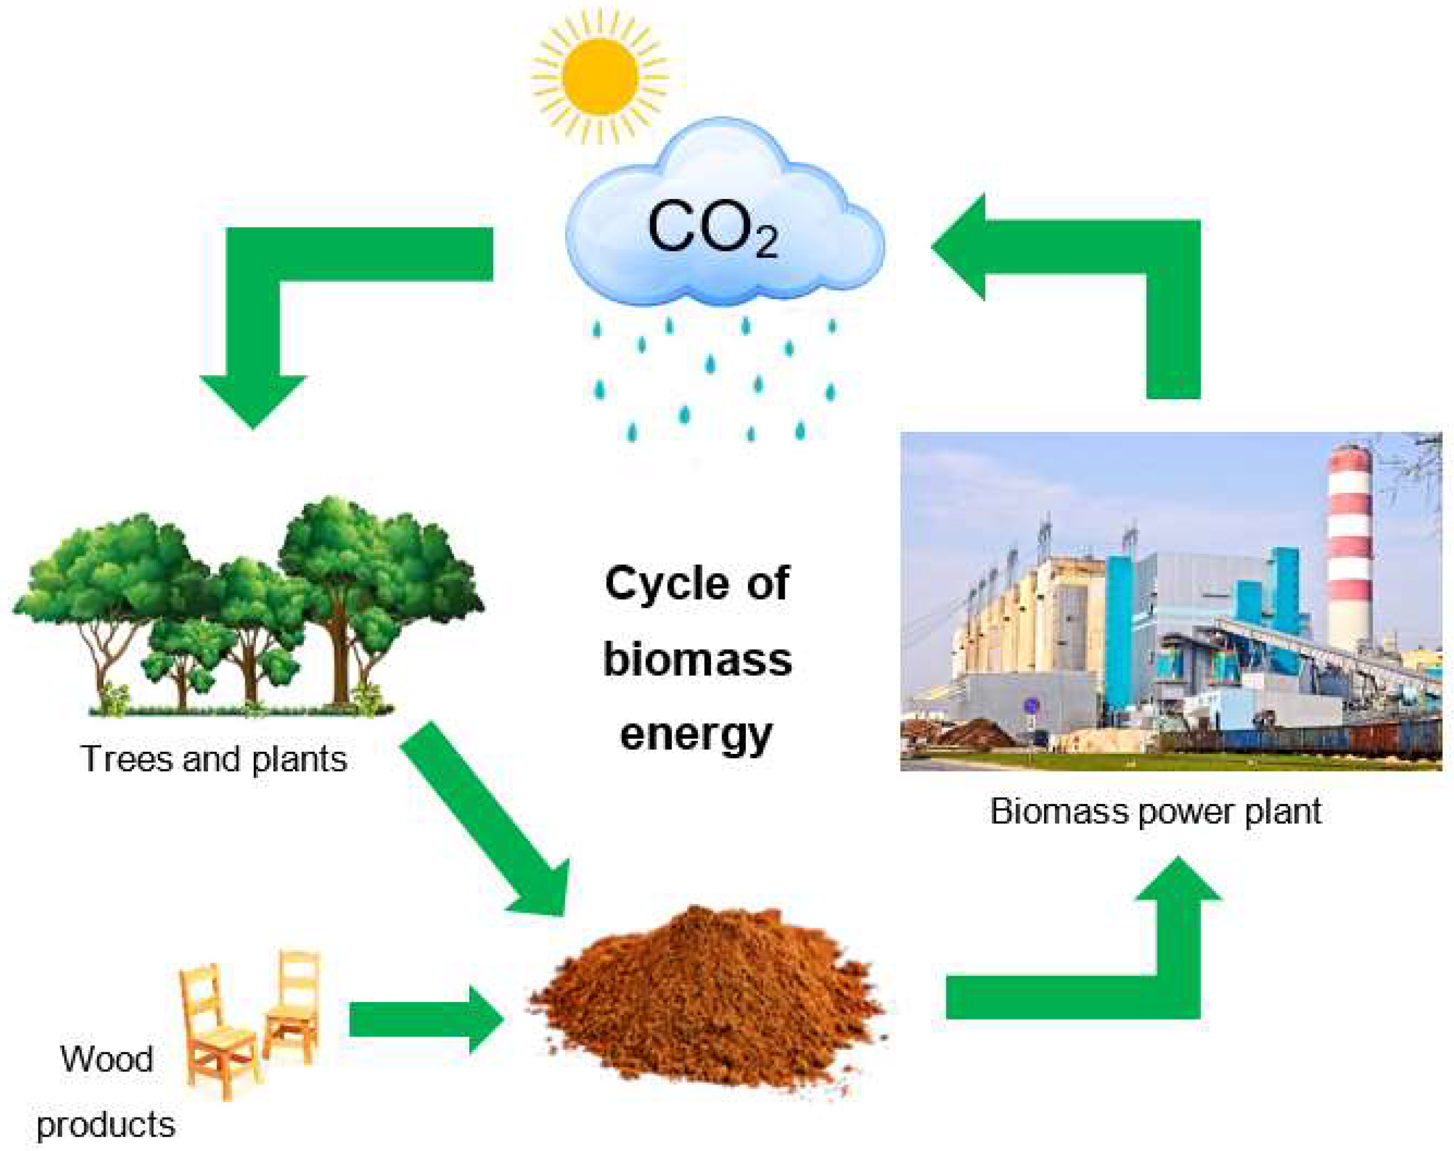
Introduction cont.…
Figure 1. The general cycle of biomass energy[1].
https://www.mdpi.com/1996-1073/16/4/1783

Slide 8
2. Motivation Behind Using Biomass Energy.
There are various reasons why biomass is important.
it is a renewable energy source that may be utilized to create bioenergy, chemicals, and value-added products.
Second, the release of hazardous heavy metals into the environment may generate environmental issues that biomass might help to address.
Heavy metals in contaminated soil can be effectively absorbed by biomass, such as biochar and activated carbon.
Furthermore, biomass is an environmentally friendly substitute for fossil fuels
Because it is carbon-neutral and can aid in lowering greenhouse gas emissions.

Slide 9
Motivation cont.…..
Moreover, biomass waste is a significant natural remediation resource since it can be used to address or resolve anthropogenic environmental concerns.
In general, biomass is essential to sustainable development goals since it provides a cleaner, renewable energy source that can lead to a more
It is renewable, rich in reserves, recyclable and can be refilled continuously, and will not diminish with human development and utilization

Slide 10
3. Utilization and Conversion of Biomass Energy sources(UCBES)
Biomass energy sources are:
Wood , which is still the largest biomass energy resource today.
Municipal solid waste
Agricultural residues
Aquatic biomass
Food waste
Energy crops
Biogas is composed mainly of methane
etc

Slide 11
UCBES Cont.…..
a. Utilization of Biomass energy:
Mapping the world's land areas according to land use is very important for generating maximum energy from biomass.
Which comprises:
mapping of the yield fluctuations, soil quality, and climate variables, will allow for a more thorough investigation of the bioenergy potential.
The enormous bioenergy potential of agricultural land can be exploited through improving the efficiency of the food, feed, fuel, and integrated production chains.

Slide 12
UCBES Cont.…..
Liquids, gasses, and solids containing bioenergy will be a major component of the future renewable energy mix.
Studies on future bioenergy potential, which take into account agricultural and forest sources, estimate 196–530 EJ or 196–530 *10⁸Jby 2050[2].
Initiatives from the voluntary sector are developing the sustainability assurance of bioenergy.
The development of criteria would be advanced to a new level by combining the power of international organizations, industry, society, and government.

Slide 13
UCBES Cont.…..
It is crucial that bioenergy standards be further harmonized using different scientific investigations
Thus, the optimal conversion techniques based on their sources should be adopted to meet the required demand
The installed capacity of biomass based on different biofuel resources and applications is presented in Fig.2
Further exploration and installation is required as observed in Fig.2

Slide 14

UCBES Cont.…..
,
Figure 2. Biomass installed capacity[3].
https://www.statista.com/statistics/476338/global-capacity-of-total-bioenergy/

Slide 15
4 . Biomass Energy Conversion Methods (BECM)
Unlike any other energy resource, using biomass to produce energy is often a way to dispose of biomass waste materials that otherwise would create environmental risks.
There are four biomass utilization technologies that produce useful energy from biomass:
    Direct Combustion
    Gasification
    Anaerobic Digestion
    Methanol & Ethanol Production

Slide 16
BECM Cont.….
a. Direct Combustion
Direct combustion remains the most common technique for converting biomass to useful energy forms.
Thus, all biomass can be burned directly for heating buildings and water.
Which is providing applications for industrial process heat, and for generating electricity in steam turbines
Direct combustion is a thermochemical technique in which the biomass is burned in open air or in the presence of excess air as presented in Fig.3.

Slide 17
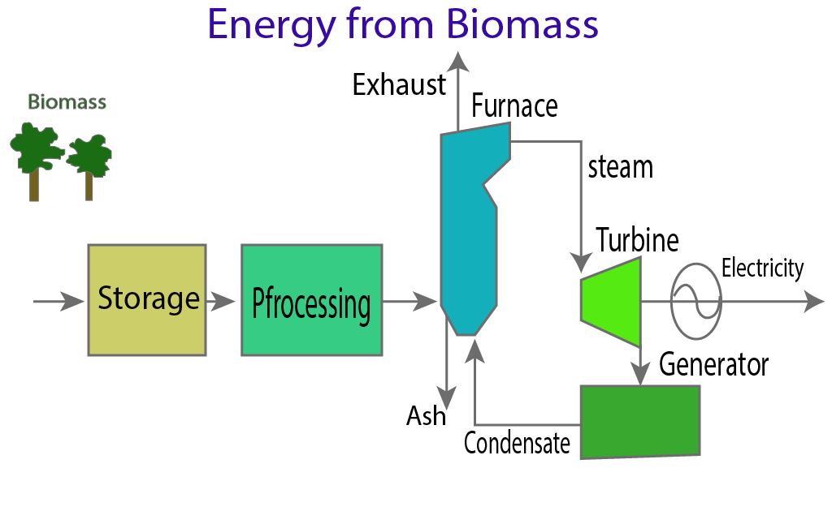
BECM Cont.….
Figure 3. Direct combustion biomass energy process [4].
https://eduinput.com/biomass-energy/

Slide 18
BECM Cont.….
In this process, the photo-synthetically stored chemical energy of the biomass will be converted into gases
Thus, a high-pressure steam is created in a boiler by burning biomass.
The turbine blades rotate as a result of the steam flowing over them.
A generator is powered by the turbine's rotation, which generates energy.
The predominant technology in the world today for electricity generation from biomass, at scales above one megawatt, is the steam-Rankine cycle.

Slide 19
BECM Cont.….
This consists of direct combustion of biomass in a boiler to raise steam which is then expanded through a turbine.
The steam-Rankine technology is a mature technology introduced into commercial use about 100 years ago.
The costs of steam-Rankine systems vary widely depending on the type of turbine, type of boiler, the pressure and temperature of the steam, and other factors.
An important characteristic of steamturbines and boilers is that their capital costs (per unit of capacity) are scale-sensitive

Slide 20
BECM Cont.….
This type of renewable energy source that is used for direct combustion to generate both heat and power is biomass.
The fuel's moisture content has a significant impact on the combustion process.
High moisture content biomass is unsuitable for direct burning.
Accordingly, the efficiency is defined as ;
eqn.(1)
Where, Chem_{EAFEG} is chemical energy available in Furnaces Gas and Chem_{BFE} is chemical fuel energy
Additional factor that affects the system efficiency is the efficiency of heat exchanger as given by eqn.2
eqn.(2)
Were, A_{PTE} is available process thermal energy and Chem_{AFEG} is chemical energy available in furnace exchange gas

Slide 21
BECM Cont.….
B. Gasification
  Combustible/Flammable gas can be produced from biomass through a high temperature thermo-chemical process.
  The term gasification commonly refers to this high-temperature thermo-chemical conversion with the product gas called producer-gas,
  And involves burning biomass without sufficient air for full combustion, but with enough air to convert the solid biomass into a gaseous fuel
  After appropriate treatment, the resulting gases can be burned directly for cooking or heat supply, or can be used in secondary conversion devices such as west products
  Internal combustion engines or gas turbines is used for producing electricity or shaft work.

Slide 22
BECM Cont.….
Gasification is a process that generates the carbon-monoxide, hydrogen, and carbon-dioxide from organic or fossil-based carbonaceous materials at high temperatures (>700°C) without combustion and with a regulated amount of oxygen
The process of biomass gasification converts biomass into gas fuel.
Using a purification system, gas purification eliminates contaminants such as ash, coke, and tar from the gas.
Burning gas fuel in a gas turbine or internal combustion engine produces gas power.
The biomass gasification power plant has a steam turbine and a heat recovery boiler to increase the efficiency of power generation.
The overall process is presented in Fig.4

Slide 23
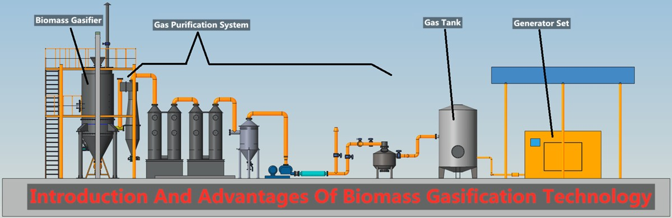
BECM Cont.….
Figure 4. Gasification process of biomass energy generation.
https://www.linkedin.com/pulse/introduction-advantages-biomass-gasification-technology-奇-苏

Slide 24
BECM Cont.….
  C. Anaerobic Digestion
Combustible gas can also be produced from biomass through the low temperature biological processes called anaerobic (without air) digestion.
In the absence of oxygen, microorganisms break down organic matter through a process known as anaerobic digestion as shown in Fig.5.
Examples of this material include food wastes, animal dung, and wastewater biosolids.
Reactors, sealed vessels used for anaerobic digestion in the production of biogas, are built to specified dimensions and forms based on the site and feedstock characteristics.

Slide 25
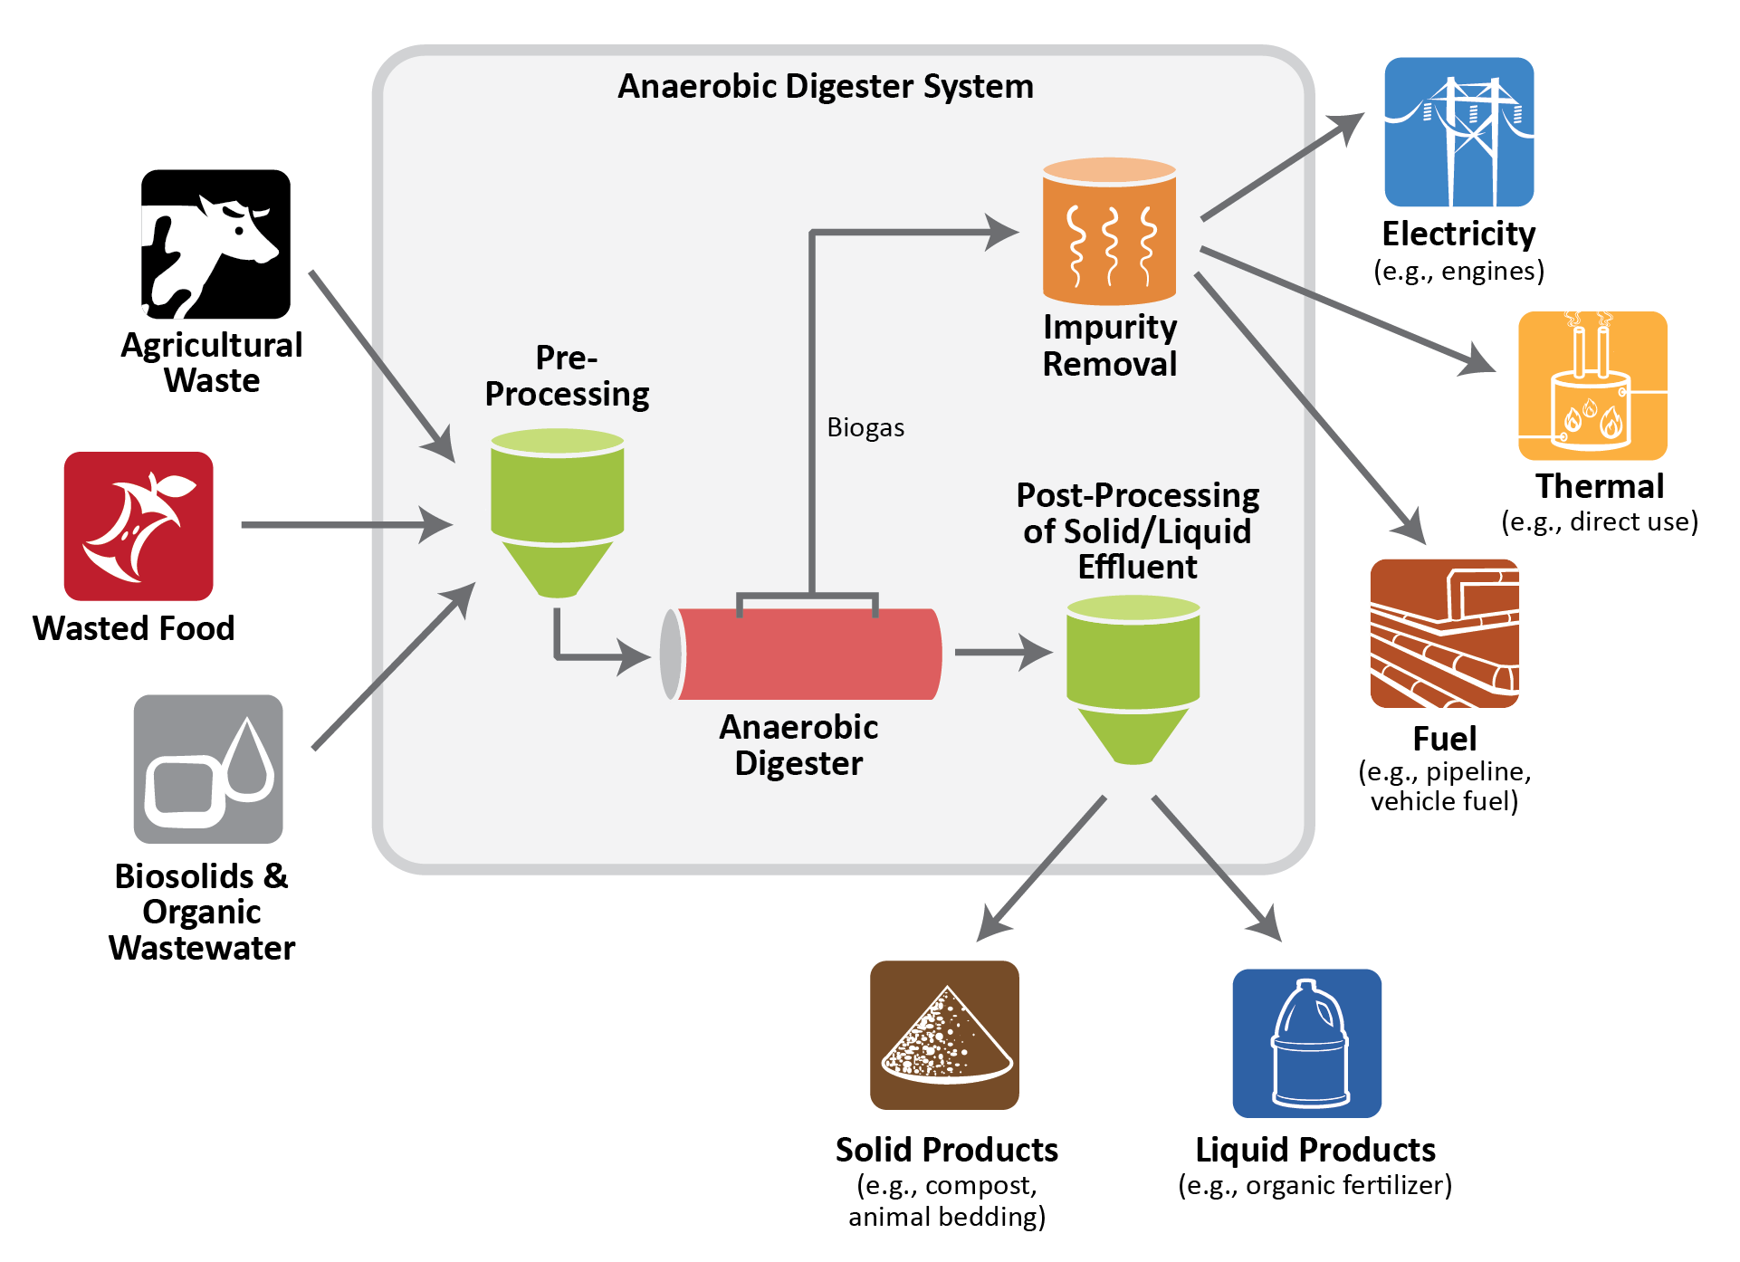
BECM Cont.….
Figure 5. Anaerobic Digestion of biogas process[5]. https://www.tn.gov/environment/program-areas/sw-mm-organics/anaerobic-digestion.html

Slide 26
BECM Cont.….
Biogas is the common name for the gas produced either in specifically designed anaerobic digesters or in landfills by capturing the naturally produced methane.
Besides biogas, an Anaerobic digestion is a biological process that produces a gas principally composed of methane (CH4) and carbon dioxide (CO2) through post-process as observed in Fig.5.
It’s observed that the biogas is produced from the following major organic wastes:
    • Solid & liquid animal manure
    • Agricultural plant waste

Slide 27
BECM Cont.….
Waste from agricultural products processing industry
Organic components in town waste
Waste waters
Landfills
D. Methanol & Ethanol Production[6]
Starch content of Biomass feed-stocks like corn, potatoes, beets, sugarcane, wheat, barley, and similar can be converted by fermentation process into alcohol (ethanol).
Fermentation is the biochemical process that converts sugars into ethanol (alcohol).
In contrast to biogas-production, fermentation takes place in the presence of air and is, therefore, a process of aerobic digestion.

Slide 28
BECM Cont.….
Ethanol producers use specific types of enzymes to convert starch crops such as corn, wheat and barley to fermentable sugars.
Some crops, such as sugar cane and sugar beets, naturally contain fermentable sugars.
The main reaction for converting oil to biodiesel is called trans-esterification.
The trans-esterification process reacts methanol with the triglyceride oils contained in vegetable oils, animal fats, or recycled greases, forming fatty acid methyl esters (biodiesel) and glycerin.

Slide 29
BECM Cont.….
The trans-esterification reaction requires 1-1.5 gallons methanol for every 10 gallons of oil used to make biodiesel (oil-to-methanol ratio of 8:1)[7].
For maximum yield, however, more alcohol is usually used.
The process usually uses pre-extracted oil as the raw material
which is usually produced by pressing the oil-bearing seeds, often followed by solvent extraction to extract any remaining oil.

Slide 30
BECM Cont.….
The process of extracting of waste biomass into methanol includes four basic steps:
pretreatment of biomass
biogas production through anaerobic route
purification of biogas
methanol production
Proper training complex ligno-cellulosic biomass waste cannot be acted upon by microbial enzymes

Slide 31
BECM Cont.….
The pretreatment step breaks-down this resistant lignin layer and makes the waste biomass more susceptible to attack by microbes
The pretreated biomass is fed into the anaerobic digester for the production of biogas.
Four basic steps namely used during anaerobic system: hydrolysis, acidogenesis, aceto-genesis, and methanogenesis
Then, purification of biogas and methanol can be created as given in Fig.6[8].

Slide 32
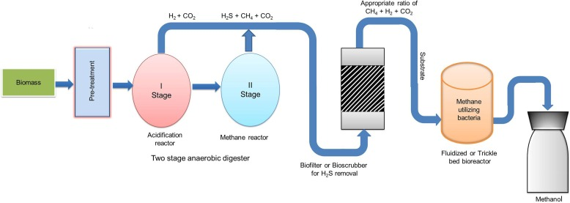
BECM Cont.….
Figure 6. Bio-methanol as renewable energy.
https://www.sciencedirect.com/science/article/abs/pii/S001623612030778X

Slide 33
Summary
In this lecture note, the basic concept of biomass renewable energy process is discussed.
The global generation capacity of biomass energy mix and its potential is also presented
In addition, the motivation behind using biomass energy is also listed
Besides this, the source of biomass energy is well presented
Finally, the energy conversion processes, especially four types of energy conversion in biomass energy well summarized

Slide 34
Reference
[1]. K., Tomasz. ‘’Potential Use of Industrial Biomass Waste as a Sustainable Energy Source in the Future’’. MDPI, energies, 2023. https://doi.org/10.3390/en16041783
[2].Holm-Nielsen, J. B., & Ehimen, E. A. Biomass Supply Chains for Bioenergy and Biorefining. Woodhead Publishing. Woodhead Publishing Series in Energy. 2016 https://books.google.dk/books/about/Biomass_Supply_Chains_for_Bioenergy_and.html?id=Xd_lBwAAQBAJ&redir_esc=y
[3]. Global capacity of bioenergy power 2009-2023. Statista Research Department, Apr 23, 2024.
[4]. M., Javier and L., Jorge. ‘’Reclamation of Degraded Landscape due to Open Pit Coal Mining: Biomass for Renewable Power Plants’’. WSEAS Transactions on environment and development. V.4(2018).
[5]. EPA. ‘’Anaerobic Digestion and its Applications’’. United state environmental protection agency’’. 2015. https://www.epa.gov/sites/default/files/2016-07/documents/ad_and_applications-final_0.pdf
[6]. H., Fumio; Y.,Shinya and L.,Kenji. ‘’Methanol or ethanol produced from woody biomass: Which is more advantageous?’’. ELSEVIER: Bioresource Technology. V.101(1). 2010.
[7]. Jason P. de Koff . ‘’Maximizing the Biodiesel Process’’. Tennessee State University
[8]. G., Pallavi; U.,Nehaa and S.K. Dubeya. ‘’Bio-methanol as a renewable fuel from waste biomass: Current trends and future perspective. Elsevier: Fuel. https://linkinghub.elsevier.com/retrieve/pii/S001623612030778X
.

Slide 35
Thank you !

