Slide 1

MARKETING MANAGEMENT & STRATEGY
WEEK 2 LECTURE
MARKETING ENVIRONMENTAL ANALYSIS
Dr. John N Kamau

Slide 2

Welcome
Welcome to week 2 lecture
It is my joy to take you through this lecture
Last week we focused on marketing management definition
We looked at marketing philosophies
We now focus on marketing management environment

Slide 3

Saying about marketing environment
1. “The nature of the global business environment guarantees that no matter how hard we work to create a stable and healthy organization, our organization will continue to experience dramatic changes far beyond our control.” Margaret J. Wheatley
2. “Organizations need to undergo fundamental changes, both in order to adapt to the new business environment and to become ecologically sustainable.” Fritjof Capra
3. “I think the most important CEO task is defining the course that the business will take over the next five or so years. You have to have the ability to see what the business environment might be like a long way out, not just over the coming months. You need to be able to both set a broad direction, and also to take particular decisions along the way that make that broad direction unfold correctly.” Chris Corrigan

Slide 4

Saying about marketing environment
4. A business leader has to keep their organization focused on the mission. That sounds easy, but it can be tremendously challenging in today's competitive and ever-changing business environment. A leader also has to motivate potential partners to join.”mMeg Whitman
5. “My family achieved success not in spite of, but because of the American system of taxation. After all, without reliable and safe roads there’d have been no Disneyland; without high functioning legal systems and a well regulated business environment there would have been no copyright protection for Mickey Mouse.” Abigail Disney

Slide 5
What is a marketing environmental analysis?
The Marketing Environment consists of the actors and forces outside marketing that affect marketing management’s ability to develop and maintain a successful relationship with target customers (Kotler and Armstrong, 2006).
Assael (1990) notes that the marketing environment includes those external forces that are a source of marketing opportunities and profits. The same forces are a source of marketing threats.

Slide 6
What is a marketing environmental analysis?
The term marketing environment implies the combination of internal and external factors that influence a company’s operating situation, including employees, customers, management, supply and demand and business regulations (Hans, 2018).
Shaikh, (2010) views environment as the surrounding external objects, influences of circumstances under which someone or something exists.
Chattopadhayay (2015) the environment of any organization is the aggregate of all conditions, events and influences that surround and affect it.”

Slide 7
Importance of environmental analysis
Revealing opportunities and threats,
Reveals firms strengths and weaknesses
Shows sensitivity to environmental conditions
Assess competitors’ activities and strategies

Slide 8

Sources of marketing opportunities and threats
A marketing opportunity is an area of buyer need and interest in which there is high probability that a firm can profitably satisfy that need.
Unmet customer needs
Competitive weaknesses
Longer-term environmental trends.
Supplying something that is in short supply.
Supplying an existing product or service in a new or superior way.
Developing a totally new product.

Slide 9
Criteria for good opportunities
The benefits involved in the opportunity should be convincingly articulated to a defined target market (s).
The target market (s) should be located and reached with cost-effective media and trade channels.
The company should possess or have access to the critical capabilities and resources needed to deliver the customer benefits.
The company can deliver the benefits better than any actual or potential competitors.
The financial rate of return meets or exceeds the company’s required threshold for investment.

Slide 10
Environmental threats
An environmental threat is a challenge posed by an unfavorable trend or development that leads, in the absence of defensive marketing action, to deterioration of sales or profits.
Threats should be classified according to seriousness and probability of occurrence.
After identifying the major threats and opportunities facing the specific business unit, the management can characterize that business’s overall attractiveness.

Slide 11
Goals of environmental analysis
Identifying changes and trends in the environment that are likely to have significant impact in their organizations
Determine potential threats that are likely to have adverse effect in a business and therefore develop counter strategy on the same
Enhance scenario planning among managers and staff of the organization
Create awareness among management on converging/diverging trends etc.

Slide 12
Models of marketing environmental analysis
a) SWOT (Strength, Weakness, Opportunity, Threat) Analysis
b) PESTEL (Political, Economic, Socio-Cultural, Technological, Legal, Environmental) Analysis
c) Industry Analysis
d) The UPPSALA Model
e) CAGE Framework
f) Structure- Conduct – Performance Model
g) VRIO
h) McKinsey 7S Model

Slide 13
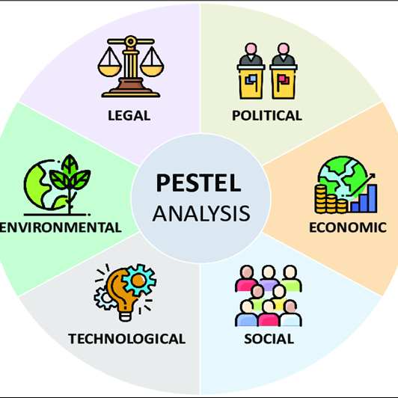
PESTEL model
Political, Economic, Socio-Cultural, Technological, Legal, Environmental
Source: adopted from Segura, E., Belmonte, L. M., Morales, R., & Somolinos, J. A. (2023)

Slide 14

PESTEL Model
a) The political factors :
Political ideologies (democracy, communism)
Elections
Civil unrest
Public opinion
Regulation
Subsidization
Taxation
Economic policies.

Slide 15
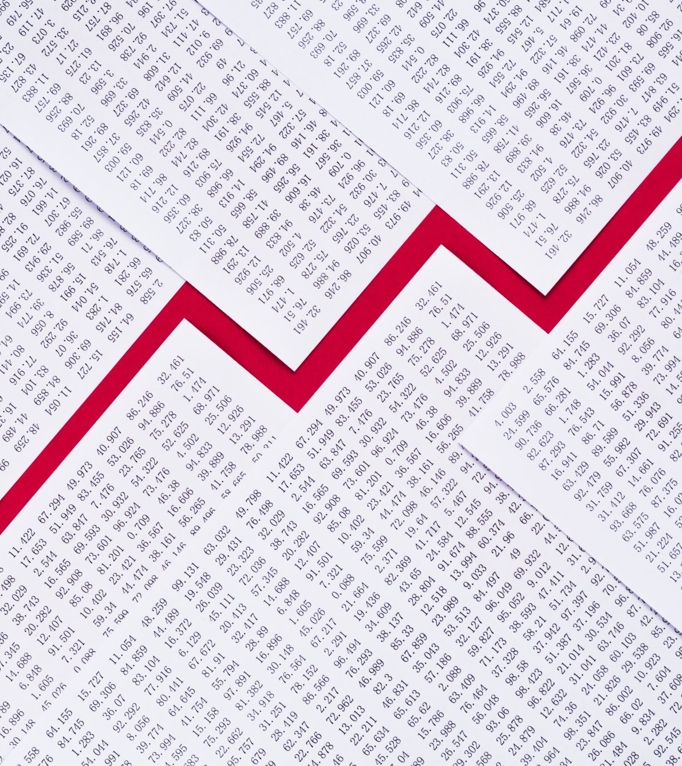
PESTEL Model
b) Economic factors:
Currency exchange rates
Levels of inflation
Unemployment
Interest rates.
Government fiscal and monetary policies
Consumer confidence
Minimum wages
Income distribution
Disposable income
Economic growth
Global economic trends

Slide 16
PESTEL Model
c) The social-cultural environment:
Demographics of a society
The people’s lifestyles
Society values
Average age
Literacy levels
Religion
Gender diversity
Diversion and inclusion
Shifts in values and attitudes
Health and wellness trends

Slide 17

PESTEL Model
d) The technological environment
Increase of computers and new software’s
Mobile technology
The internet
Data analytics and big data,
Artificial intelligence (AI),
Marketing automation platforms,
Augmented reality (AR) and virtual reality (VR)
E-commerce platforms and marketplaces

Slide 18

PESTEL Model
e) Environmental concerns:
Sustainability concerns
Green marketing and eco-labeling
Circular economy initiatives
Corporate social responsibility
Regulatory compliance
Supply chain sustainability
Energy efficiency and renewable energy
Waste reduction and packaging innovation
Climate resilience and adaptation,
Environmental activism and consumer advocacy

Slide 19
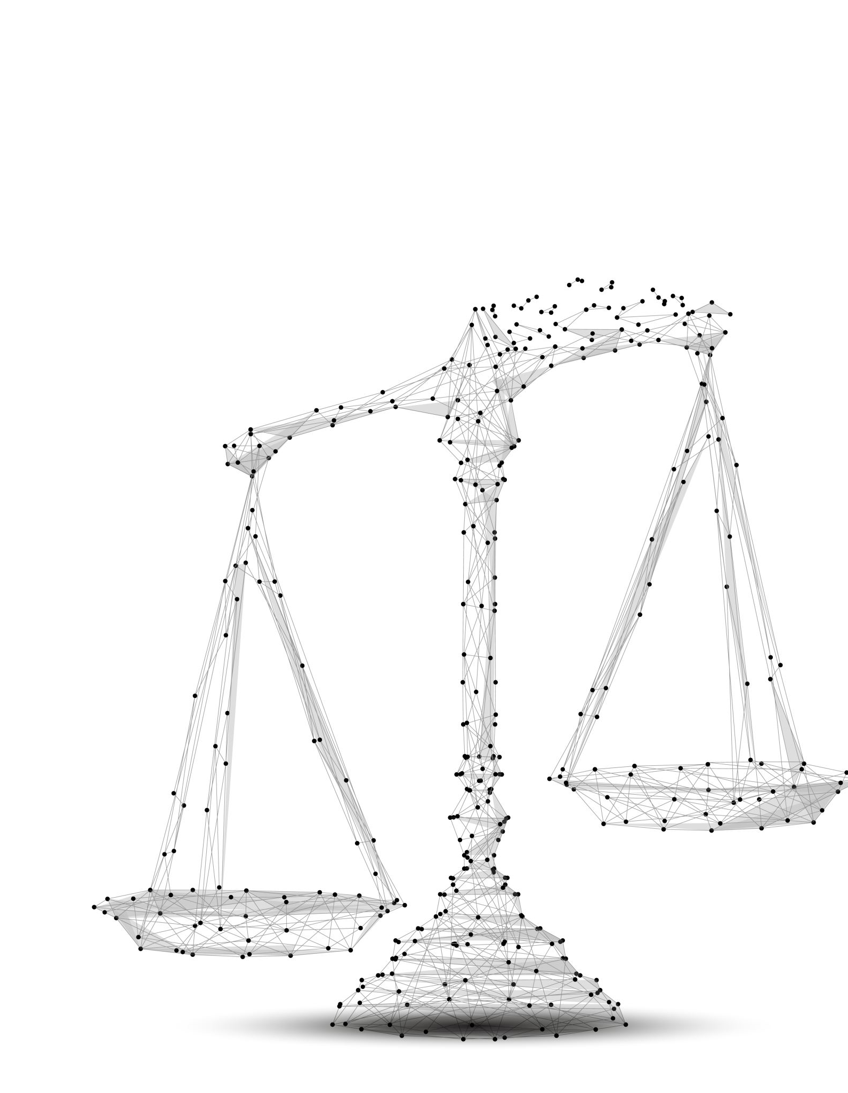
PESTEL Model
f) The legal environment :
Consumer Protection Laws
Advertising Regulations
Intellectual Property Rights
Data Privacy Regulations
Antitrust Laws
Product Liability Laws
Contract Law
E-commerce Regulations
Environmental Regulations
International Trade Laws

Slide 20
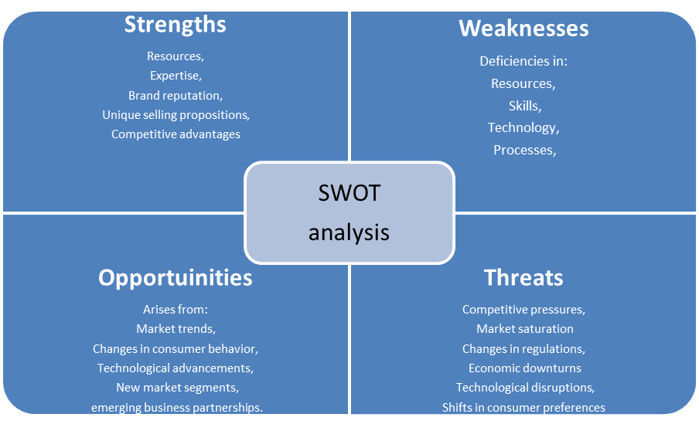
2. SWOT analysis

Slide 21
2. SWOT analysis
1. Strengths: These are internal factors that represent the advantages or capabilities of the business.
Resources
Expertise
Brand reputation
Unique selling propositions
Competitive advantages

Slide 22
2. SWOT analysis
2. Weaknesses: These are internal factors that represent the limitations or challenges within the business.
Deficiencies in:
Resources
Skills
Technology
Processes
Areas where the business lags behind its competitors.

Slide 23
2. SWOT analysis
3. Opportunities: These are external factors that represent potential avenues for growth or expansion available to the business.
Arise from;
Market trends
Changes in consumer behavior
Technological advancements
New market segments
Emerging business partnerships

Slide 24
2. SWOT analysis
4. Threats: These are external factors that pose risks or challenges to the business.
Include:
Competitive pressures
Market saturation
Changes in regulations
Economic downturns
Technological disruptions
Shifts in consumer preferences

Slide 25
3) Industry analysis model
.
SUPPLIER POWER
Factors determining power of suppliers relative to producers; same as those determining power of producers relative to buyers
THREAT OF ENTRY
Economies of scale
Absolute cost advantages
Capital requirements
Product differentiation
Access to distribution channels
Government and legal barriers
Retaliation by established producer
NDUSTRY RIVALRY
•Concentration
•Diversity of competitors
•Product differentiation
•Excess capacity and exit barriers
•Cost condition
THREAT OF SUBSTITUTES
Buyer propensity to substitute
Relative prices and performance of substitutes
BUYERS POWER
Price Sensitivity
Cost of product relative to total cost
Product differentiation
Competition between buyers
Bargaining Power
Size and concentration of buyers relative to producers
Buyers’ switching costs
Buyers’ information
Buyers’ ability to backward integrate

Slide 26

3) Industry analysis model
a) Threat of New Entrants: This force assesses the likelihood of new competitors entering the market.
Barriers to entry (e.g., High capital requirements, economies of scale, brand loyalty)
Government regulations
Access to distribution channels influence the threat of new entrants.
Addressed through strategies to strengthen brand loyalty, differentiate products, or establish barriers to entry

Slide 27

3) Industry analysis model
b) Bargaining Power of Buyers: This force examines the influence that buyers/customers have on the industry.
Buyer concentration
Price sensitivity
Switching costs
Availability of substitutes
Addressed through pricing strategies, product offerings, and customer engagement initiatives

Slide 28

3) Industry analysis model
c) Bargaining Power of Suppliers: This force assesses the influence of suppliers on the industry.
Supplier concentration
Availability of substitutes
Switching costs
Addressed through, managing supplier relationships, negotiating favorable terms, and diversifying the supplier base

Slide 29

3) Industry analysis model
d) Threat of Substitute Products or Services: This force examines the extent to which alternative products or services can fulfill the same customer needs.
Availability of substitutes
Price-performance trade-offs
Switching costs
Addressed through differentiating offerings, communicate unique value propositions, and build brand loyalty

Slide 30
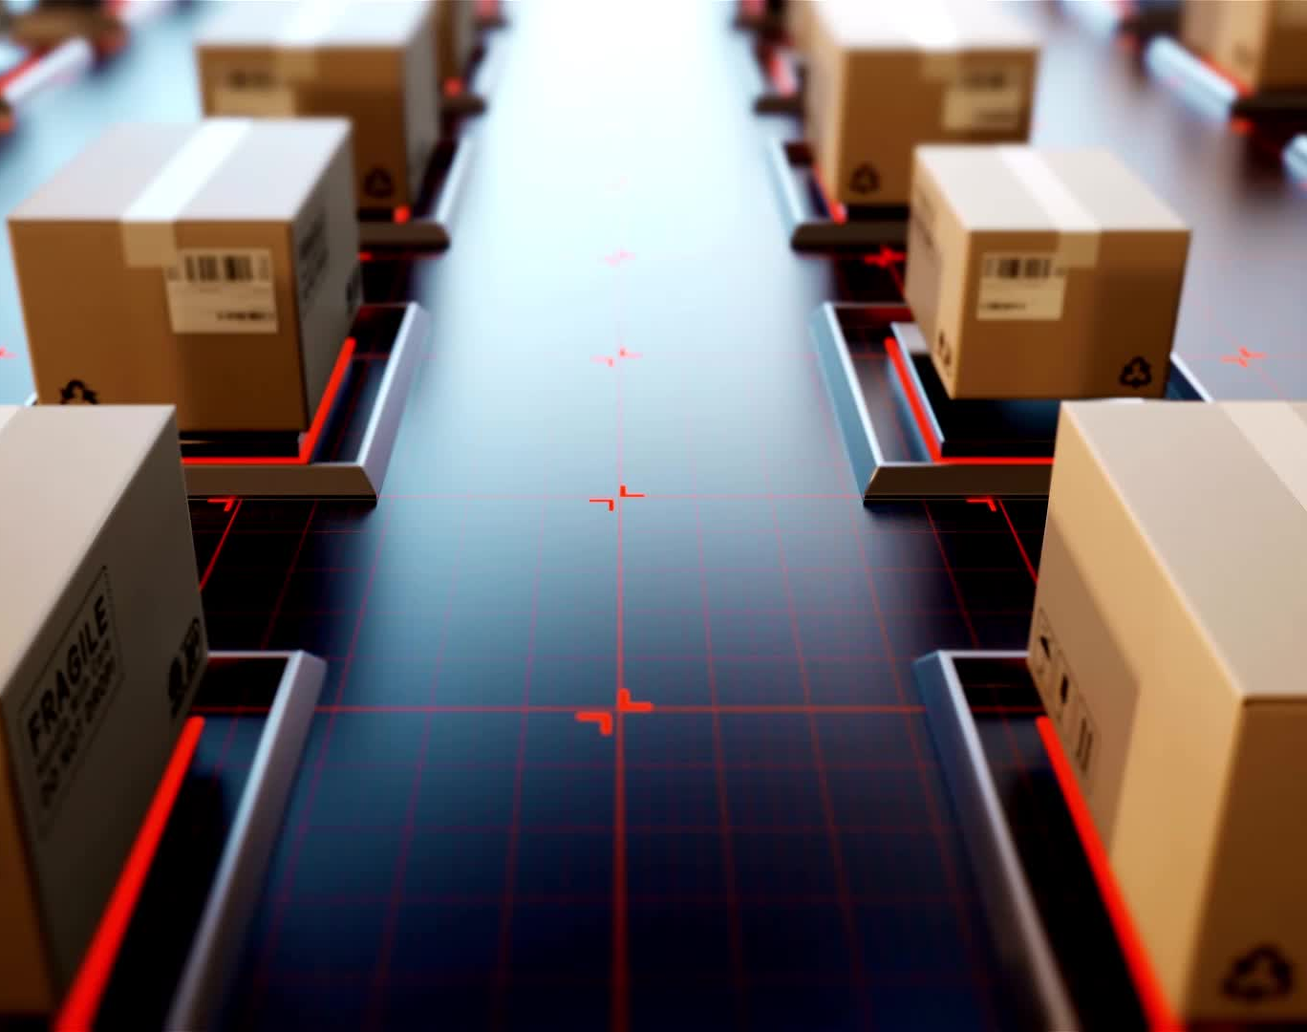
3) Industry analysis model
e) Intensity of Competitive Rivalry: This force evaluates the level of competition among existing competitors within the industry.
Industry growth rate
Market concentration
Differentiation
Exit barriers
Addressed by monitoring competitive actions, anticipate market shifts, and continuously innovating.

Slide 31
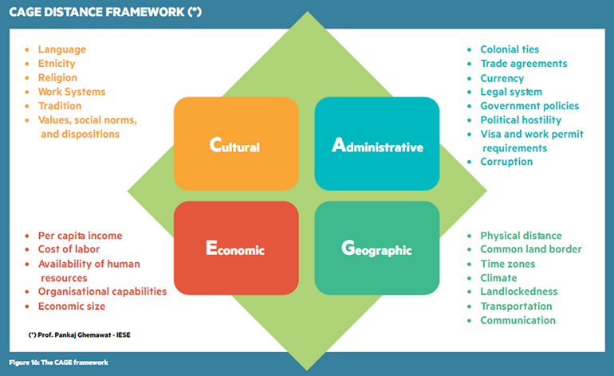
4. CAGE model
Adopted from Pankaj Ghemawat (2011), Global Prosperity and How to Achieve it

Slide 32

4) CAGE framework.
The CAGE Distance Model is a framework for understanding and analyzing the differences between countries in terms of their culture, administrative, geographic, and economic distances.
Cultural distance: Refers to differences in language, religion, values, norms, and customs between countries.
Administrative distance: Refers to differences in governance, legal systems, and regulations between countries.
Geographic distance: Refers to physical distance, time zones, and climate differences between countries.
Economic distance: Refers to differences in wealth, income levels, infrastructure, and technology between countries.

Slide 33

5. VRIO model
This model was developed in 1997 by Barney.
The acronym stands for: Value, Rarity, Imitability, and organization.
Value: This refers to the ability of the resource or capability to add value to the company's products or services. Does the resource/capability enable the firm exploit opportunities/neutralize threats?
Rarity: Rarity signifies how uncommon or scarce the resource or capability is within the industry. Is the resource common in the market?
Imitability: This aspect evaluates how easy it is for competitors to imitate or replicate the resource or capability. How difficult is it for competitors to replicate the resource?
Organization: Organization refers to the company's ability to leverage the resource or capability effectively. How organized is the firm to utilize the resource for competitive advantage?

Slide 34
Responses to changing marketing environment
Response | Explanation
Reengineering | Reengineering refers to the fundamental rethinking and redesign of business processes to achieve dramatic improvements in critical aspects such as cost, quality, service, and speed.
Outsourcing | Outsourcing is the practice of contracting out certain business functions or processes to external third-party providers rather than handling them internally.
Benchmarking | Benchmarking involves comparing one's own processes, products, or services against those of competitors or industry leaders to identify best practices and areas for improvement.

Slide 35
Responses to changing marketing environment
Response | Explanation
Customer partnering | Customer partnering involves establishing collaborative relationships with customers to better understand their needs, preferences, and challenges.
Supplier partnering | Supplier partnering refers to developing strategic alliances and collaborative relationships with suppliers.
Merging | Acquiring or merging with firms in the same or complementary industries to gain the economies of scale and scope.

Slide 36
Responses to changing marketing environment
Response | Explanation
Globalization | Globalizing involves expanding business operations and activities beyond domestic borders to international markets. Increased effort to “think global” and “act local”.
Flattening | Flattening refers to the trend of reducing hierarchical levels and layers of management within an organization.
Focusing | Focusing involves concentrating resources and efforts on core competencies or strategic priorities. Determining the most profitable business and customers and focusing on them.
Accelerating | Accelerating refers to the process of increasing the speed or pace of business activities, processes, or growth initiatives. Designing the organization and setting up processes to respond more quickly to changes in the environment
Empowering | Encouraging and empowering personnel to produce more ideas and take more initiative.

Slide 37
Marketing Management Project part 1
Identify a business in your country and conduct an environmental analysis with an aim of developing a marketing strategy.
Use one of the models discussed in this lesson.
You will present the same in class in the next lesson.

Slide 38
References
Assael, H., (1990), Consumer Behavior and Marketing Action. Boston, PWS-KENT
Barney JB (1997). Gaining and Sustaining Competitive Advantage. Addison-Wesley: Reading, MA
Chattopadhayay C. (2015) Business Environment: A Note. International Research Journal of Engineering and Technology (IRJET).
Duncan, R. (1972). 'Characteristics of organizational environments and perceived environmental uncertainty', Administrative Science Quarterly, 17, pp. 313-32
Grant R.M (2018) Contemporary Strategy Analysis, 10th Edition Wiley ISBN: 9781119495727
Hans V. B (2015) Business Environment – Conceptual Framework and Polices. ResearchGate.
Kotler P & Keller K L (2007) Marketing Management 12th Edition Prentice-Hall of India
Kotler P & Keller K.L (2016), Marketing management 16th Edition Pearson
Kotler P. & Armstrong G. (2006). Principles of marketing, (11th Ed.) Upper Saddle River: New Jersey: Prentice-Hall.
Nokia CE0 Speech Retrieved from : https://www.reddit.com/r/business/comments/ on 26 March 26, 2024
Pankaj Ghemawat (2011), Global Prosperity and How to Achieve it,, Harvard Business Review Press,pp.54-60
Segura, E., Belmonte, L. M., Morales, R., & Somolinos, J. A. (2023). A Strategic Analysis of Photovoltaic Energy Projects: The Case Study of Spain. Sustainability (Switzerland), 15(16). https://doi.org/10.3390/su151612316
Selznick, P. (1948). Foundations of the Theory of Organization. American Sociological Review, 13(1), 25–35. https://doi.org/10.2307/2086752
Shaikh, S (2010) Business Environment for Universities and Autonomous colleges of Odisha, Pearson Education inc.

Slide 39

End
End
Thank you
Next lesson: Developing the marketing plan

