Slide 1

MARKETING MANAGEMENT AND STRTAREGY
WEEK 5 LECTURE
POSITIONING AND DIFFERENTIATION STRATEGIES
Dr. JOHN KAMAU

Slide 2

Welcome!
Welcome to week 5 lecture!
Its my joy to have you in this class
In the previous lecture we focused on competitor analysis
In this lecture we focus on positioning and differentiation
Proverbs 23:19: Listen, my son, and be wise, and set your heart on the right path
Proverbs 10:1 The proverbs of Solomon: A wise son brings joy to his father, but a foolish son brings grief to his mother.

Slide 3

Subtopics
What is market positioning?
Strategic importance of brand positioning
Steps followed in positioning process.
Positioning possibilities
Positioning strategies
Positioning for small businesses
Positioning errors
Differentiation

Slide 4

Saying on positioning
“In the positioning era, the single most important marketing decision you can make is what to name the product. “
“A brand is the ultimate weapon to defeat any competition.”
“The essence of positioning is sacrifice.”
“The mind is like a sieve; it retains only what is important to it.”
“A strong position is the foundation for building a successful brand.”

Slide 5

What is positioning?
Positioning is the act of designing the company’s offering and image to occupy a distinctive place in the mind of the target market.
It can also be defined as the act of crafting the place the product will occupy in consumers’ minds relative to competing products (Kotler and Keller, 2006).
Lovelock (2014) views positioning as a process of ‘establishing and maintaining a distinctive place in the market for an organization and/or its individual product offerings.

Slide 6

What is positioning?
Ries & Trout (1984) define Positioning as an organized system for finding a window in the mind of a customer.
It is based on the concept that communication can only take place at the right time and under the right circumstances.
Positioning is all about Creating a unique and distinctive image for a brand relative to the competition.

Slide 7
Strategic importance of brand positioning
Brand positioning is fundamental for successful marketing.
a) Foundation for strategy development: positioning, is an integral component of the STP concept (segmenting, targeting, positioning).
Positioning forms the bedrock for defining a brand's strategy.
Guides decisions on how to differentiate and appeal to their target audience effectively.
b) Guidance and Coordination of Activities
Positioning acts as a guide and verifier for planned activities.
It ensures consistency across diverse brand activities
Positioning is essential for aligning various activities towards building a cohesive and sustainable image of the place brand.

Slide 8

Strategic importance of brand positioning
c) Employee Engagement and Energy:
Positioning involves all employees who can influence the image of a place brand
It fosters an emotional bond and energizes employees to contribute creatively towards fulfilling the brand's promise.
d) Strategic Planning and Activity Prioritization: Positioning helps in creating a framework to evaluate the adequacy of planned activities and prioritize them based on their alignment with the brand positioning.
Positioning serves as a valuable tool for strategic planning, ensuring that resources are allocated efficiently to activities that resonate with the brand's identity and objectives.
e) Measurement of Effectiveness and Brand Control: Internally, brand positioning facilitates brand control by enabling the measurement of effectiveness.
Helps in assessing the impact of specific activities pursued by an administrative unit.
Continuous evaluation ensures that the brand remains on track towards its objectives

Slide 9

Steps followed in positioning process.
The process of positioning involves four critical steps (Day, 1990).
1. The first step is identifying alternative positioning themes.
We may want to position as market leaders in quality, price or even customer service.
The marketer may want to confirm what customers already think or change that position to fit with his current offerings.
2. The second step is to screen each alternative: according to whether it is meaningful to customers by
examining themes feasibility given the firm’s competencies and customer perceptions of the firm
its superiority/uniqueness against competition
congruency with the company’s objectives.

Slide 10

Steps followed in positioning process.
3. The third step is choosing the position that best satisfies the criteria and generates the most enthusiasm and commitment within the organization.
4. The fourth step is designing the programs needed to implement the position which may require the firm to compare costs of these programs with likely benefits.

Slide 11

Steps followed in positioning process
1. Identify the target market.
2. Identify the competitive set of preferences in the target market
3. Identify the motivation/benefits sought by customers.
4. Identify perceptions of the strengths and weaknesses of each of the competitive set themes.
5. Identify opportunities for differentiated positioning.
6. Select and implement the position.
7. Monitor the performance of the positioning strategy over time.

Slide 12

Positioning possibilities
1. Attribute positioning: A company positions itself on an attribute such as size or number of years in existence.
For example, Maasai Mara National Park in Kenya can advertise itself as the largest national park in Africa.
2. Benefit positioning: The brand is positioned as a leader in a certain benefit. Masai Mara National Park may say that it delivers a memorable experience to visitors.
Naivas supermarket emphasizes benefits like quality, value, service, variety, style and lifestyle.

Slide 13
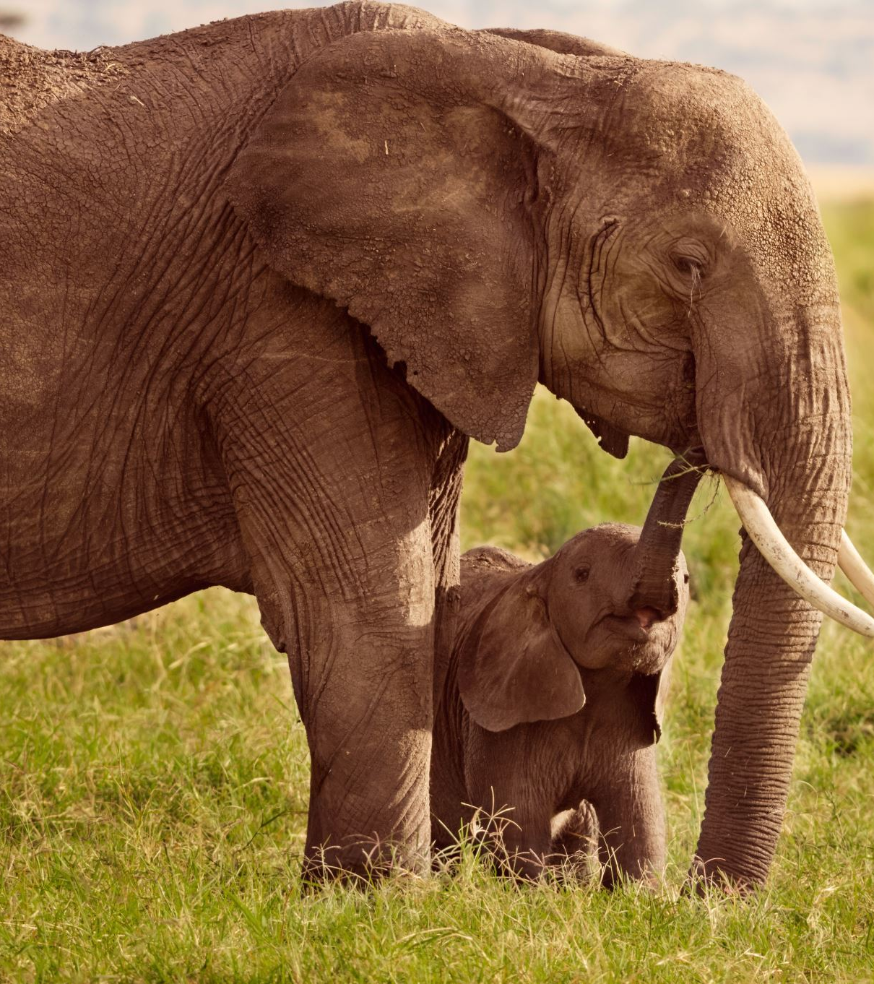
Positioning possibilities
3. Use or application positioning: This is positioning a product as best for some use or application.
Masai Mara can position itself as a place for tourist desiring to watch wild animals in a natural environment.
4. User positioning: This is positioning a product as best for some user group.
Masai Mara can advertise itself as best for “thrill seekers”, bird watchers, and “animal lovers.”
Nakuru National Park can emphasize bird watching (flamingos).

Slide 14

Positioning possibilities
5. Competitors positioning: The product claims to be better in some way than a named competitor.
For example, Masai Mara can advertise itself as having a greater variety of animals than Nairobi National Park.
6. Product category positioning: The product is positioned as a leader in a certain product category.
For example, One National Park can position itself as a recreational park, not an educational park (leader in recreation).
7. Value positioning: The product is positioned as offering the best value for money.

Slide 15
Positioning strategies
The generic Strategy: which can successfully be applied by marketers with an extremely high market share or monopolistic characteristics.
The aim of the positioning element is to stimulate demand for the whole product category a brand belongs to.
Pre-Emptive strategy where the marketer of a certain product emphasizes a benefit or attribute common to all products in the category as first and as being unique.
Positioning based on physical differentiation is referred to as unique selling proposition strategy (USP).
Products are associated with a meaningful, distinctive, consumer benefit based on a unique physical product characteristic.

Slide 16
Positioning strategies
The counterpart to USP is brand image strategy, where superiority of rather homogenous, low-technology goods with little physical differentiation is claimed via differentiation based on factors extrinsic to the product itself i.e. psychological differentiation.
The so called “positioning strategy” is a separate positioning alternative where it is required to give the product a place in the consumer’s mind relative to competition.
The Resonance Strategy where the experience of the consumer is the focus for sale.
Positioning based on the affective strategy, where the aim is to get in touch with the consumer at an emotional level.

Slide 17
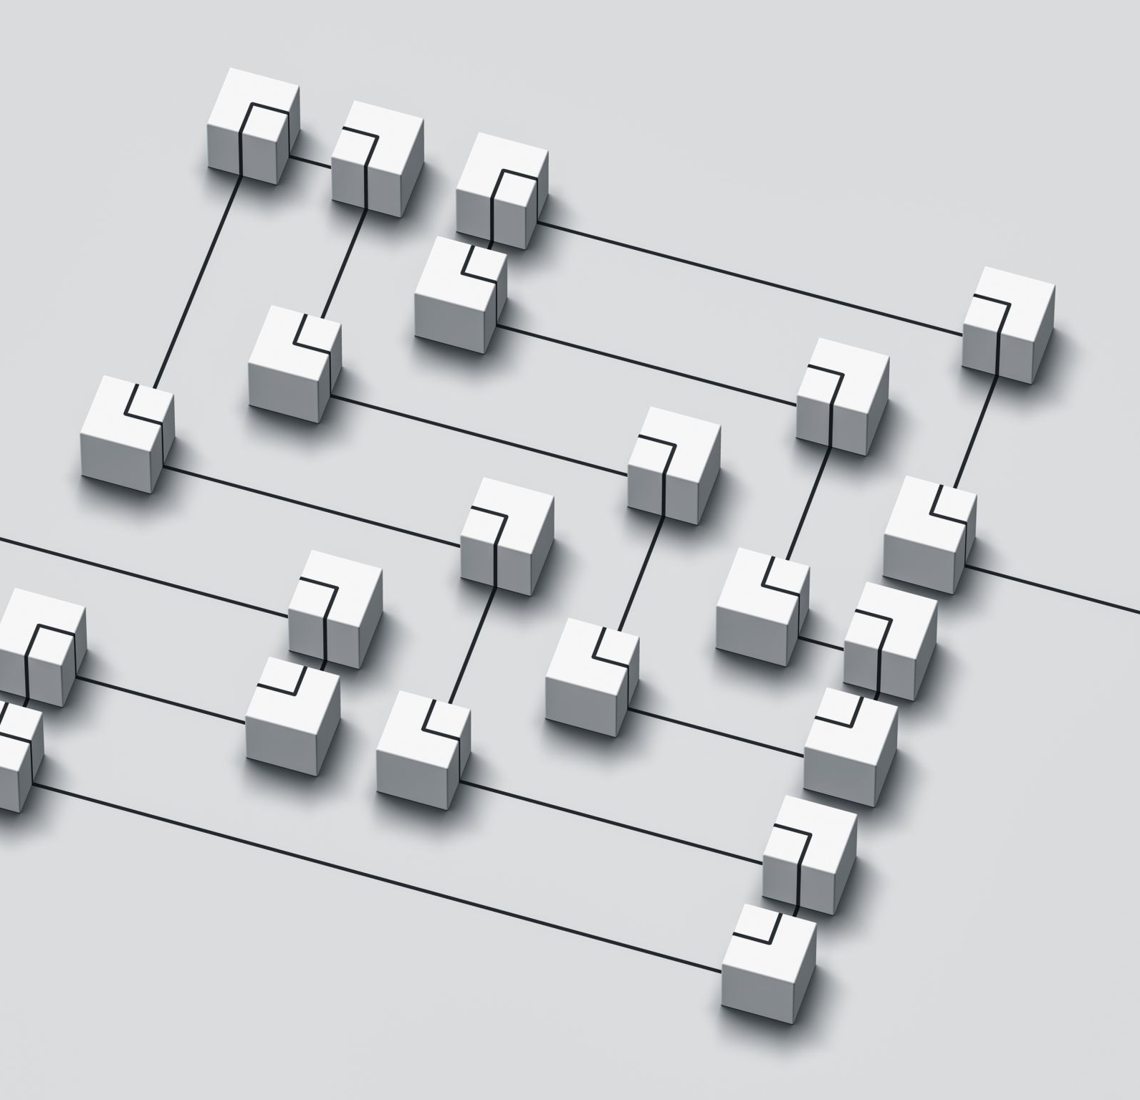
Positioning for small businesses
1. Find a compelling product, or service performance advantage.
2. Focus on building one or two strong brands based on one or two key associations.
3. Encourage product or service trial in any way possible.
4. Develop cohesive digital strategy to make the brand bigger and better.
5. Create buzz and loyal brand community.
6. Employ a well-integrated set of brands elements.
7. Leverage as many secondary associations as possible.
8. Creatively conduct low-cost marketing research

Slide 18

Communicating the company’s positioning
Once the company has developed a clear positioning,
it must communicate that positioning effectively through all the elements of marketing.
For example, if a company chooses the “best quality positioning”, quality can be communicated using physical signs and cues that people normally use to judge quality.
It can also be communicated through other marketing elements like high price, quality packaging, distribution in high-class outlets and promotion through high quality media.
In communicating positioning, all elements of the marketing mix must be consistent.

Slide 19
Positioning errors
The following positioning errors can undermine a firms overall marketing strategy (Cravens & Nigel, 2009).
1. Under-positioning occurs when consumer have only a vague idea about the company and its products and do not perceive any real differentiation.
2. Over-positioning occurs when consumers must narrow an understanding of the company, product, or brand.
3. Confused positioning occurs when frequent changes and contradictory messages confuse consumers regarding the positioning of the brand.
4. Doubtful positioning: occurs when claims made for the product or brand are not regraded as credible by consumers.

Slide 20
Differentiation
Positioning delivers a central idea about a company or an offering to the target market.
Differentiation goes beyond positioning by showing the differences that characterize the company.
It refers to the process of adding a set of meaningful and valued differences to distinguish the company’s offering from the competitor’s (Kotler and Keller, 2006).
Cravens and Nigel(2009 observe that product differentiation occurs when a product offering is perceived by the buyer as different from the competition on any physical or nonphysical product characteristic, including price

Slide 21
Differentiation criteria
Kotler and Keller (2006) observes that a difference will be stronger if it satisfies the following criteria:
Important - the difference delivers a highly valued benefit to a sufficient number of buyers.
Distinctive - the difference is delivered in a distinctive way.
Superior - the difference is superior to other ways of obtaining the benefit.
Preemptive - the difference cannot be easily copied by competitors.
Affordable - the buyer can afford to pay for the difference.
Profitable - the Company will find it profitable to introduce the difference.

Slide 22
Differentiation tools
A company can differentiate its market offering along five dimensions (Kotler and Armstrong, 2006):
a) Product differentiation: Products can be differentiated along the following dimensions: forms, features, performance conformance, durability, reliability, reparability, style and design.
Form. This includes size, shape or physical structure of a product.
Features. Most products can be offered with varying features that supplement their basic function.
Performance quality. Most products are established at one of four performance levels: low, average, high or superior.
Conformance Quality. This is the degree to which all the produced units are identical and meet the promised specifications.
Durability. This is a measure of the product’s expected operating life under natural or stressful conditions.

Slide 23

Differentiation tools
Reliability. This is a measure of the probability that a product will not malfunction or fail within a specified period.
Reparability. This is a measure of the ease of fixing a product when it malfunctions or fails.
Style. It describes the product’s look and feel to the buyer. Style has the advantage of creating distinctiveness that is difficult to copy.
Design. It is the entirety of features that affects how a product looks and functions in terms of customer requirements.
To a customer, a well-designed product is one that is pleasant to look at and easy to open, install, use, repair and dispose off.

Slide 24

Differentiation tools
b) Services Differentiation: Where the company cannot differentiate its physical product from competitors, it can add valued services.
The main service differentiators are (Kotler and Armstrong, 2006):
Ordering ease. It refers to how easy it is for the customer to place an order with the company.
Delivery. This refers to how well the product or service is delivered to the customer. It includes speed, accuracy and care in attending the delivery process.
Installation. It refers to the work done to make a product operational in its planned location. Buyers of heavy equipment expect good installation service.

Slide 25

Differentiation tools
b) Services Differentiation:
Customer training. This has to do with training the customer’s employees to use the vendor’s equipment properly and efficiently.
Customer consulting. It refers to data and information systems and advice services that the seller offers to buyers.
Maintenance and repair. It describes the service program for helping customers keep purchased products in good working order.
Miscellaneous services. Companies can find other ways of differentiating their products and services. For example, they can provide product warranty. They can also offer rewards.

Slide 26

Differentiation tools
c) Personnel Differentiation: Companies gain competitive edge by having better trained employees.
Such employees exhibit six characteristics (Kotler and Keller, 2006):
Competence – they possess the required skills and knowledge.
Courtesy – they are friendly, respectful, and considerate.
Credibility – they are trustworthy.

Slide 27

Differentiation tools
c) Personnel Differentiation
Reliability – they perform the service consistently and accurately.
Responsiveness – they respond quickly to customer requests and problems.
Communication – they make an effort to understand the customer and communicate clearly.

Slide 28

Differentiation tools
d) Channel differentiation.
Companies can gain a competitive edge through the way they design their distribution coverage, expertise and performance.
Some companies differentiate themselves by ensuring that their dealers are found in more locations than the competitor’s.
Others differentiate by ensuring that their dealers are better trained and perform more reliably.
Others like Dell Computers distinguish themselves by developing and managing high quality direct marketing channels (Kotler and Armstrong, 2006).

Slide 29
Differentiation tools
e) Image Differentiation:
Buyers respond differently to company and brand images.
A company’s distinctive image can create a strong harmony or bond with the customers.
Distinction between Identity and Image
Identity comprises the ways that a company aims to identify or position itself or its products.
Image is the way the public perceives the company or its products.
An effective identity performs the following functions.
(i) Establishes the product’s character and value proposition (benefits).
(ii) It conveys the products character in a distinctive way.
(iii) It delivers emotional power beyond a mental image.

Slide 30
Differentiation tools
The identity and image of the company can be expressed in the following ways:
Symbols, color, slogans and special attributes:
symbols: Identity can be created by using strong symbols.
Companies also use colors to identify themselves
They also use a specific piece of sound or music.
Companies also distinguish themselves through short slogans or “tag line
Companies also differentiate their image using special attributes like the company’s heritage,

Slide 31

Differentiation tools
The identity and image of the company can be expressed in the following ways:
Physical plant: This is another way that companies can generate a powerful image, i.e. by developing very unique physical facilities.
Companies can create strong images by inviting prospective customers to visit their well laid out headquarters.
Events and sponsorships: Companies can create brand images by creating and sponsoring various events.
Using multiple image building techniques: Companies can use multiple image building techniques to create a lasting image in the public’s mind.

Slide 32

References
Cravens D.W & Nigel F.P (2009) strategic marketing 9th edition McGraw Hill Irwin Boston
Frazer, C. F. (1983). Creative strategy: A management perspective. Journal of Advertising, 12(4), 36-41.
Karolina J &, Andresa I (2012)“Th e strategic importance of brand positioning in the place brand concept: elements, structure and application capabilities”, Journal of International Studies, Vol. 5, No 1, pp. 9-19.
Kotler P & Keller K.L (2016), Marketing management 16th Edition Pearson
Kotler P,(2000) Marketing Management: Analysis, Planning, Implementation, and Control, 9th edition, Prentice-Hall of India Private Limited, New Delhi, p, 229
Kotler P. & Armstrong G. (2006). Principles of marketing, (11th Ed.) Upper Saddle River: New Jersey: Prentice-Hall
Lovelock, E., Patterson, P.G. and Wirtz, J. (2014), Services Marketing, 6th ed., Pearson, London.
Ries, A., & Trout, J. (1981). Marketing warfare. New York: Plume Books.

Slide 33

Marketing Management Project
Part 4
In the last lecture we examine competitor analysis by evaluating the role of the business in the market (leader, challenger, follower or nicher) and suggest appropriate competition strategies the firm can adopt.
In this part of the project, let’s develop positioning and differentiation strategies for the business we identified.
Let’s justify the choice we make.

Slide 34

END
END
Thank you
See you in the next lecture: Product and branding strategies

