Slide 1
MARKETING MANAGEMENT AND STRATEGY
WEEK 6
PRODUCT AND BRANDING STRATEGIES
DR KAMAU JOHN NJAU

Slide 2
Welcome
Welcome to week 6 lecture
It is my joy to have you in the class
Recap of last week lecture
Begin of marketing mix strategies
All about goods

Slide 3
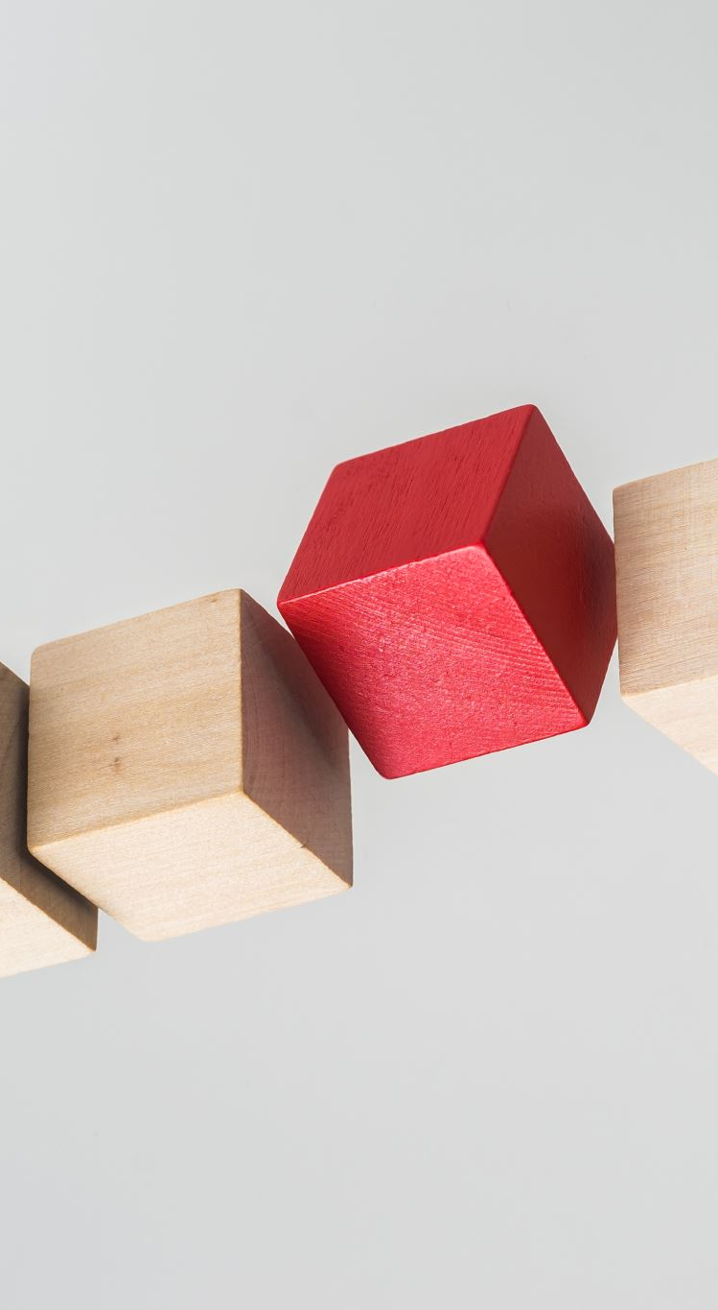
Subtopics
The concept of product, product levels and product classification.
The product hierarchy, product line product mix
The product packaging, labelling, warranties and guarantees.
Branding .
Brand equity

Slide 4

Saying on product
“Great design will not sell an inferior product, but it will enable a great product to achieve its maximum potential” Lee Iacocca
“When the product is right, you don’t have to be a great Marketer. ” Seth Godin
“Don’t find customers for your products, find products for your customers.” David Ogilvy
“Good products can be sold by honest advertising. If you don’t think the product is good, you have no business to be advertising it.” Zig Ziglar
“If you believe your product or service can fulfill a true need, it’s your moral obligation to sell it.” Eleanor Roosevelt
“I already am a product.” Ross Perot
“Business is not just doing deals; business is having great products, doing great engineering, and providing tremendous service to customers. Finally, business is a cobweb of human relationships. “Jeff Bezos

Slide 5

Product definition
A product is anything that can be offered to a market for attention, acquisition, use or consumption, that might satisfy a need (Kotler 1997).
Dibb et al (1997) define a product as everything both favorable and unfavorable that one receives in an exchange.
“According to W. Alderson “A product is a bundle of utilities consisting of various product features and accompanying services”.
Cravens, Hills and Woodruff “Product is anything that is potentially valued by a target market for the benefits or satisfactions it provides, including objects, services, organizations, places people and ideas

Slide 6
Product definition
Stanton , “A product is a set of tangible and intangible attributes, including packaging, color, price, manufacturers and retailer’s services, which the buyer may accept as offering satisfaction or wants or needs”.
A product therefore has the want satisfying attributes which drive a customer to purchase the product.
It is a package of problem-solving devices and is something more than a physical product.
A product encompasses several social and psycho-logical attributes and other intangible factors which provide satisfaction to the consumer.”

Slide 7
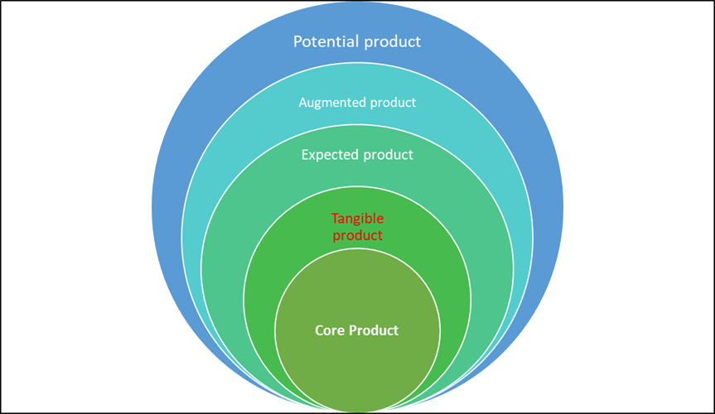
Product level
Source: adopted from Kotler 1997

Slide 8

Product levels
1. Core benefit: This is the fundamental service or benefit that the customer is really buying.
2. Tangible product: This involves turning the core benefit into a basic product.
3. Expected product: This is set of attributes and conditions buyers normally expect when they purchase this product.
4. Augmented product: It involves extra benefits that the marketer adds to his offering
5. Potential product: This encompasses all the possible augmentations and transformations the product or offering might offer in the future.

Slide 9
Product classification based on durability
Class
Strategy
a) Non-durable goods are tangible goods consumed in one or a few uses such as bread and milk.
b) Durable goods: survive many uses e.g. electronic items, machines, tools etc.
c) Services: are intangible, inseparable, variable and perishable products such as legal services, appliance repairs etc
a) The strategy is to make them available, charge low prices and advertise heavily to encourage trial and repeat purchases.
b) The strategy involves more personal selling, higher prices, guarantees and warranties.
c) The strategy for marketing such products include quality control, supplier credibility, and adaptability.

Slide 10
Based on usage classification
Consumer product: are product and services bought by final consumers for personal consumption. These will include:
Industrial product: Industrial products are goods that are destined to be sold primarily for use in producing other goods or rendering services as contrasted with goods destined to be sold primarily to the ultimate consumer.

Slide 11
Based on usage classification
Consumer Product
Strategy
a) Convenience product: customer usually buys frequently, immediately and with a minimum of comparison and buying efforts.
b) Shopping products: Less frequent purchases requiring more shopping effort and price, quality, and style comparisons.
c) Specialty product: Strong brand preference and loyalty, requires special purchase effort, little brand comparisons, and low-price sensitivity.
d) Unsought products: Little product awareness and knowledge (or if aware, sometimes negative interest).
a) Convenience product usually low priced and market placed them in many locations. (Soap, candy, newspaper)
b) Higher than convenience good pricing. Selective distribution in fewer outlets. Advertising and personal selling by producer and reseller. (Major appliances, TV’s, furniture, clothing).
c) High price. Exclusive distribution. Carefully targeted promotion by producers and resellers. (Specific brands and types of cars, high-priced photographic equipment)
d) Pricing varies. Distribution varies. Aggressive advertising and personal selling by producers and resellers. (Life insurance, cemetery plots)

Slide 12
Product Hierarchy
Product hierarchy refers to the systematic categorization of products within a company's portfolio based on various criteria such as function, price, target market, or other distinguishing factors.
It typically involves organizing products into a hierarchical structure with multiple levels of classification.
Each product is related to other products.
Product hierarchy stretches from basic needs to items that satisfy those needs.

Slide 13
Product Hierarchy
Kotler and Kelly (2016) have identified six levels in a product hierarchy.
(i) Need family: This is the core need that underlies the existence of a product family. (E.g., security).
(ii) Product family: All the classes that can satisfy a core need with reasonable effectiveness.
(iii) Product class: A group of products within the product family recognized as having a certain functional coherence
(iv) Product line: A group of products within the product class that are closely related because they perform similar function,
(v) Product type: A group of items within a product line that share one of several possible forms of the product.
(vi) Product item (product variant): It is a distinct unit within a brand or product line

Slide 14
Product hierarchy
Product hierarchy is crucial for marketers for several reasons:
Segmentation and Targeting
Product Positioning
Product Development
Brand Management
Channel Management

Slide 15
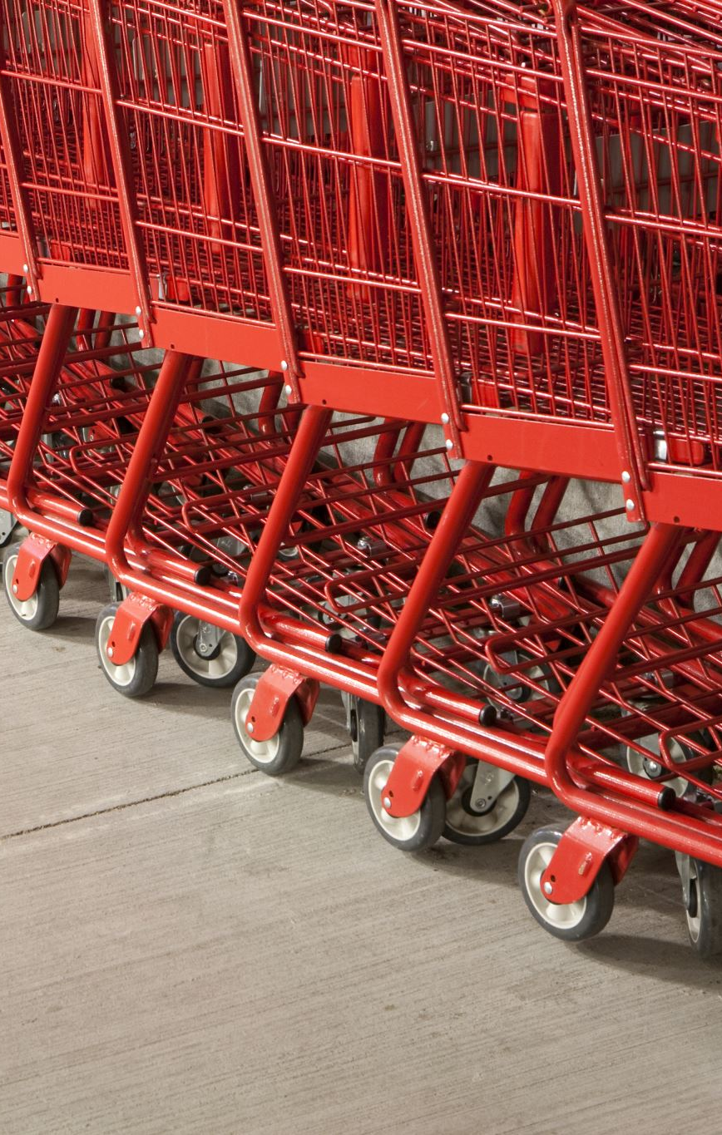
Product mix /product assortment
A product mix refers to the range of products or services that a company offers to its customers.
It encompasses all the different variations of products or services that a company manufactures, distributes, or sells.
It is the set of all products and items that a particular seller offers for sale.
Kotler and Keller (2016) four strategic decisions on marketing mix.
(i) The width of a product mix refers to how many different product lines the company carries.
(ii) The length of a product mix refers to the total number of items in the mix
(iii) The depth of a product mix refers to how many variants are offered of each product in the line.
(iv) Consistency of the product mix refers to how closely related the various product lines are in end use, production requirements, distribution channels or some other way.

Slide 16

Significance of product mix
Market Coverage
Competitive Advantage
Revenue Generation
Adaptability
Portfolio Management
A careful examination of product mix shows that a firm can expand it in four different ways:
(i) It can add new product lines, thus widening its product mix.
(ii) It can lengthen each product line.
(iii) It can add more products variants to each product and deepen its product mix.
(iv) A company can pursue more product line consistency.

Slide 17
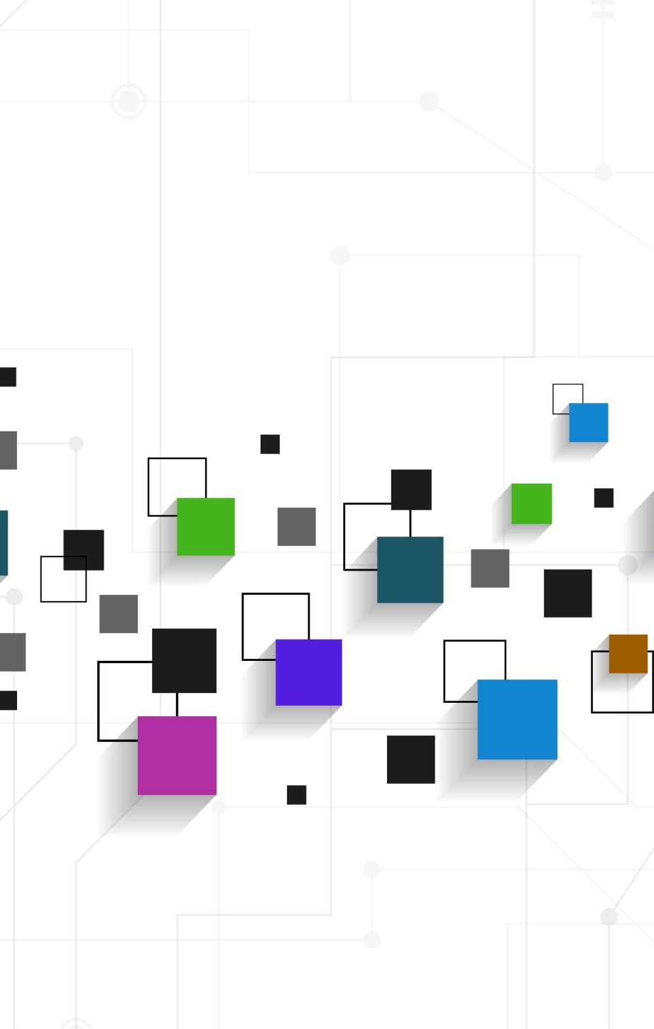
Product line decisions
A product line refers to a group of related products marketed by a company under a single brand or category.
These products typically share similar characteristics, such as functionality, target audience, distribution channels, or pricing.
Product lines help companies streamline their marketing efforts, leverage brand recognition, and cater to different customer preferences within a particular market segment.
They also allow for economies of scale in production, distribution, and marketing.

Slide 18
Major product line decisions
1. Product line analysis: It involves knowing the sales and profits analysis and market profile review:
(a) Sales and profits analysis: This involves analysis of sales and profits of each item in the product line to know which items build, maintain, harvest, or divest.
(b) Market profile review: This involves reviewing how the product line is positioned against competitors’ line.
Product line analysis helps to determine unmet demand (needs).
It also helps the company to identify market segments.

Slide 19
Major product line decisions
2. Product line length
Product line length refers to the total number of products or variations within a product line that a company offers to its customers.
It's essentially a measure of how broad or extensive the product line is.
A longer product line typically includes a greater variety of products or variations, catering to different customer needs, preferences, and market segments.
A shorter product line may have fewer options but may still effectively serve a specific niche or market.
The objectives of the company influence product line length
Product line tends to lengthen over time
Product line expansion (lengthening) leads to increased costs such as: design and engineering costs, inventory carrying costs, manufacturing change over costs, order processing costs., transportation costs and new item promotional costs.

Slide 20
Major product line decisions
2. Product line length
Product line expansion strategies
(i) Line stretching. occurs when the company lengthens its product line beyond the current range either down market, up-market or both ways.
(ii) Line filling. Achieved by adding more items within the present range.
Reaching for incremental profits.
Trying to satisfy dealers who complain about lost sales because of missing items in the line.
Trying to utilize excess capacity.
Trying to be the full line company.
Trying to plug holes to keep out competitors.

Slide 21
Major product line decisions
3. Line Modernization: Product lines need to be modernized.
In modernizing the product line, the issue is whether to overhaul the line piecemeal or all at once.
4. Featuring: This involves selecting one or a few items to feature or promote.
5. Pruning: This involves periodically reviewing the line for deadwood that is depressing profits.
The weak items can be identified through sales and cost analysis.
Pruning is also done when the company is short of production capacity.

Slide 22
Product packaging, labelling, warranties and guarantees.
Packaging includes all activities of designing and producing the container for a product.
Good packaging attracts consumers and encourages purchases.
Factors leading to growing use of packaging as a marketing tool include, self-service, consumer affluence, company and brand image as well as innovation opportunity.
The main objectives of packaging include: identifying the brand, convey descriptive and persuasive information, facilitate product transportation and protection, assist at home storage as well as aid product consumption.

Slide 23
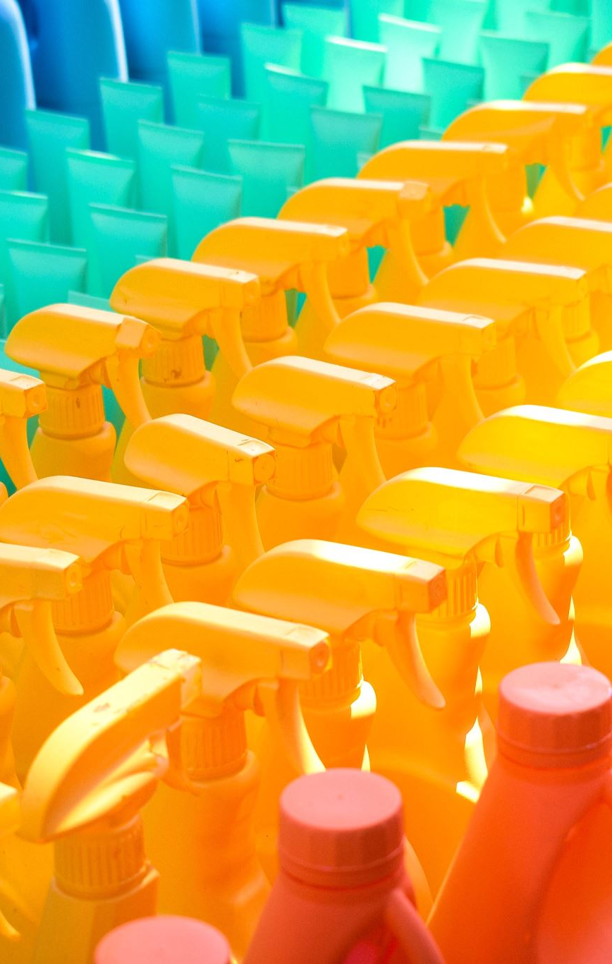
Product packaging, labelling, warranties and guarantees.
Product labeling refers to the information, symbols, or graphics displayed on a product's packaging or attached to the product itself.
This labeling serves multiple purposes, including:
Identification: Labels help identify the product, its brand, and its manufacturer
Description: Labels provide essential information about the product, such as its ingredients, nutritional content
Regulatory Compliance: Many products require specific labeling to comply with government regulations and industry standards
Marketing and Branding: Labels are an integral part of a product's marketing strategy.
Consumer Education: Labels can educate consumers about the product's features, benefits, and proper usage

Slide 24
Product packaging, labelling, warranties and guarantees.
Effective product labeling is essential for building consumer trust, ensuring product safety and compliance, and enhancing brand reputation.
Companies often invest significant effort in designing clear, accurate, and attractive labels that meet both regulatory requirements and consumer expectations.
Warranties are formal statements of expected product performance by the manufacturer.
Products under warranty can be returned to the manufacturer or designated repair center for repair, replacement, or refund.
Product guarantee: A guarantee is a pledge or assurance, often provided by the manufacturer or seller, that a product will meet certain specified conditions, such as performance standards or durability.
Guarantees are typically enforceable promises of assurance.

Slide 25
Branding
Sayings on branding
“A brand for a company is like a reputation for a person. You earn reputation by trying to do hard things well.” Jeff Bezos.
“Brand is just a perception, and perception will match reality over time.” Elon Musk.
“A brand is the set of expectations, memories, stories and relationships that, taken together, account for a consumer’s decision to choose one product or service over another.” Seth Godin
“Products are made in a factory but brands are created in the mind.” Walter Landor
"Your brand is the single most important investment you can make in your business." Steve Forbes, Editor in Chief of Forbes Magazine
"A product can be quickly outdated, but a successful brand is timeless." Stephen King, best-selling author
“Your personal brand serves as your best protection against business factors you can't control." Dan Schawbel, founder of research and advisory firm, Millennial Branding

Slide 26
Brand types
What is a brand?
American Marketing Association observes that a brand is a name, term, sign or mark, symbol or design or a combination of them intended to identify the goods and services of one seller and differentiate them from those of competition (Kotler and Kelly, 2016).
Brand naming strategies/Types of brands
Corporate Brands. This is where the company name is used essentially for all products
Corporate parent brands. These are brand names where the corporate brand is carried with individual product names.
Distinct product brands. Where manufacturers assign individual brand names to new products that are unrelated to the company name.

Slide 27
Brand types
4. Sub-brands. These include the name of the corporate brand along with the distinct product brand.
5. Co-brands. This is where two independent companies cooperate to have both brands highlighted in a product
6. Ingredient brands. This is a special case of Co-branding.
7. Retailers also create their own brands based on their store names or other factors

Slide 28

Brand types
The names given to products also come in many different terms:
They can be based on people
Places:
Animals or birds
Some brand names use words with inherent product meaning
Some brand names include prefixes and suffixes

Slide 29
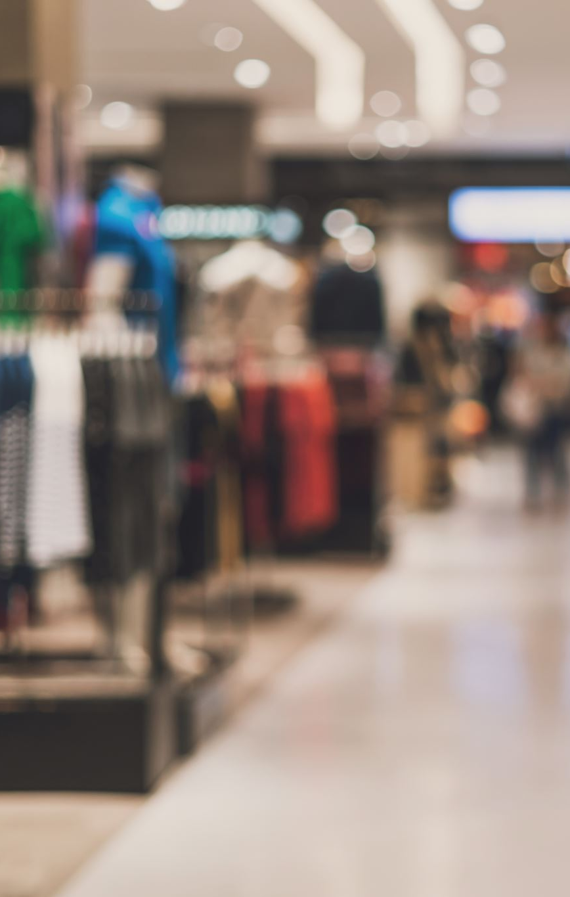
Importance of brands and branding
To consumers: To consumers, brands are important in the following ways:
Helps to identify the source or maker of the product. (They help in differentiation).
Brands have special meaning to consumers e.g., quality, fast service, friendliness etc.
Brands help consumers to easily recognize the products thus lowering the search costs.
Brands act as a promise or a bond with a consumer
Brands also serve as symbolic devices, allowing consumers to project their own self-images.
Brands are a sign of quality.
Brands serve to reduce the risks in product decisions. Such as functional risk, physical risk, financial risk, social risk-social embarrassment, psychological risk and time risk-opportunity cost.

Slide 30

Importance of brands and branding
b. To firms/organizations, brands serve the following purposes.
They are a means of identification to simplify handling or tracing of inventory.
They enhance efficiency and effectiveness of marketing programs.
They offer legal protection for unique features or aspects of a product.
Brands are a means of endowing products with unique associations
Brands signal a certain level of quality to consumers
Brands are a powerful means to secure a competitive advantage
They are source of financial returns
Enhance brand extensions.

Slide 31
Branding challenges and opportunities
(i) Brand proliferation
(ii) Media fragmentations
(iii) Increased competition and costs
(iv) Greater accountability
(v) Other challenges include difficulty in differentiating due to imitation, decreasing brand loyalty for many products due to price discounting/price competition, growth of private labels etc

Slide 32
Brand identity
Brand identity is a unique set of brand associations that the brand strategist aspires to create or maintain.
These associations represent what the brand stands for and imply a promise to customers from the organization
How to enhance brand identity?
Provide superior customer value.
Develop deep understanding of customers.
Total commitment to quality.
Provide differentiation or points of difference.
Consistency and evolution in brands – adaptation to changes in consumer tastes.

Slide 33
Brand equity
Brand equity can be defined as the added value linked to a product or service which is reflected on how consumers think, feel, and act with respect to a brand as well as the prices, market share and profitability that the brand commands for the firm Kotler and Keller (2016)
It comprises brand name awareness, perceived quality, brand loyalty, brand associations and other brand assets.
(i) Brand name awareness: Awareness refers to the strength of a brand’s presence in the consumer’s mind
(ii) Perceived quality: Perceived quality is a measure of ‘brand goodness’
(iii) Brand loyalty: A brands value to a firm is largely created by the customer loyalty it commands.
(iv) Brand associations: Brand equity is supported in great part by the associations that consumers make with a brand.
(v) Other brand assets: These are patents and trademarks.

Slide 34
Brand equity
Benefits from brand equity
Greater revenue and lower cost.
Greater loyalty
Less vulnerability to competing markets actions and crises
Larger margins
Greater trade cooperation and support
Increased marketing communication effectiveness

Slide 35
Brand equity
Benefits from brand equity
Possible licensing opportunities (right to use trademark)
Additional brand extension opportunities
Brands with positive customer-based equity may provide other advantages to the firm not directly related to the products themselves such as.
Helping the firm to attract better employees,
Generating interest for investors and
Gathering more support from shareholders.

Slide 36
References
Alnazer M. K (2005) Product and Services strategy: https://www.angelfire.com
Azam C. (n.d) marketing management. Faculty of Commerce DSPMU https://dspmuranchi.ac.in
Cravens D.W & Nigel F.P (2009) strategic marketing 9th edition McGraw Hill Irwin Boston
Dibb, S., Simkin, L., Pride, W. and Ferrell, O.C. (1997), Marketing: Concepts and Strategies, Houghton Mifflin, Boston, MA.
Kotler P & Keller K.L (2016), Marketing management 16th Edition Pearson
Kotler P,(2000) Marketing Management: Analysis, Planning, Implementation, and Control, 9th edition, Prentice-Hall of India Private Limited, New Delhi, p, 229
Kotler P. & Armstrong G. (2006). Principles of marketing, (11th Ed.) Upper Saddle River: New Jersey: Prentice-Hall
Kotler, P. (1997). Marketing Management Analysis, Planning, Implementation, and Control, 9th ed.,: Prentice-Hall International, Englewood Cliffs, NJ.

Slide 37
Marketing management project
This week we want to focus on:
A) identifying:
A product mix for our company
Product lines
Recommend ways to expand product mix and justify
B) evaluate the branding strategy employed by the company and recommend ways of enhancing the same

Slide 38
End
End
Thank you
Next lesson: Pricing strategies

