Slide 1

MARKETING MANAGEMENT AND STRATEGY
WEEK 10 LECTURE
RELATIONSHIP MARKETING
Dr. John N Kamau

Slide 2

Welcome
Welcome to week 10 lecture!
Its my joy to have you in this class!
We have now covered marketing management strategies on 4Ps of marketing
We now focus on holistic marketing strategies
We begin with Relationship marketing
Judges 18:28 “There was no one to rescue them because they lived a long way from Sidon and had no relationship with anyone else. The city was in a valley near Beth Rehob.”

Slide 3

Subtopics
Definition of relationship marketing
Significance of relationship marketing
Scope of relationship marketing
The Process of Relationship Development
Relationship cycle
Creating Customer Relationship Management Strategy.
Drawbacks to customer relationship management

Slide 4

Quotes on relationship marketing
1. “To build a long-term, successful enterprise, when you don’t close a sale, open a relationship.” Patricia Fripp
2. “Our job is to connect to people, to interact with them in a way that leaves them better than we found them, more able to get where they’d like to go.”Seth Godin
3. “Instead of using technology to automate processes, think about using technology to enhance human interaction.” Tony Zambito, lead authority in buyer personas.
4. “Marketing is no longer about the stuff you make, but about the stories you tell.”Seth Godi
5. “The aim of marketing is to know and understand the customer so well the product or service fits him and sells itself.” Peter Drucker, founder of Drucker Institute
6. “I’ve learned that people will forget what you said, people will forget what you did, but people will never forget how you made them feel.” Maya Angelou

Slide 5

Quotes on relationship marketing
7. “Even when you are marketing to your entire audience or customer base, you are still simply speaking to a single human at any given time.”Ann Handley, head of content at Marketing Profs
8. “Build something 100 people love, not something 1 million people kind of like.” Brian Chesky, cofounder of Airbnb
9. Building relationships is a vital currency you cannot afford to run out of. Yvonne A Jones
10. After all, happy customers = Wealthy business!
11. “Integrity is important in building relationships. And is the foundation upon which many other qualities for success are built, such as respect, dignity and trust.” – John C. Maxwell
12. “CRM is your GPS to a better route on your Business Development journey.” ― Bobby Darnell

Slide 6

Quotes on relationship marketing
13. “Yes, CRM is all about Customer Relationship Management … but it is also about prospect relationships.” ― Bobby Darnell
14. “If people believe they share values with a company, they will stay loyal to the brand.” – Howard Schultz
15. “One customer well taken care of could be more valuable than $10,000 worth of advertising.” – Jim Rohn
16. “The more you engage with customers, the clearer things become and the easier it is to determine what you should be doing.” – John Russell
17. “What we really need is a mindset shift that will make us relevant to today’s consumers, a mindset shift from telling to selling to building relationships.” – Jim Stengel

Slide 7

Definition of relationship marketing
1. Berry ( 1983, p. 25) states, "Relationship marketing is attracting, maintaining and-in multi-service organizations-enhancing customer relationships"
2. Berry and Para-suraman (1991, p. 133) propose that "relationship marketing concerns attracting, developing, and retaining customer relationships."
3. Jackson (1985, p. 2) refers to relationship marketing as "marketing oriented to-ward strong, lasting relationships with individual accounts."
4. Doyle and Roth (1992, p. 59) indicate that "the goal of relationship selling is to earn the position of preferred supplier by developing trust in key ac-counts over a period of time."

Slide 8

Definition of relationship marketing
5. Morgan & Shelby (1994, p.22) state that “Relationship marketing refers to all marketing activities directed toward establishing, developing, and maintaining successful relational exchanges.”
6. Bruce de (1988) Relationship marketing is the process of attracting, maintaining, and enhancing relationships with key people.
7. According to advanced dictionary of marketing (pp, 445), relationship marketing also called customer relationship marketing refers to marketing characterized by an emphasis on building a long-term customer relationship with selected customers.
Relationship marketing centers on all activities directed towards establishing, developing, and maintaining successful exchanges with customers and other constituents.

Slide 9

Significance of relationship marketing to a business
Customer Loyalty: By nurturing relationships with customers, businesses can increase loyalty.
Repeat Business: Satisfied customers are more likely to make repeat purchases.
Word-of-Mouth Marketing: Happy customers become brand advocates.
Reduced Marketing Costs: Acquiring new customers can be expensive.

Slide 10
Significance of relationship marketing to a business
Better Feedback and Insights: Building relationships allows businesses to gather valuable feedback directly from customers.
Competitive Advantage: Businesses that excel at relationship marketing often enjoy a competitive advantage
Long-Term Growth: Sustainable growth often comes from repeat business and customer referrals.
Relationship marketing recognizes that customers are more than just transactions; they're individuals with needs, preferences, and emotions.

Slide 11
Scope of relationship marketing
.
Supplier partnerships
Goods suppliers
Services suppliers
Internal partnerships
Business units
Competitors
Lateral partnerships
Employees
Focal
Firm
Non-Governmental Organizations
Functional departments
Governments
Intermediate customers
Ultimate customers
Buyer partnerships
Source: Adopted from Morgan & Hunt, 1994

Slide 12

Scope of relationship marketing
1. Supplier partnerships: Supplier partnerships in business involve establishing collaborative and mutually beneficial relationships with suppliers.
2. Internal partnerships: refer to collaborative relationships formed between different departments, teams, or individuals within the same organization.
3. Buyer partnerships: Buyer partnerships, also known as buyer-supplier partnerships or customer-supplier partnerships, are collaborative relationships between buyers (customers) and sellers (suppliers) in a business context.
4. Lateral partnerships: refer to collaborative relationships formed between different entities or organizations that operate at a certain marketing ecosystem. In our model, we consider relationship with stakeholders such as government, NGOs and other businesses.

Slide 13

The Process of Relationship Development
The process of relationship development has been defined as consisting of eight distinct stages (Stone and Woodcock,1995).
i. Recruitment: in this stage the marketer identifies the clients he would want to develop relationship with.
ii. Welcoming: in this stage the marketer welcomes the potential client and makes his intent of wanting to develop a relation with the customer clear.
iii. Getting acquainted: it is in this stage that the marketer seeks to know the goals, aspirations, needs and wants of his client.

Slide 14
The Process of Relationship Development
iv. Account Management: this is the stage of running the accounts where the client does his side of the contract and likewise the marketer.
v. Intensive Care: this occurs when the parities have a very serious difference that has the potential to cripple or even terminate the relationship.
vi. Potential divorce: occurs when the differences between the parties cannot be resolved.

Slide 15
The Process of Relationship Development
vii. Divorce: this stage is arrived at when the parties have to part ways.
Divorce must be done in such a way that there is room for coming back together and continue the business.
viii. Win back: this is the final stage where the marketer tries to win back the lost customer.
As they say in politics, there are no permanent enemies in business, and all must work to ensure they meet their interest.

Slide 16
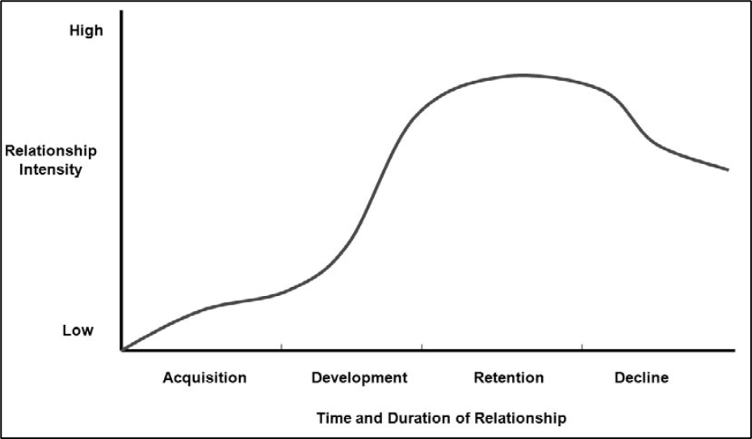
Customer relationship life cycle
Source: adopted from Fill, C., & McKee, S. (2011).

Slide 17

Customer relationship life cycle
1. Customer acquisition:
First, is a buyer–seller search for a suitable pairing.
Second, is a period of initiation during which both organizations seek out information about the other before any transaction occurs.
Third, is the socialization period during which the buyer and seller start to familiarize themselves with each other and gradually begin to reveal more information about themselves.

Slide 18
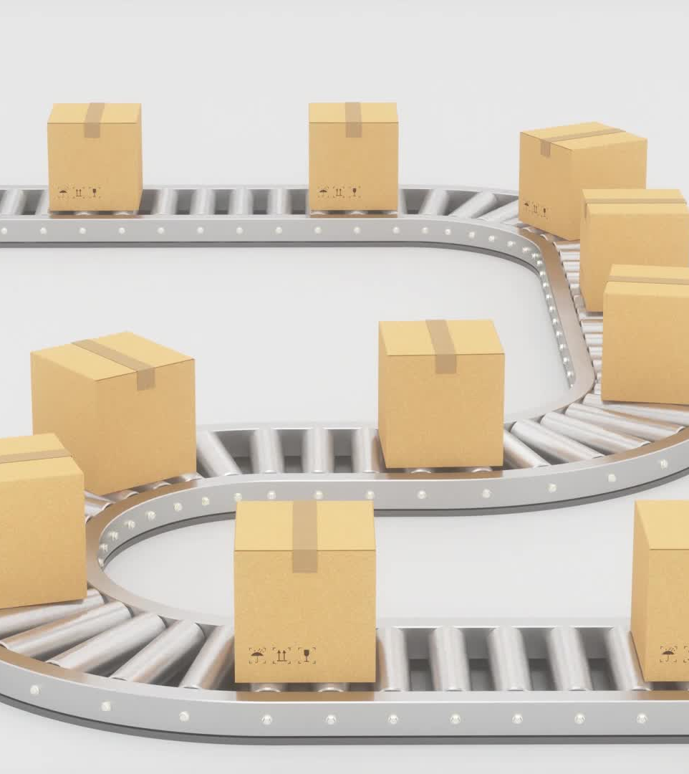
Customer relationship life cycle
2. Customer development:
The seller encourages the buyer to try other products, increase the volume of purchases, engage with other added value services and to vary delivery times and quantities.
The buyer will agree according to specific needs and increase the level of the drive to become more involved with the supplier.
The buyer is able to determine whether it is worth or not to develop deeper relationships with the seller.

Slide 19

Customer relationship life cycle
3. Customer retention:
Greater involvement in relationships results in greater levels of trust and commitment between the partners.
Whether both the buyer and seller are able to meet their individual and joint goals.
The means of measuring levels of retention as well as determining when resources are moved from acquisition to retention and back become critical.

Slide 20

Customer relationship life cycle
4. Customer decline:
This period is concerned with the demise of the relationship in which case termination may occur
The more likely process in this phase is the buying organization deciding to reduce their reliance on the seller
Notifies them formally
Begins to reduce the frequency and duration of contact and moves the business to other, competitive organizations.

Slide 21

Creating Customer Relationship Management Strategy.
1. Acquiring the right customers:
Identify the most valuable customers
Calculate the share of their purchases (wallet)
Identify current and future high-value customers,
Marketing communications to high-value customers.
2. Crafting the right value proposition:
Determine the products or services the customers
Assess competitors offering
Create new distribution channels and pricing models.

Slide 22

Creating Customer Relationship Management Strategy.
3. Instituting the best processes:
Research the best way to deliver the products or services to customers,
Determine the service capabilities that must be developed
The technology investments that are required to implement customer strategy,
Provide better information to customers
Manage logistics and the supply chain more efficiently.

Slide 23

Creating Customer Relationship Management Strategy.
4. Motivating employees:
Identify the tools the employees need to foster customer relationships.
Earn employee loyalty by investing in training and development
Align employee incentives and performance measures and
Distribute customer knowledge to employees throughout the organization.

Slide 24

Creating Customer Relationship Management Strategy.
5. Learning to retain customers:
Understand why customers defect and how to win them back.
Identify the strategies their competitors are using to win your high-value customers.
Tracking customer defection and retention and service satisfaction levels are crucial in this process.

Slide 25

Application of Technology in Customer Relationship Management.
The impact of technology in customer relationship management is profound.
The use of ICT in business relationships has seen development in automation, standardization and improved communications, greater efficiencies, and increased quantities of targeted information to identified clients.
The use of technology has destroyed some relationships as well as create opportunities for others.
Strategically orientated purchases may be maintained through strong relationships between partnerships and alliances

Slide 26

Application of Technology in Customer Relationship Management.
Customer relationship management applications were initially designed for supplier organizations to enable them to manage their end-user customers.
The aim of CRM systems is to provide all employees who interact with customers, either directly or indirectly, access to real-time customer information.
CRM applications typically consist of call management, lead management, customer record, sales support, and payment systems.
Ideally, CRM systems should be incorporated as part of an overall strategic approach (Wightman, 2000).
Rapp et al. (2010) note that durable customer relationships are best maintained using a “combination of customer-centric technology, human, and business resources along with a relationship-focused strategy”.

Slide 27
Application of Technology in Customer Relationship Management.
The success of using information technology to improve customer relationship management (CRM) depends on:
1. CRM perceived usefulness
2. Setting of accurate expectations regarding system usage
3. Salesperson innovativeness toward new technological tools
4. CRM perceived ease of use
5. Supervisor encouragement and support

Slide 28
Drawbacks of Relationship Marketing
Though relationship marketing is hailed for its contribution to increasing business performance, there are also demerits to this business strategy.
New customers negligence
Instant gratification customer
Time constrains

Slide 29
Drawbacks of Relationship Marketing
Value proposition change difficulties
Too many demands
Resource Intensive
Dependency on Individual Relationships
Potential for Over personalization

Slide 30
Drawbacks of Relationship Marketing
Difficulty Scaling up
Customer Turnover
Measurement and ROI difficulties
Despite these drawbacks, relationship marketing remains a valuable strategy for businesses looking to foster long-term customer loyalty, enhance brand reputation, and drive sustainable growth.
However, it's essential for businesses to carefully balance the benefits and challenges of relationship marketing and tailor their strategies to align with their specific goals and resources.

Slide 31
References
Avlonitis, George J. and Panagopoulos, Nikolaos G. (2005). “Antecedents and consequences of CRM technology acceptance in the sales force.” Industrial Marketing Management, Vol. 34, Iss. 4, May, 369–77.
Berry, L. L. (1983), "Relationship Marketing," in Emerging Perspectives on Services Marketing, L. Berry, G.L. Shostack, and G.D. Upah, eds. Chicago: American Marketing Association, 25-28.
Bruce De Young (1988) Relationship marketing Journal of extension Oregon State University-Corvallis
Buehrer, Richard E., Senecal, Sylvain, and Pullins, Ellen Bolman (2005). “Sales force technology usage – reasons, barriers, and support: An exploratory investigation.” Industrial Marketing Management, Vol. 34, Iss. 4, May, 399–405.
Doyle, Stephen X. and George T. Roth (1992), "Selling and Sales Management in Action: The Use of Insight Coaching to Improve Relationship Selling," Journal of Personal Selling and Sales Management, 12 (winter), 59-64.
Fill, C., & McKee, S. (2011). Business marketing face to face. Goodfellow Publishers, Limited.
Jackson, Barbara Bund (1985), Winning and Keeping Industrial Customers. Lexington, KY: Lexington Books.
Morgan, R. M., & Shelby D. H. (1994), “The Commitment-Trust Theory of Relationship Marketing.” Journal of Marketing 58 (July), 20–38.
Rapp, A., Trainor, K.J. and Agnihotri, R. (2010) Performance implications of customer linking.
Skjott-Larsen, T., Kotazab, H. and Grieger, M. (2003) Electronic marketplaces and supply
Wightman, T. (2000) e-CRM: the Critical dot.com discipline, Admap (April) 46–48.

Slide 32
Management research project
Part 9
1. Determine the extent to which the firm you are studying is applying relationship marketing strategy.
2. Recommend any changes required to improve relationships within and without the firm

Slide 33
End
End
Thank you
Next lecture: Internal marketing

