Slide 1
MARKETING MANAGEMENT AND STRATEGY
WEEK 13
STRATEGIC MARKETING IMPLEMENTATION AND CONTROL
Dr John Kamau

Slide 2

Welcome
Welcome to week 13 lecture
It is my joy to have you in this class
This second last lecture
Focus is on strategy implementation
James 1:22-25 NIV: 22 Do not merely listen to the word, and so deceive yourselves. Do what it says. 23 Anyone who listens to the word but does not do what it says is like someone who looks at his face in a mirror 24 and, after looking at himself, goes away and immediately forgets what he looks like. 25 But whoever looks intently into the perfect law that gives freedom and continues in it—not forgetting what they have heard, but doing it—they will be blessed in what they do.

Slide 3

Subtopics
Concept of strategic marketing implementation
Strategy implementation requirements
Skills required for implementing marketing programs
Challenges in implementing a marketing strategy
Marketing control
Significance of marketing control
Types of control
Major marketing weakness and the future of marketing

Slide 4

Quotes on marketing strategy implementation
1. “Strategy is execution.” – Fred Gluck.
2. “Execution without a strategy is aimless, strategy without execution is useless.” – Morris Chang.
3. “The best strategy is useless without people to execute it.” – Mike Duke.
4. “Execution is the ability to mesh strategy with reality.” – Lawrence Bossidy
5. "The essence of strategy is choosing what not to do." — Michael E. Porter, American economist and founder of strategic management

Slide 5

Quotes on marketing strategy implementation
6. "In real life, strategy is actually very straightforward. You pick a general direction and implement like hell." — Jack Welch, former CEO of General Electric
7. "However beautiful the strategy, you should occasionally look at the results." — Sir Winston Churchill
8. "The real challenge in crafting strategy lies in detecting subtle discontinuities that may undermine a business in the future. And for that there is no technique, no program, just a sharp mind in touch with the situation." — and again Henry Mintzberg
9. "Winning should be at the heart of every strategy." — A.G. Lafley & Roger L. Martin in their book Playing to Win: How Strategy Really Works.
10. "Building a visionary company requires one percent vision and 99 percent alignment." — Jim Collins & Jerry Porras in their book Built to Last: Successful Habits of Visionary Companies

Slide 6

Quotes on marketing strategy implementation
11. "Victorious warriors win first and then go to war, while defeated warriors go to war first and then seek to win." — Sun Tzu, Chinese philosopher and military strategist
12. “A goal without a plan is just a wish.” — Antoine de Saint-Exupéry, French writer and pilot
13. "There is nothing so useless as doing efficiently that which should not be done at all." — Peter Drucker
14. "An organization’s ability to learn, and translate that learning into action rapidly, is the ultimate competitive advantage." — Jack Welch
15. "Strategy is buying a bottle of fine wine when you take a lady out for dinner. Tactics is getting her to drink it." — Frank Muir, British actor and comedy writer

Slide 7

Concept of strategic marketing implementation
Marketing implementation is the process that turns marketing plans into actions assignments and ensures they accomplish the plans stated objectives.
Strategy addresses the what, and why of marketing activities, implementation addresses the who, where when and how.
Strategy implementation is the process of turning strategic plans into actions to achieve an organization's objectives.
It involves coordinating resources, aligning operations, and ensuring all departments and stakeholders work together towards the common goals set forth in the strategic plan.

Slide 8
Concept of strategic marketing implementation
Key Components of Strategy Implementation
Action Plans and Objectives
Resource Allocation
Organizational Structure
Leadership and Management
Communication
Performance Monitoring
Feedback and Adaptation

Slide 9
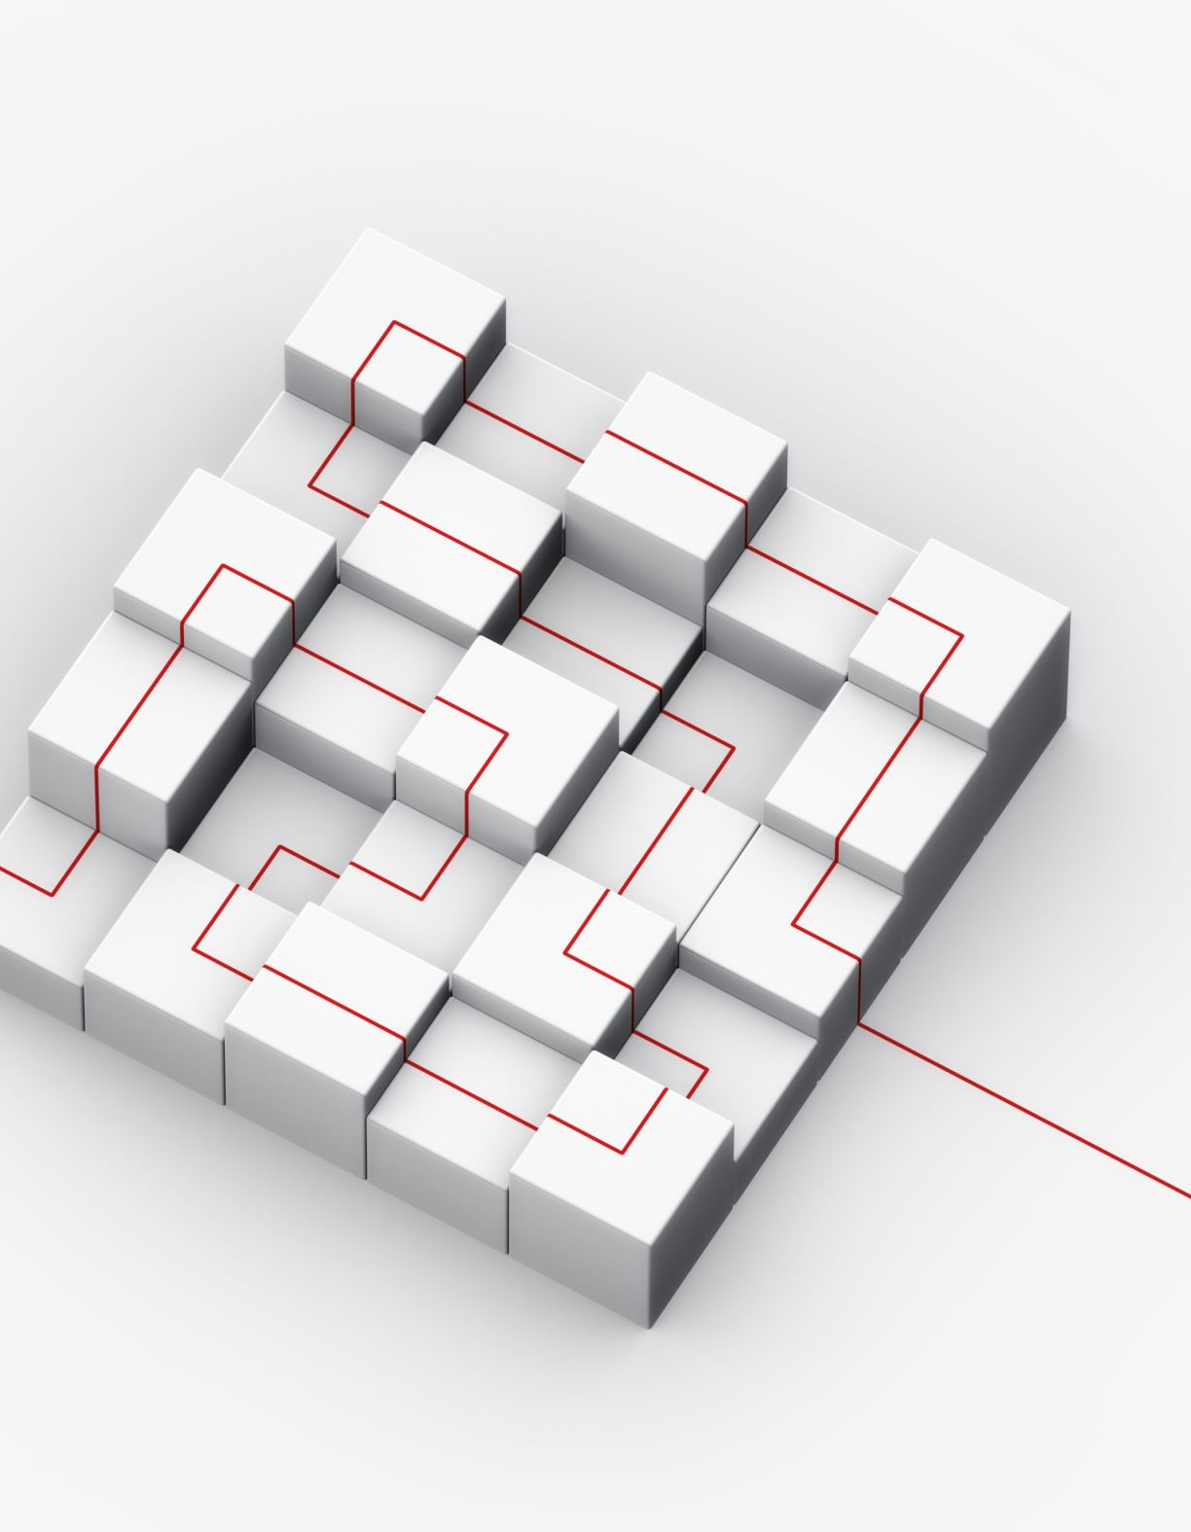
Strategy implementation requirements
The beauty of any plan lies in implementation. Implementation requires appropriate structures, personnel, and resources.
Implementation structures
1. Functional organization
2. Product organization
3. Regional organization
4. Segmental organization
5.Matrix

Slide 10

Implementation resources required
A) Tangible resources include financial, physical, technological, and organizational categories (Peng, 2009).
They include the ability to raise money or generate external funds, machinery, buildings, vehicles, raw materials, work in progress, possession of patents trademarks and copyrights, planning, command-and-control systems, and management information systems which can be measured.
B) Intangible resources include human, innovation and reputation resources and capabilities.
Intangible resources also include relational resources and competences. Relational resources are all of the means available to the firm derived from its relationship with its environment (Lowendahl,1997).

Slide 11

Resource audit
1. Financial
2. Physical
3. Technological
4. Human :resources, motivation and commitment
5. Innovation: Research and development capabilities
6. Reputation: This includes customer perceptions of product quality and reliability, and company reputation as a good employee and responsible corporate citizen.

Slide 12

Effective implementation requirements
Effective implementation of strategy requires that every process combines the following four resources:
a) Basic assets. These are the tangible and intangible assets of the business, as expressed in the financial reporting systems.
b) Explicit knowledge. This is knowledge which can be written down or otherwise recorded.
c) Tacit knowledge. This is knowledge, which is difficult or impossible to codify, and usually resides in the heads of employees.
d) Procedure. This is the mechanism by which the basic assets, explicit knowledge, and tacit knowledge are brought together.

Slide 13

Skills required for implementing marketing programs
(i) Diagnostic skills : This is the ability to determine the causes of implementation problems.
(ii) Identification of company level: This involves the ability to determine where the implementation problems occurred.
They can occur at three levels:-
the marketing function level.
the marketing program level.
the marketing policy level.

Slide 14

Skills required for implementing marketing programs
(iii) Implementation skills: To implement marketing programs successfully, marketers need other skills such as:-
Allocating skills for budgeting resources.
Organizing skills to develop an effective organization.
Interaction skills to motivate others to get things done.
(iv) Evaluation skills: Marketers also need monitoring skills to track and evaluate marketing actions.

Slide 15

Challenges in implementing a marketing strategy
1. Resource Constraints
Limited Budget
Insufficient Manpower
Inadequate Technology
2. Poor Communication which considers
Internal Miscommunication
Stakeholder Alignment
3. Resistance to Change due to
Organizational Culture
Inertia

Slide 16
Challenges in implementing a marketing strategy
4. Ineffective Coordination within the organization
Cross-Departmental Coordination
Process Integration
5. Inadequate Market Research due to:
Target Audience Misunderstanding
Outdated Data
6. Performance Measurement Issues such as:
Defining KPIs
Tracking and Analysis

Slide 17

Challenges in implementing a marketing strategy
7. External Factors that include
Market Dynamics
Regulatory Changes
8. Technology Challenges
Implementation Complexity
Training Needs
9. Maintaining Consistency issues such as:
Brand Messaging
Quality Control

Slide 18
Challenges in implementing a marketing strategy
10. Adaptability which requires:
Feedback Integration
Agility
Addressing these challenges requires a proactive approach, including thorough planning, effective communication, continuous monitoring, and a willingness to adapt as necessary.
By anticipating and managing these obstacles, organizations can improve their chances of successfully implementing their marketing strategies.

Slide 19
Marketing Control
Marketing control is the process by which firms assess the effect of their marketing activities and programs and make necessary changes and adjustments (Kotler and Kelly, 2016).
Marketing control is the process of monitoring and evaluating the implementation of marketing strategies and plans to ensure that organizational goals are achieved.
Control refers to the process of monitoring and measuring performance, identifying the shortfalls in the predetermined achievement levels and taking the required measures to ensure the achievement of the targets.

Slide 20

Marketing Control
The control process involves four main steps:
1. Establish criteria and standards: These could be quantitative or qualitative such as company image, employee motivation and customer satisfaction.
Standard is the planned level of performance which must be realistic.
2. Measure and compare performance: The actual performance is measured and compared with the planned performance.
3. Performance gap analysis: This is the difference between the planned performance and the actual performance.
4. Taking corrective measures.: This could be modification of objectives, reviewing of performance standards among others.

Slide 21
Significance of market control
1. Ensures Alignment with Objectives
Strategic Alignment
Consistent Direction
2. Monitors Performance
Performance Tracking
Data-Driven Decisions
3. Identifies Deviations and Problems
Variance Analysis
Early Detection.

Slide 22
Significance of market control
4. Facilitates Resource Optimization
Efficient Resource Use
Budget Management
5. Improves Adaptability
Responsive Adjustments.
Continuous Improvement
6. Enhances Accountability
Clear Accountability
Informed Management

Slide 23
Significance of market control
7. Boosts Profitability
Profitability Analysis
Cost Control
8. Improves Customer Satisfaction
Feedback Mechanisms
Customer-Centric Adjustments
9. Supports Strategic Decision-Making
Informed Strategy Development
Long-Term Planning
10. Competitive Advantage
Market Positioning
Adapt to Competitors

Slide 24
Types of control
1. Annual plan control: Its purpose is to monitor the and takes different approaches such as sales analysis, market share analysis, sales to expense ratio, financial analysis, and market based-score card analysis.
2. Profitability control: This examines where the company is making and losing money.
3. Efficiency control: It seeks to evaluate and improve the spending, efficiency, and impact of marketing expenditures.

Slide 25
Types of control
4. Strategic control: It is concerned with tracking the strategy as it is being implemented,
It may take different forms such as premise control, implementation control, strategic surveillance, and special alert control (Cherunilam, n.d).
- Premise control is designed to check systematically and continuously whether the premises (assumptions and conditions) set during the planning and implementation process are still valid)
- Implementation control is designed to assess whether the overall strategy should be changed in the light of unfolding events and results associated with incremental steps, and actions that implement the overall strategy.
- Strategic surveillance is designed to monitor a broad range of events inside and outside the company that are likely to threaten the course of the firm’s strategy.

Slide 26
Types of control
5. Balance scorecard: It was developed by Kaplan and Norton (1992)
Financial measures. These would include return on capital employed, cash flow, growth in share value and so forth.
Customers. These measures would include perceived value for money (not necessarily cheapness), competitive benefits package
Internal processes. These might be enquiry response time, conversion rate from enquiry to order.
Growth and improvement. This would include the number of new products on offer, the extent of employee involvement and empowerment, employee attitudes to the firm, and so forth.

Slide 27
Types of control
6. Administrative control: Based on systems, rules and procedures.
7. Social control: The control exercised by workmates and the organizational culture.
8. Self-control: Control exercised by individuals on themselves, based on their own interpretation of correct behavior.

Slide 28
Difficulties with control systems:
Control concepts are mainly borrowed from the engineering world and may not apply well in the world of management.
This is because managers deal with humans who don’t behave like machines.
1. Objectives can be devised and can be stated precisely: Most organizations do not have clear objectives, but rather have broad goals.
2. Achievement can be measured, and a measure of variance measured: Without measurable objectives, achievement cannot be easily measured.
3. Variance information can be fed back.: Unstructured activities involve judgment and are often unique, so feedback for one activity is unlikely to be directly applicable to another.
4. The feedback is sufficient to maintain control. The system will only work if the applied feedback is bigger than the environmental shift.

Slide 29
Essential features of an effective evaluation and control system:
1. Objective based: The business marketer must clarify purpose of evaluation
2. Economical: Costs must be justifiable with utility.
3. Objectivity: Evaluation system must be reality oriented.
4. Pervasiveness: The system must be appreciated throughout the organization
5. Simplicity: The evaluation system should be simple to the extent possible
6. Communication and involvement
7. Congruence: Measurements must be in congruence with the events measured.
8. Operational: Controls must be focused on action. The findings of the control must reach the people responsible for taking needed action in time.

Slide 30
Major marketing weakness and the future of marketing
Kotler and Keller (2016) have outlined the following marketing weakness.
The company is not sufficiently market focused and customer driven.
The company does not fully understand its target customers.
The company needs to better define and monitor its competitors.
The company does not properly manage relationships with stakeholders.
The company is not good at finding new opportunities.
The company marketing planning process is deficient.
Product and service policies need tightening.
The company’s brand building and communication skills are weak.
The company is not organized for effective and efficient marketing.
The company has not made maximum use of technology.

Slide 31

Major marketing weakness and the future of marketing
The future of marketing will see the following adjustments.
The demise of the marketing department and the rise of holistic marketing
The demise of free-spending marketing and the rise of ROI marketing
The demise of marketing intuition and the rise of marketing science
The demise of manual marketing and the rise of both automated and creative marketing
The demise of mass marketing and the rise of precision marketing

Slide 32

References
Bonoma, T. V. (1984). Making your marketing strategy work. Harvard Business Review, March-April, 62(2).
Band, W A (1984).: ‘A marketing audit provides an opportunity for improvement’, Sales and Marketing Management in Canada, pp. 24–6.
Blythe J & Zimmerman A (2013) Business to Business Marketing Management A global perspective Second Edition, Routledge
Cherunilam, F. (n.d.) Marketing of Industrial Goods. Global Media, . p 207
Desmond, J (2004): ‘An evaluation of organizational control strategies for relationship marketing’, Journal of Marketing 20 (1) pp. 209–37.
Eng, Teck-Yong (2008). “Customer Portfolio Planning in a Business Network Context.” Journal of Marketing Management, Vol. 24, No. 5/6, 567–87.

Slide 33
References
Finlay, P. (2000). Strategic Management. Harlow: Financial Times Prentice Hall.
Kaplan, R.S. and Norton, D.P. (1992). “The balanced scorecard – measures that drive performance.” Harvard Business Review, Vol. 70, Iss. 1, Jan.–Feb., 71–80.
Kotler, P (2003): Marketing Management, 11th edn (Pearson Education Inc., Upper Saddle
Lowendahl, B.R. (1997). Strategic management of professional business service firms. Copenhagen: Copenhagen Business School Press.
Peng, Mike W. (2009). Global Strategy. Mason OH: Southwestern Cengage Learning.
Porter, M.E. (1980): Competitive Strategy: Techniques for Analyzing Industries and Competitors
Taghian, Mehdi and Shaw, Robin N. (2008). “The Marketing Audit and Organizational Performance: An Empirical Profiling.” Journal of Marketing Theory & Practice, Vol. 16, No. 4, 341–9.

Slide 34

End
End
Thank you
Next lecture: Ethical issues in marketing management

