Slide 1

MARKETING MANAGEMENT AND STRATEGY
WEEK 14 LECTURE
ETHICAL ISSUES IN MARKETING MANAGEMENT
Dr. John N Kamau

Slide 2

Welcome
Welcome to final lecture
It is my joy to have you in this class
Appreciation for the effort
Ethics is the glue that holds everything together
1 Kings 3:9 So give your servant a discerning heart to govern your people and to distinguish between right and wrong. For who is able to govern this great people of yours?”
Isaiah 7:16: for before the boy knows enough to reject the wrong and choose the right, the land of the two kings you dread will be laid waste.
Revelation 22:11: Let the one who does wrong continue to do wrong; let the vile person continue to be vile; let the one who does right continue to do right; and let the holy person continue to be holy.”

Slide 3

Subtopics
Definition and views on ethics
Basics of ethics in marketing management
Significance of ethics in marketing management
Ethical issues common in marketing management
Making ethics work
Ethical decision-making process
Drawbacks to ethical marketing

Slide 4

Quotes in ethics
1. "Marketing is the creative use of truth" Philip Kotler
2. “It takes 20 years to build a reputation and five minutes to ruin it. If you think about that, you'll do things differently” Warren Buffett
3. “Ethics is knowing the difference between what you have a right to do and what is right to do.” Potter Stewart
4. “If ethics are poor at the top, that behavior is copied down through the organization.” Robert Noyce

Slide 5
Quotes in ethics
5. “If you don't have integrity, you have nothing. You can't buy it. You can have all the money in the world, but if you are not a moral and ethical person, you really have nothing” Henry Kravis
6. “It is easy to dodge our responsibilities, but we cannot dodge the consequences of dodging our responsibilities” Josiah Stamp
7. “Living up to your commitments is part of ethics. My word is my bond.” Isadore Sharp
8. “Sometimes when you innovate, you make mistakes. It is best to admit them quickly, and get on with improving your other innovations” Steve Jobs
9. “Many leaders are asking fundamental questions about what they're in, why they are doing it and how it can be used as a means of healing human and natural communities” Amory Lovins

Slide 6

Definition and views on ethics
Ethics means a standard of behavior, a conception of right or wrong conduct (Lawrence and Weber, 2011).
Ethical principles are guides to what is right and wrong usually derived from religious beliefs as well as industry and professions, families, friends, school, and the media.
For marketers, ethics in the workplace refers to rules (standards, principles) governing the conduct of organizational members and the consequences of marketing decisions
(Ferrell, 2005). Ethics is defined as an inquiry into the nature and grounds of morality where morality means moral judgments, standards, and rules of conduct (Tsalikis and Fritzsch,1989).
Murphy P.E (2005) mentioned ethical marketing as practices that emphasize transparent, trustworthy, and responsible personal and organizational marketing policies and actions that exhibit integrity as well as fairness to consumers and other stakeholders.

Slide 7

Definition and views on ethics
From the various definitions we take note of the following:
1. Ethics is concerned with what is right or wrong.
2. Ethics principles may differ in different contexts.
3. Both individual and organization ethical standards are significant
4. Source of ethical standards vary
5. Ethics is the applied study of what is good and evil, right and wrong and just or unjust in the actions of a firm or of the market in general

Slide 8

Basics of ethics in marketing management
Ethics in marketing refers to the application of moral principles and standards to the conduct, decisions, and strategies employed by individuals and organizations in the marketing process.
Here are key aspects of ethics in marketing:
1. Honesty and Transparency on issues such as Providing truthful information about products or services, etc.
2. Protecting consumers' personal data.: Obtaining consent before collecting or using personal information.
3. Fairness: this has to do with treating all customers equitably

Slide 9

Basics of ethics in marketing management
4. Promoting products and practices that contribute to societal well-being .
5. Accountability: This is taking responsibility for the impact of marketing practices.
6. Sustainability: This has to do with Promoting environmentally friendly products and practices and reducing the ecological footprint of marketing activities.
Ethics in marketing is crucial for building consumer trust, fostering long-term relationships, and maintaining a positive brand reputation.

Slide 10

Why should the marketers be concerned about ethics.
The marketer must be concerned about ethical practices because of many ethical issues affecting the market. Lindfelt L.L and Tornroos J. (2006) describes the following as reasons for this concern.
1. More transparent and open information availability and use across the globe.
2. Social and environmental concerns
3. Globalization of markets creates new supply and demand relationships for companies as well as between institutional actors.
4. Ethical issues have a more direct bearing on business than before.
5. Economic scandals and corruption: scandals have a “global” effect on company image as it affects their relationship to authorities and their credibility in the eyes of the public.

Slide 11
Why should the marketers be concerned about ethics.
Marketers rely on maxims to determine whether an activity is ethical or not. These are beliefs that guide the decision and will include the following:
Do unto others as you would have them do unto you.
Would I be embarrassed if the media publicized my decision?
Good ethics is in the firm’s long-term best interest.
Would colleagues view this action as proper?
When in doubt, don’t.

Slide 12
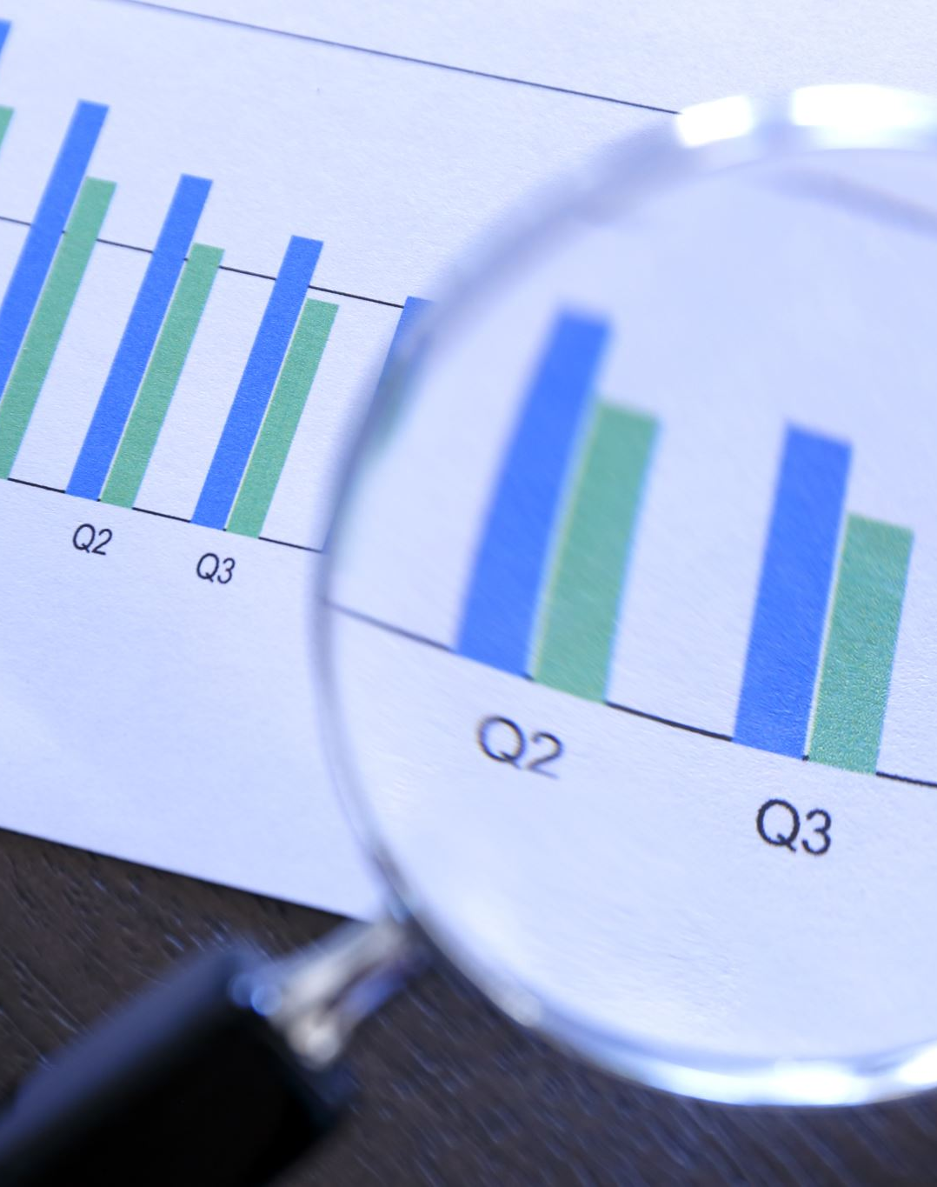
Ethical issues common in marketing management
1. Selling:
Widespread demands of bribes especially from government institutions and that attach award of contracts to the same.
Gift giving, favors and entertainment
Misrepresentation and/or overselling a product
Conflict of interest
Compensations and bookings.

Slide 13
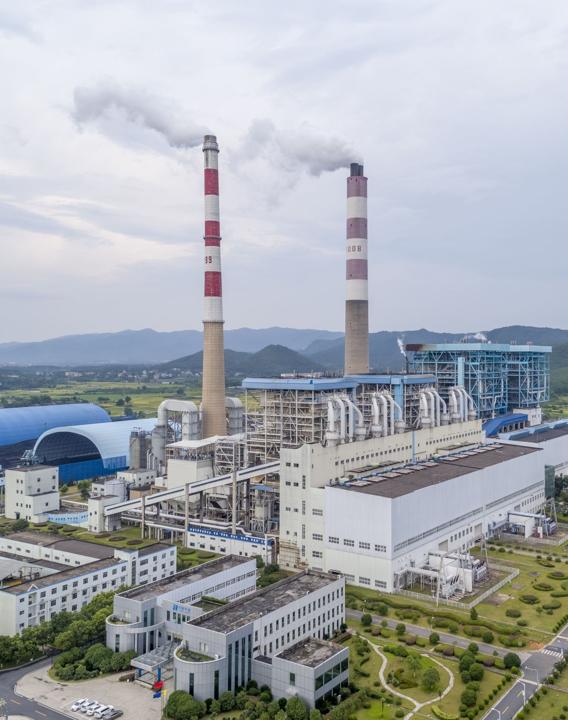
Ethical issues common in marketing management
2. Product:
Safety of products.
The rule of caveat emptor.
Products expiry
Environmental impacts of his products,
Disposal of the products
Lack of government regulations

Slide 14

Ethical issues common in marketing management
3. Marketing Communications:
the issues of deceptive/misleading advertising and/or sales promtion
use of puffery in consumer advertising
Violations of confidential information

Slide 15
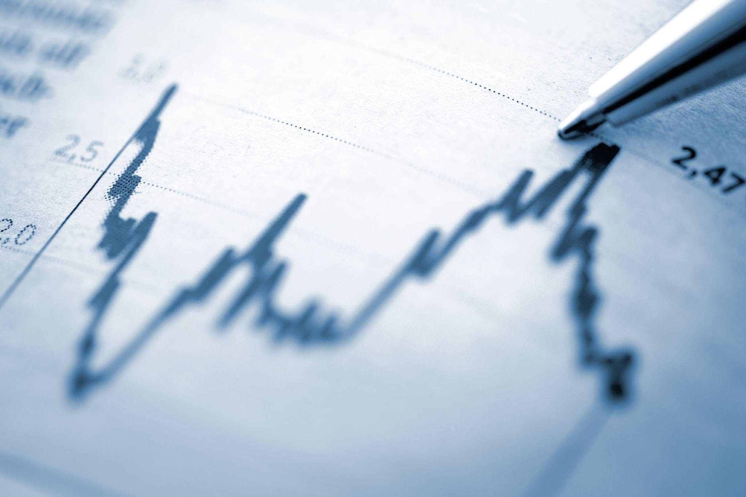
Ethical issues common in marketing management
4. Pricing:
Pricing fixing
Issue of
Secrecy in bidding.
Price discrimination in some markets.
Unfair pricing is another concern the marketer would be accused of.
Questionable invoicing
Artificial transfer pricing.

Slide 16

Ethical issues common in marketing management
4. Distribution
Fairness and equity
Transparency
Conflict of interest
Respect of intellectual property rights
Social and environmental responsibility
Corruption and bribery

Slide 17
Ethical issues common in marketing management
6. Market Research:
Respondent voluntary participation
Information confidentiality
No harm
Disclosure of any recording.
Researchers should be truthful about their skills and experiences,
Conduct research in the most cost-effective way,
Provide security for the data
Provide findings only supported by the data.

Slide 18

Ethical issues common in marketing management
7. Personnel: discrimination in hiring employees, unfair dismissal, and general treatment.
8. Cultural differences: involving potential misunderstandings related to traditional requirements of the exchange process including what may be called a bribe by one culture but not by another, different practices related to gifts, payments, favors and entertainment, and political contributions.

Slide 19

Ethical issues common in marketing management
9. Involvement in political affairs: the marketer might find himself in situations where he is forced to contribute to the political agenda of the country where he is doing .
10. Illegal/immoral activities. The marketer might as well find himself entangled in illegal and immoral activities.
In some countries the marketer might be trapped in sale of illegal products or demands to engage in immoral activities are placed on him to win contracts and be awarded tenders.

Slide 20

Ethical issues common in marketing management
11. Packaging:
Packaging sizes and the relation between packaging size
The design of the packaging implies wrongful or misleading information.
Producers imitate another’s packaging
Price that may be wrongfully indicated or absent from the packaging

Slide 21
Ethical issues common in marketing management
12. Customer care
proper customer care can create an image to the customers as the ethical and socially responsible firm
Companies should try to provide a value-added service through polite and courteous service, offering confidentiality and an open-door policy, proactive problem solving and guidance and handling requests in timely and rational manner.

Slide 22
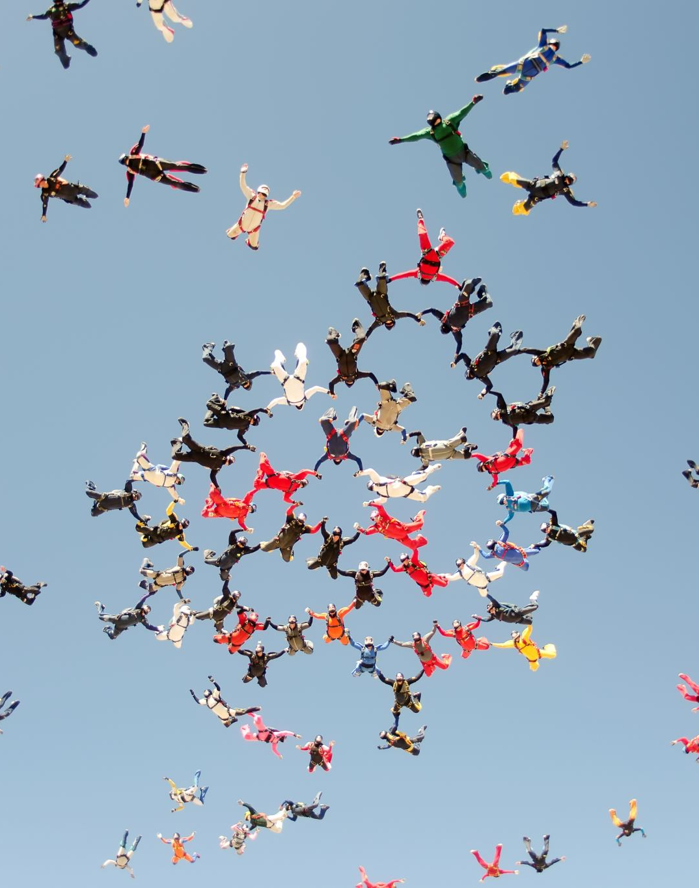
Addressing ethical challenges
The use of Donaldson and Dunfee (1999) model would be useful. According to this model there are three levels of ethical standards or norms.
a) Hyper norms – fundamental rights acceptable to all cultures and organizations.
b) Consistent norms, which are more culturally specific.
c) Moral free space. norms that are inconsistent with some of the legitimate norms described in the second level yet are often expressions of strongly held cultural beliefs.
d) Illegitimate norms. These are the norms which are incompatible with hyper norms.

Slide 23
Addressing ethical challenges
In determining the appropriate response in right of ethical questions raised, the marketer would follow the following guideline (Blythe and Zimmerman, 2013).
1. Test ethical questions against the hyper norms which form the bedrock of ethical thinking.
2. If the action is permissible when compared to consistent norms or falls into moral free space, it would then be subjected to a review in terms of utility (the benefits versus the costs), rights (whether human rights are respected), and justice (related to whether the benefits and costs are distributed).
3. Should the answers be mixed, a marketer would have to balance the concerns of all stakeholders as related to utility, rights, and justice before deciding on a course of action.

Slide 24
Making ethics work.
The marketer must make sure that ethics work in his .
1. Code of ethics
2. Management to become ethics role models
3. Ethics training
4. Appointment of ethical officer and committee
5. Ethic audits and control system
6. Association’s codes of ethics

Slide 25

Integrating ethics strategy in a business
To integrate ethics strategy in a business, Paine (1994) gives the following suggestions.
1. The guiding values and commitments must make sense and are clearly communicated.
2. Company leaders are personally committed, credible, and willing to take action on the values they espouse.
3. These values are integrated into the normal channels of management decision-making and reflected in the organization’s activities.
4. Company systems and structures support and reinforce core values.
5. Managers throughout the company have the decision-making skills, knowledge, and competence to make ethically sound decisions on a day-to-day basis.

Slide 26
Ethical decision-making process
The steps followed in ethical decision-making process would include the following (Palti et al, 2014)
1. Determine the facts of the situation: the decision maker should make an honest effort to understand the problem.
2. Identifying the ethical issues involved is the in making responsible decisions.
3. Identify relevant factors like stakeholders or laws or professional codes and consider the situation from their point of view who will be affected by a decision, policy or operation of a firm.

Slide 27
Ethical decision-making process
4. Consider the available alternatives which is also called the moral imagination.
5. Compare and weigh the alternatives which create a mental spreadsheet that evaluates the impact of each alternative devised on each stakeholder.
6. Make a rational and reasonable decision or select a course of action among the supported ethical alternatives.
7. Evaluate the implications of the selected course of action to monitor and learn from the outcomes and to modify the actions according to face with the similar challenges in the future.

Slide 28
Drawbacks to ethical marketing management
While practicing ethics in marketing management is essential for long-term success and building consumer trust, it can also present certain challenges and drawbacks.
1. Increased Costs: these would include:
Higher Quality Materials
Fair Labor Practices
Compliance and Oversight
2. Competitive disadvantage
Pricing Pressure
Market Share

Slide 29

Drawbacks to ethical marketing management
3. Complexity and Compliance
Regulatory Landscape
Specialized Expertise
4. Slower Decision-Making •
Additional Scrutiny
Stakeholder Consultations
5. Limited Creativity
Regulatory Constraints
Avoidance of Controversial Topics

Slide 30
Drawbacks to ethical marketing management
6. Market Limitations
Vulnerable Populations
Aggressive Tactics
7. Higher Prices for Consumers
8. Risk of Ethical Dilemmas that include:
Gray Areas
Reputational Risk

Slide 31

Drawbacks to ethical marketing management
9. Stakeholder Pressure
Conflicting Demands
Investor Expectations
10. Short-Term Profitability Impact
Investment vs. Return
Market Acceptance
Despite these challenges, many companies find that committing to ethical marketing yields significant long-term benefits, such as enhanced brand loyalty, a strong reputation, and greater resilience against regulatory and market changes.
The focus on ethics can ultimately lead to sustainable growth and a competitive advantage in the eyes of socially conscious consumers.

Slide 32
References
Chan, T.S. and Armstrong, Robert W. (1999). “Comparative Ethical Report Card: A Study of Australian and Canadian Managers’ Perceptions of International Marketing Ethics Problems.” Journal of Business Ethics, Vol. 18, Iss. 1, 3–15.
Chonko, Lawrence B. and Hunt, Shelby D. (2000). “Ethics and Marketing Management: A Retrospective and Prospective Commentary.” Journal of Business Research, Vol. 50, Iss. 3, 235–44.
Chonko, Lawrence B. and Hunt, Shelby D. (2000). “Ethics and Marketing Management: A Retrospective and Prospective Commentary.” Journal of Business Research, Vol. 50, Iss. 3, 235–44.
Craig, Samuel and Douglas, Susan P. (2000). International Marketing Research. Chichester, W. Sussex: John Wiley.
Donaldson, Thomas and Dunfee, Thomas W. (1999). “When Ethics Travel: The Promise and Peril of Global Business Ethics.” California Management Review, Vol. 41, No. 4, 45–63.
Ferrell O.C (2005) , “A Framework for Understanding Organizational Ethics: New Challenges for Business Schools and Corporate Leaders”. R.A. Peterson and O.C. Ferrell, (eds.) Armonk, New York: M.E. Sharpe, pp. 3-17.
IMCO, ( 2012) “Internal Market and Consumer Protection: Misleading Packaging Practices”, Directorate- General for Internal Policies, European Parliament: Policy Department A: Scientific and Economic Policy,.

Slide 33
References
J. Tsalikis and D. Fritzsch (1989), “Business Ethics: A Literature Review with a Focus on Marketing Ethics” Journal of Business Ethics, 8(2), pp. 695-743.
Lawrence, Anne T. and Weber, James (2011). Business and Society: Stakeholders, Ethics, Public Policy. New York: McGraw-Hill.
Lindfelt L.L and Tornroos J. (2006) Ethics and value creation in business research: comparing two approaches, European Journal of Marketing Vol. 40 No. 3/4, pp. 328-351
Lumen learning (n.d) Principles of marketing https://biz.libretexts.org/@go/page/16164
Murphy P.E (2005). Ethical Marketing, Upper Saddle River, NJ: Pearson Education.
Parilti N, ,Demirgüneş B. K and Özsaçmaci B.(2014) Ethical issues in marketing: an application for understanding ethical decision making https://www.researchgate.net/publication/
Singhapakdi, A., Vitell, S. J. and Kraft, K. L (1996) ., “Moral Intensity and Ethical of Marketing Professionals Decision-Making”, Journal of Business Research 36, pp. 245-255

Slide 34

End
End
Thank you
End of the course

