Slide 1
COURSE: PRINCIPLES OF HUMAN RESOURCE MANAGEMENT
LECTURE 2: SCOPE AND OBJECTIVES OF HRM
LECTURER: DR LUCY KARIMI KIRIMA
Lecture learning outcomes:
At the end of the lecture, you will be able to:
Discuss the scope of HRM
Examine the objectives of HRM

Slide 2

What is Human Resource Management
HRM is concerned with employees, both as individuals as well as a group, the aim being to get better results with their collaboration and active involvement in an organization‘s activities,
https://www.pexels.com/photo/photo-of-people-holding-each-other-s-hands-3184433/

Slide 3

Human Resource Management
Human Resource management is concerned with helping the employees to develop their potentialities and capacities to the maximum possible extent, so that they may derive great satisfaction from their job. The task takes into consideration four basic elements, namely, the capacities, interests, opportunities and personality of the employees.
https://www.pexels.com/photo/photo-of-people-looking-on-laptop-3182750/

Slide 4
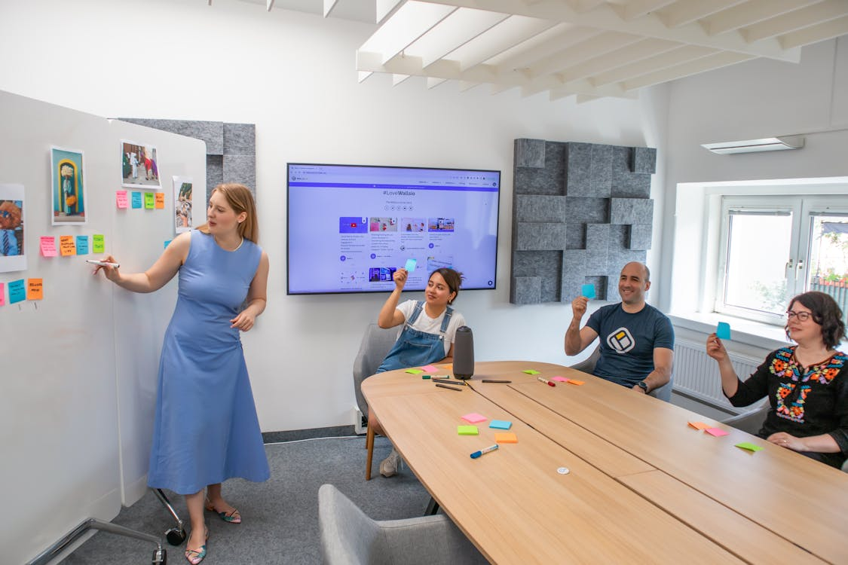
HRM Basic elements
1. Capacities- referring to those abilities or attainments, inherited or acquired, that a worker has, is capable of and must a certain degree at lease exercise in his work.
2. Interests- not only an individual‘s desires and ambitions, but also his instinctive impulsive tendencies, vague yearnings, and ill-defined cravings that may or may not stir employee to fullest action in performing duties.
https://www.pexels.com/photo/workers-in-an-office-17713880/

Slide 5

HRM Basic elements
3. Opportunities- not only opportunities for advancement, but opportunities to exercise capacities and satisfy interests.
4. Personality- the sum total of a worker‘s reaction to experiences and environment, personality is manifest by an individual‘s reception by others. The workers‘ personality has great influence upon opportunities.
https://www.pexels.com/photo/man-and-woman-wearing-brown-leather-jackets-984950/

Slide 6
The scope of HRM
The scope of HRM is wide. It is all major activities in the working life of a worker from the time of entry into an organization until the employee leaves the organization
The scope of Human Resources Management extends to:
All the decisions, strategies, factors, principles, operations, practices, functions, Activities and methods related to the management of people as employees in any type of organization.
All the dimensions related to people in their employment relationships and all the dynamics that flow from it.

Slide 7
Activities of HRM
Human Resources Planning is the process of assessing the organisation’s human resources needs in light of organizational goals and making plans to ensure that a competent, stable work force is employed. The planning process includes an analysis of skill levels among employees and in the external labour market, of current and expected job openings, of plans for expanding or reducing staff throughout the organisation, and of the external legal environment. The planning process, then, is, closely related to the staffing process and depends also on the overall strategic plans of the organisation

Slide 8
HRM Activities
Design of Organization and Job: This is the task of laying down organization structure, authority, relationship and responsibilities. This also means definition of work contents for each position in the organization. This is done by:‘job description
Job and work design specifies the tasks to be performed by individuals and groups within the Organisation, and establishes the rules, schedules and working conditions under which people perform those tasks

Slide 9
HRM Activities
Job analysis, an outgrowth of job design, is the process of investigating the tasks and behaviour associated with a particular job
Typically the information obtained from job analysis is used to write job descriptions and to establish what is required of the person who will perform each job. In turn, job descriptions are useful in the staffing process, especially in recruiting, hiring, and training new employees.
Selection and Staffing: This is the process of recruitment and selection of staff. This involves matching people and their expectations with which the job specifications and career path available within the organization

Slide 10

HRM Activities
Training and Development: This involves an organized attempt to find out training needs of individuals to meet the knowledge and skill which is needed not only to perform current job but also to fulfill the future needs of the organization.
Training is a learning process that seeks to bring about a permanent improvement in the ability and behaviour of employees by enabling them to learn new skill
Development is an educational process which is directed to increase the conceptual ability of employees to understand and apply knowledge in terms of cause and effect relationship, in the organizational situation-intended for managerial,
https://www.pexels.com/photo/photo-of-women-at-the-meeting-3811082/

Slide 11
HRM Activities
Compensation and Benefits: This is the area of wages and salaries administration where wages and compensations are fixed scientifically to meet fairness and equity criteria
Welfare aspect : Each employee is unique in character, personality, expectation and temperament. By and large each one of them faces problems everyday. Such worries must be removed to make him or her more productive and happy.

Slide 12
HRM Activities
Orientation: After an employee has been selected and placed at a specific job, the next logical step is to introduce him to the culture of the organisation, through socialization. It is a process of transmitting the key values, norms, policies and objectives of the company to the employees with a view to shaping their attitudes, thought and behaviour and assimilating them into the dominant culture of the company
Union-Labour Relations-HRM works to maintain co-ordinal relation with the union members to avoid strikes or lockouts to ensure smooth functioning of the organisation. It also covers - joint consultation, collective bargaining, grievance and disciplinary procedures, and dispute settlement.

Slide 13
HRM Activities
Collective Bargaining: The collective bargaining process refers to those events that establish a formal agreement between workers and management regarding such matters such as wages and employee benefits, hours of work, working conditions and. Grievance procedures
Performance appraisal and review: It is a process of ascertaining how effectively an employee is performing his job. The object of the appraisal is to determine the present state of efficiency of an employee in order to establish the actual need for training and motivation.

Slide 14
HRM Activities
Accommodation: The accommodation process refers to the extent to which management listens and responds to or accommodates the needs, wants, and complaints (or grievances) of organization members. People working in organizations expect to be treated fairly; moreover, they feel they have the right to be heard and to be respected as individuals.
Safety and Health Care Programs: Safety and health care programs are essential to the maintenance of employees
Every precaution should be taken to protect the employees from the damage of accidents.

Slide 15

HRM Activities
Organizational Development: This is an important aspect whereby “Synergetic effect” is generated in an organization i.e. healthy interpersonal and inter-group relationship within the organization
It may be defined as a comprehensive programme of building a climate of improved decision making adaptability and higher performance in an organization the introduction of planned changes.
Training and developing managerial people so as to make it more dynamic and effective in meeting the challenge of competition, adaptation and growth.
https://www.pexels.com/photo/women-and-men-standing-near-table-3205568/

Slide 16
HRM Objectives
The primary objective of HRM is to ensure the availability of competent and willing workforce for an organization. Beyond this, there are other objectives as outlined below:
Personal Objectives: To assist employees in achieving their personal goals, that enhance the individual’s contribution to the organization. Personal objectives of employees must be maintained, retained and motivated.

Slide 17

HRM Objectives
Functional Objectives:
To maintain the contribution of department at an appropriate level, organization should fulfill the needs. Resources are wasted when HRM is either more or less sophisticated to suit the organizations demands.
https://www.pexels.com/photo/graduate-student-destroying-diploma-9829320/

Slide 18
HRM Objectives
Organizational Objectives: it recognizes the role of HRM in bringing about organizational effectiveness. It makes sure that HRM is not a standalone department, but rather a means to assist the organization with its primary objectives. The HR department exists to serve the rest of the organization.
Societal Objectives: seek to ensure that the organization becomes socially responsible to the needs and challenges of the society while minimizing the negative impact of such demands upon the organization. The failure of the organizations to use their resources for the society’s benefit in ethical ways may lead to restriction.

Slide 19
HRM Objectives
Human capital : assisting the organization in obtaining the right number and types of employees to fulfill its strategic and operational goals
Developing organizational climate: helping to create a climate in which employees are encouraged to develop and utilize their skills to the fullest and to employ the skills and abilities of the workforce efficiently

Slide 20

HRM Objectives
To help the organization to attain its goals effectively and efficiently by providing competent and motivated employees.
To help maintain ethical policies and behavior inside and outside the organization
https://www.pexels.com/photo/woman-wears-yellow-hard-hat-holding-vehicle-part-1108101/

Slide 21
HRM Objectives
To help the organization reach its goals.
To ensure effective utilization and maximum development of human resources.
To ensure respect for human beings.
To identify and satisfy the needs of individuals
To provide the organization with well-trained and well-motivated employees.
To increase to the fullest the employee’s job satisfaction and self-actualization
To ensure reconciliation of individual goals with those of the organization.
To achieve and maintain high morale among employees.

Slide 22
HRM Objectives
To develop and maintain a quality of work life.
To be ethically and socially responsive to the needs of society.
To develop overall personality of each employee in its multidimensional aspect.
To enhance employee’s capabilities to perform the present job.
To equip the employees with precision and clarity in transactions of business.
To inculcate the sense of team spirit, team work and inter-team collaboration.
Accomplish the basic organizational goals by creating and utilizing an able and motivated workforce.

Slide 23
HRM Objectives
To establish and maintain organizational structure and desirable working relationships among all the members of the organization.
Develop co-ordination among individual and group within organization to
secure the integration of organization.
To create facilities and opportunities for individual or group development so as to match it with the growth of the organization.
To maintain high employees morale and human relations by sustaining and
improving the various conditions and facilities
To attain an effective utilization of human resources in the achievement of
organizational goals.
To identify and satisfy individual and group needs by providing adequate and equitable wages, incentives, employee benefits and social security and measures for challenging work, prestige, recognition, security, status.

Slide 24
HRM Objectives
To consider and contribute to the minimization of socio-economic evils such as unemployment, under employment, inequalities in the distribution of income and wealth and to improve the welfare of the society by providing employment opportunities
To provide an opportunity for expression and voice management.
To maintain high employees morale and human relations by sustaining and
improving the various conditions and facilities.
To provide fair, acceptable and efficient leadership.
To provide facilities and conditions of work and creation of favorable atmosphere for maintaining stability of employment.
Establish and maintain sound organizational structure

Slide 25
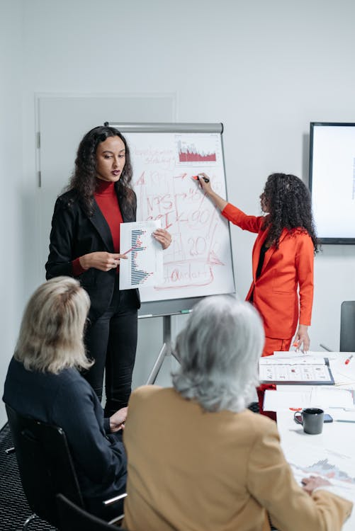
Summary
In order to achieve the above objectives, Human Resource Management undertakes the following activities
1. Human resource or manpower planning.
2. Recruitment, selection and placement of personnel.
3. Training and development of employees.
4. Appraisal of performance of employees.
https://www.pexels.com/photo/a-woman-in-a-meeting-with-her-colleagues-8424557/

Slide 26

Summary
5. Taking corrective steps such as transfer from one job to another.
6. Social security and welfare of employees.
8. Setting general and specific management policy for organizational relationship
9. Renumeration
https://www.pexels.com/photo/focused-man-working-with-female-colleague-in-office-5325104/

Slide 27

Summary
9. Reviewing and auditing manpower management in the organization
10. Potential appraisal feedback counseling.
11. Role analysis for job occupants.
12. Job rotation.
13. Quality circle, organization development and quality of working life
https://www.pexels.com/photo/man-teaching-woman-in-front-of-monitor-3285203/

Slide 28

Summary
9. Collective bargaining, contract negotiation and grievance handling.
10. Aiding in the self-development of employees at all levels.
11. Developing and maintaining motivation for workers by providing incentives.
https://www.pexels.com/photo/concentrated-black-man-grabbing-head-with-hands-sitting-at-table-7925871/

Slide 29
References
Handbook of HR Management practice,Armstrong M,Kogan,London,10th Edition, 2008
Human Resource Contemporary Perspective,Beard Well Ian &Hlen,Prentice Hall London ,2008
Human Resource Management,Legge karen,Palgrave Macmillan London,1995
Managing Human Resources, Molaner C,London,Routledge,1994
Pavel Danilyuk,2021 https://www.pexels.com/photo/a-woman-in-a-meeting-with-her-colleagues-8424557/

Slide 30
References
Human Resource Mangemngent,Chandra,M,Chadalawada Engineering College,2018-2019
Introduction to HRM,Stredwick,J,British Cataloguing in Publication Data,2005
Human Resource Management,Guru Jambheshwar University,Hisar-125001
Human Resource Management,Smt.Shyamala etl,Calicut University,Computer Section,SDE,2014
Edith Canva (2019).https://www.pexels.com/photo/photo-of-people-holding-each-other-s-hands-3184433/

Slide 31
References
Edith Caniva,2019 https://www.pexels.com/photo/photo-of-people-looking-on-laptop-3182750/
Edith Canva ,2023 https://www.pexels.com/photo/workers-in-an-office-17713880/
Edith Canva,2018 https://www.pexels.com/photo/man-and-woman-wearing-brown-leather-jackets-984950/
Edith Canva ,2020 https://www.pexels.com/photo/photo-of-women-at-the-meeting-3811082/
Cottonbro Studio,2019, https://www.pexels.com/photo/women-and-men-standing-near-table-3205568/
Chevanon Photography ,2018 https://www.pexels.com/photo/woman-wears-yellow-hard-hat-holding-vehicle-part-1108101/

Slide 32
References
Edith Canva,2020 https://www.pexels.com/photo/concentrated-black-man-grabbing-head-with-hands-sitting-at-table-7925871/
Anna Shvets,2020 https://www.pexels.com/photo/focused-man-working-with-female-colleague-in-office-5325104/
Edith Canva,2019 https://www.pexels.com/photo/man-teaching-woman-in-front-of-monitor-3285203/
Edith Canva 2021, https://www.pexels.com/photo/graduate-student-destroying-diploma-9829320/

